Slide 1
In The Name Of God

Slide 2
Endocrine Case presentation
Dr.m.zahedi dr.l.timar
16/2/98

Slide 3
ID and Source of the History
36 y/o woman
from Tehran ,
Divorced
Source of the history :
Patient and her mother (reliable)

Slide 4
Chief complaint
Short stature

Slide 5
Present illness
The patient is a 36 years old girl who has been referred to the endocrine clinic for short stature.
at 11 Y/O she referred to the endocrinology clinic due to her short stature and special feature: round face and brachydactyly .
The Karyotype done for her reported mosaicism for turner(46XX-45XO ) .
No F/U or treatment was done for her since 13 Y/O.

Slide 6
14 y/o ( 1376 )
She was taken to the emergency room due to severe Carpopedal spasm , abdominal pain and generalized cramps.
On W/U, significant hypocalcemia and high PTH levels were detected (no documentation available) .
She was under treatment with calcitriol and Calcium since 22 years ago until now.
Another symptomatic hypocalcemia has not happened as yet.
During this admission also high TSH and low T4 levels were detected and she was prescribed levothyroxine which used irregular.

Slide 7
P.I
menstruation was started at about 10 Y/O. It was regular and it's duration was about 7 days.
doctors suspected accuracy of turner diagnosis because of the regular menstruation, so; they reevaluated karyotype analysis which it's result was normal(46xx)!

Slide 8
P.I
At the age of 27, when she got divorced, she was diagnosed to have MDD and she became amenorrhea. Then she visited a gynecologist and psychologist.
By using 2 amp progesterone and cyproterone compound her menstruation became regular but her gynecologist didn't follow up the FSH & LH levels before the use of the drugs.

Slide 9
P.M.H
Hypothyroidism
Attack of hypocalcemia =1 upon a time
MDD
No Renal stone
orthodontia

Slide 10
P.S.H
Negative

Slide 11
D.H
AMP: progesterone monthly since 1389
Calcitriol: daily
Calcium: daily
Metformin: 500 mg bd since 3 years ago (IGT)
Cyproterone compound: had not been used since 2 months ago
Atorvastatin: 20 mg daily

Slide 12
F.H
Sister
34 y/o
Ht: 170cm
No impaired in menstruation ,Calcium
orthodontia
Brother:
21 y/o
Ht: 185 cm
Mother
Ht: 165 cm
No abortion
Known case of DM
Father
Ht: 180cm

Slide 13
Social history
Middle class family
Education: high school ,no academic resume
adequate access to health care and food resources

Slide 14
R.O.S
Constitutional Symptoms:
Negative: Lack of energy, unexplained weight gain or weight loss, pain in BONE, fatigue
Body:
fat central obesity, Rounded face, fat pad on back of neck
Skin:
Negative: rash, sores, itching, dryness, change in hair or nail, dermatitis, facial plethora, thin and brittle skin, easy bruising, broad and purple stretch marks ,acne, hirsutism, hyperpigmentation

Slide 15
R.O.S
Bone:
Negative: osteopenia, osteoporosis
Muscle:
Negative: Weakness, proximal myopathy atrophy of gluteal and upper leg muscles)
Eyes, Ears, nose, mouth, throat: 8 cases of dental implants
Negative: Difficulty with hearing, sinus problems, runny nose, post-nasal drip, ringing in ears, mouth sores, loose teeth, ear pain, nosebleeds, sore throat, facial pain or numbness, epi canthus fold .blurred vision

Slide 16
R.O.S
Cardiovascular:
Negative: regular heartbeat, racing heart, chest pains, swelling of feet or legs
Metabolism:
Glucose intolerance, dyslipidemia

Slide 17
R.O.S
Respiratory:
snore
Negative: night sweats, shortness of breath, prolonged cough, wheezing, sputum production, pleurisy, oxygen at home, coughing up blood
Gastrointestinal:
Negative: Heartburn, constipation, intolerance to certain foods, diarrhea, abdominal pain, difficulty swallowing, nausea, vomiting, blood in stools, unexplained change in bowel habits, incontinence

Slide 18
R.O.S
Genitourinary:
menstruation problem
Negative: Painful urination, frequent urination, urgency, bladder problems, fertility
Musculoskeletal:
Hx of dislocation of knee,
Negative: Muscle or joint pain, stiffness, bone pain, gout, backache. If present, describe location of affected joints or muscles, any swelling, redness, pain, tenderness, stiffness, weakness, or limitation of motion or activity, history of trauma. Neck or low back pain

Slide 19
R.O.S
Neurological:
Negative: Frequent headaches, weakness,, problems with walking or balance, dizziness, tremor, loss of consciousness, uncontrolled motions,
Psychiatric:
Depression
Negative: Insomnia, irritability,, recurrent bad thoughts, hallucinations, compulsions,

Slide 20
R.O.S
Endocrine:
menstrual irregularities since 9 years ago
Negative: Intolerance to heat or cold, frequent hunger/urination/thirst,, change in glove or shoe size , galactorrhea

Slide 21
G.A
An awake, oriented, very short stature woman
Wt: 62kg
Ht: 144 cm
BMI: 29.8
Abd: 95
Shoe size: 35
At birth:
Wt: 3.6kg
Lt: 50cm
Apgar: 10
HC: ?

Slide 22
G.A
Vital signs :
BP: hand
right:120/80 mmHg
left: 110/75mmHg
HR: 86 bpm
RR: 16
OT: 37 C
O2sat: 98%
BP: leg
Right: 110/70mmHg
Left: 115/65mmHg

Slide 23
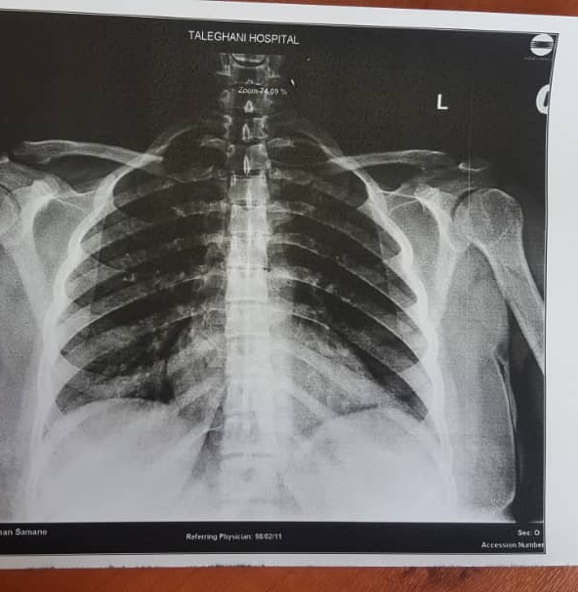
C.X.R
Vertebrae is Normal
No cervical rib
Normal lung Parenchyma
Normal Heart

Slide 24
Shoulder X-ray
Normal
Normal Clavicle distal
No Calcification in soft tissue

Slide 25
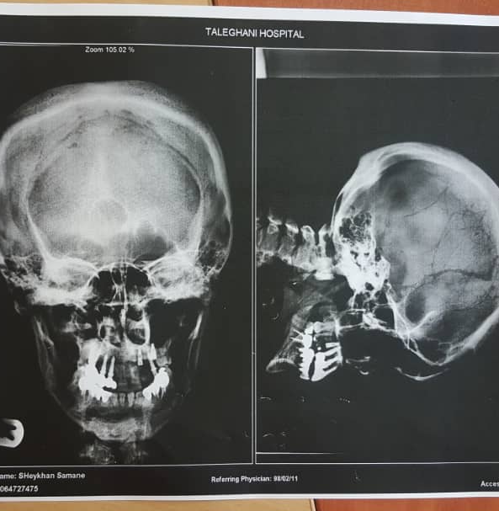
Skull x-ray
No Salt and pepper appearance
No Calcification
Small Lytic lesions
thick

Slide 26
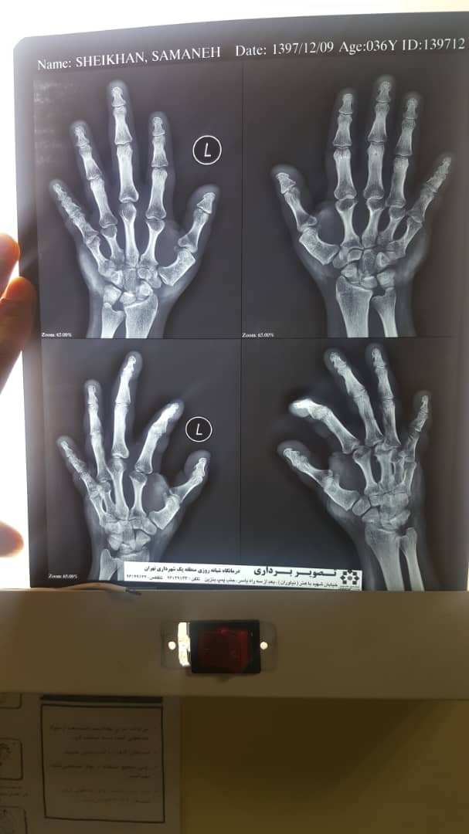
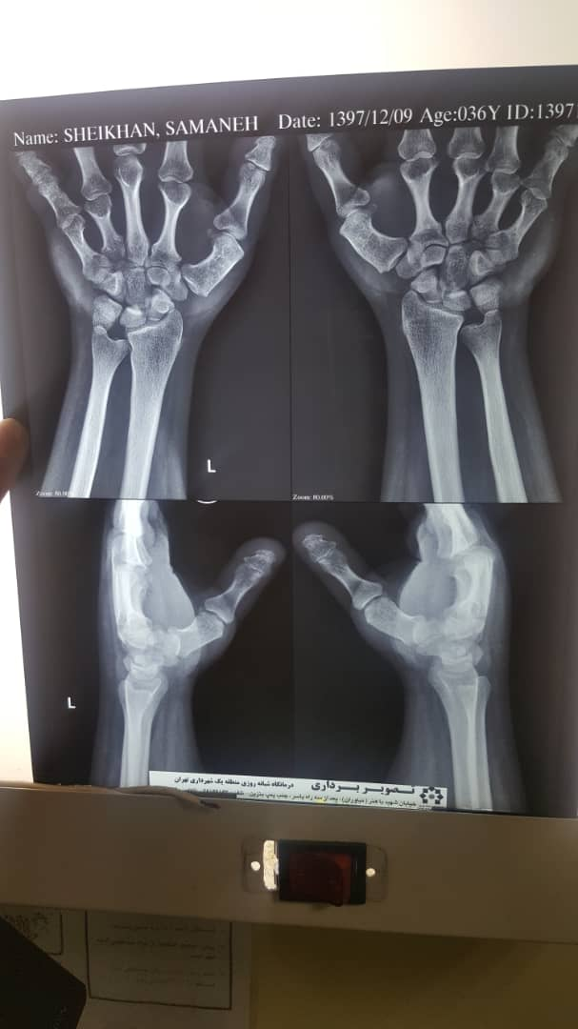
Hand x-ray
No Sub periosteal bone resorption
4th & 5th metacarpal bones are wide and short
Short distal phalanx of first digits

Slide 27
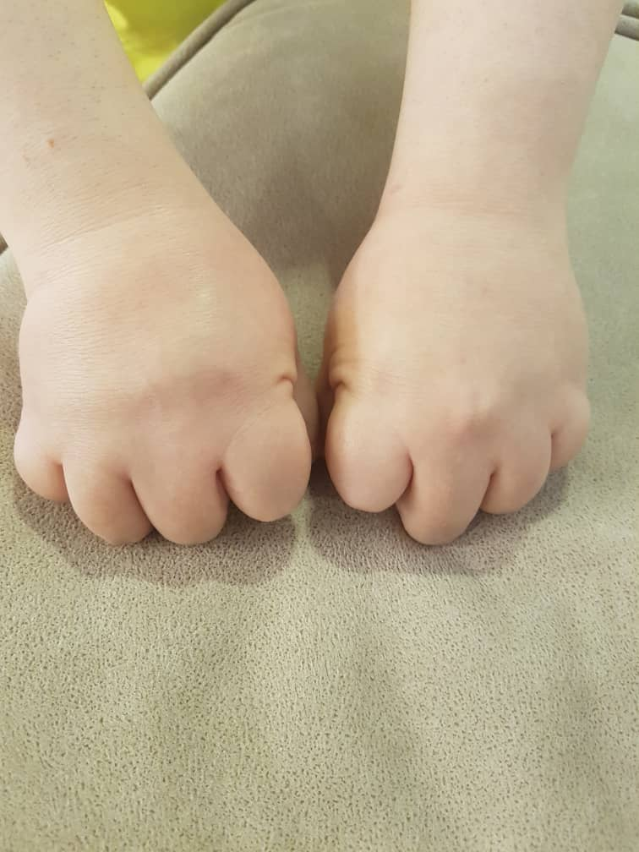
PH.E
No knuckle

Slide 28
PH.E

Slide 34
PH.EXAM
HEENT: Normal ,No Hirsutism
Head and NECK: moon face. short neck.
Negative: plethora , acanthosis nigricans, supraclavicular fat pad , gingivitis
Thyroid was normal size without nodule
BREASTS: Normal
THORAX & BACK: normal
LUNGS: Normal
HEART: Normal
ABDOMEN: no Scar of surgery , without any striae ,fatty abdomen

Slide 35
PH.E
Extremities :
Upper
Normal: range of motion , muscle tone , pulses,4th 5th short metacarpal
Lower
Normal: range of motion and pulses
No fasciculation or atrophy
No muscle tone
Normal Force of muscles
No genu varum
No genu valgum
Foot shortness

Slide 36
PH.EXAM
Neurologic Exams
Mental status : Normal
Cranial nerve : Normal, fundoscopic exam normal
Sensory exam : Normal (position, vibration, monofilament test, cold and warm sensation)
Reflexes : Normal
Babinski : plantar reflex was downward
Force : upper extremities :normal
lower extremities : normal
Gait : walking is normal and standing up is abnormal

Slide 37
CENTER LABRATORY (26.2.77)
ca | 7.7 mg/dl
FSH | 11.6 IU /L
LH | 7.1 IU/L
Ca U.A24h | 34 mg/24h
VOLUME | 800 ml/24h
Urine cr | 0.8 gr/24h

Slide 38
CENTER LABRATORY (77.11.05)
Kidney sonography: Normal
ca | 9.4 mg/dl
G6PD | sufficient
ph | 4.5 mg/dl
LFT | Normal

Slide 39
72.09.15
Abdominal and pelvic sonography: Normal
Normal size and echo kidneys

Slide 40
IRANMEHR HOSPITAL (10.5 74)
Bone age: 11y.o
Short and wide 4th & 5th metacarpal bones
Turner syndrome

Slide 41
PARS HOSPITAL (75.10.08)
PTH=75 pg/mL(Normal: 20-100)

Slide 42
IRANMEHR HOSPITAL (76.02.15)
Left wrist :
Bone age correlates with the chronologic age

Slide 43
CENTER Laboratory (97.06.27)
T3 | 0.8
T4 | 8.7
TSH | 1.66
PTH | 106.8
25OH VIT D | 35
FBS | 76
UREA | 32
Cr | 0.9
Chlo | 117
TG | 139
LDL | 110
Abdpelvic sono | normal

Slide 44
CENTER LABORATORY (30.11.97)
FSH | 0.26 m IU/ml
LH | 0.2 m IU/ml
PROLACTIN | 17 ng/ml (5-25)
Testosterone | 0.1 ng/ml (0.1- 0.7)
PTH | 243 pg/ml (15-68)
Ca U.A 24h | 80mg/24h
V | 2000ml
Cr | 1.1gr/24h

Slide 45
B.M.D TALEGHANI HOSPITAL (98.02.11)
scan | BMD | T . score | Fracture risk | Z . score
Lumbar spine | 1.035 | -0.7 | low | 0.2
Total femur | 1.029 | 0.7 | low | 1.0
Femural neck | 0.902 | 0.5 | low | 0.8

Slide 46
FARDA LABORATORY (98.02.14)
FBS | 93 Mg/dl
CHOL | 194 mg/dl
TG | 191 mg/dl
HDL | 50 mg/dl
LDL | 106 mg/dl
Ca | 10.7--- 9.5 mg/dl
Alb | 5 g/dl
ph | 4.8 mg/dl
HbA1C | 5.1 %

Slide 47
FARDA LABORATORY
FSH | 38.2 mlU /ml ( 2- 7.1)
LH | 30.2 mlU/ml (1.9- 11.6)
LH/FSH | 0.8 ratio
Estradiol | 23 pg/ml (20- 138)
PTH | 115 pg/ml (11- 67)

Slide 48
TALEGHANI LABORATORY (98.02.11)
Ca | 9.8 mg/dl (8.3-10.3)
ph | 5.6mg/dl
Total protein | 7.3 g/dl
Alb | 5.2g/dl
FSH | 28 m IU/ml (2-7.1)
LH | 23 m IU/ml(1.9-11.6)
V it D3 | 20 n g/dl insufficient

Slide 49
THANK YOU FOR YOUR ATTENTION

