Slide 1
Clinical Cases
Akbar Soltani. MD.Endocrinologist
Tehran University of Medical Sciences (TUMS)
Evidence-Based Medicine Research Center
Shariati Hospital
www.ebm.ir

Slide 2
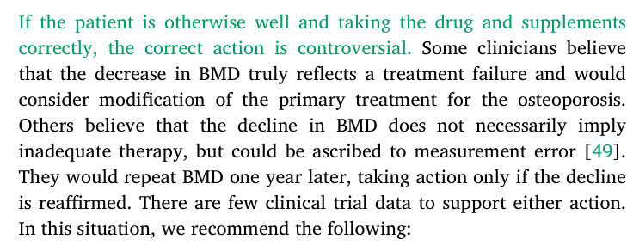
Approach to declining BMD
Up-To-Date

Slide 3
How Should Clinicians Respond to Follow-up BMD Results?
BMD changes in
treated subject
Increased
Same
(Within LSC)
Decreased
(>LSC)
No change
Evaluate
No change

Slide 4
Hypothetical low risk scenario
A 69-year-old woman comes to you for evaluation of osteoporosis. She has been treated with risedronate, 3.5 mg orally once weekly with good adherence to therapy.
She has been taking cholecalciferol, 2000 IU daily, in addition to calcium carbonate, 600 mg twice daily with meals.
Her initial DXA scan revealed the following T scores: lumbar spine, - 1 .9, femoral neck, -2.8, and total hip -2.6

Slide 5
Hypothetical high risk scenario
A 53-year-old woman comes to you for evaluation of osteoporosis. She had a hip fracture 6 months ago and multiple vertebral compression fracture and loss of height during last three years. She has been treated with risedronate, 3.5 mg orally once weekly with low adherence to therapy
She has been taking cholecalciferol, 2000 IU daily, in addition to calcium carbonate, 600 mg twice daily with meals.
Her initial DXA scan shortly after his fracture, revealed the following T scores: lumbar spine, - 1 .9, femoral neck, -2.8, and total hip -2.6

Slide 6
Scenario
BMD decreased
At the time of her original study, her femoral bone density study was 0.960 g/cm2.
Two years later, the femoral BMD was 0.920 g/cm2. Is this a significant change?
% Change from Baseline = 4%
Next intervention?
Notes:
% Change from Baseline = [(0.760 g/cm2 − 0.730 g/cm2)/0.760 g/cm2] × 100

Slide 7
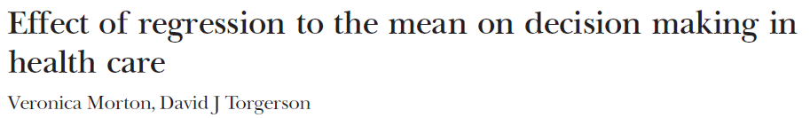
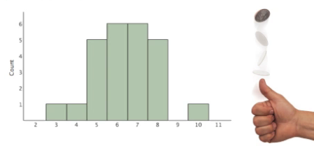
Regression to the mean occurs whenever a nonrandom sample is selected from a population and two imperfectly correlated variables are measured, such as two consecutive BP measurements.
Notes:
Francis Galton documented the phenomenon in 1886.
Ignorance of this phenomenon is widespreadAlso, the more extreme the value from the population mean, the more room there is to regress to the mean.

Slide 8
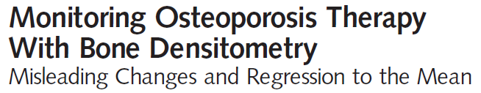
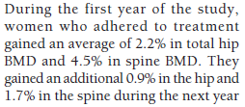
Bisphosphonate Treatment Effect on Bone Mineral Density
FIT trial
N>3000
Alendronate
S.Cummings et al. JAMA 1998;2077
. S.Cummings et al. JAMA 2000 ;283

Slide 9

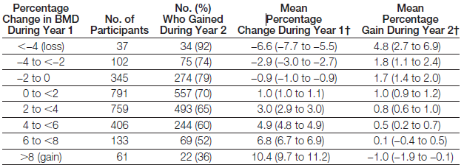
Change in Total Hip (BMD) During Year 1 Compared With the Probability of Gaining BMD and the Mean Percentage Gain in BMD During the Second Year of Treatment With Alendronate Sodium
. Cummings SR et al. JAMA 2000 Mar 8;283(10):1318-21
Notes:
Change in Total Hip Bone Mineral Density (BMD) During Year 1 Compared With the Probability of Gaining BMD and the Mean Percentage Gain in BMD During the Second Year of Treatment With Alendronate Sodium

Slide 10
Effect of Raloxifene on BMD in Post-menopausal Women with Osteoporosis-N>7700
Meunier P. et al, Osteoporosis Int. 1999; 10:330

Slide 11
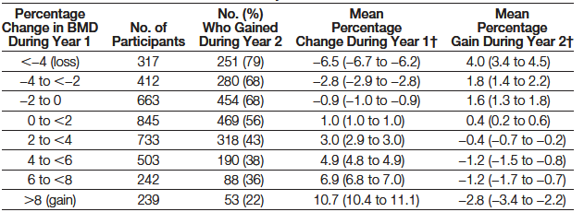
. JAMA 2000 Mar 8;283(10):1318-21

Slide 12
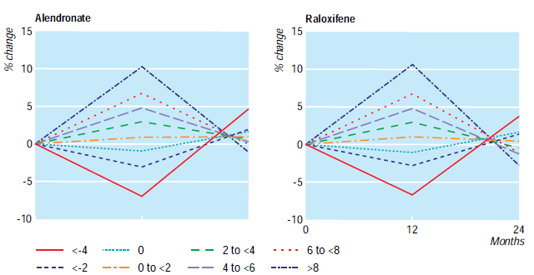
Change in Hip Bone Mineral Density
BMJ VOLUME 326 17 MAY 2003
Notes:
Percentage changes in bone mineral density among women treated with alendronate or
raloxifene after 12 and 24 months, showing regression to the mean at 24 months. Women
are grouped according to the percentage change at 12 months, and values for 24 months are
percentage change from value at 12 months

Slide 13
practical implications
Treatment should be continued in patients who appear to lose BMD initially, because most patients( > 80%) will gain it with continued treatment.
Large changes in BMD during observation of untreated patients might also be due to measurement error.
If a new treatment is begun after observing a large loss in BMD, it is likely to increase in the next year, but much of this increase may be due to regression to the mean.
Notes:
Change in Femoral Neck Bone Mineral Density (BMD) During Year One Compared With the Probability of Gaining BMD and the Mean Percentage Gain in BMD During the Second Year of Treatment With Raloxifene Hydrochloride

Slide 14
Approach to declining BMD
Up-To-Date

Slide 15
practical implications
New treatments: patients who are most ill OR excluded patient from clinical trials
Placebo effect: patients with the worst clinical scores(extreme menopausal symptoms) have the biggest placebo effect!
Public health: road crash or vaccination(meningitis)
Clinical audit: policy of aggressive procedures to control infection
Notes:
Healthcare management
New treatments: patients who are most ill OR excluded patient from clinical trials
Placebo effect: patients with the worst clinical scores(extreme menopausal symptoms) have the biggest placebo effect!
Public health: road crash or vaccination(meningitis)
Clinical audit: policy of aggressive procedures to control infection

Slide 16
Scenario
BMD decreased
At the time of her original study, her femoral bone density study was 0.96 g/cm2.
Two years later, the femoral BMD was 0.92 g/cm2. Is this a significant change?
% Change from Baseline = 4%
Low risk patient?
High risk patient?

Slide 18
Case
A 31-year-old woman is referred with a history of multiple vertebral fractures. At age 29 years she was involved in a motor vehicle accident.
Four months later she developed severe back pain and was found to have compression fractures of T8, T10, L1, and L4.
One year later back pain recurred and new fractures of T11, L2, and L3 were documented, along with multiple rib fractures and 2 inches of height loss.

Slide 19
1. What additional history would you seek?
You should focus your questions on:
history of fractures
diseases (eg, celiac disease, cystic fibrosis, anorexia nervosa…)
medication exposures (eg, glucocorticoids, anticonvulsants) during childhood or adolescence.
A family history of fractures and nephrolithiasis is important.
A detailed menstrual/reproductive history and alcohol history is key.

Slide 20
2. What physical examination findings would you look for?
Signs of Cushing’s Syndrome, osteogenesis imperfecta, kyphosis, mastocytosis
3. Which laboratory tests would you order?
Certainly a DXA scan, CBC, chemistry panel including total alkaline phosphatase, serum 25-OHD and 1,25(OH)2D, PTH, 24-hour urine calcium and free cortisol, celiac screen and other tests as appropriate.

Slide 21
4. She is anxious to have a child. What would you advise her regarding breast feeding?
In general, I suggest such women avoid breast feeding, as the rapid decrease in BMD could exacerbate their problems and perhaps precipitate more fractures.
Notes:
That being said, many patients insist on breast feeding and in my clinical experience, many do not go on to have more fractures

Slide 22
5. Would you recommend therapy? If so, which therapy and why?
Management depends on whether there is any secondary cause; if so, it should be treated directly if possible. Conservative management with adequate calcium, vitamin D, and weight bearing exercise.
SERMs should be avoided. If she is menstruating normally, there is probably no point in oral contraceptivepills.

Slide 23
5. Would you recommend therapy? If so, which therapy and why?
Bisphosphonates should be avoided at this age and if imminent childbearing is being considered.
Teriparatide may be of some help, but there are few data on how long the effect of the drug lasts, and antiresorptive therapy may be required after completion of teriparatide to consolidate gains in BMD.
There are no data on whether treatment of osteoporosis in premenopausal women reduces the risk of future fractures.

Slide 25
67 year old White male
Recently relocated and seeing you for the first time regarding osteoporosis treatment.
Long smoking history; continues with ~ 2 packs per day
Has GERD with chronic PPI use
Recently fell and sustained a pubic ramus fracture
Has received zoledronic acid annually for three years; last dose ~12 months ago
Has “low T” and receiving topical testosterone therapy

Slide 26
67 year old White male
Laboratory evaluation (chemistries, 25(OH)D and total testosterone all within normal limits
DXA report: “BMD establishes the diagnosis of osteoporosis. No prior study for comparison.”
What Would You Do?
Initiate a bisphosphonate holiday?
Repeat ZA infusion?
Check additional labs?
Other?

Slide 27
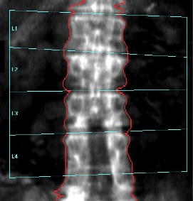
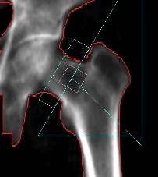
Review the DXA Images
T-scores
L1 = -2.2
L2 = -2.4
L3 = -1.5
L4 = -3.4
L1-4 = -2.4
T-scores
FN = -2.7
TF = -2.0
The spine image documents prior laminectomy
Also suggests an L2 fracture
Consider additional spine imaging

Slide 28
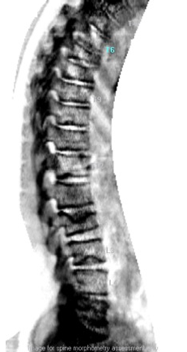
VFA identifies multiple vertebral fractures (T7, T8, L2 and L3)

Slide 29
Indications for Spinal Imaging
Lateral spine imaging with standard radiography or densitometric VFA is indicated when T-score is < -1.0 and one or more of the following is present:
  Women age ≥ 70 years or men ≥ age 80 years
  Historical height loss > 4 cm (>1.5 inches)
  Self-reported but undocumented prior vertebral fracture
  Glucocorticoid therapy equivalent to ≥ 5 mg of prednisone or equivalent per day for ≥ 3 months

Slide 30
Teaching Points
Always need to review the DXA image
Laminectomy lowers lumbar spine BMD
Spine imaging is important and may affect your treatment decision
There is no single “right” answer in this case
  This patient is at very high risk for future fracture given his recent fall with pelvic fracture and multiple vertebral fractures
  One could consider teriparatide
  Alternatively, could continue zoledronic acid
  Finally, one could consider him adequately treated and initiate a bisphosphonate holiday

Slide 32
Case 2
A healthy 70-year-old woman returns for followup of generalized osteoporosis. She has been on ALN, 70 mg by mouth weekly with excellent compliance for 4 years as well as adequate calcium and vitamin D.
A repeat DXA shows stable values at all sites with T-scores of –2.8 at the spine (8% increase since baseline), –3.0 at the FN, and –2.8 at the TH (4.5% increase since baseline).

Slide 33
Case 2
After sustaining a wrist fracture at age 65, she has done well. Two months after seeing you, she trips over a branch while hiking in the woods, fracturing her left humerus.
Laboratory work-up reveals normal CBC, Ca, Phos, creatinine, 25OHD, serum and urine protein electrophoresis, alk phos, and urinary calcium excretion.
A fasting serum CTX comes back in the lowest 25th percentile for premenopausal women.

Slide 34
Case 2
What is the most appropriate management?
A. Stop ALN and begin teriparatide.
B. Stop ALN and begin ZA.
C. Stop ALN and begin DMA.B
D. Continue ALN for now.

Slide 35
Case 2
This case explores what to do when a patient on potent antiresorptive therapy fractures, despite improvements in BMD and suppression of BTMs. According to the International Osteoporosis Foundation Position Paper (4), she does not warrant a change in therapy unless the wrist fracture occurred after 6–12 months on OT (which it did not).
However, in the real world, this would clearly be a disappointing result for both patient and physician. Teriparatide significantly reduces nonvertebral fractures but its effect on hip fractures is not established. Intravenous ZA will not increase BMD in patients already responding to ALN.

Slide 36
In contrast, DMAB has been shown to significantly increase BMD at the spine and hip, even in patients coming off of long-term ALN.
We have no fracture outcomes to support this change but extension studies suggest that DMAB may be superior to bisphosphonates in the long term.
After 8 years of DMAB, BMD continues to increase at both spine and hip while TH BMD plateaus at a lower level after only 4.5 years on ZA (28).

Slide 37
Case 3
A 72-year-old woman with osteoporosis comes to see you with acute midback pain after lifting a bag of mulch. She had taken ALN 70 mg weekly for 4 years followed by DMAB 60 mg sc every 6 months for the past 18 months.
On examination, her midback is tender and she has lost 1 in in height. Imaging shows an acute biconcave vertebral compression fracture at T10 and mild-to-moderate anterior wedge compression fractures at 2 other vertebrae that seem to be old.
Her last DXA from 6 months ago revealed T-scores of –2.5 at L1-L4, –2.8 at the left FN, and –2.5 at the left TH.

Slide 38
Case 3
All were significantly improved compared with the previous scan. An extensive laboratory work up including 24 hour urine free cortisol, serum tryptase, serum and urine protein electrophoresis, and PTH comes back negative. Fasting serum CTX is suppressed.
What is the most appropriate management?
A. Stop DMAB and switch to ZA.
B. Stop DMAB and switch to teriparatide.
C. Switch to ZA and add teriparatide.
D. Continue DMAB and add teriparatide.

Slide 39
Case 3
This case illustrates the patient who clearly meets criteria for a change in therapy. She has fractured on two potent antiresorptive agents, ALN and DMAB. Compliance is not an issue and her workup for secondary causes is negative.
She needs anabolic therapy. However, she has osteoporosis at the hip sites and thus is at high risk for a hip fracture.
Teriparatide has not shown efficacy against hip fractures and can lead to declines in BMD at the femoral neck.

Slide 40
Case 3
In this particular situation, combination therapy with DMAB plus TPT should be strongly considered.
In clinical trials, this combination seems to lead to the most robust improvements in BMD at both spine and hip although no fracture data are available. Changing to ZA would not offer any added value in this situation.

Slide 41
Changing Therapy: A Rational Approach
Table 2 shows the seven major osteoporosis therapies available in the United States. The numbers in the boxes represent statistically significant relative risk reductions in spine, nonvertebral, and hip fractures based on meta-analyses or randomized clinical trials.
The most effective agents for reducing spinal fractures are ZA, DMAB, and teriparatide. For nonvertebral fractures, results are much more modest and not all agents are effective.
Finally, ALN, RIS, ZA, and DMAB are the sole agents to have significantly reduced hip fractures in clinical trials.

Slide 42
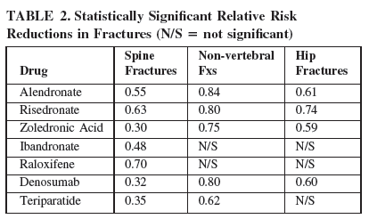

Slide 43
Changing Therapy: A Rational Approach
Only 11 studies
  mainly open label
  short duration (2 y)
  small sample sizes
have been performed to evaluate outcomes when transitioning from oral bisphosphonates (ALN or RIS) to other agents
None of these studies include fracture outcomes.

Slide 44
Approaches to Combination or
Sequential Therapy
Alendronate
Another oral
Bis
In general, switching poorly compliant patients from ALN to another oral bisphosphonate, such as RIS or ibandronate does not lead to any measurable improvements.
Women on long-term ALN who switched over to ZA had significantly lower BTMs at 3 months compared with those continuing on ALN. At 1 year, however, there were no differences in BMD or bone biopsies
continuing
Alendronate
ZA
3
Notes:
Bottom line: Oral ALN may not maximally suppress bone resorption, even after 4 years of therapy. ZA leads to greater suppression of BTMs in the short term but no change in BMD.

Slide 45
Approaches to Combination or
Sequential Therapy
Patients with poor adherence to ALN had significant decreases in BTMs, significant increases in BMD, and greater patient satisfaction when switched to DMAB compared with those switched to oral ibandronate
Alendronate
DMAB
Similarly, in another study, patients switched to DMAB had significant decreases in BTMs and significant increases in BMD at both spine and hip after 12 months, compared with those continuing on ALN .
Bottom line: DMAB leads to greater suppression of BTMs as well as generalized improvements in BMD within 1 year of switching from chronic ALN.
3

Slide 46
Approaches to Combination or
Sequential Therapy
ALN or
RIS
TPT
After 12 months, patients previously on RIS showed significantly greater gains in BMD at both spine and hip on TPT compared with those previously on ALN.

Slide 47
Approaches to Combination or
Sequential Therapy
Bisphosphonate
PTH
A delay, if present,
is overcome
Bisphosphonate
No approaches yet
have been shown
to be better than monotherapy
PTH
This sequence is needed to maintain densitometric gains with PTH
PTH
Bisphosphonate
Adding TPT to ALN or ZA increases BMD
at the hip beyond PTH alone;
at the spine, however, there is no additive effect of
combination therapy.
3

Slide 48
Approaches to Combination or
Sequential Therapy
Raloxifene
PTH
Raloxifene
With RLX, either adding or switching to TPT led to equivalent gains in BMD at the spine and hip (25).
PTH

Slide 49
Approaches to Combination or
Sequential Therapy
DMAB
DMAB plus TPT shows additive effects at BMD of spine and hip compared with either drug alone.
PTH
In the opinion of one expert: for “… patients previously treated with bisphosphonates who suffer hip fractures or who have very low or declining BMD at the hip, strong consideration should be given to starting TPT and continuing a potent antiresorptive therapy (possibly switching to ZA or DMAB) to improve hip BMD and strength quickly.”

Slide 50
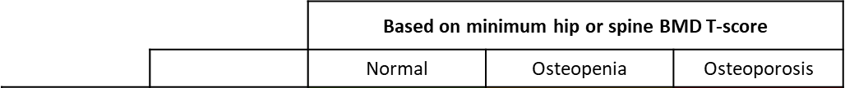

Based on Spine TBS | ≥ 1.300
 | 1.200 < > 1.300
 | ≤ 1.200

Slide 51
Case 1
68 year old woman
Diagnosis of osteoporosis in 2001
Fosamax 70mg/week
Calcium 500mg/d + vitamin D 400 IU
Follow-up densitometry
Decrease in BMD suggesting suboptimal response or non response to treatment
Question:
What can be done to improve therapeutic response?

Slide 52
Case 5
Patient NC: 57 y/o with inflammatory bowel dz on steroids
57 year old postmenopausal woman with inflammatory bowel disease on prednisone 5 to 20 mg daily for the past 4 years. Currently on 5 mg/day
DXA T-score LS: -2.1, FN -1.8
FRAX 10 year risk: major fractures: 8%; hip fracture: 1.2%
CBC, comprehensive metabolic profile, PTH, 25(OH)D and 24-hour urine calcium - normal
Does she need pharmacologic therapy?
Would you order any other tests?
Notes:
52

Slide 53

GIOP Treatment Recommendations
Prescribe adequate calcium and vitamin D for all
  *FDA approved therapy: alendronate, risedronate, zoledronic acid and teriparatide
 | Daily Dose | Treatment*
Postmenopausal women and men ≥ 50 | ≥7.5 mg | Yes
 | ≤7.5 mg
 | FRAX ≤10% | No
 | FRAX >10% | Yes
Premenopausal women and men<50 | Treat only if history of fracture
Men and non-childbearing women | ≥5 mg | Yes, if fracture
Childbearing women | ≥7.5 mg | Yes, if fracture
Notes:
53
Per current ACR guidelines, this patient does not meet the criteria for treatment (prednisone < 7.5, FRAX < 10%, no known fracture) Time to discuss the importance of evaluating for the presence of an “asymptomatic” vertebral fracture, common in patients on glucocorticoids.

Slide 54
Case 5
Patient NC: 57 y/o with inflammatory bowel dz on steroids
57 year old postmenopausal woman with inflammatory bowel disease on prednisone 5 to 20 mg daily for the past 4 years. Currently on 5 mg/day
DXA T-score LS: -2.1, FN -1.8
FRAX 10 year risk: major fractures: 8%; hip fracture: 1.2%
CBC, comprehensive metabolic profile, PTH, 25(OH)D and 24-hour urine calcium - normal
Does she need pharmacologic therapy?
Would you order any other tests?
Notes:
54

Slide 55
Indications for Spinal Imaging
Lateral spine imaging with standard radiography or densitometric VFA is indicated when T-score is < -1.0 and one or more of the following is present:
  Women age ≥ 70 years or men ≥ age 80 years
  Historical height loss > 4 cm (>1.5 inches)
  Self-reported but undocumented prior vertebral fracture
  Glucocorticoid therapy equivalent to ≥ 5 mg of prednisone or equivalent per day for ≥ 3 months

Slide 56
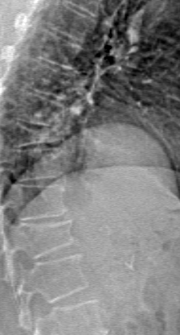
Case 5
VFA
Patient NC: 57 y/o with IBD on steroids
2 vertebral compression fractures
  Clear indication of skeletal fragility
  Strong indication for pharmacotherapy
Notes:
pharmacotherapy FRAX 10 year risk:
major fractures: 16%
hip fracture: 3.3%
56

Slide 57
Case 5:
Patient NC: 57 y/o with inflammatory bowel dz on steroids
Teaching Points
GIOP is associated with high fracture risk
Consider evaluation for “asymptomatic” vertebral fracture in patients on glucocorticoids
Underlying disease may contribute to osteoporosis; look for treatable secondary causes (eg malabsorption with IBD)
Use lowest possible dose of glucocorticoids; consider alternative, steroid-sparing therapies if possible
All steroid-treated patients require sufficient calcium and vitamin D and consideration of pharmacologic therapy as appropriate
Notes:
57

Slide 58
Case 1
68 year old woman
Diagnosis of osteoporosis in 2001
Fosamax 70mg/week
Calcium 500mg/d + vitamin D 400 IU
Follow-up densitometry
Decrease in BMD suggesting suboptimal response or non response to treatment
Question:
What can be done to improve therapeutic response?
➔ Review scan

Slide 59
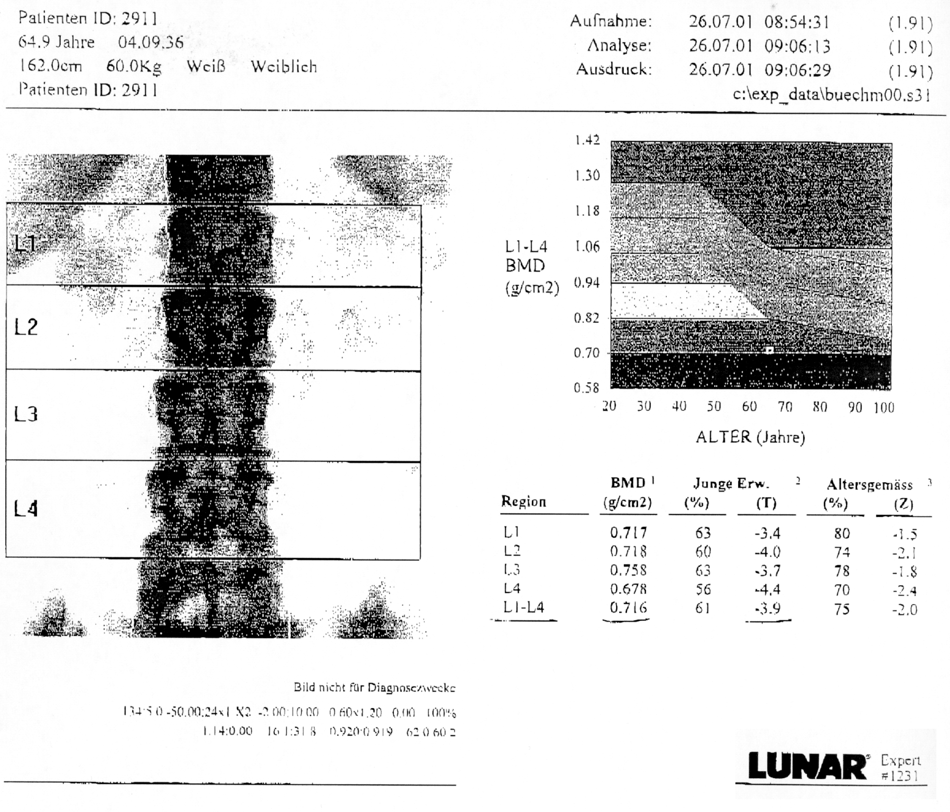
Case 1

Slide 60
Case 1
Valid study ?
positioning: ok
ROI: ok
artifacts: no

Slide 61
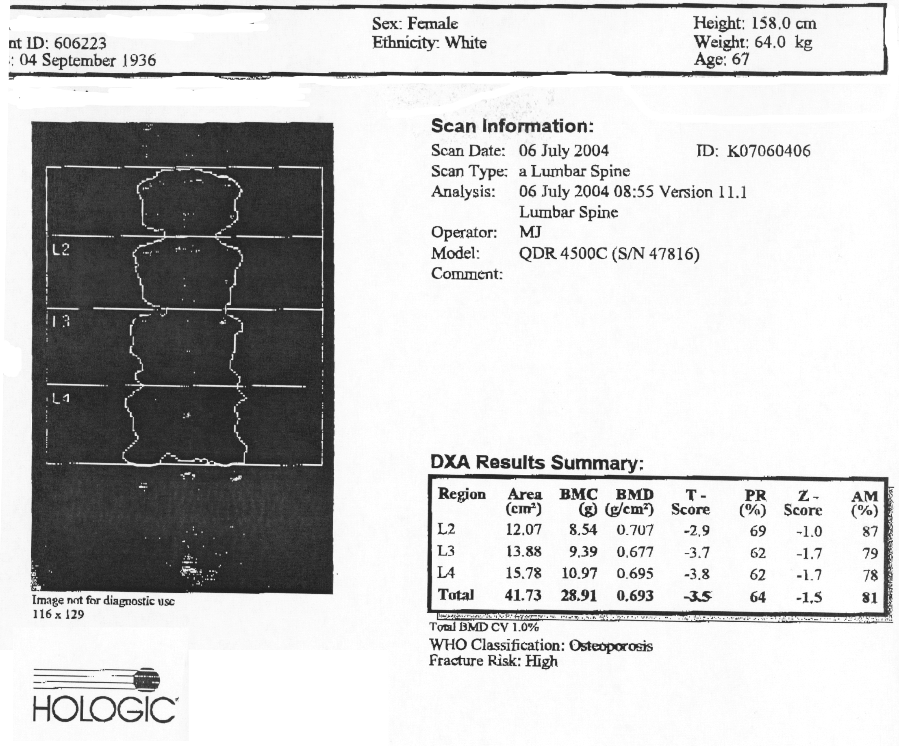
Case 1

Slide 62
Case 1
Valid study ?
Appears ok

Slide 63
Case 1

Slide 64
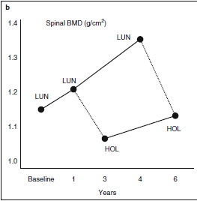
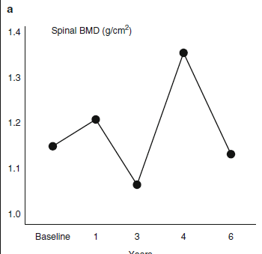
machines made by different manufacturers had been used

Slide 65
Standardized BMD
Spine
  sBMD = 1000 • 1.076 • BMD (Norland XR-26)
  sBMD = 1000 • 0.9522 • BMD (Lunar DPX-L)
  sBMD = 1000 • 1.0755 • BMD (Hologic QDR-2000)
Total Femur
  sBMD = 1000 • [1.012 • BMD (Norland XR-26)] +0.026
  sBMD = 1000 • [0.979 • BMD (Lunar DPX-L)] - 0.031
  sBMD = 1000 • [1.008•BMD (Hologic QDR-2000)]+ 0.006
BMD from any one of three DXA devices should fall within
3-6%(femoral) or 2-5%(lumbar) of sBMD of any of other two.

Slide 66
Standardized BMD
Blake GM, Harrison EJ, Adams JE.
Dual X-ray Absorptiometry: Cross-Calibration of a New Fan-Beam System.
Calcif Tissue Int. 2004.
Boonen S, Kaufman JM, Reginster JY, Devogelaer JP.
Patient assessment using standardized bone mineral density values and a national
reference database: implementing uniform thresholds for the reimbursement of
osteoporosis treatments in Belgium.
Osteoporos Int. 2003;14(2):110-115.
Hui SL, Gao S, Zhou XH et al.
Universal standardization of bone density measurements: a method with optimal
properties for calibration among several instruments.
J Bone Miner Res. 1997;12(9):1463-1470

Slide 67
Case 1 - Standardized BMD
meas. BMD
sBMD
(g/cm2)
(mg/cm2)
Lunar
0.718
684
Hologic
0.692
744
%-Change
8.77%
Therefore: good response to bisphosphonate treatment

