Slide 1
Research Methodology Study Design (3)
Davood Khalili, MD, MPH, PhD
Department of Biostatistics & Epidemiology
Research Institute for Endocrine Sciences
Shahid Beheshti University of Medical Sciences

Slide 2
Study Design
Observational
Experimental (Randomized Control Trial - RCT)
Descriptive
Analytic
Cross-Sectional
Case-Control
Cohort

Slide 3
Analytic Studies
Target Population
Take care of Selection Bias
Exposure Outcome
Study Population
Take care of Information Bias

Slide 4
Cohort Study
Disease +
Disease -
Exposure+
Exposure-
Cohort
Time
Disease +
Disease -
Target population

Slide 5
Cohort Study
Target population
Exposure +
Disease +
Disease -
Time
Exposure -
Disease +
Disease -

Slide 6
Results of a Cohort Study
Risk factor | Disease
 | Yes (cases) | No (controls)
Yes N1 | a | b
No N2 | c | d
Total
N1 and N2 are fixed numbers

Slide 7
Case-control Study
people who get the disease people who do not get the disease
Compare
Population at risk
Cases
Yes
No
past "exposures“
Yes
Controls
No

Slide 8
In comparison Results of a Case-Control Study
Risk factor | Disease
 | Yes (cases) | No (controls)
Yes | a | c
No | b | d
Total | N1 | N2
N1 and N2 are fixed numbers

Slide 9
Some Special study Designs

Slide 10
Matched Case-Control Studies
cases
controls
Non-cases
Cases
cases
Controls
controls
Matched controls
Non-cases
Cases
cases
Controls
controls
Non-cases

Slide 11
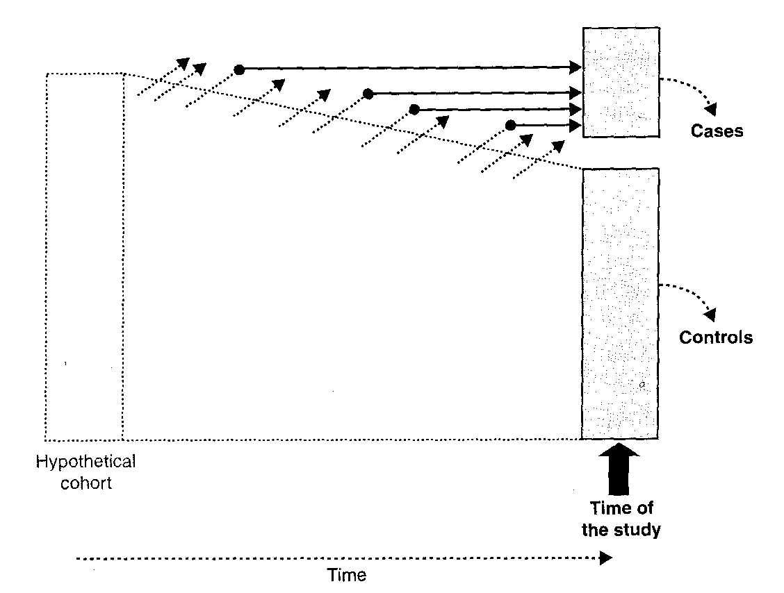
What happens in a cohort during follow-up

Slide 12
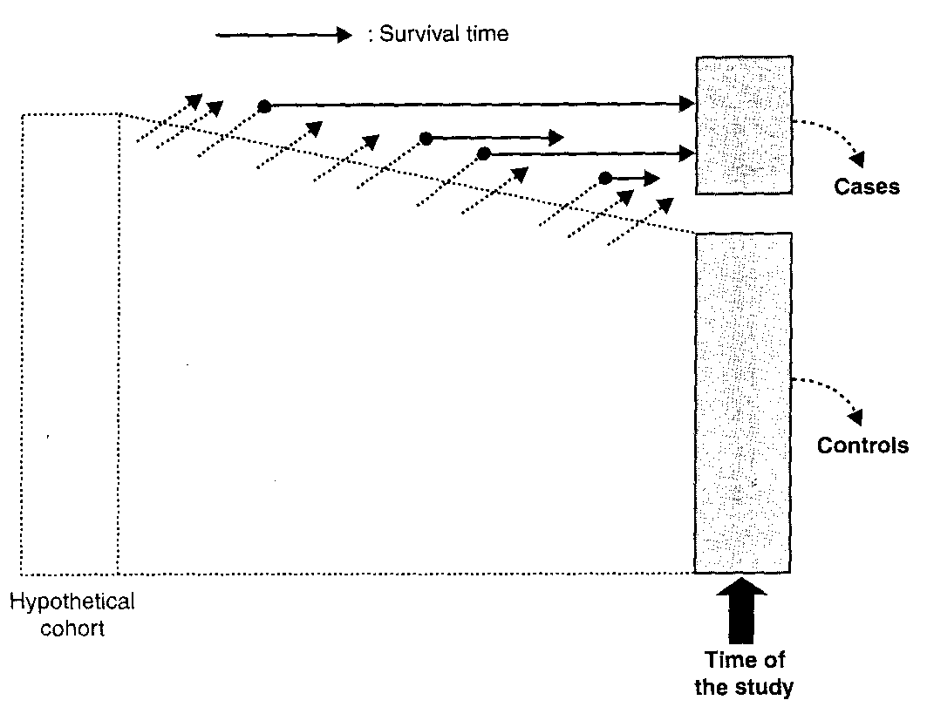
New cases vs. prevalent cases

Slide 13
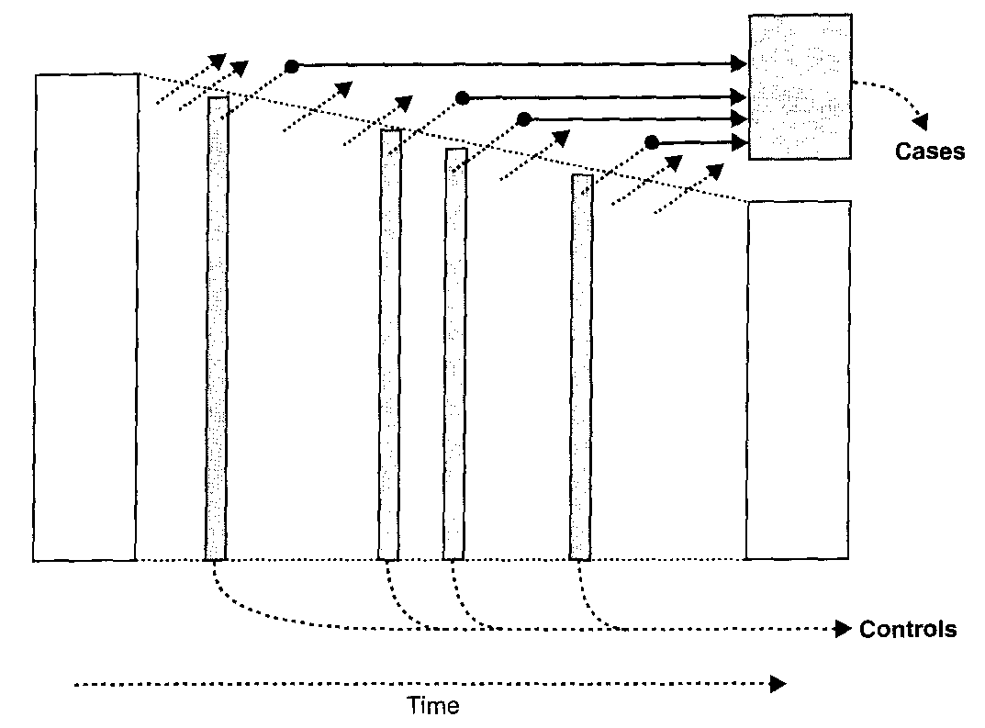
Nested case-control study

Slide 14
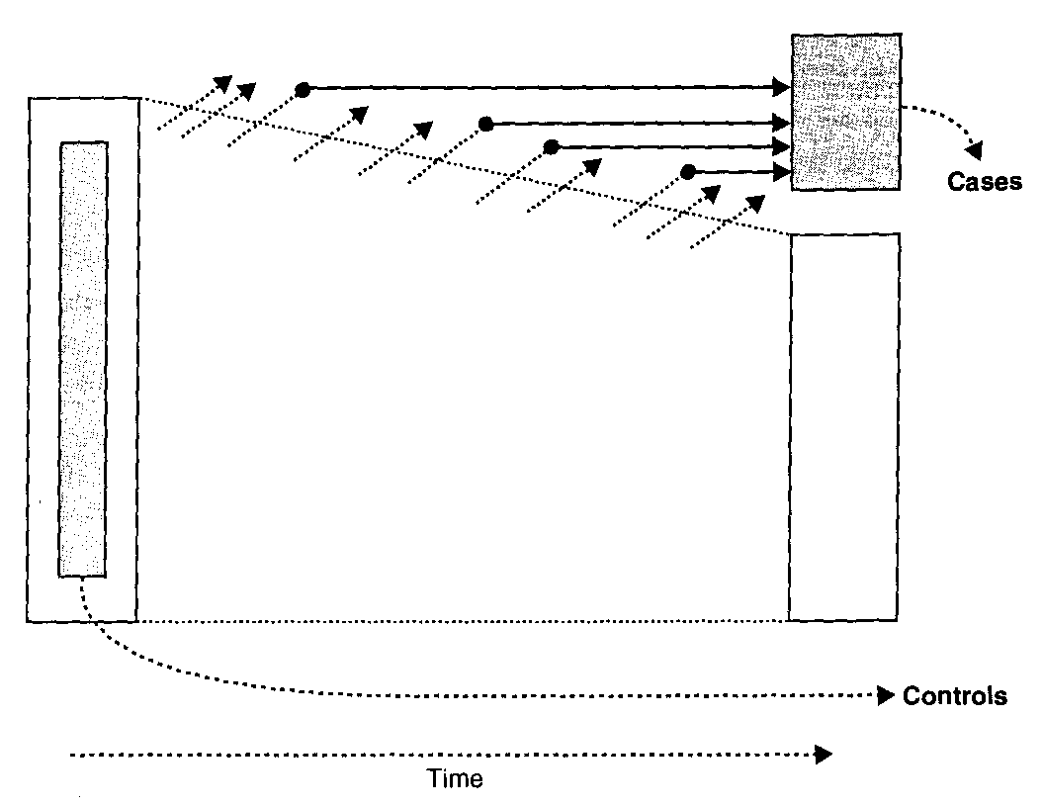
Case-cohort study

Slide 15
Cross-Sectional Case-Control Study
Target population
Case Non-Case

