Slide 1
IN THE NAME OF GOD

Slide 2
Diabetes and Pregnancy:
An Endocrine Society Clinical Practice Guideline
Shadi Haghi M.D.
Research Institute for Endocrine Sciences
Shahid Beheshti University of Medical sciences
29 September 2014

Slide 3
Method of Development of Evidence-Based Clinical Practice Guidelines
In terms of the strength of the recommendation:
  Strong recommendations use the phrase “we recommend” and the number 1
  Weak recommendations use the phrase “we suggest” and the number 2.
Cross-filled circles indicate the quality of the evidence,such that denotes
  Very low quality evidence;
  Low quality;
  Moderate quality;
  High quality

Slide 4
Preconception care of women with DM
We recommend that preconception counseling
be provided to all women with diabetes who are
considering pregnancy. (1 | ++00)
We suggest that women with DM seeking to
conceive strive to achieve blood glucose and (HbA1C)levels as close to normal as possible when they can be safely achieved without undue hypoglycemia. (2|++oo)

Slide 5
Evidence
Maternal hyperglycemia in the first few weeks of pregnancy increases the risk of fetal malformations, spontaneous abortions, and perinatal mortality .
Ideal preconception blood glucose levels have not been definitively established , and the exact degree of risk of a congenital anomaly for a given HbA1C is not precisely known.
It has, however,also been reported that there is a stable degree of anomaly risk of 3.9% to 5.0% with a periconceptional HbA1C of up to 10.4%, with this risk then climbing to 10.9% if the HbA1C is 10.4% or higher

Slide 6
Insulin therapy
We recommend that insulin-treated women
with diabetes seeking to conceive be treated with
multiple daily doses of insulin or continuous sc insulin
infusion in preference to split-dose, premixed insulin
therapy.
Because the former allow for the achievement of target blood glucose levels preconceptionally and, in the event of pregnancy, are more likely to allow flexibility or precise adjustment of insulin therapy.
(1|++oo)

Slide 7
Insulin therapy
We suggest that insulin-treated women with DM seeking to conceive, be treated with rapidacting insulin analog therapy (with insulin aspart or insulin lispro) in preference to regular (soluble) insulin.(2|++oo)
We suggest that women with DM successfully
using the long-acting insulin analogs insulin
detemir or insulin glargine preconceptionally may
continue with this therapy before and then during
pregnancy.(2|++oo)

Slide 8
Evidence
Rapid-acting insulin analogs are likely more able than regular human insulin to help a woman:
achieve postprandial blood glucose targets
less likely to cause hypoglycemia
fetal outcomes seem comparable
. Compared with NPH insulin,use of the long-acting insulin analogs insulin detemir or insulin glargine is associated with lower rates of nocturnal hypoglycemia
Insulin detemir, but not insulin glargine, is approved for use by the (FDA) during pregnancy.
Both of these long-acting insulin analogs,however, are widely used in pregnancy, with evidence of safety in this setting .

Slide 9
Folic acid supplementation
We recommend that beginning 3 months before withdrawing contraceptive measures or otherwise trying to conceive, a woman with diabetes take a daily folic acid supplement to reduce the risk of neural tube defects.(1|++oo)
We suggest a daily dose of 5 mg(2|++oo)

Slide 10
Ocular care
We recommend that all women with DM who are seeking pregnancy have a detailed ocular assessment by a suitably trained and qualified eye careprofessional .(1|++++)
If retinopathy is documented, the patient should
be apprised of the specific risks to her of this worsening during pregnancy.
If the degree of retinopathy warrants therapy, we recommend deferring conception until the retinopathy has been treated and found to have stabilized. (1|++++)

Slide 11
Ocular care
We recommend that women with established
retinopathy be seen by their eye specialist every
trimester, then within 3 months of delivering,and then as needed(1|+ooo)
We suggest that pregnant women with DM
not known to have retinopathy have ocular assessment performed soon after conception and then periodically as indicated during pregnancy (2|++oo)

Slide 12
Evidence
Established retinopathy can rapidly progress during, and up to 1 year after, pregnancy and can lead to sight-threatening deterioration .
The greater the degree of preconceptional retinopathy, the greater is the risk of retinopathy progressing during pregnancy
. The absence of retinopathy before conception confers very small risk of development of significant retinopathy during pregnancy; nonetheless, significant retinopathy can develop and progress during pregnancy, even if not identified preconceptionally
. Additional risk factors for progression of retinopathy during pregnancy include preexisting hypertension, poorly controlled hypertension during pregnancy , preeclampsia , and poor glycemic control at the onset of and during pregnancy

Slide 13
Renal function(preconception & during pregnancy)
We suggest that all women with DM considering pregnancy have their renal function assessed (by measuring their urine alb / cr, serum cr, and estimated [GFR]) (ungraded rec.)
We suggest that a woman with DM who has a significantly reduced GFR be assessed by a nephrologist before pregnancy, both for baseline renal assessment and to review the woman’s specific risk of worsening renal function in the event of pregnancy. (Ungraded rec)

Slide 14
Renal function
We suggest that all women with DM and
preconceptional renal dysfunction have their renal function monitored regularly during pregnancy (Ungraded rec.)

Slide 15
Evidence
Renal dysfunction in a pregnant woman with type 1 diabetes is associated with an increased risk of adverse maternal and fetal outcomes, including an increased risk of preeclampsia .
Mild preconceptional renal dysfunction manifesting only as microalbuminuria may worsen during pregnancy with greater amounts of proteinuria
however, the degree of worsening is typically both modest and reversible once pregnancy is completed so long as BP and blood
glucose remain well controlled during the pregnancy
. More severe preconceptional renal dysfunction,as evidenced by a reduced GFR and elevated serum cr can significantly deteriorate during pregnancy and may not be reversible

Slide 16
Management of HTN
We recommend that satisfactory (BP) control (<130/80 mm Hg) be achieved andmaintained before withdrawing contraception (1|++oo)
We recommend that a woman with DM who is seeking conception while taking an (ACE) inhibit or ARB in almost all casess should discontinue the medication (1|++oo)

Slide 17
Management of HTN
We suggest that in the exceptional case where the degree of renal dysfunction is severe and there is uncertainty about when conception will occur, physicians and patients be engaged in shared decisionmaking about whether to continue ACE inhibitors or ARB
. The patients should be informed about the possible loss of the renal protective properties if the medication is discontinued and the risk of teratogenesis if it is continued. (Ungraded rec)
. We recommend when ACE inhibitors or ARB have been continued up to the time of conception that the medication should be withdrawn immediately upon the confirmation of pregnancy.(1|++oo)

Slide 18
Evidence
ACE inhibitors and ARB are teratogenic .
This is most proven for use of these drugs during the second and third trimesters .

Slide 19
ADA 2014
In a pregnancy , target blood pressure goals of SBP 110–129 mmHg and DBP 65–79 mmHg
Lower blood pressure levels may be associated with fetal growth.
During pregnancy, treatment with ACE inhibitors and ARBs is
contrandicated.
Antihypertensive drugs known to be effective and safe in pregnancy include:
methyldopa, labetalol, diltiazem,clonidine, and prazosin.
Chronic diuretic use during pregnancy has been associated with restricted maternal plasma volume, which may reduce uteroplacental perfusion

Slide 20
Elevated vascular risk
We recommend that if a woman with diabetes has sufficient numbers of vascular risk factors(particularly the duration of the DM and her age), screening studies for (CAD) be undertaken in advance of withdrawing contraceptive .(1|+ooo)
. We recommend that if a woman with diabetes is seeking pregnancy and has CAD, its severity should be ascertained, treatment instituted, and counseling provided as to the potential risks of pregnancy to the woman and fetus before the woman withdraws contraception . .(1|++++)

Slide 21
Management of dislipidemia
We recommend against the use of statins in women with Dm who are attempting to conceive.(1 ++oo)
In view of their unproven safety during pregnancy we suggest against the routine use of fibrates and/or niacin for women with DM and hyperTG attempting to conceive.(2 ++oo)
We suggest that bile acid-binding resins maybeused in women with DM to treat hypercholesterolemia;
however, this is seldom warranted(2 ++oo)

Slide 22
ADA 2014
Drugs Contraindicated in Pregnancy:
Statins & ACE inhibitors are category X
(contraindicated for use in pregnancy)and should be discontinued before conception
ARBs are category C (risk cannot be ruled out) in the first trimester but category D (positive evidence of risk) in later pregnancy and should generally be discontinued before pregnancy.

Slide 23
Thyroid function
For women with type 1 DM,we recommend measurement of serum TSH and,if their thyroid peroxidase status is unknown, measurement of AntiTpo before withdrawing contraceptive measures or otherwise trying to conceive(1 +ooo)

Slide 24
Evidence
Autoimmune thyroid disease is common among women of childbearing age with type 1 DM with prevalence rates as high as 44%

Slide 25
Overweight & obesity
We recommend weight reduction before pregnancy for overweight and obese women with diabetes.(1 +++o)

Slide 26
Gestational diabetes
Testing for overt diabetes in early pregnancy
We recommend universal testing for DM with a FBS,HbA1C or an untimed random plasma glucose at the first prenatal visit (before 13 weeks gestation or as soon as possible thereafter) for those women not known to already have DM(1 ++oo)
In the case of overt diabetes, but not GDM, a second test (either a FBS, untimed random plasma glucose, HbA1C, or OGTT) must be performed in the absence of symptoms of hyperglycemia and found to be abnormal on another day to confirm the diagnosis.

Slide 27
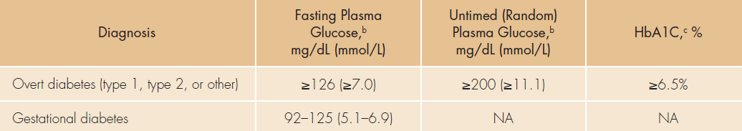
Diagnostic Criteria for Overt DM and GDM at the First Prenatal Visit (Before 13 Weeks Gestation or as Soon as Possible Thereafter) for Those Women Not Known to Already Have DM

Slide 28
Evidence
pregnant women with overt DM and insufficient blood glucose control in early pregnancy are at increased risk of having a fetus with congenital anomalies and are at increased personal risk of worsening of retinopathy and Nephropathy
. A systematic review and meta-analysis demonstrated that abnormal screening test results were associated with worse maternal and fetal outcomes.
The quality of supporting evidence for screening, however, remains low because there are no RCT that compare a screening vs.no-screening strategy and measure patient-important outcomes

Slide 29
Testing for GDM at 24-28 wk pregnancy
We recommend that pregnant women not previously identified with overt diabetes or GDM be tested for gestational diabetes by having a 2-hour, 75-g OGTT performed at 24 to 28 weeks gestation.(1 +++o)
One or more abnormal values establishes the diagnosis

Slide 30
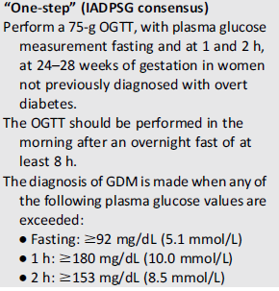
Screening for & diagnosis of GDM (ADA 2014)

Slide 31
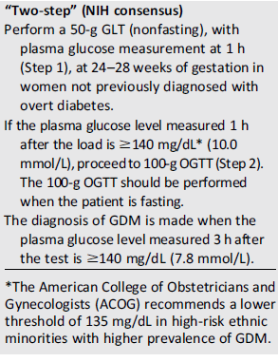
Screening for & diagnosis of GDM (ADA 2014)

Slide 32
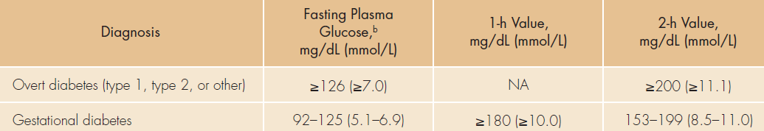
Diagnostic Criteria for Overt Diabetes and Gestational Diabetes Using a 2-Hour 75-g OGTT at 24 to 28 Weeks Gestation

Slide 33
Evidence
The Hyperglycemia and Adverse Pregnancy Outcome study and other studies have confirmed continuous graded relationships between higher maternal glucose and increasing frequency of birth weight above the 90th percentile, primary cesarean section, neonatal hypoglycemia, and elevated cord C-peptide level
an increased risk for preeclampsia, preterm delivery,shoulder dystocia/birth injury, hyper Bil,NICU admission.

Slide 34
Evidence
The Task Force commissioned a systematic review to assess the yield, utility, and benefits of previously employed screening tests for GDM.
The review identified 39 original studies enrolling87,830 women. None of the studies directly compared the maternal and fetal outcomes of women who received screening vs. women who did not receive screening.
The studies, however, described a statistically significant correlation between a positive screening test and the development of macrosomia and gestational HTN
The overall quality of this evidence was considered low

Slide 35
Management of elevated blood GLC
We recommend that women with GDM target blood glucose levels as close to normal as possible(1 ++oo)
We recommend that the initial treatment of GDM should consist of MNT and daily moderate exercise for 30 minutes or more.(1 +++o)
We recommend using blood glucose-lowering
pharmacological therapy if lifestyle therapy is insufficient to maintain normoglycemia in women with GDM.(1++++)

Slide 36
Evidence
Even mild hyperglycemia alters the normal metabolic adaptation to pregnancy , and correction of maternal hyperglycemia reduces or prevents adverse outcomes
Lifestyle therapy for GDM results in a lower incidence of reduced birth weight, large-for gestational-age births, and preeclampsia
Both aerobic exercise and non-weightbearing
exercise have been shown to lower blood glucose levels in women with GDM

Slide 37
Post partum care
We recommend that postpartum care for women who have had GDM should include measurement of FBS or fasting self-monitored blood glucose for 24 to 72 hours after delivery to rule out ongoing hyperglycemia.(1 +ooo)
We recommend that a 2-hour, 75-g OGTT should be undertaken 6 to 12 weeks after delivery in women with GDM to rule out prediabetes or diabetes(1+++o)
If results are normal,we recommend this or other diagnostic tests for diabetes should be repeated periodically as well as before future pregnancies(1++oo)

Slide 38
Post partum care
We recommend that all women who have had GDM receive counseling on lifestyle measures to reduce the risk of type 2 DM, the need for future pregnancies to be planned, and the need for regular DM screening, especially before any future pregnancies. (1 +ooo)
We suggest blood glucose-lowering medication should be discontinued immediately after delivery for women with gestational diabetes unless overt diabetes is suspected, in which case the decision to continue such medication should be made on a case-by-case basis(2++oo)

Slide 39
Evidence
Women who have had GDM are at high risk for the later development of IFG, IGT, overt DM, and the metabolic syndrome .
Infants born to mothers with GDM are at increased risk of the later development of obesity or type 2 diabetes

Slide 40
Self monitoring of blood GLC
We recommend self-monitoring of blood glucose in all pregnant women with GDMor overt DM(1++++)
suggest testing before and either 1 or 2 hours after the start of each meal and, as indicated, at bedtime and during the night(2++oo)

Slide 41
Glycemic targets
We recommend pregnant women with overt or GDM strive to achieve a target preprandial blood glucose <95 mg/dL( 1++oo) for fasting ,1+ooo) for other meals.
We suggest that an even lower fasting blood glucose target of <90 mg/dL be strived for(2 +ooo) if this can be safely achieved without undue hypoglycemia.
We suggest pregnant women with overt or GDM strive to achieve target blood glucose levels 1 hour after the start of a meal <140 mg/dL and 2 hours after the start of a meal <120 mg/dL (2+ooo)
We suggest pregnant women with overt DM ,HbA1C <7% (ideally <6.5%). (2+ooo)

Slide 42
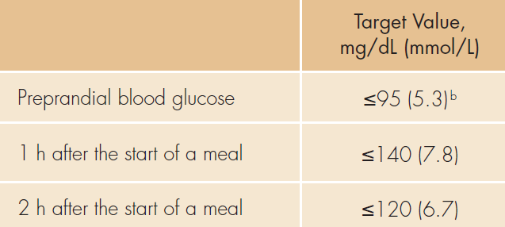
Glycemic Targets Preconceptionally for
Women with Overt Diabetes and During Pregnancy for Women With Either Overt Diabetes or Gestational Diabetesa

Slide 43
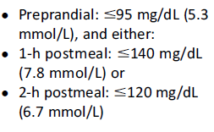
Glycemic target for GDM women(ADA 2014)

Slide 44
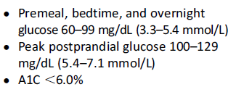
Glycemic goal for pregnant women with pre existing type1 or type2 DM (ADA2014)

Slide 45
Continuous GLC monitoring
We suggest that continuous glucose monitoring be used during pregnancy in women with overt or GDM when SMBG levels are not sufficient to assess glycemic control (2++oo)

Slide 46
Nutrition therapy
We recommend MNT for all pregnant women with overt or GDM to help achieve and maintain desired glycemic control while providing essential nutrient requirements.
(1++oo)

Slide 47
Weight management
We suggest obese women with overt or GDM reduce their calorie intake by approximately one-third (compared with their usual intake before pregnancy) while maintaining a minimum intake of 1600 to 1800 kcal/d
(2++oo)

Slide 48
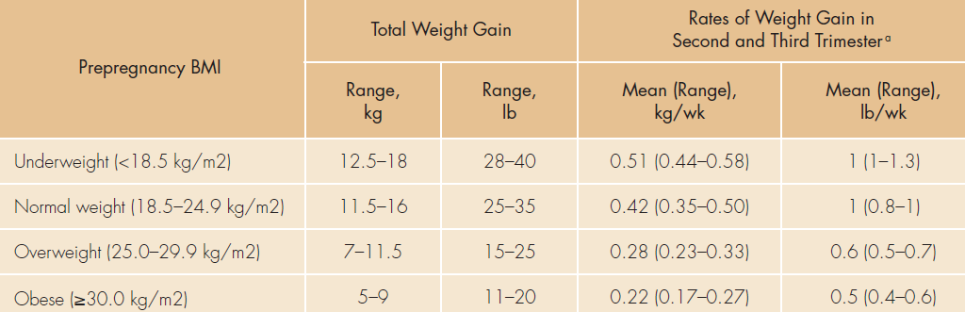
2009 Institute of Medicine Recommendations for Total Weight Gain and Rate of Weight Gain During Pregnancy, by Prepregnancy BMI

Slide 49
Evidence
Moderate energy restriction (1600–1800 kcal/d) in
pregnant women with overt DM improves mean
glycemia and fasting insulinemia without inhibiting fetal growth or inducing ketosis
Energy intake of approximately 2050 kcal in all BMI
categories in women with GDM has been reported to limit maternal weight gain, maintain euglycemia, avoid ketonuria, and maintain an average birth weight of 3542 g

Slide 50
Carbohydrate intake
We suggest women with overt or gestational
DM limit carbohydrate intake to 35% to45% of total calories, distributed in 3 small- to moderate-sized meals and 2 to 4 snacks including an evening snack.(2|++oo)

Slide 51
Evidence
There is no definitive evidence for the optimal proportion of carbohydrate in the diet of women with overt or GDM; values from 40% to 45% of energy intake to 60% (if the carbohydrate is from complex sources) have been recommended.
Some authorities suggest that a minimum of175 g/d carbohydrate should be provided, which is
higher than the 130 g/d recommended for nonpregnant women

Slide 52
Evidence
No interventional studies, however, have been conducted using the glycemic index in pregnant women with diabetes

Slide 53
Nutritional supplements
We recommend pregnant women with overt or
GDM should follow the same guidelines for the intake of minerals and vitamins as for women
without DM (1|++oo ), with the exception of taking folic acid 5 mg daily beginning 3 months before withdrawing contraceptive .
We suggest that at 12 weeks gestation, the dose of folic acid be reduced to 0.4 to 1.0 mg/d, which should be continued until the completion of breastfeeding(2|++oo)

Slide 54
Insulin therapy during pregnancy
We suggest that the long-acting insulin analog detemir may be initiated during pregnancy for those women:
who require basal insulin
for whom (NPH) insulin, in appropriate doses, has previously resulted in
or for whom it is thought NPH insulin may result in, problematic hypoglycemia
insulin detemir may be continued in those women with DM already successfully taking insulin detemir before pregnancy.(2|++++)

Slide 55
Insulin therapy during pregnancy
We suggest that those pregnant women successfully using insulin glargine befor pregnancy may continue it during pregnancy.
(2|++oo)
. We suggest that the rapid-acting insulin analogs lispro and aspart be used in preference to regular(soluble) insulin in pregnant women with DM.(2|+++o)

Slide 56
Insulin therapy during pregnancy
We recommend the ongoing use of continuous sc insulin infusion during pregnancy in women with DM when this has been initiated before pregnancy.(1+++o)
But suggest that continuous sc insulin infusion not be initiated during pregnancy
unless other insulin strategies including multiple daily doses of insulin have first been tried and proven unsuccessful.(2|++oo)

Slide 57
Evidence
In nonpregnant women, insulin detemir is associated with less hypoglycemia than NPH insulin .
Insulin detemir has not shown adverse maternal or neonatal effects
. Glargine use during pregnancy was not associated with unexpected adverse maternal or fetal outcomes in a large cohort study;however, the lack of a control group and the retrospective nature of this study limit the interpretation of the findings .
Several retrospective cohort and case-control studies of pregnant women found that overall, the outcome with insulin glargine treatment was no different from, or was superior to, NPH insulin

Slide 58
Remarks
Of the two available long-acting insulin analogs,detemir has a theoretical advantage over glargine during pregnancy because glargine’s much higher affinity for the IGF-1 receptor raises concerns about increased mitogenic activity .
Nonetheless,glargine is unlikely to cross the placenta ,animal studies have not shown glargine to be embryotoxic, and women treated with insulin glargine during the first trimester have a similar rate of congenital malformations as women treated with insulin NPH .
Insulin detemir is now approved(Category B) by the FDA for use during pregnancy
whereas insulin glargine does not currently have such approval.

Slide 59
Noninsulin AHA therapy
We suggest that glyburide (glibenclamide) is a
suitable alternative to insulin therapy for glycemic
control in women with GDM who fail to achieve sufficient glycemic control after a 1-week trial of MNT and exercise
except for:
Those women with a diagnosis of GDM before 25 weeks gestation
and for those women with FBS >110 mg/dL, in which case insulin therapy is preferred.(2|++oo)

Slide 60
AHA therapy
We suggest that metformin therapy be used for glycemic control only for those women with:
GDM who do not have satisfactory glycemic control despite MNT
and who refuse or cannot use insulin or glyburide
and are not in the first trimester.
(2|++oo)

Slide 61
Evidence(glyburide)
In pregnant women taking glyburide, the umbilical cord glyburide concentration is undetectable or, very low
. Glyburide is effective in controlling blood glucose in women with GDM and has been associated with favorable neonatal outcomes including the rate of LGA infants macrosomia
NICU admission, and neonatal hypoglycemia

Slide 62
Evidence(glyburide)
Although some evidence does exist of higher rates of macrosomia and LGA infants in pregnant women taking glyburide compared with women taking insulin, neonates had similar body composition,measures of glycemic control, and cord metabolic biomarkers.
The safety of glyburide in pregnancy is also supported by a meta-analysis of 6 RCT with overall good methodological quality,which found no significant differences in glycemic
control, neonatal hypoglycemia, birth weight, or rate of LGA infants born to mothers taking oral agents (metformin or glyburide) vs.mothers taking insulin.

Slide 63
Evidence(glyburide)
Glyburide, however, has been found to be less likely to maintain satisfactory blood glucose control in women with GDM who have:
FBS >110 mg/dL
on a 100-g OGTT or 50-g glucose challenge
have had their GDM detected before 25 weeks gestation
have glyburide initiated after 30 weeks
have FBS ≥110 mg/dL or 1-hour postprandial glucose ≥140 mg/dL
or have pregnancy weight gain >12 kg

Slide 64
Remarks
Glyburide appears to be a safe and effective alternative to insulin in most women with GDM.
glyburide may be more convenient, is less expensive , does not require intensive educational instruction at initiation of therapy, and is preferred by most patients
. Before instituting glyburide to treat GDM, the clinician should have a full discussion with the pregnant woman regarding glyburide’s possible advantages and disadvantages and its lack of FDA approval for this indication.

Slide 65
Remarks
there are no RCT regarding the use of noninsulin AHA in pregnant women with type 2 diabetes.
Most women with type 2 diabetes requiring blood glucose-lowering medications are treated with insulin

Slide 66
Evidence(metformin)
Pregnancy outcomes in women exposed to metformin have been favorable.
Compared with women with insulin, those taking metformin have no difference in maternal glycemic control, significantly lower rates of neonatal hypoglycemia, and no increased risk of congenital anomalies or other serious maternal or neonatal adverse events.
Although not shown to be deleterious to the fetus, metformin does cross freely through the placenta

Slide 67
Evidence (metformin)
Also, nearly half of women with GDM treated with metformin monotherapy have glycemic control failure rates requiring conversion to insulin therapy.
Additionally, metformin treated women with GDM have increased rates of preterm birth

Slide 68
Remarks
Compared with insulin therapy, metformin is typically more convenient and less expensive and is not associated with the risk of hypoglycemia
Nonetheless,certain concerns, as described, still preclude its routine use in the treatment of GDM.
Because data on the safety and efficacy of the use of
other noninsulin antihyperglycemic medications during pregnancy,including the use of incretin-based therapies during pregnancy, are not yet available, we do not recommend their use in this setting.

Slide 69
ADA 2014
Metformin & acarbose are :category B
Other AHA are :category C

Slide 70
Blood glucose targets during labor and delivery
We suggest target blood glucose levels of 72 to126 mg/dL during labor and delivery for pregnant women with overt or GDM.
(2|++oo)

Slide 71
Lactation
We recommend whenever possible women with
overt or GDM should breastfeed their infant.
(1|++++)
. We recommend that breastfeeding women with
overt diabetes successfully using metformin or
glyburide therapy during pregnancy should continue to use these medications, when necessary.(1|++++)

Slide 72
Postpartum contraception
We recommend that the choice of a contraceptive method for a woman with overt DM or a history of GDM should not be influenced by virtue of having overt DM or a history of GDM.(1|+++o)

Slide 73
Evidence(contraception)
Combined OCP use by women with type 1 DM does not affect their glycemic control or increase their risk of end-organ injury .
Combined OCP use by women with history of GDM does not increase the risk of later developing type 2 DM .
Use of a contraceptive patch or vaginal ring exerts a similar metabolic effect to that of oral contraceptives.

Slide 74
Evidence(contraception)
Compared with women without DM, women with DM using an device (copper or levonorgestrel-releasing) are not at increased risk of untoward effects .
Progestin-only OCP do not affect blood glucose values or BP in women with type 1DM
however, there is some limited evidence that these medications increase the risk for later developing type 2 DM in women who have had GDM intrauterine

Slide 75
Screening for postpartum thyroiditis
We suggest that women with type 1 DM be screened for postpartum thyroiditis with a TSH at 3 and 6 months postpartum
(2|++oo)

Slide 76

Thank You

