Slide 1
Medullary Carcinoma a case presentation
Presented by : A.Saffarian MD

Slide 2
A 48 year old male, from Afghanistan, lives in Saveh, Married, Has three children, He is a building worker

Slide 3
Present illness and patient Hx
Presented with chief complaint of chronic diarrhea since one year ago.
He suffers from watery diarrhea about 8-10 times a day without abdominal pain or tenesmus. Diarrhea continues with fasting. He has no history of rectorrhagia, steatorrhea, nausea, vomiting and fever. He has had 15 kg weight loss since one year ago.
He has the Hx of an epidural mass in lower thoracic (T10-11) in 14 years ago (1382) that results of biopsy and resected mass revealed metastatic medullary carcinoma (IHC: Cytokeratin, Chromogranin, Calcitonin positive)

Slide 4
A thyroid US in 1382 showed 3 thyroidal nodules (one hypoechoic 14*6 mm nodule with calcification in the left lobe and two 5 mm with calcification and 4 mm nodules in the right lobe) but thyroid surgery was not done. He remained untreated for 8 years.
Lab data (1382):
Calcitonin >680 pg/ml (<95)
TFT : normal
CEA : mildly elevated
24h urine 5-HIAA : 8 mg (NL)
Ca : 9.6 Ph : 4.1
ESR & CRP : Neg

Slide 5
He was again hospitalized in 6 years ago (1390) due to severe sweating and palpitation and underwent total thyroidectomy and modified radical bilateral LN dissection and right internal jugular vein excision.
Calcitonin (1390) > 2000 pg/ml

Slide 6
Pathologic Results of Thyroid Bx
Thyroid:
Medullary carcinoma with a focus of papillary carcinoma
Medullary carcinoma:
Tumor size; right lobe (4 nodules): 0.6,0.1,0.5 and 0.5 cm. Left lobe (2 nodules): 0.3 and 0.1 cm
Papillary carcinoma:
Tumor type: follicular variant
Right lobe 0.3 cm
Vascullar invasion and extrathyroidal extension were not seen.

Slide 7
Pathologic Results of lymph nodes
Left post lateral Lymph nodes:
All seven lymph nodes are involved by medullary carcinoma
Right post lateral lymph nodes resection and jugular vein biopsy:
All four lymph nodes are involved by medullary carcinoma
Vascular invasion is evident

Slide 8
After thyroid surgery he remained untreated for thyroid cancer until his recent admission due to chronic diarrhea.

Slide 9
Based on patient past medical records, MEN 2 syndrome has been ruled out (but not documented RET oncogene study).

Slide 10
Past medical Hx:
Diabetes mellitus since one month earlier
Nephrolithiasis 15 years ago (ESWL) and 5 years ago
Cataract surgery 6 months ago
Right clavicle fracture due to trauma and surgery two years ago

Slide 11
Drug history
Levothyroxine 900 mcg/week
Ins Lantus 6 u sc QHS
Ins Novorapid (4 u morning, 4 u afternoon, 3 u evening)

Slide 12
Family and social history
Unremarkable

Slide 13
ROS
Weigh loss 15 kg since one year ago
Non productive Cough since two month ago
Polyuria (+), polydipsia(+), intermittent bone pain in lower spinal and lower extremities
Hoarseness (-), dysphagia(-)
Hypertension(-), Flushing (-), sweating (-), palpitation(-),
dyspnea (-), chest pain (-), anxiety (-)
Headache (-), dizziness (-), vertigo (-),

Slide 14
Physical exam
He is conscious and oriented, he seems cachectic.
BP : 110/70 PR: 84/min RR:18/min OT: 37.3 orthostatic hypotension (-)
Wt: 58 kg Ht: 178 cm BMI: 18.3
Skin examination : normal appearance
Head & Neck :
There is a thyroidectomy scar. Thyroid is not palpable.
There is a firm, fixed, 15 mm LN anterior to left SCM and three non tender, firm immobile lymph nodes with largest diameter of 15 mm posterior to right SCM are palpable.

Slide 15
Chest : Normal heart and breath sounds
Abdominal : distension (-), tenderness (-), guarding (-)
Extremities : edema(-), deformities (-)
Neurologic examination : unremarkable
Muscular force : Nl
There is a surgical scar in thoracic spine. No spinal tenderness

Slide 16
Problem list
Epidural mass (metastatic medullary carcinoma)resected in 14 years ago
Total thyroidectomy and radical cervical lymph node dissection in 6 years ago
Chronic diarrhea since one year ago
Calcitonin >2000 pg/ml, CEA: 55

Slide 17
Lab data 96/5
FBS BUN Cr Na K AST ALT ALKP TG Chol LDL HDL Ca Ph | 253 12 1 135 3.5 18 16 300 38 118 44 55 8.3 3
WBC RBC Hb MCV Plt | 5.1 4 12 84 197
VBG PH 7.45 CO2 38.5 PO2 47.1 HCO3 23.6
ESR 43 CRP 4
Stool exam × 3
Appearance Color Protozoae & cyst Ova & Parasite WBC RBC Stool culture | Loos Brown Not seen Not seen 0-1 0-1 Normal flora
TSH | 4.4 miu/ml
T4 | 7 mcg/dl
T3 | 0.9 ng/dl
T3RU | 34 %

Slide 18
96/5/10
96/4/10
CEA 55 (<5) Calcitonin 82.1 pg/ml
Calcitonin >2000 pg/ml

Slide 19
Whole body Scan 96/4

Slide 20
Thyroid sonography:
4 hypoechoic round lesion with vascularity in bed of the right lobe medial to carotid artery (largest diameter : 7*5.5 mm) compatible with lymphadenopathy or remnant of thyroidal cancer.
One hypoechoic 5*3.5 mm lesion in the bed of left lobe.
One oval lymph node with calcification foci 7*21 mm in left jugular region.
One round lymph node 5*3 mm in right jugular region.

Slide 22
Whole Body Bone Scan by TC99-MDP 96/5/10
There are multiple hyperactivities in skull, right 4th costovertebral junction, T6, T8, T9
Remainder of skeleton is unremarkable

Slide 23
Upper GI Endoscopy (96/1/20) : mild gastritis
Colonoscopy (96/1/20): normal
Echocardiography (96/5/11) : normal LV & Rv size and function. EF : 55 %. PAP : 25 mmHg

Slide 24
Abdominal sonography Report 96/5/9:
There is a heteroechoic round lesion with a diameter of 63*40 mm in right lobe of the liver with internal and peripheral vascularity that has a compressive effect on the surrounding vessels suggesting metastasis.

Slide 26
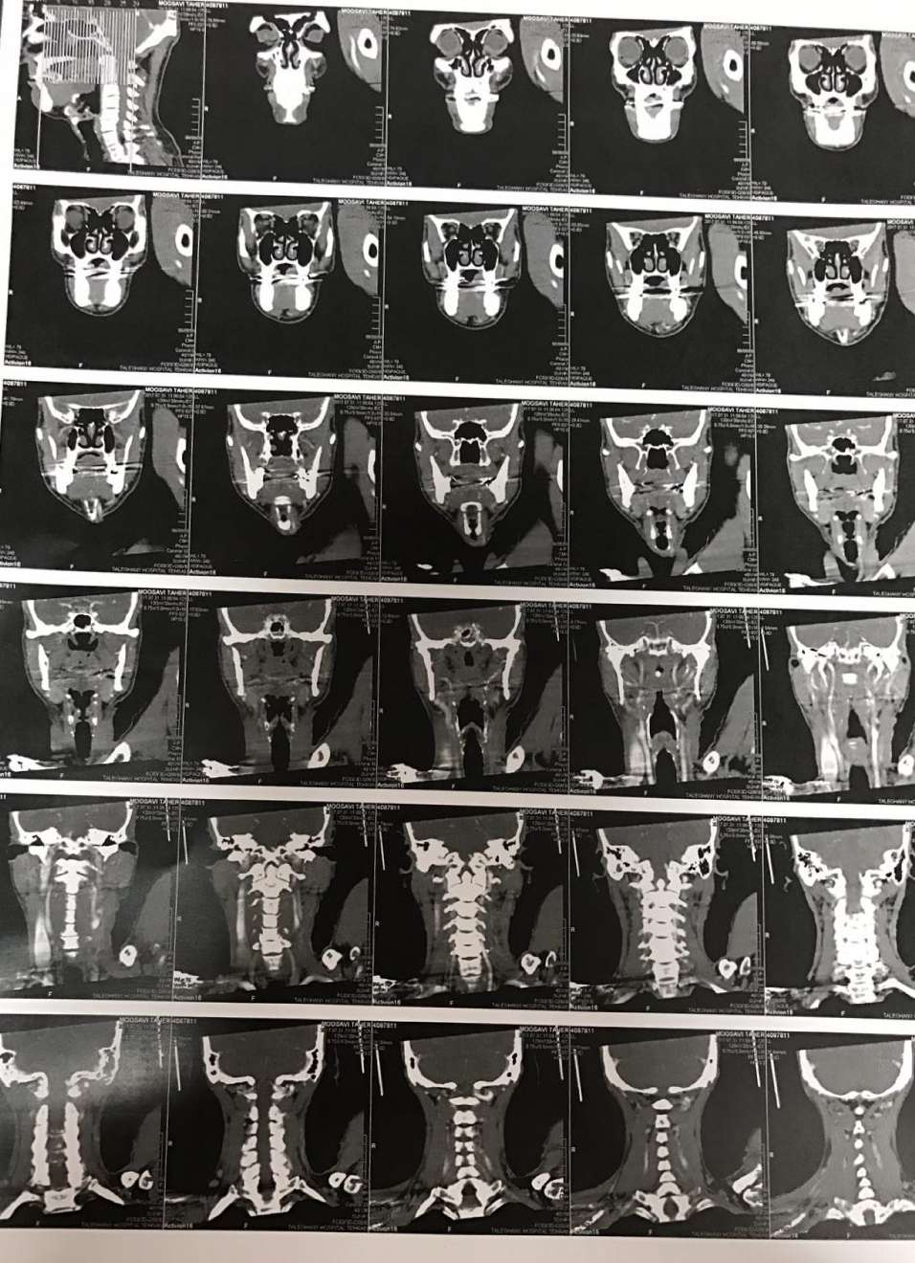

Slide 30
Spiral Neck CT Scan Report 96/5/9:
There is a small remnant of thyroid tissue in the right lobe.
A soft tissue mass with diameter of 44*16 mm is evident in right paravertebral area at T10 level along with lytic lesion in T10.
There are two enhancing lymph nodes with largest diameter of 15 mm in posterior cervical region.

Slide 31
Spiral Chest CT Scan Report 96/5/9:
There are scattered micro nodules in upper part of both lungs suggesting metastasis.
Multiple calcified lymphadenopathies in right paratracheal, precarinal and bilateral hilar
There is no pleural effusion

