Slide 1
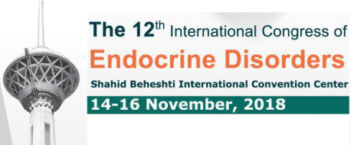
Rezvan Salehidoost, M.D. Isfahan Endocrine and Metabolism Research Center Isfahan University of Medical sciences
Preoperative Management of Patients with Thyrotoxicosis
Version December 2014

Slide 2
Agenda
Preoperative Management of Patients with Thyrotoxicosis for Nonthyroid Surgery
Preoperative Management of Patients with Hyperthyroidism who are to Undergo Thyroid Surgery

Slide 3
Agenda
Preoperative Management of Patients with Thyrotoxicosis for Nonthyroid Surgery
Preoperative Management of Patients with Hyperthyroidism who are to Undergo Thyroid Surgery

Slide 5
Clinical manifestations that may impact perioperative outcome
Dyspnea may occur for a variety of reasons, including:
respiratory muscle weakness
decreased lung volume
increased basal oxygen consumption
increased carbon dioxide (CO2) production
Exertional dyspnea and ventilation in hyperthyroidism. Chest 1992; 101:1268.
Respiratory muscle weakness and dyspnea in thyrotoxic patients. Am Rev Respir Dis 1990; 141:1221.

Slide 6
Clinical manifestations that may impact perioperative outcome
Patients with hyperthyroidism who are undergoing surgery are at risk for developing thyroid storm, a scenario characterized by tachycardia, confusion, fever, gastrointestinal complaints, and potentially leading to cardiovascular collapse.
Thyroid storm usually occurs during surgery or in the first 18 hours after the procedure. The mortality rate for patients with thyroid storm can be as high as 40 percent.
Nonthyroid surgery in the patient with thyroid disease. Uptodate.2018.

Slide 7
Subclinical and Overt Hyperthyroidism Definition
Subclinical hyperthyroidism is defined as a low TSH with normal free T4 and T3.
Overt hyperthyroidism is defined as a suppressed TSH with elevated free T4 and/or T3 concentrations.
American Thyroid Association Guidelines for Diagnosis and Management of Hyperthyroidism and Other Causes of Thyrotoxicosis. Thyroid 2016;
Nonthyroid surgery in the patient with thyroid disease. Uptodate.2018.

Slide 8
Can Patients with subclinical hyperthyroidism proceed with surgeries? (Elective? Urgent?)

Slide 9
Subclinical Hyperthyroidism and Nonthyroid surgery
Patients with subclinical hyperthyroidism can typically proceed with elective or urgent surgeries.
In patients with subclinical disease, in the absence of contraindications, preoperative β-blockade is considered sufficient.
Perioperative Management of Thyroid Dysfunction. Health Services Insights.2016;1-5
Nonthyroid surgery in the patient with thyroid disease. Uptodate.2018.

Slide 10
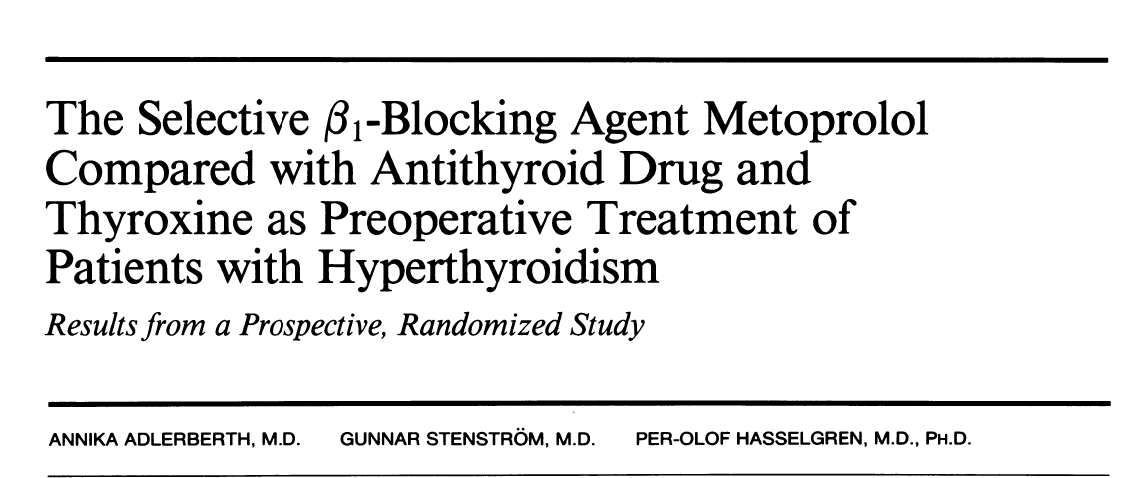
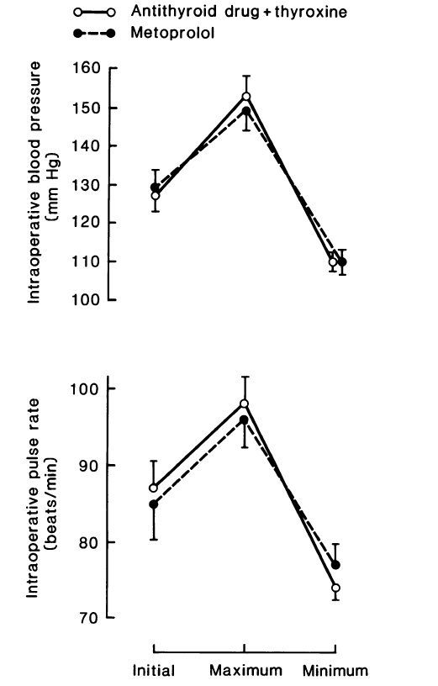
A prospective randomized trial showed that in hyperthyroid patients undergoing thyroidectomy who were treated with just 5 weeks of metoprolol preoperatively, there were no serious intra- or postoperative complications, compared with patients who were pretreated for 12 weeks with a combination of methimazole and levothyroxine to render them euthyroid.
The selective beta 1-blocking agent metoprolol compared with antithyroid drug and thyroxine as preoperative treatment
of patients with hyperthyroidism. Results from a prospective, randomized study. Ann Surg. 1987;205:182–188.

Slide 11
Can Patients with overt hyperthyroidism proceed with surgeries? (Elective? Urgent?)

Slide 12
Overt Hyperthyroidism and Nonthyroid surgery
Elective surgery – Because of the risk of precipitating thyroid storm, experts suggest postponing all elective surgeries in patients with overt hyperthyroidism until the patient has achieved adequate control of their thyroid condition (normal free T4 and T3), which usually takes three to eight weeks after initiating β-blockers and thionamides.
Urgent surgery – For overtly hyperthyroid patients in whom surgery cannot be postponed, preoperative treatment of hyperthyroidism should be initiated as soon as possible.
Perioperative Management of Thyroid Dysfunction. Health Services Insights.2017;1-5
Nonthyroid surgery in the patient with thyroid disease. Uptodate.2018.

Slide 13
Preoperative preparation for urgent nonthyroid surgery
Evaluatation for possible cardiopulmonary disease
Administration of β-blockers
Administration of Antithyroid drugs
Administration of Iodine
Administration of glucocorticoid
Administration of cholestyramine
Administration of Iopanoic acid
Perioperative Management of Thyroid Dysfunction. Health Services Insights.2017;1-5
Nonthyroid surgery in the patient with thyroid disease. Uptodate.2018.

Slide 14
Preoperative preparation for urgent nonthyroid surgery
The hyperthyroid patient requiring urgent surgery should be evaluated for possible cardiopulmonary disease, and the patient should be monitored for the possible development of arrhythmias, cardiac ischemia, and congestive heart failure.
Perioperative placement of an arterial line or central venous pressure monitor is appropriate if there is evidence of cardiopulmonary disease or the patient is not hemodynamically stable.
Perioperative Management of Thyroid Dysfunction. Health Services Insights.2017;1-5
Nonthyroid surgery in the patient with thyroid disease. Uptodate.2018.

Slide 15
Preoperative preparation for urgent nonthyroid surgery
Treatment directed against the thyroid gland
Inhibition of new hormone synthesis: Thionamide drugs (PTU, MMI)
Inhibition of thyroid hormone release: Iodine (SSKI, Lugol’s solution), iopanoic acid, Lithium
Treatment directed against circulating thyroid hormone and its effects
Inhibition of T4-to-T3 conversion: PTU, Corticosteroids, Iopanoic acid, Propranolol
Symptom relief and cardioprotective benefits: β-blockers, Calcium channel blockers
Removal of excess circulating thyroid hormone: cholestyramine
Perioperative management of the thyrotoxic patient. Endocrinol Metab Clin North Am 2003;32:519

Slide 16
β-blocker
Preoperative preparation for urgent nonthyroid surgery
In the absence of contraindications, β-blocker is recommended preoperatively for patients with overt hyperthyroidism undergoing urgent nonthyroid surgery.
Atenolol may be preferred in patients who are candidates for therapy.
It is a beta- 1-selective agent which may be tolerated better in patients with reactive airway disease.
Its long half-life facilitates once-daily dosing and an oral dose taken one hour before surgery will usually maintain adequate beta blockade until the patient is able to take oral medications postoperatively.
American Thyroid Association Guidelines for Diagnosis and Management of Hyperthyroidism and Other Causes of Thyrotoxicosis. Thyroid 2016;
Perioperative Management of Thyroid Dysfunction. Health Services Insights.2017;1-5
Nonthyroid surgery in the patient with thyroid disease. Uptodate.2018.

Slide 17
β-blocker
Preoperative preparation for urgent nonthyroid surgery
Supplemental intravenous propranolol can be used to control pulse and blood pressure and even decrease fever intraoperatively. (0.5 to 1 mg over 10 minutes followed by 1 to 2 mg over 10 minutes every few hours)
Propranolol in high doses (above 160 mg/day) inhibits T4-to-T3 conversion. But this effect of propranolol is slow, occurring over 7 to 10 days.
Perioperative Management of Thyroid Dysfunction. Health Services Insights.2017;1-5
Nonthyroid surgery in the patient with thyroid disease. Uptodate.2018.

Slide 18
Preoperative preparation for urgent nonthyroid surgery
Calcium channel blockers should be used in patients who cannot tolerate β-blockers. These drugs should be titrated to achieve a heart rate under 80 beats per minute.
.
Perioperative Management of Thyroid Dysfunction. Health Services Insights.2017;1-5
Nonthyroid surgery in the patient with thyroid disease. Uptodate.2018.

Slide 19
Antithyroid drugs
Preoperative preparation for urgent nonthyroid surgery
In cases where thyrotoxicosis is due to the increased synthesis of thyroid hormone( ie, in the Graves disease and toxic nodular disease), but not in cases of exogenous thyroid hormone intoxication or thyroiditis, antithyroid drugs (ATDs) should be used as soon as possible to decrease thyroid hormone levels.
Perioperative Management of Thyroid Dysfunction. Health Services Insights.2017;1-5
Nonthyroid surgery in the patient with thyroid disease. Uptodate.2018.

Slide 20
Antithyroid drugs
Preoperative preparation for urgent nonthyroid surgery
Thionamides, including propylthiouracil (PTU) and methimazole, are actively transported into the thyroid gland where they inhibit both the organification of iodine and the coupling of iodotyrosines.
They inhibit de novo production of thyroid hormone but do not actually affect the release of preformed hormone. Thus, their effects may be apparent after several days.
Antithyroid drugs. N Engl J Med 2005; 352:905.

Slide 21
Antithyroid drugs
Preoperative preparation for urgent nonthyroid surgery
Methimazole (10 mg two to three times daily or 20 to 30 mg once daily) is usually preferred to propylthiouracil (PTU), except during pregnancy, because of its longer duration of action (allowing for single daily dosing) and a lesser degree of toxicity.
PTU (100 to 150 mg every six to eight hours) is preferred by some clinicians for the initial treatment of thyroid storm since it reduces T4-to-T3 conversion.
Patients who cannot take oral medications will need rectal administration of thionamides.
Perioperative Management of Thyroid Dysfunction. Health Services Insights.2017;1-5
Nonthyroid surgery in the patient with thyroid disease. Uptodate.2018.

Slide 22
Iodine
Preoperative preparation for urgent nonthyroid surgery
If hyperthyroidism is severe and the need for surgery is urgent, potassium iodide solution can be given one hour after thionamides.
Perioperative Management of Thyroid Dysfunction. Health Services Insights.2017;1-5
Nonthyroid surgery in the patient with thyroid disease. Uptodate.2018.

Slide 23
Iodine
Preoperative preparation for urgent nonthyroid surgery
In hyperthyroid patients, iodine acutely inhibits hormonal secretion, occurring within hours of the start of therapy.
A second effect involves inhibition of iodine organifcation in the thyroid gland, thereby diminishing thyroid hormone biosynthesis, a phenomenon called the Wolff-Chaikoff effect.
However, as escape from the Wolff-Chaikoff effect is anticipated to occur after approximately 10 days, treatment with iodine should not be started more than 10 days preoperatively.
Serum thyroxine and triiodothyronine concentrations during iodide treatment of hyperthyroidism. J Clin Endocrinol Metab 1975
Iodine in the treatment of hyperthyroidismUptodate.2018.

Slide 24
Iodine
Preoperative preparation for urgent nonthyroid surgery
KI can be given as:
5–7 drops of Lugol’s solution (8 mg iodide/drop)
1–2 drops of SSKI (50 mg iodide/drop)
three times daily mixed in water or juice for 10 days before surgery
American Thyroid Association Guidelines for Diagnosis and Management of Hyperthyroidism and Other Causes of Thyrotoxicosis. Thyroid 2016;

Slide 25
Iodine
Preoperative preparation for urgent nonthyroid surgery
In patients with known or suspected toxic adenoma/MNG, it is imperative that administration of a thionamide precedes that of iodide because of iodine excess may trigger thyroid hormone production in patients with autonomously functioning nodular goiters (Jod-Basedow effect.)
Thus, SSKI should not be used at all in a patient with toxic adenoma/MNG if the patient will be unable to continue oral or rectal thionamides.
Perioperative Management of Thyroid Dysfunction. Health Services Insights.2017;1-5
Nonthyroid surgery in the patient with thyroid disease. Uptodate.2018.

Slide 26
Iopanoic acid
Preoperative preparation for urgent nonthyroid surgery
Iopanoic acid (an oral cholecystographic agent which is rich in iodine) blocks both release of T4 and T3 from the gland and T4-to-T3 conversion.
Perioperative Management of Thyroid Dysfunction. Health Services Insights.2017;1-5
Nonthyroid surgery in the patient with thyroid disease. Uptodate.2018.

Slide 27
Glucocorticoids
Preoperative preparation for urgent nonthyroid surgery
Glucocorticoids decrease T4-to-T3 conversion regardless of the source of T4, so they may be added preoperatively and tapered over 3 days postoperatively.
Suggested regimens include:
hydrocortisone 100 mg every 8 hours
dexamethasone 2 mg every 6 hours
betamethasone 0.5 mg every six hours
Perioperative Management of Thyroid Dysfunction. Health Services Insights.2017;1-5
Nonthyroid surgery in the patient with thyroid disease. Uptodate.2018.

Slide 28
Cholestyramine
Preoperative preparation for urgent nonthyroid surgery
cholestyramine (4 g four times daily) decreases circulating hormone levels by binding thyroid hormone in the intestine and decreasing its reabsorption regardless of whether it was endogenously produced or exogenously administered.
As the enterohepatic circulation of thyroid hormone is increased in thyrotoxic patients, this binding resin is effective.
Adjunctive cholestyramine therapy for thyrotoxicosis. Clin Endocrinol. 1993;38:39–43

Slide 29
Intolerance to Thionamides
Preoperative preparation for urgent nonthyroid surgery
Adverse effects of thionamides include:
common and minor (eg, rash)
rare but serious, such as agranulocytosis and hepatotoxicity.
Although thionamide toxicity is uncommon, some patients are unable to continue thionamides because rare side effects such as agranulocytosis or hepatotoxicity or because of allergy.
Perioperative Management of Thyroid Dysfunction. Health Services Insights.2017;1-5
Nonthyroid surgery in the patient with thyroid disease. Uptodate.2018.

Slide 30
Intolerance to Thionamides
Preoperative preparation for urgent nonthyroid surgery
Patients with severe hyperthyroidism who are allergic to or unable to tolerate thionamides can treat with:
Beta blockers
Glucocorticoids (to inhibit conversion of T4 to T3)
Bile acid sequestrants (to reduce enterohepatic circulation of thyroid hormone)
Iodine (in patients with Graves' disease)
The iodine-induced hyperthyroidism (Jod- Basedow effect) is not relevant in patients with the Graves disease.
Perioperative Management of Thyroid Dysfunction. Health Services Insights.2017;1-5
Nonthyroid surgery in the patient with thyroid disease. Uptodate.2018.

Slide 31
Agenda
Preoperative Management of Patients with Thyrotoxicosis for Nonthyroid Surgery
Preoperative Management of Patients with Hyperthyroidism who are to Undergo Thyroid Surgery

Slide 32
Preoperative Management of Patients with Hyperthyroidism who are to Undergo Thyroid Surgery
“If surgery is chosen as treatment for GD, patients should be rendered euthyroid prior to the procedure with ATD pretreatment, with or without b-adrenergic blockade. A KI-containing preparation should be given in the immediate preoperative period.”(Strong recommendation, low-quality evidence, RECOMMENDATION 24)
A iodine containing preparation should be given for GD in the immediate preoperative period (for up to 10 days before ). Iodine decreases the vascularity of the thyroid gland and surgical blood loss.
American Thyroid Association Guidelines for Diagnosis and Management of Hyperthyroidism and Other Causes of Thyrotoxicosis. Thyroid 2016;

Slide 33
Preoperative Management of Patients with Hyperthyroidism who are to Undergo Thyroid Surgery
“when it is not possible to render a patient with GD euthyroid prior to thyroidectomy, the need for thyroidectomy is urgent, or when the patient is allergic to ATDs, the patient should be adequately treated with β-adrenergic blockade, iodine, glucocorticoids, and potentially cholestyramine in the immediate preoperative period.” (Strong recommendation, low-quality evidence. RECOMMENDATION 26)
American Thyroid Association Guidelines for Diagnosis and Management of Hyperthyroidism and Other Causes of Thyrotoxicosis. Thyroid 2016;

Slide 34
Preoperative Management of Patients with Hyperthyroidism who are to Undergo Thyroid Surgery
“Calcium and 25-hydroxyvitamin D should be measured preoperatively and repleted if low or given prophylactically. Calcitriol supplementation should be considered preoperatively in patients at increased risk for transient or permanent hypoparathyroidism”. (Strong recommendation, low-quality evidence. RECOMMENDATION 25)
Monitoring for hypocalcemia after near-total or total thyroidectomy is necessary. Serum calcium and albumin should be measured on the evening of surgery and the next morning.
American Thyroid Association Guidelines for Diagnosis and Management of Hyperthyroidism and Other Causes of Thyrotoxicosis. Thyroid 2016;

Slide 35
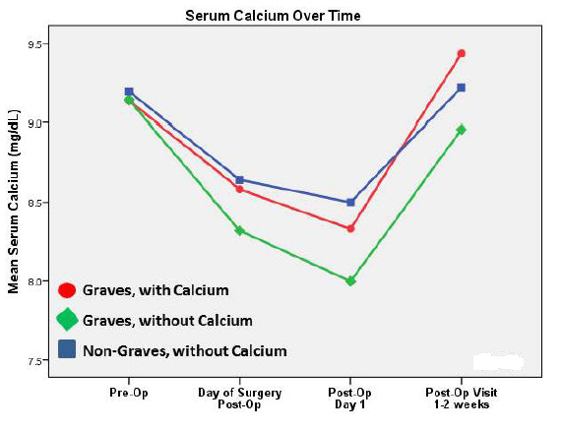
Oltmann et al. compared 45 Graves’ patients treated with 1 g oral calcium carbonate three times a day for 2 weeks prior to surgery to 38 Graves’ patients who underwent thyroidectomy without treatment as well as to 38 euthyroid controls; rates of biochemical and symptomatic hypocalcemia were significantly higher in nontreated Graves’ patients compared to the two other treatment groups.

Slide 36
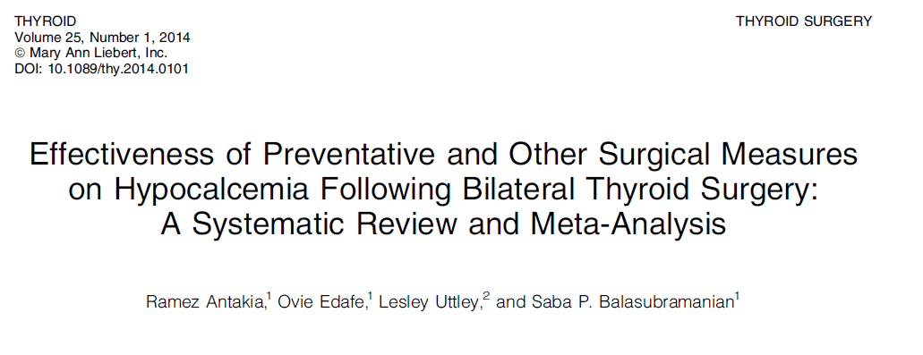

Slide 37
Preoperative Management of Patients with Hyperthyroidism who are to Undergo Thyroid Surgery
“If surgery is chosen as treatment for TMNG or TA, patients with overt hyperthyroidism should be rendered euthyroid prior to the procedure with MMI pretreatment, with or without b-adrenergic blockade. Preoperative iodine should not be used in this setting.”
(Strong recommendation, low-quality evidence, RECOMMENDATION 46)
Preoperative iodine should not be used for TMNG or TA. because of the risk of exacerbating the hyperthyroidism. Usually hyperthyroidism is less severe in patients with TMNG, so that in most cases, patients with allergy to ATDs can be prepared for surgery, when necessary, with b-blockers alone.
American Thyroid Association Guidelines for Diagnosis and Management of Hyperthyroidism and Other Causes of Thyrotoxicosis. Thyroid 2016;

Slide 38
1
2
3
4

Slide 39
Conclusion
Patients with subclinical hyperthyroidism can proceed with elective or urgent surgeries.
Because of the risk of precipitating thyroid storm, experts suggest postponing all elective surgeries in patients with overt hyperthyroidism until the patient has achieved adequate control of their thyroid condition.
For overtly hyperthyroid patients in whom surgery cannot be postponed, preoperative treatment of hyperthyroidism should be initiated as soon as possible.

Slide 40
Conclusion
In cases where thyrotoxicosis is due to the increased synthesis of thyroid hormone antithyroid drugs (ATDs) should be used as soon as possible to decrease thyroid hormone levels.
If hyperthyroidism is severe and the need for surgery is urgent, potassium iodide solution can be given one hour after thionamides.

Slide 41
Conclusion
For all patients with thyrotoxicosis, regardless of cause, corticosteroids, beta blockers and cholestyramine may be considered, as their functionality is independent of thyroid hormone production and regardless of whether it was endogenously produced or exogenously administered.

