Slide 2
Treatment of Hyperglycemia in T2DM
Insulin secretagogues
H. Delshad M.D
Endocrinologist
Research Institute for Endocrine Sciences

Slide 3
TYPE 2 DIABETES MELLITUS
Is a complex heterogeneous condition characterized by abnormalities of both:
►Insulin Secretion
►Insulin action

Slide 4
• Insulin • Glucagon • Incretins • Amylin
Glucose homeostasis is governed by a
complex interplay among different hormones

Slide 5
Insulin Secretion After A Meal In Normal Individual

Slide 6
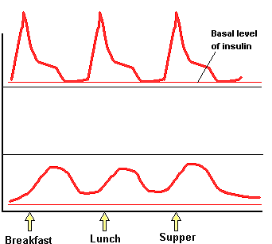
Insulin secretion in Type 1 and 2 DM
Prandial
Bolus
Bolus
Normal
Type 1
Type 2

Slide 7
Type 2 Diabetes : A Failure of Mealtime Insulin Secretion Early- phase Insulin secretion loss occurs early and second - phase release loss later in T2DM
Normal subjects
Patients with type 2 diabetes
PPG < 150 mg/dl
PPG > 300 mg/dl
Notes:
As a person deteriorates from having a normal insulin profile to having impaired glucose tolerance and, finally, type 2 diabetes, the insulin response to glucose becomes both blunted and delayed, and eventually fails completely. As we might expect, these changes have profound effects on glucose metabolism.
1. Coates PA, et al. A glimpse of the ‘natural history’ of established type 2 diabetes mellitus from the spectrum of metabolic and hormonal responses to a mixed meal at the time of diagnosis. Diabetes Res Clin Pract 1994; 26: 177–87.

Slide 8
Classes of OHA
Medications that increase insulin secretion
• Sulfonylureas
• Meglitinides
• D-phenylalanine derivatives
Medications that improve insulin action
• Biguanides
• Thiazolidinediones
Medications that slow glucose absorption
• a-Glucosidase inhibitors
Medications that restore incretin action
• GLP-l agonists
• DPP-IV inhibitors
Medications that increase glucosuria

Slide 9
Limitation of
Anti-diabetic agents

Slide 10
Expected HbA_{1c} reduction according to intervention
Intervention | Expected ↓ in HbA_{1c} (%)
Lifestyle interventions | 1 | to | 2%
Metformin | 1 | to | 2%
Sulfonylureas | 1 | to | 2%
Insulin | 1.5 | to | 3.5%
Glinides | 1 | to | 1.5%¹
Thiazolidinediones | 0.5 | to | 1.4%
α-Glucosidase inhibitors | 0.5 | to | 0.8%
GLP-1 agonist | 0.5 | to | 1.0%
Pramlintide | 0.5 | to | 1.0%
DPP-IV inhibitors | 0.5 | to | 0.8%
Notes:
10
10

Slide 11
Efficacy of Monotherapy with Oral Diabetes Agents
DeFronzo Annals of Internal Medicine 1999;131:281-303
Nathan N Engl J Med 2002; 347:1342-1349
Notes:
There are a number of antihyperglycemic agents available for patients with type 2 diabetes. With the exception of the alpha-glucosidase inhibitors, most of the drug classes share a similar level of efficacy.
Drug therapy decisions must take into consideration patient conditions which may contraindicate the use of the drug, any adverse effects as well as any beneficial effects such as weight loss, and patient and physician preferences. In addition to taking antihyperglycemic agents, all patients with type 2 diabetes should be encouraged to maintain a healthy lifestyle by exercising and following an appropriate diet. Additional medications may also be required to treat conditions such as hypertension or dyslipidemia.

Slide 12
Some concern about oral hypoglycemic drug
B cell exhaution.
Less effective
Hypoglycemia
Expensive

Slide 13
Sulfonylureas
Since 1950s, have been used extensively as insulin secretagogues for the treatment of T2DM.
Sulfonylureas cause only first-phase insulin release whereas nutrients stimulate both first-phase and second-phase insulin release

Slide 14
Sulfonylureas
► First generation = 1955
○Tolbutamide
○ Acetohexamide
○ Tolazamide
○ Chlorporpamide
►Second generation = early 1980s
○ Glyburide (Glibenclamide)
○ Glipizide
○ Gliclazide
○ Glimepiride
The different sulfonylureas are equally effective in lowering blood glucose concentrations. There are, however, differences in absorption and metabolism, as well as in effective dose.

Slide 15
Drug |  | Duration of biologic effect, h | Usual daily dose, mg | Dosing per day
First-generation
Acetohexamide | 12 to 18 |  | 500 to 750 | Once or divided
Chlorpropamide | 24 to 72 |  | 250 to 500 | Once
Tolbutamide | 14 to 16 |  | 1000 to 2000 | Once or divided
Second-generation
 | 14 to 16 |  | 2.5 to 10 | Once or divided
Glipizide
 | 24 |  | 40 to 240 | Once
Gliclazide
 | 20 to 24+ |  | 2.5 to 10 | Once
Glyburide
Glimepiride | 24+ |  | 2 to 4 | Once

Slide 16
Sulfonylureas
Mechanism of action:
●Pancreatic effect
●Extra-pancreatic effect

Slide 17
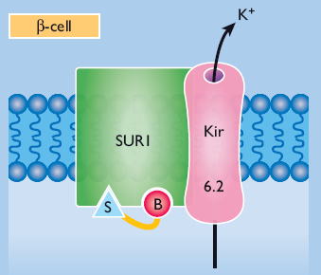
Sulfonylureas
The sulfonylurea receptor is a component of the ATP-dependent potassium channel in the pancreatic beta cells
The SUR affinity of the first-generation is only about 1/1000 of that of the second generation

Slide 18
Different SURs in different tissues
Pancreatic beta-cell SUR1
Vascular smooth muscle SUR1
Cardiac and skeletal muscle SUR2A
Non-vascular smooth muscle SUR2B
Brain SUR1-2B
Proks P et al., Diabetes 2002; 51: S368-S376.
Notes:
KATP channels have been identified in many tissue types, including myocardial cells.
In most tissues, Kir6.2 serves as the pore-forming subunit, but it associates with different SUR subunits; for example, it associates with SUR1 in the pancreas and brain; SUR2A in heart and skeletal muscle; and SUR2B in brain and smooth muscle. In vascular smooth muscle, the KATP channel is composed of Kir6.1 in association with SUR2B.
Amaryl® is highly selective for pancreatic channels over cardiac potassium channels, and therefore has a neutral CV profile

Slide 19
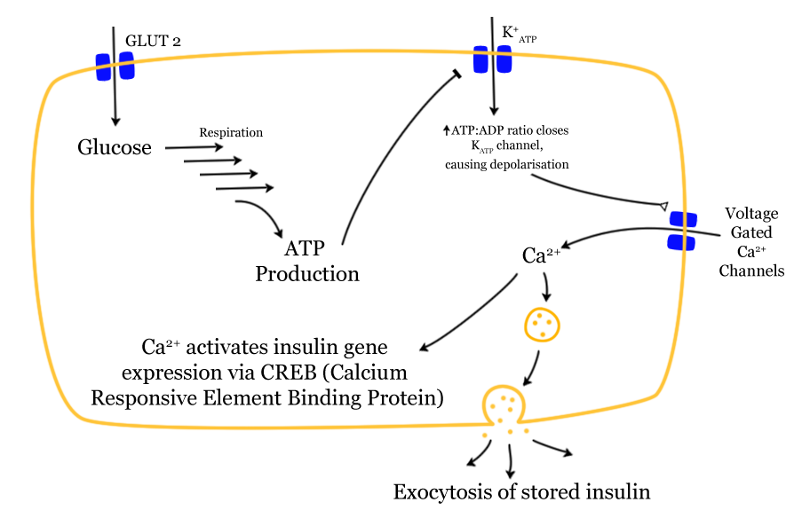
Glucose induced Insulin secretion
S
●
SR
●

Slide 20
Extrapancreatic Effects of Sulfonylureas
Sulfonylureas exert minor glucose lowering effects independently of increased insulin secretion :
• A small reduction in glucagon concentrations
• Increased peripheral glucose transport
• Increased hepatic glucose deposition
But these effects are not regarded to be of sufficient magnitude to be clinically relevant

Slide 21
Sulfonylureas : Pharmacokinetic
They are effectively absorbed from GI tract and reach peak plasma concentration in 2 – 4 hours.
Food can reduce the absorption of SUL.
Sulfonylureas are more effective when given 30 minutes before eating.
Plasma protein binding is high 90 – 99 % , mainly bind to albumen.

Slide 22
Sulfonylureas : Pharmacokinetic
●All sulfonylurea are metabolized by liver and their metabolites are excreted in urine with about 20 % excreted unchanged.
●Sulfonylurea should be administered with caution to patients with either renal or hepatic insufficiency.
●The metabolites of Glibenclamide are active while those of Glimipride and Gliclazide are inactive.

Slide 23
Sulfonylureas : Pharmacokinetic
Glyburide (glibenclamide)
Hypoglycemic effect appears to be equal to that of other sulfonylureas. Is associated with a high rate of serious and fatal hypoglycemia.
Modest weight gain.
Relative lack of specificity on the different KATP channels.
Glipizide
Short-acting formulation and extended-release formulation
The short-acting form is rapidly absorbed and is completely bioavailable.
Is eliminated with a half-life of 2 to 4 hours
Glimepiride & Gliclazide
More selective for the βcell KATP channel
Bind 2.5- to 3.0-fold faster and dissociate 8.0- to 9.0-fold faster than glyburide
from its β-cell KATP-binding site
Insulin release is more rapid and of shorter duration than that with glyburide.

Slide 24
Sulfonylureas :
Indications and contraindications
Sulfonylureas : Pharmacokinetic
As monotherapy and in combination with Metformin or a TZDs
Begin with a low dose, with SMBG at least once daily during the first few weeks.
Up titrate the dosage at 2 – 4 week intervals
Hypoglycemia, or early hypoglycemic symptoms are the main limitation to dose escalation
Maximal blood glucose – lowering effect is usually achieved at a dose that is well below the recommended maximum

Slide 25
Sulfonylureas :Efficacy
As monotherapy sulfonylureas reduce HbA1c of 1 – 2%
A rapid deterioration of glycemic control during sulfonylurea therapy “ secondary failure ” occurs in approximately 5 – 10% of patients per year
Sulfonylureas generally have little effect on blood lipids.
Occasionally, their use will cause a small decrease in plasma triglyceride or increase in HDL chol.

Slide 26
Sulfonylureas :Adverse effects
• Very occasionally, sensitivity reactions :
usually transient cutaneous rashes.
• Erythema multiforme is rare.
• Fever, jaundice, acute porphyria, photosensitivity
and blood dyscrasias are also rare.
• Chlorpropamide (no longer in common use) :
- Facial flushing with alcohol
- Water retention and hyponatremia.
• Weight gain : 1 – 4 kg
• Hypoglycemia

Slide 27
SUL and HYPOGLYCEMIA
Situations in which hypoglycemia is most likely to occur:
When the drug dose is too high
With the use of longer-acting drugs (Glyburide, Chlorpropamide)
Undernourished or abuse alcohol
Impaired renal or cardiac function or gastrointestinal disease
With concurrent therapy with Salicylates, Sulfonamides, Fibric acid derivatives and warfarin

Slide 28
SUL. Association with coronary disease outcomes
Some studies suggest that sulfonylureas may be associated with poorer outcomes after a myocardial infarction.
An increased mortality from cardiovascular disease in diabetic patients taking tolbutamide was noted over three decades ago in the University Group Diabetes Study.
While this study was not supported by results from the UKPDS, which reported no increase in fatality for patients taking sulfonylurea therapy at the time of myocardial infarction .
Others have supported the association

Slide 29
SUL. Association with coronary disease outcomes
In 185 consecutive diabetic patients undergoing coronary angioplasty after myocardial infarction at the Mayo Clinic,
The odds ratio for death was 2.77 for patients treated with a sulfonylurea at the time of the myocardial infarction, after correcting for other factors
Garratt KN, Brady PA, Hassinger NL, et al. Sulfonylurea drugs increase early mortality in patients with diabetes mellitus after direct angioplasty for acute myocardial infarction. J Am Coll Cardiol 1999; 33:119.

Slide 30
SUL. Association with coronary disease outcomes
In the DIGAMI (Diabetes Mellitus, Insulin Glucose Infusion in Acute Myocardial Infarction) trial, the patients with the poorest outcome were those treated with a sulfonylurea at the time of the myocardial infarction and who were not given a glucose-insulin-potassium infusion
Malmberg K. Prospective randomised study of intensive insulin treatment on long term survival after acute myocardial infarction in patients with diabetes mellitus. DIGAMI (Diabetes Mellitus, Insulin Glucose Infusion in Acute Myocardial Infarction) Study Group. BMJ 1997; 314:1512.

Slide 31
SUL. Association with coronary disease outcomes
In a retrospective Canadian study, n= 5795 subjects who received initial monotherapy with either a sulfonylurea or metformin,
Deaths per 1000 person-years during the follow-up period (mean 4.8 years) were:
67.6 for first-generation sulfonylurea
61.4 for glyburide
39.6 for metformin
Simpson SH, Majumdar SR, Tsuyuki RT, et al. Dose-response relation between sulfonylurea drugs and mortality in type 2 diabetes mellitus: a population-based cohort study. CMAJ 2006; 174:169.

Slide 32
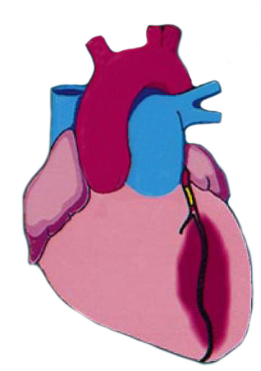
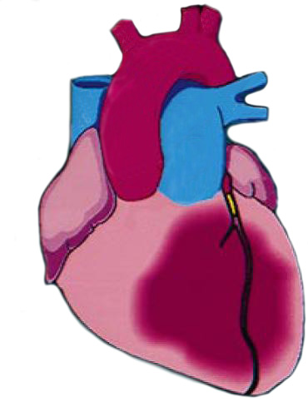
Since ATP-dependent potassium channels are present on cardiac cells and coronary vessels, it is possible that the presence of sulfonylureas at the time of a myocardial infarction prevents adequate coronary vasodilation and thus may result in a larger area of myocardial damage.
NO ISCHEMIC PRECONDITIONING
Prolonged occlusion of a major coronary artery leads to myocardial infarction
ISCHEMIC PRECONDITIONING
Repeated and brief occlusion of the same vessel preconditions the myocardium such that subsequent prolonged occlusion leads to a smaller infarct
SULFONYLUREAS
Sulfonylureas other than Glimepiride abolish ischemic preconditoning, resulting in large infarction size
Brady et al. J Am Coll Cardiol 1998;31(5):950.
Notes:
IP occurs when cardiac K_{ATP} channels open automatically during brief episodes of mild myocardial ischemia
Drugs that inhibit cardiac K_{ATP} channel opening (e.g. glibenclamide) may be harmful to the ischemic myocardium by blunting the K_{ATP} channel-dependent component of the ischemic preconditioning response

Slide 33
SUL. Association with coronary disease outcomes
In a study of 1310 French patients with diabetes who were hospitalized for myocardial infarction, in-hospital mortality rates were significantly lower in patients previously treated with sulfonylureas compared with other oral medications, insulin, or no medication (3.9, 6.4, 9.4, and 8.4 percent, respectively).
Among the SU treated patients, mortality was significantly lower in patients receiving Gliclazide or Glimepiride rather than Glyburide.
Zeller M, Danchin N, Simon D, et al. Impact of type of preadmission sulfonylureas on mortality and cardiovascular outcomes in diabetic patients with acute myocardial infarction. J Clin Endocrinol Metab 2010; 95:4993.

Slide 34
Newer sulfonylureas, such as Gliclazide and Glimepiride, are selective for the pancreatic sulfonylurea receptors over the cardiac receptors and do not appear to be associated with increased cardiovascular mortality

Slide 35
SUL. : choice of agent
The choice of sulfonylurea is primarily dependent upon cost and availability, because their efficacy is similar.
However, given the relatively high incidence of hypoglycemia in patients taking glyburide or chlorpropamide, shorter acting drugs should be used, especially in elderly patients .
In a patient who is not a candidate for metformin or who cannot tolerate metformin as initial monotherapy, a shorter-duration sulfonylurea, such as glipizide is suggested.

Slide 36
ADA/EASD Consensus Algorithm for Management of Diabetes Diabetes Care. 2009, 32:193-203
At diagnosis:
Lifestyle
+
Metformin
Tier 1: Well-validated core therapies
Lifestyle+Metformin
+
Basal Insulin
Lifestyle+Metformin
+
Intensive insulin
Lifestyle+Metformin
+
Sulfonylurea
Step 1
Step 2
Step 3
Tier 2: less well-validated
therapies
Lifestyle+Metformin
+
Pioglitazone
+
Sulfonylurea
Lifestyle+Metformin
+
Pioglitazone
(No hypoglycemia, edema,
CHF, bone loss)
*Useful when hypoglycemia is to be avoided
Lifestyle+Metformin
+
GLP1
(No hypoglycemia, wt loss,
Nausea/vomiting)
Lifestyle+Metformin
+
Basal Insulin
Amylin agonists, Glinides
DPP-4 inhibitors may be appropriate in selected patients

Slide 37
2012

Slide 38
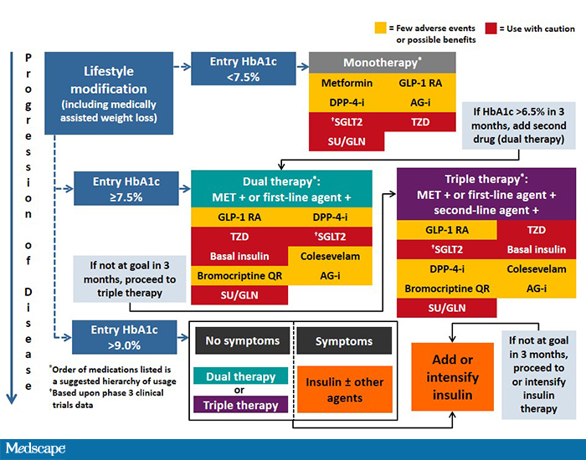
AACE, 2015

Slide 39
Meglitinides ( short - acting prandial insulin releasers)
Glinides
●Were introduced as prandial insulin releasers.
● Stimulation of pancreatic insulin release by closing ß-cells K_{ATP} channels.
● Very rapid onset of action and short duration (T_{MAX} = 1 hour, metabolized by liver T_{1/2} = 70 minutes).
● No hypoglycemic metabolites.
Meglitinide (1980s )
Repaglinide (1998 )
Nateglinide (2001)

Slide 40
Glinides
Agent | Dose(mg/meal) | Max. daily dose (mg) | Duration (h)
Repaglinide | o.5 – 4.0 | 16 | 4 - 6
Nateglinide | 60 – 180 | 540 | 3 - 5

Slide 41
Glinides
Clinical efficacy:
Improves postprandial glycemia
Less effective in decreasing fasting blood glucose levels and HbA_{1C}
As add-on to metformin, they can reduce HbA1c by an additional 0.5 – 1.5% .
Adverse effects
Hypoglycemic episodes are fewer and less severe than with sulfonylureas.
Sensitivity reactions, usually transient, are uncommon.
They may cause a small increase in body weight

Slide 42
Glinides :Indications and contraindications
For individuals who exhibit post-prandial Hyperglycemia while retaining near normal fasting glycemia.
For individuals with irregular lifestyles & unpredictable or missed meals.
For some elderly patients, particularly if other agents are contraindicated.
Repaglinide is ideally taken 15 – 30 min. before a meal.
Start with a low dose (e.g. 0.5 mg), titrate every 2 weeks up to a maximum of 4 mg before each main meal.

Slide 43
Efficacy
Insulin Secretagogues
Nateglinide
Repaglinide
Glipizide
Glimepiride
Gliclazide
Glyburide
(micronized)
Glyburide
(nonmicronized)
Most rapid
Least rapid

Slide 44
توحـید گوی تو نه بنـی آدمنـد و بـس
هـربلـبلی که زمـزمه بر شـاخسار کرد

