Slide 1
Case discussion
Prepared by:
Dr Batoul Birjandi

Slide 2
Problem List
Recurrent renal stone( coax) & oxaluria
Previous Parathyroid surgery(Twice)
persistant Hypercalcemia
Hyperphosphatemia(??)
Nl to mildly elevated PTH
Sufficient 25(OH)D level
soft tissue calcinosis

Slide 3
DDX:
Hypercacemia:
Parathyroid mediated:
Primary hyperparathyroidism(sporadic)
Inherited:MEN/FIHP/HP-JT
FHH
Tertiary HP(renal failure)
Non parathyroid mediated:
Hypercalcemia of malignancy
VIT D intoxication
Chronic granulomatous disorders: increased calcitriol
Chronic hyperphosphatemia:
-psudohyperphosphatemia
-acute phosphate load
-Cellular shift: lactic or ketoacidosis
-decreased renal clearance:
Reduced GFR
Increased tubular reabsorption: Hypoparathyroidism/Acromegaly/bisphosphonate/vit D toxicity/familia tumoral calcinosis

Slide 4
hyperoxaluria
Primary hyperoxaluria: AR
PH1:88 and 352 mg per 24 h(med age:15)……70-80%
PH2:88 and 176 mg per 24 h
PH3: med age: 2 Y
Secondary
Our patient:
1120mg/24h(first)
765 mg/24h
405 mg/24h
31 mg/24h (last)
PH type 2 typically have elevated urinary L-glycerate (>28 mmol/mol creatinine), which is pathognomonic for type 2 disease , whereas patients with type 1 disease typically have elevated urinary glycolate excretion

Slide 5
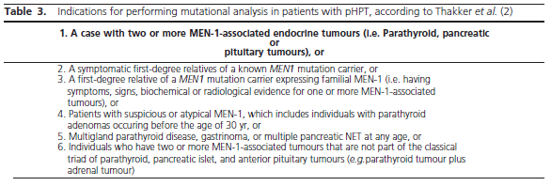
FIHP/MEN1
Lassen T1,et al.J Clin Endocrinol Metab.2014

Slide 6
DDX:
Hyperparathyroidism +
Chronoc granulomatous disorders
Hyperphosphatemic Familial Tumoral Calcinosis

Slide 7
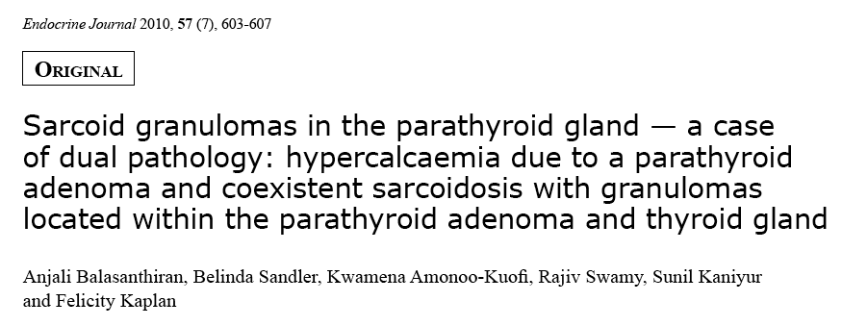
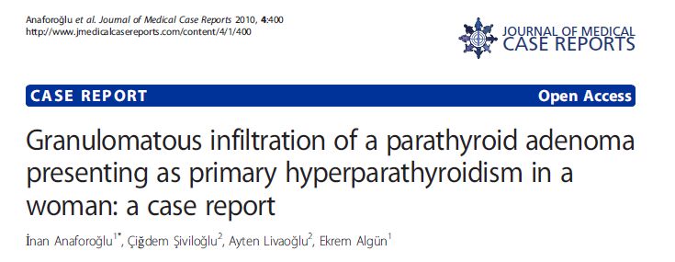
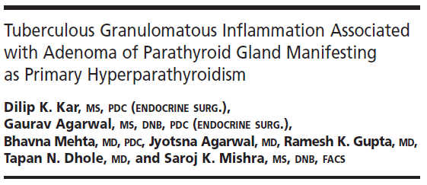
Parathyroid adenoma and coexistent Granulomatous Disorder

Slide 8
Design and Setting:
This was a retrospective observational study of patients with both disorders at our institution between January 1980 and December 2011.( N=50)

Slide 9
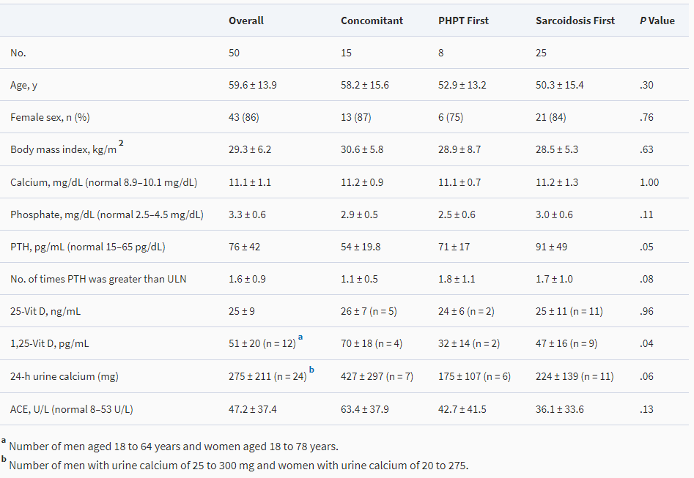

Slide 10
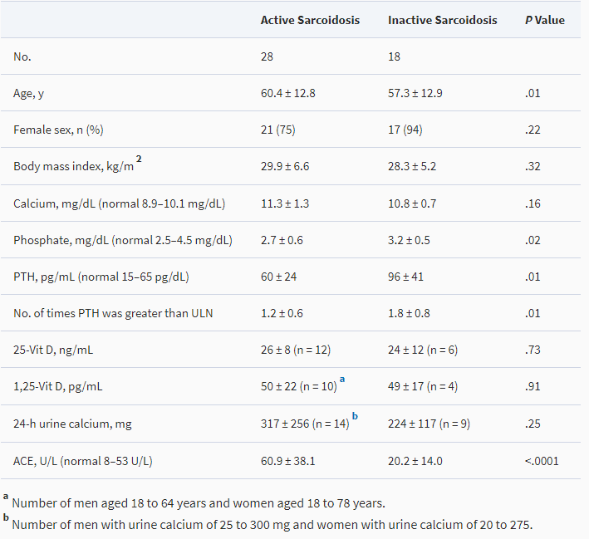

Slide 11
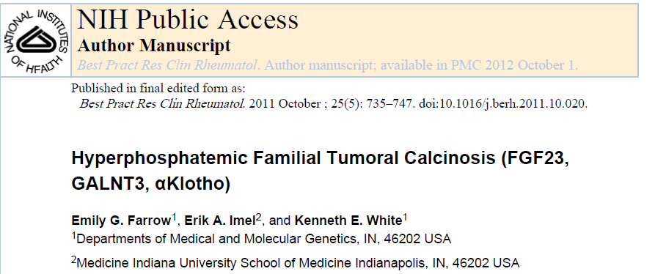

Slide 12
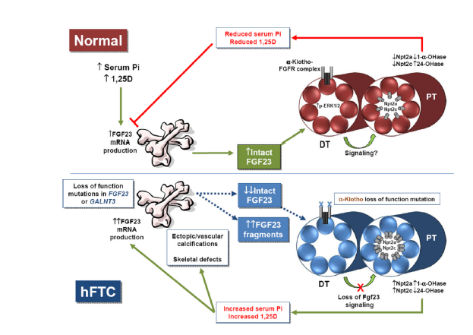

Slide 13
TC due to:
FGF23 loss of function mutations
loss of function GALNT3 mutations(results in O-glycosylation of FGF23 and results in decreased susceptibility to proteolytic degredation )
Mutations in FGF-23 or Klotho (Kl) genes
hyperphosphatemia, increased %TRP(tubular reabsorption of phosphate)and inappropriately normal or elevated 1,25D concentrations.
TRP= 1- clearance ph/ clearance cr…..Nl: 70-80%
Our patient: 88%/89%

Slide 14
Serum calcium and PTH levels are usually normal
Increased levels of calcitriol
Normal serum calcium levels in setting of hyperphosphatemia leads to elevated Ca/Phos product, leading to ectopic calcifications (Although Hyperostosis-hyperphosphatemia syndrome (HHS) had been distinguished from hFTC by the presence of bone involvement and the absence of ectopic calcifications, following GALNT3 mutation detection several groups have now demonstrated that the HHS and hFTC clearly represent different manifestations of the same genotype)

Slide 15
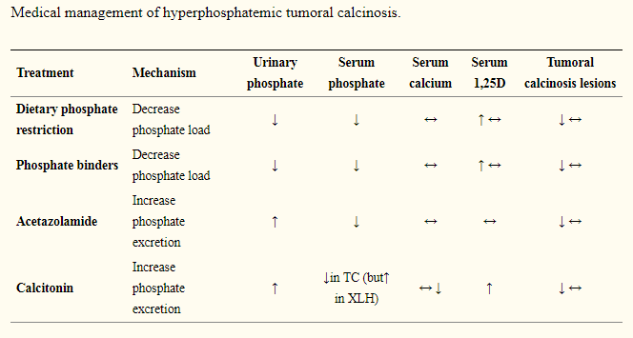

Slide 16
Plan:
Genetic analysis for MEN1
phosphate binders + Acetazolamide(phosphaturic)…….. Genetic analysis for hFTC
Resurgery

