Slide 1
How accurate is Harris-Benedict equation for predicting resting metabolic rate in normal and overweight young females in Tabriz-Iran?
Presented By: Nazli Namazi
Ph.D Student of Nutrition
Tabriz University of Medical Sciences

Slide 2
Background:
WHO REPORT(2008):
Prevalence of overweight: More than 1.4 billion
Prevalence of obesity: About 500 million
1

Slide 3
Cont´d
Recommendations of health provider
Media, fashion and advertisements of thinness
Tendency to obtain desirable body weight
Self-diet management or consulting the dietitian
Amariles et al,2006
2

Slide 4
Diet Planning
First Step:
Calculation of individual energy requirement
Carol et al,2012
3

Slide 5
Resting Metabolic Rate (RMR)
Methods for RMR measurement:
Direct calorimetry
Doubly labeled water
Indirect calorimetry
Predictive formula
Disadvantages of first three methods:
Time consuming
Expensive
hardly feasible in clinical settings
Mcdoniel S et al,2007
4

Slide 6
Predictive RMR formula
The most commonly used equation: Harris-Benedict
H-B formula in women:
7-27% overestimation in normal and obese individuals in U.S population
665 + 9.56 * weight + 1.84 * hight - 4.67 * age
Carol et al,2012
Tseng et al,2011
5

Slide 7
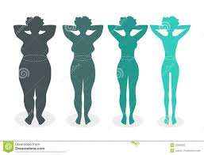
Differences in accuracy of H-B equation in different:
Range of BMI
Age group
Sex
Race
Body Mass Index
Li et al,2010
7

Slide 8
Aim of Study
Determination of accuracy for Harris-Benedict equation to predict resting energy expenditure in normal and overweight young females in Tabriz-Iran
8

Slide 9
Materials & Methods
A cross-sectional study
Sample: 200 (100 normal & 100 overweight) volunteer female students
Criteria:
Exclusion criteria
Diabetes, cardiovascular and Thyroid disorders
Taking any losing /gaining weight medications and supplementation
Anti psychotic, Diuretic & Corticosteroid drugs during 3 months ago
Inclusion criteria:
Sex: Female
Age: 18-30 years
BMI: 18.5 to 29.9 kg/m²
9

Slide 10
Measurements
Anthropometric assessments (weight, height and BMI)
Physical activity assessment (IPAQ)
RMR measurement by indirect calorimetry (Fitmate, Cosmed, Rome, Italy)
Calculation RMR by Harris-Benedic (H-B)
IPAQ: International Physical Activity Questionnaire
10

Slide 11
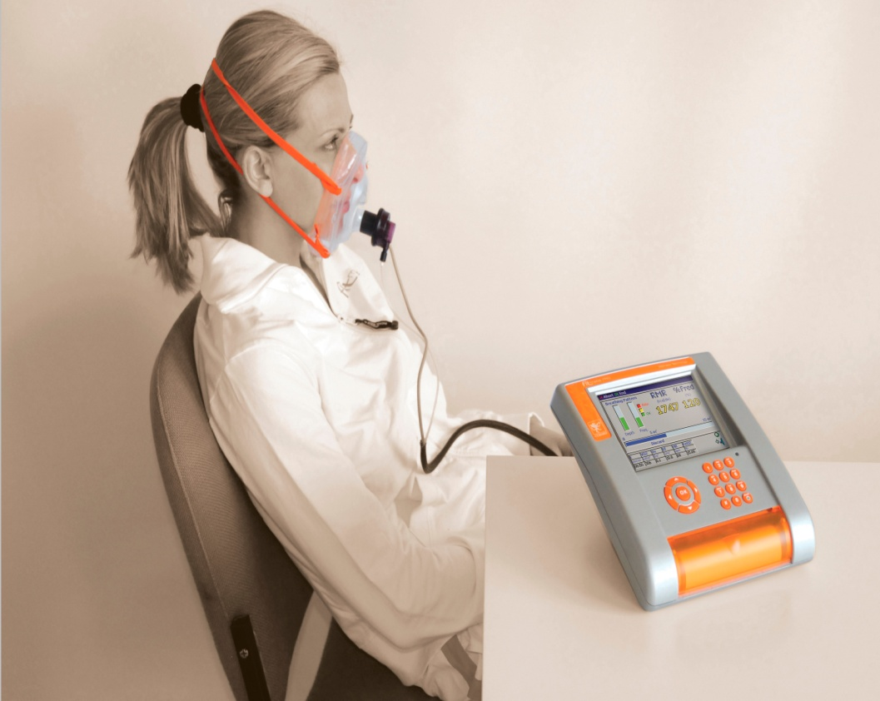
Fitmate instrument
An indirect calorimetry
Measures REE based on VO₂ and VCO₂ with respiratory quotient (RQ) of 0.85
Volume of oxygen consumption
Volume of produced CO₂
11

Slide 12
RMR measurement
After 12-14h fasting
Free of psychological stress
No consumption of caffeinated beverages, severe physical activity before RMR measurement
During 8:30 to 10:00 A.M
At the supine position
In a quiet room with the temperature around 25°C.
15 min for each subject
12

Slide 13
Statistical analysis
Quantitative variables are presented as mean±SD.
Frequency of qualitative variable is reported in percent.
Independent t-test: Comparison basal characteristic of subjects between two groups.
Paired t-test: Comparison measured RMR with predicted RMR.
Accuracy of H-B equation: The percentage of subjects with a difference between predicted and measured RMR within ±10%
13

Slide 14
Cont´d
Overestimation: The percentage of subjects with a difference between predicted and measured RMR within >10% of measured value
Underestimation: The percentage of subjects with a difference between predicted and measured RMR within <10% of measured value
P-value <0.05 considered significant.
SPSS software version 16.0 (SPSS Inc. Chicago,IL)

Slide 15
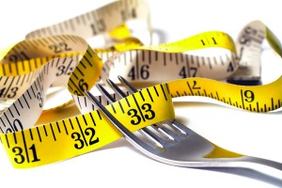
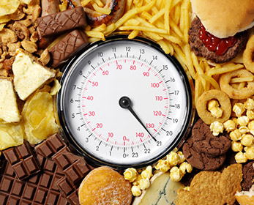
Result

Slide 16
Table 1- Basal characteristic of study subjects
Variable | Overweight (n=100) | Normal weight (n=100) | †p-value
Age(yrs) | 22.50±2.94 | 23.04±2.62 | 0.36
Weight(kg) | 70.93±7.46 | 55.42±5.60 | <0.01
Height(cm) | 161.84±4.40 | 160.87±6.23 | <0.01
BMI(kg/m2) | 27.06±2.45 | 21.37±1.22 | <0.01
Physical activity level(%) | 83 17 | 81 19 | 0.15††
Sedentary
Medium
^{†:t-test}
^{††:Exact Fisher test}

Slide 17
Table 2- Comparison of measured and predicted RMR in study groups
1527.33
1468.04
1374.75
1271.32
Kcal
* Pair t-test ; p<0.01

Slide 18
Table 3- Comparison of measured with estimated RMR by H-B formula in study subjects
Subject | †Bias ( kcal/day ) | Accuracy (%) | Over- estimated (%) | Under- estimated (%)
Normal weight | 103.4±119.1 | 67.3 | 30.6 | 2.0
Overweight | 59.28±100.82 | 83.30 | 16.7 | 0
(±10%)
(>10%)
(<10%)
†: Mean ± SD
15

Slide 19
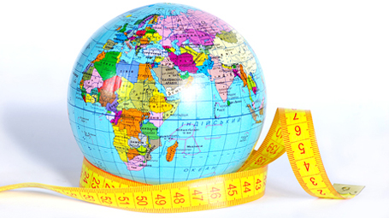
Discussion

Slide 20
IN THE PRESENT STUDY :
Overweight:
No significant bias
Accuracy:83%
Overestimation:16%
Normal weight:
Significant bias
Accuracy:67%
Overestimation:30%
Underestimation:2%
Author/ year | Country | Sample size | Age(yrs) | BMI (kg/m2) | Result
Shaneshin et al,2011 | Iran | 187 women | 18-45 | 27.7± 5.8 | No significant Bias
Li et al,2011 | Canada | 47 girls | 19-25 | 21.8±2.1 | 100% Overestimation
Rao et al, 2010 | China | 43 Both sexes | 18-25 | 20.6±1.97 | Accuracy:31.82% Underestimation:4.5% Overestimation:63.6%
Muller et al,2004 | German | 284 Both sexes | 30-70 | 25±1.5 | No significant Bias Accuracy:71.6%
Frankefield et al,2003 | U.S | 83 Both sexes | 30-40 | 24.9±0.5 | 33% Overestimation
17

Slide 21
Limitation
Small sample size
2) Narrow range of age and BMI
3) Single RMR measurement that could not estimate the intra-individual variation.
19

Slide 22
Conclusion
It seems that H-B formula can be used in Iranian overweight females to predict RMR in clinical practice. But further studies are needed
18

Slide 24
Normal weight
H-B-Fitmate
Mean diff
Limit of agreement
Average of RMR

Slide 25
overweight

Slide 26
Accuracy:
=IF(AP83<$Q83-0.1*$Q83,-1,IF(AP83<$Q83+0.1*$Q83,0,1))
Overestimation:
=COUNTIF(AT63:AT105,1)
Underestimation:
=COUNTIF(AT63:AT105,-1)

Slide 27
Cont
Increasing media, fashion and advertisements of thinness
Prevalence of Body image dissatisfaction in United States:
52% of men and 66% of women
Tendency to obtain desirable body weight
Self-diet management or consulting the dietitian

Slide 28
Suggestions:

Slide 29
Figure 1- Bland-Altman plot for H-B equation in study groups

