Slide 2
Case Report:

Slide 3
Present illness:
We describe the case of a 55 year old housewife woman who currently lives in Tehran, referred to endocrine unit complaining of a rapidly enlarging right supraclavicular neck mass over a month that is painless but has caused compressive symptoms such as dyspnea and dysphagia and hoarseness.
She does not complain of any hyper/hypothyroidism symptoms such as changes in weight, palpitation, irritability, heat or cold intolerance, and tremor. Neither she complains of fever, appetite loss and night sweats.

Slide 4
Past medical history:
She is married, has three living children , no history of abortion or still-birth, menopause at 42, have not undergone HRT.
No past medical history of thyroid disorders and hematopoietic malignancies.
History of hypertension, cardiac diseases, coronary artery disease and diabetes is negative.
Habitual history is also negative for smoking, alcohol consumption and neck irradiation.
No family history of thyroid disease and malignancies or hematopoietic disorders.

Slide 5
Physical exam:
General appearance: normal
Scalp hair and skin: normal
Body weight=70kg weight=160cm BMI:27.34
Vital sign: HR:74/min BP:120/65 T:36.6 oral 7AM RR:14/min
Head and neck: there is a palpable firm fixed untender mass in approximate size of 5*4cm in right lobe of thyroid and could be palpated over isthmus of thyroid which causes left trachea deviation. Left lobe of thyroid is normal. No cervical adenopathy is detected.

Slide 7
No Pemberton’s sign , no bruit, warmness or fluctuation over the mass, mild stridor over trachea is heard by stethoscope.
Chest: normal heart and breath sounds
Abdomen: soft without tenderness, without palpable mass and tenderness, no splenomegaly was detected
No adenopathy was detected in axillary and inguinal area
Neurologic exams are normal, normal gait and equilibrium
Distal pulses are normal and symmetric.

Slide 8
Paraclinical studies:
Lab exam:
WBC:5900 Uricacid:4 mg/dl LDH:549 Iu/L(high) (NL range:200-400)
HB:14.3 gr/dl Ca:9.2 mg/dl FBS:86 mg/dl
MCV:87 FL Ph:3.5 mg/dl Albumin:3.9 gr/dl
PLT:221000 Na:141 mEq/L TSH:1.1 mlu/ml
CRP:NEG K:3.9 mEq/L T3:1 nmol/L
ESR:14 mm/h AST:20 Iu/L T4:8.2 microgr/dl
BUN:16 mg/dl ALT:17 Iu/L
Cr:0.8 mg/dl ALKP:171 U/L

Slide 9
Thyroid US revealed a hypo-echoic mass in size 59*38mm and high vascularity in right lobe of thyroid which made left trachea deviation. Left thyroid is normal echoic in size 36*12*10mm.
Technetium scan: a large cold nodule in the right thyroid lobe
Us of abdomen was normal and showed liver with normal diameter and normal parenchymal echo. Spleen with span of 78mm was normal. Kidneys and other abdominal and pelvic structures were normal.

Slide 12
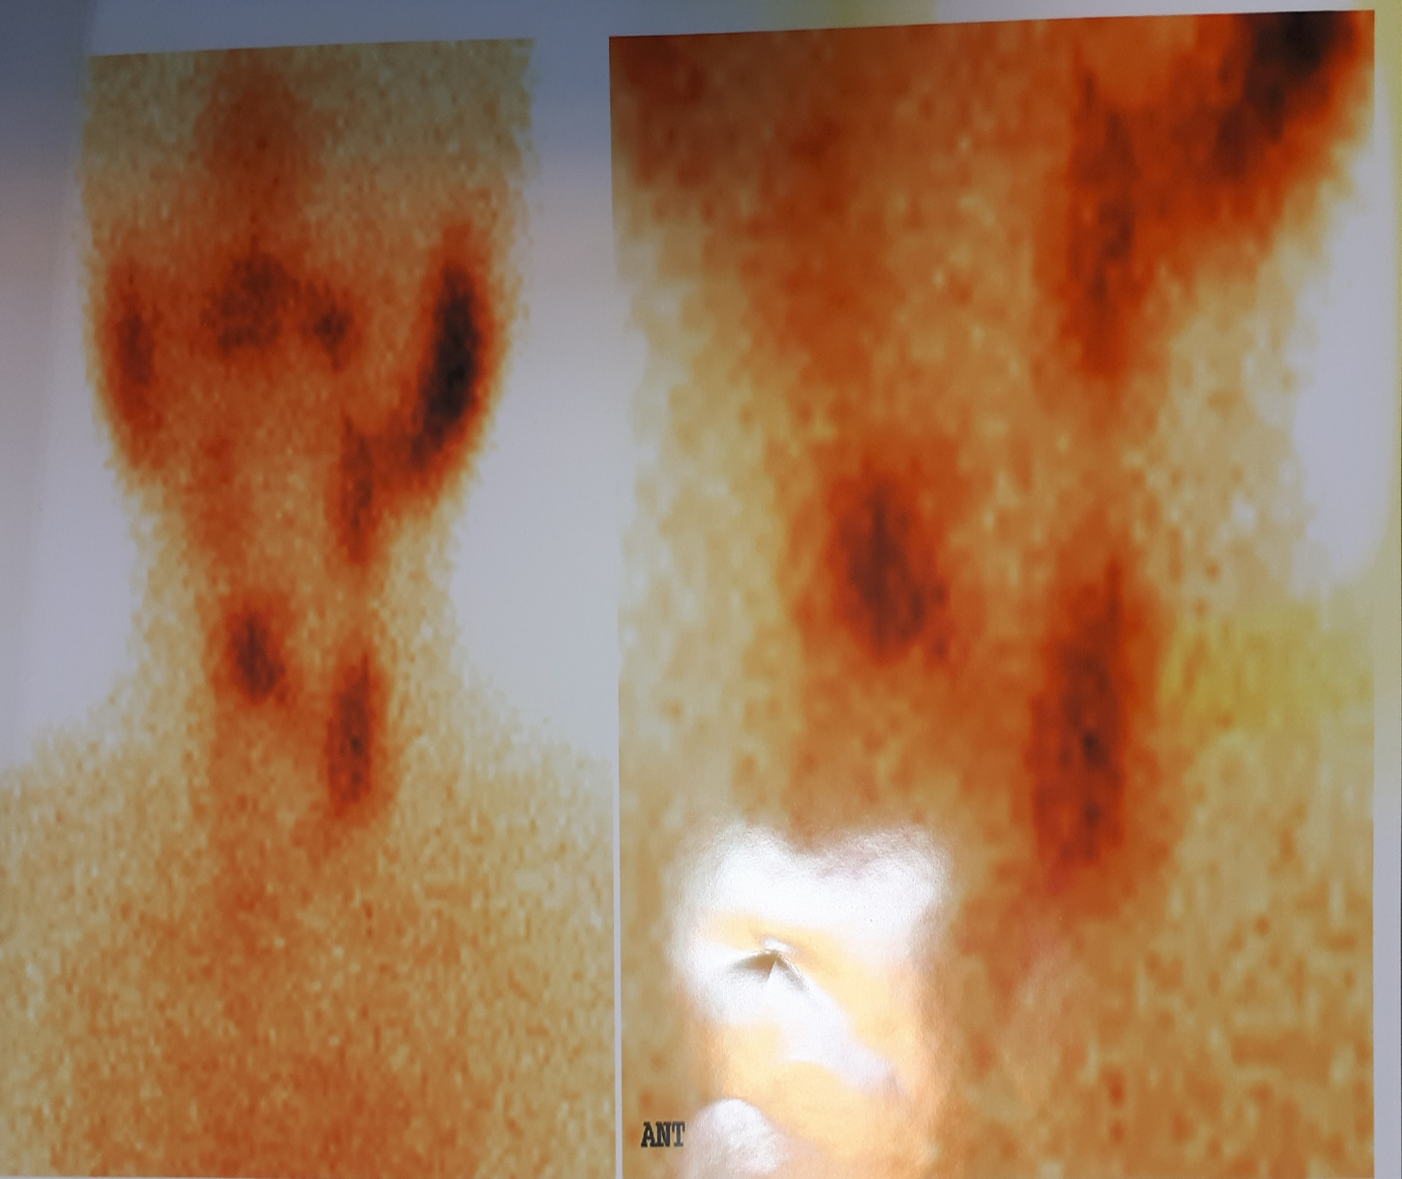

Slide 13
FNA was performed and pathology reported Follicular suspicious neoplasm. Pathologist also commented that due to monomorphic pattern of lymphoid cell lymphoma can not be ruled out.
Cause the history was suggestive of thyroid lymphoma a CT scan of neck, thorax and abdomen with IV contrast was performed. No abnormal vessels, adenopathy, hepatic lesions, or splenomegaly was shown in CT scan.

Slide 15
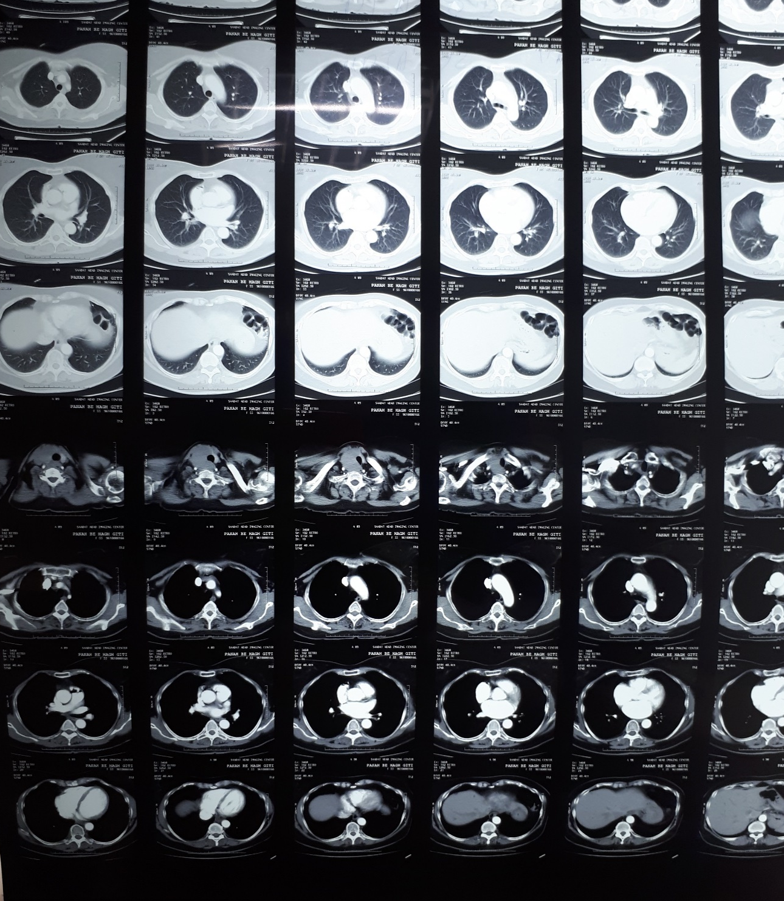

Slide 18
Core needle biopsy was performed and tissue was sent to pathology centre for further study and IHC.
Pathology reported Non-Hodgkin lymphoma. IHC showed Ki67 98%positive, CD20 positive, and LCA diffuse strong positive. IHC results were compatible with primary thyroid lymphoma.
The patient was referred to oncology unit for therapeutic chemotherapy after diagnosing non-Hodgkin thyroid lymphoma.
She has received first section of chemotherapy of R-CHOP regimen.

