Slide 1
Perioperative Endocrine Management Of Pituitary Tumors
Mahshid Babaei M.D.
Endocrinologist
98.4.13

Slide 2
agenda
Pre- op assessment
Adrenal insufficiency
Post-op assessment

Slide 3
Patients with pituitary disease present unique challenges to the anesthesiologist secondary to the prominent role of the pituitary gland in the endocrine system.
Successful surgical management of patients harboring pituitary tumors requires a multidisciplinary approach and is critically dependent on the quality of perioperative care.

Slide 4
Preoperative management
a complete medical history & physical exam
formal neuro-ophthalmologic assessment with formal visual field testing if the MRI shows evidence that the tumor is abutting or compressing the optic chiasm
evaluation for potential medical comorbidities:
a complete blood count
A metabolic panel to evaluate possible
hyponatremia(adrenal –thyroid- post.pit),
hypercalcemia (MEN-1)
hyperglycemia, and other metabolic abnormalities
Cardiovascular and respiratory disease
Hormone hypersecretion
Hormone defficiency

Slide 5
Preoperative management (Cont’d)
Baseline endocrine studies should include:
HPA axis evaluation
Free thyroxine (FT4), TSH
Prolactin (neat and diluted)
LH,FSH(alfa subunit), testosterone (men)
Insulin like growth factor-1 (IGF-1)

Slide 6
agenda
Pre- op assessment
Post-op assessment
Adrenal insufficiency

Slide 8
Preoperative assessment of HPA axis function
Before pituitary surgery, in all patients with pituitary disease HPA axis function should be tested:
ITT:
Traditionally,” ITT” has been the gold standard test for integrity of HPA function and, in some units, is still the preferred preoperative test.
short ACTH 1–24 (Synacthen) test :
Because these patients require reassessment of adrenal function postoperatively ,most endocrinologists prefer this test as their initial preoperative test of HPA axis function in a patient with a known pituitary tumor.

Slide 9
Preoperative assessment of HPA axis function
In the setting of long-standing ACTH deficiency, the 250µg ACTH 1–24 test generally correlates well with the ITT.
Normal cortisol response to 250 µg ACTH1–24 :
Cutoff of >550 nm (20µg/dl), at 60 min

Slide 10
Abnormal ACTH 1–24 (Synacthen) test:
Start standard maintenance doses of glucocorticoid (15–30 mg hydrocortisone daily, depending on factors such as age, sex, and body habitus) in the lead-up to surgery.
These patients should be treated perioperatively with 48 h of supraphysiological GC therapy with rapid dose reduction.

Slide 11
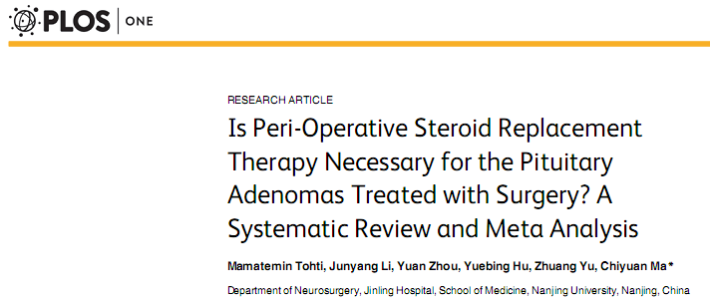
Normal ACTH 1–24 (Synacthen) test
Empiric glucocorticoid coverage ?
Steroid – sparing method?

Slide 12
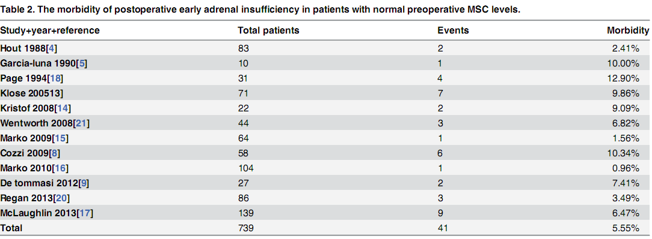
The results suggested that there was a low incidence of adrenal insufficiency .
This may suggests the unnecessity of routine cortisol supplementation therapy.

Slide 13
its occurrence varies depending on:
the operating neurosurgeon’s experience
the size and consistency of the tumor
the extension of surgical manipulation
surgery for recurrent

Slide 14
Normal ACTH 1–24 (Synacthen) test
postoperative course
extent of surgery
expertise of the team taking care of the patient
the turnaround time of serum cortisol measurements
percentage of post-
operative AI at each center or each surgeon
glucocorticoid coverage for 48 h is recommended.

Slide 15
Suggested regimen:
Hydrocortisone 50 mg /q 8 h on day 0,
25 mg/q8 h on day 1, and
25mg at 0800 h on day 2.
Alternative regimen:
Dexamethasone 4mg at induction of anesthesia,
2 mg at 0800 h on day 1, and
0.5 mg at 0800 h on d 2.

Slide 16
Post operative Management

Slide 17
The decision regarding ongoing GC replacement should initially be based on 8:00am plasma cortisol in the early postoperative period
Time of measurements:
Plasma cortisol should be measured:
In patients not treated with glucocorticoids:
on day 1–3
In patients covered with GC for the initial 48h:
on day 3–5

Slide 18
Definitive test required | Glucocorticoid replacement (hydrocortisone equivalent) | 0800-h Cortisol level
No—deficient HPA axis | 15–30 mg/d (maintenance) | <100 nM/L (<3.7µg/dl)
Yes | 10–20 mg, single morning dose | 100-250nM/L 3.7-9.2µg/dl
Yes if 8am cortisol <350 (12.6) | Stress only, safe to withhold routine replacement until definitive test | 250-450 nM/L 9.2-16.5 µg/dl
No—normal HPA axis | No | >450 Nm/L >16.5 µg/dl
an 0800 h plasma cortisol level >350 nm at day 7 is highly predictive of a normal response to ITT.
Overall, the data show that less than 4%of patients with morning cortisol of more than 350 nm fail the ITT, and these are usually associated with peak cortisol levels close to or above 500 nm.

Slide 19
Which test should be performed?
ITT
Overnight metyrapone test
Glucagon stimulation test
CRH test
ACTH 1–24 test (short synachten test)

Slide 20
Insulin Tolerance Test (ITT)
The gold standard test for normal HPA function
Despite a low incidence of serious adverse events, many clinicians are reluctant to subject their patients to ITT
ITT contraindication:
IHD
Arrhythmia
Epilepsy
Over-65 age(should be used with caution)
More time consuming for nursing and medical staff
Greater consumable and assay costs
Cut off>500-550nM/L

Slide 21
Overnight metyrapone test
30 mg/kg metyrapone taken at 2400 h, with food
Plasma cortisol and 11-DOC are measured at 0800 h on the morning after metyrapone administration
Normal response is 11-DOC level >200nm (7µg/dl)

Slide 22
Glucagon stimulation test
The recommended dose is 1 mg/IM
The criteria for an adequate peak cortisol response is >500 nm (18 µg/dl)
CRH test:
In the setting of pituitary disease is inferior to that of basal 0800 h cortisol
Not recommend

Slide 23
ACTH 1–24 test (short synachten test)
In the early postoperative period is not the investigation of choice (inability of this test to detect recent onset ACTH deficiency)
Commonly, in North America, where access to metyrapone may be difficult, an ACTH 1–24 test is performed at the 6-wk time point

Slide 24
When is the optimal time to perform the test?
The literature is unable to give any fixed time-point.
Most studies that have examined the HPA axis by ITT or metyrapone testing between 7 and 14 d post surgery show a strong predictive value between these results and the need for long-term GC requirement.
Another alternative is to routinely perform a definitive dynamic test of pituitary function between 4 and 6 wk postoperatively.

Slide 25
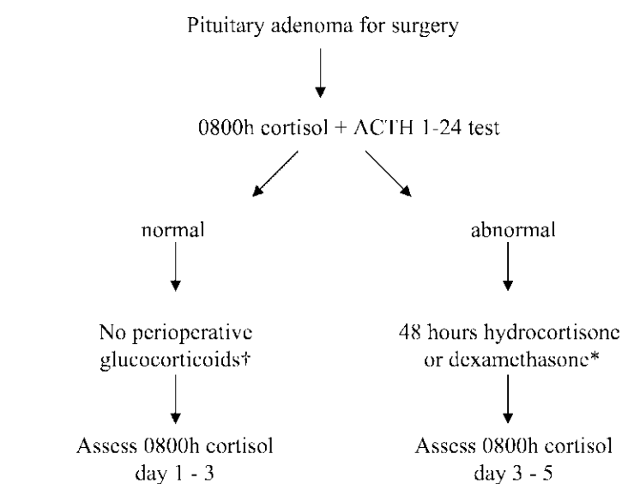

Slide 26
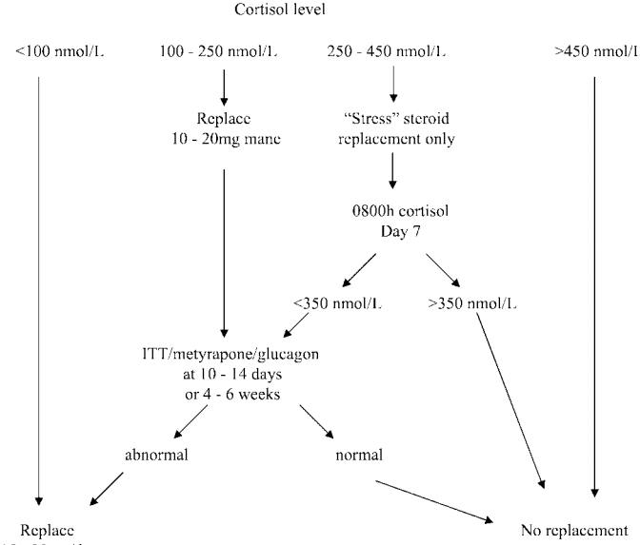

Slide 27
agenda
Pre- op assessment
Adrenal insufficiency
Post-op assessment

Slide 28
Major complications in the immediate postoperative period after TSS can be categorized into:
surgical
Endocrine:
fluid and electrolyte abnormalities
acute adrenal insufficiency

Slide 29
DI
DI is a relatively common complication of transsphenoidal surgery but is most often transient.
DI does occur commonly in the early phase after pituitary surgery (4–80%):
Transient
Permanent (0.5-15%)
Postoperative DI typically manifests in the first 24–48 h after pituitary surgery.
Its onset is heralded by the abrupt onset of polyuria along with accompanying thirst and polydipsia.

Slide 30
Polyuria
a urine volume >2 L/m² /24h
approximately >150 ml/kg/24 h at birth
100–110 ml/kg/24 h until the age of 2 years>
40–50 ml/kg/24 h in an older child or adult.
>2.5 cc/Kg/hour for 2 consecutive hours
>250 cc/hour for 2 consecutive hours

Slide 31
Central DI after Pituitary surgery
Potential Causes of Postoperative Polyuria
Diuretic and mannitol
Anesth Analg 2005;101:1170–81

Slide 32
dx
Polyuria
Urine SG<1.005
Urine osm <100 mosm/l (<200)
Urine osm <1
NA: normal or high
Plasma osm : normal or high
plasma

Slide 33
DI can be
transient
permanent
remit and then recur later postoperatively in a classic tri-phasic response (3%)In the latter scenario, patients can initially develop DI in the first 24 to 48 hours followed by transient SIADH developing 4 to 10 days postopera- tively, followed by the return of DI in a matter of weeks.

Slide 34
Treatment should be considered if there is a significant discrepancy in fluid intake and output, an increasing serum sodium (above 145 mEq/L), and when excessive urine output significantly interferes with sleep.

Slide 35
Specific treatment of DI may be undertaken with a synthetic analog of ADH, desmopressin(DDAVP).
An initial dose of 0.1 mg of DDAVP can be administered orally and usually is effective in controlling postoperative DI.
Alternatively, if the patient is unable to take oral medications,1 µg of DDAVP can be administered subcutaneously.
The IV administration of DDAVP is rarely necessary.

Slide 36
hyponatremia
SIADH
Cerebral salt wasting
it is important to distinguish between SIADH and CSW as they both share several diagnostic criteria( assessment of Na+, water loss, and extracellular fluid volume).

Slide 37
The basis for laboratory diagnosis of SIADH resulting in hyponatremia is contingent upon demonstration of low serum sodium in the context of a hyposmolar serum, hyperosmolar urine, and a euvolemic state.
Na<135 mEq/L
hyposmolar serum (<275)
hyperosmolar urine (>100)
excess sodium excretion in the urine >40mEq/L
general euvolemic (or mildly hypervolemic) state
Low serum uric acid

Slide 38
CSW is characterized by a low plasma volume with symptoms of dehydration, low serum osmolality, and a large urinary excretion of Na+ and Cl−, whereas
SIADH shows a high plasma volume with low plasma osmolality.

Slide 39
SIADH | CSW
⇑ or normal | ⇓ | Plasma volume
Variable | Negative | Salt balance
⇑ or normal | Negative | Water balance
Absent | Present | Signs and symptoms of dehydration
⇑ or normal | ⇓ | Central venous pressure
⇓ | ⇓ | Serum Osmolality
Unchanged | ⇑ or normal | Hematocrit
⇓ | ⇑ or normal | Plasma BUN/creatinine
⇑ | ⇑⇑ | Urine sodium
⇓ or normal | ⇑⇑ | Urine volume
Fluid restriction Hypertonic saline Furosemide-Democyclin | Normal saline Hypertonic saline Fludrocortisone | Treatment

Slide 40
Visual Field Assessment
Formal visual field examinations :
At the 3-mo visit after surgery for patients who presented with any preoperative visual deficits.
Diagnosis and management of pituitary tumors,chapter13,2001

Slide 41
Thanks for your attention

