Slide 1


Slide 2

Title:
Improvement of cardiovascular function by estrogen in postmenopausal type 2 diabetic rats: correlation with inflammatory and metabolic parameters
Presented by: Navid Ebrahimi
November 2018

Slide 3
Introduction

Slide 4
Introduction
Diabetes mellitus (DM) consists group of common metabolic disorders and cause death of many people every year.¹
Increase in the danger of cardiovascular diseases is one of the consequences this diabetes.
In total, females has less risk of cardiovascular diseases in compare with males, while this protection will be disappeared after the menopause.²
Notes:
1- اختلال تنظيم متابوليكي ناشي از ديابت سبب بروز تغييرات پاتوفيزيولوژيك ثانويه اي در اندام هاي متعدد بدن مي شود
2- به طوری که مطالعات نشان می دهند که ریسک CVD در زنان دیابتی بعد از یائسگی بیش از زنان پیش از یائسگی می باشد

Slide 5
Exact relations between diabetes type II and menopause are not well known. Also, there is low information among the effects of menopause on the females either with or without diabetes in relation with cardiovascular diseases.

Slide 6
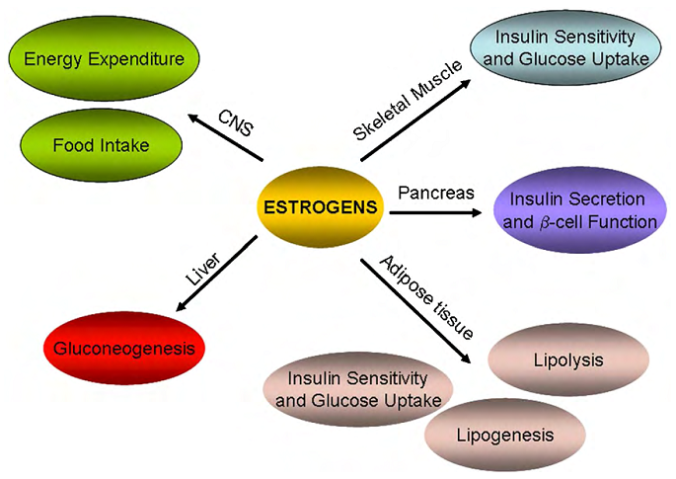
                Estrogen and diabetes
Metabolic acts of estrogen
Notes:
1- استروژن ها از طریق عمل بر روی گیرنده های خود به عنوان مهمترین تنظیم کننده‌های هومئوستاز متابولیک و متابولیسم لیپیدها شناخته شده‌اند.
2- استفاده از مدل‌های حیوانی به خوبی ثابت کرده‌اند که استروژن تنظیم‌کننده متابولیسم گلوکز و لیپیدها است
3- مطالعات در حیوانات فاقد تخمدان نشان داده اند که کاهش استروژن منجر به افزایش وزن بدن و توده چربی می‌شود
4- هم چنین موش های فاقد تخمدان دارای دیسلیپیدمی، نقص تحمل گلوکز و نقص برداشت گلوکز توسط عضله هستند
5- یک ارتباط معکوس بین سطوح استروژن، سطوح انسولین و گلوکز ناشتا وجود دارد به طوری که کاهش سطوح استروژن در ارتباط با افزایش سطوح انسولین و گلوکز ناشتا در زنان در دوره گذر از پیش از یائسگی به یائسگی می باشد.

Slide 7
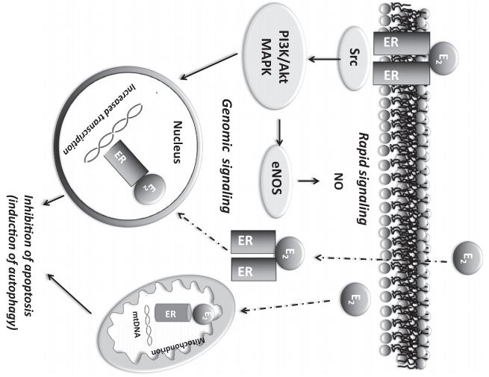
  Estrogen receptors: Classic and none classic
Estrogen exerts its effects by using three receptors which named Erα, Erβ and GPR30
Notes:
1- Erα عمدتا در کلیه قلب، استخوان، رحم، کبد و بافت چربی وجود دارد در حالی که ERβ بیشتر در تخمدان، پروستات، مثانه و سیستم عصبی مرکزی وجود دارد و گیرنده کلاسیک نامیده می شوند
2- GPR30 در غشای پلاسمایی یا در داخل سلول قرار گرفته است و اغلب درگیر در پیام رسانی سریع غیر ژنومیک استروژن که شامل رهاسازی کلسیم درون سلولی، فعال شدن کیناز وابسته به کلسیم کالمودولین، PI3K و MAPK است.

Slide 8
Estrogen role in cardiovascular function
Currently there are lots of evidence on the local production of estrogen in the heart.¹
All three estrogen receptors are expressed in the heart but had different distribution. ²
Estrogen consumption considerably causes an improvement in the myocardial ATP in the heart.
Both ERα and ERβ had role in the anti hypertrophic and anti arrhythmic responds.
Sexual differences are diagnosed in the hearts electrical features. 3
Notes:
1- در حال حاضر شواهد زیادی برای وجود آنزیم آروماتاز در قلب وجود دارد.
2- به طور کلی تفاوت در توزیع سلولی این گیرنده ها مسئول اعمال متفاوت استروژن در سیستم قلبی عروقی می باشد..
3- بین زنان و مردان سالم تفاوت های بارزی در الکتروکادیوگرام وجود دارد به طوری که زنان دارای فاصله QT بیشتر و مدت زمان کمتر QRS هستند. هم چنین فاصله QT در حین سیکل جنسی نیز تغییر می کند.

Slide 9
Cytokinins and cardiovascular
Effect on the heart metabolism regulation in addition to involving in inflammation, made IL-6 interesting to every one. ¹
Heart is an organ that can produce TNF-α through myocardial macrophages and manufacturing in the heart myocytes.
TNF-α moderates both hearts contractility and peripheral resistance.
In fact, IL-10 has some protective features against atherosclerosis disease.
IL-10 is able to suppress inflammation responds and causes in improvement of left ventricle function in myocardial damage conditions.
Notes:
1- سطح IL-6 در تعدادی از CVD مانند نارسایی قلبی افزایش پیدا می کند. هم چنین IL-6 فاکتور اصلی التهابی است که در پاتوژنز بیماری آترواسکلروزیس نقش دارد.

Slide 10
Cytokinins and ovaries hormones
IL-6 plasmatic level is increased during diestrous, estrus and metestrus cycles. Also, it increased in the OVX animals while its level decreased in the proesterus Cycle. ¹
Estrogen consumption often cause level decrease of TNF-α in monocytes and macrophages. In this action Erβ oddly has important role in compare with Erα.
Estrogen also cause in increase of IL-10 expresion in blood. Because IL-10 promotors consists elements that responds to estrogen (ERE). ²
Notes:
1- هم چنین این تغییرات در قلب نیز رخ می‌دهند.
2- به طور کلی به نظر می‌رسد اثرات ضد التهابی استروژن از طریق افزایش سیتوکین ضدالتهابی IL-10 و کاهش سیتوکین های پیش التهابی است.

Slide 11
Material and methods

Slide 12
Study groups
Notes:
در این مطالعه از 162 سر، موش ماده صحرایی نژاد ویستار استفاده شد.
در این مطالعه حیوانات به 2 گروه دیابتی و شاهد تقسيم می شوند سپس گروه دیابتی خود به دو گروه A: شم و B: فاقد تخمدان تقسيم مي شوند. این گروهها مجدداً به زیر گروه هایی تقسیم بندی خواهند شد و در مجموع 27 گروه خواهیم داشت که تعداد نمونه ها در هر گروه 6 سر می باشد

Slide 13
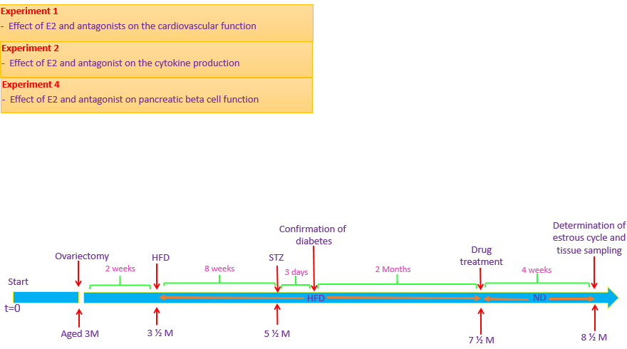
Experiment methods

Slide 14
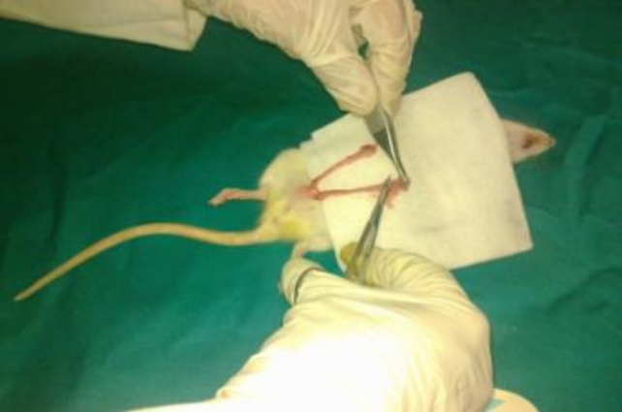
Dual ovariectomy method

Slide 15
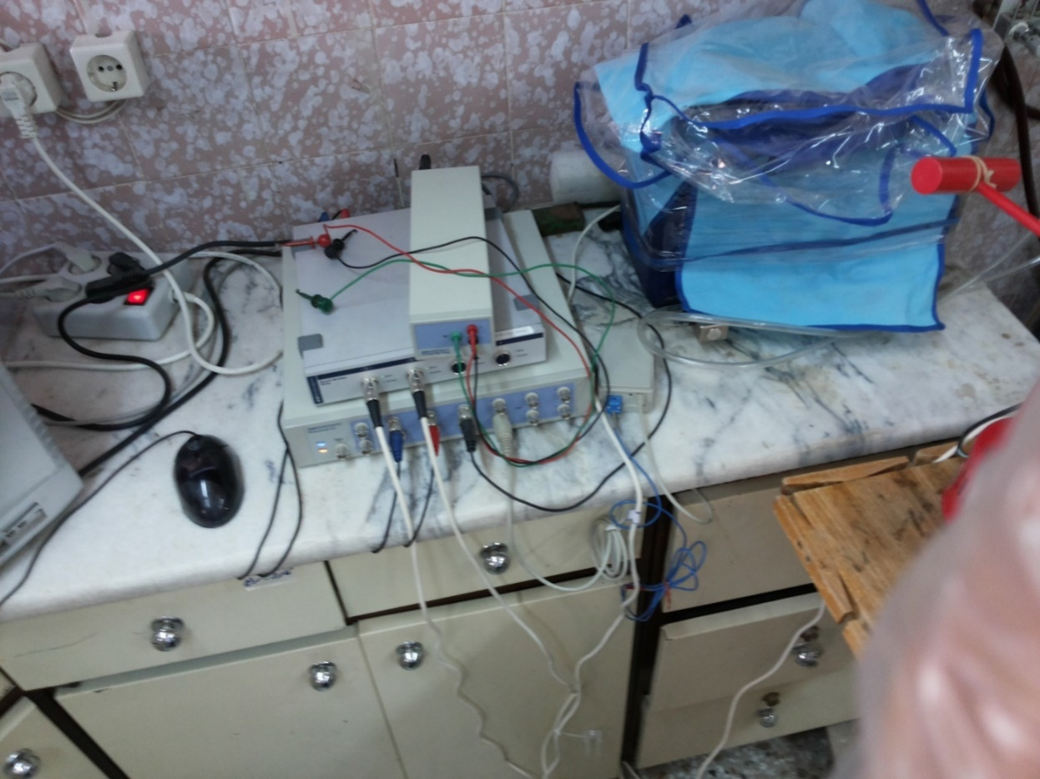
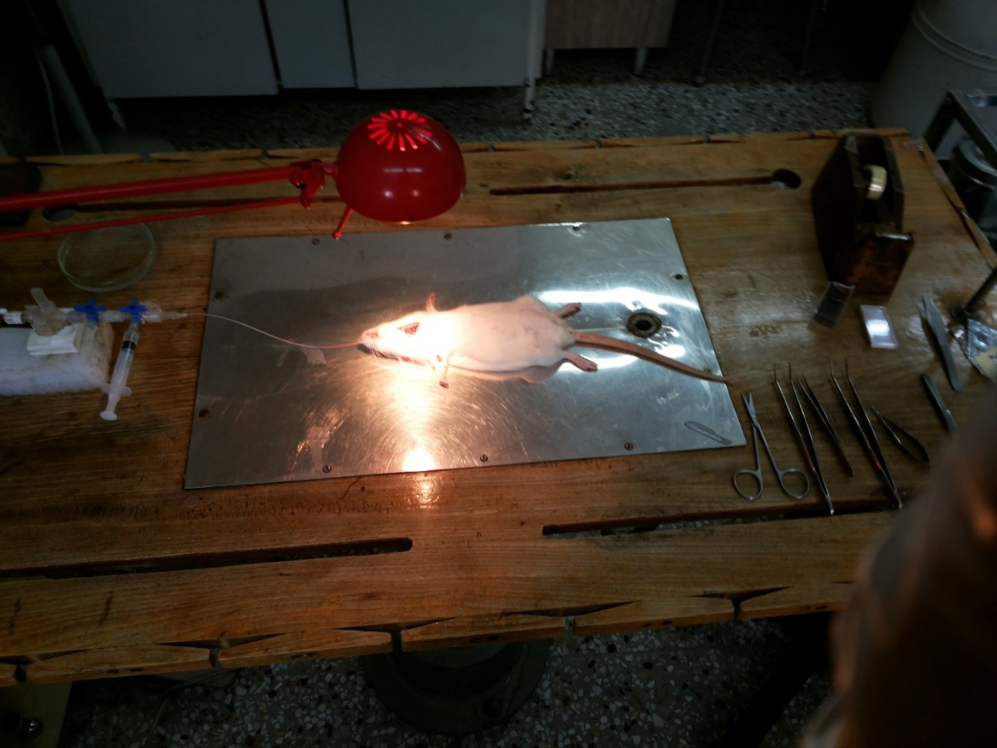
Electrocardiogram and blood pressure record

Slide 16


Pancreas functional indicators measurement

Slide 17



Hypertrophy, atherogenic and heart risk indicators measurement

Slide 18
ELISA method:
Inflammation and anti inflammation cytokinins
Insulin
Angiotensin II
Western blot method:
Measurement of estrogen receptors expression in heart tissue

Slide 19
Results and discussion

Slide 20
Consent:
High fat diet for four weeks cause in weight increase and when diabetes induced by streptozotocin injection in animals, more weight lose where caused (Bansal S, 2014).
Sanjay et al had reported that induction diabetes in rats causes more water and food consumption.
Lots of studies showed that diabetes and menopause induction cause high atrophy in uterus and uterus weight loose (Tariq S, 2016; Bansal S, 2018).
Mechanisms:
Mechanisms that cause increase in food consumption after diabetes are as below:
1- Decrease in insulin and leptin messaging in brain (Schwartz M. W., 2000).
2- Increase in NPY and AGRP expression in brain due to diminish of insulin (Obici S, 2002).
3- increase of inflammation in hypothalamus and blood circuit (Thaler J. P., 2012).

Slide 21
Consent:
Studies showed that diabetes induction and diabetes induction with HFD+STZ method cause in blood pressure increase (Bhandari U, 2015; Rahman M.M., 2017).
Mechanism:
High diabetes and blood pressure has some similar pathophysiologic mechanisms including:
1- RAS inappropriate function
2- Oxidative stress and inflammation
3- Disorders in start and adaptation of immune responds
4- Kidney sodium abnormal process and insulin mediated vasodilatory defect by disorders in PI3K/Akt messaging pathway
5- Decrease in Nitric oxide phosphorylation and activation of eNOS (Lastra G, 2014).

Slide 22
Consent:
Increase in ventricle cardiomyocytes size and increase in heart weight proportion to body weight in biabetes (Reichelt M. E., 2013).
an increase of heart weight proportion to body weight were shown in a study of T2D animal model in female mice (Reichelt M. E., 2013).
Hypertrophy mechanism:
1- ROS increase and inflammation and transcription of NFĸB (Apaijai N, 2017).
2- Increase of MMP (Fielitz J, 2004).

Slide 23
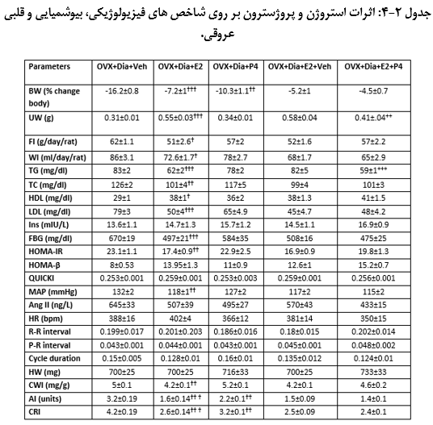

Slide 24
Consent:
Estrogen treatment cause weakness in diabetes effects in the body weight, decrease in water and food consumption after diabetes by HFD+STZ method, Also decrease in food consumption of OVX mice (Bansal S, 2014).
In humans, like rodents food consumption in preovulatory cycle that has highest level of estrogen, will decrease (Asarian L, 2002).
It has been reported that treatment with progesterone cause in body weight lose prevention in diabetic animals (Atif F, 2017).
Mechanism:
Increase in POMC neurons function in arc core and inhibiting the ghreline secretion (Clegg D. J., 2007).
Decrease of NPY in OVX mice effect regressively in food consumption (Santollo J, 2008).

Slide 25
Consent:
It been reported that estrogen deletion cause the decrease of insulin sensitivity and increase of plasmatic level of glucose (Apaijai N, 2017).
Insulin injection to the OVX mice or menopaused female cause in multi aspect improvement of metabolic syndrome such as FBS, insulin and also insulin resistance reduction (Sharma G, 2018).
It been shown that old females that shown estrogen production decrease, had less insulin resistance in compare with male (Reichelt M. E., 2013).
Mechanism:
Insulin has regulatory effects on the PI3K/Akt messaging pathway. Also it case in inflammation reduction and decrease in insulin secretion (Albayrak A, 2011; Tiano J. P., 2012).
Progestron has a role in insulin resistance creation by reduction of GLUT4 expression reduction in fat and muscle tissues (Gonzalez C, 2000; Sugaya A, 2000).

Slide 26
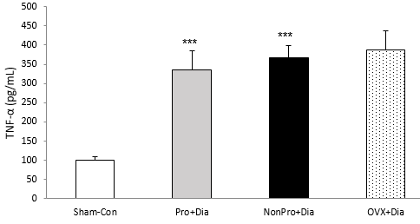
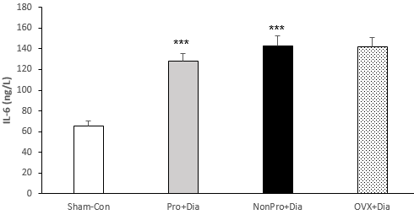
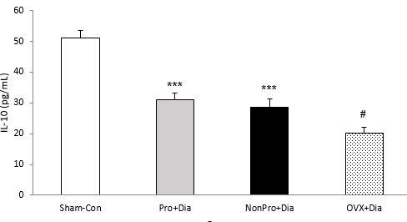

Slide 27
Consent:
Chronic activation of pre inflammation pathways in the insulin target cells probably had roles in obesity, insulin resistance and T2D associated diseases (Lontchi-Yimagou E, 2013).
TNF-α cause in insulin secrete decrease and lipid and glucose metabolism change (Hotamisligil G, 1999).
IL-6 plasmatic density is more in the fat and insulin resisted people. Also, high density of IL-6 often predicts the occurrence of T2D (Lontchi-Yimagou E, 2013).
In contrast to TNF-α and IL-6 that are pre inflammational, IL-10 is anti inflammational and cause insulin sensitivity (Lontchi-Yimagou E, 2013).
Mechanism:
TNF-α inhibits the insulin signals transportation through increase and release of fatty acids from the adiposits (Hotamisligil G, 1999).
IL-6 level Increase in diabetes cause reduction in tyrosine kinase activity of insulin receptors. Also, cause deactivation and parsing of IRS protein through increase in SOCS1 and SOCS3 (Lebrun P, 2008).

Slide 28
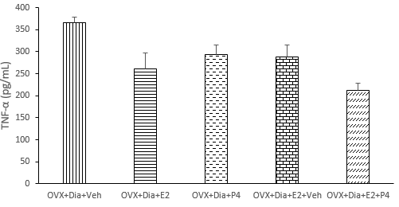
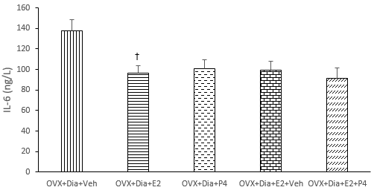
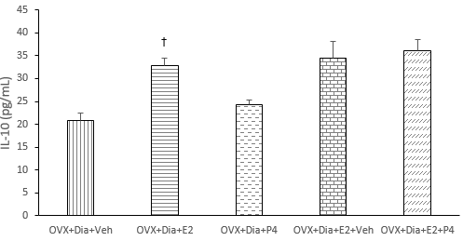

Slide 29
Consent:
Estrogen can reduce the IL-6 level by inhibiting the expression of its gene and prevent the damage of pre inflammation cytokinins invasion (Hoffman G. E., 2006).
Also, other studies shown the increase of IL-10 level through estrogen and shown that IL-10 is able to reduce pre inflammation cytokinis (TNF-α and IL-6) (Oberholzer A, 2000; Khaksari M, 2015).
Mechanism:
Studies shown that estrogen cause the production of cytokinins through an improvement in the manufacturing of the IKB and inhibiting of NFKB (Yang S, 2006).
Estrogen causes modification in the production of NO, reduction of prostaglandins and stimulation in the production of Lipoxin IV (Das UN, 2010; 2013).
Notes:
دلیل نتایج مخالف بین ما و دیگران می تواند تفاوت در بررسی نوع بافت، جنس، سن حیوانات، نوع آسیب و مدت زمان دیابت باشد.

Slide 30
Conclusion
In general
1- Diabetes probably cause cardiovascular disorders by altering cytokinins, lipid profile.
2- Menopause escalated the effects of diabetes.
3- Estrogen can remove diabetes and menopause effects by its membrane receptors.
4- Tamoxifen also can improve diabetes and cardiovascular disorders through improvement in inflammation balance.

Slide 31
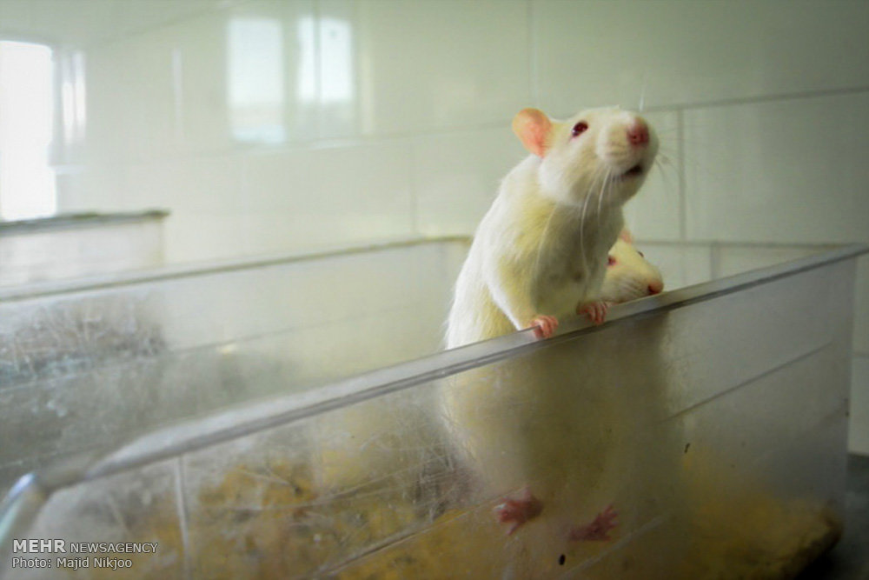

Slide 32


