Slide 2
Dr.Zahra Davoudi
Endocrinology department of Loghman Hakim Hospital, Shahid Beheshti University of Medical Sciences

Slide 3
Unusual case of
Acromegaly

Slide 4
Case presentation
A 22-year-old female presented to the endocrinology clinic with CC::
Weight gain
Menstrual disorder (oligomenorrhea)since 1 year ago
The menstruation onset age was 13 years old has been regular since the beginning
Excessive body hair (hirsutism),
Hair loss

Slide 5
Physical Examination
Vital sign was stable,
weight: 66 kg, height:164 cm, BMI:23.68,
The Ferriman-Gallwey score for hirsutism was> 15
Frontal region hair loss, thin hair,
Acanthosis nigricans behind the neck
There was no finding in favor Cushing syndrome

Slide 6
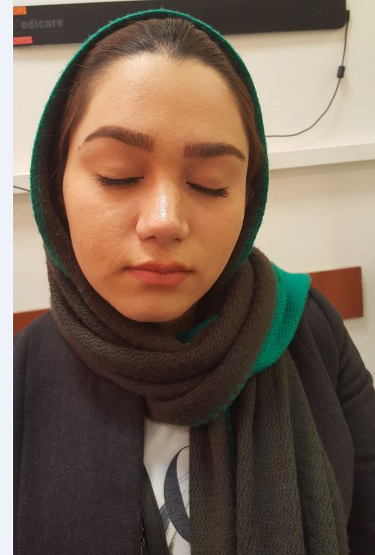
History of recent rhinoplasty (persistent nasal edema after surgery)

Slide 7
According to the hyperandrogenism feature and mensturation disorder,
And history of recent rhinoplasty and
(no other signs and symptoms related to acromegaly)
For R/O polycystic ovarian disease (PCOD) and other related disorder
lab tests (IGF1) and pelvic sonography were requested

Slide 8
Results of lab tests :
FSH: 5 IU/L,
LH: 14 IU/L,
Testosterone: 0.59 ng/ml,
17OHP:1.2 ng/ml,
TSH: 2.6 mIU/l, T4:8 ug/dl
PRL: 450 mIu/mL
Insulin level: 12.5 μIU/ml,, FBS: 74 mg/dl
IGF1:1140 ng/ml
Pelvic sonography::: PCOD

Slide 9
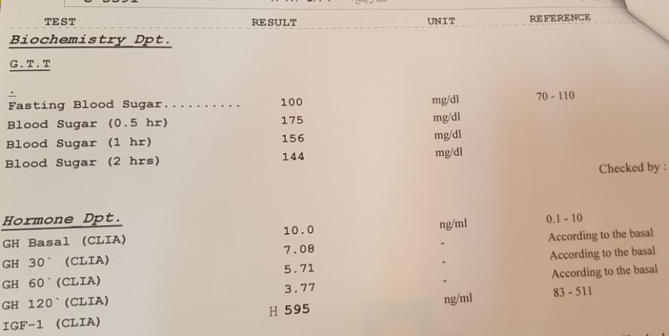
Repeat lab test

Slide 10
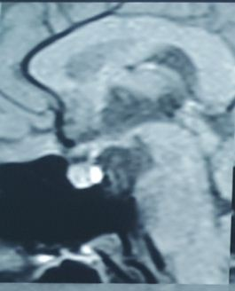
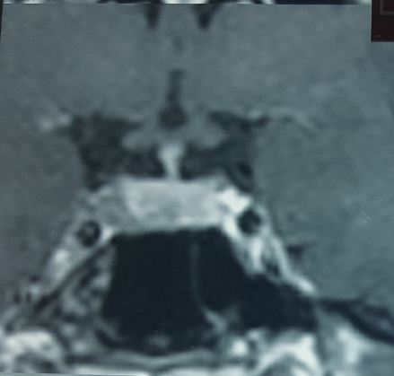
Pituitary MRI

Slide 11
Patient with diagnosis of Acromegaly was candidate for endoscopic trans sphenoidal surgery(ETSS).
Pathology reports shown::::
Pituitary adenoma 0.7×0.5×0.2 cm
KI67 : 4-5%
P53 :negative
GH : positive
PRL : negative

Slide 12
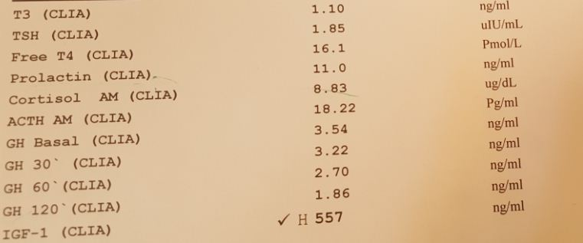
persistent Acromegaly
3 moths after surgery,
DH: negative
Mensturation ::NL

Slide 13
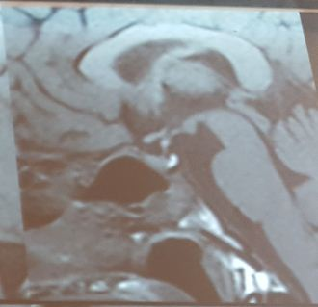
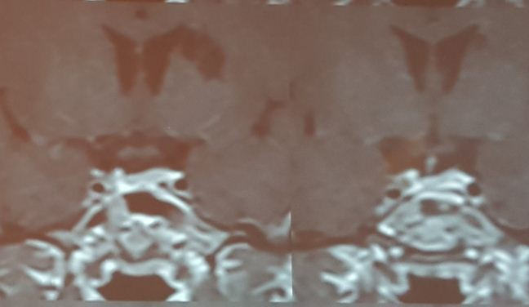
Post op MRI :: Resisue at right side

Slide 14
How to define controlled in acromegaly? Resolution of symptoms and signs, Normalization of age-adjusted IGF1, Random GH <1 ng/ml Restoration of GH suppressibility after glucose load (<0.4 ng/ml) A Consensus on Criteria for Cure of Acromegaly,jcem2010

Slide 15
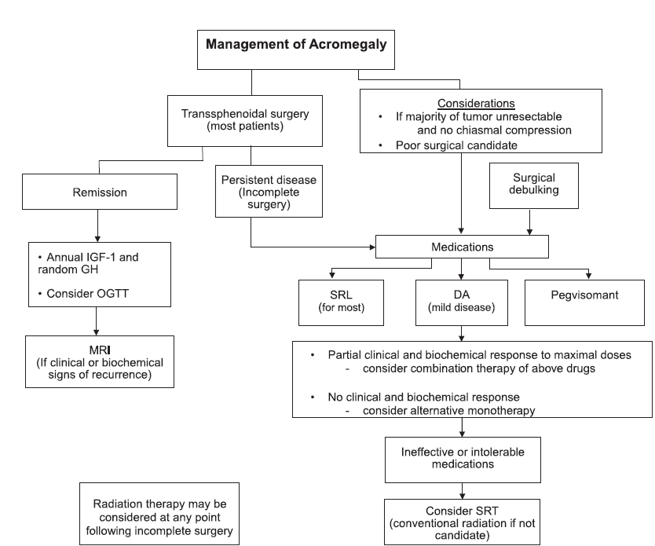
Acromegaly Clinical Practice Guidelines J Clin Endocrinol Metab, 2014

Slide 16
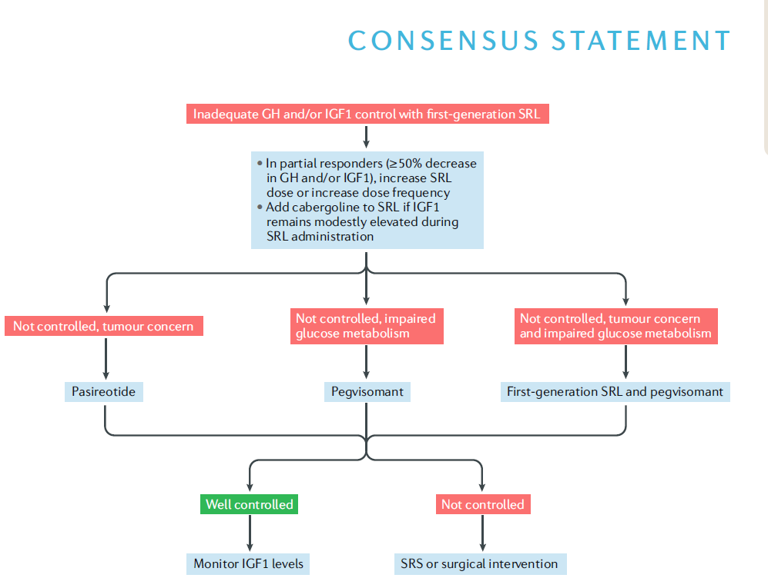
A Consensus Statement on acromegaly therapeutic outcomes Shlomo Melmed1*, Marcello D. Bronstein2…Springer Nature… 2018

Slide 17
Patient was treated with sandostatin 20 mg
After 3 months
GH base:0.4 ng/ml
IGF1: 280 ng/ml

Slide 18
In summary
Presentation of patient
With hyperendrogenism feature and menstrual disorders which the most prevalent differential diagnosis was PCOD.
According to history of recent rhinoplasty and high IGF1 in lab tests:;;;
,
we thought about acromegaly and Early diagnosis pituitary adenoma).

Slide 19
In summary
Secondary PCOD is common in patients with acromegaly.
PCOD related to acromegaly is due to the direct effects of GH ,IGF1 on ovary and is independent of LH as opposed to classical PCOD .
Hyperandrogenemia is due to decreased SHBG, insulin resistance, hyperinsulinemia, and increased ovarian steroidogenesis.

Slide 20
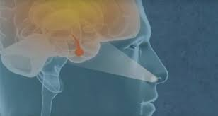
Thanks for your attention

