Slide 1
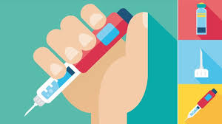
Injectable Therapies in Diabetes Management
Hengameh Abdi
Endocrine Research Center
Research Institute for Endocrine sciences
Shahid Beheshti University of Medical Sciences
02 May 2019

Slide 2
Agenda
Guidelines review
Case presentation
Conclusion

Slide 3
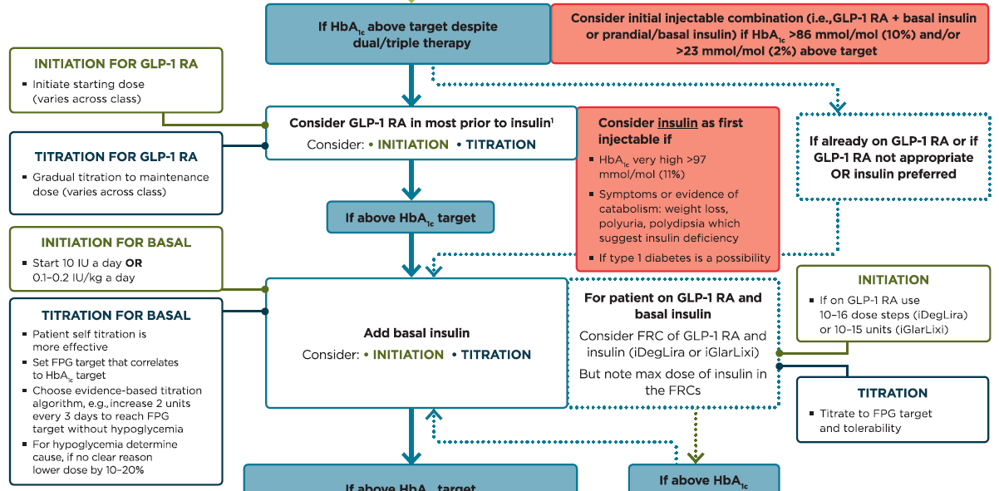
Intensifying to injectable therapies
FRC, fixed-ratio combination
Davies MJ, et al. Diabetes Care 2018;41:2669-2701.
Diabetes Care 2019;42(Suppl. 1):S90-S102.

Slide 4
Initiation for basal insulin
Basal insulin alone is the most convenient initial insulin regimen and can be added to metformin and other oral agents.
Starting doses can be estimated based on body weight (e.g., 10 units a day or 0.1-0.2 units/kg/day) and the degree of hyperglycemia, with individualized titration over days to weeks as needed.

Slide 5
Titration for basal insulin
Patient self titration is more effective.
Choose evidence-based titration algorithm, e.g. increase 2 units every 3 days to reach FPG target without hypoglycemia.
For hypoglycemia, determine cause; if no clear reason, lower dose by 10-20%.

Slide 6
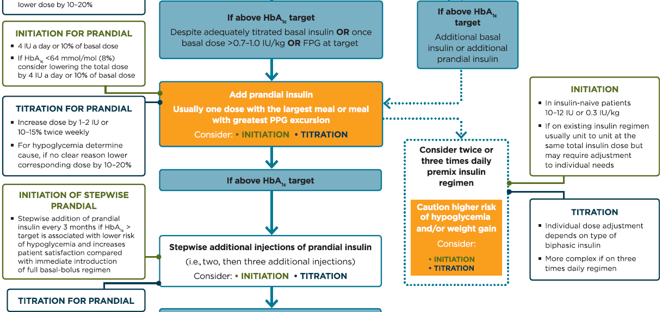
Intensifying to injectable therapies
Davies MJ, et al. Diabetes Care 2018;41:2669-2701.
Diabetes Care 2019;42(Suppl. 1):S90-S102.

Slide 7
An important point
When initiating combination injectable therapy, metformin therapy should be maintained while sulfonylureas and DPP-4 inhibitors are typically discontinued.

Slide 11
Interactive Case Discussion

Slide 12
Case 1
A 62-year-old woman with 10-year history of type 2 diabetes and 4-year history of hypertension came to an endocrine clinic for follow-up.
She is a busy lawyer and her diet is very irregular.
She has history of percutaneous coronary angioplasty in about 1.5 year ago.
She has no evidence of heart failure.
Medications:
Gliclazide MR 60 mg daily
Sitagliptin/Metformin 50/1000 mg twice daily
Atorvastatin 80 mg daily
Aspirin 80 mg daily
Valsartan/Amlodipine 80/5 mg daily

Slide 13
Case 1
P/E:
BMI: 32 kg/m²
Blood pressure: 132/80 mmHg
Laboratory:
FBS: 142 mg/dL
HbA1C: 8.4%
Urine albumin/Cr: 12 mg/g
eGFR: 75 ml/min/1.73 m²

Slide 14
Case 1
Considering all aspects of her medical problems, in addition to lifestyle modification, which treatment would you recommend?
Add pioglitazone 15 mg daily with appropriate dose titration
Add empagliflozin 10 mg daily with appropriate dose titration
Add liraglutide 0.6 mg daily with appropriate dose titration and discontinue sitagliptin
Add liraglutide 0.6 mg daily with appropriate dose titration and discontinue gliclazide

Slide 15
Case 2
A 48-year-old driver man with 6-year history of T2DM is referred to you. He is taking Metformin 2000 mg/day and Gliclazide MR 60 mg/day.
He has no history of microvascular or macrovascular complications.
In the past few months, his fasting glucose levels have ranged from 160-200 mg/dl.
BMI: 25 kg/m², HbA1c: 9.2%, Cr: 0.8 mg/dl.
In addition to lifestyle modification, which treatment addition would you recommend to him?
Long-acting insulin analogue with titration
Insulin NPH with titration
Glucagon like peptide 1 agonist
Premixed insulin

Slide 16
Case 3
A 55-year-old woman with 12-year history of T2DM came to you.
She tells about 4-year history of hypertension and non-proliferative diabetic retinopathy.
Medications:
Sitagliptin/Metformin 100/2000 mg daily
Insulin detemir 20 U 9 am, 30 U 9 pm
Valsartan/amlodipine 160/5 mg daily
Atorvastatin 10 mg daily
She complains of high costs of her treatment.

Slide 17
Case 3
Weight: 70 kg; BMI: 29 kg/m²; BP: 125/80 mmHg
eGFR: 72 mL/min
FPG: 95-142 mg/dL, postprandial BS: 190-270 mg/dL, HbA1c: 8.7%.

Slide 18
What are your recommendations?

Slide 19
Case 4
A 48-year-old woman with type 2 diabetes mellitus presents for a follow-up visit. Her glycemic control has recently worsened and a change in therapy is needed.
Her diabetes is currently treated with gliclazide MR, 60 mg daily, in conjunction with metformin, 1000 mg twice daily.
A review of her blood glucose values reveals the following profile:
Fasting blood glucose: 140-170 mg/dL
2-hour post-meal blood glucose: 180-220 mg/dL
She has no symptomatic or documented hypoglycemia. She expresses concern over the weight gain that she has experienced while on sulfonylurea therapy and would not like to consider therapies that might exacerbate this further. She has not been adherent to recommended lifestyle modifications.

Slide 20
Case 4
BMI: 31 kg/m²
HbA1c: 7.9%
In addition to lifestyle modification, and keeping in mind the patient's concerns, which of the following would be the best therapeutic addition?
A. Basal insulin at bedtime
B. A GLP-1 receptor agonist
C. Rapid-acting insulin at mealtime
D. Premixed insulin

Slide 21
Case 5
A 34-year-old healthy pregnant woman with gestational age of 30 weeks is referred to you. Two weeks ago, based on the results of screening glucose tolerance test, gestational diabetes has been diagnosed and after 2 weeks diet therapy, her blood glucose levels are as follows:
FBS: 100-120 mg/dl, Postprandial BS: 90-120 mg/dl
Which of the following treatment strategies would you recommend?
Initiation of basal-bolus insulin regimen
Initiation of insulin glargine
Initiation of insulin NPH
Initiation of insulin detemir
C and D

Slide 22
Concluding remarks
Consider cardiovascular and renal benefits of GLP-1 receptor agonists.
The progressive nature of type 2 diabetes should be regularly and objectively explained to patients, and providers should avoid using insulin as a threat or describing it as a sign of personal failure or punishment. Rather, the utility and importance of insulin to maintain glycemic control once progression of the disease overcomes the effect of oral agents should be emphasized.
Educating and involving patients in insulin management is beneficial.

Slide 24
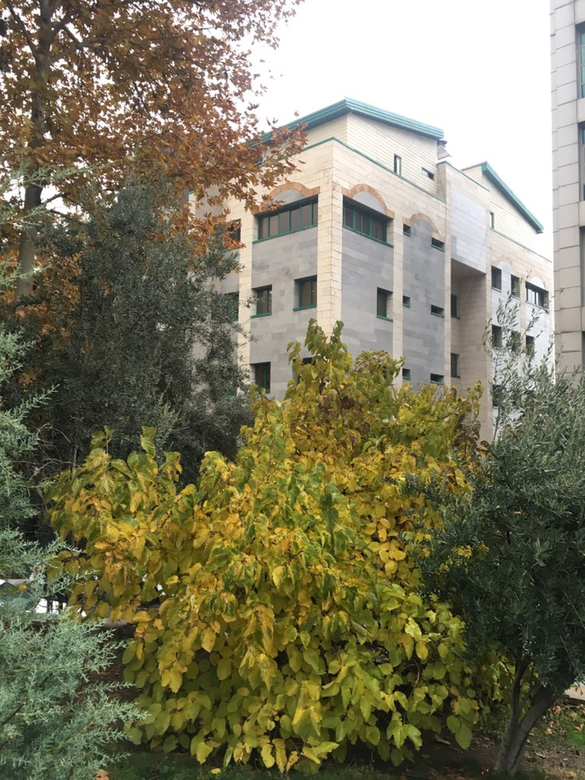
Thanks for your patience.
Photo by Majid Valizadeh, MD.

