Slide 1
Case Discussion Session Persistent Cushing’s Disease After Pituitary Surgery
G.K. Stella, MD
M. Zeinalizadeh, MD
M.K. Shahrzad, MD
M.Nakhjavani, MD
ICED October 2014

Slide 2
A 30-year-old woman referred because of a 4-year-history of weight gain, menstrual irregularity, hirsutism and muscle weakness
Physical examination:
reveals truncal obesity, plethora, moon face, bruising, and red-purple striae
Investigation of the patient confirms diagnosis of Cushing’s disease.

Slide 3
Diagnostic Work-up
Date July/2014 Lab Results
Serum cortisol mcg/dl 26 mcg/dl
Urine Free Cortisol 410 , 3377 mcg/24 hr
Serum cortisol after overnight DST 21.6
Serum cortisol after LDDST 21
Urine free cortisol after LDSST 67
Serum cortisol after HDDST 1.6
Urine free cortisol after HDDST 15
ACTH Baseline (pg/ml) 32, 50

Slide 4
Pituitry Imaging
high sensitivity but low specificity

Slide 5
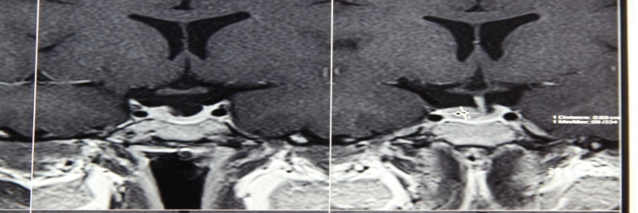
Imaging
unsatisfactory predictive criteria

Slide 6
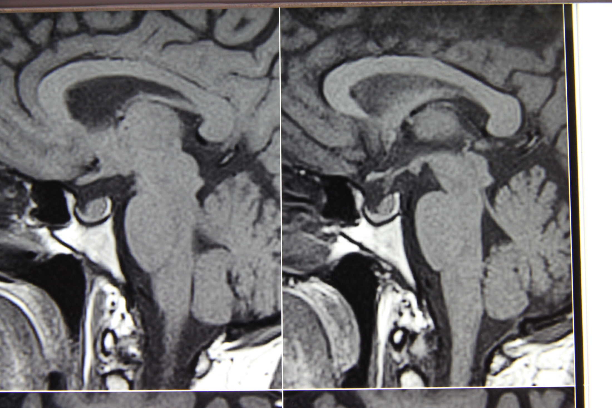
Vascular Architecture of Malignant Nodes
5-6) deplacement of longitudinal vessels and aberrant vessels
7) focal absence of perfusion
8) subcapsular vessels (non hilar)

Slide 7
Endoscopic removal of pituitary adenoma was carried out in November 13, 2012

Slide 8
Post-operative Course
No CSF leak
Received hydrocortisone intravenously
Had transient elevation of blood sugar
Lost 3 Kegs weight in the first 5 days
Developed LOC, hyponatremia (Na 115 meq/L) in November 18, 2014, treated with fluid restriction and got better

Slide 9
Pathology Report
Macroscopy: Multiple pieces of soft tissue measuring 1x0.8x0.8 cm
Microscopy: Fragments of normal pituitary gland tissue, in one of the fragments there are proliferation of monomorphic cells which have dark nuclei and pale eosinophilic cytoplasm arranged as nest.
Diagnosis: Pituitary adenoma

Slide 10
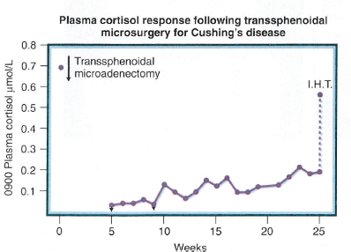
Post-operative Lab Findings
Nov. 13, 2012:
Serum cortisol was 14 mcg/dl
November 16, 2012:
Cortisol= 21 mcg/dl
ACTH= 25.5 pg/ml

Slide 11
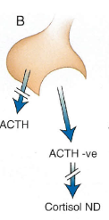
Successful Removal of ACTH Secreting Pituitary Microadenoma

Slide 12
Post-operative course
Questions
How common is this problem?
What test to order?
What is the appropriate management in this step?

Slide 13
Pituitry Imaging After TSS
high sensitivity but low specificity

Slide 14
Pituitry Imaging After TSS
high sensitivity but low specificity

Slide 15
Pituitry Imaging After TSS

Slide 16
Pituitary Irradiation
Gama Knife Treatment was carried out in March 13, 2013

Slide 17
Follow-up Lab Findings
Date Lab Results
Serum cortisol UFC ACTH
May 24, 2013 21.5 60
August 19, 2013 142
November 19, 2013 17.3 82
March 1, 2014 21 75
May 24, 2014 23.8 92
September 9, 2014 30 164

Slide 18
Pituitry Imaging 18 month After Gama Knife
high sensitivity but low specificity

Slide 19
Pituitry Imaging 18 month After Gama Knife
high sensitivity but low specificity

Slide 20
Pituitry Imaging 18 month After Gama Knife
high sensitivity but low specificity

Slide 21
Incomplete removal of pituitary adenoma

Slide 22
A 30-year-old woman referred because of a 4-year-history of weight gain, menstrual irregularity, hirsutism and muscle weakness
How should this patient be treated?

