Slide 1
Papillary thyroid carcinoma
Tall cell variant

Slide 2
5 - 10% of PTCs
Usually older age patients
Female more than males
Site of origin: Thyroid
Exceedingly rare at other sites (ectopic thyroid tissues)
Sporadic in most cases
Risk factors: same as most other variants of PTC
Ionizing radiation and pre-existing benign thyroid disease

Slide 3
The most common aggressive variant of PTC
Extra-thyroidal extension and metastatic lymph nodes are commonly seen
Microscopy:
  WHO 2017 definition: Tall cells (2 - 3x height / width cells) occupying ≥ 30% tumor
  Well developed PTC nuclear features
  If tall cell features are > 10% but < 30%, the tumor should be designated as PTC with tall cell features
    PTCs with tall cell features (≥ 10% tall cells) have worse prognosis than those without tall cells; more than 10% tall cells in a tumor should be reported in final pathology reports

Slide 4
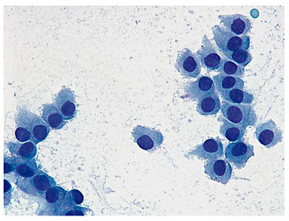
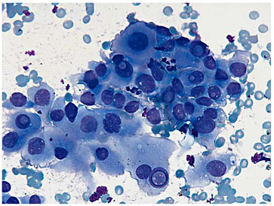
Diagnosis
  Tall cell features may be recognized by cytology but a definitive diagnosis of a tall cell variant requires histologic evaluation
  Gold standard for the Dx: histopathologic evaluation of thyroidectomy specimens

Slide 5
Prognosis of Tall cell variant of PTC
A more aggressive behavior than classic PTC independent of age, gender and tumor size, even without extra-thyroidal extension
Compared to classic PTC: (often but not always)
  larger tumor size
  more frequent extra-thyroidal extension
  more frequent lymph node involvement
  a higher stage at presentation
  higher recurrence rate
  increased tumor related mortality
  more frequent distant metastases (reported cases: pancreas, brain)
  accounts for ~20% of radioiodine refractory thyroid carcinomas
  accounts for many non-anaplastic fatal thyroid carcinomas
Risk of dedifferentiation into poorly differentiated or anaplastic thyroid carcinoma (tall cell PTC often seen as a component of these tumors)
Anaplastic transformation of tall cell papillary carcinoma typically occurs in the form of a spindle cell squamoid type of anaplastic carcinoma
The tall cell variant of papillary microcarcinoma (< 1 cm) is also associated with aggressive features at presentation and should be differentiated from other papillary thyroid microcarcinomas

Slide 6
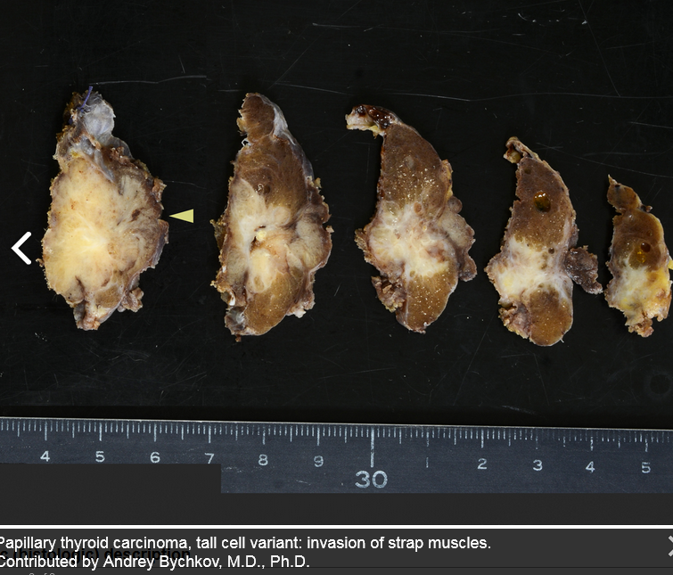
Pathology
Gross description:
Tend to be large (> 5 cm)
Extra-thyroidal extension
may be grossly apparent

Slide 7
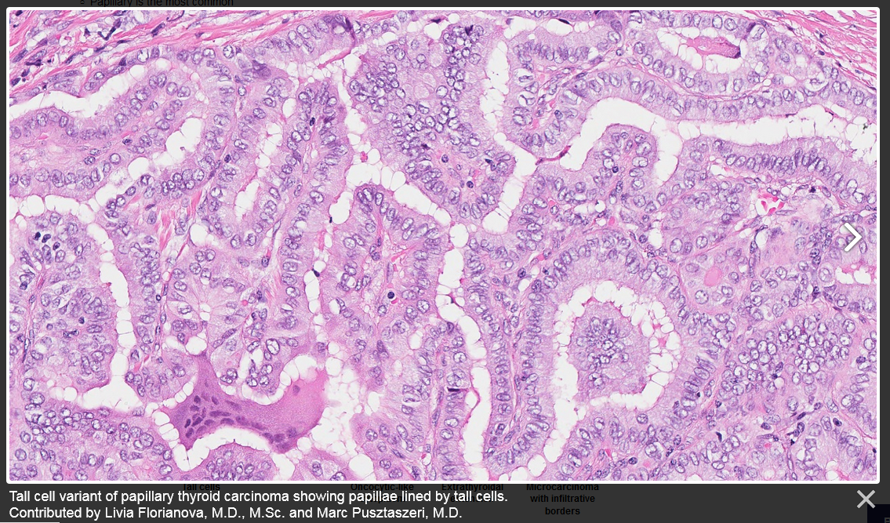

Slide 8
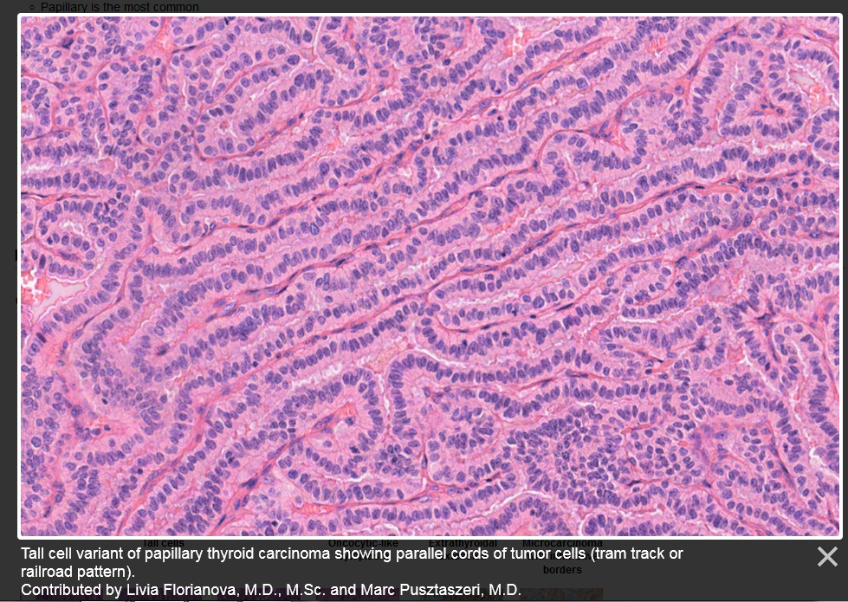

Slide 9
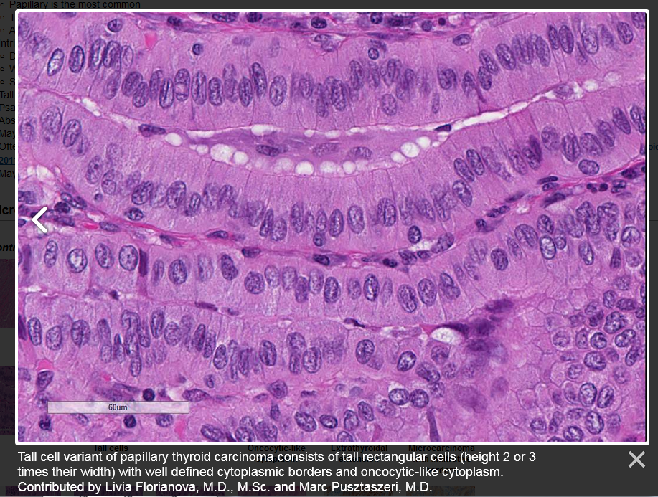

Slide 10
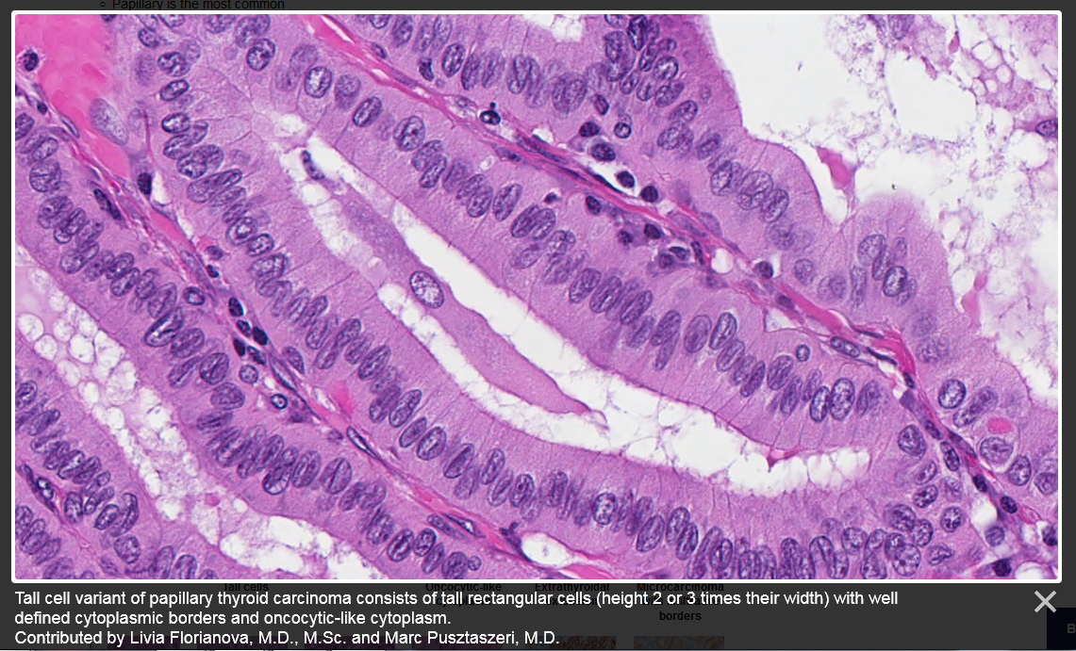

Slide 11
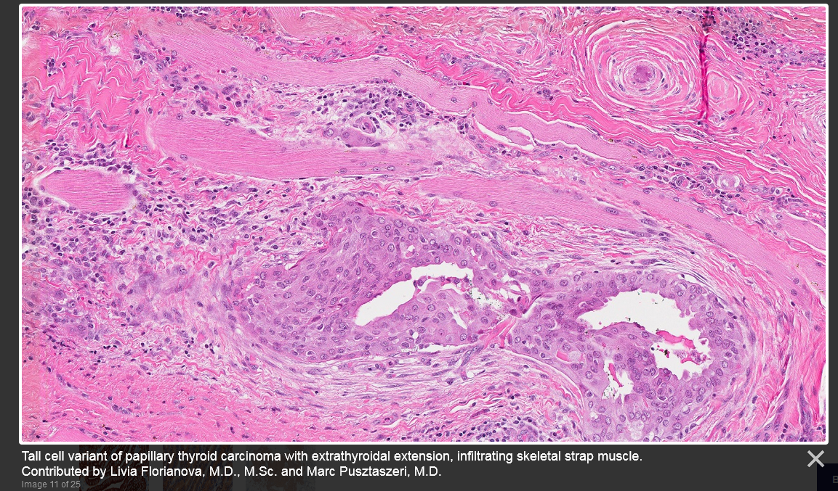

Slide 12
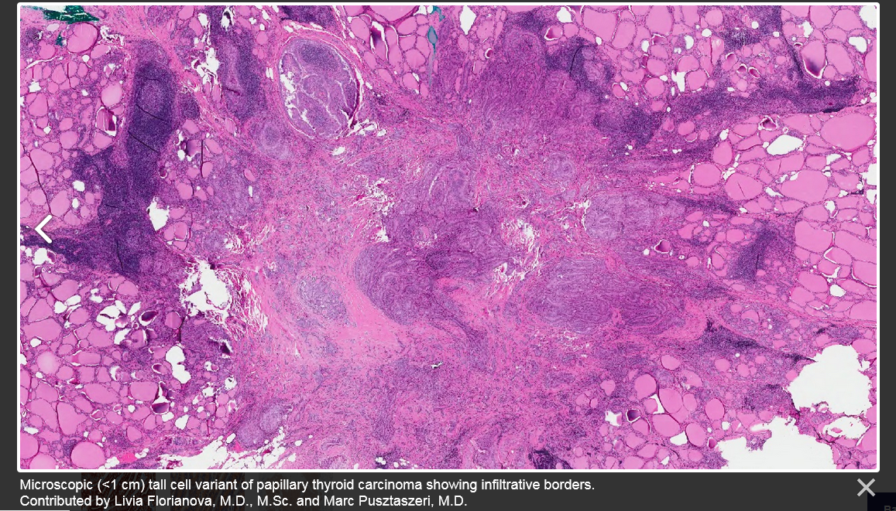

Slide 13
IHC staining chractristics
  Positive stains
    Thyroid specific: Thyroglobulin, TTF1, PAX8
    Cytokeratins: CK19, broad spectrum cytokeratins (AE1 / AE3)
    HBME, galectin3
    BRAF V600E by mutation specific antibody (VE1)
  Negative stains
    Calcitonin
    Chromogranin
    Synaptophysin

Slide 14
Molecular / cytogenetics description
  Highest mutation density (DNA copy number alterations) of all PTC variants
  BRAF V600E mutation in ~80% of cases
  Higher frequency of TERT (telomerase reverse transcriptase) promoter mutations than in classic PTC (5 - 30% versus 10%)
  RAS mutations have not been identified

Slide 15
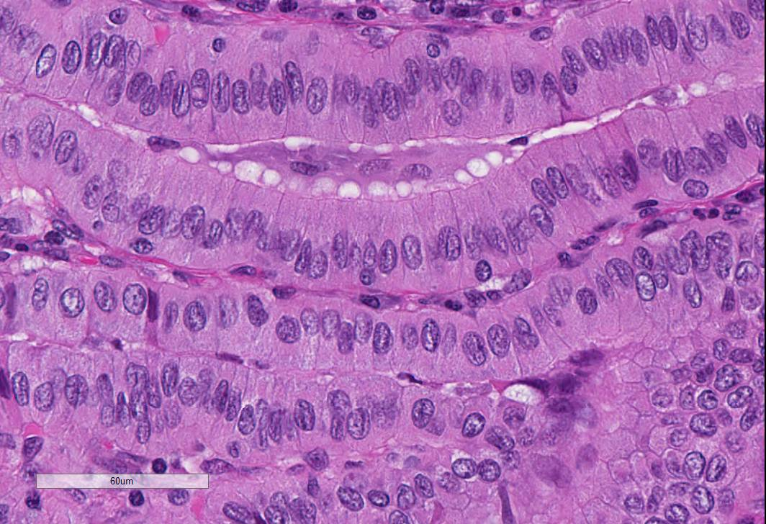
Columnar cell Variant of PTC
Tall cell Variant of PTC

Slide 16
Differential diagnoses
Other papillary thyroid carcinoma variants:
  Classic variant with tall cell features:
    < 30% of tall cell component
  Columnar cell variant:
    Nuclear stratification, rare nuclear pseudoinclusions, absence of eosinophilic cytoplasm and distinct cell borders
    Often CDX2 positive
  Warthin-like variant:
    Dense lymphocytic infiltration within vascular cores of stroma, rarely infiltrative
  Oncocytic variant:
    No or only rare tall cells, lack of distinct cell borders, prominent nucleoli
Breast tall cell carcinoma with reversed polarity (very rare):
  Focal positivity for GATA3, GCDFP-15 and mammaglobin
  TTF1, thyroglobulin and BRAF V600E consistently negative

