Slide 1
Persistent HTN after Unilateral Adrenalectomy due to APA a case report
Presented by:B.Rezvankhah.MD
February 2017

Slide 2
Recommendations for screening primary hyperaldosteronism:
All patients with the combination of hypertension and hypokalemia, (spontaneous or diuretic-induced)
Young patients with hypertension,
Patients with early onset of cerebrovascular accident (<age 50),
Patients with a positive family history of early stroke in a first-degree relative,
Patients with hypertension and adrenal incidentalomas,
Those whose blood pressure is difficult to control (resistant hypertension),
Primary hyperaldosteronism is especially common among patients with resistant hypertension.
In evaluations by several different investigators, the prevalence of primary hyperaldosteronism has been consistently reported as about 20% among subjects with resistant hypertension.
De Groot 2016

Slide 3
Recommendation for case detection of primary aldosteronism:
In patients with sustained blood pressure (BP) above 150/100 mm Hg on each of three measurements obtained on different days,with hypertension (BP140/90mm Hg) resistant to three conventional antihypertensive drugs (including a diuretic) or controlled BP (140/90 mm Hg) on four or more antihypertensive drugs;
Hypertension and spontaneous or diuretic-induced hypokalemia; hypertension and adrenal incidentaloma;
Hypertension and sleep apnea;
Hypertension and a family history of early onset hypertension or cerebrovascular accident at a young age (40 years);
Hypertensive first-degree relatives of patients with PA.
The Management of Primary Aldosteronism: Case Detection,Diagnosis, and Treatment: An Endocrine Society Clinical Practice Guideline(J Clin Endocrinol Metab, 2016)

Slide 4
Primary Hyperaldostronism
Recent studies report prevalence of PA in >5% and possibly >10% of hypertensive patients, both in general and in specialty settings.
Only a minority of patients with PA (9 to 37%) has hypokalemia.
Patients with PA have higher cardiovascular morbidity and mortality than age- and sex-matched patients with essential hypertension and the same degree of BP elevation.

Slide 6
Adrenocortical Adenoma
Women are more frequently affected,the tumor is usually unilateral and solitary.
In unusual circumstances, multiple adenomas or an adenoma with associated macronodular hyperplasia or smaller satellite nodules can be found.
Bilateral adenomas with two types of adenoma cells associated with both primary aldosteronism and Cushing’s syndrome also has been reported.
They are intraadrenal, often unencapsulated, but may show a true capsule or a pseudocapsule due to compression of the surrounding gland by the expansile pattern of growth.

Slide 7
Idiopathic Hyperaldosteronism
Adenoma was formerly considered to be the most common abnormality,before use of PA:PRA ratios for case detection.
IHA is now the most common subtype (63%).
The zona glomerulosa usually demonstrates either diffuse or focal hyperplasia with normal ultrastructure but may be macroscopically normal.
Associated nodules may be microscopic or as large as 2 cm in diameter and their ultrastructure is typical of clear cells of zona fasciculata origin.

Slide 8
Horm Metab Res 2012

Slide 9
Renin is not the sole regulator of aldosterone production and plasma levels.
Other important regulators:potassium and adrenocorticotrophin (ACTH) and changes in hepatic blood flow.
A limitation of the ARR is that, in the presence of very low renin levels (e. g., at PRA values of ≤ 0.1 ng/ml/h), the ARR may be elevated even when plasma aldosterone is also very low.

Slide 11
! If all potentially problematic agents cannot be safely withdrawn, an ARR should be performed and the results considered in the light of the potential confounding factors. For example, in some patients with severe PA, treatment with an MR antagonist cannot be safely discontinued; in this setting, PA-related testing can be pursued as long as renin is suppressed.

Slide 12
Ann Surg Oncol 2013

Slide 13
Of the 136 patients, 95 underwent surgical intervention for unilateral primary hyperaldosteronism with histologic examination.
Of these, 66 patients had an APA, and 14 patients demonstrated an APA with diffuse adrenal hyperplasia; histopathology of the remaining 15 patients showed diffuse cortical hyperplasia without evidence of a cortical adenoma.

Slide 14
Ann Intern Med. 2009

Slide 15
High rate (37.8%) of CT/MRI results did not agree with AVS results.
Few authors have reported false-positive AVS findings of unilateral abnormality.
AVS is technically unsuccessful in about 20% of cases.

Slide 16
Posture stimulation test
Findings show that the PAC in patients with APA showed diurnal variation and was relatively unaffected by changes in angiotensin II levels, whereas IAH was characterized by enhanced sensitivity to a small change in angiotensin II that occurred with standing.
In a review of 16 published reports, the accuracy of the posture stimulation test was 85% in 246 patients with surgically verified APA. The lack of accuracy is explained by the fact that some APAs are sensitive to angiotensin II and some patients with IHA have diurnal variations in aldosterone secretion.

Slide 17
18-Hydroxycorticosterone levels
Patients with APA generally have recumbent plasma 18-OHB levels greater than 100 ng/dL at 8:00 a.m., whereas patients with IAH have levels that are usually less than 100 ng/dL.
A recent study has shown a considerable degree of separation between APA and IHA,with less than 40% of patients not able to be allocated to one or the other on the basis of 18-oxocortisol measurements.

Slide 18
Hypertension. 2015

Slide 19
In this study, we measured p18oxoF and p18OHF in 261 patients with PA, who were subsequently classified based on the results of AVS into 113 patients with APA, 121 patients with BHA, and 27 patients with micro-APA.
In all the 113 patients with APA and 27 patients with micro-APA who underwent adrenalectomy, the diagnosis was further confirmed postoperatively based on PAC and immunohistochemical analysis of steroidogenic enzymes in resected adenomas.
We found that p18oxoF was a more reliable diagnostic parameter to differentiate between APA and BHA than p18OHF.

Slide 21
De Groot 2016

Slide 22

The resected adrenal gland sometimes contains macro- or micro-nodular lesions in addition to APA.
These nodules are multiple and generally bilateral and lead to a more complex differential diagnosis than the presence of a unilateral solitary mass.
This bilateral nodularity is not synonymous with hyperplasia, and adrenal venous sampling is required to detect cases of surgically correctable APA.
The clinical significance of these nodular lesions in patients with APA is not fully clear.

Slide 23
Exp Clin Endocrinol Diabetes 2009

Slide 24
Chronic administration of spironolactone activates the endogenous renin-angiotensin system,therefore, the possibility that the hyperplasia of ZG might have been induced by the administration of spironolactone is undeniable.
However, the hyperplastic ZG cells and subcapsular micronodules in the attached adrenal cortex demonstrated intense mRNA expression for StAR, CYP11A1, HSD3B2 and CYP21A2, but not CYP17A1, which expression pattern was the same as that in UAH and BAH cases.

Slide 25
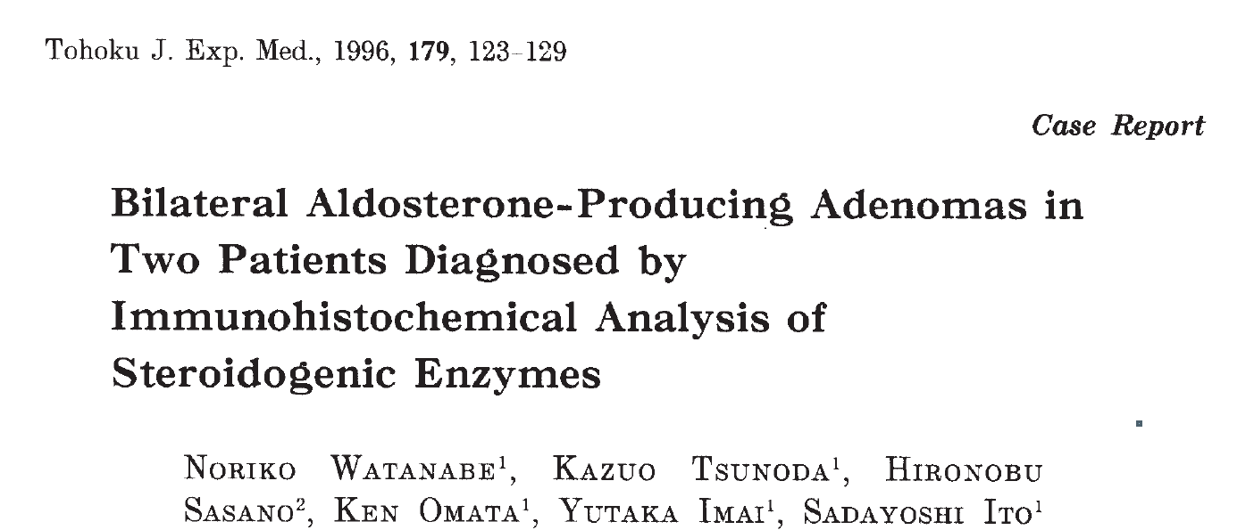
3

Slide 26
Bilateral adenoma with pseudo hyperplasia of adjacent adrenal gland in both cases.
The zona glomerulosa of the adrenal gland adjacent to the aldosteronoma occasionally demonstrated hyperplasia which makes it difficult to differentiated APA from IAH.
In both cases, cytochrome P-450 and 3B_HSD that were involved in aldosterone synthesis were found mainly in tumor, but little in the zona glomerulosa of the adjacent adrenals, which showed paradoxical hyperplasia.

Slide 27
Journal of Human Hypertension 2016

Slide 28
Bilateral adrenocortical tumours were mainly composed of clear cortical cells and bilateral attached nontumourous adrenal tissues showed hyperplasia of the zona glomerulosa.
The present case could have been possibly diagnosed as unilateral, left-sided disease based only on C-AVS findings,because both the lateralization index of 4.71 (9.78/2.08) and the right contralateral suppression index of 0.56 (2.08/3.74) could be interpreted as consistent with predominantly left PA accompanied by contralateral suppression, suggesting that the right adrenal cortical nodules could have been regarded as a clinically nonfunctioning tumour, in most of referral centres.

Slide 29
Q J Med 2008

Slide 30
From July 1994 to Jan 2007, 190 patients diagnosed with PA underwent surgical intervention at our hospital. Bilateral APA was diagnosed in 7/164 patients with histologically-proven APA.
All patients underwent an IV contrasted CT scan.
Dexamethasone suppression adrenocortical scintigraphy(DSS) was performed for those with suspicious bilateral lesions.

Slide 32
Microscopic analysis of the resected adrenal gland in our patients demonstrated large, encapsulated nodules, while the residual adrenal tissue showed no evidence of hyperplasia in the outer portions of the zona fasiculata. These findings were completely different from those in BAH, in which there is hyperplasia of the zona glomerulosa and the outer portions of the zona fasciculate,and also different from those of nodular hyperplasia, which is marked by cortical cells streamed into the outer rim of zona facsiculata, adrenal capsule or periadrenal fat.

Slide 33
Human Pathology (2013)

Slide 35
Jpn J Med 1991

Slide 37
APAs that solely consist of zona glomerulosa cells are very rare and usually, APAs are composed of different cell types.
Thus, APAs seem to have the potential of excess co-secretion of both aldosterone and cortisol.
In vitro studies revealed the capacity of APA cells to produce cortisol.
35 patients with A/CPA reported to date, including ours (12–37) and 24 patients with ACC who were documented to have both PA and hypercortisolism.
The vast majority of patients with A/CPA presented with therapy-resistant hypertension, combined with electrolyte disorders.

Slide 38
Even with improved diagnostic efforts,untreated postoperative normotension is only achieved in 42 %of operative candidates, but most studies observe greater than 90 % of their surgical cohort have improved blood pressure on a reduced number of antihypertensive medications.
Several preoperative indicators have been associated with improved outcomes (blood pressure control),including age < 40, female gender, body mass index(BMI) < 25, duration of hypertension<6 years, and the need for <2 antihypertensive medications.
Hormone and Metabolic Research, 2012

Slide 39
Medical Treatment
The starting dose for spironolactone should be 12.5 to 25 mg/d in a single dose. The lowest effective dose should be found by very gradually titrating upward, if necessary,to a maximum dose of 100 mg/d.
Despite improvement in electrolyte status, the blood pressure response is often suboptimal and additional drugs are required.
These can include amiloride and calcium-channel blocking agents such as nifedipine.

Slide 40
Thank you

