Slide 2
انتخاب روش درماني مناسب پركاري تيروئيد
دكتر فريدون عزيزي
پژوهشکده علوم غدد درون ريز و متابوليسم
دانشگاه علوم پزشكي شهيد بهشتي

Slide 3
Introduction
The most obvious objective in the treatment of hyperthyroidism is to render the patient euthyroid off drug therapy. The major drawback of treatment with thionamide drugs for hyperthyroidism is the frequent reappearance of thyrotoxicosis, up to 20-70% when therapy is discontinued. Therefore, radioiodine is increasingly considered the treatment of choice because of its safety and ease of administration.

Slide 4
History of Radioiodine Therapy (1)
In November 1936, Saul Hertz, the director of the Thyroid Clinic (1931 – 1943) at Massachusetts General Hospital (MGH) in Boston, sat across town in a luncheon meeting at Harvard Medical School, listening to Massachusetts Institute of Technology (MIT) president Karl Compton describe “What Physics Can Do for Biology and Medicine.” Hertz, who had been studying iodine’s effects on the thyroid, spontaneously asked Compton whether iodine could be made radioactive, his goal being to use this theoretical radioactive iodine to treat hyperthyroidism. Compton responded about a month later by letter, writing that iodine could indeed be made radioactive.
Bagley D. Endocrine News 2016; 27-30

Slide 5
History of Radioiodine Therapy (2)
by 1938 Hertz and Roberts began conducting studies with iodine 128 (I-128) on rabbits, showing that the rabbits’ thyroid glands rapidly took up I-128, and thus a tracer was born. However, as Clark T. Sawin and David V. Becker wrote in their paper “Radioiodine and the Treatment of Hyperthyroidism: The Early History,” published in the journal Thyroid in 1997, there was no hope of using I-128 as a treatment for hyperthyroidism because of I-128’s 25-minute half-life.
Bagley D. Endocrine News 2016; 27-30

Slide 6
History of Radioiodine Therapy (3)
In 1941 the Boston group (with their brand-new cyclotron) was able to create these new radioactive iodines and used a mixture of I-130 and I-131 to treat patients with hyperthyroidism. Hertz administered this therapeutic treatment to the first human patient at MGH in January of 1941, making this year the 75th anniversary of using a radioactive material to treat a patient — the birth of nuclear medicine.
Bagley D. Endocrine News 2016; 27-30

Slide 7
History of Radioiodine Therapy (4)
By 1941, Hertz had advanced his research, and he was administering I-130 to patients at MGH to treat hyperthyroid patients, and over time, he gathered a series of almost 30 patients. Meanwhile, Hitler was advancing through Europe, so Hertz joined the Navy and was shipped off to World War II in 1943.
Bagley D. Endocrine News 2016; 27-30

Slide 8
History of Radioiodine Therapy (5)
Hertz shipped out, he asked Chapman to continue his research.
“But when Hertz came back from the Navy two years later, it looks like he didn’t want to give it up, and they had a lot of arguments, and they had a rift and weren’t really talking to each other.”
Bagley D. Endocrine News 2016; 27-30

Slide 9
History of Radioiodine Therapy (6)
Hertz used lower doses and followed it with stable iodine, while Chapman was more aggressive, using higher doses without stable iodine. Sawin and Becker also write that they disagreed over “who was in charge” and it “led to their falling out.”
Bagley D. Endocrine News 2016; 27-30

Slide 10
History of Radioiodine Therapy (7)
Chapman wrote his paper first, and sent it to the Journal of the American Medical Association (JAMA) to be published. But the paper was too long and was sent back to Chapman for revisions. Hertz got wind of this, and he rushed to finish his paper.
“Although the editor of JAMA was puzzled by two papers on the same topic from the same institution,” Sawin and Becker write, “both papers appeared in the same issue of JAMA on May 11, 1964, and announced the new therapy was effective treatment for hyperthyroidism.”
Bagley D. Endocrine News 2016; 27-30

Slide 11
History of Radioiodine Therapy (8)
Saul Hertz, sadly, had a relatively short career. He died at age 45 and did not have much time to teach students and pass his findings and techniques on to them.
Bagley D. Endocrine News 2016; 27-30

Slide 12
INTRODUCTION
Reasons for increased reliance in radioiodine treatment:
↑ Atrial fibrillation due to hyperthyroidism
↑ Cardiovascular and cerebrovascular morbidity
High relapse after discontinuation of antithyroids
Ease, effectiveness and low cost
Notes:
Original text
Slide # 20 Find a title + summarize +++
Accepting diabetes and its associated complications as a progressive, potentially devastating, disease needing life-long treatment and accounting for a significant proportion of health care budgets makes this condition a subject of major concern. Specific considerations for prevention and control of type 2 diabetes are needed at all levels of the healthcare system in order to improve healthcare delivery to patients. Education of healthcare teams in the management of diabetes and methods for increasing knowledge in the community are major aspects that need reinforcement.
The network for control and management of type 2 diabetes in the Islamic Republic of Iran is a systematic approach for delivery of healthcare to patients. Evaluation and monitoring of this network has been initiated, and will play an important role in the enhancement of this urgently needed network.

Slide 13
Long Term Consequences of RAI Therapy:
Thyroid failures 50-70% to 90-100%
↑ Morbidity from vascular causes
(? Due to hyperthyroidism itself)
↑ Cancer incidence and mortality
Dependency on thyroxine therapy

Slide 14
Problems with hypothyroidsm after RAI therpy
Occurs in 50-70% of patients after low dose and in 90-100% following high dose radioiodine treatment.
Many years after the patient has attained euthyroidism by radioiodine (long-term follow up of thyroid function).
The risk of over replacement of levothyroxine on the heart and bones.
Dubious potency, uniformity and reproducibility of thyroxine preparations.
Lack of compliance.

Slide 15
Patients under levothyroxine replacement therapy may be at risk for consequences of under- and over- treatment
32% of patients on levothyroxine replacement therapy had abnormal TSH concentrations, while 92% of them had seen a health care provider the previous year.
In the Colorado Thyroid Disease Prevalence Study of patients who reported taking thyroid medication, nearly 40% had an abnormal serum TSH level
In Tehran Thyroid Study 21.1% of radioiodine-induced hypothyroid patients on levothyroxine therapy, had elevated TSH during the 10 years of follow up.

Slide 16
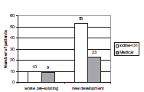
Number of patients with worsening of preexisting TAO [10 of 22 patients (45%) in group I; and nine of 19 patients (47%) in group M] and de novo development of TAO [53 of 141 patients (38%) in group I; and 23 of 131 patients (18%) in group M] at any time during follow-up
Trasik F, et al, 2009; 94: 3700

Slide 17
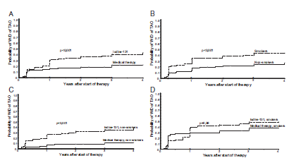
The Kaplan-Meier curves for worsening or development (W/D) of ophthalmopathy between treatment with iodine-131 (163 patients) and medical therapy for Graves’ hyperthyroidism (150 patients) (A); smokers (121 patients) vs. nonsmokers (190 patients) (B); nonsmokers who received medical therapy (86 patients) vs. iodine-131 treatment (104 patients) (C); and smokers who received iodine-131 (59 patients) vs. medical therapy (62 patients) (D). The markers on the x-axes represent ophthalmology assessments according to the protocol.
Trasik F, et al, 2009; 94: 3700

Slide 18
Outcome of very long-term treatment with antithyroid drugs in Graves’ hyperthyroidism associated with Graves’ orbitopathy Laura Elbers, Maarten Mourits and Wilmar Wiersinga Thyroid 2011, in press
After a median 3.5 year ATD therapy, relapse rate was 37%
Long term ATD therapy of patients until Graves’ orbitopathy has become inactive is accompanied by no worsening of GO

Slide 19
TSH receptor autoimmunity in Graves’ disease after therapy
70
60
50
40
TRAb %
30
Radioiodine
20
Surgery
10
Medication
0
0 1 2 3 4 5
Laurberg et al EJE 2008
Years

Slide 20
Factors favoring relapse of thyrotoxicosis after treatment of Graves’ disease with thionamides
More consistent factors:
Severe degree of thyrotoxicosis
Large goiter
Lack of decrease of goiter size during therapy
High T3 to T4 ratio in serum
Higher baseline levels of anti-TSH receptor antibodies
Lack of normalization of serum TSH
Inconsistent factors:
Sex, age, cigarette smoking, duration of symptoms before diagnosis, presence of ophthalmopathy, psychiatric disorders, (depression, hypochondriasis, paranoia, mental fatigue) and problems of daily life
Azizi F. Exper Opin Drug Saf 2006; 5: 107-116

Slide 21
Comparison of remission rate at 6, 12, and 24 months after ATD discontinuation between the H-TSH and N-TSH groups
Choo YK, et al. Thyroid 2010; 20: 949

Slide 22
Advantages and Disadvantages of Available Treatment Modalities for Graves’ Disease Thyrotoxicosis
Treatment Modality | Advantages | Disadvantages
Radioiodine | Definitive treatment of thyrotoxicosis Rare, mild and transient side effects No surgical risks Easy to perform Fast | Delayed control of thyrotoxicosis Lower efficacy in large goiters Radiation hazard (?) CVD, cancer Possible appearance of ophthalmopathy Worsening of preexisting ophthalmopathy Problems with treatment of hypothyroidism
Thyroidectomy | Definitive treatment of thyrotoxicosis No radiation hazards Removal of large goiters Fast | High cost Hypoparathyroidism (0.9%-2%) ` Bleeding/infections/anesthesia Scarring
Thionamides | No radiation hazards No surgical risks No permanent hypothyroidism Low cost | Frequent relapses Requires frequent testing Side effects and adverse reactions

Slide 23
“In patients with recurrent hyperthyroidism after disontinution of antithyroid drugs, long term (mean 10 years) continuous treatment with methimazole (MMI) was safe, and had comparable expense and complications with radioiodine treatment”
Azizi F, et al. Europ J Endocrinol 2005; 152: 695

Slide 24
PATIENTS AND METHODS
Clinical trial
Between march 1989 and July 2009
Mean follow up 14 ±3 (range 5-20) years
Patients with diffuse toxic goiter
Tehran; area of iodine sufficiency
59 patients on MMI and 73 on levothyroxine for treatment of radioiodine induced hypothyroidism
Followed every 3-6 months with TFT’s for mean of 14 years
Notes:
Original text
Slide # 20 Find a title + summarize +++
Accepting diabetes and its associated complications as a progressive, potentially devastating, disease needing life-long treatment and accounting for a significant proportion of health care budgets makes this condition a subject of major concern. Specific considerations for prevention and control of type 2 diabetes are needed at all levels of the healthcare system in order to improve healthcare delivery to patients. Education of healthcare teams in the management of diabetes and methods for increasing knowledge in the community are major aspects that need reinforcement.
The network for control and management of type 2 diabetes in the Islamic Republic of Iran is a systematic approach for delivery of healthcare to patients. Evaluation and monitoring of this network has been initiated, and will play an important role in the enhancement of this urgently needed network.

Slide 25
The relative risk and confidence interval (CI) of variables in the continuous MMI treated (group 1), as compared with the radioiodine induced hypothyroid patients (group 2)
Variable | Relative risk(95%CI) | P Value
During follow up
TSH<0.3 mU/l | 1.95(1.4-2.72) | <0.01
TSH>5 mU/l | 3.6 (2.52-5.06) | <0.01
At final visit
Antithyroperoxidase antibody>100 mU/l | 0.38(0.16-0.92) | <0.05
Total goiter rate | 0.51(0.27-0.95) | <0.05
Serum cholesterol>200 mg/dl | 2.18(1.12-4.22) | <0.03
Serum LDL-C>130 mg/dl | 1.9(1.13-3.33) | <0.02
Number BMD<1.5 SD Z score
Vertebra | 1.12(0.55-2.26) | NS
Hip | 1.44(0.81-2.57) | NS
Radius | 1.4(0.74-2.68) | NS
Azizi F. Europ J Endocrinol 2005; 152: 695
0 2 4 6
In favor of
Group 2
In favor of
Group 1

Slide 26
Patients with recurrent hyperthyroidism
(104)
Randomization
Radiiodine therapy
(51)
Excluded
(29)
MMI treatment
(34)
LFU (10)
LFU (6 )
Hypothyroid
(25)
Euthyroid
(16)
Hyper (1)
Hypo (1)
Euthyroid(26)
Thyroxine treated
Euthyroid
(25)
RAI R%
Non
Randomized
MMI R%
Euthyroid (33)
Hypothroid on
T4 R%
(48)
RAI
(73)
MMI
(59)

Slide 27
Health Status and Neuro-psychology Tests
Name of test | Assessment
1. SF 36 Health Survey Questionnaire | General health
2. General Health Questionnaire (GHQ) | Mental disorders
3. Rey Complex Figure Test | Cognitive processes
4. Bender-Gestalt test (BGT) | Cognitive ability
5. Wechsler Memory Scale-Revised (WMSR) | Memory
6. Wechsler Adult Intelligence Scales (WAIS) | Intelligence quotient
7. Symptom Checklist-90 (SCL-90) | Psychological distress
8. Hospital Anxiety and Depression Scale (HADS) | Anxiety & Depression

Slide 28
Age, BMI and physical activity in methimazole and radioiodine treated patients at final visit
Variable | MMI (n=59) | RAI (n=73) | P | Adjusted P (sex)
Gender (F/M) | 41/18 | 62/11 | 0.02
Age (yr) | 51±16 | 53±11 | 0.53 | 0.65
BMI (kg/m²) | 26.2±3.5 | 27.8±4.5 | 0.04 | 0.143
Physical activity (%)
Mild | 53 | 77 | 0.009 | 0.012
Moderate | 47 | 23 | 0.006
Goiter rate (%) | 62 | 3 | 0.001 | 0.001
TPOAb (IU/ml) | 23 (7-82) | 8 (5-15) | 0.001 | 0.001
TRAb (U/ml) | 2.1 (1.6-3.6) | 1.8 (1.4-2.2) | 0.02 | 0.86

Slide 29
Serum lipids and lipoproteines concentrations in methimazole and radioiodine treated patients
*
†
†
*
* p<0.001, † p<0.02

Slide 30
Findings of echocardiography in methimazole and radioiodine treated patients
P<0.001
P<0.02

Slide 31
Occurrence of abnormal serum TSH in methimazole and radioiodine treated
patients during mean 15 years follow up
P<0.001
P<0.04

Slide 32
Summary statistics and p values for neuro-psychologic tests
Measure | MMI (n=59) | RAI (n=73) | P
SCL - 90
Compulsion
Normal & marginal | 48 (81)* | 61 (84) | 0.281
Abnormal | 11 (19) | 12 (16)
Psychotic
Normal & marginal | 53 (90) | 61 (84) | 0.046
Abnormal | 6 (10) | 12 (16)
WMSR
Direction | 5 (5-6)† | 5 (4-5) | 0.033
Logical memory | 6 (4-7) | 4 (3-6) | 0.049
Repeating numbers | 9 (8-11) | 9 (8-11) | 0.010
Memory score | 96.6±13.9 | 93.6±13.9 | NS
WAIS
Intelligence quotient | 107±20 | 99±15 | 0.02
*:Number in parenthesis denote percentage; †: numbers are median (interquartile interval); ‡ mean± SD SCL- 90: . Symptom Checklist-90 WMSR: Wechsler Memory Scale-Revised; WAIS: Wechsler Adult Intelligence score

Slide 33
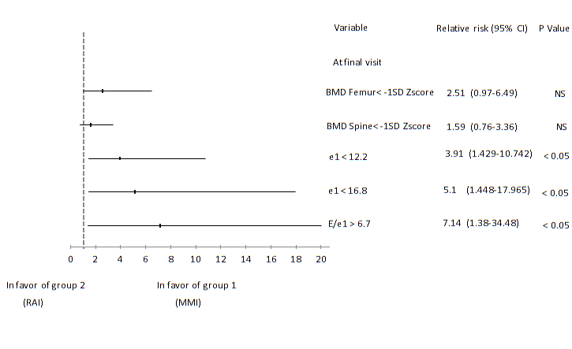
The relative risk and confidence interval of the rate of occurrence of bone mineral density <-1 SD Zscore and é velocity <12 and 16.8 cm and early diastolic (E)/ é ratio <6.7 in continuous MMI- treated, compared to radioiodine-treated patients
Variable
Relative risk
(95% CI)
P Value
At final visit

Slide 34
CONCLUSIONS (1)
Long-term continuous MMI tratement:
Effective
Safe, rare side effects
High treatment compliance
Comparable expense with RAI therapy
Notes:
Original text
Slide # 20 Find a title + summarize +++
Accepting diabetes and its associated complications as a progressive, potentially devastating, disease needing life-long treatment and accounting for a significant proportion of health care budgets makes this condition a subject of major concern. Specific considerations for prevention and control of type 2 diabetes are needed at all levels of the healthcare system in order to improve healthcare delivery to patients. Education of healthcare teams in the management of diabetes and methods for increasing knowledge in the community are major aspects that need reinforcement.
The network for control and management of type 2 diabetes in the Islamic Republic of Iran is a systematic approach for delivery of healthcare to patients. Evaluation and monitoring of this network has been initiated, and will play an important role in the enhancement of this urgently needed network.

Slide 35
CONCLUSIONS (2)
Long-term continuous MMI tratement compared to thyroxine-treated RAI-induced hypothyroidism:
More physical activity • More goiter
Better lipid profile • Higher TPOAb titers
Better memory, mood and IQ
Less psychotic
Less subclinical hypo-and hyperthyroidism
Notes:
Original text
Slide # 20 Find a title + summarize +++
Accepting diabetes and its associated complications as a progressive, potentially devastating, disease needing life-long treatment and accounting for a significant proportion of health care budgets makes this condition a subject of major concern. Specific considerations for prevention and control of type 2 diabetes are needed at all levels of the healthcare system in order to improve healthcare delivery to patients. Education of healthcare teams in the management of diabetes and methods for increasing knowledge in the community are major aspects that need reinforcement.
The network for control and management of type 2 diabetes in the Islamic Republic of Iran is a systematic approach for delivery of healthcare to patients. Evaluation and monitoring of this network has been initiated, and will play an important role in the enhancement of this urgently needed network.

Slide 36
CONCLUSIONS (3)
Continuous methimazole treatment should be considered as an optional approach to long – term treatment of patients with diffuse toxic goiter, in particular those with recurrent hyperthyroidism.

Slide 37
Algorithm for the Use of Antithyroid Drugs
among Patients with thyrotoxicosis
Very large diffuse goiter, multinodular goiter, toxic adenoma
Small or moderately enlarged thyroid; children or pregnant or lactating women; patients with severe eye disease
Radioiodine therapy
? surgery
Antithyroid drug therapy
Normalization of thyroid function
With antithyroid drugs before therapy in elderly patients and those with heart disease
Discontinue drug therapy after 18 mo
Monitor thyroid function
Relapse
Remission
Definitive radioiodine therapy
Second course of antithyroid drug therapy in children and adolescents
Monitor thyroid function every 12 mo indefinitely
Continuous MMI therapy

Slide 38
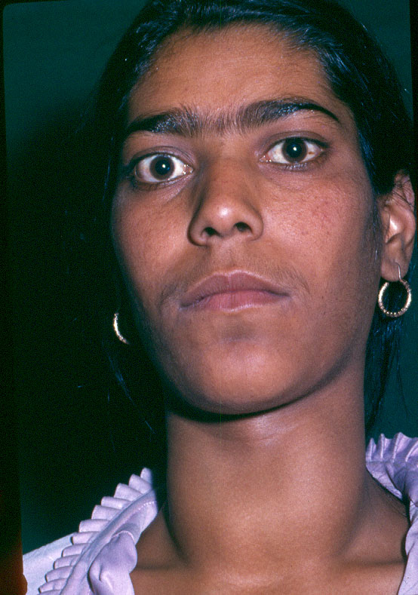
Thyrotoxicosis in pregnancy
Occurs in 0.2% of women
Mostly caused by Graves’ disease

Slide 39
Management of Hyperthyroidism in Pregnancy
Antithyroid drugs should be initiated in women with Graves’ hyperthyroidism or a toxic nodule in pregnancy. PTU is preferred in the first trimester. Following the first trimester, patients should be changed to methimazole.
A block-replace regimen with both LT4 and ATD should not be used in pregnancy.
Azizi F. Expert Opin Daug saf 2006; 5: 107
Mandel SJ et al. J Clin Endocrinol Metab 2001; 86: 2354
Bahn RS et al. Thyroid 2009; 19:673

Slide 40
WHICH TESTS SHOULD BE PERFORMED DURING TREATMENT WITH ATD AND WHAT LEVELS SHOULD BE ACHIEVED?
An estimate of free T4 (FT4I )and TSH should be monitored approximately every 4 weeks. The primary goal is a serum free T4 at or just above the upper limit of the normal range.
Momotani N et al. N Engl J med 1986; 315: 24

Slide 41
Should anithyroid drug therapy be discontinued in the last part of pregnancy?
Can postpartum recurrence of Graves’ disease be prevented by the continuation of antithyroidis during pregnancy?

Slide 42
Postpartum recurrence and exacerbation of Graves’ hyperthyroidism
Nekagawa et al. Clin Endocrinol 57: 467,2002

Slide 43
What are the long-term effects of antithyroid treatment in pregnancy on growth, intellectual development and thyroid function of the offspring?

Slide 44
Anthropometric data, serum thyroid hormones, and TSH,
Urinary iodine, thyroid antibodies, and liver function tests
in children of thyrotoxic mothers and control group
Parameters | Children of thyrotoxic mothers (n=23) | Controls (n=30)
Age at testing (yr) | 5.61±1.9 | 5.7±2.0
Sex | 7M/16F | 11M/19F
Height (cm) | 113±11 | 111±13
Weight (kg) | 18.0±5.2 | 19.7±7.9
T4 (µg/dl) | 9.7±2.2 | 9.5±2.0
T3 (ng/dl) | 147±33 | 142±40
TSH (mU/l) | 1.25±0.5 | 1.45±0.6
RT3Up (%) | 28.3±2.2 | 28.7±2.1
Urinary iodine (µg/dl) | 22.3±11.7 | 20.5±8.5
Anti Tg (IU/ml) | 52.4±41.5 | 62.6±50.0
Anti TPO (IU/ml) | 32.9±31.1 | 43.6±37.1
Azizi et al. J Endocrinol Invest 2002;25:586

Slide 45
Wechsler tests scores in children whose mothers were taking methimazol (MMI)
( ), and in control ( ).
20
control
case
15
IQ (verbal)
10
5
0
Information
Vocabulary
Mathe matics
Similarities
Comprehension
Sentences
Azizi et al.J Endocrinol Invest 2002;25:586

Slide 46
WHAT IS THE VALUE OF TSHRAB MEASUREMENT IN THE EVALUATION OF A PREGNANT WOMAN WITH GRAVES’ HYPERTHYROIDISM?
If the patient has a past or present history of Graves’ disease, a maternal serum measure of TSHRAb should be obtained at 22-26 weeks gestation.
Lution O et al. J Clin Endocrinol Metab 2005; 90: 6093
Laurberg P et al. Europ J Endocrinol 2009;160: 1-8
Zwaveling- Soonawala N et al. Thyroid 2009; 19: 661-2.

Slide 47
UNDER WHAT CIRCUMSTANCES SHOULD ADDITIONAL FETAL ULTRASOUND MONITORING FOR GROWTH, HEART RATE, AND GOITER BE PERFORMED IN WOMEN WITH GRAVES’ HYPERTHYROIDISM IN PREGNANCY?
Fetal surveillance should be performed in women who have uncontrolled hyperthyroidism or who have highly elevated TSHRAb titers. Such monitoring may include ultrasound monitoring for heart rate, growth, and fetal goiter.
Papendieck P et al. J Ped Endocrinol Metabol 2009; 22: 547

Slide 48
Management of thyrotoxicosis in pregnancy
Confirm diagnosis
Start propylthiouracil or methimazole
Render patient euthyroid: continue with low-dose ATD up to and during labor and postpartum
Monitor thyroid function:
Throughout gestation; adjust ATD if necessary to maintain
T4 at upper level of normal
Check TSAb at 26 weeks
Discuss treatment with patient
effect on patient
effect on fetus
breast feeding
Inform obstetrician and pediatrician
Review postpartum-check for exacerbation

Slide 49
HOW SHOULD WOMEN WITH GRAVES’ DISEASE BE COUNSELED PRE-PREGNANCY?
Hyperthyroidism should be well controlled before attempting pregnancy.
Patients on anti-thyroid drugs should be switched to PTU when pregnancy is being attempted or at time of conception (?).
In patients with high titers of TRAb antibodies requiring definitive therapy for Graves’ disease in the setting of a planned pregnancy within the next two years, surgery is preferable to radioactive iodine (?).

Slide 50
TSH receptor autoimmunity in Graves’ disease after therapy
70
60
50
40
TRAb %
30
Radioiodine
20
Surgery
10
Medication
0
0 1 2 3 4 5
Laurberg et al EJE 2008
Years

Slide 51
A proposed algorithm for the systemic approach to suspected pregnant women for hyperthyroidism
Serum FT4 (FT4I) , TSH
Normal
Normal FT4 (FT4I), ↓TSH
High FT4 (FT4I), suppressed TSH
Adjusted TT3
History of Graves’ ,
goiter, ophthalmopathy
Nausea, vomiting,
weight loss
Normal
Increased
Positive
TPOAb
TBII
Pelvic Ultrasonography
Repeat TFT’s after first trimester, if indicated
PTU in the first trimester; adjust to have FT4
at upper level of normal, switch to MMI after 12 weeks, check TSAb at 22-26 weeks
(+)
Hydatidiform mole
(-)
Gestational
thyrotoxicosis
Surgery
Supportive therapy

Slide 52
SUBCLINICAL THYROTOXICOSIS
Decreased Thyrotropin normal L- thyroxine and triiodothyronine and no complains;
Exogenously caused by L- thyroxine treatment
Endogenous prevalence up to 20% in multinodular goiter
Increased risk for atrial fibrillation, slightly increased bone turnover and decreased bone mineral density in postmenopausal women
Antithyroid drug treatment is indicated in endogenous subclinical thyrotoxicosis associated with atrial fibrillation
A trial of antithyroid drug thrapy in asymptomatic patients remains debatable.

