Slide 1
Nonalcoholic Fatty Liver Disease Case Discussion
Hengameh Abdi, MD
Endocrine Research Center
Research Institute for Endocrine Sciences
Shahid Beheshti University of Medical Sciences
21 July 2016

Slide 2
Case 1

Slide 3
Case 1
A generally healthy 42 y/o lady came to you for evaluation of fatty liver (grade I) discovered during a routine abdominal ultrasound.
She reports no risk factors or symptoms of chronic liver disease.
PMH and family history: Unremarkable
She takes no medications.

Slide 4
Case 1
Physical examinations:
BMI: 28 kg/m²
BP: 120/80 mm Hg
Others: Unremarkable

Slide 5
Case 1
Which of the following laboratory assessments are necessary?
Liver biochemistry
FBS
Lipid profile
All above

Slide 6
Case 1
In patients with unsuspected hepatic steatosis detected on imaging who lack any liver-related symptoms or signs and have normal liver biochemistries, it is reasonable to assess for metabolic risk factors (e.g., obesity, glucose intolerance, dyslipidemia) and alternate causes for hepatic steatosis such as significant alcohol consumption or medications.
(AASLD/ACG/AGA 2012 strong recommendation, Evidence-A)
Chalasani N, et al. Hepatology 2012; 55(6):2005-2023

Slide 7
Case 1
All individuals with steatosis should be screened for features of metabolic syndrome, independent of liver enzymes.
(EASL/EASD/EASO 2016 strong recommendation, Evidence-A)
Diabetologia 2016; 59:1121-1140
Journal of Hepatology
Obesity Facts

Slide 8
Case 2

Slide 9
Case 2
A generally healthy 56 y/o active man has been referred to you due to increased serum transaminase levels.
(AST: 45 IU/L; ALT: 56 IU/L)
He reports no risk factors or symptoms of chronic liver disease.
PMH and family history: Unremarkable.
He is smoker (20 pack-years).
He takes no medications.

Slide 10
Case 2
Physical examinations:
BMI: 32 kg/m²
Waist circumference: 105 cm
BP: 120/80 mmHg
Others: Unremarkable

Slide 11
Case 2
Laboratory:
FBS: 91 mg/dL
Creatinine: 0.8 mg/dL
Total cholesterol: 250 mg/dL
(LDL-C:160 mg/dL, HDL-C: 52 mg/dL)
Triglyceride: 190 mg/dL
Normal CBC

Slide 12
Case 2
Which of the following diagnostic work-ups do you suggest?
Liver US
Repeat AST, ALT in 3 months
HBsAg, HCV Ab
Autoimmune markers

Slide 13
Case 2
Screening for NAFLD in adults attending primary care clinics or high-risk groups attending diabetes or obesity clinics is not advised at this time due to uncertainties surrounding diagnostic tests and treatment options, along with lack of knowledge related to the long-term benefits and cost-effectiveness of screening.
(AASLD/ACG/AGA 2012 strong recommendation, Evidence-B)
Chalasani N, et al. Hepatology 2012; 55(6):2005-2023

Slide 14
Case 2
All individuals with persistently abnormal liver enzymes should be screened for NAFLD, because NAFLD is the main reason for unexpectedly elevated liver enzymes.
(EASL/EASD/EASO 2016 strong recommendation, Evidence-A)
In subjects with obesity or metabolic syndrome, screening for NAFLD by liver enzymes and/or ultrasound should be part of routine work-up.
In high-risk individuals (age >50 years,T2DM, Metabolic syndrome) case finding of advanced disease (i.e. NASH with fibrosis) is advisable.
(EASL/EASD/EASO 2016 weak recommendation, Evidence-A)
Diabetologia 2016; 59:1121-1140
Journal of Hepatology
Obesity Facts

Slide 15
Case 3

Slide 16
Case 3
A generally healthy 60 y/o married salesman.
Intermittent mild transaminase abnormalities since 11 years ago that have become more consistent since 6 years ago.
ALT: 40-50 (most values); highest level: 72 U/L
AST: highest level: 47 U/L
No symptoms of chronic liver disease.
H. Afdhal N. JAMA 2012; 308(6):608-616

Slide 17
Case 3
PMH: HTN, obesity, dyslipidemia, a benign thyroid nodule, hypogonadism.
FH: His father died at age 37 years of cirrhosis (he was not a heavy drinker and the cause of the cirrhosis was not known).
He has 1 to 2 alcoholic drinks per month.
No history of smoking or drug use.
He exercises for 45 minutes to 1 hour on a daily basis.

Slide 18
Case 3
Medications:
Aspirin
Fenofibrate
Omega-3
Irbesartan
Hydrochlorothiazide
Omeprazole
Testosterone

Slide 19
Case 3
Physical examinations:
Wt: 94 kg
Ht: 160 cm
BMI: 37 kg/m²
PR: 84/min
BP: 122/70 mm Hg
Regular, unlabored respirations
Normal heart, lungs and abdomen
No stigmata of chronic liver disease

Slide 20
Case 3
Laboratory:
FBS: 94 mg/dL
Creatinine: 1.1 mg/dL
ALT: 49 U/L
AST: 39 U/L
Creatine phosphokinase: 420 ng/mL
Total cholesterol: 208 mg/dL (LDL-C:118 mg/dL; HDL-C: 33 mg/dL)
Triglyceride: 288 mg/dL
Normal CBC, thyrotropin, testosterone, prostate-specific antigen levels.
Normal iron studies and ceruloplasmin level.
Negative viral markers.

Slide 21
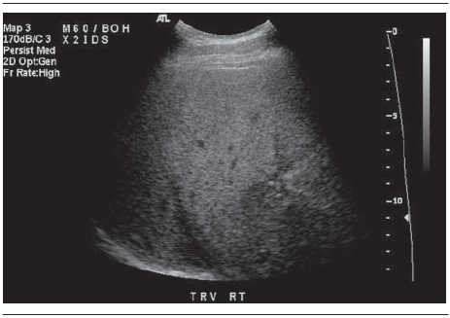
Case 3
Abdominal ultrasound:
Diffuse increased echogenicity with scattered granulomas

Slide 22
Case 3
Which of the following items do you suggest to this patient?
Liver biopsy
Lifestyle modification
Fibroscan
A and B

Slide 23
Case 3
Liver biopsy should be considered in patients with NAFLD who are at increased risk to have steatohepatitis and advanced fibrosis.
(AASLD/ACG/AGA 2012 strong recommendation, Evidence-B)
The presence of metabolic syndrome and the NAFLD Fibrosis Score may be used for identifying patients who are at risk for steatohepatitis and advanced fibrosis.
(AASLD/ACG/AGA 2012 strong recommendation, Evidence-B)
Liver biopsy should be considered in patients with suspected NAFLD in whom competing etiologies for hepatic steatosis and co-existing chronic liver diseases cannot be excluded without a liver biopsy.
(AASLD/ACG/AGA 2012 strong recommendation, Evidence-B)
Chalasani N, et al. Hepatology 2012; 55(6):2005-2023

Slide 24
Case 3
Biomarkers and scores of fibrosis, as well as transient elastography, are acceptable non-invasive procedures for the identification of cases at low risk of advanced fibrosis/cirrhosis.
(EASL/EASD/EASO 2016 weak recommendation, Evidence-A)
The combination of biomarkers/scores and transient elastography might confer additional diagnostic accuracy and might save a number of diagnostic liver biopsies.
(EASL/EASD/EASO 2016 weak recommendation, Evidence-B)
Diabetologia 2016; 59:1121-1140
Journal of Hepatology
Obesity Facts

Slide 25
Case 3
Weight loss generally reduces hepatic steatosis, achieved either by hypocaloric diet alone or in conjunction with increased physical activity.
(AASLD/ACG/AGA 2012 strong recommendation, Evidence-A)
Loss of at least 3-5% of body weight appears necessary to improve steatosis, but a greater weight loss (up to 10%) may be needed to improve necroinflammation.
(AASLD/ACG/AGA 2012 strong recommendation, Evidence-B)
Exercise alone in adults with NAFLD may reduce hepatic steatosis but its ability to improve other aspects of liver histology remains unknown.
(AASLD/ACG/AGA 2012 strong recommendation, Evidence-B)
Chalasani N, et al. Hepatology 2012; 55(6):2005-2023

Slide 26
Case 3
In overweight/obese NAFLD, a 7–10% weight loss is the target of most lifestyle interventions, and results in improvement of liver enzymes and histology. (EASL/EASD/EASO 2016 strong recommendation, Evidence-B)
Both aerobic exercise and resistance training effectively reduce liver fat. The choice of training should be tailored based on patients’ preferences to be maintained in the long term.
(EASL/EASD/EASO 2016 weak recommendation, Evidence-B)
Diabetologia 2016; 59:1121-1140
Journal of Hepatology
Obesity Facts

Slide 27
Case 1 (Mr T)
What is the most likely diagnosis?
What additional laboratory or imaging studies do you request?

Slide 28
Case 3
What is the next step?

Slide 29
Case 2 (Ms ?)
A 50 y/o housekeeper woman with 4-year history of poorly-controlled DM.
Has been referred for evaluation and management of elevated aminotranferases detected on a routine laboratory.
PMH: HTN
No history of smoking or alcohol use.
She does not exercise routinely.

Slide 30
Case 2
Medications:
Gliclazide 120 mg/day
Metformin 1500 mg/day
Aspirin
Enalapril
Hydrochlorothiazide
Hormone replacement therapy (conjugated estrogen and MPA) since 6 months ago

Slide 31
Case 2
Physical examinations:
BMI: 31.2 kg/m²
PR: 73/min
BP: 140/70 mm Hg
No retinopathy
Normal heart, lungs and abdomen
No stigmata of chronic liver disease
Evidence of distal symmetric polyneuropathy

Slide 32
Case 2
Laboratory:
FBS: 145 mg/dL; HbA1c: 8.9%
Creatinine: 0.9 mg/dL
ALT: 86 U/L
AST: 72 U/L
Total bilirubin: 0.9 mg/dL
Serum albumin: 4.1 g/dL
Total cholesterol: 208 mg/dL (LDL-C:102 mg/dL; HDL-C: 51 mg/dL)
Triglyceride: 325 mg/dL
Negative viral markers.

Slide 33
Case 2
What additional laboratory or imaging studies do you request?
and
When?

Slide 34
Case 2
Should she have a liver biopsy?

Slide 35
Case 2
What is the treatment options?

Slide 36
Case 4

Slide 37
Case 4
A 44 y/o generally healthy woman.
Has been referred for management of fatty liver found on abdominal ultrasound survey due to a mild RUQ discomfort.
No history of smoking or alcohol use.

Slide 38
Case 4
Physical examinations:
BMI: 24.2 kg/m²
Waist circumference: 92 cm
PR: 65/min
BP: 125/70 mm Hg
Normal heart, lungs and abdomen
No stigmata of chronic liver disease

Slide 39
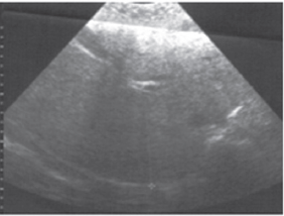
Case 4
Hepatic US report:
Fatty liver (Grade III)

Slide 40
Case 4
Laboratory:
FBS: 91 mg/dL
ALT: 49 U/L (two times, 6 months apart)
AST: 50 U/L (two times, 6 months apart)
Total bilirubin: 0.6 mg/dL
Alkaline phosphatase: 88 IU/L (RR: 60-300 IU/L)
Serum albumin: 3.9 g/dL
Total cholesterol: 276 mg/dL (LDL-C:193 mg/dL; HDL-C: 61 mg/dL)
Triglyceride: 109 mg/dL
Negative viral markers.
Normal CBC, thyrotropin and iron studies.

Slide 41
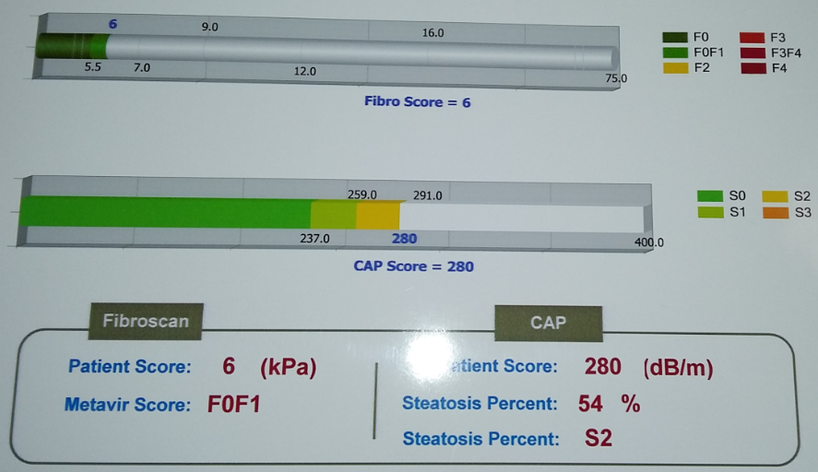
Fibroscan Report

Slide 42
Case 4
Which of the following items do you suggest?
Lifestyle modification
Liver biopsy
Atorvastatin
A and C

Slide 43
Case 4
Most lean persons with NAFLD display insulin resistance and altered body fat distribution even though they have less severe metabolic disturbance than overweight NAFLD. Follow-up is nonetheless required because of possible disease progression.
(EASL/EASD/EASO 2016 weak recommendation, Evidence-B)
Diabetologia 2016; 59:1121-1140
Journal of Hepatology
Obesity Facts

Slide 44
Case 4
Given the lack of evidence to show that patients with NAFLD and NASH are at increased risk for serious drug-induced liver injury from statins, statins can be used to treat dyslipidemia in patients with NAFLD and NASH.
(AASLD/ACG/AGA 2012 strong recommendation, Evidence-B)
Chalasani N, et al. Hepatology 2012; 55(6):2005-2023

Slide 45
Case 4
Statins may be confidently used to reduce LDL cholesterol and prevent cardiovascular risk, with no benefits or harm on liver disease.
(EASL/EASD/EASO 2016 strong recommendation, Evidence-B)
Diabetologia 2016; 59:1121-1140
Journal of Hepatology
Obesity Facts

Slide 46
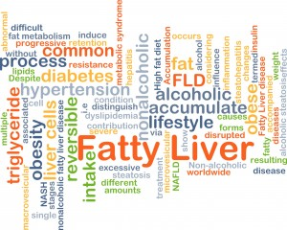
Thanks for your attention!

