Slide 1
بنام خدا
انسولین درمانی
دکتر اکبر - علی عسگرزاده منخصص داخلی - فوق تخصص غدد و متابولیسم استادبخش غدد- گروه داخلی
دانشکده پزشکی- دانشگاه علوم پزشکی تبریز
مرکز آموزشی - درمانی و تحقیقاتی امام رضا
اصول مراقبت و کنترل دیابت و درمان های نوین دیابت
سومین دوره بازآموزی منطقه‌ای
2-4 مرداد 1398، تبریز
انجمن متخصصین غدد درون‌ریز ایران، انجمن دیابت ایران

Slide 2
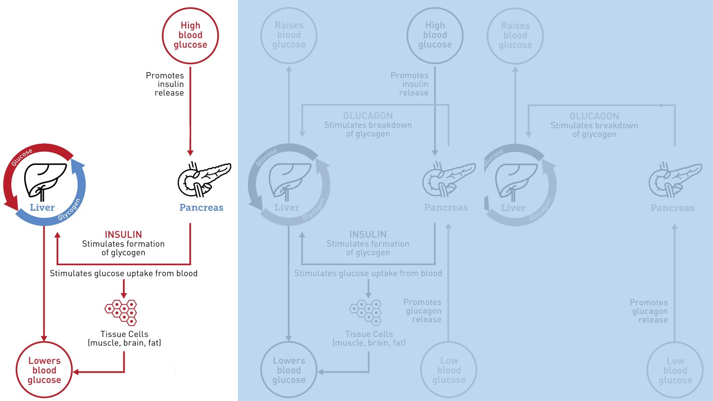

Slide 3
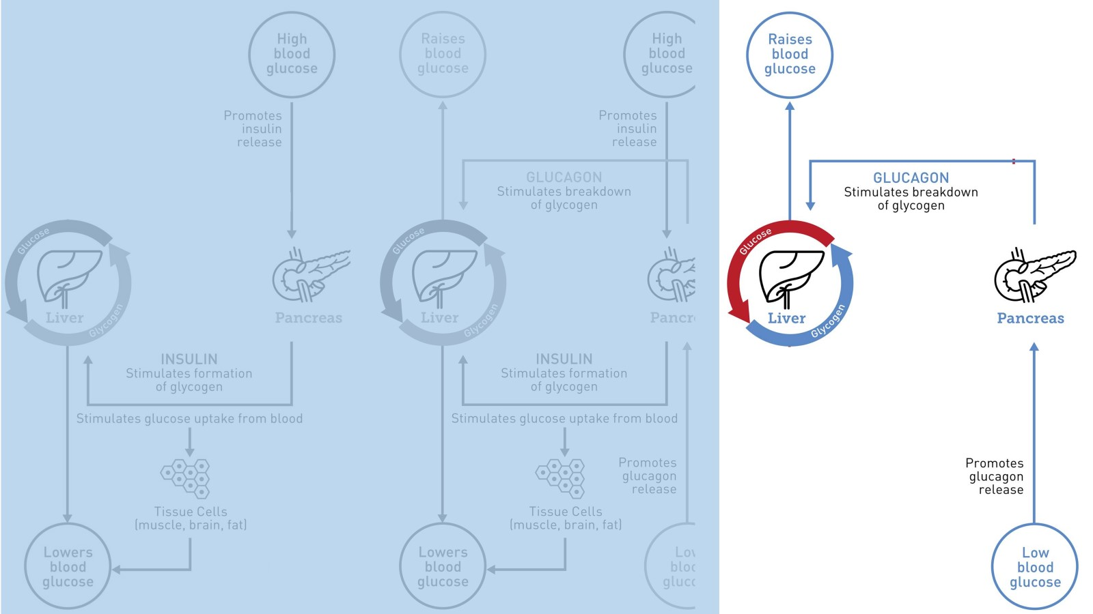

Slide 4
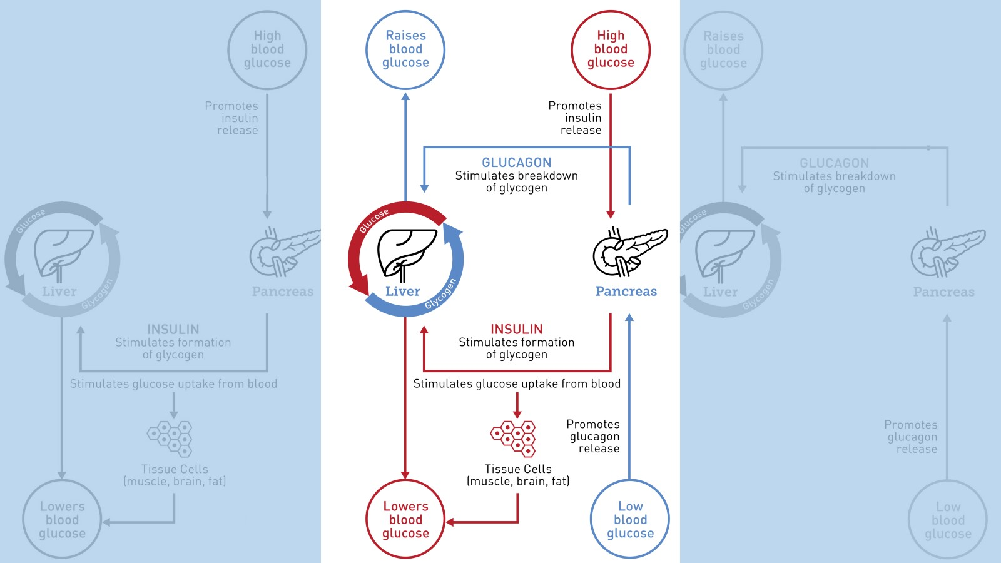

Slide 5
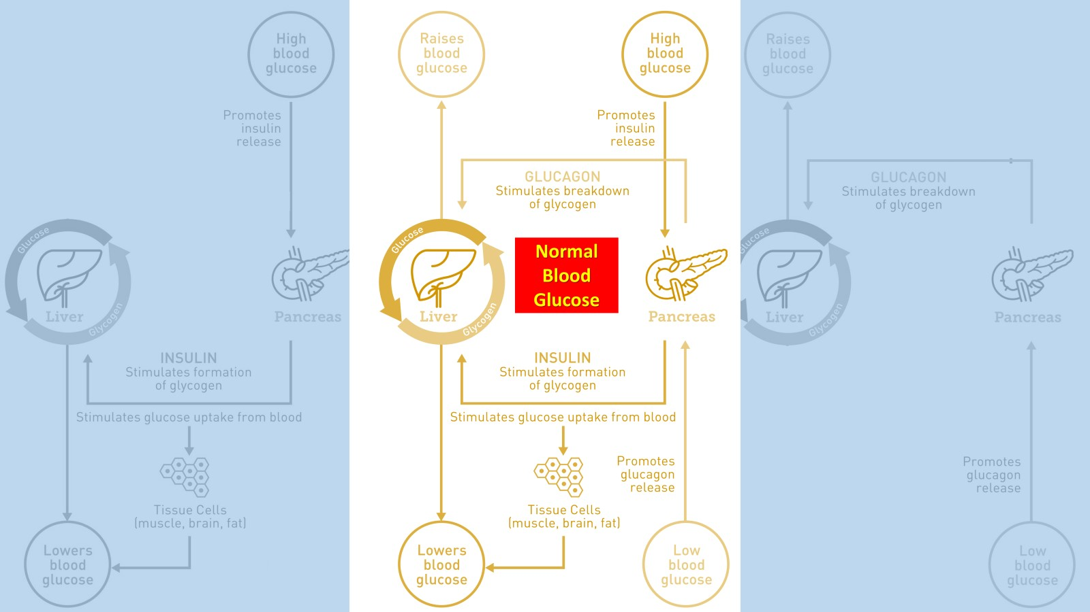

Slide 8
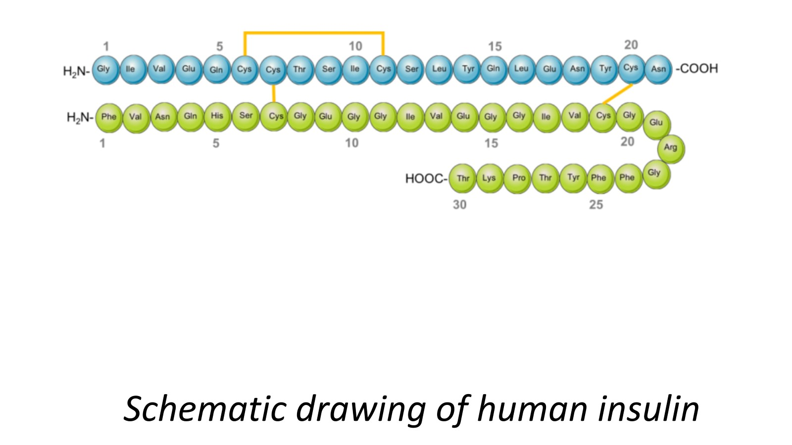

Slide 9
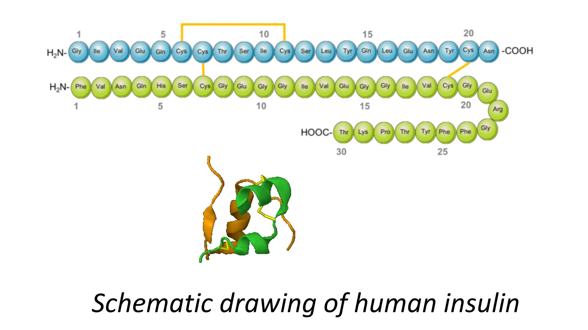

Slide 17
Brief 100 year history of Insulin
1890 von Merring and Minkowski study the efrect of pancreatectomy on dogs and identify the link between the pancreas and diabetes
Lente family of long acting insulins introduced
Non-injectable insulin formulations
Longer acting insulin formulations based on protamine and/or zinc are developed (e. g. PZI)
1898: Zuelzer and others administer pancreatic extracts with severe side effects
1959: Sanger discovers the primary sequence of bovine insulin
1996: First human Insulin analogue, insulin lispro
2000: First long-acting insulin analogue, insulin glargine
1890s
1920s
1930s
1940s
1950s
1960s
1970s
1990s
2000s
1921: Banting, Best, Collip, MacLeod discover Insulin
Neutral protamine Hagedorn insulin
First chemically synthesized human insulin
Development of insulin pump therapy
2004: insulin glulisine approved for clinical use
1978: First recombinant human insulin
2004: Insulin detemir launched on the market
1922: First therapeutic use of regular human insulin on 14 year old Leonard Thompson, Toronto General Hospital, Canada
2011: Insulin degludec in phase III clinical trials

Slide 19
The Discovery of Insulin (Toronto 1921)

Slide 20
The Miracle of Insulin

Slide 25
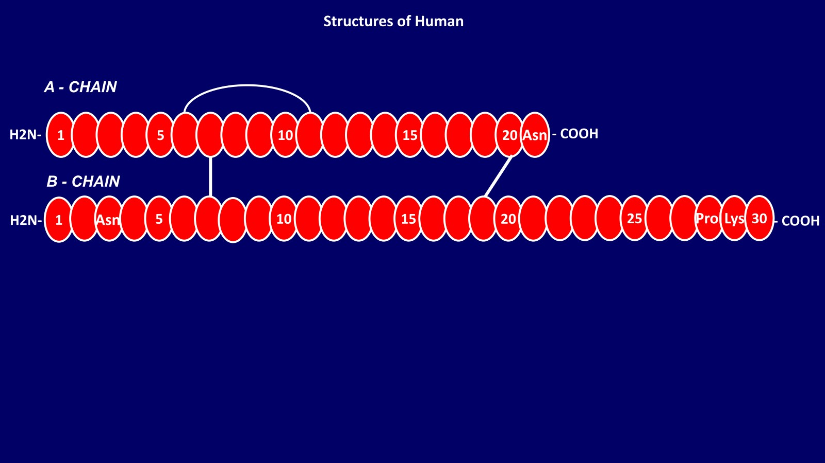

Slide 26
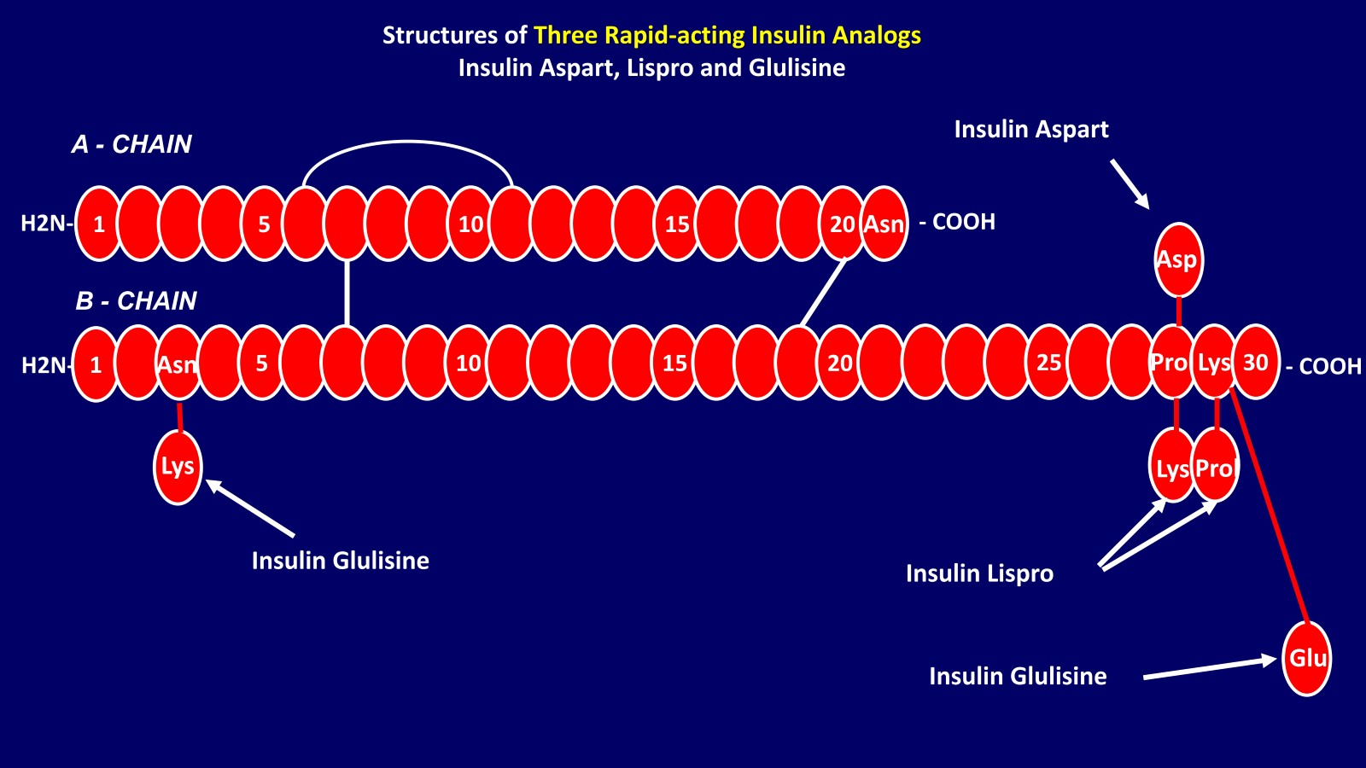

Slide 28
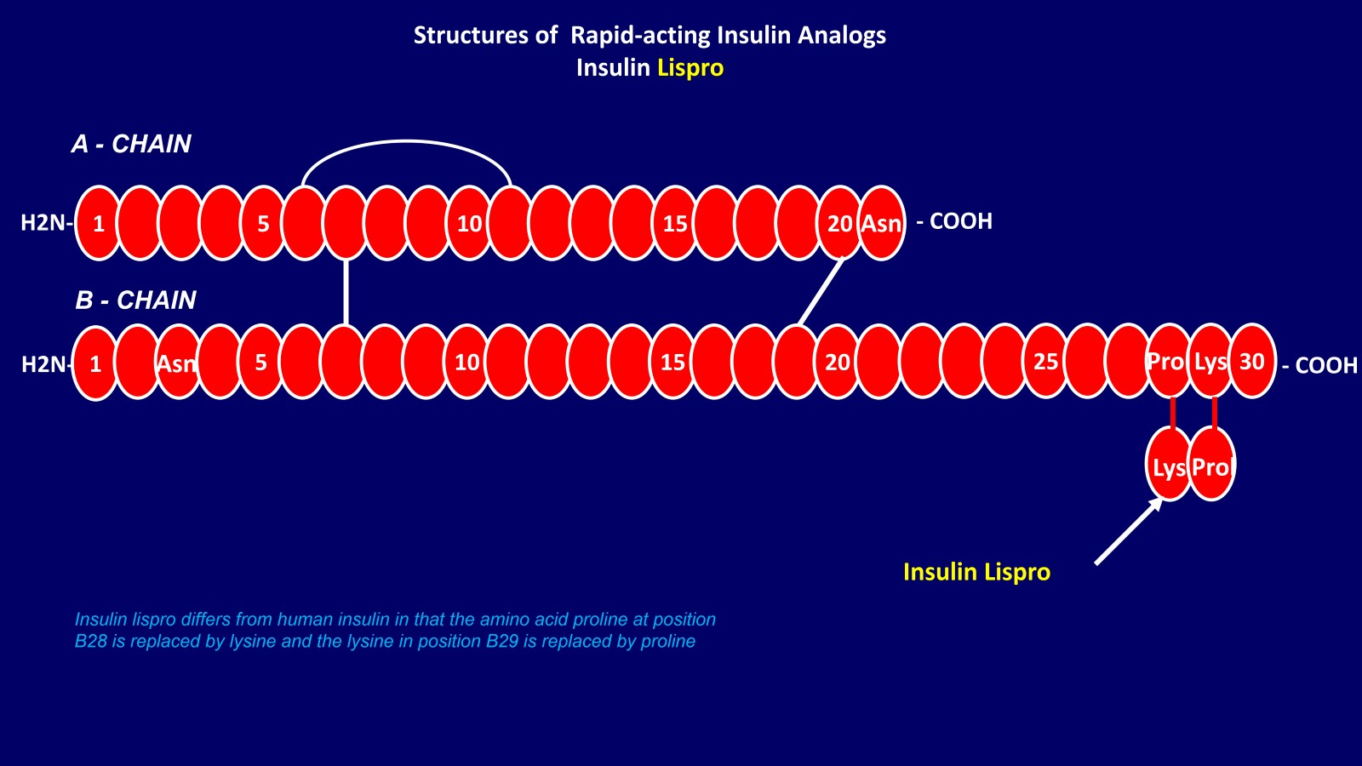

Slide 35
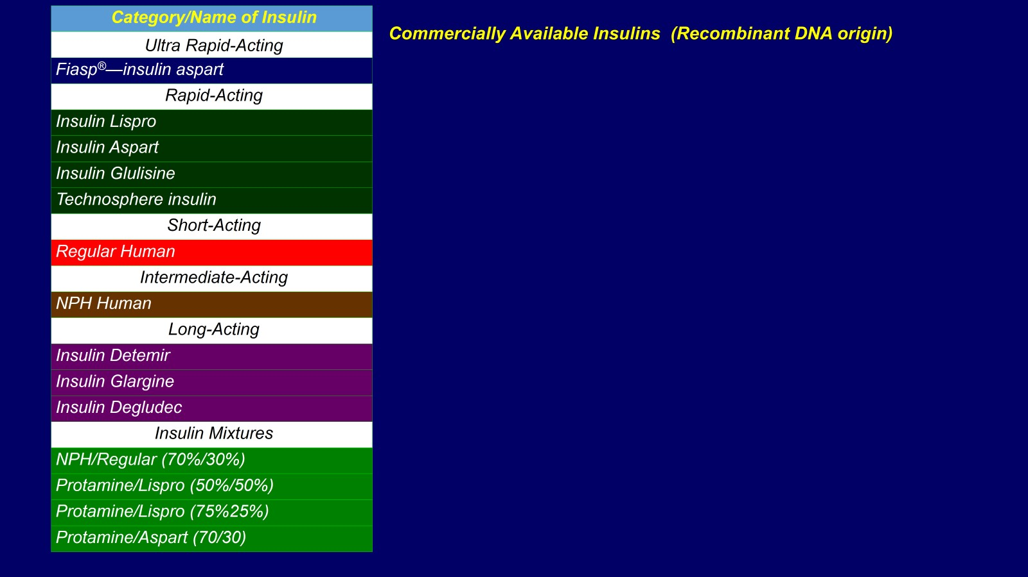

Slide 36
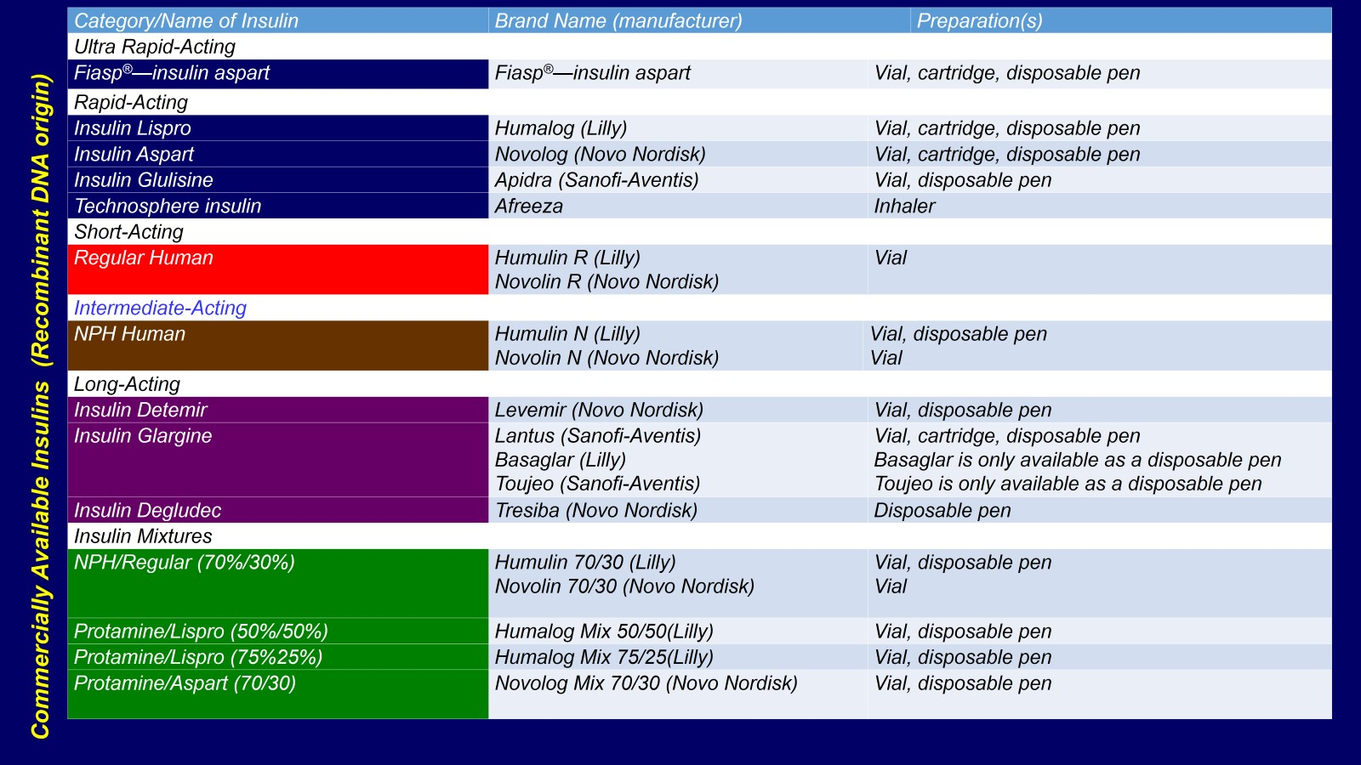

Slide 37
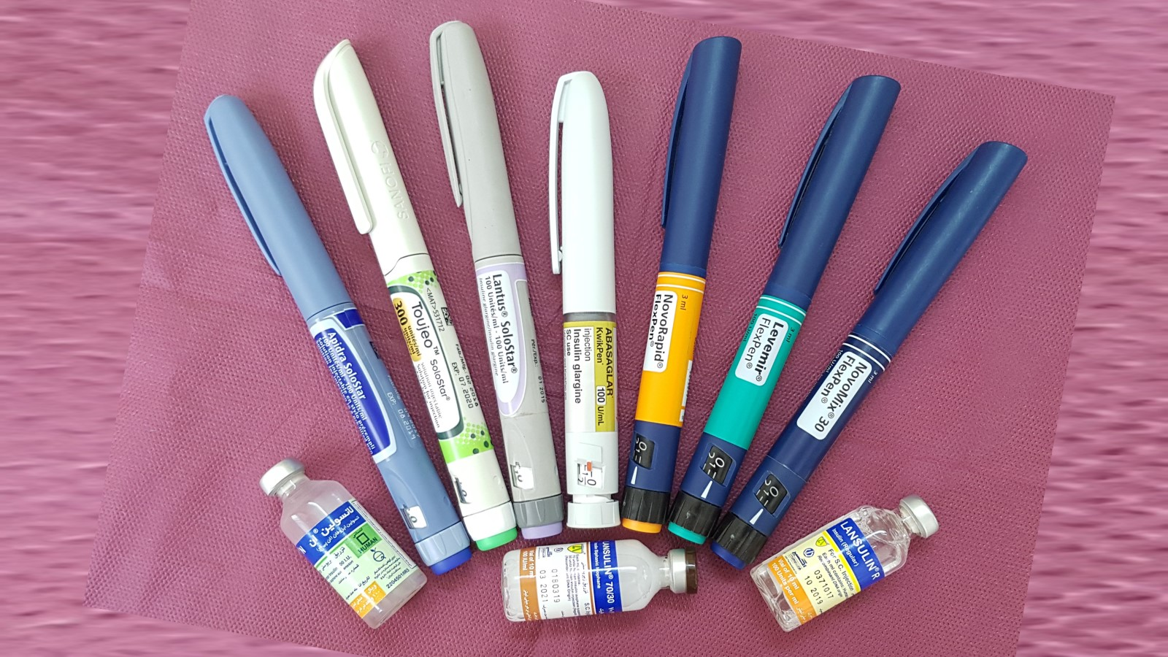

Slide 38
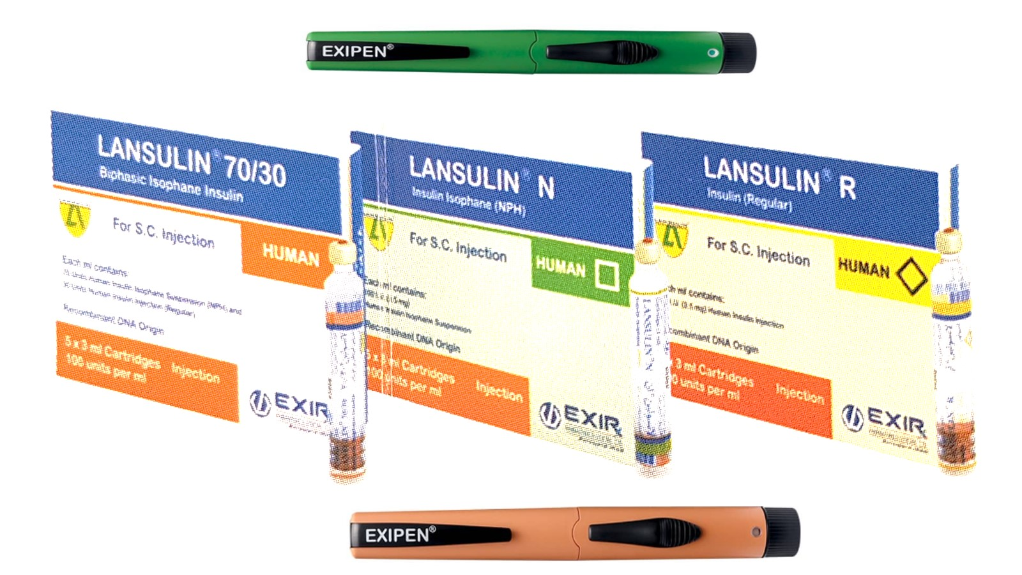

Slide 39
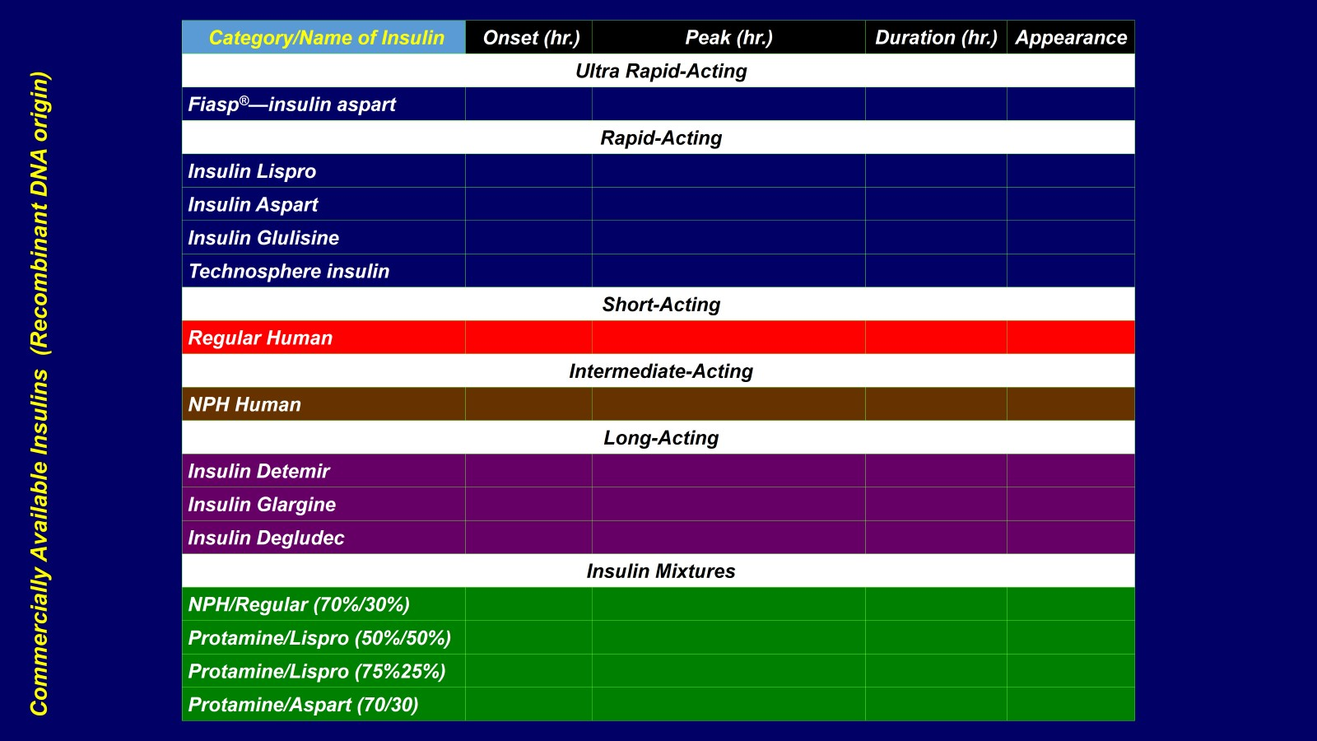

Slide 40
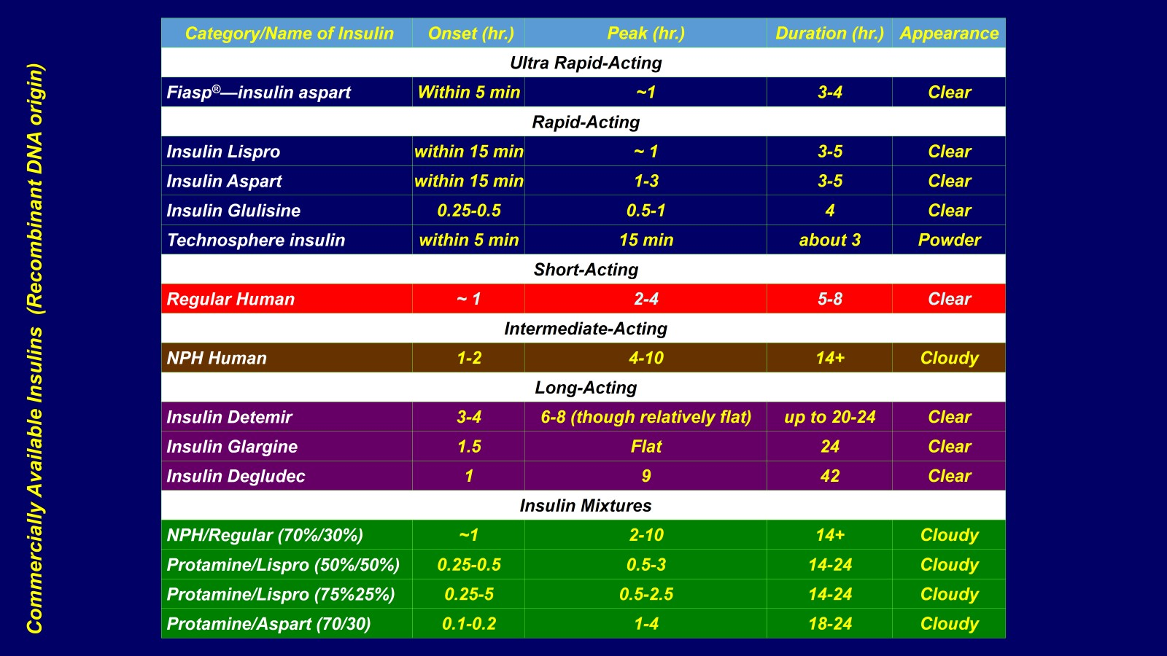

Slide 41
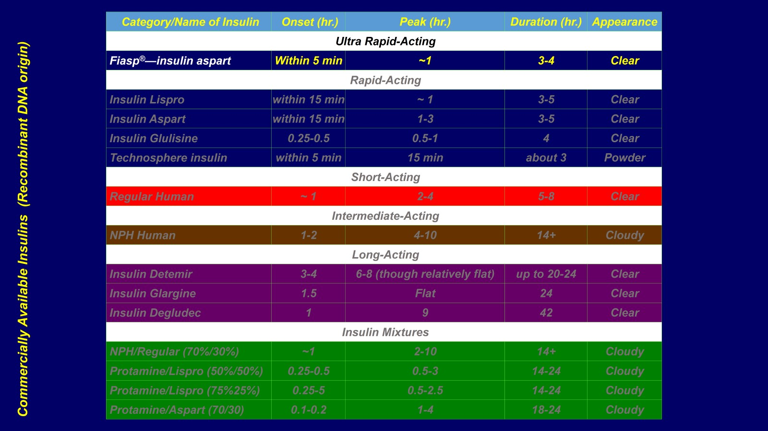

Slide 42
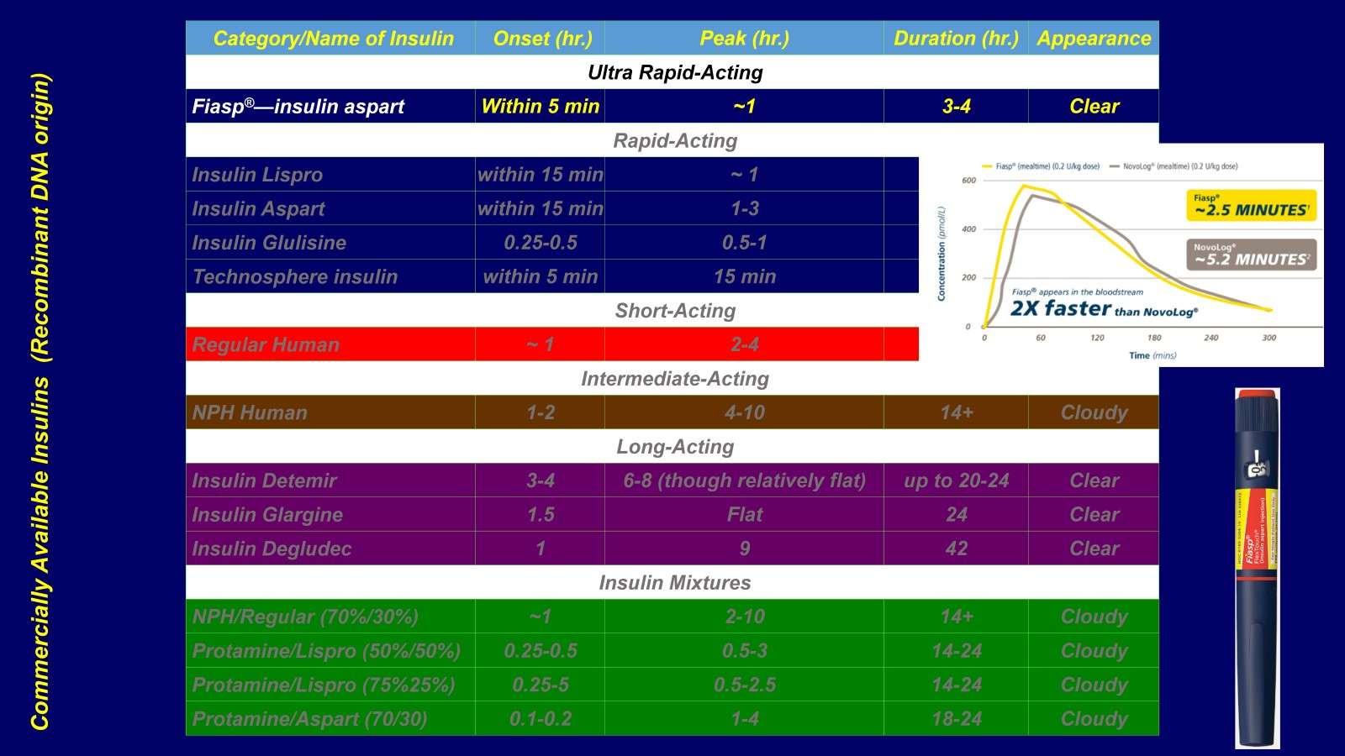

Slide 44
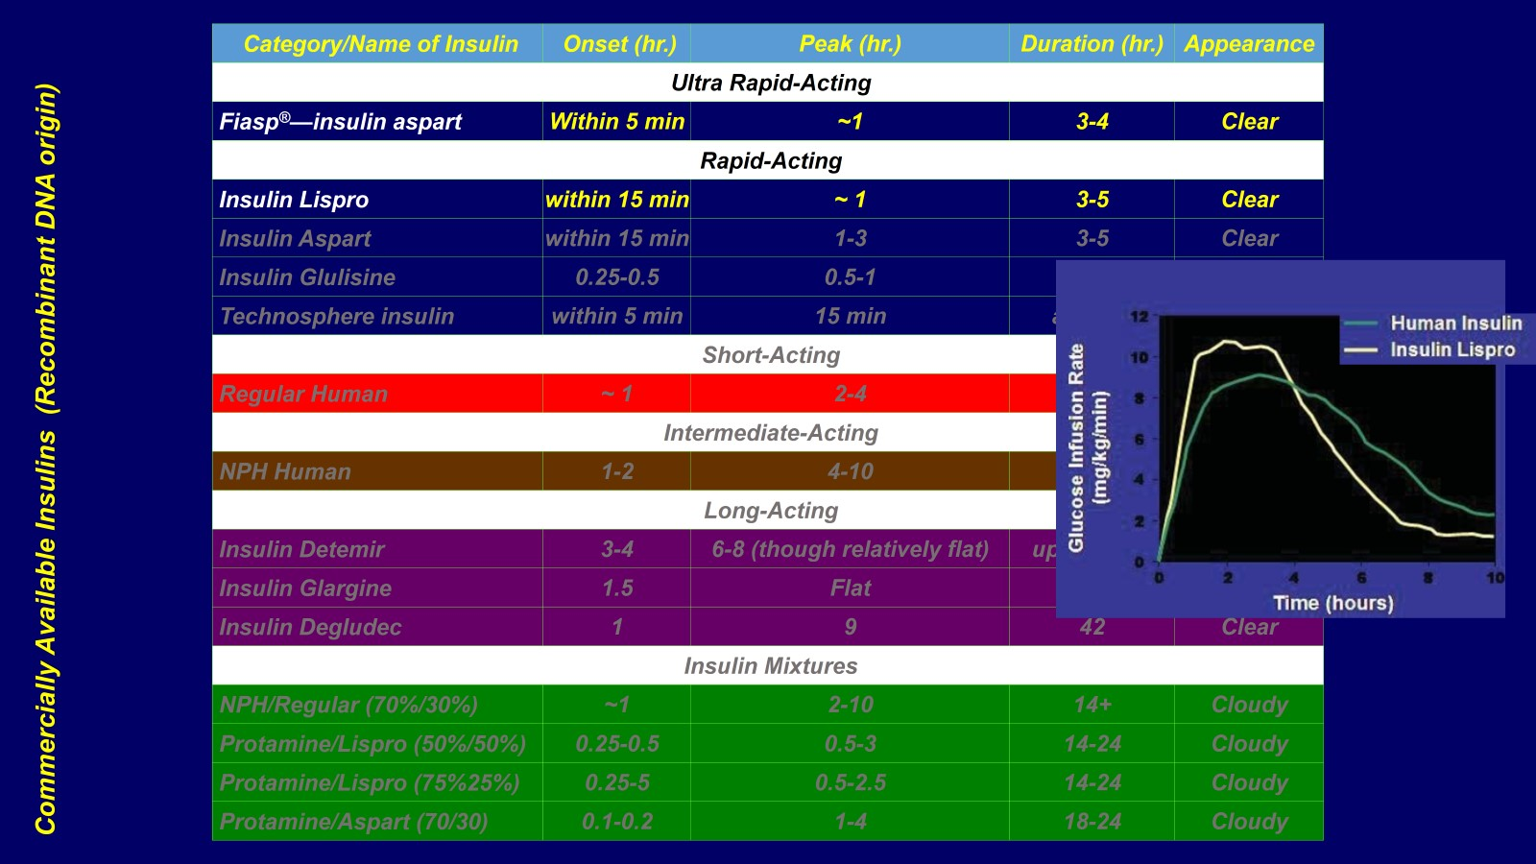

Slide 45
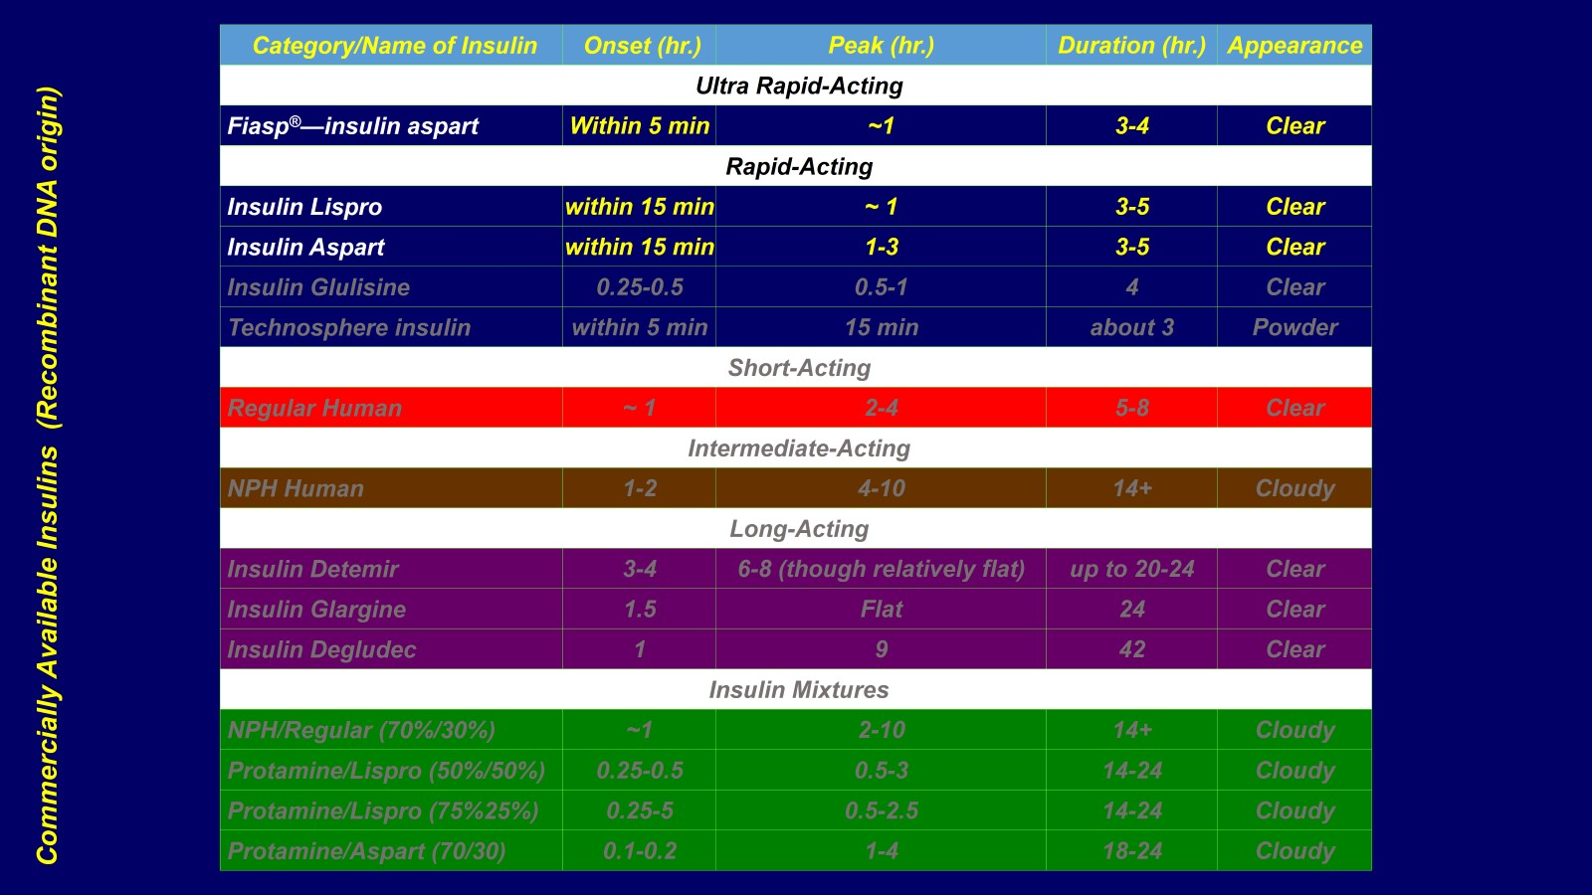

Slide 47
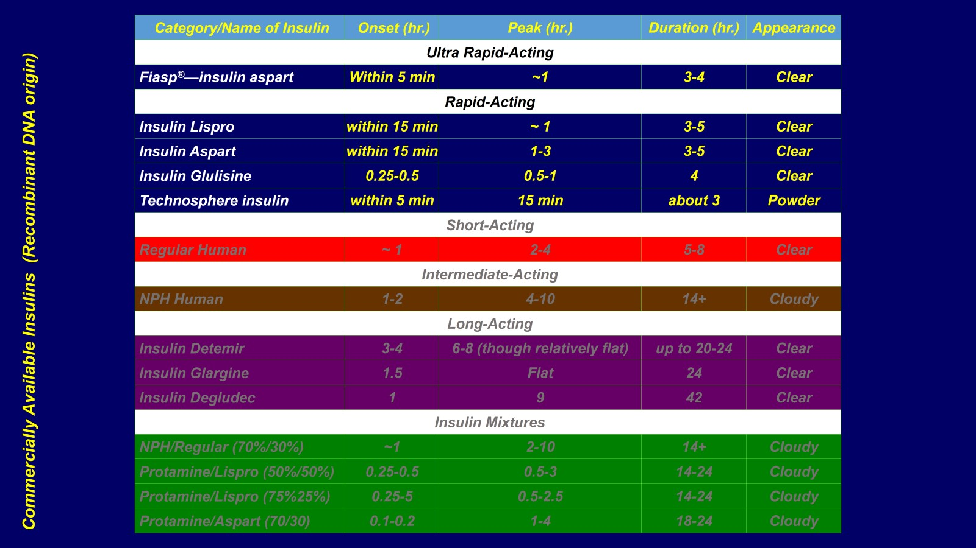

Slide 51
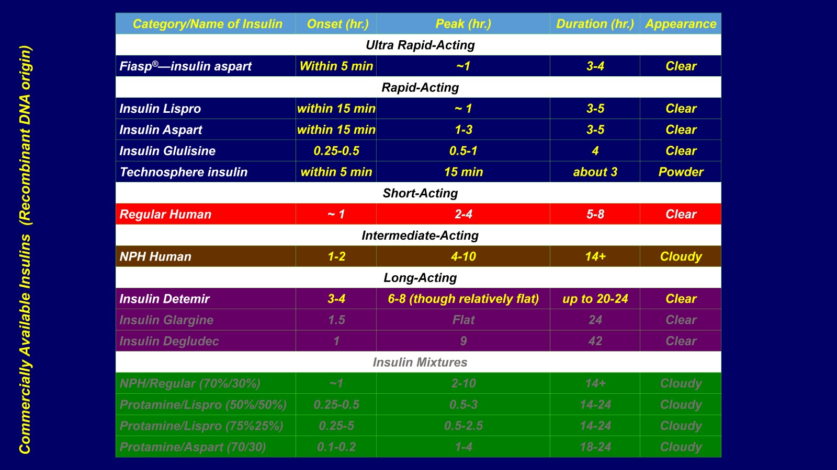

Slide 53
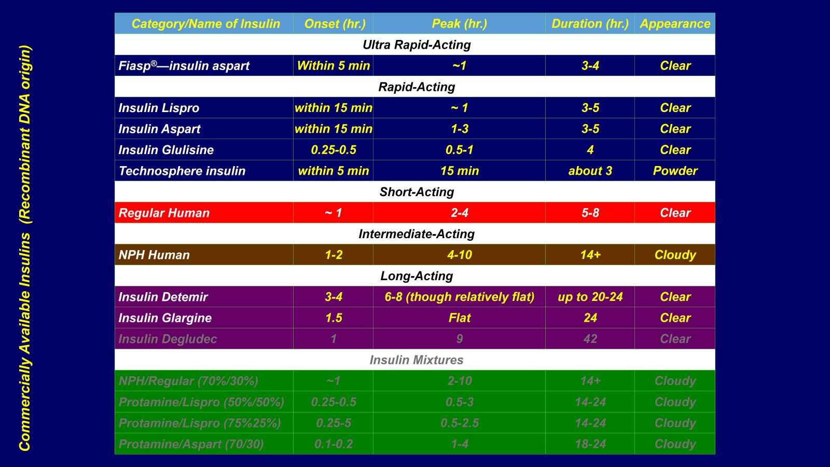

Slide 55
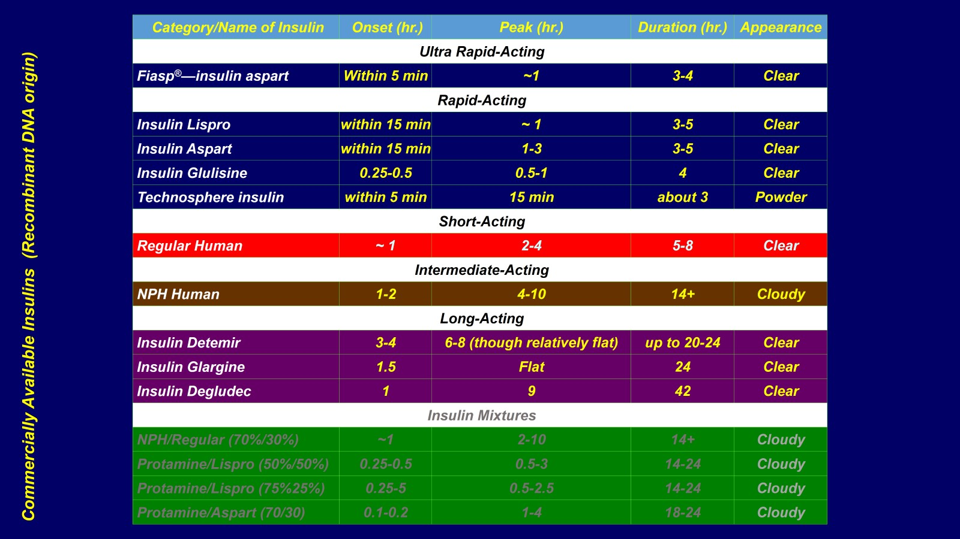

Slide 72
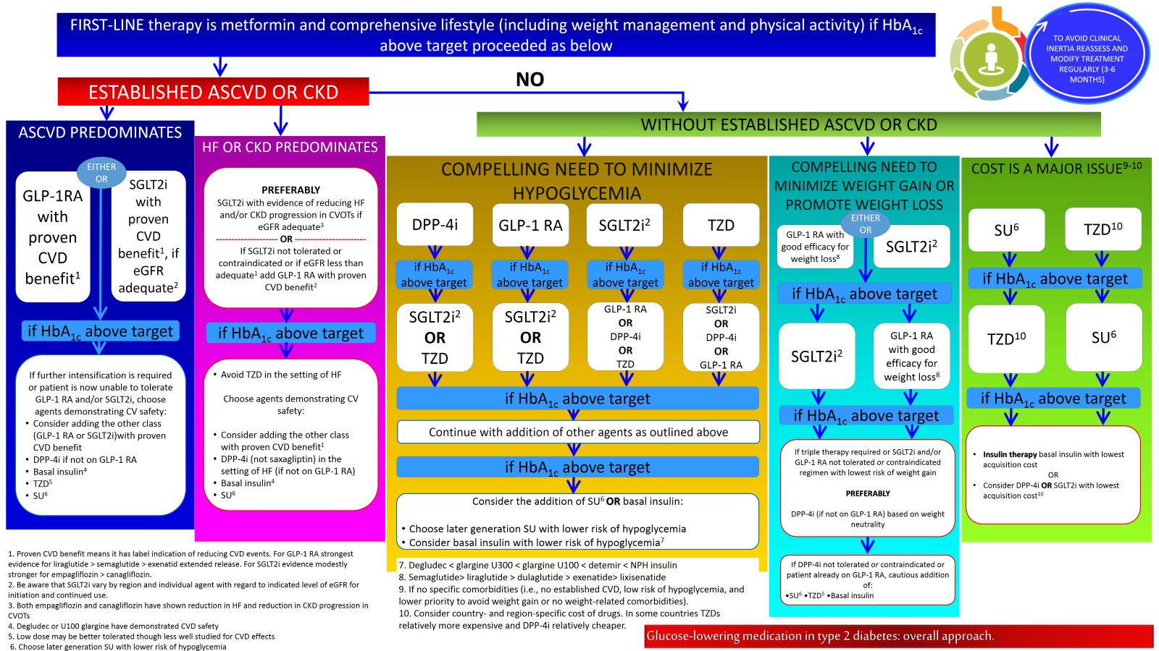

Slide 75
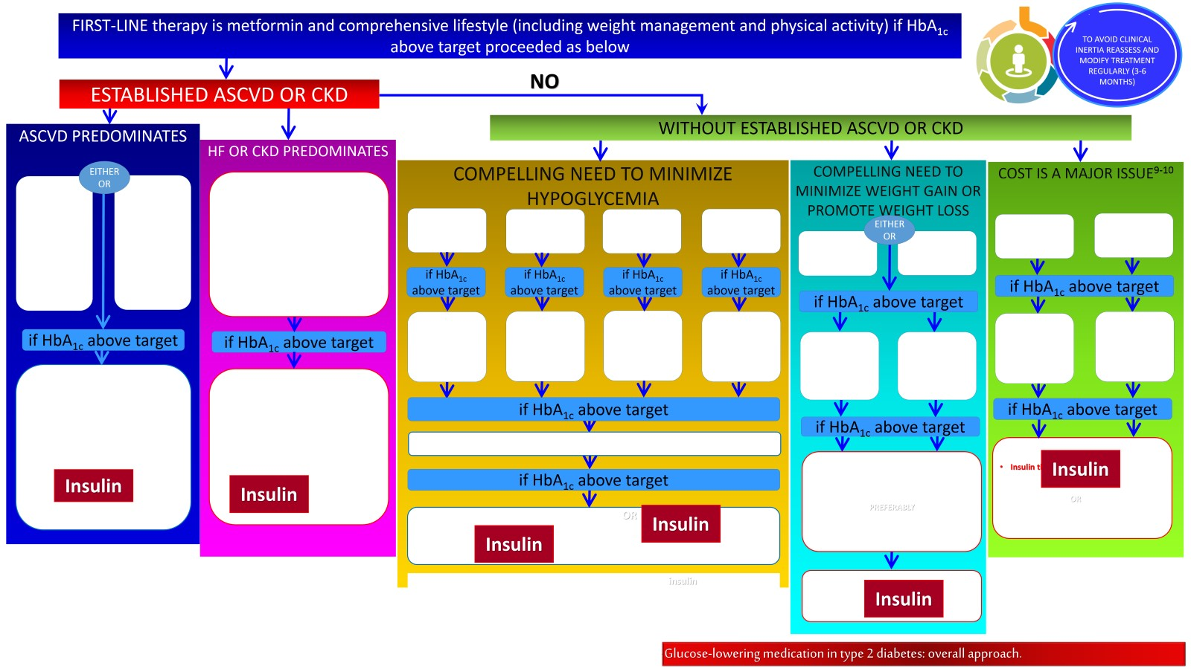

Slide 86
