Slide 1
Outcome of Liver Transplant in Diabetic Patients in Shiraz Transplant Center
IN THE NAME of GOD
Rahmani P. Jeddi M. Moini M. Ranjbar Omrani Gh.
Presented by: Dr Marjan Jeddi
Endocrinology and Metabolism Research Center,
Shiraz University of Medical Sciences, Shiraz, IRAN

Slide 2
INTRODUCTION
Liver transplantation is widely accepted as an effective therapeutic modality for acute and chronic liver failure
Complications are common in the early and long term period and contribute to significant morbidity and mortality

Slide 3
PLTDM
One of the most frequent complications after liver transplantation is the development new onset DM after transplant (NODAT)
In addition to all the well-known complications of DM, NODAT is associated with reduced graft function, increased risk of transplant loss, increased incidence of infectious complications, and worsened patient survival

Slide 4
Outcome
Several studies have examined the influence of preexisting DM on the outcome of liver transplantation, and the recent studies, with relative large samples and good design, had the consensus that patients with DM were associated with a marked higher post-transplant morbidity and mortality than those without DM
But some other studies demonstrated that NODAT did not have any adverse consequence on patient prognosis after liver transplantation

Slide 5
The Aim
The aim of this study is evaluation of post-transplant complication and comparing it in diabetic (pre existing DM or NODAT) and non-diabetic patients in Shiraz liver transplant center

Slide 6
Subjects
Subjects of this retrospective study were liver transplanted patients in Shiraz Transplant Center from 2006 till 2010
Based on history and two fasting blood glucose level measured after transplant (in first and second visits) and ADA criteria, the patients divided into four groups: non diabetic, pre diabetic, new onset diabetes after transplant, and pre transplant diabetes

Slide 7
Method
Complications such as of Infections, cardiovascular, musculoskeletal, and biliary complications, rejection, and death was assessed in each group, based on chart review and call with the patients.

Slide 8
Results (Demographic)
In this study 603 transplanted subjects aged 54.8±15.5 years old were evaluated. Of this population, 389 (64.8%) were male and 211 (35.2%) were female. Years from transplant was 6-11 years (mean: 8.4 years).

Slide 9
Results (cause of cirrhosis)
The most common causes of cirrhosis were
HBS:19.6%
Cryptogenic:19.1%
Autoimmune hepatitis:18.5%
Primary sclerosing cholangitis:11.5%
Wilson: 8.5%
Other causes: less than 4%

Slide 10
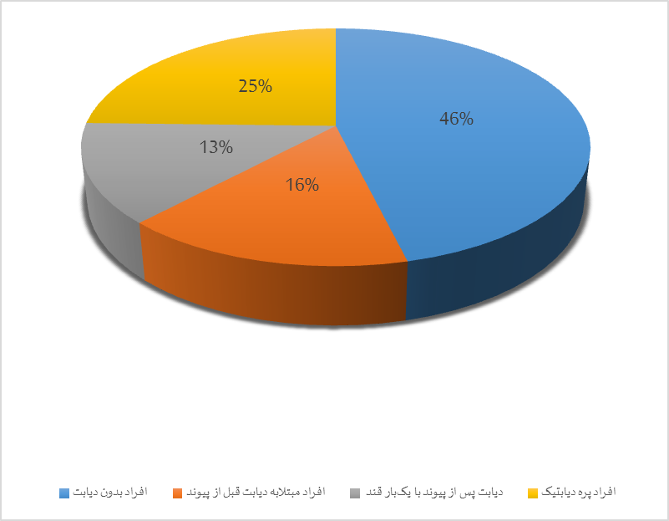
Results (DM)
Of total 603 patients, 259 (46.1%) was non diabetic, 88 (15.7%) had DM before transplant, 77 (13.6%) were been known as post-transplant DM and 138 (24.6%) as post-transplant pre diabetes

Slide 11
Results (complications)
Of these patients, 3% had myocardial infarction, 3% congestive heart failure, 4.3% infection, 2.2% musculoskeletal complications, 8.6% mild rejection, 4.2% moderate rejection, 4.5% severe form of rejection, and 30.3% were dead
Rate of complication was not different between diabetic and non-diabetic patients (p>0.05)

Slide 12
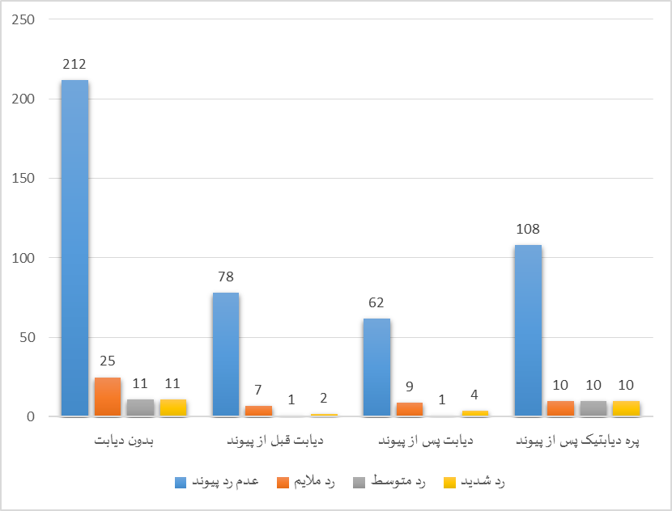
Variable Stages of Rejection in Diabetic versus non Diabetic Recipients
P=0.22

Slide 13
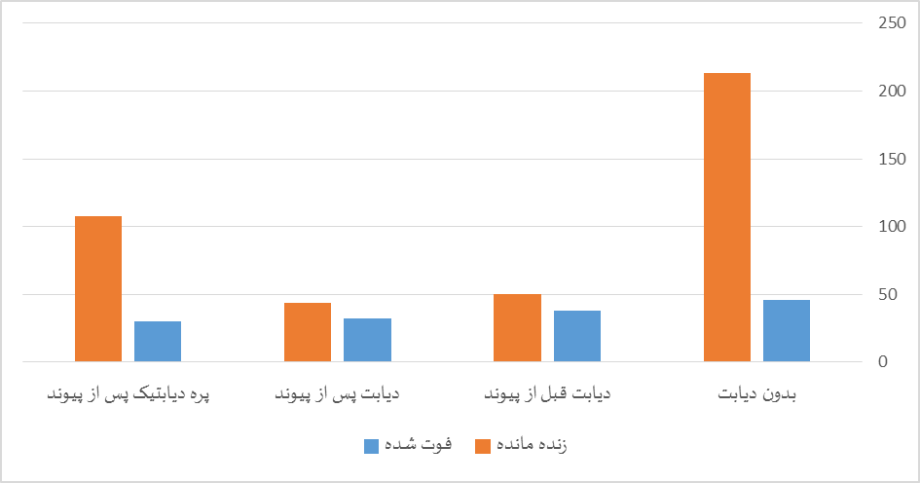
Mortality Rate in Diabetic versus non Diabetic Recipients
death was greater in diabetic patients (69.9% versus 30.1%) (P<0.001) and the larger number of death was in pre transplant diabetic patients than in NODAT patients (P=0.001)

Slide 14
Discussion
Long term outcomes after liver transplantation are the true new frontier in this ever-evolving field
Diabetes in liver transplant recipients has serious adverse consequences and may require multiple therapies to achieve glycemic control, Patients are at heightened risk of death and infection and possibly at increased risk of graft loss

Slide 15
Discussion (cont)
Patients considered to be at high risk for NODAT should be given the least diabetogenic immunosuppressive regimen compatible with effective prevention of rejection, notably by limiting corticosteroid exposure
In diabetic individuals, modification of immunosuppression should be considered, and every effort should be made by a judicious use of antidiabetic drugs coupled to lifestyle modifications to pursue tight glycemic control in liver transplant patients with diabetes

Slide 16
Conclusion
This retrospective study showed greater mortality in diabetic transplanted patients especially in those with overt pre transplant DM
Prospective studies are needed to properly define prevalence, risk factors and impact of NODAT on recipients

