Slide 2
Prosthetic choice for Lap hernia repair
Z.Zarghamifard
Fellowship of MIS

Slide 3
Mesh based hernia repair
Safe
Effective
Less pain
Decreased recurrence
Gold standard

Slide 4
Ideal mesh
Inert
Good strength
Not allergen
Avoid infection
Easy handling
Resist contracture
Simple & inexpensive

Slide 5
prosthesis
Synthetic
Non-synthetic:
Biologic
Human tissue
Useful in infected site
High recurrence
Names: Alloderm, Surgisis

Slide 6
Synthetic Prosthesis
Mesh :
Polypropylene & Polyester
Fibroblast ingrowth
Collagen deposition
Long term fixation
Sheet (membrane):
e-PTFE (Gore-Tex)
No fibrous response
Less adhesion
For intraperitoneal use

Slide 7
Polypropylene mesh
Synthetic nonabsorbable
Hydrophobic
Electrostatically neutral
Permanent
Most popular
Brands:
monofilament
Prolene (ethicone)
Prolite (covedien)
Marlex
Polyfilament : Surgipro

Slide 8
Polyester meshes
Parietex (Covedien)
Mersilene (Ethicone)
Inflammation & contracture as PP meshes

Slide 9
New meshes
Vypro & Vypro II (Ethicon):
Light weight /Large pores
Compose of multifilament PP + Vicryl
Ultrapro:
Light weight /Large pores (>3 mm)
Monofilament PP+ Monocryl
Lowest FBR
Optimized handling
Dual meshes:
Goretex + PP
PVDF + PP (new)
PVDF: polyvinylidenflourid

Slide 10
Complications of mesh
Minor (in %50):
Seroma
Discomfort & decreased abd wall mobility
Major (rare) :
Recurrence
pain:
Neuropathy / immediately after surg
Chronic pain/ 1 year later/due to FBR
Infection
Fistula
(FBR: foreign body reaction)

Slide 11
Light weight with large pores (>1mm) meshes
are better than heavy weight with
small pores (<1mm) meshes

Slide 12
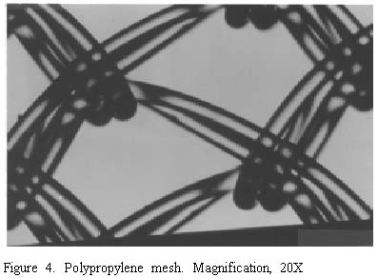
Advantagas of light weight meshes
Decreased restriction of Abd mobility:
Flexible & elasticity like Abd wall
Appropriate tensile strength
less surface area in contact with host tissue:
Decreased foreign body reaction
Equivalent recurrence
Less shrinkage(probably):
Less fibrotic scar around mesh
No fibrotic bridging in pores
Similar infection
Good handling

Slide 13
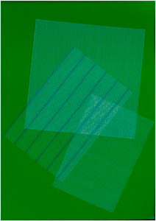
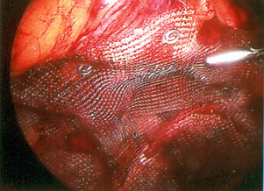
Generations of meshes
First :
heavy weight small porous meshes
Second :
light weight large porous meshes
In the future :
light weight large porous meshes

Slide 14
Fixation of mesh

Slide 15
Aims of fixation
Prevent migration or rollup
Prevent shrinkage

Slide 16
Fixation or no fixation in TEP
New pain in 23% of pt with fixation
No difference in recurrence after 6 month

Slide 17
Fixation
Staples (10 mm port)
Tacks :
5 mm port
Counter pressure is needed
Fibrin glue:
Less chronic pain
Equivalent recurrence
Absorbable tacks
Full thickness sutures

Slide 18
THANKS

