Slide 1
Excluding other related diseases for making a precise diagnosis of PCOS: What does it mean in real practice?
Hengameh Abdi
Endocrine Research Center
Research Institute for Endocrine sciences
Shahid Beheshti University of Medical Sciences
15 November 2018

Slide 2
Outlines
Background
Overview of related statements from international societies
In women suspected to have PCOS, to exclude other disorders:
Which investigations should be done in all women?
Which investigations should be done in selected women?
Conclusions

Slide 3
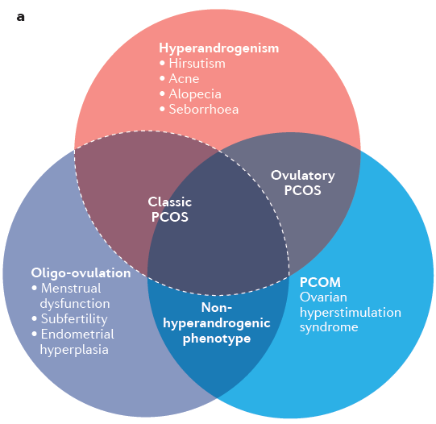
The heterogeneous nature of PCOS
Escobar-Morreale HF. Nat. Rev. Endocrinol 2018;14(5):270-284.

Slide 4
We suggest that the diagnosis of PCOS be made if two of the three following criteria are met: androgen excess, ovulatory dysfunction, or polycystic ovaries (PCO), whereas disorders that mimic the clinical features of PCOS are excluded.
These include, in all women: thyroid disease, hyperprolactinemia, and nonclassic congenital adrenal hyperplasia (primarily 21-hydroxylase deficiency by serum 17-hydroxyprogesterone [17-OHP]). In select women with amenorrhea and more severe phenotypes, we suggest more extensive evaluation excluding other causes.
J Clin Endocrinol Metab 2013;98:4565-4592.

Slide 5
Eur J Endocrinol 2014;171(4):1-29.
Endocr Pract 2015;21(11):1291-1300.
Hum Reprod 2018;33(9):1602-1618.

Slide 6
Diagnosis after exclusion of:
Other causes of chronic anovulation:
Thyroid disorders
Hyperprolactinemia
Pregnancy
Hypothalamic amenorrhea
Primary ovarian insufficiency
Other causes of androgen excess:
Nonclassical congenital adrenal hyperplasia
Idiopathic hirsutism/Idiopathic hyperandrogenism
Androgen-secreting tumor
Severe insulin resistance syndromes
Cushing syndrome
Acromegaly

Slide 7
Diagnosis after exclusion of:
Other causes of chronic anovulation:
Thyroid disorders
Hyperprolactinemia
Pregnancy
Hypothalamic amenorrhea
Primary ovarian insufficiency
Other causes of androgen excess:
Nonclassical congenital adrenal hyperplasia
Idiopathic hirsutism/Idiopathic hyperandrogenism
Androgen-secreting tumor
Severe insulin resistance syndromes
Cushing syndrome
Acromegaly

Slide 8
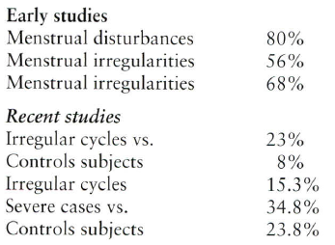
Menstrual disturbances associated with hypothyroidism
Krassas GE, et al. Werner & Ingbar's The Thyroid 10th ed 2013;457-467.

Slide 9
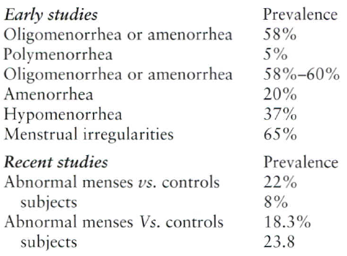
Menstrual disturbances associated with thyrotoxicosis
Krassas GE, et al. Werner & Ingbar's The Thyroid 10th ed 2013;457-467.

Slide 10
Diagnosis after exclusion of:
Other causes of chronic anovulation:
Thyroid disorders
Hyperprolactinemia
Pregnancy
Hypothalamic amenorrhea
Primary ovarian insufficiency
Other causes of androgen excess:
Nonclassical congenital adrenal hyperplasia
Idiopathic hirsutism/Idiopathic hyperandrogenism
Androgen-secreting tumor
Severe insulin resistance syndromes
Cushing syndrome
Acromegaly

Slide 11
Hyperprolactinemia
Menstrual dysfunction
Hyperprolactinemia is one of the most common causes of secondary amenorrhea.
Increased adrenal androgen production
Associations of PCOS and hyperprolactinemia: Conflicting data

Slide 12
Diagnosis after exclusion of:
Other causes of chronic anovulation:
Thyroid disorders
Hyperprolactinemia
Pregnancy
Hypothalamic amenorrhea
Primary ovarian insufficiency
Other causes of androgen excess:
Nonclassical congenital adrenal hyperplasia
Idiopathic hirsutism/Idiopathic hyperandrogenism
Androgen-secreting tumor
Severe insulin resistance syndromes
Cushing syndrome
Acromegaly

Slide 13
Nonclassical congenital adrenal hyperplasia (CAH)
Presentations are very much like those with PCOS.
Endocrine Society:
Routine screening of all women with early-morning follicular phase serum 17(OH)-progesterone.
Some other authorities:
Case-finding only in women with a pre- or perimenarcheal onset of hirsutism, a family history of CAH, or high-risk ethnicity (Hispanic, Mediterranean, Slavic, Ashkenazi Jewish, or Yupic Eskimo heritage).
Legro RS, et al. J Clin Endocrinol Metab 2013;98:4565-4592.
Fritz MA & Speroff L.Clinical Gynecologic Endocrinology and Infertility 8th ed 2011;495-531.

Slide 14
Nonclassical congenital adrenal hyperplasia (CAH)
Early-morning follicular phase serum 17(OH)-progesterone:
< 200 ng/dL excludes nonclassical CAH.
> 800-1000 ng/dL establishes nonclassical CAH.
200-800 ng/dL suggests the possibility of nonclassical CAH and a confirmatory test by ACTH stimulation test is needed:
One-hour post 250 µg ACTH IV injection serum 17(OH)-progesterone should increase to > 1000 ng/dL.
Legro RS, et al. J Clin Endocrinol Metab 2013;98:4565-4592.
Fritz MA & Speroff L.Clinical Gynecologic Endocrinology and Infertility 8th ed 2011;495-531.

Slide 15
Diagnosis after exclusion of:
Other causes of chronic anovulation:
Thyroid disorders
Hyperprolactinemia
Pregnancy
Hypothalamic amenorrhea
Primary ovarian insufficiency
Other causes of androgen excess:
Nonclassical congenital adrenal hyperplasia
Idiopathic hirsutism/Idiopathic hyperandrogenism
Androgen-secreting tumor
Severe insulin resistance syndromes
Cushing syndrome
Acromegaly
Clinical History and Physical Examination

Slide 16
Idiopathic hirsutism:
Hirsutism
Normal androgen concentrations
Normal ovulatory cycles
Normal ovarian morphology
Idiopathic hyperandrogenism:
Clinical hyperandrogenism
Biochemical hyperandrogenism
Regular ovulatory cycles of normal length
Normal ovarian morphology
Carmina E. Best Pract Res Clin Endocrinol Metab 2006; 20(2): 207-220.
Escobar-Morreale, et al. Hum Reprod Update 2012; 18(2): 146-170.

Slide 17
Androgen-secreting ovarian and adrenal tumors
Rare disorders.
They should be considered in the presence of severe or rapidly progressive hirsutism or symptoms or signs of virilization (deepening of the voice, temporal or male pattern balding, breast atrophy, increased muscle mass, and clitoromegaly).
They should be investigated by serum testosterone and DHEAS and appropriate imaging studies.
Legro RS, et al. J Clin Endocrinol Metab 2013;98:4565-4592.
Fritz MA & Speroff L.Clinical Gynecologic Endocrinology and Infertility 8th ed 2011;495-531.

Slide 18
Conclusions
PCOS, a heterogeneous disorder, is a diagnosis of exclusion.
To exclude other specific diagnoses, after a thorough history taking and physical examination, request the following laboratory:
Serum TSH
Serum prolactin
Serum 17(OH)-progesterone (?)
Other investigations should be reserved for selected women based on specific findings in clinical history and physical examinations.

