Slide 1
In The Name of GOD

Slide 2
History
A 33-year old woman with history of hyperthyroidism, presented with thyroid nodule.
Her symptoms showed up for the first time in her 15th , as she described with palpitation, anxiety, tremors, weight loss.
As she said (without documentation) she was diagnosed with hypothyroidism! And levothyroxine was prescribed.

Slide 3
History
For 1 yr. symptoms progressed and she lost about 20 kg, when she visited another physician and diagnosis of hyperthyroidism was made.
There is no documentation about type of hyperthyroidism.
She was treated with methimazole and propranolol for 6 month, then iodine was prescribed (dosage ?)

Slide 4
History
For 7 years she was drug free; then the symptoms relapsed although milder.
She describes that with diagnosis of hyperthyroidism relapse, she received iodine again after 8 month of methimazole and indral.
She reports at least 11 nodules in her thyroid ultrasound.
This time after 2 month of iodine therapy she became hypothyroid and levothyroxine was prescribed.
No FNA at this time

Slide 5
History
H.H: neg.
FH: neg. in first degree

Slide 6
P/E :
BP:130/80 PR:68/min
Wt: 68 kg Ht: 165 cm BMI: 24.9
Head & neck :
no sign of ophthalmopathy
hair loss : neg.
thyroid : nodule in both lobe is palpable.
Skin : no sign of dryness
Ext. : no tremor

Slide 7
Date | TSH | T4 | T3 | Medication
1393.4.21 | 0.15 | 16 | 300 | Methimazole 15 mg / Propranolol 20 mg
1393.6.25 | 0.5 | 5 | - | Methimazole 10 mg
1393.9.26 | 0.2 | 5 | - | Methimazole 5 mg
1394.1.18 | 0.15 | 11 | - | Methimazole 5 mg
1394.1.30 | - | - | - | 12 mci ¹³¹I / Methimazole 5 mg / Propranolol 10 mg
1394.3.31 | 42 | 2 | - | Levothyroxine 700 µg/wk
1394.6.2 | 4 | 11 | -
1394.11.20 | 18 | 11 | - | Levothyroxine 900 µg/wk
1398.7.17 | 1.14 | - | - | Levothyroxine 1000 µg/wk

Slide 8
Ultrasound 1398.2.29
Right lobe: A 10x7x9 mm well-defined hypoechoic nodule with peripheral and central vascularity and without calcification is seen at mid pole (TIRADS:IV)
Left lobe: A 9x6x8 mm well-defined, hypoechoic nodule with peripheral and central vascularity and without calcification is seen at lower pole (TIRADS:IV)

Slide 9
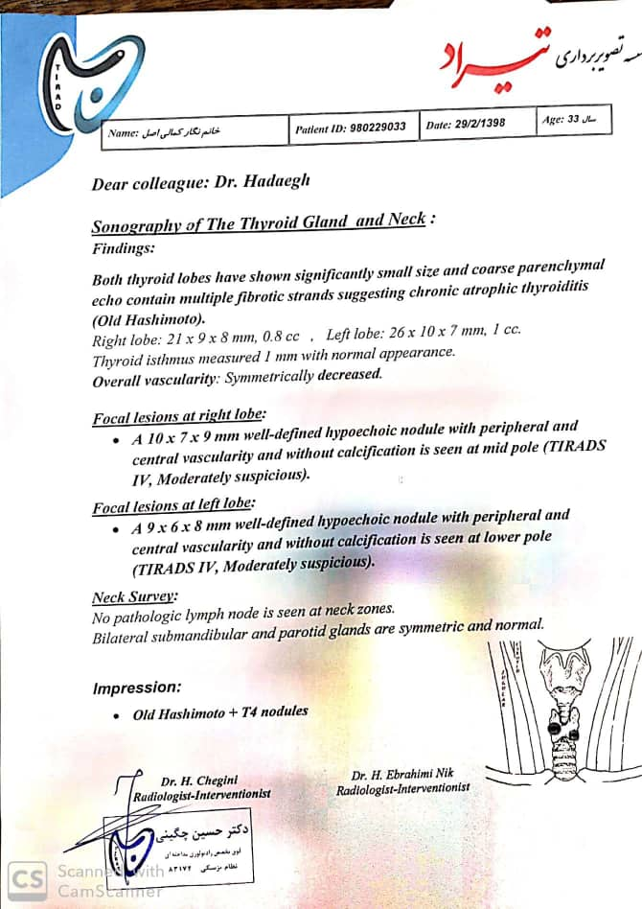
Slide Title

Slide 11
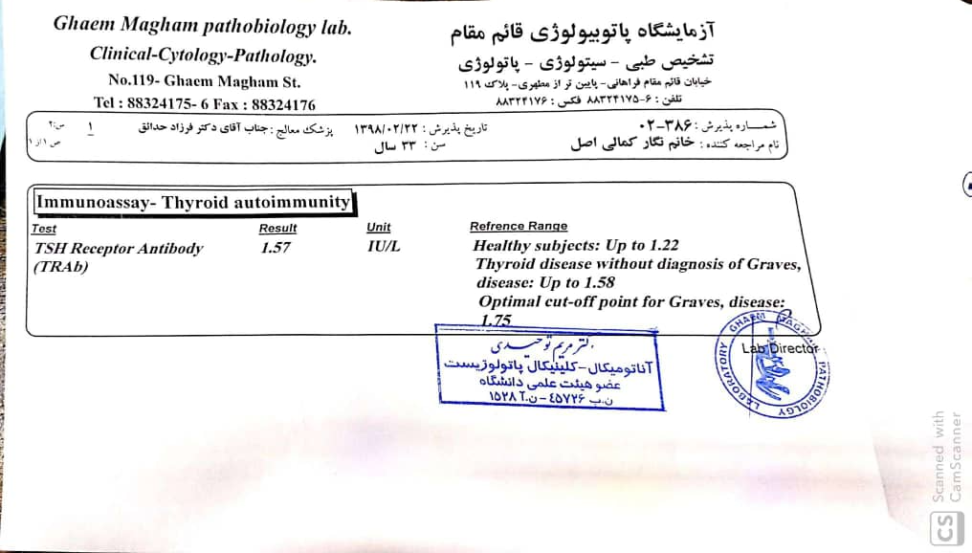

Slide 12
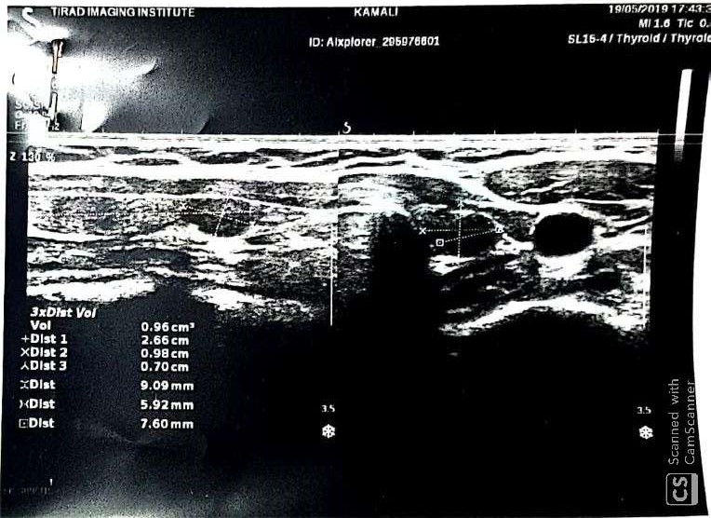
Slide Title

Slide 13
FNA was done for the first time at 1398.4.1:
Right thyroid nodule: Hypocellular smears, suggestive of adenomatous goiter with Hurthle cell change.
Left thyroid nodule: Hurthle cell-rich follicular lesion (atypia) of undetermined significance.

Slide 15
FNA repeated at 1398.7.22 :
Right thyroid nodule: Hurthle cell lesion
Left thyroid nodule: Hurthle cell lesion

Slide 17
Thank you for your attention

