Slide 1


Slide 2
Medical Nutrition Therapy (MNT) in Non-alcoholic Fatty Liver Disease
Golaleh Asghari
Nutrition and Endocrine Research Center
Research Institute for Endocrine Sciences
Shahid Beheshti University of Medical Sciences

Slide 3
Introduction
The MNT of NAFLD patients should be based on:
Insulin resistance
Metabolic syndrome
Oxidative stress
Dyslipidemia
Cardiovascular risk

Slide 4
Lifestyle recommendations
Usual management of NAFLD includes lifestyle counseling to increase physical activity and achieve gradual weight reduction

Slide 5
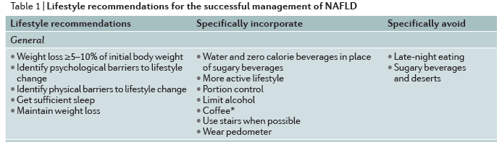
Lifestyle recommendations
Rinella ME et al. Nat Rev Gastroenterol Hepatol 2016, 13, 196–205.

Slide 6
Lifestyle recommendations
Management of weight and overall fitness is the cornerstone of treatment for all patients with NAFLD.
Several studies have demonstrated the benefit of weight loss in reducing steatosis or the NAFLD activity score on histology, with greater weight loss associated with more substantial improvements.
Rinella ME et al. Nat Rev Gastroenterol Hepatol 2016, 13, 196–205.

Slide 7
Lifestyle recommendations
Reductions in ALT levels and steatosis occur even with small decreases in weight, whereas resolution of NASH, or even fibrosis, occurs with more marked or sustained weight loss, such as that observed after bariatric surgery
Wong VW, et al. J Hepatol 2013, 59: 536–542.

Slide 8
Lifestyle recommendations
A prospective study of 293 patients in a community health-care setting demonstrated the effect of weight loss of varying degrees on NASH histology.
Monitored diet = comprising a 750 kcal per day reduction from their calculated resting energy requirements.
Patients achieved >5% weight loss showed histological improvement.
90% of those achieving >10% weight loss showed resolution of NASH after biopsy.
Vilar-Gomez E, et al. Gastroenterology 2015; 149: 367–378.

Slide 9
Calculation of Energy Requirement

Slide 10
Calculation of Energy Requirement
1- What is Desirable Body Weight?
  Actual body weight : if BMI < 25
  Adjusted body weight : if BMI ≥ 25
    Adjusted body weight = current weight - ideal body weight × 0.25 + ideal body weight

Slide 11
Calculation of Energy Requirement
2- What is Ideal Body Weight?
To know how much excess weight an individual has
To know how many steps an individual needs to lose weight
To calculate adjusted ideal body weight
Usually it is BMI=22-23

Slide 12
Calculation of Energy Requirement
Weight loss of 10% of total body weight over 6 months should be the initial goal.
For the next 4-6 months the focus changes from weight loss to weight maintenance.
Dietary changes include an energy deficit of 500-1000 kcal/day.

Slide 13
Calculation of Energy Requirement
HARRIS-BENEDICT EQUATION FOR CALCULATING THE BASAL METABOLIC RATE
Males | BMR = 66.5 + (13.8 × kg body weight) + (5.0 × height in cm) - (6.8 × age in y)
Females | BMR = 655 + (9.6 × kg body weight) + (1.8 × height in cm) - (4.7 × age in y)
Caloric needs are calculated by multiplying the BMR by the activity factors: sedentary or little or no exercise, multiply BMR by 1.2; lightly active, light exercise, or sports 1 to 3 days per week, multiply BMR by 1.37; moderately active, moderate exercise, or sports 3 to 5 days per week, multiply BMR by 1.55; heavy exercise, hard exercise, or sports 6 to 7 days per week, multiply BMR by 1.72.

Slide 14
Calculation of Energy Requirement
Basal energy expenditure (BEE)
Male BEE = 1 × 24 (hours) × desirable body weight (kg)
Female BEE = 0.95 × 24 (hours) × desirable body weight (kg)
Physical activity level (PAL)
Very low: 30% BEE, Low: 50%, Moderate: 75%, High: 100%
Thermogenic effect of food (TEF)
10% (BEE + energy for PAL)
Total energy expenditure (TEE) = BEE + energy for PAL + TEF

Slide 15
Example 1
Man with desirable body weight = 77 kg
BEE: 1 × 24 × 77 = 1848 kcal
1848 × 30% = 554 kcal
1848 + 554 = 2402 kcal
2402 × 10% = 240 kcal
TEE = 1848 + 554 + 240 = 2642 ≈ 2650 kcal

Slide 16
Calculation of Energy Requirement
To simplify:
Females
TEE = DBW × 24 × 0.95 × 1.3 (1.2-2) × 1.1
Males
TEE = DBW × 24 × 1.3 (1.2-2) × 1.1

Slide 17
Example 2
28-year woman:
Wt = 86 kg
Ht = 164 cm
BMI = 32
PAL = low

Slide 18
Example 2
23 = IBW/(1.64)² IBW= 62 kg
AIBW = (86 – 62) × 0.25 + 62 = 68 kg

Slide 19
Example 2
TEE = 68 × 24 × 0.95 × 1.3 × 1.1
= 2139 kcal ≈ 2100 kcal
2100 – 500 = 1600 kcal
2100 کیلوکالری میزان انرژی مورد نیاز برای حفظ وزن است نه کاهش وزن
1600 کیلوکالری میزان انرژی مورد نیاز کاهش وزن تقریبا نیم کیلوگرمی در هفته است

Slide 20
Composition of diet
In addition to total energy intake, the composition of the diet also affects metabolic and endocrine functions, and overall energy balance in NAFLD patients

Slide 21
Composition of diet
Dietary carbohydrate content has been linked to heightened systemic inflammation and carbohydrate-restricted hypocaloric diets have been associated with greater reductions in hepatic steatosis than a general hypocaloric diet alone
Browning JD, et al. Am J Clin Nutr 2011; 93: 048–1052.
Browning JD, et al. Hepatology 2008; 48: 1487–1496.
Oarada M, et al. Nutrition 2015; 31: 757–765.

Slide 22
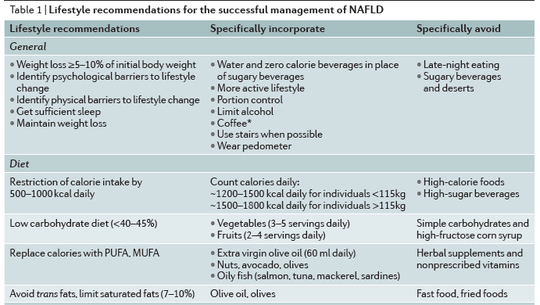
Composition of diet
Rinella ME et al. Nat Rev Gastroenterol Hepatol 2016, 13, 196–205.

Slide 23
Composition of diet
Reductions in the intake of fructose
Encourage consumption of diets rich in fruits and vegetables.
  Such diets would provide a significant amount of bioactive components (polyphenols, anthocyanins, and resveratrol ) with known beneficial effects due, in part, to their anti-inflammatory and anti-oxidative properties

Slide 24
Composition of diet
Reductions in the intake of total fat, saturated fatty acids, trans fatty acids, and cholesterol
Excess dietary cholesterol promotes hepatic de novo lipogenesis and increased levels of intracellular free cholesterol that can be cytotoxic

Slide 25
Composition of diet

Slide 26
Composition of diet
Where do Trans fats come from?
Food Source | % in Diet
Snacks: cakes, cookies, crackers, pies | 40
Animal products | 21
Margarine | 17
Fried potatoes | 8
Potato chips, corn chips, popcorn | 5
Shortening | 4
Candy, breakfast cereals, other foods | 5

Slide 27
Composition of diet
Saturated fat: Comparing different foods
Foods | Amt | Saturated fat (g) | Calories
Regular cheese Low fat cheese | 1 oz | 6.0 1.2 | 114 49
Regular ground beef Extra lean | 3 oz | 6.1 2.6 | 236 148
Regular ice cream Frozen yogurt (low fat) | ½ cup | 4.9 2.0 | 145 110
Whole milk Low fat (1%) milk | 1 cup | 4.6 1.5 | 146 102

Slide 28
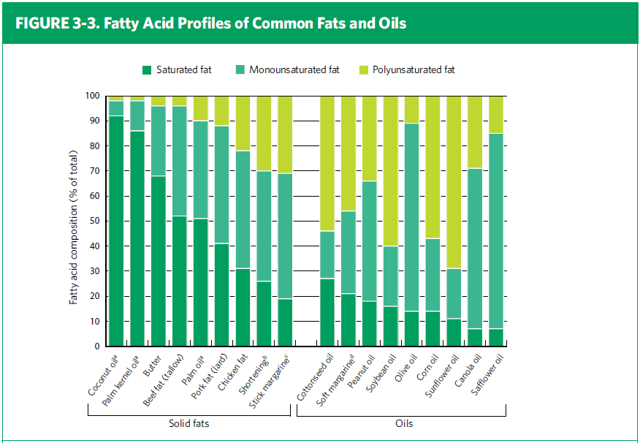
Fatty Acid Profiles of Fats and Oils
Notes:
This slide illustrates how food sources of fats and oils contain the three types of fatty acids in varying proportions . It serves to clarify the rationale for use of the concepts of “solid fats” and “oils.”

Slide 29
Optimal Diet
Eating patterns:
  Low carbohydrate
  Low fat
  Low GI (glycemic index)
  Mediterranean (more vegetables, whole grains, fruit, legumes, nuts, fish, low-fat dairy, olive, and MUFA/PUFA; less red meat and SFAs)
  Vegetarian

Slide 30
Optimal Diet
Mediterranean diet effectively reduce hepatic steatosis when compared with an isocaloric low-fat, high-carbohydrate diet.
The beneficial effects of the Mediterranean diet on hepatic steatosis were independent of patient weight loss

Slide 31
Coffee
To encourage patients to drink unsweetened coffee as part of lifestyle modifications to promote a healthy liver, as long as the patient does not have medical conditions that might be exacerbated by coffee intake.

Slide 32
Carotenoids
Antioxidant micronutrients, such as vitamins and carotenoids, exist in abundance in fruits and vegetables and defend against reactive oxygen species
Carotenoids may participate in an antioxidant defense system when free radical species in the liver are present at high concentrations

Slide 33
Synbiotic
Synbiotic supplementation in addition to lifestyle modification is superior to lifestyle modification alone for the treatment of NAFLD, at least partially through attenuation of inflammatory markers in the body
Eslamparast T et al. Am J Clin Nutr 2014;99:535–42.

Slide 34
Synbiotic

Slide 35
Key Home Message
Lifestyle counseling
Gradual weight reduction
Limit carbohydrate to less than 45% energy intake
Limit simple sugars in particular fructose
Limit SFA, trans fatty acid, and cholesterol

Slide 36

Thank you

