Slide 1
IN THE NAME OF GOD
Algorithm for the management of patients at low, high and very high
risk of osteoporotic fractures
Dr. Roya Alaei

Slide 2
Agenda
FRAX and limitation
Categorization of risk for osteoporotic fracture
Assessment thresholds
Intervention Thresholds for Pharmacological Intervention
Impact of sequential treatment on very high risk fracture
Combination therapy for patients at very high risk of fracture

Slide 3
The International Osteoporosis Foundation (IOF) and European Society for Clinical and Economic Aspects of Osteoporosis and Osteoarthritis (ESCEO) published guidance for the diagnosis and management of osteoporosis in 2019.

Slide 4
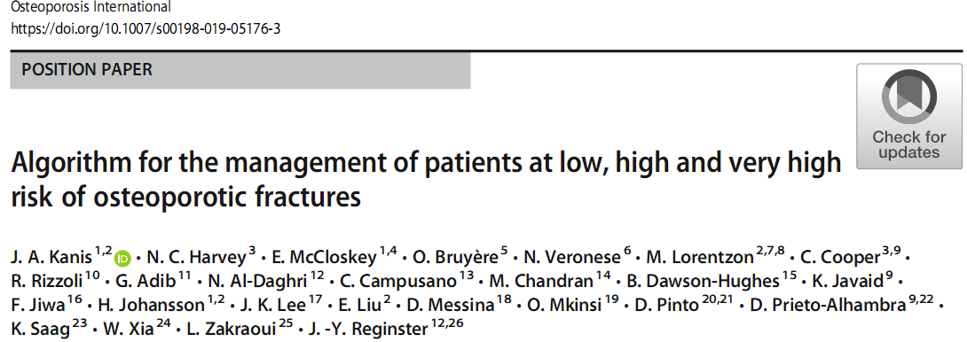
Review and update the assessment of osteoporosis, in particular the categorisation of risk to better target therapeutic interventions for the prevention of fragility fracture in postmenopausal women.
Systematic reviews, meta-analyses and RCT using PubMed subsequent to the generation of the recent European Guidelines.
Recommendations in this guidance have been endorsed by ESCEO and IOF.

Slide 5
Executive summary of the European guidance for the diagnosis and management of osteoporosis in postmenopausal women
Osteoporosis
Systemic skeletal disease characterised by low bone mass and microarchitectural deterioration of bone tissue, with a consequent increase in bone fragility and susceptibility to fracture
Operational definition: T-score for BMD assessed by DXA at the femoral neck or spine BMD 2.5 SD or more below the young female adult mean.

Slide 6
Major Risk Factors for Fragility Fractures
BMD:
Many cross-sectional and prospective population studies indicate that the risk for fracture increases by a factor of 1.5 to 3.0 for each standard deviation decrease in bone mineral density
Age
Sex
Low body weight (less than 58 kg[127 1b])
previous fragility fracture
parental history of hip fracture
glucocorticoid treatment
current smoking
alcohol intake of 3 or more units daily
causes of secondary osteoporosis.

Slide 7
Additional risk factors that are of use in case finding include height loss (> 4 cm) and thoracic kyphosis
Bone markers (serum procollagen type I N propeptide (s-PINP) and serum C-terminal cross-linking telopeptide of type I collagen (s-CTX) as markers of bone formation and bone resorption, respectively) have some prognostic significance for fracture in situations where BMD is unavailable.

Slide 8
FRAX
Algorithms that integrate the weight of clinical risk factors for fracture risk, with or without information on BMD, were developed in 2007 by the then WHO Collaborating Centre for Metabolic Bone Diseases at Sheffield.
The resulting FRAX tool (www.shef.ac.uk/FRAX) computes the 10-year probability of hip fracture or a major osteoporotic fracture, (clinical spine, hip, forearm or humerus fracture).

Slide 9
FRAX
FRAX involved extensive analysis of data from 12 large prospective epidemiological studies involving about 60,000 men and women in different world regions, with over 250,000 person-years of observation and >5000 fractures
The models have been validated in an additional 11 cohort studies with 230,000 men and women and more than 1.2 million person-years of observation
The tool has been externally validated in independent cohorts and calibrated to the epidemiology of fracture and death in 67 countries covering more than 80% of the world population at risk

Slide 10
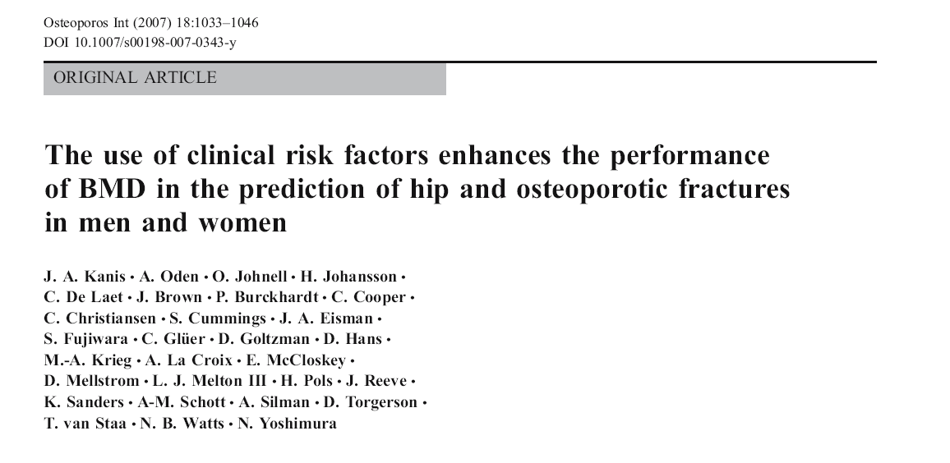

Slide 11
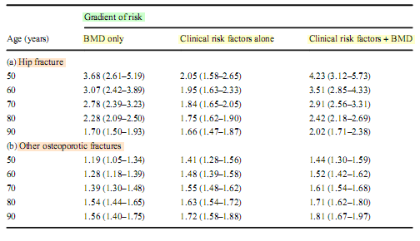

Slide 12
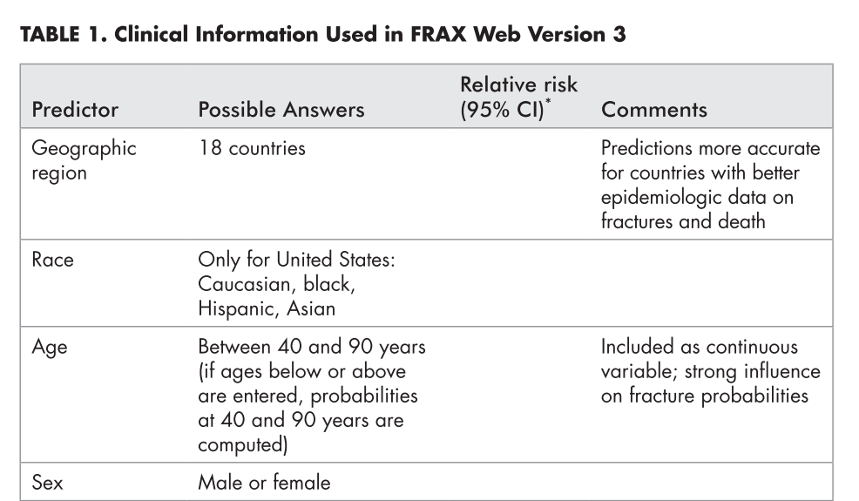

Slide 13
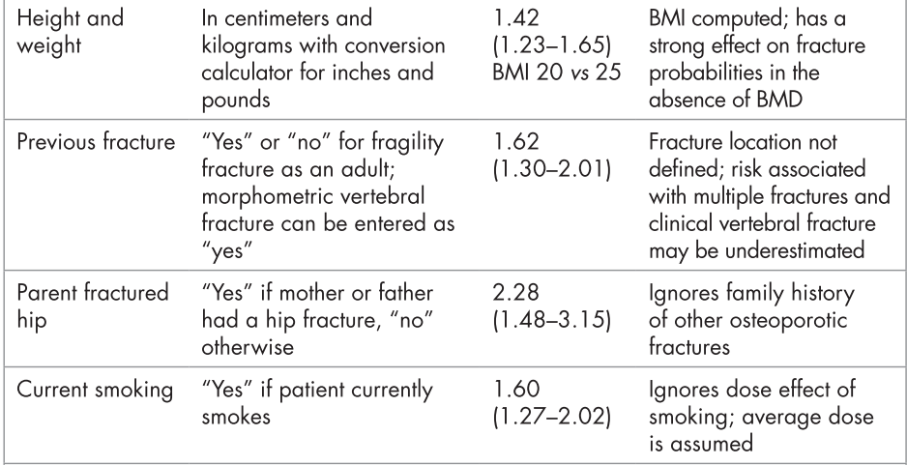

Slide 14
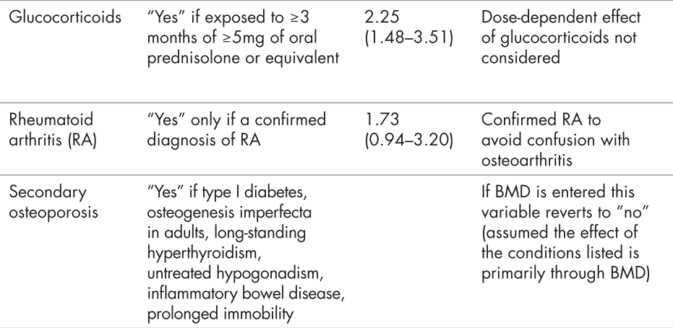

Slide 15
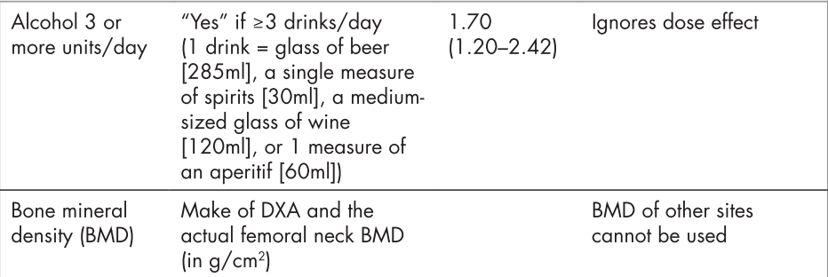

Slide 16
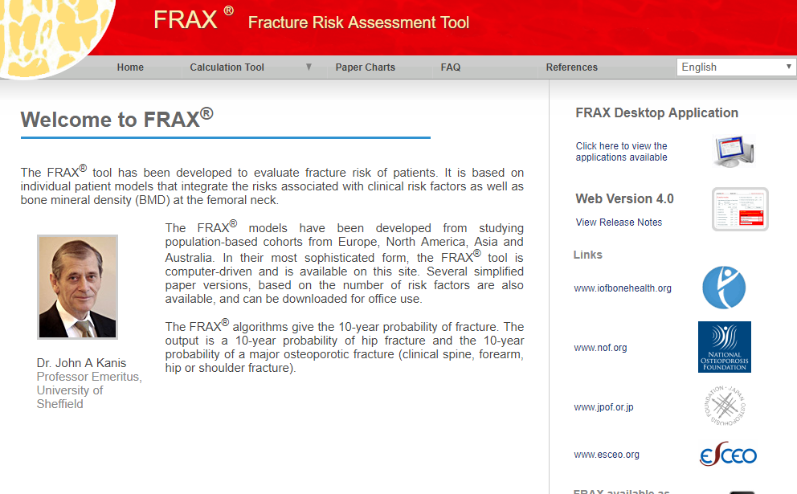
https://www.sheffield.ac.uk/FRAX

Slide 17
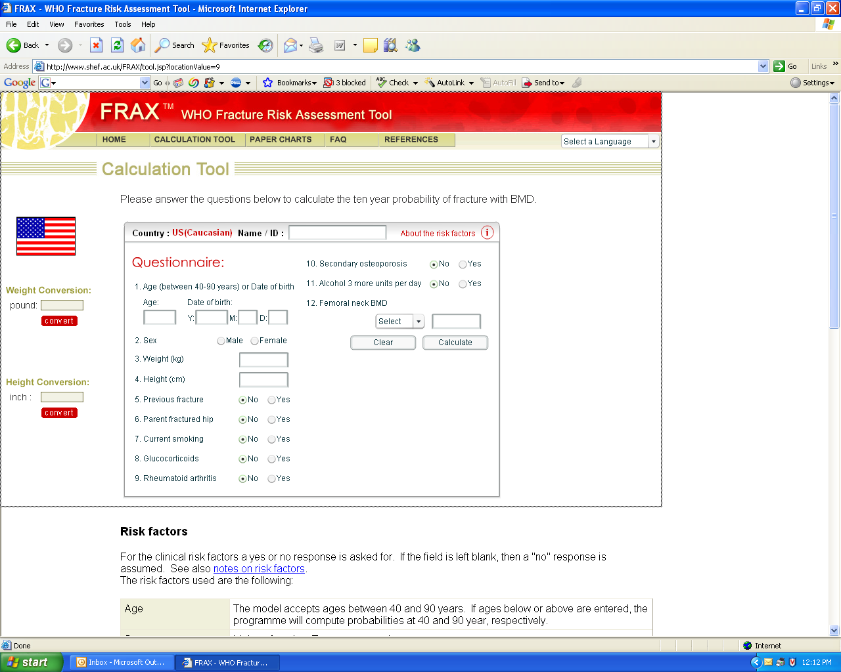

Slide 18
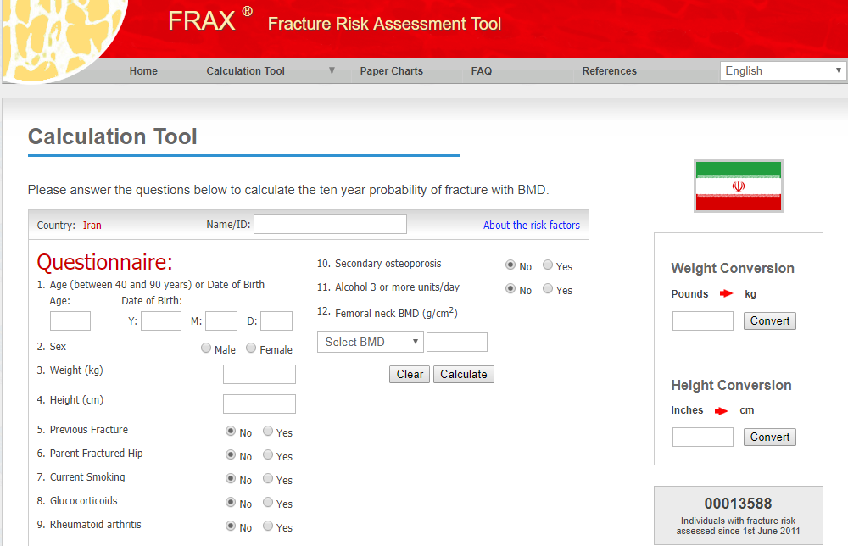

Slide 19
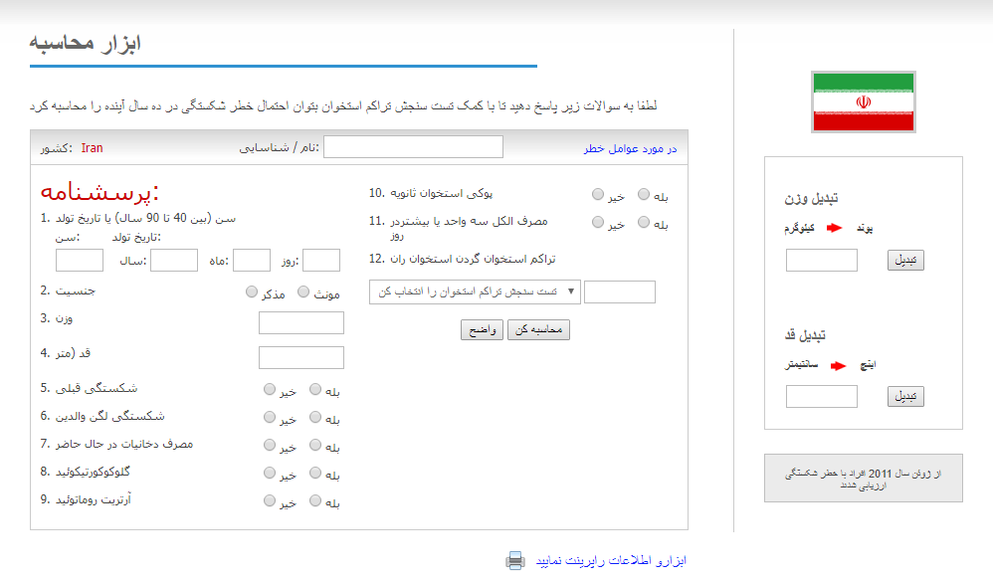

Slide 20
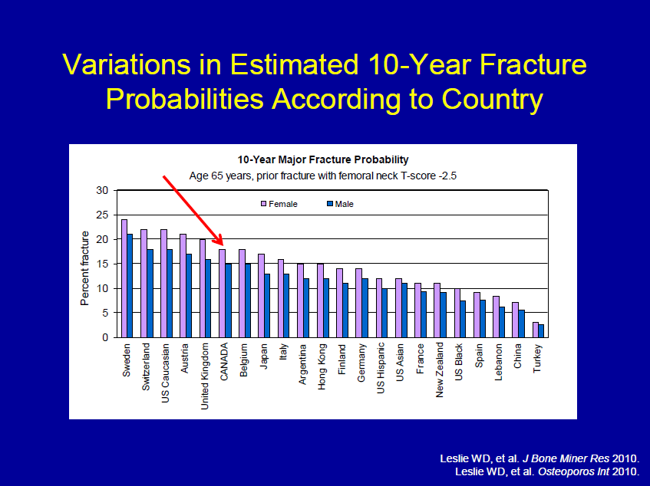

Slide 21
Limitations of FRAX
While there is evidence that duration and dose of tobacco smoking may impact on fracture risk, quantification of this risk is not possible
Falls are a risk factor for fractures but are not accommodated as an entry variable in the current FRAX model.
Fracture probability may be underestimated in individuals with a history of frequent falls, but quantification of this risk is not currently possible
Evidence that bone turnover markers predict fracture risk independent of Bone Mineral Density (BMD) is inconclusive. Therefore, bone turnover markers are not included as risk factors in FRAX

Slide 22
There is a relationship between number of prior fractures and subsequent fracture risk. FRAX underestimates fracture probability in persons with a history of multiple fractures
There is a relationship between severity of prior vertebral fractures and subsequent fracture risk. FRAX may underestimate fracture probability in individuals with prevalent severe vertebral fractures
While there is evidence that hip, vertebral, and humeral fractures appear to confer greater risk of subsequent fracture than fractures at other sites, quantification of this incremental risk in FRAX is not possible
A parental history of non-hip fragility fracture may be a risk factor for fracture. FRAX may underestimate fracture probability in individuals with a parental history of non-hip fragility fracture

Slide 23
There is a dose relationship between glucocorticoid use of greater than 3 months and fracture risk. The average dose exposure captured within FRAX is likely to be a prednisone dose of 2.5-7.5 mg/day or its equivalent.
Frequent intermittent use of higher doses of glucocorticoids increases fracture risk. Because of variability in the dose and dosing schedule, quantification of this risk is not possible.
High dose inhaled glucocorticoids may be a risk factor for fracture. FRAX may underestimate fracture probability in users of high dose inhaled glucocorticoids.
Appropriate glucocorticoid replacement in individuals with adrenal insufficiency has not been shown to increase fracture risk In such patients , use of glucocorticoids should not be included in FRAX calculations

Slide 24
To enhance fracture risk assessment, relatively simple arithmetic adjustments have been developed, which can be applied to conventional FRAX estimates of probabilities of hip fracture and a major fracture to adjust the probability assessment with knowledge of
High, moderate and low exposure to glucocorticoids
Concurrent data on lumbar spine BMD
Trabecular bone score of the lumbar spine
Hip axis length
Falls history
Immigration status
Type 2 diabetes
Chronic kidney disease
Recency of fracture

Slide 25
Aim :To estimate the adjustment for fracture probability based upon the dose of glucocorticoids
Methods: Dose responses for fracture risk during exposure to glucocorticoids were taken from the General Practice Research Database and used to adjust the relative risks for glucocorticoids in FRAX

Slide 26
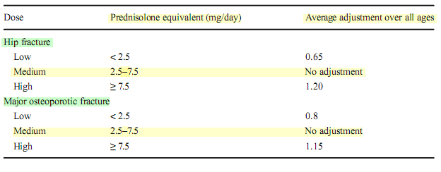
Average adjustment of 10-year probabilities of a hip fracture or a major osteoporotic fracture in postmenopausal women and older men according to dose of glucocorticoids.

Slide 27
2017 American College of Rheumatology Guidline for the Prevention and Treatment of Glucocorticoid-Induced Osteoprosis

Slide 28
FRAX may underestimate or overestimate major osteoporotic fracture risk when lumbar spine T-score is much lower or higher (>1 Standard Deviation discrepancy) than femoral neck T-score

Slide 29
Aim: To describe a simple procedure for using lumbar spine BMD to enhance fracture risk assessment under the FRAX system.
The Manitoba BMD database was used to identify baseline LS and FN DEXA examinations (33,850 women and 2,518 men age 50 and older) with FRAX estimates for a major osteoporotic fracture categorized as low (<10%), moderate (10–20%),and high (>20%).
Fracture outcomes were assessed from population-based administrative data

Slide 30
lumbar spine–femoral neck “offset”
numeric difference in the respective T-scores (lumbar spine T-score minus femoral neck T-score)
A negative offset indicated that the T-score of the lumbar spine was lower than that of the femoral neck
A positive offset indicated the T-score of the lumbar spine was higher than that of the femoral neck

Slide 31
Simple procedures:
Increase/decrease osteoporotic FRAX estimate by one tenth for each rounded T-score difference between the lumbar spine and femoral neck.”

Slide 32
Practical example
Consider an individual with a femoral neck T-score of −1.7 and a major osteoporotic FRAX probability of 18%.
If the lumbar spine T-score is −3.5 then this indicates an offset of −1.8 (−3.5 minus −1.7). This is rounded to the nearest whole number(−2)
One tenth of the FRAX estimate based upon the femoral neck is 1.8%, which is multiplied by the rounded offset value (giving 3.6%).
This is then added (because lumbar spine T-score is worse than femoral neck T-score) to the original FRAX estimate (18%) giving a final (rounded) probability of 22% (18%+3.6%)

Slide 33
Intervention and assessment thresholds
IOF and ESCEO:
Postmenopausal women with a prior fragility fracture should be treated without further assessment, although BMD measurement and incorporation into the FRAX calculation is sometimes appropriate, particularly in younger postmenopausal women.
In women without a previous fragility fracture, the management strategy should be based on assessment of the ten-year probability of a major osteoporotic fracture (clinical spine, hip, forearm or humerus) with FRAX tool.

Slide 34
FRAX-based 10-year probability (%) of a major osteoporotic fracture:
Intervention thresholds:
equivalent to women of the same age with a previous fracture (no other clinical risk factors, BMI of 24 kg/m2 and without BMD).
The lower assessment thresholds:
equivalent to women without clinical risk factors (a body mass index of 24 kg/m2 and without BMD).
The upper assessment thresholds:
1.2 times the intervention threshold.
The same thresholds are used in men since the cost-effectiveness of interventions is broadly similar in men and women.

Slide 35
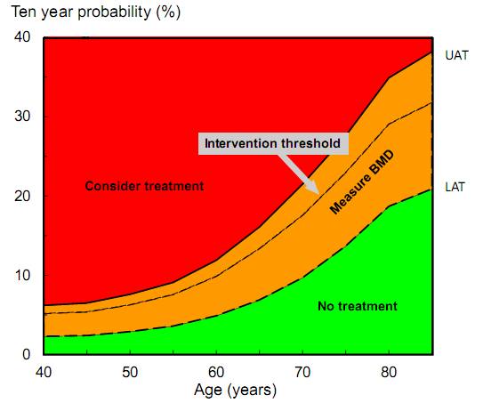

Slide 36
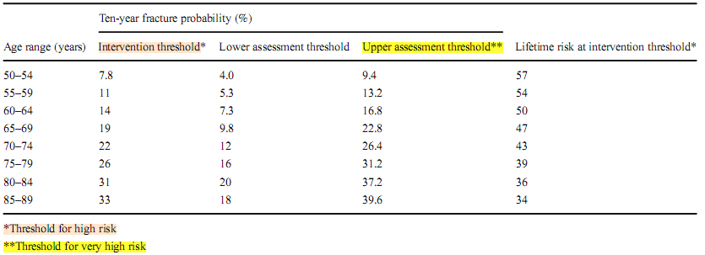
The numerical data for these thresholds are given based on the weighted average of 5 European countries (Germany, France, Italy, Spain and the UK) but will vary by country.

Slide 37
Cost effective
Some agencies have been reluctant to reimburse treatments on the basis of fracture probability, particularly at younger ages where the 10-year probability of a major osteoporotic fracture is less than 10%.
In the UK, for example, the intervention threshold for women aged 50–54 years is 8.18%. At the same age, however, the remaining lifetime probability of a major fracture is high (57%).
Moreover, there are cost effective scenarios for treatment available at these levels of risk.

Slide 38
Categorisation of risk
In addition to the categories of low and high risk espoused in the current IOF-ESCEO guideline, very high risk can be identified.
Very high risk is defined as a fracture probability that lies above the upper assessment threshold after a FRAX assessment, with or without the inclusion of BMD, i.e. where BMD testing is unavailable, the same probability threshold can be used.

Slide 39
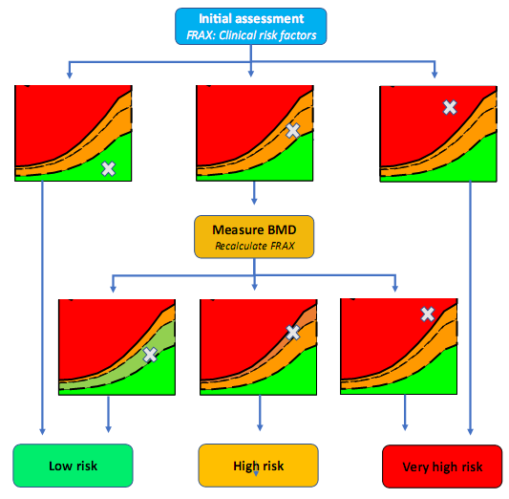
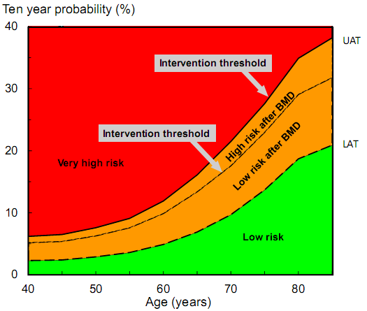

Slide 40
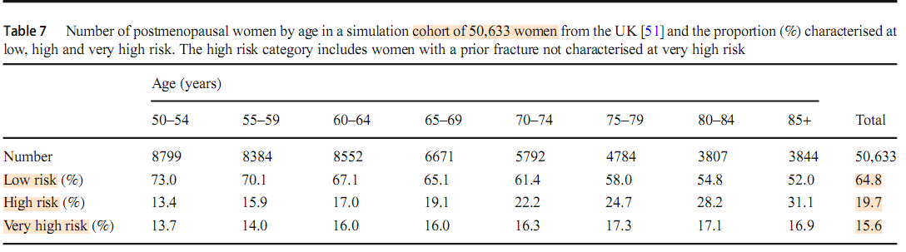
Proportion of women characterised at low risk decreased with age and, conversely, those at high risk increased with age.
The proportion of women characterised at very high risk increased with age though the quantum of effect was modest.

Slide 41
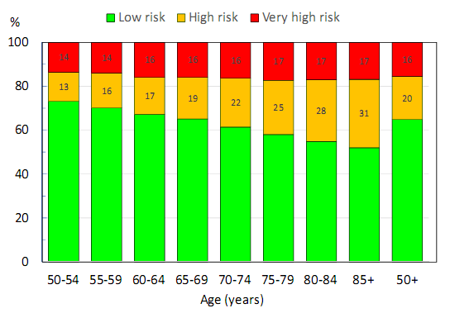

Slide 42
Impact on treatment
The rationale for the more refined characterisation of risk is to direct appropriate interventions.
High risk: initial treatment recommendations might most usually start with an inhibitor of bone resorption.
IOF/ESCEO guidelines recommend oral bisphosphonates but a very large range of pharmacological interventions are recommended worldwide.
Very high risk: might be more suitably treated with an anabolic treatment followed thereafter by an inhibitor of bone resorption.

Slide 43
Non-pharmacological management:
For all patients, education on osteoporosis (e.g. knowledge of osteoporosis, medications, diet and exercise) and advice for daily weight-bearing physical activity are appropriate.
Where indicated, the addition of fall prevention measures, including supervised exercise and/or rehabilitation, has been shown to be useful in reducing falls but the effects on fracture risk remain uncertain.
Programmes should continue over a duration of at least 50 hours, be progressive in nature and include strength and balance training components

Slide 44
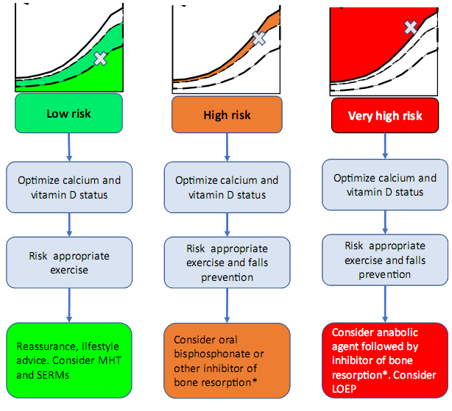
Fig. 3 Treatment pathways
according to the categorisation of fracture risk. For treatment
modalities (inhibitors of bone
resorption, anabolic agents, etc.)

Slide 45
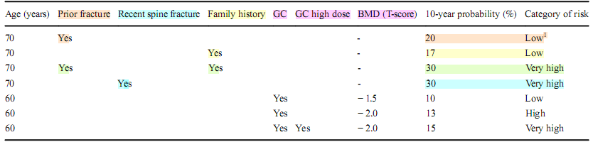
Examples of risk assessment in women from the UK (BMI to 25 kg/m2). Risk factors include prior fracture (of uncertain recency prior clinical vertebral fracture within the past two years, family history of hip fracture, exposure to glucocorticoids, exposure to higher than average doses of glucocorticoids and bone mineral density (BMD) T-score at the femoral neck

Slide 46
Prior fragility fracture for a woman age 70 years:
undetermined recency (16%. Low risk) treatment with an inhibitor of bone resorption is indicated by the IOF-ESCEO guidance and many other guidelines by virtue of the prior fracture.
A family history of hip fracture in the absence of any other risk factors (low risk): lifestyle advice recommended.
The combination of a prior fragility fracture of uncertain recency and a family history of hip fracture is associated with a much higher risk than either risk factor alone or falls into the category of very high risk where an anabolic regimen might be recommended.

Slide 47
There is now a substantial body of evidence that the risk of a subsequent osteoporotic fracture is particularly acute immediately after the index fracture and wanes progressively with time.
Thus, the incidence of a second fracture in those who will sustain a further fracture is particularly high in the first 2 years after the index event.
In the case of hip fracture, 61% of subsequent fractures over a 10-year time horizon will occur within the first 2 years.
For forearm, spine and humerus fractures the recurrence within two years is 54, 42 and 53%, respectively.
A recent population-based study demonstrated that the phenomenon of immediate risk was also age dependent.

Slide 48
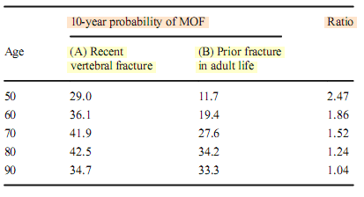
Icelandic women at different ages,

Slide 49
The ratios given in previous Table can be used to adjust fracture probabilities derived from FRAX for recency of clinical vertebral fracture.
For a woman at age 70 years, a prior clinical vertebral fracture within the past 2 years is associated with a 1.52-fold higher fracture probability than for a woman of the same age with a prior fragility fracture of uncertain recency .
Thus, a recent clinical vertebral fracture uplifts the fracture probability from 16 to 24% and would place the woman in the category of very high risk.

Slide 50
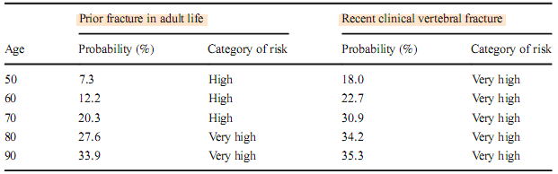
Table 3 Unadjusted probabilities of a major fracture in women a prior fragility fracture by age using the UK FRAX model together with the categories of risk and adjusted FRAX probabilities for women with a recent clinical vertebral fracture. BMI set at 24 kg/m

Slide 51
Impact of sequential treatment on fracture
In patients at very high risk of fracture, starting treatment with an anabolic agent seems most appropriate to promptly reduce the fracture risk.
Given that treatments with anabolic agents are limited to 12–24 months and that efficacy will wane once treatment is stopped, the real potential of the anabolic treatments is that their greater effect on BMD and fracture can be maintained with the inhibitors of bone turnover once anabolic treatment is stopped.

Slide 52
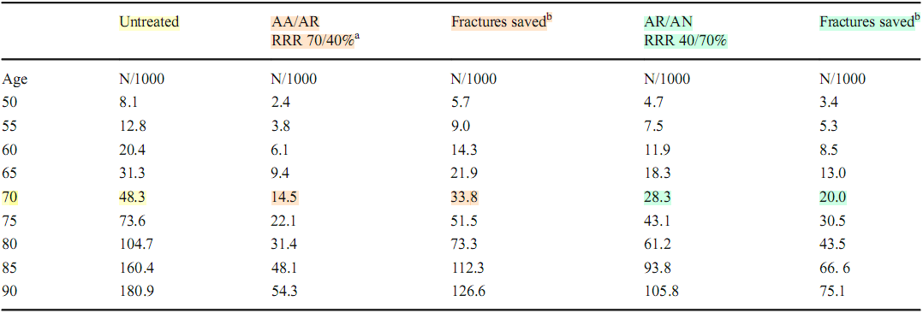
Postmenopausal woman from the UK with a recent major osteoporotic fracture.
The efficacy (RRR) of the anabolic agent is modelled at 70% and that of the antiresorptive at 40%.
The effect on hip fracture (number/1000 patient years)

Slide 53
RESULT 1
“Imminent risk”: Risk of a subsequent osteoporotic fracture is particularly acute immediately after an index fracture and wanes progressively with time
This very high fracture risk and the consequent further utility loss immediately after a subsequent fracture suggests that preventive treatment given as soon as possible after fracture would avoid a higher number of new fractures and reduce the attendant morbidity, compared with treatment given later.
This provides the rationale for very early intervention immediately after a sentinel fracture and necessitates treatment with agents that have the most rapid effect on fracture reduction

Slide 54
RESULT 2
A further recent development is the demonstration of a more rapid and greater fracture risk reduction of anabolic compared with antiresorptive treatments, with the potential to revolutionise treatment strategies, particularly in individuals at very high fracture risk

Slide 55
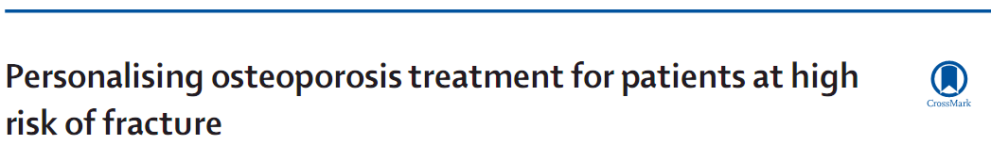
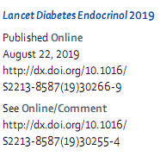
Therapeutic strategy for fracture prevention has generally been rather simplistic—ie, a one-size-fits-all approach.
Clinical practice guidelines for the pharmacological management of osteoporosis by the Endocrine Society: four categories of risk (low, moderate, high, and very high risk)
Despite this thorough classification, the guidelines do not specify which medications would be the preferred treatment for specific risk groups and also do not address combination therapy in patients—eg, in patients who are at very high risk of fracture.

Slide 56
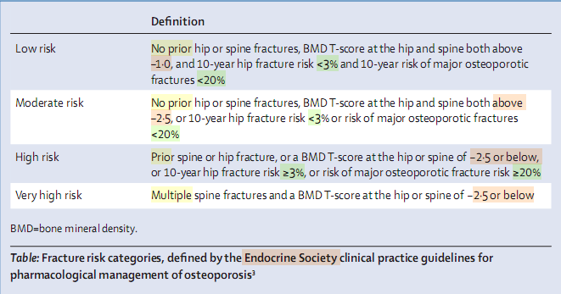

Slide 57
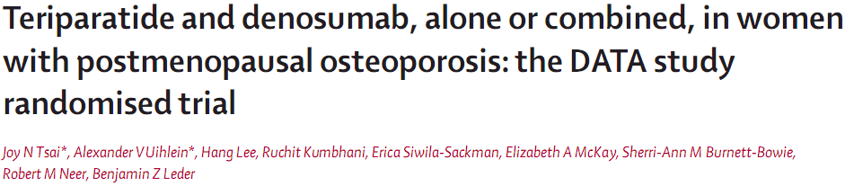

Slide 58
2009 – 2011, RCT
Postmenopausal women with osteoporosis
Patients were assigned in a 1:1:1 ratio to receive 20 μg teriparatide daily, 60 mg denosumab every 6 months, or both.
BMD was measured at 0, 3, 6, and 12 months.

Slide 59
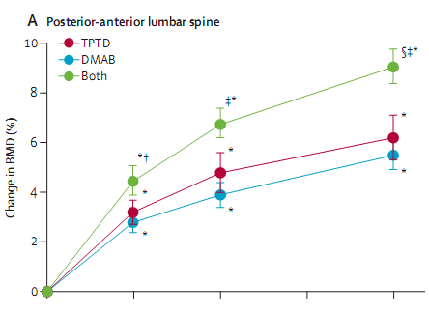
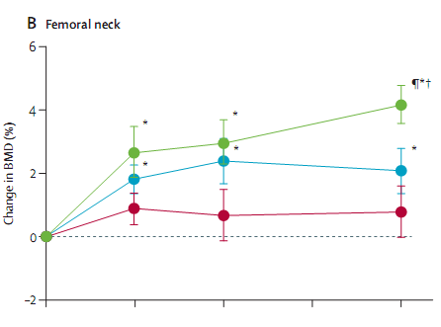
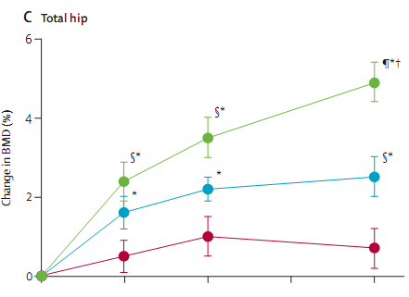
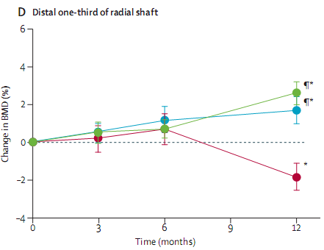

Slide 60
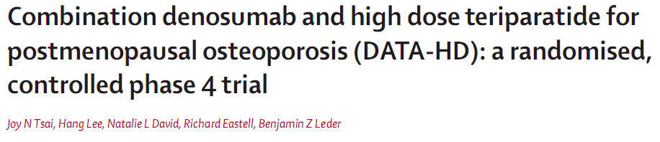

Slide 61
RCT, Massachusetts General Hospital.
Postmenopausal women with osteoporosis.
Patients assigned (1:1) to receive teriparatide 20 µg (standard dose) or 40 µg (high dose) s.c daily for 9 months. At 3 months, both groups were started on denosumab 60 mg s.c every 6 months for 12 months.
BMD was measured at 0, 3, 9, and 15 months.
Primary endpoint was percentage change from baseline in spine areal BMD at 15 months.

Slide 62
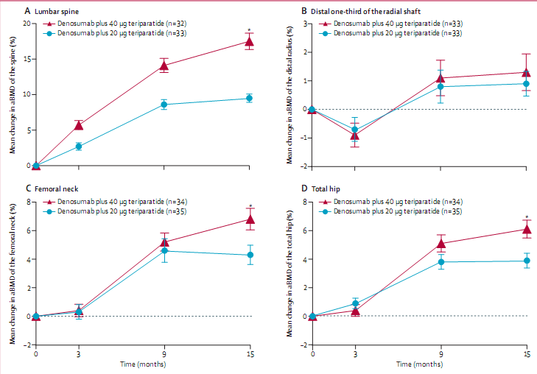

Slide 63
On the basis of the findings of DATA-HD:
A subset of patients at high risk of fracture and perhaps many patients who would be categorized as very high risk categories according to Endocrinology Society clinical guidelines could be considered for treatment with high dose teriparatide and denosumab to rapidly and substantially increase their BMD, which in many cases could perhaps result in the achievement of non-osteoporotic BMDs.

Slide 64
Small size of the DATA-HD:
Which limits the direct assessment of fracture incidence.
Need for a larger trial powered to investigate anti-fracture efficacy (costs make it unlikely) Cost (US$76 000)
For patients at very high risk of fracture the benefits of the marked increases in BMD observed with combination therapy, are likely to offset the uncertainty that BMD gains will translate into anti-fracture efficacy.
Dose of teriparatide approved by the FDA is 20 µg/day:
Physicians would either need to prescribe the standard dose (as given in DATA) or prescribe the higher dose of-label, following appropriate discussions with the patient regarding risks and benefits.
Thus, it is unlikely that high dose would be widely used, but in selected patients it could be an important option.

Slide 65
Important issue following combination (or anabolic) skeletal therapies:
In the absence of continuing anti-resorptive therapy (eg, a bisphosphonate or denosumab), the increases in BMD are lost over time.
Continuing denosumab in patients at very high risk of fracture might be the most efficacious approach, since the optimal protocol for switching from denosumab to a bisphosphonate remains to be established.
Specifically, a bisphosphonate might not be effective following denosumab treatment because the bisphosphonate might not be appropriately incorporated into remodeling sites when remodeling is markedly reduced by denosumab.

