Slide 1


Slide 2
Pharmacotherapy in T2DM
BY:
Dr. Majid Valizadeh
Associate Professor of SBMU

Slide 3
Scope of this talk
Type 2 Diabetes
Outpatients
Focus on established, proven therapies
  (not on complications or associated illnesses)
Practical application of important guidelines

Slide 4
Some things I won’t cover
Detail of non pharmacological treatment
Treatment of diabetes in hospitalized patients¹
Treatment of diabetes related illnesses
Treatment of diabetes complications
¹American College of Endocrinology. Position Statement on Inpatient Diabetes and Metabolic Control. Endo Practice. 10(1); Jan/Feb 2004.

Slide 5
Road Map
Background:
  Importance of glycemic control
  Glycemic goals
Overview of the pathogenesis of T2DM
Therapy of Type 2 Diabetes
  Oral hypoglycemic agents
Real life cases
Cases discussion according ADA/EASD consensus & AACE Guideline
Take home message

Slide 6
Relative Risk of Progression of Diabetic Complications
RELATIVE RISK
Mean A1C
        DCCT Research Group, N Engl J Med 1993, 329:977-986.

Slide 7
What are the effects of treatment?
Lowering blood glucose levels prevents long term complications
  Type 1: microvascular AND cardiovascular ?(DCCT)
  Type 2: microvascular and? cardiovascular (UKPDS)
  Both studies show strong correlations with HgbA1C level and complications
Notes:
Recent epidemiologic data from UKPDS suggests lowering glycemia may reduce CV disease in T2DM.

Slide 8
Primary Objectives of Effective Management
Diagnosis
lGæde P, Vedel P, Larsen N, Jensen GVH, Parving H-H, Pedersen O. Multifactorial intervention and cardiovascular disease in patients with type 2 diabetes. N Engl J Med. 2003;348:383-393.
A1C
%
9
8
7
Reduction
of both
micro- and macro-
vascular
event
rates
…by 75%!
SBP
mm Hg
145
130
LDL
mg/dL
140
100
45
50
55
60
65
70
75
80
85
90
Patient Age
Notes:
Key Points
The primary objectives of effective diabetes management are to reduce A1C to as near-normal levels (ie, 4%–6%) as is possible and safe, to lower systolic blood pressure to <130 mm Hg, and to decrease LDL cholesterol to <100 mg/dL
Achieving target levels of A1C, systolic blood pressure, and LDL cholesterol may reduce the risk of the micro- and macrovascular complications of diabetes by up to 75%
As illustrated in this slide, the objectives of effective diabetes management are to reduce A1C to as near-normal levels as is possible and safe (ie, 4%–6%), lower systolic blood pressure to <130 mm Hg, and to decrease LDL cholesterol to <100 mg/dL. Evidence suggests that achieving these target levels can reduce the risk of both microvascular and macrovascular complications of diabetes by >75%.¹
Most recently, the Steno-2 Study followed 160 patients with type 2 diabetes and microalbuminuria over 7.8 years to determine the effect of intensive treatment on long-term CV and microvascular outcomes. Researchers found that target-driven, intensive treatment consisting of stepwise diet, exercise, and pharmacotherapy for glycemia, microalbuminuria, lipids, and blood pressure resulted in a decreased risk of CV and microvascular events of about 50%. Control group members received conventional treatment in accordance with national guidelines. However, factors leading to diminished degrees of separation between the intensive treatment and control groups (eg, more than 50% of control group members were referred for specialist treatment during the course of the study) led the authors to estimate that the actual risk reduction associated with intensive versus conventional therapy may be even greater than that observed.²
References
American Diabetes Association. Clinical Practice Recommendations. Implications of the United Kingdom Prospective Diabetes Study. Diabetes Care. 2003;26(suppl 1):S28-S32.
Gæde P, Vedel P, Larsen N, Jensen GVH, Parving H-H, Pedersen O. Multifactorial intervention and cardiovascular disease in patients with type 2 diabetes. N Engl J Med. 2003;348:383-393.

Slide 9
Clinical Diabetes. 23(2):78-86, 2005.

Slide 10
ADA-EASD Position Statement Update:
Management of Hyperglycemia in T2DM, 2015
3. ANTI-HYPERGLYCEMIC THERAPY
Glycemic targets
  HbA1c < 7.0% (mean PG ∼150-160 mg/dl [8.3-8.9 mmol/l])
  Pre-prandial PG <130 mg/dl (7.2 mmol/l)
  Post-prandial PG <180 mg/dl (10.0 mmol/l)
  Individualization is key:
    Tighter targets (6.0 - 6.5%) - younger, healthier
    Looser targets (7.5 - 8.0%⁺) - older, comorbidities, hypoglycemia prone, etc.
  Avoidance of hypoglycemia
PG = plasma glucose
Diabetes Care 2012;35:1364–1379; Diabetologia 2012;55:1577–1596
Diabetes Care 2015;38:140-149; Diabetologia 2015;58:429-442
Notes:
In general, the goal in diabetes is to reduce glucose so that the glycated hemoglobin (HbA1c) concentration is reduced to 7% or less. Individualization of treatment targets is important, however. Young patients may benefit from tighter control, below 6.5%, since they are apt to have more years of life and exposure to hyperglycemia which can lead to long-term vascular complications. In contrast, in older individuals, especially those with multiple comorbidities, established vascular complications, or with a predisposition to hypoglycemia, more conservative targets are necessary, such as 7.5 – 8.0% or even higher, depending on the patient’s condition.

Slide 11
ADA-EASD Position Statement Update:
Management of Hyperglycemia in T2DM, 2015
Patient-Centered Approach
“...providing care that is respectful of and responsive to individual patient preferences, needs, and values - ensuring that patient values guide all clinical decisions.”
Gauge patient’s preferred level of involvement.
Explore, where possible, therapeutic choices. Consider using decision aids.
Shared Decision Making – a collaborative process between patient and clinician, using best available evidence and taking into account the patient’s preferences and values.
Final decisions regarding lifestyle choices ultimately lie with the patient.
Diabetes Care 2012;35:1364–1379; Diabetologia 2012;55:1577–1596
Notes:
There is increasing emphasis on ‘patient-centeredness’ in chronic disease management. This has been described by the Institute of Medicine as “providing care that is respectful of and responsive to individual patient preferences, needs, and values – ensuring that patient values guide all clinical decisions.” Shared decision making (SDM) is a key component of patient-centered care. This is of particular importance in those conditions, like diabetes, that necessitate patient involvement in lifestyle changes.

Slide 12
Modulation of the intensiveness of glucose lowering therapy in T2DM
Diabetes Care 2015;38:140-149; Diabetologia 2015;58:429-442
Notes:
Here is on element of decision-making used to determine appropriate efforts to achieve glycemic targets – the risks potentially associated with drug side effects, especially hypoglycemia. Again, greater concerns about this domain is represented by increasing height of the ramp. Less risk justifies more stringent efforts to lower HbA1c, whereas higher risk compels less stringent efforts.
(Adapted with permission from Ismail-Beigi et al, Ann Intern Med 2011;154:554-559.)

Slide 13
Modulation of the intensiveness of glucose lowering therapy in T2DM
Diabetes Care 2015;38:140-149; Diabetologia 2015;58:429-442
Notes:
Here is another element of decision-making used to determine appropriate efforts to achieve glycemic targets – diabetes duration. Less years of diabetes justifies more stringent efforts to lower HbA1c, whereas longer disease duration suggests the need for less stringent efforts.
(Adapted with permission from Ismail-Beigi et al, Ann Intern Med 2011;154:554-559.)

Slide 14
Modulation of the intensiveness of glucose lowering therapy in T2DM
Diabetes Care 2015;38:140-149; Diabetologia 2015;58:429-442
Notes:
Another element to consider is life expectancy. Longer life expectancy justifies more stringent efforts to lower HbA1c, whereas more conservative efforts are acceptable when life expectancy is shorter.
(Adapted with permission from Ismail-Beigi et al, Ann Intern Med 2011;154:554-559.)

Slide 15
Modulation of the intensiveness of glucose lowering therapy in T2DM
Diabetes Care 2015;38:140-149; Diabetologia 2015;58:429-442
Notes:
Important comorbidities (i.e. significant medical conditions other than diabetes) are another patient characteristic that drives decision making re A1c targets. Being in otherwise good health justifies more stringent efforts to lower HbA1c, whereas extensive comorbid conditions may compel the need for less stringent efforts.
(Adapted with permission from Ismail-Beigi et al, Ann Intern Med 2011;154:554-559.)

Slide 16
Modulation of the intensiveness of glucose lowering therapy in T2DM
Diabetes Care 2015;38:140-149; Diabetologia 2015;58:429-442
Notes:
Similarly, the clinician should weigh the presence of established vascular complications. Having no vascular complications justifies more stringent efforts to lower HbA1c, whereas advanced complications mandates a more conservative approach.
(Adapted with permission from Ismail-Beigi et al, Ann Intern Med 2011;154:554-559.)

Slide 17
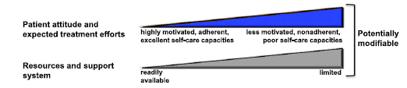

Slide 18
Modulation of the intensiveness of glucose lowering therapy in T2DM
Diabetes Care 2015;38:140-149; Diabetologia 2015;58:429-442
Notes:
Another potentially modifiable patient feature involves his or her resources and support systems. When these are not available, more stringent efforts will be more challenging. If readily available, more aggressive approaches are possible. As in the previous slide, the care team can help in certain aspects of this domain, such as assisting the patient in pursuing drug discounts, more advantageous insurance coverage, etc.
A reminder that, where possible, such decisions should be made in conjunction with the patient, reflecting his or her preferences, needs and values.
Note that this ‘scale’ is not designed to be applied rigidly but to be used as a broad construct to help guide clinical decisions.
(Adapted with permission from Ismail-Beigi et al, Ann Intern Med 2011;154:554-559.)

Slide 20
ADA-EASD Position Statement Update:
Management of Hyperglycemia in T2DM, 2015
  2. BACKGROUND
Overview of the pathogenesis of T2DM
  Insulin secretory dysfunction
  Insulin resistance (muscle, fat, liver)
  Increased endogenous glucose production
  Decreased incretin effect
  Deranged adipocyte biology
Diabetes Care 2012;35:1364–1379; Diabetologia 2012;55:1577–1596
Notes:
The pathogenesis of T2DM is complex with multiple defects in multiple organ systems. Insulin resistance appears to be a primary defect, followed by relative beta cell failure with insulin secretory abnormalities, and increased endogenous (hepatic) glucose production. There are also derangements in incretin physiology and in the certain aspects of adipocyte biology.

Slide 21
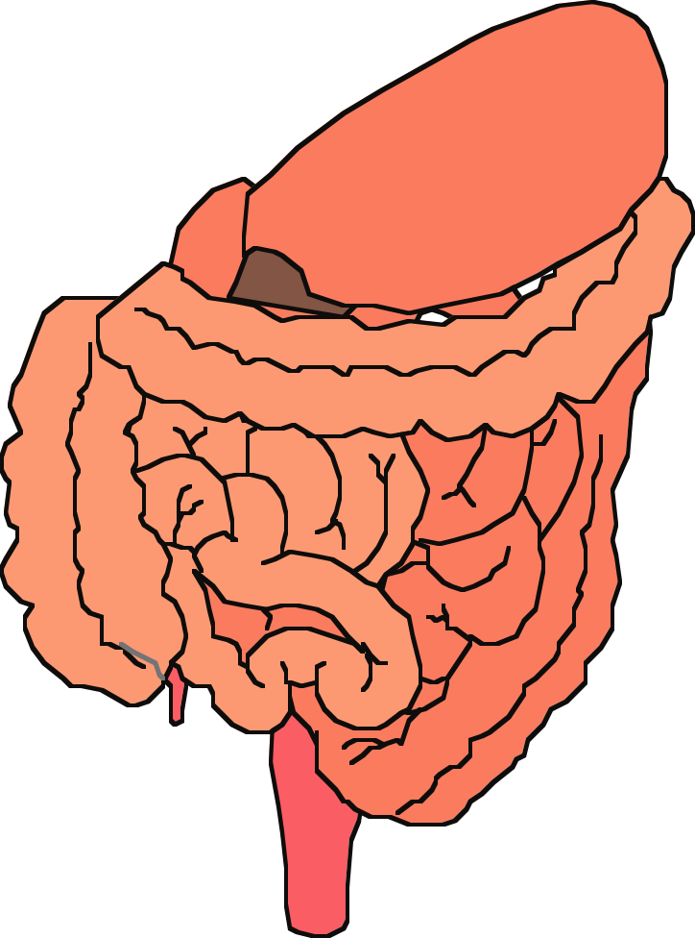
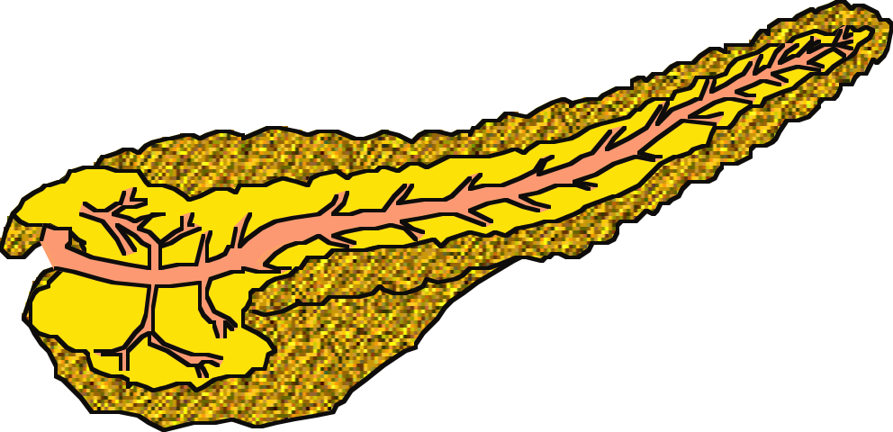


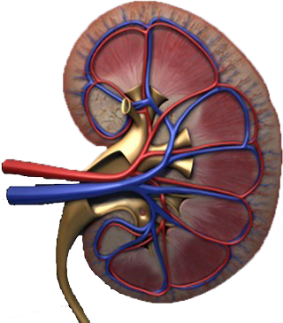
Multiple, Complex Pathophysiological Abnormalities in T2DM
pancreatic
insulin
secretion
incretin
effect
pancreatic
glucagon
secretion
_
?
gut
carbohydrate
delivery &
absorption
HYPERGLYCEMIA
_
+
peripheral
glucose
uptake
hepatic
glucose
production
renal glucose excretion
Adapted from: Inzucchi SE, Sherwin RS in: Cecil Medicine 2011
Notes:
This slide provides a broad overview of the main pathophysiological defects in type 2 diabetes. Insulin resistance is demonstrated in peripheral tissues, such as skeletal muscle and adipocytes. The pancreas develops relative insulin secretory failure and is no longer provide the amount of insulin required for normal glucose. The pancreas also demonstrates a failure of the normal suppression of glucagon after meals. This may be mediated through abnormalities in the incretin axis. Hepatic glucose production is also increased. Renal glucose output is set at a higer threshold than normal. Many of these defects may be influenced by abnormal central control of metabolism.

Slide 22
Multiple, Complex Pathophysiological Abnormalities in T2DM
GLP-1R
agonists
Insulin
pancreatic
insulin
secretion
incretin
effect
Glinides
S U s
DPP-4
inhibitors
Amylin
mimetics
pancreatic
glucagon
secretion
_
DA agonists
?
A G I s
gut
carbohydrate
delivery &
absorption
HYPERGLYCEMIA
Metformin
_
T Z D s
Bile acid
sequestrants
+
peripheral
glucose
uptake
hepatic
glucose
production
renal glucose excretion
Adapted from: Inzucchi SE, Sherwin RS in: Cecil Medicine 2011
Notes:
Anti-hyperglycemic drugs for patients with T2DM are targeted at one or more of the pathophysiological abnormalities of this disease. On this slide, the main sites of action of the currently available 12 individual drug classes is depicted. Combination glucose-lowering therapy has become a standard treatment strategy when patients do not adequately respond to a single agent (often metformin.)

Slide 23
Oral Class | Mechanism | Advantages | Disadvantages | Cost
Biguanides | Activates AMP-kinase (?other) ↓ Hepatic glucose production | Extensive experience No hypoglycemia Weight neutral ? ↓ CVD | Gastrointestinal Lactic acidosis (rare) B-12 deficiency Contraindications | Low
Sulfonylurea | Closes K_{ATP} channels ↑ Insulin secretion | Extensive experience ↓ Microvascular risk | Hypoglycemia ↑ Weight Low durability ? Blunts ischemic preconditioning | Low
Meglitinides | Closes K_{ATP} channels ↑ Insulin secretion | ↓ Postprandial glucose Dosing flexibility | Hypoglycemia ↑ Weight ? Blunts ischemic preconditioning Dosing frequency | Mod.
TZDs | PPAR-g activator ↑ Insulin sensitivity | No hypoglycemia Durability ↓ TGs (pio) ↑ HDL-C ? ↓ CVD events (pio) | ↑ Weight Edema/heart failure Bone fractures ↑ LDL-C (rosi) ? ↑ MI (rosi) | Low
Table 1. Properties of anti-hyperglycemic agents
Diabetes Care 2015;38:140-149;
Diabetologia 2015;58:429-442
Notes:
Here are some of the older oral drug classes used in T2DM. The table describes the mechanism of action of each class, its advantages, disadvantages and cost. Less commonly used classes are denoted in grey font.

Slide 24
Oral Class | Mechanism | Advantages | Disadvantages | Cost
a-Glucosidase inhibitors | Inhibits a-glucosidase Slows carbohydrate digestion / absorption | No hypoglycemia Nonsystemic ↓ Postprandial glucose ? ↓ CVD events | Gastrointestinal Dosing frequency Modest ↓ A1c | Mod.
DPP-4 inhibitors | Inhibits DPP-4 Increases incretin (GLP-1, GIP) levels | No hypoglycemia Well tolerated Weight neutral | Angioedema / urticaria ? Pancreatitis ? ↑ Heart failure | High
Bile acid sequestrants | Bind bile acids ? ↓ Hepatic glucose production | No hypoglycemia ↓ LDL-C | Gastrointestinal Modest ↓ A1c Dosing frequency | High
Dopamine-2 agonists | Activates DA receptor Alters hypothalamic control of metabolism ↑ insulin sensitivity | No hypoglyemia ? ↓ CVD events | Modest ↓ A1c Dizziness, fatigue Nausea Rhinitis | High
SGLT2 inhibitors | Inhibits SGLT2 in proximal nephron Increases glucosuria | ↓ Weight No hypoglycemia ↓ BP Effective at all stages | GU infections Polyuria Volume depletion ↑ LDL-C ↑Cr (transient) | High
Table 1. Properties of anti-hyperglycemic agents
Diabetes Care 2015;38:140-149
Diabetologia 2015;58:429-442
Notes:
Additional oral agent classes used in T2DM are included on this slide. The table describes the mechanism of action of each class, its advantages, disadvantages and cost. Less commonly used classes are denoted in grey font.

Slide 25
Injectable Class | Mechanism | Advantages | Disadvantages | Cost
Amylin mimetics | Activates amylin receptor ↓ glucagon ↓ gastric emptying ↑ satiety | ↓ Weight ↓ Postprandial glucose | Gastrointestinal Modest ↓ A1c Injectable Hypo if insulin dose not reduced Dosing frequency Training requirements | High
GLP-1 receptor agonists | Activates GLP-1 R ↑ Insulin, ↓ glucagon ↓ gastric emptying ↑ satiety | ↓ Weight No hypoglycemia ↓ Postprandial glucose ↓ Some CV risk factors | Gastrointestinal ? Pancreatitis ↑ Heart rate Medullary ca (rodents) Injectable Training requirements | High
Insulin | Activates insulin receptor Myriad | Universally effective Unlimited efficacy ↓ Microvascular risk | Hypoglycemia Weight gain ? Mitogenicity Injectable Patient reluctance Training requirements | Variable
Table 1. Properties of anti-hyperglycemic agents
Diabetes Care 2015;38:140-149;
Diabetologia 2015;58:429-442
Notes:
Here now are the injectable drugs used in T2DM. The table describes the mechanism of action of each class, its advantages, disadvantages and cost. Less commonly used classes are denoted in grey font.

Slide 26
پوشش بیمه | قیمت (تومان) | تعداد | نام دارو
√ | 7500 (19500) | 100 | متفورمین
√ | 4000 | 100 | گلی بن کلامید
√ | 11000 (19000) | 100 | گلی کلازید
√ | 5500 | 100 | ریپگلیناید
√ | 9000 | 100 | ریپگلیناید
√ | 13000 | 100 | ریپگلیناید
● | 32-40-48000 | 100 | گلوتازون (15-30-45)
● | 22-34000 | 100 | آکاربوز
● | 30000 | 30 | زیپتین 50
√ | 12000 | 1 ویال | NPH
√ | 12000 | 1 ویال | Regular
● | 20000 | 100 عدد | سرنگ

Slide 27
Effectiveness
safety profiles
Side effects
Cost
Patient satisfaction
.extraglycemic effect.

Slide 28
Metformin intolerance or
contraindication
HbA1c ≥9%
Uncontrolled hyperglycemia (catabolic features,
BG ≥300-350 mg/dl, HbA1c ≥10-12%)
Diabetes Care 2015;38:140-149; Diabetologia 2015;58:429-442
Notes:
Potential sequences of antihyperglycemic therapy for patients with type 2 diabetes are displayed, the usual transition being vertical, from top to bottom (although horizontal movement within therapy stages is also possible, depending on the circumstances). The figure denotes relative glucose lowering efficacy, risk of hypoglycemia, effect on body weight, other side effects and approximate relative cost for each drug class.
In most patients, begin with lifestyle changes; metformin monotherapy is added at, or soon after, diagnosis, unless there are contraindications.

Slide 29
بیمار 1:
خانم 50 ساله، در آزمایشات غربالگری:
FBS: 145 mg/dl
FBS: 130 mg/dl
Hb A1c: 7.5%
PE: BP: 130/80, BMI: 30 Kg/m2
اقدام شما چیست؟

Slide 30



ADA-EASD Position Statement Update:
Management of Hyperglycemia in T2DM, 2015
3. ANTI-HYPERGLYCEMIC THERAPY
Therapeutic options: Lifestyle
  Weight optimization
  Healthy diet
  Increased activity level
Diabetes Care 2012;35:1364–1379; Diabetologia 2012;55:1577–1596
Notes:
Non-pharmacological options are critically important – they are cost effective and have no side effects, per se. Patients with T2DM should become more physically active, eat a healthy diet and try to optimize body weight. These efforts will result in less insulin resistance, with better blood glucose control the result. There are also additional health benefits from such interventions.

Slide 31
Anti-hyperglycemic therapy in T2DM: General recommendations
Diabetes Care 2015;38:140-149; Diabetologia 2015;58:429-442
Notes:
Potential sequences of antihyperglycemic therapy for patients with type 2 diabetes are displayed, the usual transition being vertical, from top to bottom (although horizontal movement within therapy stages is also possible, depending on the circumstances). The figure denotes relative glucose lowering efficacy, risk of hypoglycemia, effect on body weight, other side effects and approximate relative cost for each drug class.
In most patients, begin with lifestyle changes; metformin monotherapy is added at, or soon after, diagnosis, unless there are contraindications.

Slide 32
رژیم غذایی
ورزش
دارو: متفورمین 500 میلی گرم 2 بار در روز پس از غذا

Slide 33
بیمار از تهوع و سوزش سردل شاکی است، اقدام بعدی شما؟

Slide 34
کاهش دوز و شروع تدریجی
تغییر برند (Glucophage)
استفاده از فرآورده های Extended release

Slide 35
3 ماه بعد:
DH: Metformin 500 BD
BP: 120/80, BMI: 29 Kg/m2:
FBS: 110 mg/dl
Hb A1c: 6.9%

Slide 37
بیمار 2
خانم 65 ساله، با سابقه بیماری عروق کرونر که یکبار بالون شده و Stent گذاری گردیده
DH: متورال 25 میلی گرم 2 بار در روز + آسپرین 80 + آتورواستاتین 20 میلی گرم
BP: 130/80, W: 78 Kg, BMI: 28 Kg/m2
FBS: 150 mg/dl , Hb A1c: 8.0%
Creatinin: 1.6 mg/dl
توصیه شما؟

Slide 38
Targeted Hb A1c?
eGFR: 52 ml/hr
( 140 – age) Weight /72 * Creatinin

Slide 39
بیمار 3
آقای 60 ساله با شکایت تشنگی، پرادراری، ناکتوری (3 بار در طول شب)از 4 هفته پیش مراجعه کرده/ 2 کیلوگرم ↓ وزن
FBS: 300 mg/dl BS: 450 mg/dl Hb A1c:9%
Creatinin: 1.2 mg/dl
BP: 110/80, BMI: 25 Kg/m2
اقدام بعدی؟

Slide 40
OHA or Insulin?
  Catabolic Sign
  Severity of Symptoms
Glucose Toxicity
Monotherapy or combination (Dual ) Therapy
Which of them?

Slide 41
Metformin intolerance or
contraindication
HbA1c ≥9%
Uncontrolled hyperglycemia (catabolic features,
BG ≥300-350 mg/dl, HbA1c ≥10-12%)
Diabetes Care 2015;38:140-149; Diabetologia 2015;58:429-442
Notes:
Potential sequences of antihyperglycemic therapy for patients with type 2 diabetes are displayed, the usual transition being vertical, from top to bottom (although horizontal movement within therapy stages is also possible, depending on the circumstances). The figure denotes relative glucose lowering efficacy, risk of hypoglycemia, effect on body weight, other side effects and approximate relative cost for each drug class.
In most patients, begin with lifestyle changes; metformin monotherapy is added at, or soon after, diagnosis, unless there are contraindications.

Slide 42
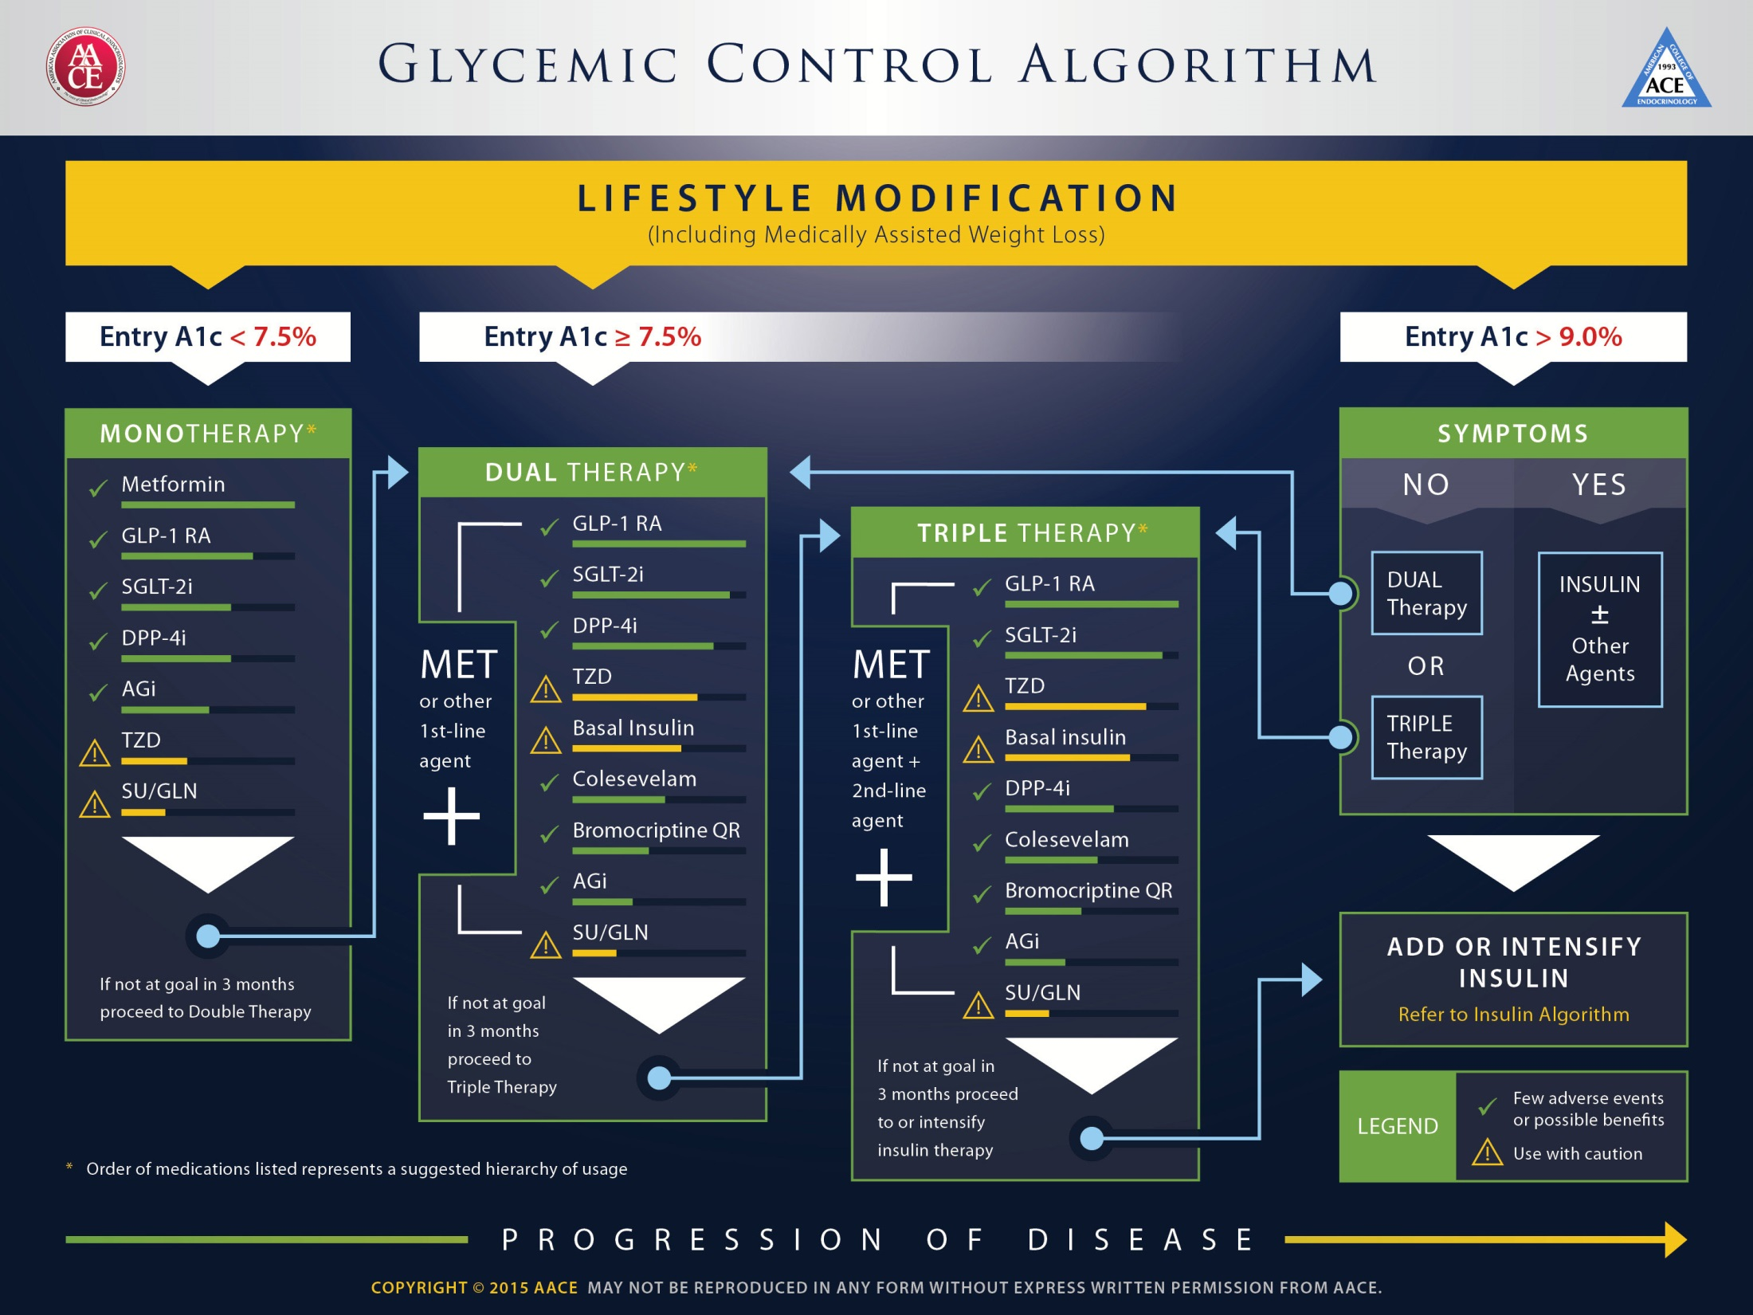

Slide 43
بیمار 4
خانم 50 ساله، سابقه 2 ساله دیابت
DH: Metformin 2000 gr/d
PE: BP: 130/80, BMI: 32 Kg/m2
FBS: 155 mg/dl
BS: 210 mg/dl
Hb A1c: 7.9%
اقدام بعدی شما چیست؟

Slide 44
Anti-hyperglycemic therapy in T2DM: General recommendations
Diabetes Care 2015;38:140-149; Diabetologia 2015;58:429-442
Notes:
Potential sequences of antihyperglycemic therapy for patients with type 2 diabetes are displayed, the usual transition being vertical, from top to bottom (although horizontal movement within therapy stages is also possible, depending on the circumstances). The figure denotes relative glucose lowering efficacy, risk of hypoglycemia, effect on body weight, other side effects and approximate relative cost for each drug class.
In most patients, begin with lifestyle changes; metformin monotherapy is added at, or soon after, diagnosis, unless there are contraindications.

Slide 45
Anti-hyperglycemic therapy in T2DM:
Avoidance of weight gain
Diabetes Care 2015;38:140-149; Diabetologia 2015;58:429-442

Slide 46
بیمار 4
خانم 75 ساله با سابقه دیابت از 6 سال پیش ، ظرف یکماه اخیر 6 بار افت قندخون داشته که یکبار منجر به بیهوشی وی گردیده تنها زندگی می کند
DH: Metformin 500 mg BD/ Glibenclamide 5 mg BD
BP: 130/80, W: 48 Kg/
FBS: 70 mg/dl, Hb A1c: 5.5% Creatnin: 1 Mg/dl
توصیه شما چیست؟

Slide 47
Targeted Hb A1c?
eGFR: 37 ml/min

Slide 48
Effects of Agents Available for T2D
Q4. How are glycemic targets achieved for T2D?
 | Met | GLP1RA | SGLT2I | DPP4I | TZD | AGI | Coles | BCR-QR | SU/ Glinide | Insulin | Pram
NAFLD benefit | Mild | Mild | Neutral | Neutral | Mod | Neutral | Neutral | Neutral | Neutral | Neutral | Neutral
Hypo-glycemia | Neutral | Neutral | Neutral | Neutral | Neutral | Neutral | Neutral | Neutral | SU: mod to severe Glinide: mild to mod | Mod to severe* | Neutral
Weight | Slight loss | Loss | Loss | Neutral | Gain | Neutral | Neutral | Neutral | Gain | Gain | Loss
AGI = α-glucosidase inhibitors; BCR-QR = bromocriptine quick release; Coles = colesevelam; DPP4I = dipeptidyl peptidase 4 inhibitors; GLP1RA = glucagon-like peptide 1 receptor agonists; Met = metformin; Mod = moderate; NAFLD, nonalcoholic fatty liver disease; SGLT2I = sodium-glucose cotransporter 2 inhibitors; SU = sulfonylureas; TZD = thiazolidinediones.
*Especially with short/ rapid-acting or premixed.
Continued from previous slide

Slide 49
Effects of Agents Available for T2D
Q4. How are glycemic targets achieved for T2D?
 | Met | GLP1RA | SGLT2I | DPP4I | TZD | AGI | Coles | BCR-QR | SU/ Glinide | Insulin | Pram
Renal impair-ment/ GU | Contra-indicated in stage 3B, 4, 5 CKD | Exenatide contra-indicated CrCl <30 mg/mL | GU infection risk | Dose adjust-ment (except lina-gliptin) | May worsen fluid retention | Neutral | Neutral | Neutral | Increased hypo-glycemia risk | Increased risks of hypo-glycemia and fluid retention | Neutral
GI adverse effects | Mod | Mod* | Neutral | Neutral* | Neutral | Mod | Mild | Mod | Neutral | Neutral | Mod
CHF | Neutral | Neutral | Neutral | Neutral† | Mod | Neutral | Neutral | Neutral | Neutral | Neutral | Neutral
CVD | Possible benefit | Neutral | Neutral | Neutral | Neutral | Neutral | Neutral | Safe | ? | Neutral | Neutral
Bone | Neutral | Neutral | Bone loss | Neutral | Mod bone loss | Neutral | Neutral | Neutral | Neutral | Neutral | Neutral
AGI = α-glucosidase inhibitors; BCR-QR = bromocriptine quick release; Coles = colesevelam; CHF = congestive heart failure; CVD = cardiovascular disease; DPP4I = dipeptidyl peptidase 4 inhibitors; GI = gastrointestinal; GLP1RA = glucagon-like peptide 1 receptor agonists; GU = genitourinary; Met = metformin; Mod = moderate; SGLT2I = sodium-glucose cotransporter 2 inhibitors; SU = sulfonylureas; TZD = thiazolidinediones.
*Caution in labeling about pancreatitis.
†Caution: possibly increased CHF hospitalization risk seen in CV safety trial.
Continued from previous slide

Slide 50
Anti-hyperglycemic therapy in T2DM:
Avoidance of hypoglycemia
Diabetes Care 2015;38:140-149; Diabetologia 2015;58:429-442

Slide 51
بیمار 5
آقای 48 ساله با سابقه دیابت از 10 سال پیش
بدون عوارض
DH: Metformin 500 TDS, Glibenclamide 5 BD, Atorvastatin 20/d, Losar 25 BD
BP: 130/80, BMI: 34 Kg/m2
FBS: 160 mg/dl, BS: 220 , Hb A1c: 8%

Slide 52
Metformin intolerance or
contraindication
HbA1c ≥9%
Uncontrolled hyperglycemia (catabolic features,
BG ≥300-350 mg/dl, HbA1c ≥10-12%)
Diabetes Care 2015;38:140-149; Diabetologia 2015;58:429-442
Notes:
Potential sequences of antihyperglycemic therapy for patients with type 2 diabetes are displayed, the usual transition being vertical, from top to bottom (although horizontal movement within therapy stages is also possible, depending on the circumstances). The figure denotes relative glucose lowering efficacy, risk of hypoglycemia, effect on body weight, other side effects and approximate relative cost for each drug class.
In most patients, begin with lifestyle changes; metformin monotherapy is added at, or soon after, diagnosis, unless there are contraindications.

Slide 54
بیمار 5
آقای 48 ساله با سابقه دیابت از 10 سال پیش
بدون عوارض
DH: Metformin 500 TDS, Glibenclamide 5 BD, Atorvastatin 20/d, Losar 25 BD
BP: 130/80, BMI: 34 Kg/m2
FBS: 140 mg/dl, BS: 280 , Hb A1c: 8%

Slide 55
Effects of Agents Available for T2D
Q4. How are glycemic targets achieved for T2D?
 | Met | GLP1RA | SGLT2I | DPP4I | TZD | AGI | Coles | BCR-QR | SU/ Glinide | Insulin | Pram
FPG lowering | Mod | Mild to mod* | Mod | Mild | Mod | Neutral | Mild | Neutral | SU: mod Glinide: mild | Mod to marked (basal insulin or premixed) | Mild
PPG lowering | Mild | Mod to marked | Mild | Mod | Mild | Mod | Mild | Mild | Mod | Mod to marked (short/ rapid-acting insulin or premixed) | Mod to marked
AGI = α-glucosidase inhibitors; BCR-QR = bromocriptine quick release; Coles = colesevelam; DPP4I = dipeptidyl peptidase 4 inhibitors; FPG = fasting plasma glucose; GLP1RA = glucagon-like peptide 1 receptor agonists; Met = metformin; Mod = moderate; PPG = postprandial glucose; SGLT2I = sodium-glucose cotransporter 2 inhibitors; SU = sulfonylureas; TZD = thiazolidinediones.
*Mild: albiglutide and exenatide; moderate: dulaglutide, exenatide extended release, and liraglutide.
Continued on next slide

Slide 56
Metformin intolerance or
contraindication
HbA1c ≥9%
Uncontrolled hyperglycemia (catabolic features,
BG ≥300-350 mg/dl, HbA1c ≥10-12%)
Diabetes Care 2015;38:140-149; Diabetologia 2015;58:429-442
Notes:
Potential sequences of antihyperglycemic therapy for patients with type 2 diabetes are displayed, the usual transition being vertical, from top to bottom (although horizontal movement within therapy stages is also possible, depending on the circumstances). The figure denotes relative glucose lowering efficacy, risk of hypoglycemia, effect on body weight, other side effects and approximate relative cost for each drug class.
In most patients, begin with lifestyle changes; metformin monotherapy is added at, or soon after, diagnosis, unless there are contraindications.

Slide 58
Road Map
Background:
  Importance of glycemic control
  Glycemic goals
Overview of the pathogenesis of T2DM
Therapy of Type 2 Diabetes
  Oral hypoglycemic agents
Real life cases
Cases discussion according ADA/EASD consensus & AACE Guideline
Take home message

Slide 59
Take home message
Management of DM patients must be individualized for each patients
Financial constrains need to be considered to avoid the pitfalls of nonadherence & poor follow up
Avoid combination therapy with drugs that have Same pathophysiologic mechanism
Efficacy of the third antidiabetic agents decrease when added to dual therapy

Slide 61

از توجه شما متشکرم

