Slide 1
In the name of God A 43 y/o male with parathyroid carcinoma, repeated locoregional recurrence and pulmonary metastasis

Slide 2
Questions: 1- What are the differences between parathyroid carcinoma & benign parathyroid disease? 2- What is the diagnostic pitfalls ? 3- What is the next step for the patient?

Slide 3
1-Metastatic Parathyroid Carcinoma +diagnostic pitfall : (IHC: positive calcitonin) V/S 2-Coexistent Parathyroid carcinoma + MTC +/- PTC
What are the SENARIOS ?

Slide 4
Parathyroid carcinoma Is a rare cause of PHPT Most studies show a prevalence of <1% of all cases of PHPT One of the rarest of malignancies: The estimated prevalence is 0.005% of all solid malignancies

Slide 5
A study using the population database SEER compiled data of PC in the USA between 1988 to 2003, to better identify changes over time: The incidence of PC was evaluated over a period of 16 years, and it was shown to have increased . study also found a decrease in larger tumors (>4 cm) and increase in percentage of patients with negative L.N. These findings indicate an earlier point of diagnosis for these patients. Cancers 2019, 11, 1676; doi:10.3390/cancers11111676

Slide 6
The vast majority of cases are sporadic Whereas the rest occur in the context of genetic syndromes such as: MEN1 or HPT-JT E. Kebebew, “Parathyroid carcinoma,” Current Treatment Options in Oncology, vol. 2, no. 4, pp. 347–354, 2001. J. M. Sharretts and W. F. Simonds, “Clinical and molecular genetics of parathyroid neoplasms,” Best Practice & Research Clinical Endocrinology & Metabolism, vol. 24, no. 3, pp. 491–502, 2010.

Slide 7
MOLECULAR PATHOGENESIS -HRPT2/CDC73 Tumor suppressor gene Parafibromin: inhibition of cell proliferation HRPT2 mutations: both HPT-JT & sporadic PC One original study: HRPT2 mutations in 10 / 15 sporadic PC -Other genes PI3K/AKT/MTOR pathway in 20 %, cyclin D1 in 30 % MEN1, TP53, … in a small subset of tumors Discoveries significance: treatment initially designed to target such mutations in other tumor types.

Slide 8
MOLECULAR PATHOGENESIS More recently germline mutations have been noted in CDC73 gene in >50% of HPT-JT kindreds as well as in about 20% of patients thought to have sporadic PC
Cancers 2019, 11, 1676; doi:10.3390/cancers11111676

Slide 9
Major clinical manifestations of PC
Mean age – 44 to 54 years
Mean calcium – 14.6 to 15.9 mg/dL
PTH – 5- to 10 -fold higher than upper limit of normal
● Calcium > 14 mg/dL– 65 to 75 percent
● Parathyroid crisis – 12 %
● Neck mass – 34 to 52
● Bone disease – 34 to 73
● Renal disease – 32 to 70
● Pancreatitis – 0 to 15
● No symptoms – 2 to 7

Slide 10
Variable presentation in parathyroid cancer
Cancers 2019, 11, 1676; doi:10.3390/cancers11111676

Slide 11
Comparison with clinical manifestations of benign parathyroid disease Increase the likelihood of parathyroid cancer : 1. Benign hyperpara is more in women (3:1) Incidence of PC: equal between two genders 2. More symptoms, larger tumor size, bone & kidney disease, marked hypercalcemia, very high PTH

Slide 12
At presentation: PC should be suspected in PHPT who presents with parathyroid crisis or neck mass.
DIAGNOSIS

Slide 13
Sono : PC v/s benign adenomas : -larger mass size -More non-homogenous* -Decrease in echogenicity* -Evidence of degeneration : both cystic cavities* & calcifications may be seen, as well as irregular borders). The ultrasound is also useful for lateral neck compartments for lymph nodes. If abnormal, the presence of carcinoma in those lymph nodes can be confirmed with an ultrasound guided tissue biopsy.? Cancers 2019, 11, 1676; doi:10.3390/cancers11111676
Preoperative Imaging

Slide 14
Sestamibi scans : Relatively high level of sensitivity for parathyroid lesions MOA: increased uptake of technetium 99-m within the mitochondria of the abnormal parathyroid gland They are not as adept at differentiating between parathyroid adenomas & carcinoma Important point False negative sestamibi scans : PC cystic degeneration* Cancers 2019, 11, 1676; doi:10.3390/cancers11111676
Preoperative Imaging

Slide 15
In cases where PC is suspected based on preoperative labs and symptoms, higher resolution imaging 4D CT/MRI may also be helpful to identify possible ectopic glands and relationship to surrounding soft tissue structures . Cancers 2019, 11, 1676; doi:10.3390/cancers11111676
Preoperative Imaging

Slide 16
18-FDG PET : PET are qualitative in nature & can be quantified using standardized uptake values (SUVs). < SUV level & aggressiveness of parathyroid tumor : positive correlation > PET imaging roles: 1- Identification of locoregional spread 2- More important role: PC recurrence PET scans after treatment are usually delayed for 3-6 mo to reduce positive results. It is important to note that micrometastatic lesions (<6 mm) can be missed by a PET . Cancers 2019, 11, 1676; doi:10.3390/cancers11111676
Preoperative Imaging

Slide 17
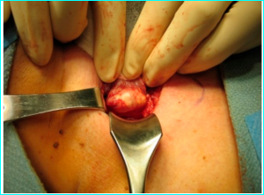
At the time of neck exploration: Malignant tumors are large (>3 cm) * Weighing between 2 and 10 g (All 4 nl parathyroid glands is 150 mg) * They are often hard, firm, whitish-gray ,with invasion or adherence to the adjacent tissues such as the strap muscles, thyroid gland, recurrent laryngeal nerve, trachea, or esophagus.
DIAGNOSIS

Slide 18
Classic pathologic features, highly suggestive ; Trabecular pattern Mitotic figures Thick fibrous bands* Capsular & vascular invasion* 2 criteria upon which a more definitive diagnosis : Local invasion of contiguous structures * or Lymph node or distant metastases *
DIAGNOSIS

Slide 19
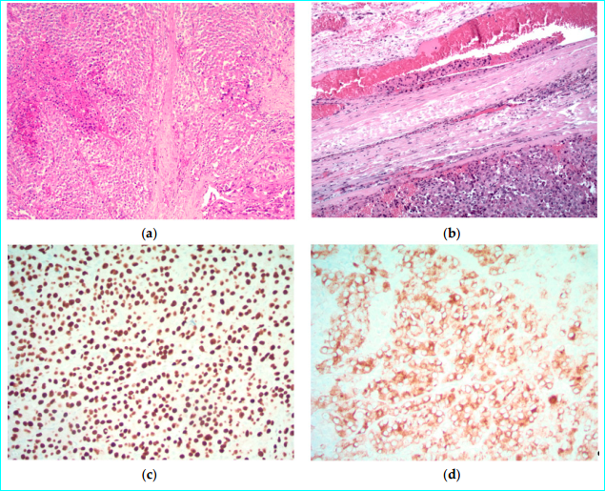
Seets of parathyroid cells with fibrosis band
Vascular invasion: tumor cells within vascular channels associated with fibrin
cytoplasmic positivity for chromogranin
Nuclear positivity for GATA3
parathyroid hormone (not shown)

Slide 20
IHC panel: Parafibromin, galactin-3, PGP9.5, Ki67 has been suggested from a small series to aid in diagnosis of PC, with a sensitivity of 80 % , specificity of 100 %
DIAGNOSIS

Slide 21
cyclin D1 : In normal glands, cyclin D1 was present in 6% of cases Cyclin D1 was present in 91% of PC 29% of parathyroid adenomas 61% of hyperplastic parathyroid glands. These studies confirm the high frequency of cyclin D1 expression in adenomas and carcinomas, but they also indicate that high levels of expression may also occur in hyperplasia. Presence of p53 : P53 36% of adenomas 40% of carcinomas These results indicate that the analysis of p53 by IHC is not useful in the distinction of the various proliferative states of parathyroid. DABBS IHC
DIAGNOSIS

Slide 22
1-Metastatic Parathyroid carcinoma with diagnostic pitfall : (IHC: positive calcitonin) (NL serum calcitonin) V/S 2-Coexistent Parathyroid carcinoma + MTC +/- PTC
What are the SENARIOS ?

Slide 23
After 3rd operation we have suprising report of a pathological examination: (Farvardin 99) Chromogranin : Strong diffuse + Synaptophysin : Strong diffuse + Calcitonin : Strong diffuse + CEA : - Tg : + (?) Dx : Medullary thyroid carcinoma
DIAGNOSIS ???

Slide 24
Corresponding author: Ozgur Mete, MD, FRCPC, Department of Pathology, University Health Network, 200 Elizabeth St, 11th Fl, Toronto, ON M5G 2C4, Canada; Fax:
Received: June 19, 2016; Accepted: June 27, 2016
Published online Month 00, 2016 in Wiley Online Library

Slide 25
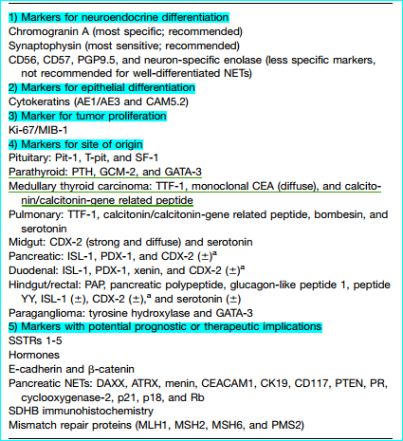

Slide 26
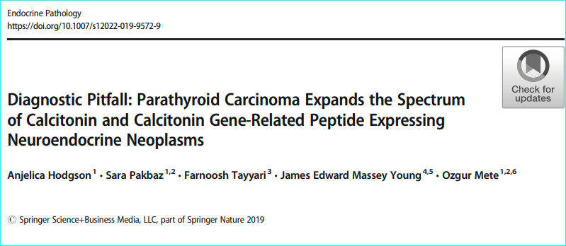
Department of Laboratory Medicine and Pathobiology, Faculty of Medicine, University of Toronto, Toronto, ON, Canada

Slide 27
Case History : A 59-year-old man with primary hyperparathyroidism (PTH 76 pmol/L, normal 2–9) - hypercalcemia (3.4 mmol/L, normal 2.15–2.55) CT & Sestamibi scan: localized left thyroid neck mass Intraoperatively, 2 cm mass attached to inferior aspect of left thyroid lobe: En bloc resection of mass with left lobe + Right hemithyroidectomy for nodular goiter. Post op : PTH have significantly dropped (5.6 pmol/L): supporting uniglandular source

Slide 28
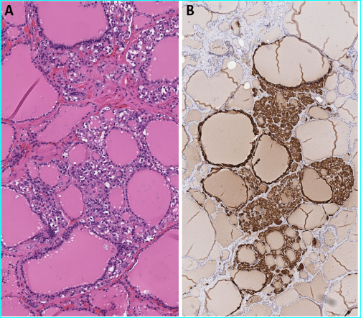
C-cell hyperplasia Both thyroid lobes Calcitonin IHC confirmed : C-cell hyperplasia

Slide 29
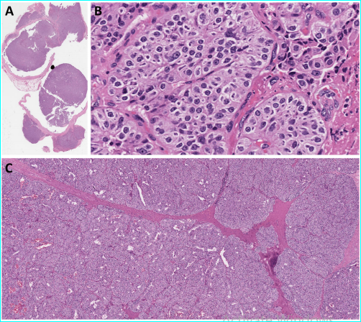
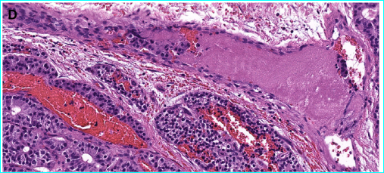
locally invasive nodular growth Epithelial cells: nuclear enlargement, variable perinuclear clearing Band-forming fibrosis
Angioinvasion
( Intravascular tumor cells admixed with thrombus)

Slide 30
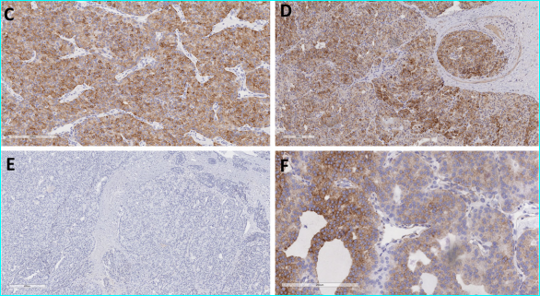
Diffusely + PTH
GATA-3
Confirming parathyroid origin
+ calcitonin
+ CGRP
calcitonin gene-related peptide
- monoclonal CEA
Reduced expression for bcl-2 (f)

Slide 31
+ Chromogranin-A* , low molecular weight keratin (CAM5.2) - Thyroglobulin ?, TTF-1* Ki67 labeling index : 6 %* Overall, combined clinical, morphological, and immunohistochemical features: Dx: Parathyroid carcinoma with aberrant calcitonin & CGRP expression.
What Is Your Diagnosis?

Slide 32
RET germline testing; No pathogenetic RET variants. Somatic and/or germline CDC73/HRPT2 : were not investigated Given the absence of RET germline mutations, bilateral C-cell hyperplasia is considered to represent a secondary phenomenon to PHPT related hypercalcemia.

Slide 33
PC is a rare epithelial malignant neuroendocrine neoplasm . Parathyroid glands often stain with PTH. most ,PTH immunoreactivity sufficient to confirm parathyroid origin in the appropriate morphological and clinical setting It should be recognized that PTH or PTHrp can be expressed by other neuroendocrine neoplasms Furthermore, metastases to the parathyroid glands, although rare, do not only cause diagnostic challenges but have also been shown to cause deranged calcium homeostasis .
Comment

Slide 34
Unlike hormones, developmental transcription factors are rarely aberrantly expressed in well-differentiated neuroendocrine neoplasms. Therefore, the use of transcription factors in association with hormones and other specific site specific biomarkers has a better diagnostic accuracy in the confirmation of the cellular origin Positivity for PTH along with TF, GCM2 (a master regulatory gene for parathyroid development) and/or GATA-3 (a TF in embryological development of parathyroid gland & adult proliferation of mature parathyroid tissue) confirms parathyroid origin .

Slide 35
Most diagnosticians consider calcitonin positivity to be a diagnostic biomarker of MTC; however, calcitonin along with CGRP expression is not specific to MTC. These tumors are often distinguished from other tumors by: Coexpression << CEA + calcitonin and/or CGRP>> Several neuroendocrine neoplasms can be + ive for calcitonin and/or CGRP including : head & neck regions, pulmonary, thymic and pancreatic origins) .

Slide 36
While diffuse positivity for PTH and GATA-3 and negativity for TTF-1 and monoclonal CEA confirmed the parathyroid origin in this case, expression for calcitonin and CGRP was an interesting finding.

Slide 37
-Symptomatic hypercalcemia
-Biochemical :
High level of PTH, negative serum calcitonin (R/O Hook effect)
-Absence of MTC in thyroid gland
-Negative CEA in IHC study
Dx: METASTATIC PARATHYROID CARCINOMA

Slide 38
TREATMENT EXTENT OF RESECTION (for resectable dx) Preoperatively suspected PC Parathyroidectomy or en-bloc resection of parathyroid mass & any adjacent tissues that invaded by tumor . En-bloc resection : Ipsilateral thyroid lobe, paratracheal alveolar & lymphatic tissue, thymus, neck muscles, RLN It is important to avoid capsular violation or tumor spillage.

Slide 39
Principles of en Bloc Surgery 1.Exploration of all four glands R/O multi glandular carcinomas 2. bloodless field, ensures no injury to neighboring structures 3. Minimal manipulation 4. Careful inspection for any tumor 5. Nodal involvement necessitates a regional lymph node dissection of that compartment. It is important to note that prophylactic lateral neck dissection has not improve survival, is associated with an increased morbidity: not recommended 6. In most cases, RLN can & should be preserved. Evidence of RLN involvement: it may be resected with tumor
Cancers 2019, 11, 1676

Slide 40
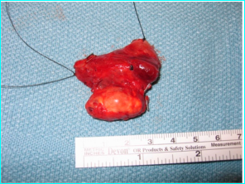
During resection the adenoma ( suspicious features): large mass, whitish capsule, adherence to adjacent structures: En bloc resection En bloc resection has an 8% local recurrence rate, long-term overall survival rate of 89%. Pts often not assessed for PC: initial sx may not address wide resection. Recurrence occurs : 2 - 5 years after surgery, local recurrence rate : 33% - 82% at 5 years. Diffuse metastatic disease are less likely to benefit from surgical resection.

Slide 41
who diagnosed preoperatively with PC & en bloc resection : recurrence rate of 33% compared to those who were diagnosed after their initial surgery: recurrence rate of >50% * L.N involvement in PC is more infrequent < recurrence in neighboring soft tissue structures L.N examined at the time of surgery : data has not shown a difference in the rate of metastases or death sensitivity analysis performed in the same study show: increased likelihood of positive lymph nodes in tumors larger than 3 cm
Cancers 2019, 11, 1676

Slide 42
Patients with poor outcomes : - Incomplete resection - Positive surgical margins - Tumor seeding - History of recurrence - local excision rather than en bloc resection have poor outcomes. For localized recurrent tumors, a cervical and/or mediastinal exploration with wide resection is recommended.

Slide 43
Postoperatively diagnosed Reoperation with ipsilateral thyroidectomy is frequently performed. If a parathyroid tumor appears to be well demarcated but is found on pathological examination to invade adjacent tissue: reoperation to remove all tumor tissue is recommended because there are no pathologic criteria that distinguish a carcinoma that will follow an indolent course from one with a more aggressive course.

Slide 44
(for resectable dx) Metastatic disease (Cervical lymph nodes, lungs, liver and bone.) Nonsurgical Tx : disappointing Surgical resection of distant metastases (bone and lung) has been performed in some circumstances, primarily to debulk tumor as palliation of the effects of hypercalcemia . Recurrent disease Also be treated surgically Most recurrences : neck Resection result in significant palliation of hypercalcemia. Reoperations are associated with morbidity Complications: most commonly RLN palsies = 32%. Preoperative localizing studies are recommended to minimize morbidity

Slide 45
Postoperative management - Monitoring serum calcium Close monitoring of the patient's serum calcium . Patients in whom the preoperative serum calcium is very high may develop the "hungry bone syndrome" after the tumor is completely removed (This may be exaggerated in patients who received preoperative bisphosphonates for hypercalcemic crisis) - Role of adjuvant radiation therapy We do not routinely administer adjuvant radiation, because: 1. difficult to differentiate atypical parathyroid adenomas from carcinoma at initial Sx 2. difficulty of subsequent neck surgery The experience limited to small observational studies

Slide 46
Unresectable disease When PC is widely disseminated and no longer amenable to surgical resection: prognosis is generally poor. Palliative radiation Tx (bone metastases / locoregional dx) has been reported.

Slide 47
Major morbidity & mortality result from: severe hypercalcemia Adequately controlling hypercalcemia can prolong survival Controlling hypercalcemia Initial treatment is similar to management in patients with hypercalcemia due to other causes
Postoperative management

Slide 48
Bisphosphonates Zoledronic acid or pamidronate are preferred agents . zoledronic acid, which is more potent than pamidronate in hypercalcemia of malignancy ,would also be effective for hypercalcemia due to PC , although this effect has not yet been documented. Administration & dosing : to treat hypercalcemia due to PC are the same as those to treat other causes of hypercalcemia.
Postoperative management

Slide 49
Calcimimetics For refractory to bisphosphonates Calcimimetic drugs reduce PTH secretion by increasing sensitivity of calcium-sensing receptor Cinacalcet, a longer-acting calcimimetic drug, is approved by FDA for: 1. hypercalcemia in PC 2. 2` hyperpara associated with renal failure 3. Severe hypercalcemia in PHPT unable to parathyroidectomy

Slide 50
Initial dose of cinacalcet : 30 mg twice daily Increased sequentially every 2 to 4 weeks: (60 mg twice daily, 90 mg twice daily, 90 mg three times or four times daily) Depending : calcium level & tolerance Nausea & vomiting often limit increase dose Ca & P should be monitored within 1 week of dose initiation /adjustment. If a maintenance dose is achieved: every 1 to 2 mo

Slide 51
Calcimimetics In a 16-week, study of 29 patients with inoperable PC cinacalcet (to achieve calcium ≤10 or up to 90 mg four times daily) successfully reduced calcium by at least 1 mg/dL in 62 % of patients Adverse events (nausea, vomiting, headache, dehydration) were common discontinuation in five patients.

Slide 52
Denosumab Option for hypercalcemia refractory to bisphosphonates & cinacalcet. Potent inhibitor of bone resorption In case reports, denosumab, typically used as monotherapy, effectively controlled refractory hypercalcemia in PC previously treated with surgery, bisphosphonates, calcium receptor agonist, and dacarbazine . In one patient, high-dose (120 mg) monthly denosumab was required to reduce severely elevated serum calcium levels . Stabilization of serum calcium may last for a few weeks or as long as two years.

Slide 53
Other Treatment Modalities for PC The primary goal in metastatic disease is : controlling PTH-driven hypercalcemia. Calcitonin, glucocorticoids, mithramycin, plicamycin, gallium nitrate as well as hemodialysis in addition to generous hydration. These medications decrease calcium in short term, but long-term remission is rarely seen.

Slide 54
Novel precision/molecularly targeted cancer therapy Some metastatic/surgically incurable PC can carry tumor-specific mutations (PIK3CA or MTOR mutations) against which new targeted therapeutic agents may already exist. Inclusion of PC patients in "basket" clinical trials of new targeted agents, in which eligibility is based a particular driver mutation without regard to the tissue/histologic origin of tumor, should be seriously considered when clinically appropriate.

Slide 55
Chemotherapy In general, reduce tumor burden with chemotherapy : disappointing Given the rarity of PC, chemotherapy has been difficult to evaluate systematically, & there are no prospective randomized trials One patient with pulmonary metastases responded to treatment with : dacarbazine, 5-fluorouracil, cyclophosphamide with normalization of calcium for 13 mo Another with recurrent disease responded to dacarbazine alone with a two-month normalization of serum calcium .

Slide 56
Chemotherapy There is no standard chemotherapy regimen for PC Most of experience comes from a limited number of case reports. Regimens include: monotherapy: Dacarbazine combination : - Fluorouracil, cyclophosphamide, dacarbazine - Methotrexate, doxorubicin, cyclophosphamide, lomustine. There is no survival benefit associated with chemotherapy in PC

Slide 57
Radiotherapy PCs are usually radiotherapy resistant Radiation tx as primary tx has not been shown any significant effect either locally /distant sites. External-beam adjuvant radiotherapy may be considered in: high-risk or positive surgical margins 1. One study : local recurrence rate is lower independent of the surgical procedure or stage, in addition to improved disease-free survival. 2. A study at Mayo Clinic : in aggressive tumors , radiation after surgery achieved better locoregional disease control Adjuvant radiation therapy does not appear to affect survival but there is some evidence that decreases locoregional disease progression.

Slide 58
Biotherapy Gene products Parafibromin, inhibitor of cell proliferation Telomerase inhibitors : azidothymidine Immune therapy Novel emerging therapies with encouraging in vitro results & may prove useful clinically in the future

Slide 59
Other modalities : radiofrequency ablation and transcatheter arterial embolization for diffuse metastatic disease & ultrasound-guided percutaneous alcohol injection for unresectable disease. Insufficient information is available These therapeutic options should be decided on a case-by-case basis.

Slide 60
FOLLOW-UP AND NATURAL HISTORY Require lifelong F/U as at least half develop recurrent disease Average time to recurrence: is slightly over 33 mo The rate of recurrence is higher : -When diagnosis is not initially known and en bloc parathyroidectomy is not performed -disruption of parathyroid capsule occurred

Slide 61
FOLLOW-UP AND NATURAL HISTORY PTH & calcium should be initially every 6 mo & then annually (CANCER 2019: every 3 mo up to 1 y) If there is biochemical evidence of persistent disease: Ultrasound of neck is the best next step. Whole-body sestamibi scan ,CT or MRI of chest, neck, abdomen, for metastases. The sensitivity (neck) : Ultrasound 69%, Sestamibi 93%, CT 79%, MRI 67% If these noninvasive studies are nondiagnostic: selective venous sampling for PTH to localize site of recurrence There is no role for imaging in patients in whom calcium & PTH levels are normal (1)

Slide 62
COURSE AND OUTCOME It appears that the disease typically follows one of three courses: -1/3 cured at initial or follow-up surgery, -1/3 recur after a prolonged disease-free survival but may be cured with reoperation, -1/3 experience a short & aggressive course .

Slide 63
COURSE AND OUTCOME As noted, the recurrence rate is high, even after seemingly successful surgery. In several other older studies, the combined 5- and 10-year survival rates varied from 50 to 70 and 13 to 35 percent, respectively ,with a mean survival time of six to seven years .

Slide 64
COURSE AND OUTCOME Improved survival . Young age Female gender Recent year of diagnosis Smaller tumor size Absence of distant metastases

Slide 65
FOLLOW-UP AND NATURAL HISTORY If isolated distant metastases are confirmed, resection might be helpful in controlling disease both clinically & biochemically. Local recurrence is usually treated with reoperation and resection of cervical and/or mediastinal disease. This often helps to improve symptoms & calcium in up to 75% of patients. Disseminated disease are less likely to benefit & are usually offered medical management

Slide 66
PROGNOSIS With a mean follow-up of 6 years, Talat and Schulte15 showed : 35% : died of disease Relative risk of recurrence : 1.7 Risk increases to 4.3 when there is vascular invasion Failure en bloc resection : relative risk of 2 for reoperation Studies have shown that recurrence is detected on average 2 to 4 years after the initial operation, and these patients have a median survival of 5 to 6 years after the initial diagnosis. Patients with PC may have long survival, but this will typically involve multiple reoperations and a high rate of complications.

Slide 67
THANK YOU…

Slide 68
GENETIC TESTING A subset of patients with sporadic parathyroid cancer has clinically unsuspected germline HRPT2/CDC73 mutations ,and such mutations carry important implications : 1- Management of the patient 2- Early detection or prevention of PC in family members . Indications - Genetic testing for germline HRPT2 mutation is clinically appropriate in most patients with sporadic PC, particularly if there are family members who could benefit from the genetic diagnosis. - Genetic HRPT2 testing is also indicated when PC occurs in a setting of known familial hyperparathyroidism - When are present in the index patient. features suggestive of HPT-JT

Slide 69
GENETIC TESTING It is not known whether germline HRPT2 testing may be indicated in patients with sporadic "atypical" parathyroid adenomas, which exhibit clinical or pathological features suggestive of, but insufficient for, diagnosing . Genetic diagnosis of a germline HRPT2 inactivating mutation in a patient with sporadic PC indicates that such a patient may have classic HPT-JT, expressing its initial manifestation, or phenotypic variants, such as familial isolated hyperparathyroidism, or a form of HPT-JT with altered penetrance of the component features. Pending additional data on variant syndromes ascertained in this fashion, one must conservatively assume they carry a similarly amplified risk of parathyroid cancer (15 %), as is found in classic HPT-JT

Slide 70
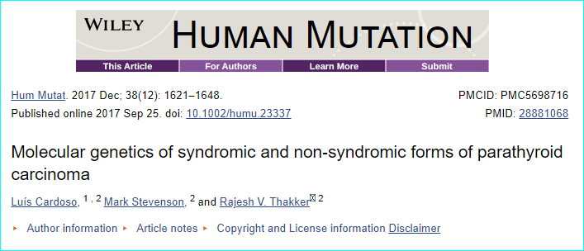

Slide 71
Parathyroid carcinoma in multiple endocrine neoplasia
Gender Age | 1st manifestation | Calcium mg/dL | PTHb pg/mL | Associated conditions | Predicted effect | Notes | References
Male 47yr | Moderate hypercalcemia | 13.6 | 443 | MTC | p.Cys634Tyr | -Unknown primary location -Bone metastasis -No MEN2 FMHX | Jenkins, et al., 1997
Male 49yr | Severe hypercalcemia Osteitis fibrosa cystica | 15.1 | 1399 | MTC | - | -No Unknown primary location of PC -Lung metastasis -Son : pHPT | Alfaro, et al., 2002
Male 54yr | Asymptomatic | 9.2 | 57 | Pheo | p.Cys618Arg | -Uniglandular PC -cervical LN metastasis -Fmhx: MEN2 | Posada‐Gonzalez, et al., 2014

Slide 72
J J Alfaro, C Lamas, J Estrada, T Lucas, Division of Endocrinology and
Nutrition, Clínica Puerta de Hierro, Madrid, Spain
Correspondence to: Dr José Joaquín Alfaro Martínez, Servicio de
Endocrinología y Nutrición, Clínica Puerta de Hierro, C/ San Martín de
Accepted 24 July 2001

Slide 73
CASE REPORT
A 49 y/o man was admitted because of Acute MI.
Total calcium was 3.6 mmol/l
Phosphorus 0.58 mmol/l
Intact PTH 370 ng/l
Dx: PHPT
Sono: compatible with a parathyroid adenoma
Neck exploration : left upper parathyroid gland was removed
pathological study : 12.5 g parathyroid adenoma.
After surgery:
Calcium was 2.67 mmol/l
PTH 118 ng/l.

Slide 74
12 months after surgery repeat cervical surgery for a thyroid nodule casually found in an sono
No pathological parathyroid tissue was found and a right hemithyroidectomy was performed.
Pathology: Medullary carcinoma & Thyroidectomy was completed.
Dx: MEN-2A.
Calcitonin = 75.8 ng/l (normal 23–71) after sx & 57 ng/l 17 months later.
Metanephrines & VMA = nl
Genetic study did not reveal any known mutation in the MEN-2A gene.
The patient didn't have a known familial history of hypercalcaemia or any thyroid or adrenal neoplasia
after this diagnosis his son was studied and a PHPT was discovered. A subtotal parathyroidectomy and total prophylactic thyroidectomy were performed.
Pathology of the thyroid showed hyperplasia of C cells.

Slide 75
6 years after initial diagnosis, chest radiography showed multiple nodular images
CEA = 9.4 μg/l (normal <3) & calcitonin was undetectable.
Dx: metastatic MTC
No additional treatment was administered.
Ten years after the initial diagnosis:
Ca = 3.77 mmol/l
P = 0.84 mmol/l
PTH =1399 ng/l

Slide 76
The patient developed a severe osteitis fibrosa cystica. It was thought that this was caused by a growth of hidden parathyroid adenomatous or hyperplastic tissue
A ^{99m}Tc-sestamibi scan : mediastinic activity compatible with an ectopic parathyroid gland.
MRI: confirmed this finding and showed an increase in the size of the pulmonary nodules.
The patient underwent surgery again to remove the pathological parathyroid tissue and as much metastatic MTC tissue as possible, at which time mediastinic fat was removed and seven pulmonary segmentectomies were performed.
A meticulous pathological study of the mediastinic fat could not find any parathyroid tissue, but both an enlarged lymphatic node and the pulmonary lesions showed parathyroid carcinoma metastasis.
Immunochemistry was positive for PTH and negative for calcitonin in pulmonary samples.
Postsurgical :
Calcium fell to 2.0 mmol/l
PTH to 588 ng/l
CEA to 4.7 μg/l

Slide 77
DISCUSSION
To our knowledge, this is the second reported case of MEN-2A associated parathyroid carcinoma.
We misdiagnosed the pulmonary nodules because no signs of malignancy were found in the pathological study of the original parathyroid samples and because parathyroid carcinoma in MEN-2A is exceedingly rare.
This unusual presentation, with high levels of carcinoembryonic antigen, and the possibility that low basal calcitonin was a false negative result,³ supported the diagnosis of metastatic MTC. The rise in calcium was attributed to growth of parathyroid adenomatous or hyperplastic tissue.
Synthesis of carcinoembryonic antigen is well known in medullary carcinoma,⁴ but has not been reported in parathyroid carcinoma, although it is a very unspecific marker.
Another interesting issue in this case was the initial serum calcium level. Usually MEN-2A associated hyperparathyroidism is mild and develops after the diagnosis of MTC.
The discordance between high PTH and normal calcium level after surgery in our patient may suggest a low bioactivity of the PTH molecule.

Slide 78
Differential diagnosis Parathyroid adenoma Benign parathyroid neoplasm composed of chief cells, oncocytes or transitional oncocytes or an admixture of these cell types Usually asymptomatic, no palpable mass and grossly smaller than parathyroid carcinoma Serum calcium level elevated but often not as high as carcinoma Scattered mitosis could be seen but high mitotic rate rare and usually lacks atypical mitosis Lack of definitive diagnostic features of parathyroid carcinoma (invasion or metastases Atypical parathyroid adenoma Rare type of adenoma which exhibits some of the features of parathyroid carcinoma such as cytological atypia, mitotic activity, fibrous bands, adherence to adjacent structures, trabecular growth pattern, tumor cells within the capsule Lack of definitive diagnostic features of parathyroid carcinoma (invasion or metastases) Ancillary immunohistochemical markers could be used for differential diagnosis of parathyroid adenoma and carcinoma (ki67, parafibromin, galectin3, PGP9.5, Rb, BCL2, P27, MDM2 and APC) (Endocr Pathol 2018;29:113)

Slide 79
Well differentiated thyroid carcinoma Well differentiated thyroid malignancy arising from follicular epithelial cells Papillary or follicular growth pattern, may have colloid, typical nuclear features for papillary carcinoma, lacks well defined cytoplasmic membrane Positive for TTF1, thyroglobulin; negative for PTH, GATA3 (Endocr Pathol 2018;29:91), PAX8 expression can be overlapped between thyroid and parathyroid tumors and should not be considered as reliable marker for differential diagnosis Poorly differentiated thyroid carcinoma Follicular cell neoplasm that shows limited evidence of follicular differentiation Solid, trabecular or insular growth pattern and lacks well defined cytoplasmic membrane Positive for TTF1, thyroglobulin (reduced expression); negative for PTH, GATA3 (Endocr Pathol 2018;29:91)

Slide 80
Medullary thyroid carcinoma Malignant neuroendocrine tumor derived from C cells of thyroid Also lacks colloid and is positive for neuroendocrine markers and keratin Positive for calcitonin, CEA, TTF1; negative for PTH and GATA3 (Endocr Pathol 2018;29:91) Paraganglioma Nonepithelial tumor originating from neural crest derived paraganglion cells Also positive for neuroendocrine markers and GATA3 (some parasympathetic paraganglioma can be negative for chromogranin A) (Arch Pathol Lab Med 2014;138:182) Negative for keratin (with the exception of paraganglioma of cauda equine and gangliocytic paragangliomas) and PTH; positive for tyrosine hydroxylase (can be negative in parasympathetic paraganglioma) (Endocr Pathol 2018;29:91, Endocr Pathol 2018;29:113) Metastatic neuroendocrine tumors Clinical history, radiological and laboratory findings are important Usually positive for neuroendocrine markers and keratin (Cancer Cytopathol 2016;124:871) TTF1 (lung, but also positive in medullary carcinoma), CDX2 (gastrointestinal), p16 (cervical), ISL1 and PDX1 (pancreatic) useful for detection of primary tumor site (Cancer Cytopathol 2016;124:871)

Slide 81
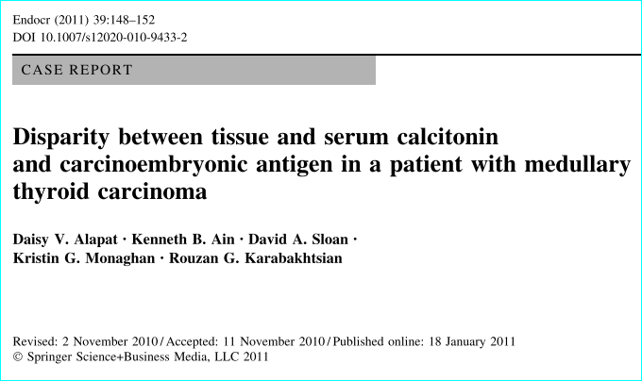

Slide 82
Patient history a 16-year-old woman with a 3-year history of a slowly growing left neck mass causing pressure symptoms & shortness of breath. previous malignancy/exposure to radiation. : - ive There was a history of a thyroidectomy for her paternal great aunt with a thyroid cancer of unknown type & in her paternal great grandmother for unknown reason.

Slide 83
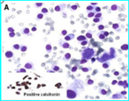
FNA of thyroid mass: neoplastic single cells showing abundant granular cytoplasm, eccentric uniform round to oval nuclei with punctuate chromatin. Strongly positive for calcitonin immunostaining, supporting diagnosis of MTC

Slide 84
Preoperatively: basal serum calcitonin = 4.0pg/ml (nl \4.6 pg/ml) CEA = less than 1 ng/ml (nl \3 ng/ml) catecholamine & fractionated metanephrine = nl Preop CT of the body = negative for other extrathyroidal lesions. Intraoperatively 3-cm hard mass in left thyroid lobe. A total thyroidectomy , complete central compartment nodal dissection ,left modiﬁed radical neck dissection After 3 months postoperatively: serum calcitonin = 0.6 serum CEA = less than 2.0 Over the course of 20 months: Multiple site CT = negative for residual or recurrent disease.

Slide 85
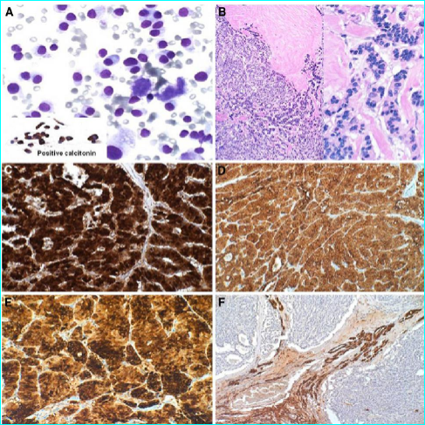
FNA
H&E stained tissue showing tumor cells in nests, cords and follicles with ﬁbrous band outline.
cCalcitonin diffusely positive
d Diffusely positive CEA.
e Diffusely positive chromogranin A.
f Negative thyroglobulin

Slide 86
Strong and diffuse positivity for thyroid transcription factor (TTF-1) Histopathologic & IHC ﬁndings Dx : MTC No invasion or extension All lymph nodes: - ive Germline mutation analysis of the RET proto-oncogene Results did not reveal any deleterious mutation.

Slide 87
Discussion To exclude the possibility of rare metastases from extrathyroidal neuroendocrine tumors to the thyroid that may have a similar histological appearance as MTC and immunohistochemical expression of chromogranin A ,we performed IHC for TTF-1. The primary thyroid origin of this tumor was supported: + TTF-1 + calcitonin - Imaging :excluding any other extrathyroidal source of tumor (lungs) The sporadic (non-familial) presentation is evidenced by: - clinical features of MEN syndromes - germline mutations in clinically relevant regions of the RET protoncogene. - C-cell hyperplasia, typically in hereditary forms of MTC ( normal thyroid tissue)

Slide 88
MTC usually presents as an ill- deﬁned, non-encapsulated, hard, invasive mass that most commonly originates in the upper central lobes of the thyroid. The tumor cells +ive for calcitonin, CEA, chromogranin A / - ive for thyroglobulin. Regional metastases occur early in the disease, while the distant metastases to the liver, lung, bone, brain, and adrenal glands occur later in the course of the disease

Slide 89
It has been shown that calcitonin and CEA are present in normal, hyperplastic, and malignant C-cells. These molecules serve as tumor markers for MTC and are used to support the diagnosis of MTC as well as assist in screening for residual or recurrent disease. Calcitonin and CEA can also be elevated in other malignancies such as : lung, breast, and pancreas in some benign conditions: such as renal failure , inﬂammatory bowel disease, heavy smokers . A signiﬁcant increase of baseline or stimulated (calcium or pentagastrin infusion) calcitonin levels above 1000 pg/ml conﬁrms the presence of MTC. Immunostaining for calcitonin can also be used to detect C-cell hyperplasia, a precursor to clinical MTC .

Slide 90
MTC + Nl basal serum calcitonin + very weak /no calcitonin by IHC = Suggesting a loss of tumor expression of calcitonin Our patient MTC + strongly & diffusely for calcitonin, CEA, chromogranin A, despite NL tumor markers in the circulation. = Failure of extracellular calcitonin secretion This gives support for a potential secretory defect in these tumor cells affecting both CEA and calcitonin.

Slide 91
The ultrastructural studies of MTC cells show cytoplasmic inclusions composed of particulate and ﬁbrillar structures that stain positively for calcitonin . Disintegration of these inclusions is likely needed for the discharge of calcitonin into the cellular matrix and for extracellular secretion. Although there is a small number of cases of MTC reported with low preoperative basal calcitonin, only 2 of such cases reported this ﬁnding in association with a strong immunohistochemical staining of the primary tumor for calcitonin . Our case, along with these two other cases, may constitute an unique subgroup of MTC with abnormal secretory capacity. The clinical consequence of this feature is the need to rely upon radiological evaluation for recurrent or disseminated disease without the beneﬁt of serum tumor markers.

Slide 92
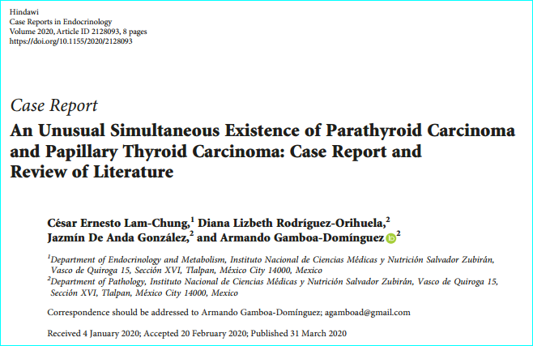

Slide 93
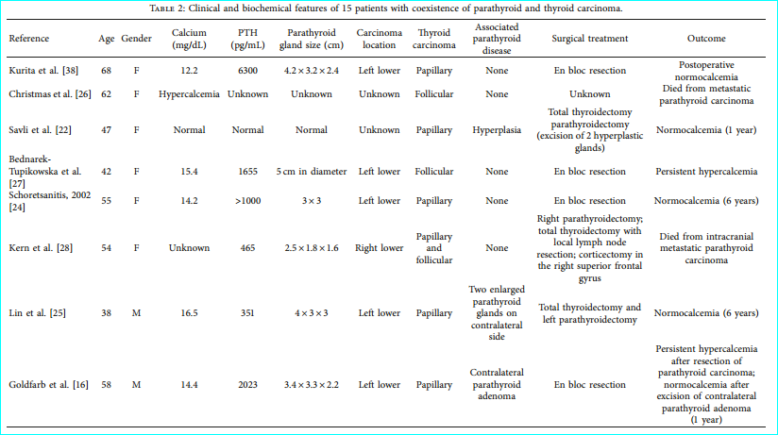

Slide 94
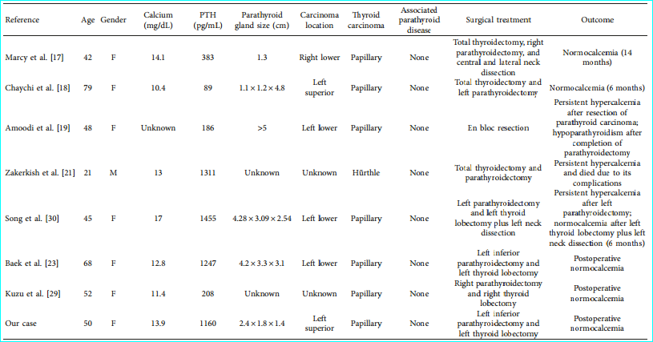

Slide 98
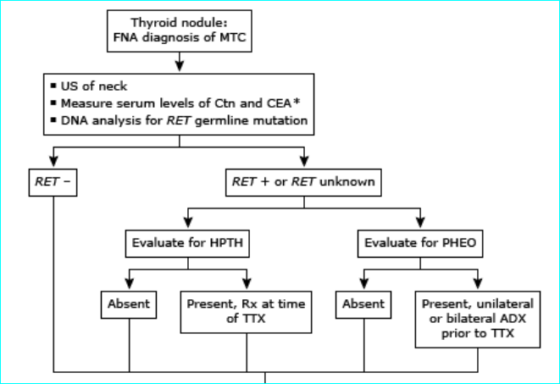
Evaluation and management of patients with medullary thyroid cancer diagnosed on the basis of fine needle aspiration biopsy of a thyroid nodule

Slide 100
Genetic screening in sporadic MTC — We suggest germline RET testing in all patients with newly diagnosed C cell hyperplasia or apparently sporadic MTC. Initial germline testing in patients with C cell hyperplasia or apparently sporadic MTC should include sequencing of exons 10, 11, and 13 through 16 of the RET gene. Sequencing of the remaining exons in the RET gene should be considered in patients with clinical features or family history highly suggestive of hereditary medullary syndromes who demonstrate no mutations in exons 10, 11, or 13 through 16 [40]. While it is possible for clinicians to directly order genetic testing from reference laboratories, we strongly encourage consultation with genetic counselors who are familiar with both the ethical issues and legal informed consent requirements (which can vary significantly in different regions) that are involved in germline testing [1]. When the index patient is positive for a germline mutation, family members should be offered genetic counseling and genetic screening

Slide 101
An important question is what proportion of patients with apparently sporadic MTC have unsuspected germline mutations in the RET proto-oncogene (the underlying defect in MEN2) and, therefore, have heritable disease. Studies of unselected patients with MTC have found, on average, that approximately 6 to 7 percent (range 1.5 to 24 percent) have germline RET mutations [41-45]. In one report, 35 of 482 patients (7.3 percent) with apparently sporadic MTC had mutations, and in 18 of these 35, gene carriers were identified in relatives [45]. Seventy-five percent of the familial medullary cases had no prior family history. A much higher percentage (approximately 60 percent) of patients with sporadic MTC have somatic (acquired) mutations in the RET gene within the tumor cells (table 1) [46-49]. These mutations are present only in the tumor cells and are not detected by standard genetic testing, ie, using leukocyte DNA. The presence of somatic RET mutations correlate with lymph node metastases, persistent disease, and lower survival [50]. However, in one study, only mutations in exons 15 and 16 of the RET gene were associated with the worse prognosis, while those in other exons had a more indolent course [48]. Since it is unclear how knowledge of a specific somatic (acquired) RET mutation should impact clinical management, we do not routinely test tumor samples.

Slide 102
Testing for coexisting tumors — Most patients require biochemical evaluation for coexisting tumors (particularly pheochromocytoma and hyperparathyroidism) prior to thyroidectomy. Even when genetic screening is performed preoperatively, the results are rarely known prior to surgery. For patients with unknown RET mutational status and for patients who have a germline RET mutation, we measure :
Serum calcium (to rule out hyperparathyroidism requiring concomitant surgical intervention). ● Plasma fractionated metanephrines (as the initial screen for pheochromocytoma). Normal plasma fractionated metanephrines values exclude a symptomatic catecholaminesecreting neoplasm, but mildly elevated values of normetanephrine could be falsely positive, in which case additional evaluations including 24-hour urinary fractionated metanephrines, catecholamines, and adrenal imaging may be required to effectively rule in or rule out pheochromocytoma prior to surgery. Adrenal imaging should not be performed unless there is biochemical evidence suggesting a possible pheochromocytoma.
In a patient with negative RET proto-oncogene testing and no family history of MEN2 syndrome, biochemical testing for coexisting tumors is typically not required.

Slide 103
Stage I – Medullary thyroid cancers (MTCs) that are less than 2 cm in diameter without evidence of disease outside of the thyroid gland ● Stage II – Tumors >2 cm confined to the thyroid or tumors of any size without lymph node metastasis that demonstrate gross extrathyroidal extension invading only the strap muscles (sternohyoid, sternothyroid, thyrohyoid, or omohyoid muscles) ● Stage III – Tumors of any size demonstrating metastatic lymph node involvement in the central neck (levels VI or VII; pretracheal, paratracheal, or prelaryngeal/Delphian, or upper mediastinal lymph nodes) with or without gross invasion into the strap muscles (sternohyoid, sternothyroid, thyrohyoid, or omohyoid muscles) ● Stage IV – Any distant metastases, or lymph node involvement outside of the central neck (level VI/VII), or gross invasion into other structures of the neck (beyond just strap muscle involvement)

Slide 104
Surgical treatment and prognosis
Patients with medullary thyroid cancer (MTC) can be cured only by complete resection of the thyroid tumor and any local and regional metastases.
For patients with residual or recurrent disease after primary surgery or for those with distant metastases, the most appropriate treatment (surgery, chemotherapy, or radiotherapy) is less clear
PREOPERATIVE EVALUATION
Newly diagnosed MTC:
calcitonin, CEA, ultrasonography of the neck
genetic testing for germline RET mutations (can be performed pre or postoperatively), in all patients who have either unknown RET mutation status or a germline RET mutation, biochemical evaluation for coexisting tumors (especially pheochromocytoma)
local lymph node metastases on ultrasound /preop basal calcitonin >500 pg/mL (high risk of local or distant metastatic disease):
Additional imaging is required to assess for metastatic disease.

Slide 105
For patients with sporadic MTC:
we recommend total thyroidectomy rather than lobectomy for initial therapy (Grade 1B).
Owing to the multicentric and bilateral nature of hereditary MTC (and its precursor C cell hyperplasia), total thyroidectomy is the only way to cure hereditary MTC
MTC confined to the neck
Up to 10 percent of patients with sporadic MTC & all inherited MTC have bilateral or multifocal disease The extent of cervical lymph node dissection depends on the findings on preoperative ultrasound as well as intraoperative identification of lymph node metastases prophylactic lateral neck dissection.
Small intrathyroidal MTCs & preop calcitonin <20 pg/Ml (as metastatic lymph nodes are exceedingly rare in this ) :
Prophylactic central neck dissection is not required
For patients with MTC confined to the neck and no evidence of involved cervical lymph nodes on preoperative ultrasound:
we routinely perform bilateral dissection of the central lymph node compartment without prophylactic lateral neck dissection.
For patients with evidence of central cervical lymph node involvement:
dissection of the involved lateral neck compartment is also performed.

Slide 106
Lateral lymph node dissection – Whether or not to perform lateral neck dissections in the absence of ultrasonographically identifiable lymph node metastases as part of the primary surgery remains controversial. The lateral jugular and mediastinal nodes should be carefully evaluated intraoperatively, followed by modified neck and/or mediastinal dissections only if positive nodes are identified. Although we do not routinely advise lateral neck dissections in the absence of identifiable lymph node metastases (regardless of the serum calcitonin level), dissection of the ipsilateral lateral lymph node compartment is performed for patients with intraoperative evidence of central lymph node involvement. ● In one study, ipsilateral lateral lymph node metastases were found in 10 percent of patients with no central node involvement, 77 percent of patients with one to three central nodes, and 98 percent of patients with more than four central nodes; contralateral lateral lymph node metastases were found in 4.9 percent of patients with no central nodes, 38 percent of patients with one to nine central nodes, and 77 percent with more than nine central nodes [9]. The American Thyroid Association (ATA) guidelines committee could not achieve a consensus agreement on this topic but did recommend that prophylactic lateral neck dissections "may be considered based on serum calcitonin levels" [2]. Some members recommended against routine prophylactic lateral neck dissections if there was no evidence of disease on preoperative neck ultrasound. Other members utilized preoperative calcitonin values to guide the extent of prophylactic neck dissections by recommending prophylactic ipsilateral central and ipsilateral lateral neck dissection for patients with basal serum calcitonin values >20 pg/mL and prophylactic dissection of uninvolved contralateral lateral neck compartments for serum calcitonin >200 pg/mL [2].

Slide 107
The primary argument in favor of routine use of prophylactic lateral neck dissection in patients with a preoperative basal calcitonin level of ≤1000 pg/mL is that at least one-half of them will achieve biochemical cure (calcitonin <10 pg/mL) [4]. Since a biochemical cure is associated with 98 percent 10-year survival and approximately 3 to 4 percent recurrence rate, proponents of prophylactic lateral lymph node dissection argue that the benefits outweigh the additional risks and complications associated with routine use of prophylactic lateral neck dissections when done by experienced surgeons [10-12]. The counter argument is that long-term survival rates are also excellent in patients with a biochemical incomplete response to initial therapy (abnormal postoperative calcitonin in the absence of structural disease progression), ranging from 90 to 100 percent at 10 years of followup, with the highest survival rates seen in patients with intrathyroidal MTC without evidence for local or distant metastases [10,13,14]. Thus, the excellent outcomes attributed to more aggressive upfront resection of the lateral compartment subclinical lymph nodes may be more related to the underlying biology of the disease rather than to our therapeutic interventions. Furthermore, routine use of prophylactic lateral neck dissections will expose patients to additional morbidity, particularly knowing that most of these surgeries are not done by high-volume, very experienced surgeons. Thus, it remains unclear if there is truly a survival benefit from more aggressive upfront lymph node dissection done in an effort to achieve an initial excellent response to therapy as opposed to a more measured surgical intervention, recognizing that some patients will have a biochemical incomplete response that may or may not require additional therapy in the future based on followup imaging and the trend in calcitonin/carcinoembryonic antigen (CEA) values.

Slide 108
Ultrasound evidence of cervical lymph node involvement :
For patients with MTC involving the thyroid and known cervical lymph nodal involvement preoperatively, total thyroidectomy with bilateral central compartment dissection and dissection of the involved lateral neck compartment(s) is the preferred initial treatment. In addition to compartment-oriented dissection of the clinically involved ipsilateral neck, prophylactic neck dissection of uninvolved contralateral neck compartments should also be considered in patients with a basal calcitonin level greater than 200 pg/mL if there is no evidence of distant metastases

Slide 109
Locally advanced or metastatic MTC:
total thyroidectomy + resection of involved lymph node compartments in most patients.
Since the goals of surgery are largely palliative in this setting, a less aggressive surgical approach to the thyroid primary and to lymph node dissection in the central and lateral neck compartments may be warranted in order not to impair speech, swallowing, parathyroid function, and shoulder mobility
In the presence of grossly invasive disease, more extended procedures with resection of involved neck structures may be appropriate in properly selected patients, but function-preserving (speech, swallowing) approaches are preferred.
Disfiguring radical neck dissections do not improve prognosis and are not indicated. The surgical approach should be individualized based upon the patient's wishes, life expectancy, and other medical comorbidities

Slide 110
For patients with locally advanced or metastatic disease:
total thyroidectomy with resection of involved lymph node compartments is performed in most patients.
However, since the goals of surgery are largely palliative in this setting, a less aggressive approach to both the primary tumor and to locoregional metastases may be warranted.
Thyroxine therapy should be started immediately after surgery.
Goal : Euthyroidism.
Suppression of TSH is not indicated in patients with MTC, because C cells are not TSH responsive.
Similarly, adjuvant therapy with radioiodine is not indicated, because the tumor cells do not concentrate iodine.
Treatment options for patients with recurrent/residual disease :
observation/active surveillance, surgical resection, external beam radiation therapy (EBRT), and other directed therapies (such as radiofrequency ablation, cryoablation, embolization) or systemic therapies. Choice of therapy depends upon clinical factors and the potential morbidities of therapy

Slide 111
POSTOPERATIVE MANAGEMENT
Monitor for postoperative complications
monitored closely for the development of hypoparathyroidism
injury to either the recurrent or superior laryngeal nerves.
Thyroxine therapy
Assessment of tumor samples for somatic mutations :
Somatic mutations in RET, HRAS, KRAS, or, rarely, NRAS can be identified in tumors of patients with sporadic MTC.
In some [17-19], but not other [20], studies, tumors with an identifiable RET mutation had a more aggressive course than those without a mutation.
Nonetheless, we agree that somatic mutational analysis of tumor samples is not required as part of routine clinical care
SUBSEQUENT MANAGEMENT After thyroidectomy, it is important to evaluate patients to determine if surgery was curative [10]. We measure serum calcitonin and carcinoembryonic antigen (CEA) to assess for cure. Subsequent management depends upon these values. ???

Slide 112
Management of persistent/recurrent disease — Treatment options for patients with recurrent/residual disease include observation/active surveillance, surgical resection, EBRT, and other directed therapies (such as radiofrequency ablation, cryoablation, embolization) or systemic therapies. In the past, patients with identifiable residual or recurrent MTC were operated on routinely. However, despite routine lymphadenectomy or excision of palpable tumor, their serum calcitonin concentrations often did not normalize after surgery [51]. This has led to a more critical evaluation of the need for and timing of therapeutic interventions and reevaluation of the role of cautious observation in properly selected patients. The following approach to management of residual disease is based upon observational studies and clinical experience. The recommended treatment approach for persistent/recurrent disease depends upon a variety of clinical factors, including: Whether or not the disease can be localized ● The volume of disease ● The precise location(s) of the metastatic disease ● Whether or not the disease is causing symptoms ● The rate (or likelihood) of clinically significant structural disease progression

Slide 113
Macroscopic gross residual disease in the thyroid bed or cervical soft tissue metastases – If the gross residual disease is confirmed to be unresectable or if the patient/treatment team agree that a complete surgical resection would produce unacceptable morbidity, we suggest EBRT to improve locoregional control. While systemic therapy (such as tyrosine kinase inhibitors) can be considered in this setting, our preference is to use EBRT to achieve local regional control as the initial treatment unless there are other pressing indications to begin systemic therapy.
Symptomatic or large-volume locoregional lymph node disease – Resection of large-volume locoregional lymph node disease may be necessary to prevent invasion into surrounding major structures. Occasionally, lymph node metastases can present as painful lesions that can be readily palliated with surgical resection. However, since additional surgery rarely achieves a biochemical cure if the basal serum calcitonin is >1000 pg/mL or if more than five metastatic lymph nodes were removed with a previous surgery, cautious observation or systemic therapies (tyrosine kinase inhibitors) can be considered for asymptomatic large-volume lymph node metastases detected in this setting. ● Symptomatic or large-volume distant metastasis – Rather than immediately initiating systemic therapy, we prefer to treat individual (or a few) isolated symptomatic or large-volume distant metastases with locally directed therapies such as surgical resection, EBRT, embolization, or radiofrequency ablation. For patients with symptomatic or progressive metastatic disease that cannot be effectively treated by locally directed therapies, systemic treatment with biologic response modifiers (ie, tyrosine kinase inhibitors) may improve progression-free survival. Kinase inhibitors are reviewed in more detail separately

Slide 114
Locally directed therapies are recommended in the following clinical settings:
Large-volume solitary metastatic lesions in the lung, liver, or brain should be considered for surgical resection. Radiofrequency ablation may be an option for smaller peripheral lung metastases. • Oligometastatic lesions in the bone can be treated with surgical resection, EBRT, embolization, and/or antiresorptive agents (eg, bisphosphonates, denosumab). EBRT is often utilized to palliate painful bone metastases or decrease the risk of fracture from progressive growth of a bone metastasis. • Multiple liver metastases may be amenable to localized therapies such as transarterial chemoembolization or, less commonly, percutaneous ethanol ablation or radiofrequency ablation. • • Skin metastases are usually treated with surgical resection or, less commonly, with EBRT

Slide 115
PROGNOSIS Age and stage of disease at the time of diagnosis have been shown to be important factors that influences prognosis [2,6];
the 5- and 10-year disease-free survival rates are higher among patients 40 years old or less as compared with patients over age 40 years (95 versus 65 percent and 75 versus 50 percent, respectively) [6,56].
However, another study found no effect of age if survival was compared with the expected mortality rates in the general population [57]. The 10-year survival rates for patients with stages I, II, III, and IV medullary thyroid cancer (MTC) are 100, 93, 71, and 21 percent, respectively [2,11]. A nomogram that integrates age, gender, postoperative calcitonin, vascular invasion, and TNM (tumor, node, metastasis) status has been developed that can be used to easily predict cause-specific mortality [58].
Calcitonin and carcinoembryonic antigen (CEA) doubling times provide sensitive markers for progression and aggressiveness of metastatic MTC.
Calcitonin doubling times less than 6 to 12 months are associated with poor survival, while doubling times >24 months are associated with a very favorable prognosis [34,35].

Slide 116
Controlling for the effect of age, the prognosis of patients with inherited disease is probably similar to those with sporadic disease [60,61]. Specific germline mutations in RET predict the aggressiveness of the tumor [2]. As an example, patients with multiple endocrine neoplasia type 2B (MEN2B; germline RET mutation codon 918) are more likely to have invasive disease and therefore a worse prognosis than those with either classical multiple endocrine neoplasia type 2A (MEN2A) or familial MTC [60]. In some [17-19], but not other [20], studies, tumors with an identifiable RET mutation (ie, a somatic mutation) had a more aggressive course than those without a mutation. Other factors that may predict a poor prognosis include cellular heterogeneity, paucity of tumor immunostaining for calcitonin [62], prominent tissue immunostaining for galectin-3 [63] or immunostaining for CEA associated with scant or absent tissue staining for calcitonin [64], high preoperative serum CEA [65], a less than 10-fold increase in preoperative calcitonin levels after stimulation with pentagastrin [66], an elevated procalcitonin-to-calcitonin ratio [67], and a rising CEA level associated with a stable or declining calcitonin level.

Slide 118
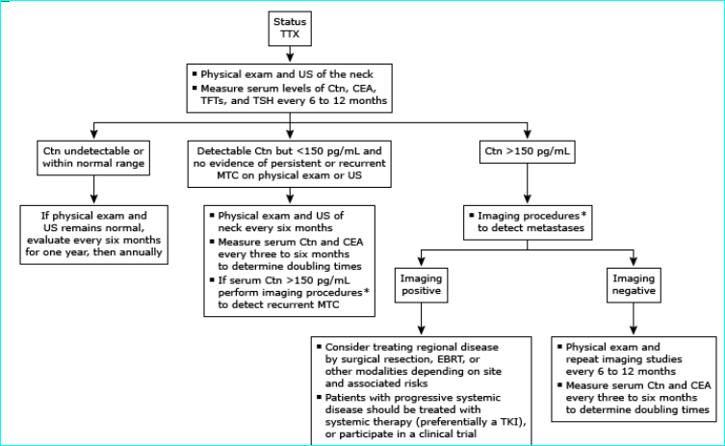
Management of patients following thyroidectomy for medullary thyroid cancer

Slide 119
Chemotherapy and immunotherapy
Patients with progressive or symptomatic metastatic disease who cannot be treated by surgery or radiotherapy should be considered candidates for systemic therapy.
New approaches based upon application of targeted chemotherapies are now available as effective interventions for progressive disease, with additional investigational options emerging.
These may provide some benefit for occasional patients

Slide 120
SUGGESTED APPROACH
The availability of TKIs that can stabilize progressive metastatic disease is changing the standard approach to treating metastatic MTC .
Complete responses are rare, but kinase inhibitors can potentially provide long-term disease stabilization and delay progression in selected patients. However, no study has yet reported these agents' effects to improve survival.
These newer "targeted therapies" have significant toxicities and, therefore, it is important to limit the use of systemic treatments to patients at significant risk for morbidity or mortality due to progressive metastatic disease.
Patients treated with systemic agents should have a baseline performance status sufficiently functional to tolerate these interventions, such as being ambulatory at least 50 percent of the day .

Slide 121
Overall goal of developing new treatments : extend the duration of life without unduly harming quality of life.
Presently, no novel treatment has been demonstrated to improve survival for thyroid cancer patients.
Toxicities of many of these new therapies, although probably less lifethreatening than cytotoxic chemotherapies, are common and can be dose limiting, and clinicians must be familiar with recognizing and managing the side effects if they intend to use these agents.
Finally, low rate of partial response
absence of complete responses
emergence of resistance
all of various monotherapy trials => identify the need to develop either more effective single agents or rational combinations of therapeutic targets
MTCs are NETs of thyroid parafollicular cells that do not concentrate iodine.
The primary treatment for MTC is extensive and meticulous surgical resection.
There is a limited role for external beam radiotherapy.

Slide 122
Asymptomatic metastatic tumors less than 1 - 2 cm in diameter: growing in diameter < 20 % per year:
we recommend not giving systemic therapy (Grade 1C).
Such patients should be monitored for disease progression.
Known sites of metastatic disease should be imaged by CT or MRIevery 6 to 12 mo,
potential new sites of disease should be imaged every 12- 24 mo

Slide 123
● metastatic tumors at least 1 - 2 cm in diameter:
growing by at least 20 % per year:
symptoms related to multiple metastatic foci that cannot be alleviated with surgery or external beam radiotherapy:
We prefer to administer systemic treatment as part of a clinical trial, particularly if a RET-selective inhibitor is appropriate.

Slide 124
For patients with metastatic tumors at least 1 to 2 cm in diameter, growing by at least 20 percent per year, or for patients with symptoms related to multiple metastatic foci who cannot participate in a clinical trial:
- we suggest an oral tyrosine kinase inhibitor (TKI), rather than traditional cytotoxic chemotherapy (Grade 2C).
For initial TKI therapy: we suggest cabozantinib or vandetanib rather than sorafenib or sunitinib (Grade 2C).
Alternative option ( cannot tolerate or who fail multiple TKIs) : Cytotoxic chemotherapy
dacarbazine-based regimens such as cyclophosphamide-vincristine-dacarbazine are preferable
As vandetanib and cabozantinib have both been approved for use in the United States on the basis of randomized phase III trial results, we suggest either drug as an appropriate initial choice of TKI

