Slide 1
IN THE NAME OF GOD
A 20 yrs. Young boy known case of Histiocytosis
Referred for Panhypopituitarism + Hands & feet bigness
Presentation By Dr. Ali Golshaian
20th Tir 1401

Slide 2
Patients ID:
20 yrs. Young man
Born & live in Eslamshahr - Tehran
Educated until Class 11
Working in Box making

Slide 3
Present Illness:
He is referred by one of our colleagues due to:
↓Cortisol + 2nd Hypogonadism + Acromegaloid feature
His recent main problem (~ 1 y) compelling patient to refer to a doctor, is bigness of his feet & hands, also feet & ankle malalignment.
He is known case of Histiocytosis from childhood.

Slide 4
Past medical history:
He is born at 1381.12.06
His mother`s pregnancy (especially 1st trimester) coincided with Chemotherapy, Radiotherapy & Surgery due to Breast tumor.
At under 2 yrs old, probably, polyuria has resulted in diagnosis of DI.
After diagnosis until now, patient uses Spray DDAVP (1 puff / day)

Slide 5
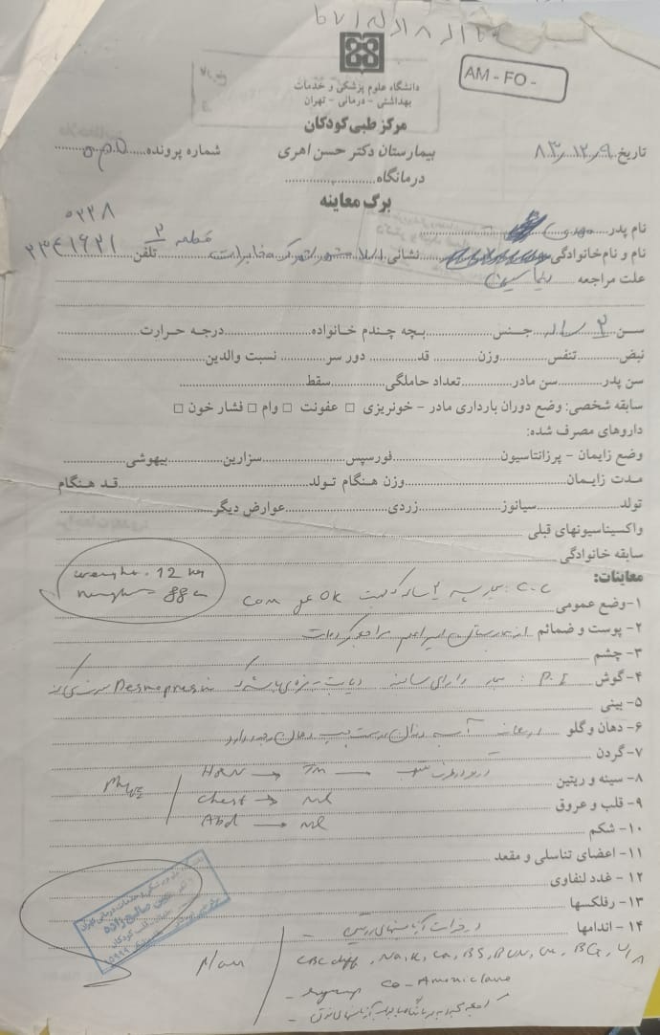
Past medical history:
Document at 1383.12.09 (at 2 yrs Old):
C.C: OK for COM surgery
Hx of DI
Wt: 12 Kg Ht: 88 cm
Left dental abscess
Both TM inflammation
Dental falling – Maxilla

Slide 6
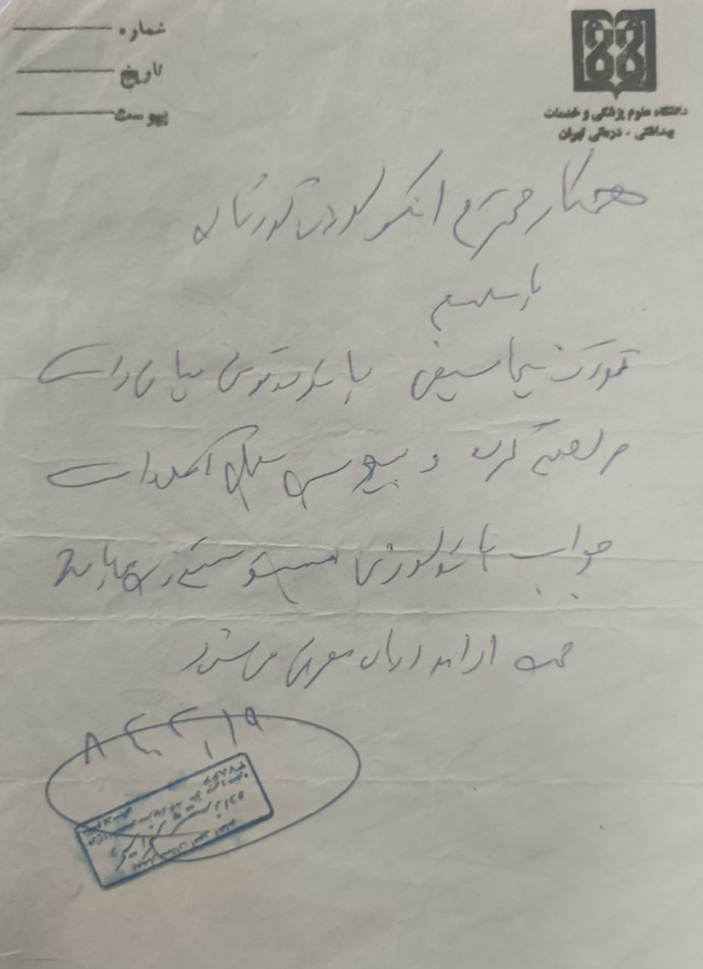
Past medical history:
Document at 1384.02.19:
Referring to
Pediatric Oncologist due to
Pathology of Rt Middle Ear report:
Histiocytosis

Slide 7
Past medical history:
He received regular & programizied Chemotherapy (?) for ~ 3 yrs.
At ~ 3 – 4 yrs old, patient manifested polyphagia & obesity.
He became Obese more over than his same ages.
About 7 yrs old, Second course of chemotherapy was begun with these manifestation: Inflammation in mandible + Dental instability + Cystic lesion in OPG (on base his oncologist documentation)

Slide 8
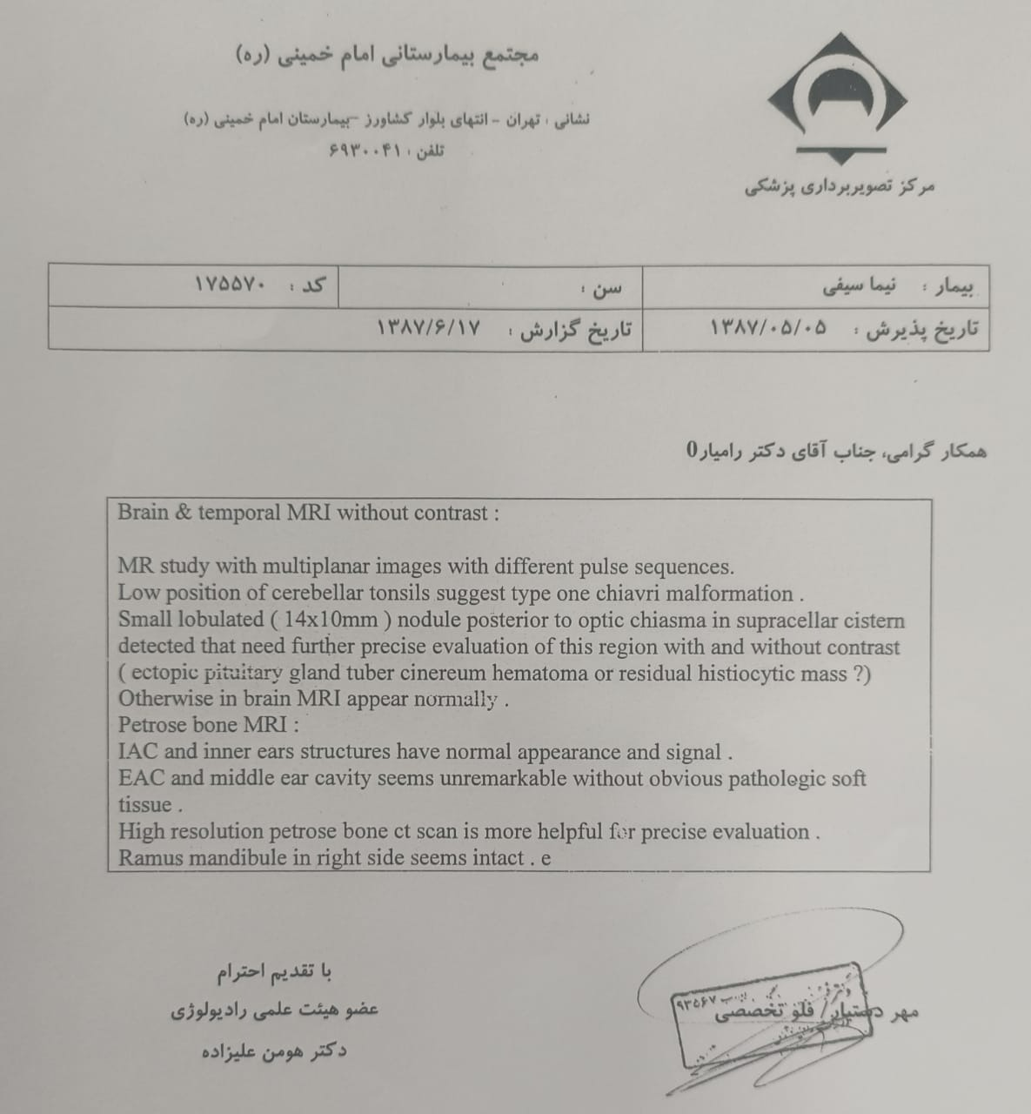
Past medical history:
MRI 1387.06.07
Small lobulated (14*10 mm) nodule posterior to optic chiasma in suprasellar cistern (residual histiocytic mass ?)

Slide 9
Past medical history:
At 1400.11:
After over 10 yrs, He referred to doctor due to Bigness of his feet & hands & his feet malalignment.
He was visited by an Endocrinologist and due to his appearance & delayed puberty some laboratory evaluation was done. >>> Panhypopituitarism was diagnosed & treatment was begun.
During over 10 yrs before recent visiting, without any F/U: His stature among school times, seems be good and about mid range of Nl on base of his father speeches.

Slide 10
Past medical history:
At last, he was referred to this center:
↓Cortisol + 2nd Hypogonadism + Acromegaloid feature

Slide 11
Habitual History:
Neg
Social History :
Neg
Family History :
Neg

Slide 12
Drug History:
Levothyroxine 600 μg / week
Prednisolone 5 mg / day
Testosterone 200 mg / 2 weeks
Spray DDAVP 1 puff / day

Slide 13
Review of Systems:
Hand & Foot Bigness / No Gigantism / No Frontal bossing
Dental problems
Headache (-) Nausea & Vomiting (-) Visual problems (-)
Weight changes (Now: Neg, Hx: +) Appetite changes (Now: Neg, Hx: +)
Skin: Acanthosis nigricans (+)
Cardiovascular: Nl, Palpitation (-)
Respiratory: Nl
Gastrointestinal: Nl,
Musculoskeletal: Nl
Neurological: Nl

Slide 14
Physical Examination:
GENERAL APPEARANCE:
20 yrs. old man with boyish face, awake and alert
Vital Sign: BP: 110/80 mmHg
Height: 176 cm Arm Span: 179 cm
Upper: 87 cm Lower: 89 cm
Weight: 101 kg BMI: 32.6

Slide 15
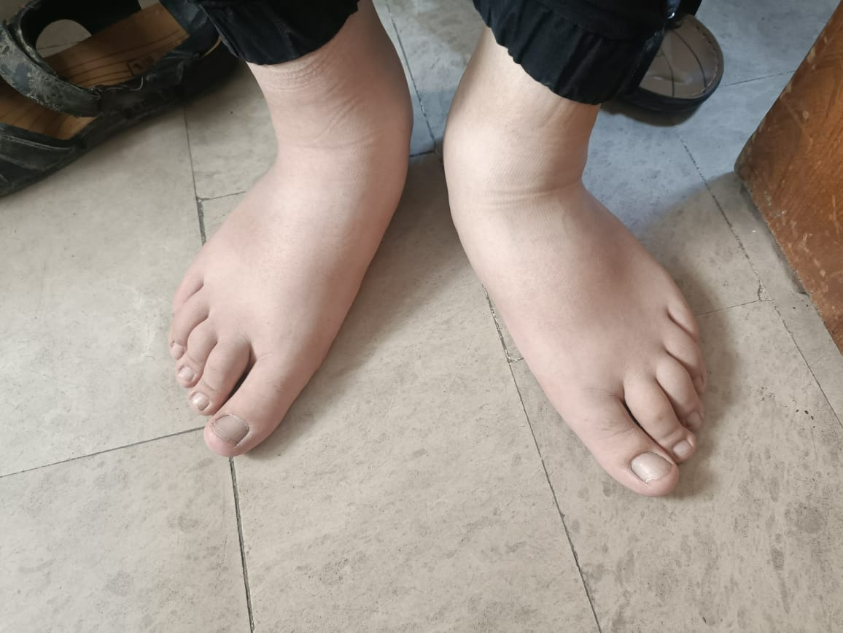
Physical Examination:
Acromegaliod feature: Gigantism (-) / Hand & Foot Enlargement (+) / Frontal bossing (-) / Prominent Nose (-) / Ear Enlargement (-)
Face: Scares beard
Dental problems: Fallings
Neck: Acanthosis Nigricans
Thorax, Heart, Lung: Nl
Abdomen : Nl - Obese
Extremities : Upper : Mild hands enlargement
Lower Mild feet enlargement
Genital: Testis V: 4 cc, SPL: 9 cm >>> G1 P1>2

Slide 16
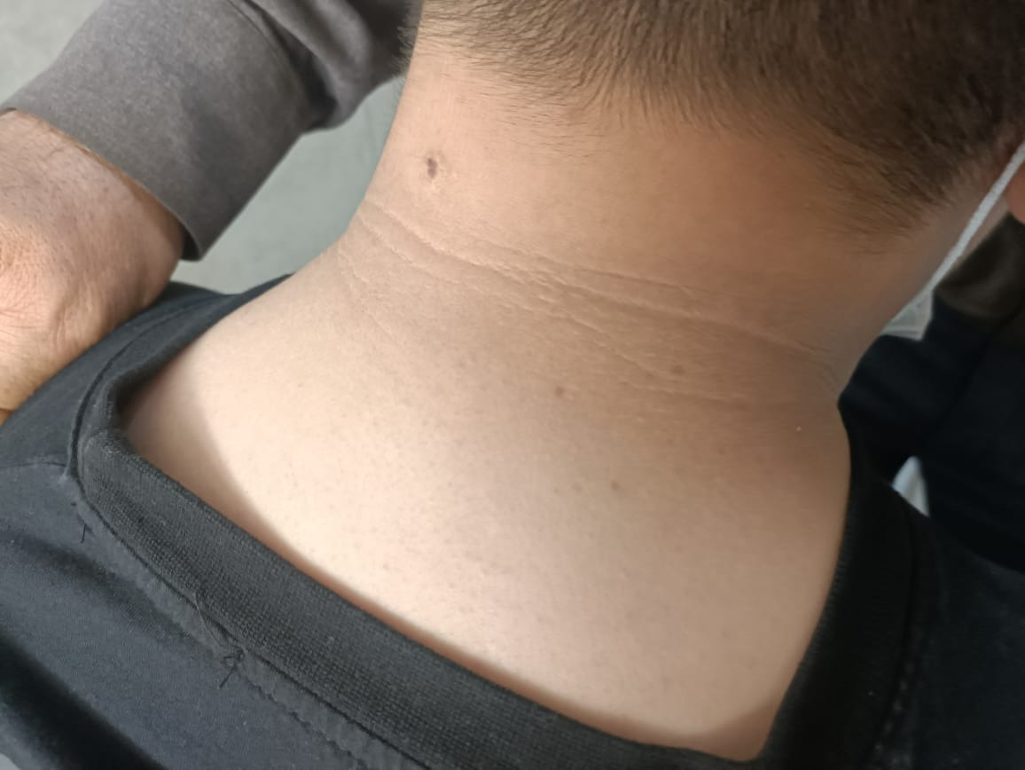
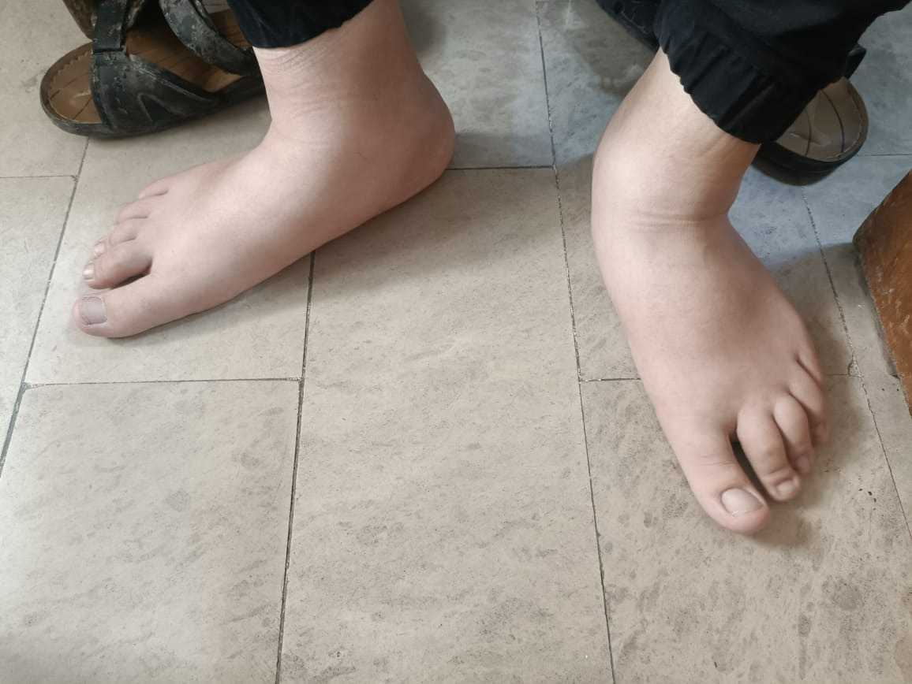
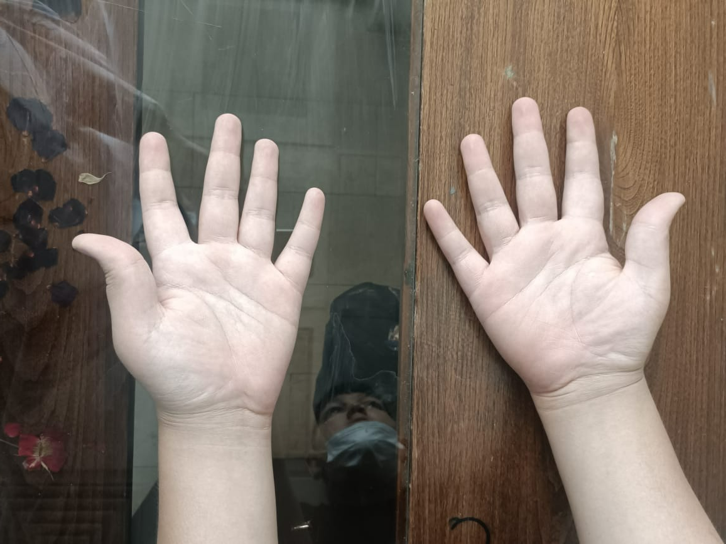

Slide 17
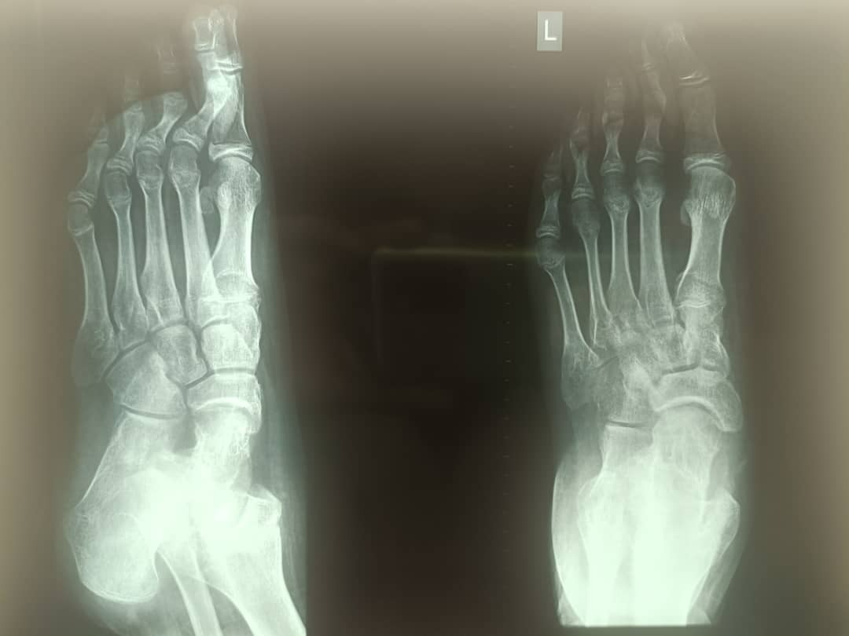
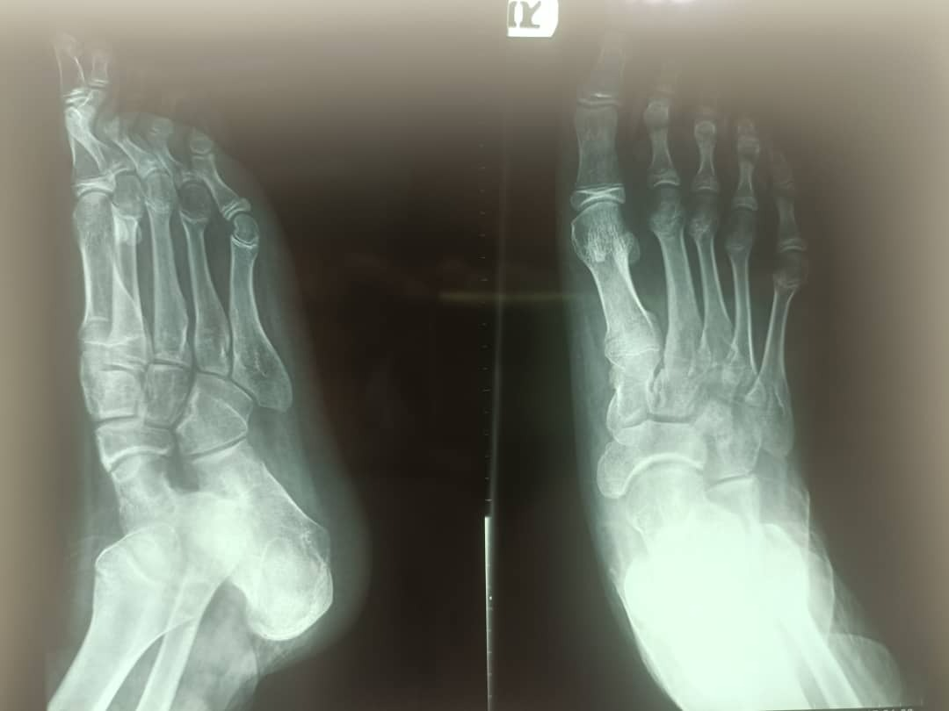
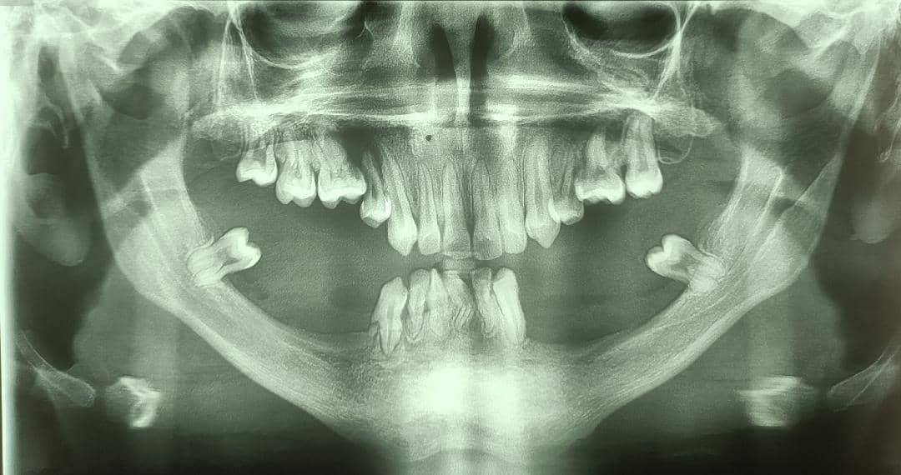
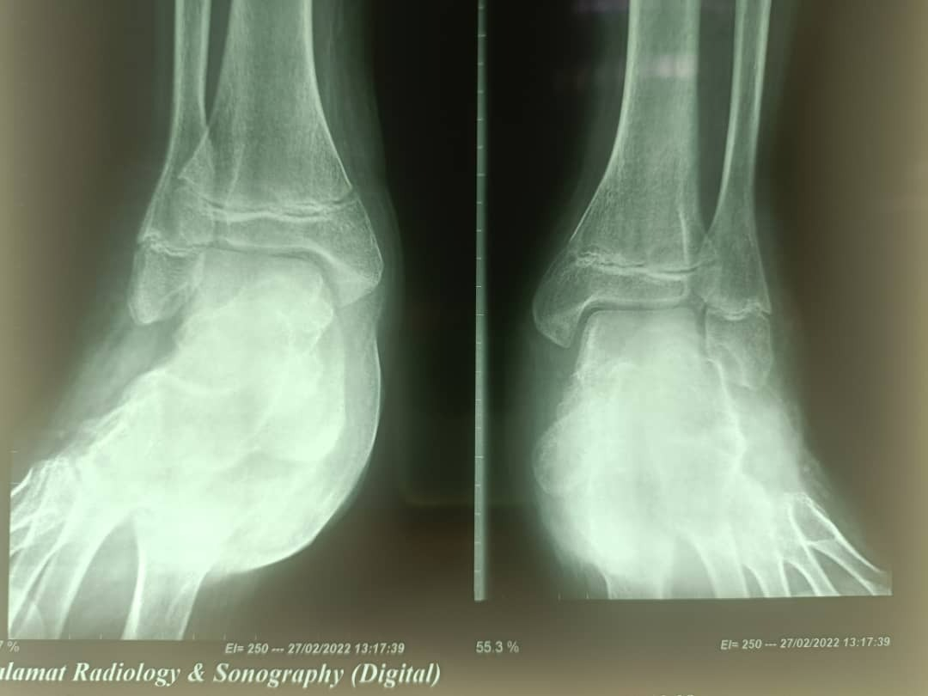

Slide 18
PROBLEM LIST
20 yrs. Young man
known case of Histiocytosis from childhood
1st presentation: DI under 2 yrs old
COM candidate for surgery + Left dental abscess (Maxilla) at 2 yrs old
Normal documented growth until 2 yrs old
Regular & programizied Chemotherapy after Histiocytosis diagnosis
Polyphagia & obesity, about 3-4 yrs old
Recurrent bone involvement (mandible + Dental instability) at 7 yrs old
Another course of chemotherapy
At 19 yrs old: Bigness of his feet & hands & his feet malalignment
He was visited by a Endocrinologist >>> Panhypopituitarism

Slide 19
 | 1400.11.16 | 1401.01.28 | 1401.03.09
IGF1 |  |  | 46.4ng/ml (91-442)
Growth Hormone |  |  | 1.8 nmol/l
GH (60 min) |  |  | 0.45 nmol/l
GH (120 min) |  |  | 0.07 nmol/l
Cortisol 8 AM |  |  | 0.7 ng/ml (3.7-19.4)
ACTH |  |  | 6.19 pg/ml (7-69)
TSH | 4.09 | 0.05 | 1.2
T4 | 2.84 | 6.31 | 7.2
LH | 0.31 mIu/ml (0.8-6) | 0.99 mIu/ml (1.7-8.6)
FSH | 0.86 mIu/ml (0.7-11.1)
Testosterone | <20 ng/dl (118-949) | 1.97 ng/ml (2.49-8.37) | <20 ng/dl (72-853)
Prolactin | 24.78 ng/ml (4.04-15.2) |  | 229 (31-433)
FBS | 87
HB | 12.2 |  | 12.8
Ferritin | 318 |  | 200
Vit D (25 OH) | 9.5

Slide 20
 | 1401.04.12
FBS | 78
BS 2h after 75g Glu | 121
Insulin - Fasting | 12.7 (2.6-24.9)
Insulin - 2h after 75g Glu | 123.7
IGF1 | 29.6 (140.2-462.7)
 | 1401.04.12
Chol | 188
TG | 179
LDL | 105
HDL | 58
AST | 32
ALT | 34

Slide 21
Paraclinic evaluation
Liver Sonography 1402.04.13:
Mild hepatomegaly, Liver span: 162 mm
Fatty liver II-III
Others data: Nl
Hypopituitary MRI 1400.12.14:
Sella, Pituitary: Nl
Homogeneous both before & after contrast

Slide 22
Histiocytosis
Hypothalamus involvement (DI – Polyphagia – Panhypopituitarism)
Bone & dental involvement (Mastoid – Maxilla – Mandible)
Panhypopituitarism

Slide 23
AGENDA
Case Presentation
Langerhans cell histiocytosis Overview
Endocrine involvement
Why does our patient have a normal (even elevated) stature despite GH deficiency?
Effect of obesity & various hormones on linear growth
Role of insulin in growth / HOMA-IR
When & why did our patient develop GH deficiency (Panhypopituitarism)?
Management

Slide 24
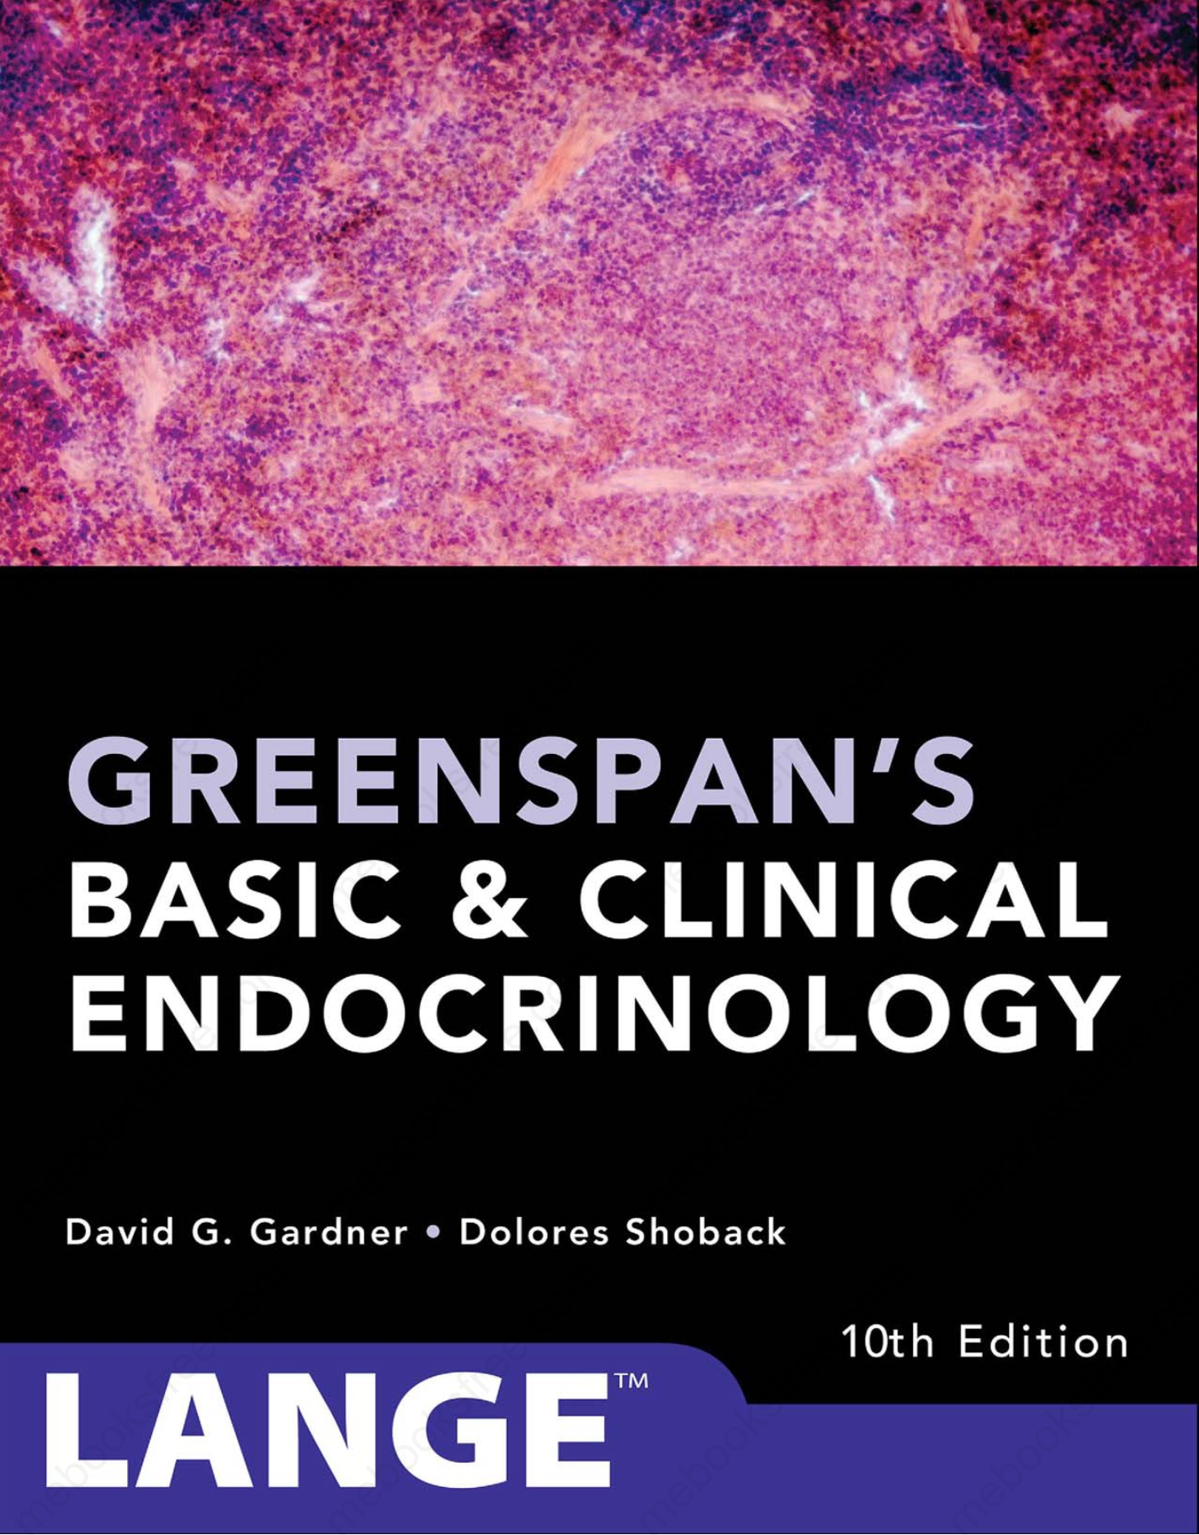
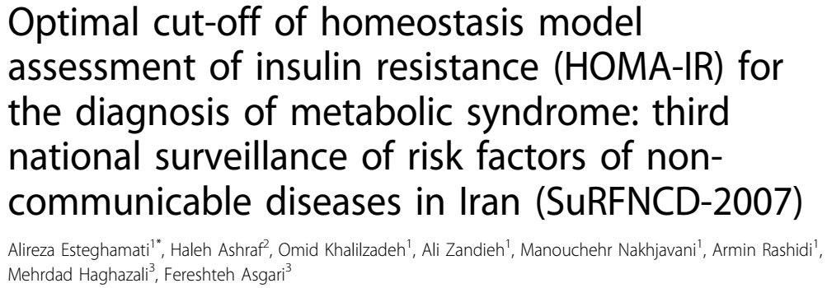
AGENDA

Slide 25
AGENDA
Case Presentation
Langerhans cell histiocytosis Overview
Endocrine involvement
Why does our patient have a normal (even elevated) stature despite GH deficiency?
Effect of obesity & various hormones on linear growth
Role of insulin in growth / HOMA-IR
When & why did our patient develop GH deficiency (Panhypopituitarism)?
Management

Slide 26
Langerhans cell histiocytosis Overview
Langerhans cell histiocytosis is a rare neoplasm of hematopoietic myeloid precursor cells that most commonly affects white male children, with a peak incidence of 1 to 3 years of age.
Histiocytes (tissue macrophages) derive from hematopoietic myeloid progenitors, which further differentiate into monocytes, macrophages, and dendritic cells.
Despite their phenotypic resemblance to normal Langerhans cells, which are dendritic cells of the skin and mucosa, the pathologic cells in Langerhans cell histiocytosis (LCH) derive from immature myeloid precursor cells. In the past, they had been erroneously thought to derive from Langerhans cells, because of their phenotypic resemblance and shared markers.
(2018) Krooks J, Minkov M, Weatherall AG. Langerhans cell histiocytosis in children: History, classification, pathobiology, clinical manifestations, and prognosis. J Am Acad Dermatol. 2018 Jun;78(6):1035-1044. doi: 10.1016

Slide 27
Langerhans cell histiocytosis Overview
The clinical presentation and subsequent course may vary remarkably, from single-system disease that may resolve spontaneously to treatment refractory multisystem involvement with a 20% mortality.
Significant risk factors for LCH include:
Maternal urinary tract infection during pregnancy, feeding problems or blood transfusions during infancy, Hispanic ethnicity, crowding, low education level, neonatal infections, solvent exposure, family history of thyroid disease and in vitro fertilization.
Protective factors include black race, childhood vaccinations and supplemental vitamins.
(2018) Krooks J, Minkov M, Weatherall AG. Langerhans cell histiocytosis in children: History, classification, pathobiology, clinical manifestations, and prognosis. J Am Acad Dermatol. 2018 Jun;78(6):1035-1044. doi: 10.1016

Slide 28
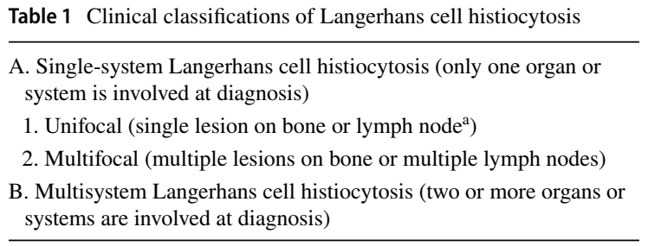
Langerhans cell histiocytosis Overview
Sites of involvement include the bone (79%), skin (36%), pituitary gland (25%), liver (16%), bone marrow (15%), spleen (14%), lymph nodes (13%), lungs (13%), and central nervous system (5%)
(2019) Leung AKC, Lam JM, Leong KF. Childhood Langerhans cell histiocytosis: a disease with many faces. World J Pediatr. 2019 Dec;15(6):536-545. doi: 10.1007

Slide 29
Langerhans cell histiocytosis Overview
Bone:
The most common site of involvement is the skull, followed by the spine, extremities, pelvis, and ribs. The hands and feet are often spared.
Skin:
First manifestation in approximately 80% of cases and are often the leading clue for disease diagnosis. Common cutaneous manifestations include a seborrheic dermatitis-like eruption.
(2019) Leung AKC, Lam JM, Leong KF. Childhood Langerhans cell histiocytosis: a disease with many faces. World J Pediatr. 2019 Dec;15(6):536-545. doi: 10.1007

Slide 30
Langerhans cell histiocytosis Overview
Endocrine:
Hypothalamic–pituitary axis:
Central diabetes insipidus is the most common endocrine manifestation.
Approximately 50% of patients with central diabetes insipidus develop deficiency of anterior pituitary hormones (such as GH, TSH, ACTH, LH, FSH) with resultant growth failure, hypothyroidism, hyperprolactinemia, hypoadrenalism, hypogonadism, amenorrhea, and precocious or delayed puberty.
Non-endocrine hypothalamic dysfunction may present with eating disorders, obesity, sleeping disorders, fatigability, temperature instability, and autonomic disturbance.
(2019) Leung AKC, Lam JM, Leong KF. Childhood Langerhans cell histiocytosis: a disease with many faces. World J Pediatr. 2019 Dec;15(6):536-545. doi: 10.1007

Slide 31
Langerhans cell histiocytosis Overview
Endocrine:
Hypothalamic–pituitary axis:
Hormone deficiencies develop in 20% of patients overall.
The second most common endocrinopathy is growth hormone deficiency (10%). Accordingly, growth should be monitored in all LCH patients, particularly in those with diabetes insipidus, who have a 37% and 53% 5- and 10-year risk, respectively, of developing growth hormone deficiency.
Thyroid involvement is rare, with only 75 cases reported in the literature, and may present with either diffuse (59%) or nodular (26%) nontender enlargement. Patients are typically euthyroid (41%), hypothyroid (20%), or subclinically hypothyroid (11%)
(2018) Krooks J, Minkov M, Weatherall AG. Langerhans cell histiocytosis in children: History, classification, pathobiology, clinical manifestations, and prognosis. J Am Acad Dermatol. 2018 Jun;78(6):1035-1044. doi: 10.1016

Slide 32
Langerhans cell histiocytosis Overview
Liver and spleen
Bone marrow
Lymph nodes
Lungs
Central nervous system
Historically, different clinical phenotypes of LCH have been described as distinct entities (e.g, eosinophilic granuloma of bone, Hand-Schüller-Christian disease, Letterere-Siwe disease, and Hashimotoe-Pritzker disease).
1: (2019) Leung AKC, Lam JM, Leong KF. Childhood Langerhans cell histiocytosis: a disease with many faces. World J Pediatr. 2019 Dec;15(6):536-545. doi: 10.1007
2:(2018) Krooks J, Minkov M, Weatherall AG. Langerhans cell histiocytosis in children: History, classification, pathobiology, clinical manifestations, and prognosis. J Am Acad Dermatol. 2018 Jun;78(6):1035-1044. doi: 10.1016

Slide 33
Langerhans cell histiocytosis Overview
Management
Treatment depends on the site and extent of the disease.
The current recommended first-line therapy for patients with multisystem LCH is 12 months therapy with prednisone and vinblastine.
Vemurafenib, a BRAF V6000 inhibitor, may be considered for the subset of high-risk patients with same mutations.
Additional therapy:
Complications such as diabetes insipidus, short stature, hypothyroidism, hypoadrenalism, and hypogonadism may require treatment with appropriate hormones.
Hearing loss and musculoskeletal disabilities should be properly treated.
Patients with LCH need to have long-term follow-up to monitor for disease recurrence and late effects.
(2019) Leung AKC, Lam JM, Leong KF. Childhood Langerhans cell histiocytosis: a disease with many faces. World J Pediatr. 2019 Dec;15(6):536-545. doi: 10.1007

Slide 34
Langerhans cell histiocytosis Overview
The hypothalamicpituitary system is involved in up to 50% of children with LCH who prevalently develop DI.
Hypothalamic involvement in these patients may also cause sleep disturbances, hyperphagia with obesity, temperature dysregulation & behavioral abnormalities.
Anterior pituitary dysfunction occurs in up to 20% of patients.
Growth retardation is found in 40% of patients with prepubertal onset of disease and is caused by GH deficiency which is the most frequent and earlier anterior pituitary hormone abnormality due to altered formation and/or release of GHRH by the hypothalamus.
Gonadotrophin deficiency is also common, Mild hyperprolactinemia may be observed in adult LCH patients.
(2017) Shlomo Melmed, The Pituitary, 4th Edition P: 320

Slide 35
AGENDA
Case Presentation
Langerhans cell histiocytosis Overview
Endocrine involvement
Why does our patient have a normal (even elevated) stature despite GH deficiency?
Effect of obesity & various hormones on linear growth
Role of insulin in growth / HOMA-IR
When & why did our patient develop GH deficiency (Panhypopituitarism)?
Management

Slide 36
Why does our patient have a normal (even elevated) stature despite GH deficiency?
Also, What is cause of his feet & hands bigness?
This is a rare & extra-natural condition, and these are so poor documentations to can say which hormones could lead growth in this situation.

Slide 37
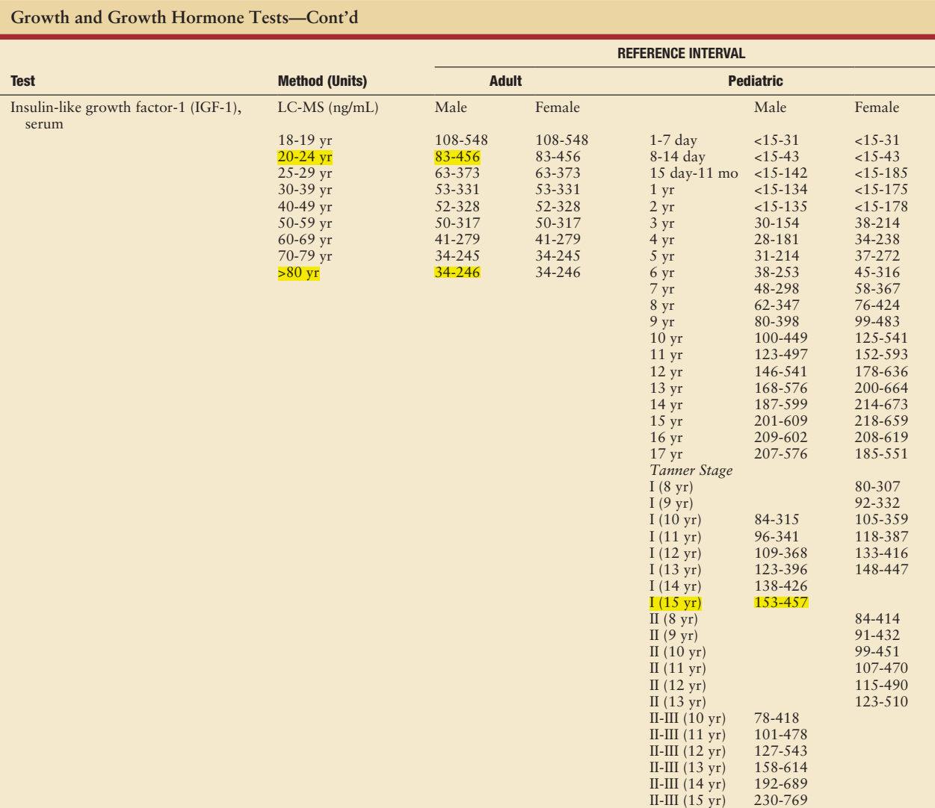
For our patient:
IGF1: 29.6
(2016) De Groot J, Larry Jameson MD PhD Leslie J, Endocrinology Adult & Pediatric 7th Edition P: 2669

Slide 38
Why does our patient have a normal (even elevated) stature despite GH deficiency?
Case reports
In summary, we have reported an unusual case of GH deficiency (23 y-male) in which the patient attained normal height with unfused epiphyses because of hypogonadotropic hypogonadism. This case suggests that males can grow without GH under certain circumstances. ¹
37 y-male + Growth independent of GH has been reported in some cases of craniopharyngioma, but in only one case of hypopituitarism. ²
There exist some growth promoting factors other than GH and IGF-I. Thyroid hormone, insulin, prolactin (PRL) and IGF-II play significant roles in postnatal somatic growth even without GH. ²
1: (2000) Wada S, et al. A patient of hypogonadotropic hypogonadism accompanied by growth hormone deficiency and decreased bone mineral density who attained normal growth. Intern Med. 2000 Aug;39(8):641-5. doi: 10.2169
2: (1998) Kageyama K, Watanobe H, Nasushita R, Nishie M, Horiba N, Suda T. A hypopituitary patient who attained tall stature without growth hormone. Intern Med. 1998 May;37(5):472-5. doi: 10.2169

Slide 39
Why does our patient have a normal (even elevated) stature despite GH deficiency?
GH-deficient newborns can have a length within the normal range, which suggests that other growth factors dominate longitudinal gain during gestation.
Obese children grow at a normal rate despite their low serum GH levels.
Several possible mechanisms might underlie the growth stimulation in obese children, such as:
Elevated levels of insulin
Reduced levels of IGF binding protein-1
Elevated leptin levels in obese children were found to affect the bone growth
Sex hormones stimulate growth through a direct GH-independent effect on the bone growth centers
(2002) Phillip M, et all. Growth without growth hormone. J Pediatr Endocrinol Metab. 2002 Dec;15 Suppl 5:1267-72

Slide 40
Why does our patient have a normal (even elevated) stature despite GH deficiency?
Growth patterns of obesity during childhood are well described, documenting increased linear growth in early childhood associated with accelerated pubertal maturation resulting in normal adult height.
Decreased baseline GH levels have been well documented in obese patients.
In prepubertal children with simple obesity, growth velocity is increased in association with these lower GH values.
(2013) Fennoy I. Effect of obesity on linear growth. Curr Opin Endocrinol Diabetes Obes. 2013 Feb;20(1):44-9. doi: 10.1097/MED.0b013e32835b7f15

Slide 41
Why does our patient have a normal (even elevated) stature despite GH deficiency?
Ghrelin has been considered a potential regulator of GH release in obesity.
Administration of ghrelin to humans and rats results in increased GH secretion as well as stimulating appetite.
Ghrelin is also known to stimulate insulin secretion.
Ghrelin levels in obese children are lower than in normal.
The contribution of ghrelin stimulation of insulin to the growth patterns in childhood obesity, however, remains to be determined.
(2013) Fennoy I. Effect of obesity on linear growth. Curr Opin Endocrinol Diabetes Obes. 2013 Feb;20(1):44-9. doi: 10.1097/MED.0b013e32835b7f15

Slide 42
Why does our patient have a normal (even elevated) stature despite GH deficiency?
In obesity, despite low GH values, total IGF-1 has been measured as low to slightly reduced or normal leading to the hypothesis that free IGF-1 is elevated.
However, free IGF-1 has been variously reported as low or elevated.
Diet has been implicated as a regulator of IGF levels.
Short-term overeating itself was associated with suppressed GH, but maintenance of normal IGF-1, increased IGF-BP3, and increased free IGF-1 was thought to be related to decreased IGF-BP2.
(2013) Fennoy I. Effect of obesity on linear growth. Curr Opin Endocrinol Diabetes Obes. 2013 Feb;20(1):44-9. doi: 10.1097/MED.0b013e32835b7f15

Slide 43
Why does our patient have a normal (even elevated) stature despite GH deficiency?
Insulin has also been shown to negatively feed back on the pituitary to inhibit GH release in normal weight individuals and in the obese.
Increased insulin secretion in SGA infants was associated with both the catch-up growth and increased linear growth.
Insulin, as a growth promoting hormone however, may also contribute to the increased linear growth of simple obesity.
(2013) Fennoy I. Effect of obesity on linear growth. Curr Opin Endocrinol Diabetes Obes. 2013 Feb;20(1):44-9. doi: 10.1097/MED.0b013e32835b7f15

Slide 44
Why does our patient have a normal (even elevated) stature despite GH deficiency?
Leptin
Leptin receptors have been identified in the hypothalamus and in the gonadotrope cells of the anterior pituitary. In the hypothalamus, leptin has a direct stimulatory effect on the HPG axis by accelerating GnRH secretion. ¹
Adiponectin
Resistin
(2003) Shalitin S, Phillip M. Role of obesity and leptin in the pubertal process and pubertal growth--a review. Int J Obes Relat Metab Disord. 2003 Aug;27(8):869-74. doi: 10.1038

Slide 45
Why does our patient have a normal (even elevated) stature despite GH deficiency?
Some features of IR in children discussed herein are: a strong tendency to low birth weight for gestational age, adverse effects of adrenarche and therapeutic steroid therapy, predisposition to premature pubarche, acanthosis nigricans, tall stature despite pituitary GH suppression, allergic diathesis, hyperandrogenism and PCOS, dyslipidemia and fatty liver disease.
Children with IR are often taller than their peers and outgrow their parents. A small number even shown acromegaloid features despite suppressed pituitary GH levels.
(2007) Maclaren NK, et al. Childhood obesity and insulin resistance. Cell Biochem Biophys. 2007;48(2-3):73-8. doi: 10.1007/s12013-007-0017-6

Slide 46
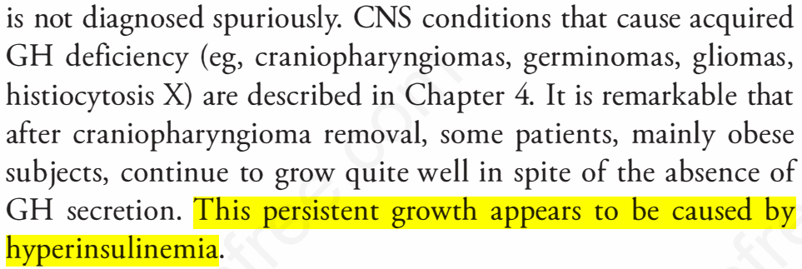
Why does our patient have a normal (even elevated) stature despite GH deficiency?
(2018) David G. Gardner, et al. Greenspan’s Basic and Clinical Endocrinology 10th Edition P: 155

Slide 47
Insulin resistance & Acromegaloid feature
Insulin and IGF-I share a range of biological activities.
Insulin and IGF-I both exhibit affinity for each other’s primary receptors. ¹
Activation intact mitogenic signaling pathways and stimulation pathological tissue growth induced by the extreme elevation of serum insulin occurring in compensation for the impaired metabolic signaling. ²
1: (2011) Sam AH, Tan T, Meeran K. Insulin-mediated "pseudoacromegaly". Hormones (Athens). 2011 Apr-Jun;10(2): 156-61. doi: 10.14310
2: (2019) Moradi L, Amiri F, Shahbazian H. Insulin resistance and pseudoacromegaly: A case report. Diabetes Metab Syndr. 2019 Mar-Apr;13(2):901-903. doi: 10.1016

Slide 48
Insulin resistance & Acromegaloid feature
The human proinsulin polypeptide begins with the 30-amino-acid B chain domain, extends through a 35-amino-acid connecting segment & ends with the 21–amino-acid A chain domain.
Mature IGF-1 and IGF-2 contain 70 and 67 amino acids & the regions homologous to the B chain of insulin, the C peptide, the A chain and also a D extension peptide.
Proinsulin has a longer C peptide region compared to IGF-1 or IGF-2.
The A chain and B chain peptide regions are of similar length. The sequences in this region are 41% and 43% homologous with proinsulin.
(2016) De Groot J, Larry Jameson MD PhD Leslie J, Endocrinology Adult & Pediatric 7th Edition P: 258,361

Slide 49
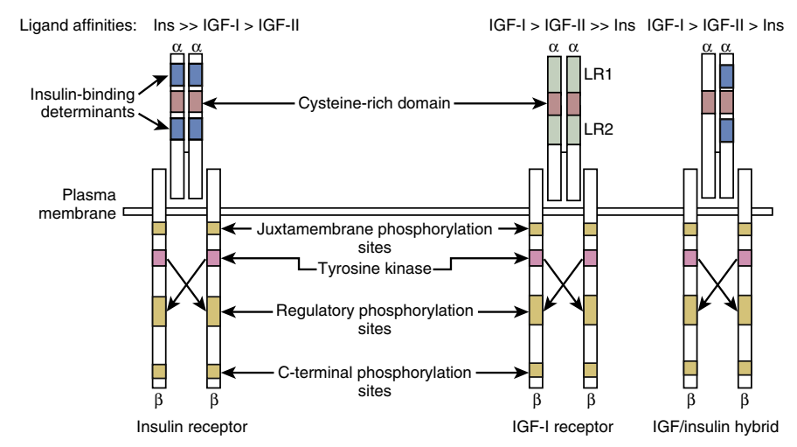
Insulin resistance & Acromegaloid feature
The receptors are heterotetrameric glycoprotein composed of two ligand-binding subunits termed alpha subunits and two beta subunits.
The IGF-1 receptor binds IGF-1
IGF-2 binds with sixfold lower affinity,
and insulin with a 200- to 300-fold lower affinity.
α-subunit of both the IGF-1 and insulin receptors shows that there are two important differences, one in LR1 and one in CR1.
(2016) De Groot J, Larry Jameson MD PhD Leslie J, Endocrinology Adult & Pediatric 7th Edition P: 362,363

Slide 50
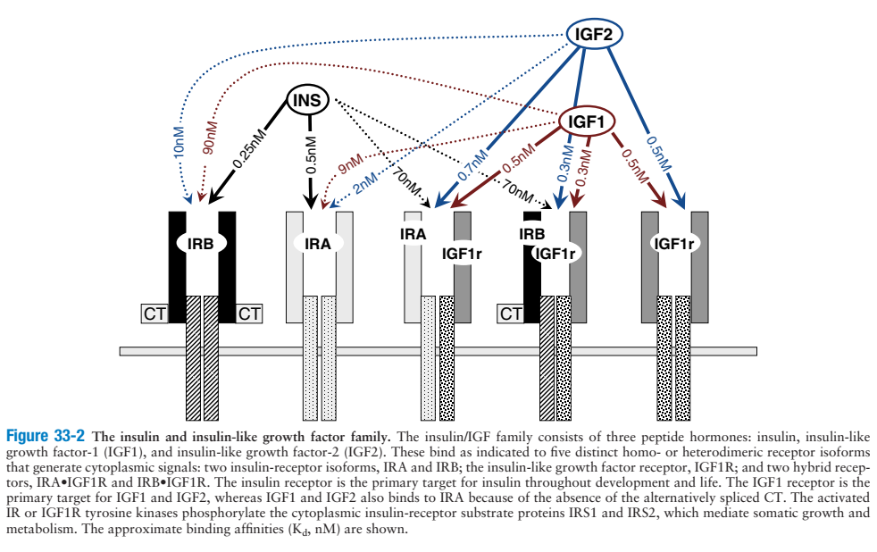
Insulin resistance & Acromegaloid feature
(2016) De Groot J, Larry Jameson MD PhD Leslie J, Endocrinology Adult & Pediatric 7th Edition P: 560

Slide 51
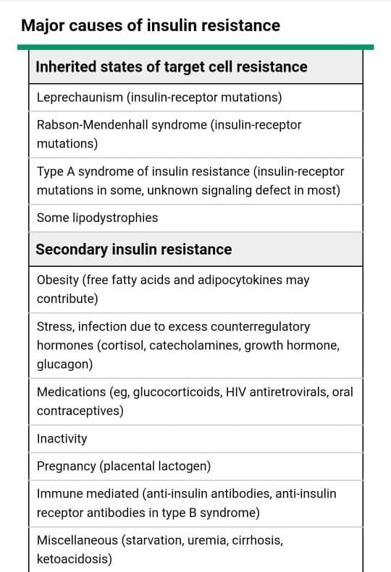
Why does our patient have a normal (even elevated) stature despite GH deficiency?
Does our patient have insulin resistance?
 | 1401.04.12
FBS | 78
BS 2h after 75g Glu | 121
Insulin - Fasting | 12.7 (2.6-24.9)
Insulin - 2h after 75g Glu | 123.7
IGF1 | 29.6 (140.2-462.7)

Slide 52
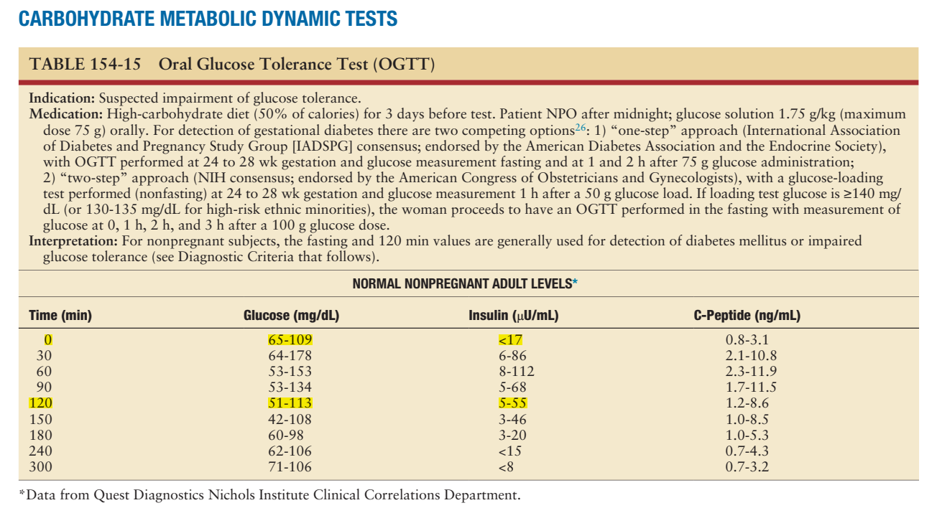
Why does our patient have a normal (even elevated) stature despite GH deficiency?
For our patient:
78 12.7
121 123.7
(2016) De Groot J, Larry Jameson MD PhD Leslie J, Endocrinology Adult & Pediatric 7th Edition P: 2682

Slide 53
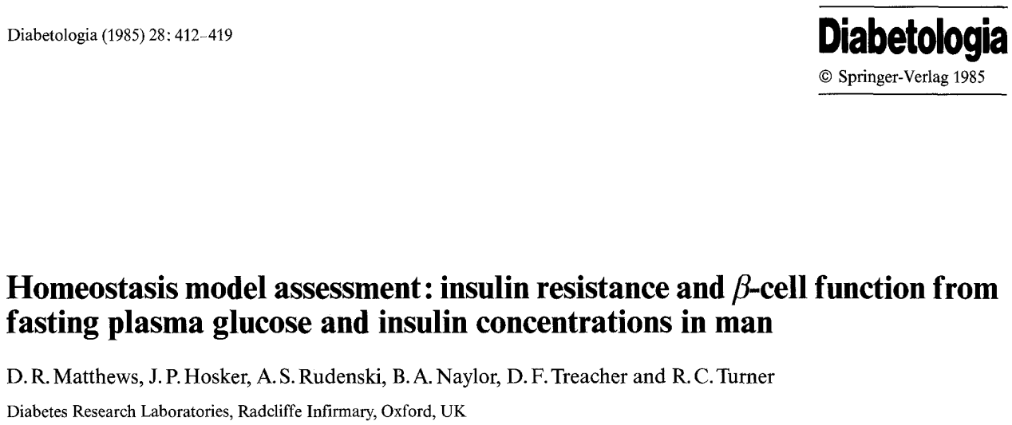
Why does our patient have a normal (even elevated) stature despite GH deficiency?
Normal Insulin levels & HOMA-IR
A mathematical model
HOMA-IR = (insulin * glucose) / 22.5
for the glucose concentration in mmol/L, or
HOMA-IR: 2.45
HOMA-IR = (insulin * glucose) / 405
for glycemia in mg/dL. In both cases the insulin is in mU/L
(1985) Matthews DR, et al. Homeostasis model assessment: insulin resistance and beta-cell function from fasting plasma glucose and insulin concentrations in man. Diabetologia. 1985 Jul;28(7):412-9. doi: 10.1007/BF00280883

Slide 54
Why does our patient have a normal (even elevated) stature despite GH deficiency?
Normal Insulin levels & HOMA-IR
The HOMA-IR cut-off points to diagnose insulin resistance cannot be readily applied to all populations and may vary from race to race.
Youden index [sensitivity- (1-specificity)], and the point with shortest distance value form the point (0,1) [(1 - sensitivity)² + (1 - specificity)²] were calculated.
The HOMA-IR method requires measuring a single fasting plasma glucose and the corresponding fasting plasma insulin level
(2007) Esteghamati A, et al. Optimal cut-off of homeostasis model assessment of insulin resistance (HOMA-IR) for the diagnosis of metabolic syndrome: third national surveillance of risk factors of non-communicable diseases in Iran (SuRFNCD-2007). Nutr Metab (Lond). 2010 Apr 7;7:26. doi: 10.1186/1743-7075-7-26

Slide 55
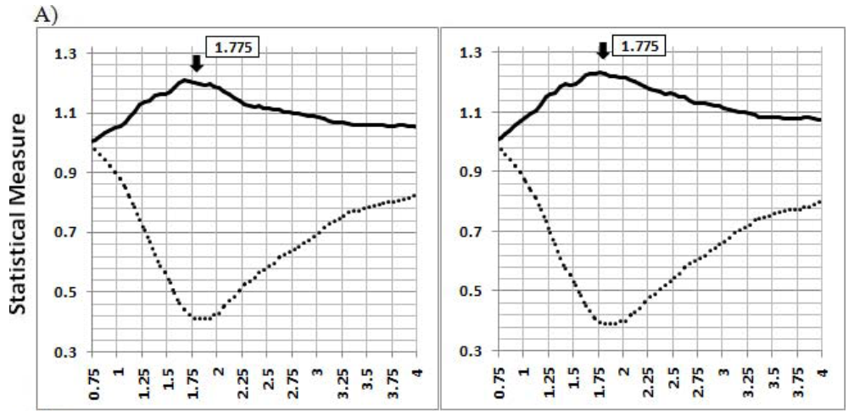
(2007) Esteghamati A, et al. Optimal cut-off of homeostasis model assessment of insulin resistance (HOMA-IR) for the diagnosis of metabolic syndrome: third national surveillance of risk factors of non-communicable diseases in Iran (SuRFNCD-2007). Nutr Metab (Lond). 2010 Apr 7;7:26. doi: 10.1186/1743-7075-7-26

Slide 56
Why does our patient have a normal (even elevated) stature despite GH deficiency?
Normal Insulin levels & HOMA-IR
The optimal cut-off point of HOMA-IR for the diagnosis of MetS in our population was estimated to be 1.775 in non-diabetics and around 4 in diabetic patients.
For our patent: HOMA-IR: 2.45
In line with previous population-based studies, we found that insulin resistance and MetS were significantly associated, and HOMA-IR levels were directly related to the number of MetS components.
(2007) Esteghamati A, et al. Optimal cut-off of homeostasis model assessment of insulin resistance (HOMA-IR) for the diagnosis of metabolic syndrome: third national surveillance of risk factors of non-communicable diseases in Iran (SuRFNCD-2007). Nutr Metab (Lond). 2010 Apr 7;7:26. doi: 10.1186/1743-7075-7-26

Slide 57
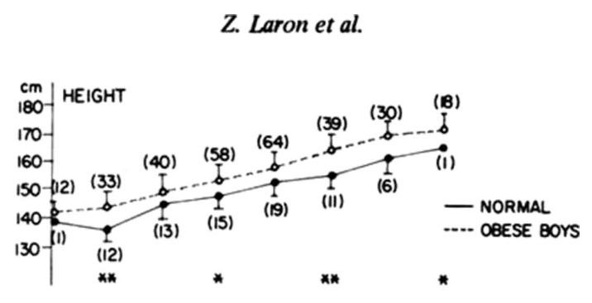
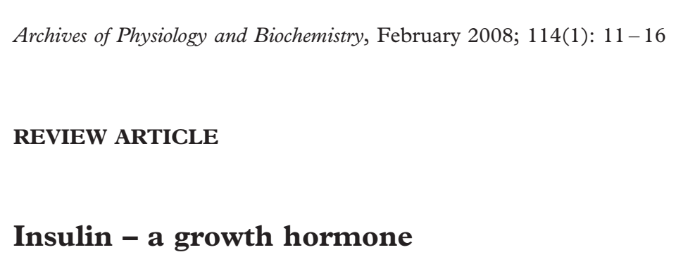
Why does our patient have a normal (even elevated) stature despite GH deficiency?
Children with hyperinsulinemia have an accelerated growth.
While it was initially assumed that the growth activities of insulin are facilitated via cross-talk with the closely related insulin-like growth factor-1 receptor (IGF-1R), it is now clear that the vast majority of these activities are mediated via direct interaction with the insulin receptor (IR).
(2008) Laron Z. Insulin--a growth hormone. Arch Physiol Biochem. 2008 Feb;114(1):11-6. doi: 10.1080
(2020) Laron Z, Werner H. Insulin: A Growth Hormone and Potential Oncogene. Pediatr Endocrinol Rev. 2020 Mar;17(Suppl 1):191-197. doi: 10.17458

Slide 58
Why does our patient have a normal (even elevated) stature despite GH deficiency?
Serum insulin levels are poor measures of insulin resistance. Furthermore, there is no clinical benefit in measuring insulin resistance in clinical practice.
Clinicians should shift from identifying "insulin resistance" to identifying risk factors, such as fasting glucose and lipid levels, hypertension and central obesity.
These proven risk factors converge within the metabolic syndrome. Individuals "at risk" of diabetes and atherosclerotic cardiac disease can be identified simply and inexpensively.
(2006) Samaras K, et al. Insulin levels in insulin resistance: phantom of the metabolic opera? Med J Aust. 2006 Aug 7;185(3):159-61. doi: 10.5694

Slide 59
AGENDA
Case Presentation
Langerhans cell histiocytosis Overview
Endocrine involvement
Why does our patient have a normal (even elevated) stature despite GH deficiency?
Effect of obesity & various hormones on linear growth
Role of insulin in growth / HOMA-IR
When & why did our patient develop GH deficiency (Panhypopituitarism)?
Management

Slide 60
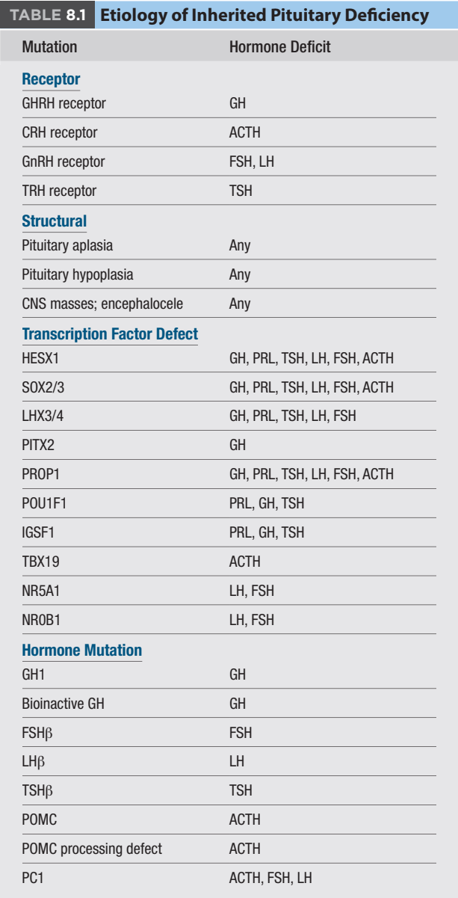
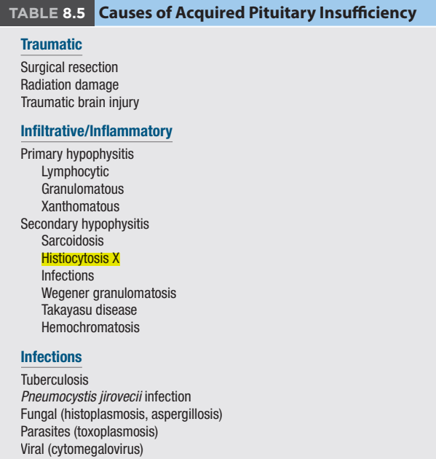
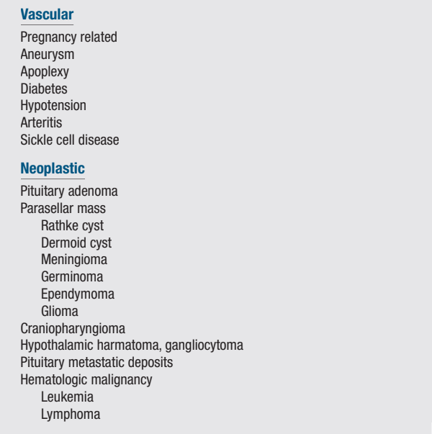
When & why did our patient develop GH deficiency (Panhypopituitarism)?
Heritable Disorders
Acquired Disorders
(2020) Williams Textbook of Endocrinology, 14th edition P:1585

Slide 61
When & why did our patient develop GH deficiency (Panhypopituitarism)?
Our patient stature was documented near normal until age 2 y old.
He has been observed by oncologist until about 7 years, and seems all thing good on that time.
His stature during school times, seems be good and about mid range of Nl.
Father reported a period of polyphagia about age 4-5 y, that may be a feature of hypothalamus involvement, so it may be considered as an option for beginning time of panhypopituitarism. >>> ???

Slide 62
When & why did our patient develop GH deficiency (Panhypopituitarism)?
There is not any significant document about adverse effect of Vinblastine, drug of choice for LCH, on pituitary causing hormone deficiency. (can cause SIADH)
Effect of chemotherapy & radiotherapy during pregnancy on fetus
The use of cytotoxic drugs during fertilization or implantation can lead to one of 2 opposite phenomena: the death of the embryo or the proper development of the embryo.
The administration of cytotoxic drugs during the 1st trimester is particularly dangerous because it is frequently associated with the development of malformations, embryo death, and spontaneous abortion.
Transient myelosuppression / Neuropsychological issues / Heart development. ¹
1: (2016) Esposito S, Tenconi R, Preti V, Groppali E, Principi N. Chemotherapy against cancer during pregnancy: A systematic review on neonatal outcomes. Medicine (Baltimore). 2016 Sep;95(38):e4899. doi: 10.1097

Slide 63
When & why did our patient develop GH deficiency (Panhypopituitarism)?
LCH on childhood by DI & bone envovlement manifestation >>> Delayed hormone deficiency, At time: Prepubertal that has allowed to patient for normal growth.
Polyphagia at age 4-5 & consequent Obesity may have played a role by insulin resistance effect, and may have contributed in Growth development despite GH deficiency.

Slide 64
AGENDA
Case Presentation
Langerhans cell histiocytosis Overview
Endocrine involvement
Why does our patient have a normal (even elevated) stature despite GH deficiency?
Effect of obesity & various hormones on linear growth
Role of insulin in growth / HOMA-IR
When & why did our patient develop GH deficiency (Panhypopituitarism)?
Management

Slide 65
Management
Hormone replacement therapy with an architectural structure mimicing natural puberty.
Management of Cosmetic Appearance
Orthopedic surgery

Slide 66
Thanks for your attention

