Slide 2
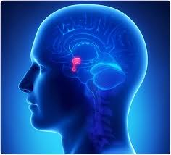
ENDOCRINOLOGY GRAND ROUNDS
1398/02/09
Dr. Nosrat Zehi
Dr. Kazazi

Slide 3
ID and Source of the History
A 48 y/o woman , from Tehran , single
Source of the history : herself and was reliable

Slide 4
Chief Complaint
Generalized weakness ,Visual Impairment , Irritability And paranoid psychosis.

Slide 5
Present illness
Headache
Proximal myopathy
Easy bruising
Menstruation problem (metrorrhagia)
Depression
Weight loss : 7 kg in 2.5 months
Recent Diabètes mellitus
Recent hypertension

Slide 6
Past history
PMH : Not significant
PSH : Negative
HH : Negative (smoking, Alcohol, opioid or drug abused)
Gyn. History : The onset of menstruation has been
regular since at 12 years old (except from 2 years ago )
FH : Meningioma In Her Mother (alive) and have 2 sisters and 4 brothers without prior history of diseases or medical problem.
DH : Negative before recent surgery At 25.1.98 (Levothyroxine 0.1 mg daily, Tab prednisolone 7.5 mg daily, DIAMOX 250 mg QID, Novomix 20U morning/10U night & Metformin 500 mg BD )

Slide 7
Review of systems
Constitutional Symptoms: weight loss ,
Negative For ( Lack of energy, unexplained weight gain , loss of appetite , fever, night sweats , pain in jaws when eating , scalp tenderness , prior diagnosis of cancer , fatigue , central obesity, Rounded face, fat pad on back of neck (buffalo hump) ).
Skin: easy bruising ,
Negative for (rash, sores, itching, dryness, change in hair or nail, dermatitis, facial plethora, thin and brittle skin,, broad and purple stretch marks ,acne, hirsutism, hyperpigmentation ).

Slide 8
Review of systems
Bone : Negative for (bone fractures)
Muscle : Weakness & proximal myopathy (difficulty climbing stairs or getting up from a chair)
Eyes, Ears, nose, mouth, throat: Negative for (Difficulty with hearing, sinus problems, runny nose, post-nasal drip, ringing in ears, mouth sores, loose teeth, ear pain, nosebleeds, sore throat, facial pain or numbness )

Slide 9
Review of systems
Cardiovascular: Negative for ( Irregular heartbeat, racing heart, chest pains, swelling of feet or legs, pain in legs with walking )

Slide 10
Review of systems
Respiratory: Negative for (shortness of breath, night sweats, prolonged cough, wheezing, sputum production, pleurisy, oxygen at home, coughing up blood)
Gastrointestinal: Negative for ( Heartburn, constipation, intolerance to certain foods, diarrhea, abdominal pain, difficulty swallowing, nausea, vomiting, blood in stools, unexplained change in bowel habits, incontinence

Slide 11
Review of systems
Genitourinary: menstruation problems ,
Negative for ( Painful urination, frequent urination, urgency, bladder problems, impotence,, dysmenorrhea,
Musculoskeletal : Generalized weakness ,
Negative for ( Muscle or joint pain, stiffness, bone pain, gout, backache. No swelling, redness, pain, tenderness, stiffness,, or limitation of motion or activity or history of trauma, No Neck or low back pain)

Slide 12
Review of systems
Neurological: Negative for ( problems with walking or balance, loss of consciousness Frequent headaches, double vision, change in sensation,, dizziness, tremor, uncontrolled motions, episodes of visual loss )
Psychiatric: Negative for ( Insomnia,, depression, recurrent bad thoughts, hallucinations, compulsions and have irritability, depression, sometimes disorientation, paranoid psychosis )

Slide 13
Review of systems
Endocrine: menstrual irregularities
Negative for ( Intolerance to heat or cold,, frequent hunger/urination/thirst, excessive sweating, change in glove or shoe size , galactorrhea )

Slide 14
Review of systems
Hematologic/Lymphatic and immune system : easy bruising ,
Negative for ( Easy bleeding, abnormal blood tests,, unexplained swollen areas, )
Allergic/Immunologic: Negative for ( Seasonal allergies, hay fever symptoms, itching, frequent infections )

Slide 15
Physical examination
General appearance :
A 48 y/o who is awake and alert and appears healthy
W : 70 kg H : 167 cm BMI : 25.09
Vital signs :
BP : 140/80 HR : 86 RR: 16 OT : 37 O2sat : 98

Slide 16
Physical examination
•
Skin and hair : No Acne or Hirsutism or alopecia
Head and NECK : No moon face, plethora , acanthosis
nigricanse , supraclavicular fat pad
Thyroid : was normal size without nodule
BREASTS : Normal
THORAX & BACK : normal
LUNGS : Normal breathing sound
HEART : Normal Heart sound , no murmur
ABDOMEN : Soft ,No Scar of surgery , without any striae
•
•
•
•
•
•

Slide 17
Physical examination
Extremities :
Upper : Normal (range of motion , muscle tone , pulses )
Lower : Normal range of motion and pulses
No fasciculation or atrophy
No muscle tone
Force of muscles : proximal 3/5 and distal 5/5
Mental status : Mood depression
Neurologic Exams :
Cranial nerve : Normal, funduscopic exam normal
Sensory exam : Normal (position, vibration, monofilament test, cold and warm sensation)
Reflexes : Normal
Babinski : plantar reflex was downward
Force : upper extremities : proximal 3/5 and distal 5/5
lower extremities : proximal 3/5 and distal 5/5
Gait : walking is normal and standing up is abnormal
•
•

Slide 18
Lab Data Potassium changing
K : 2.8 -> 4.3 -> 3 -> 3.2

Slide 19
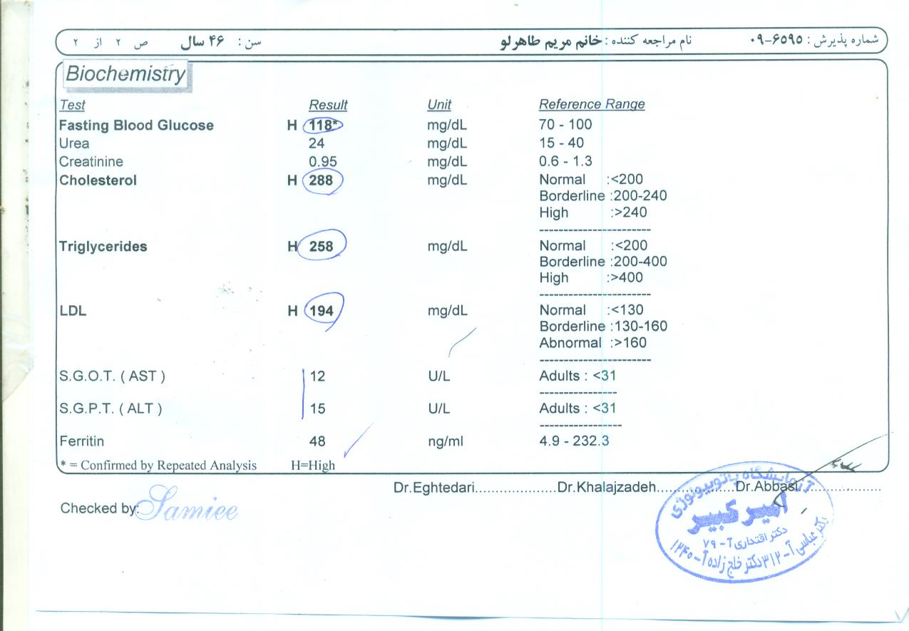

Slide 20
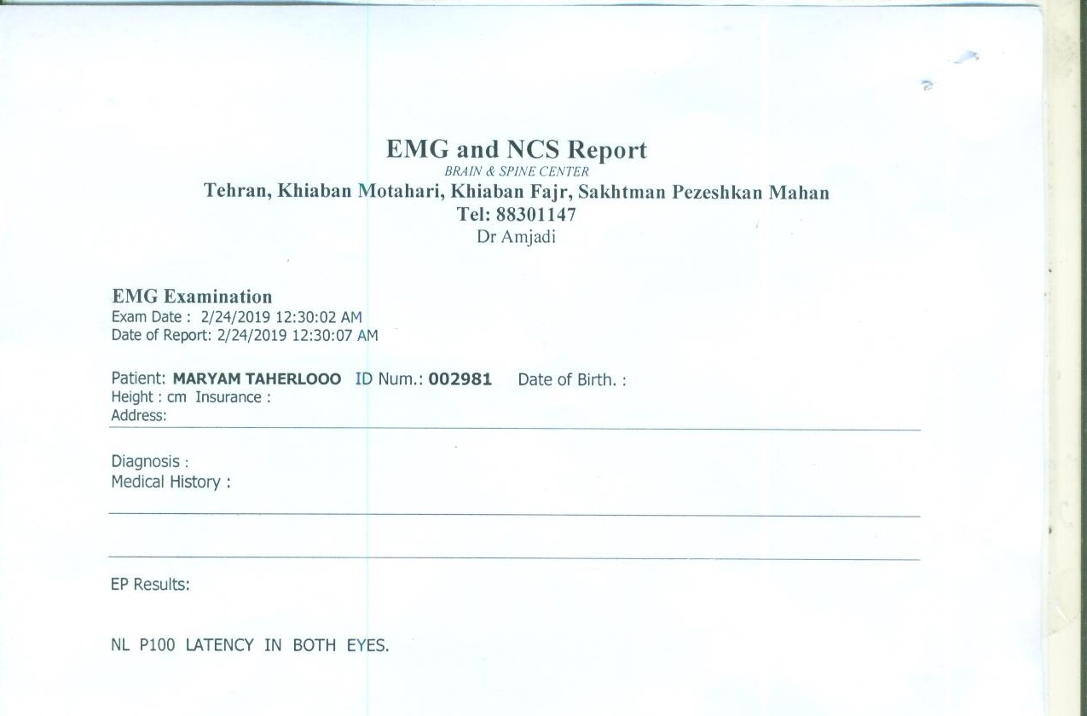

Slide 21
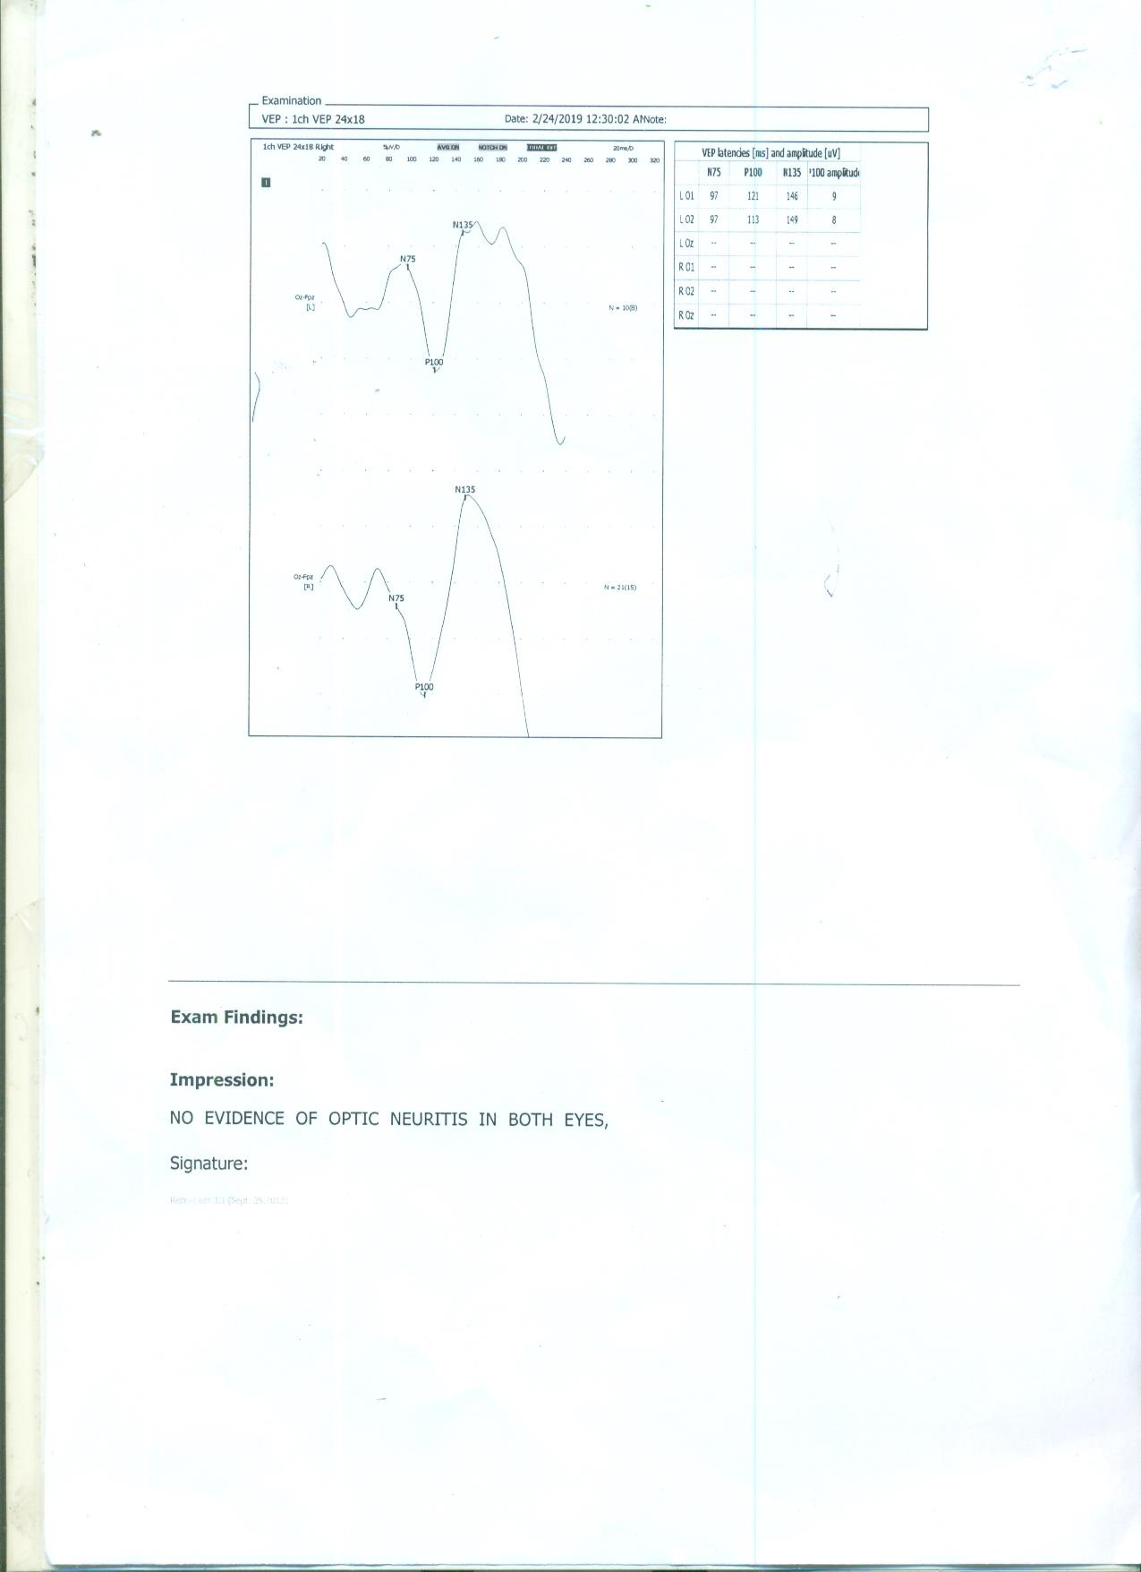

Slide 22
ECG

Slide 25
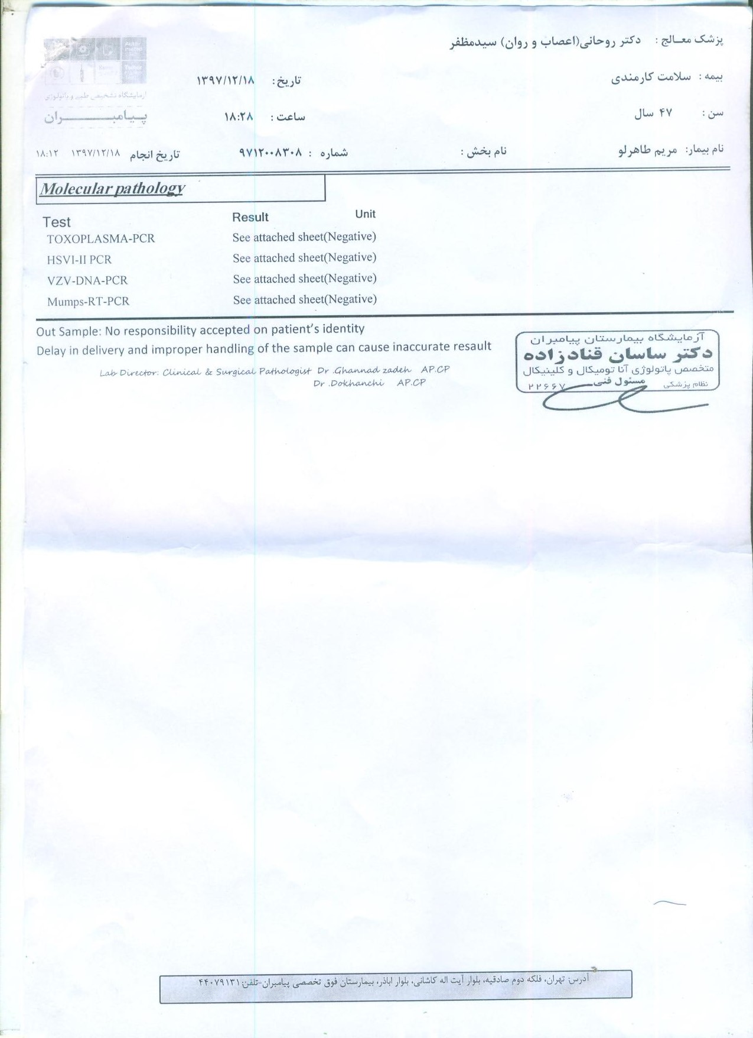

Slide 26
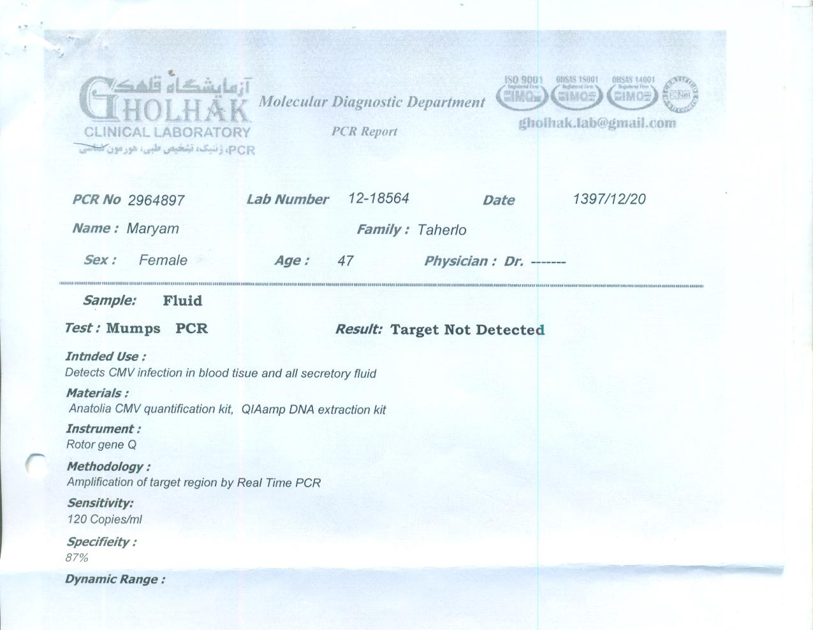

Slide 27
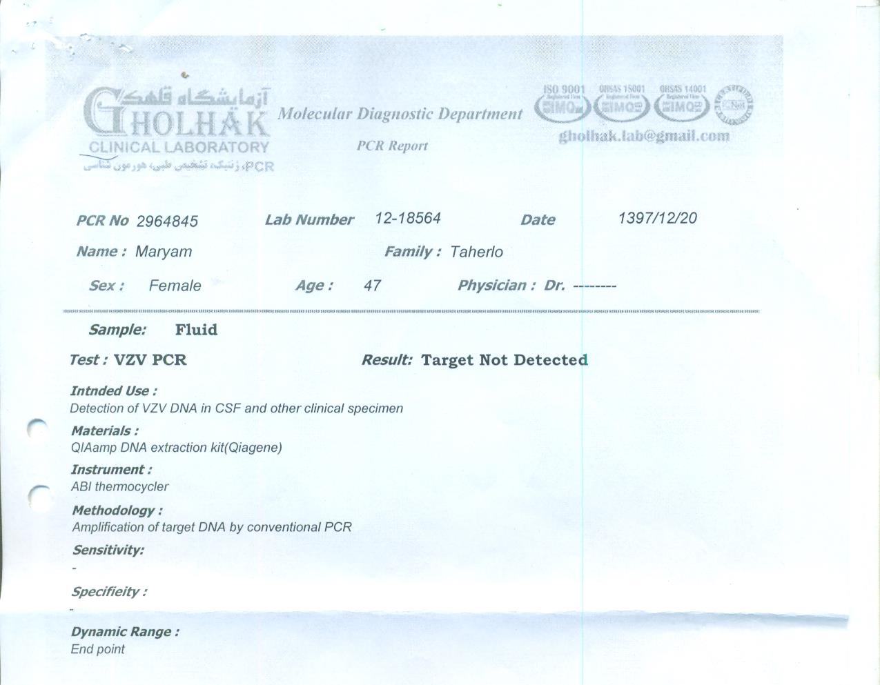

Slide 28
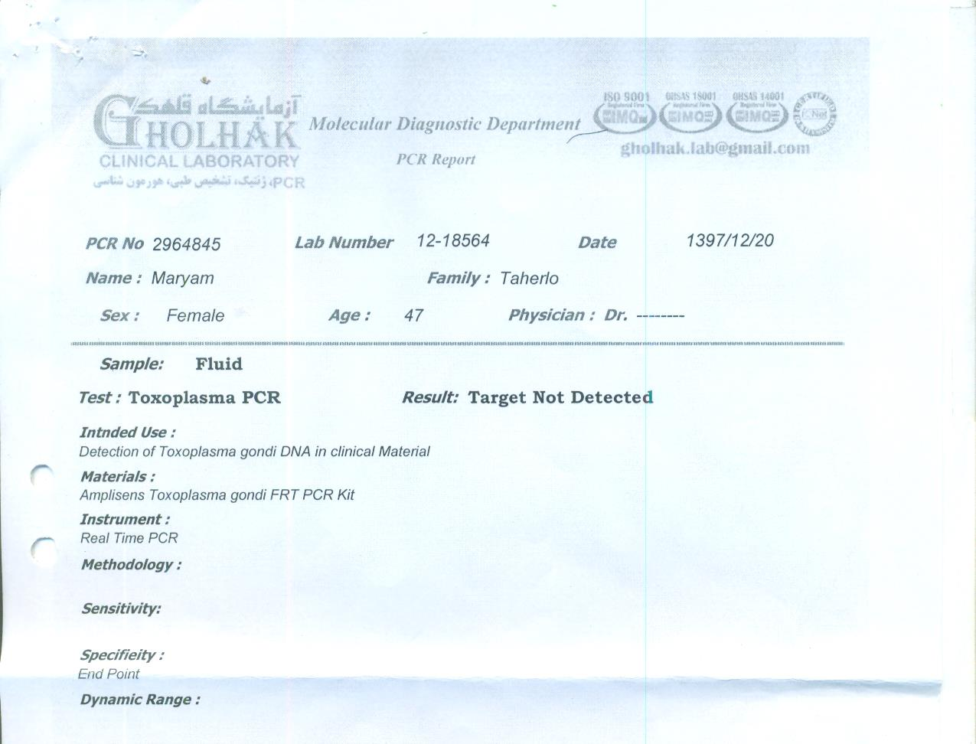

Slide 29
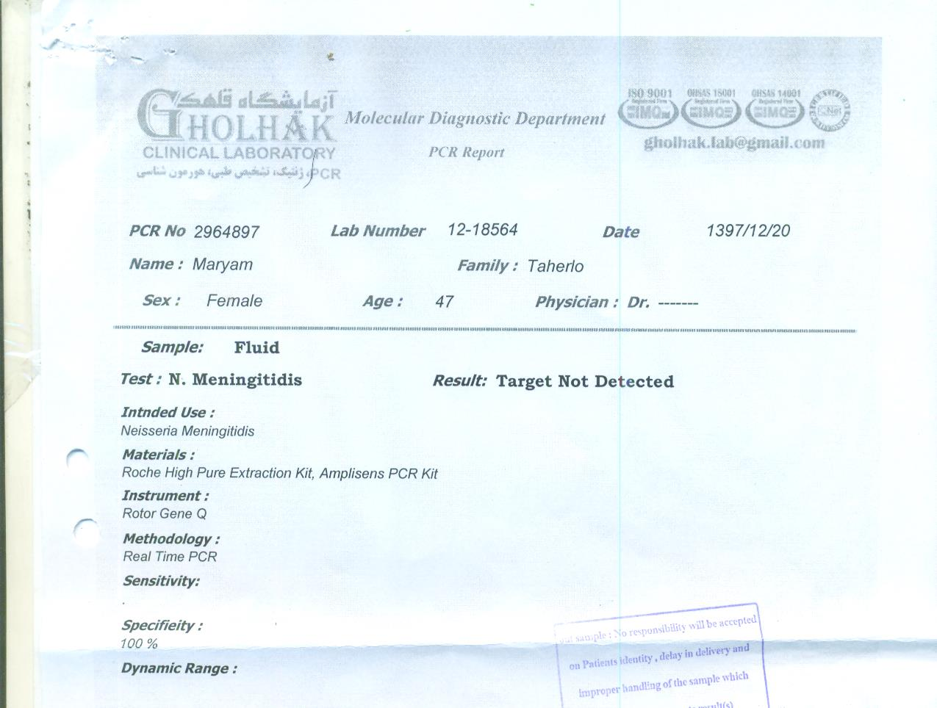

Slide 30
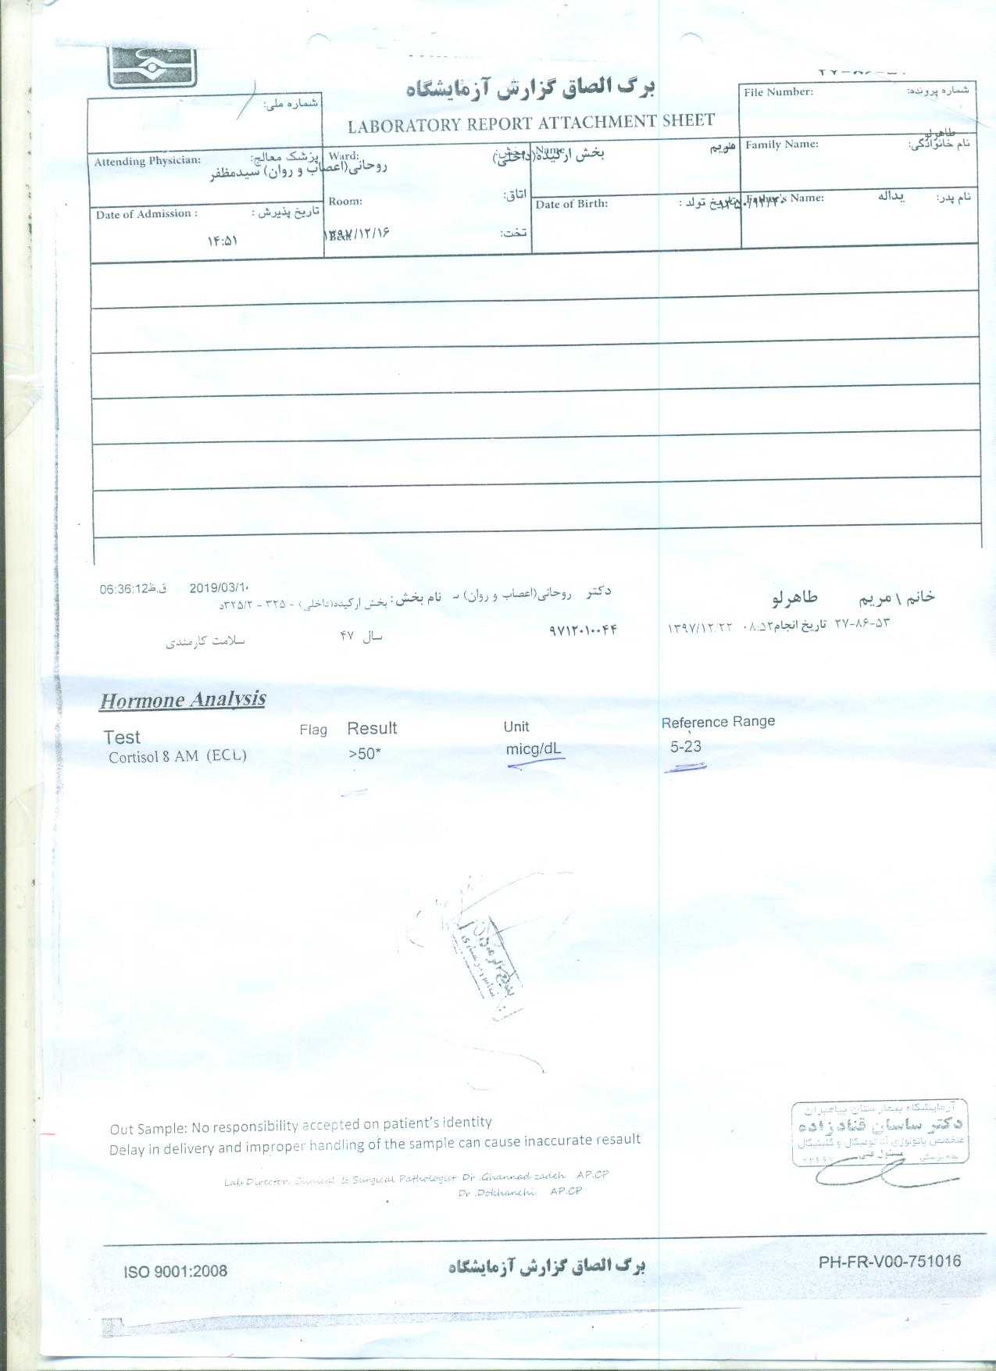

Slide 31
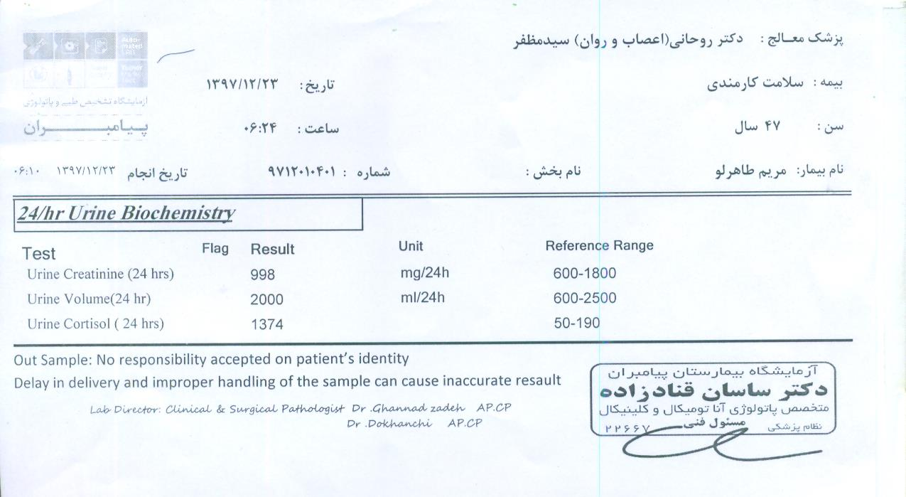

Slide 32
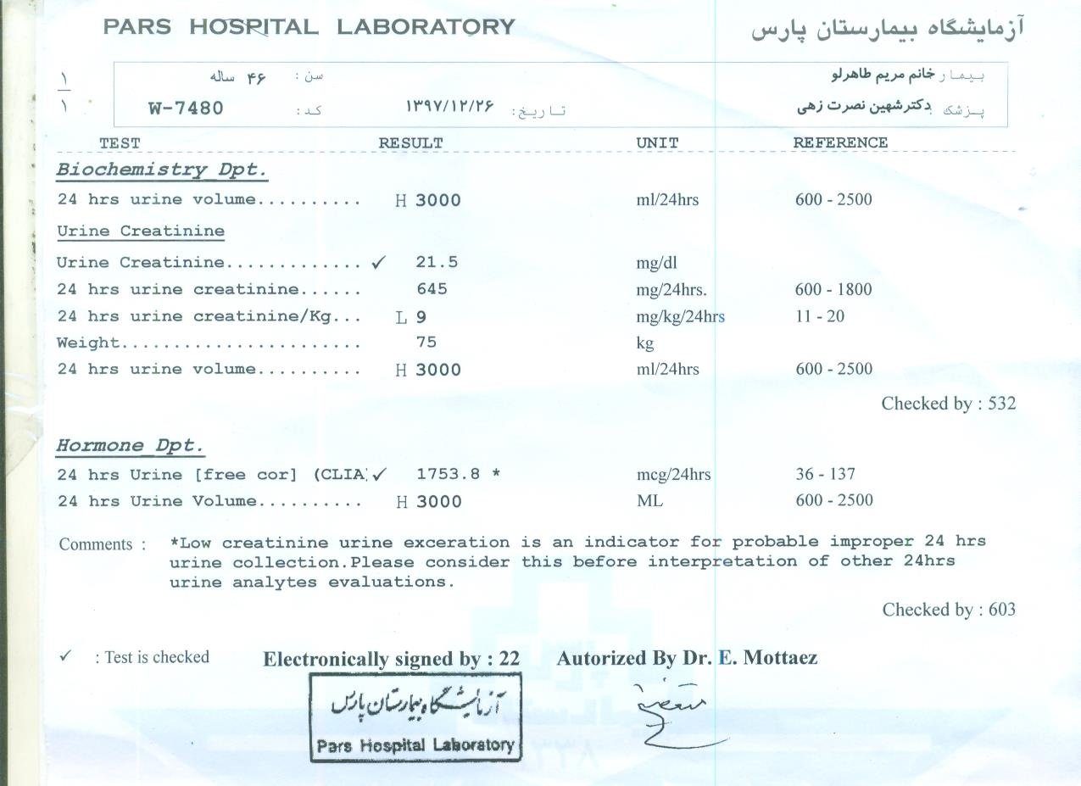

Slide 33
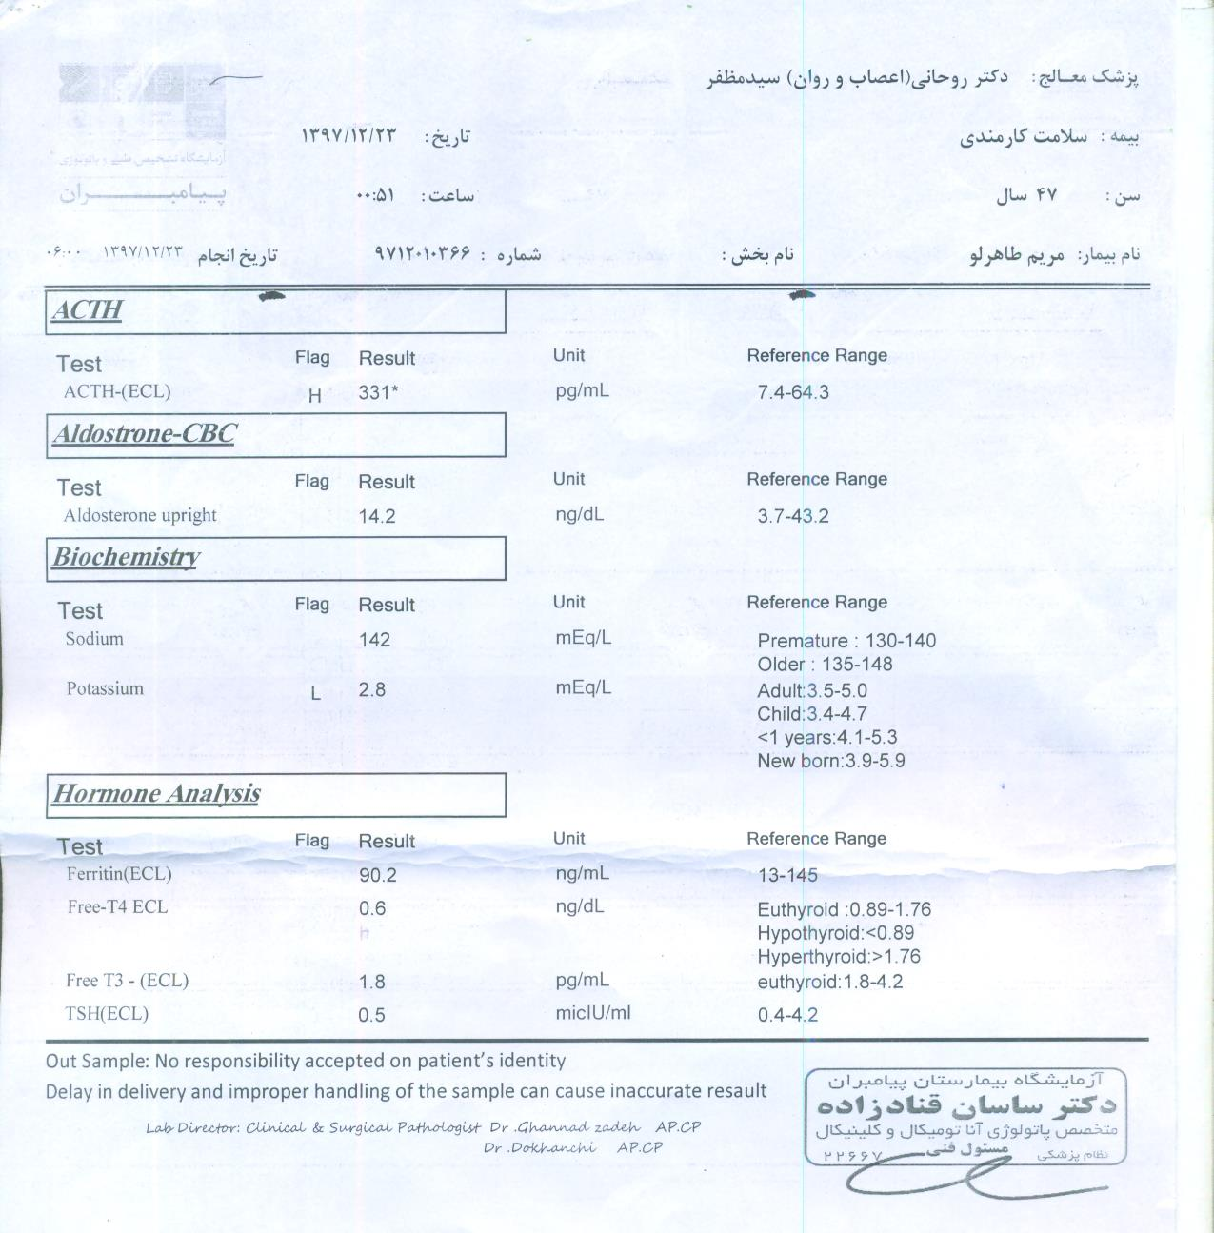

Slide 34
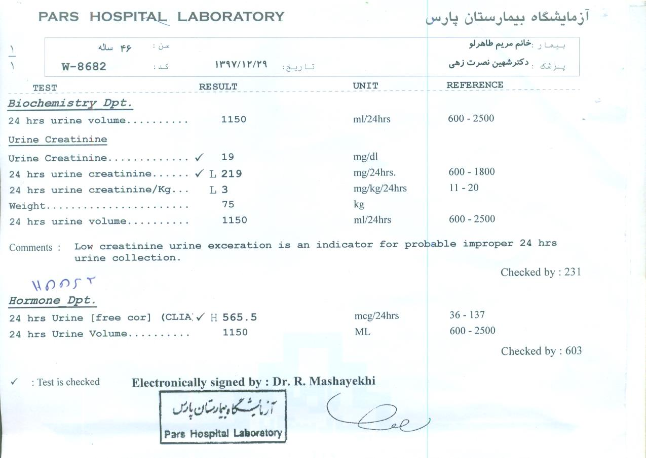

Slide 35
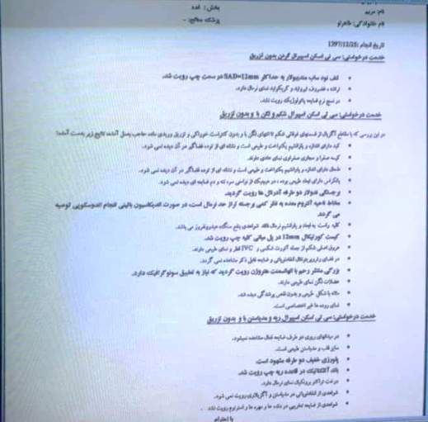

Slide 36
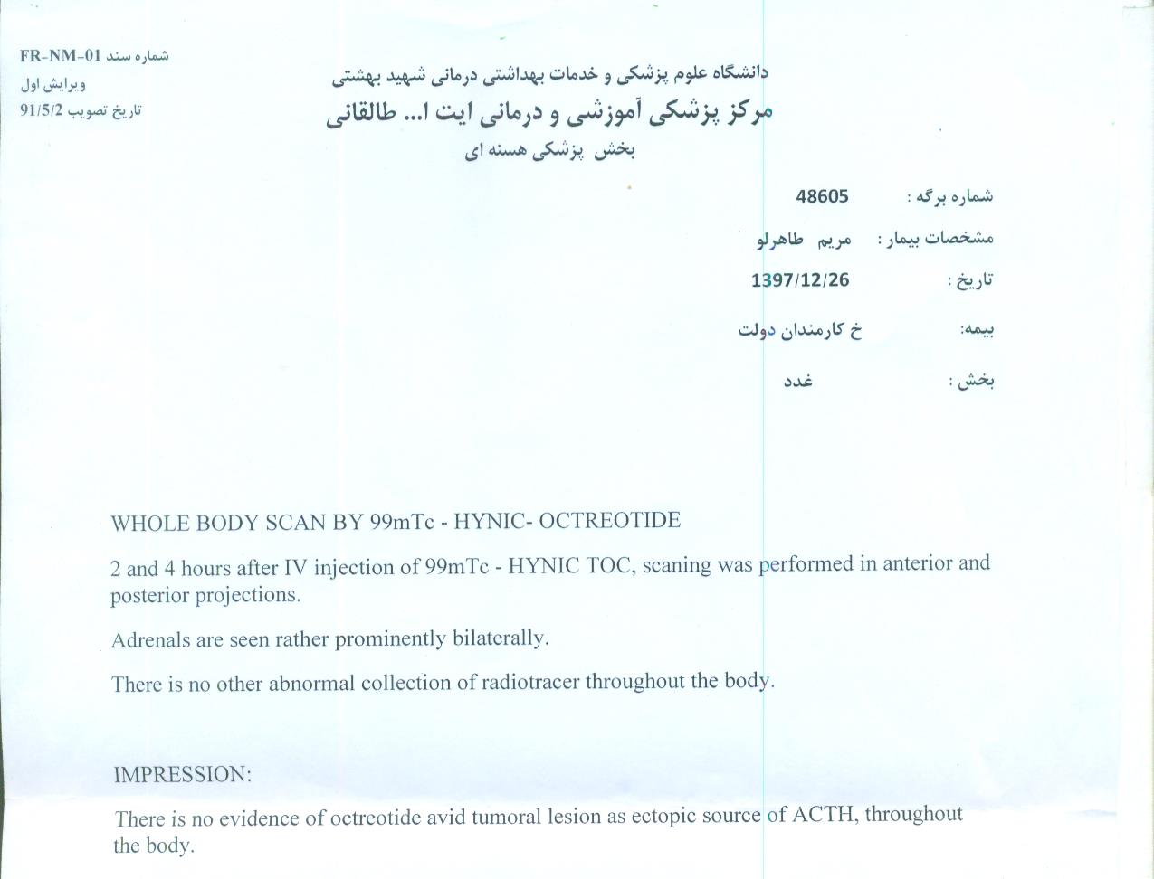

Slide 37
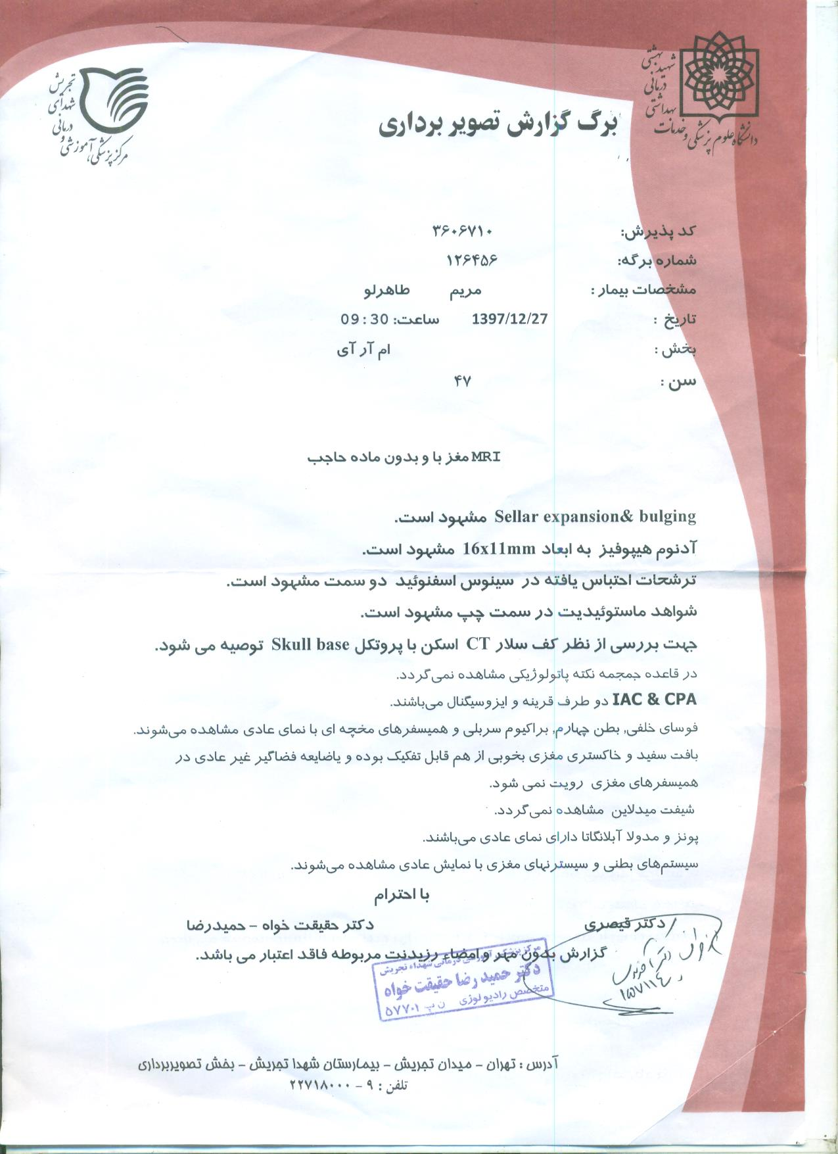

Slide 38
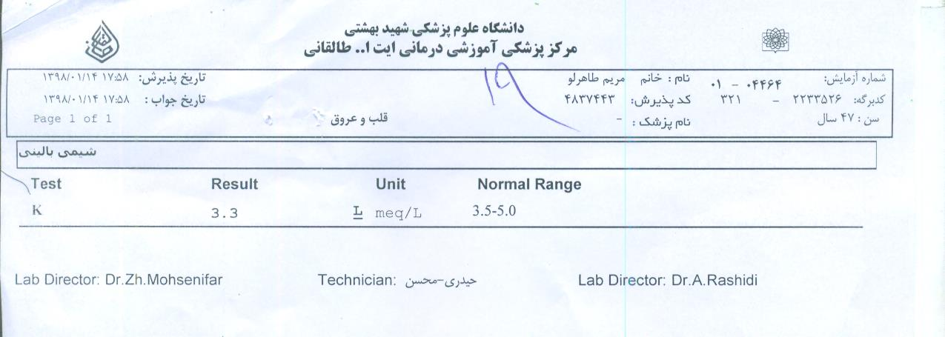

Slide 39
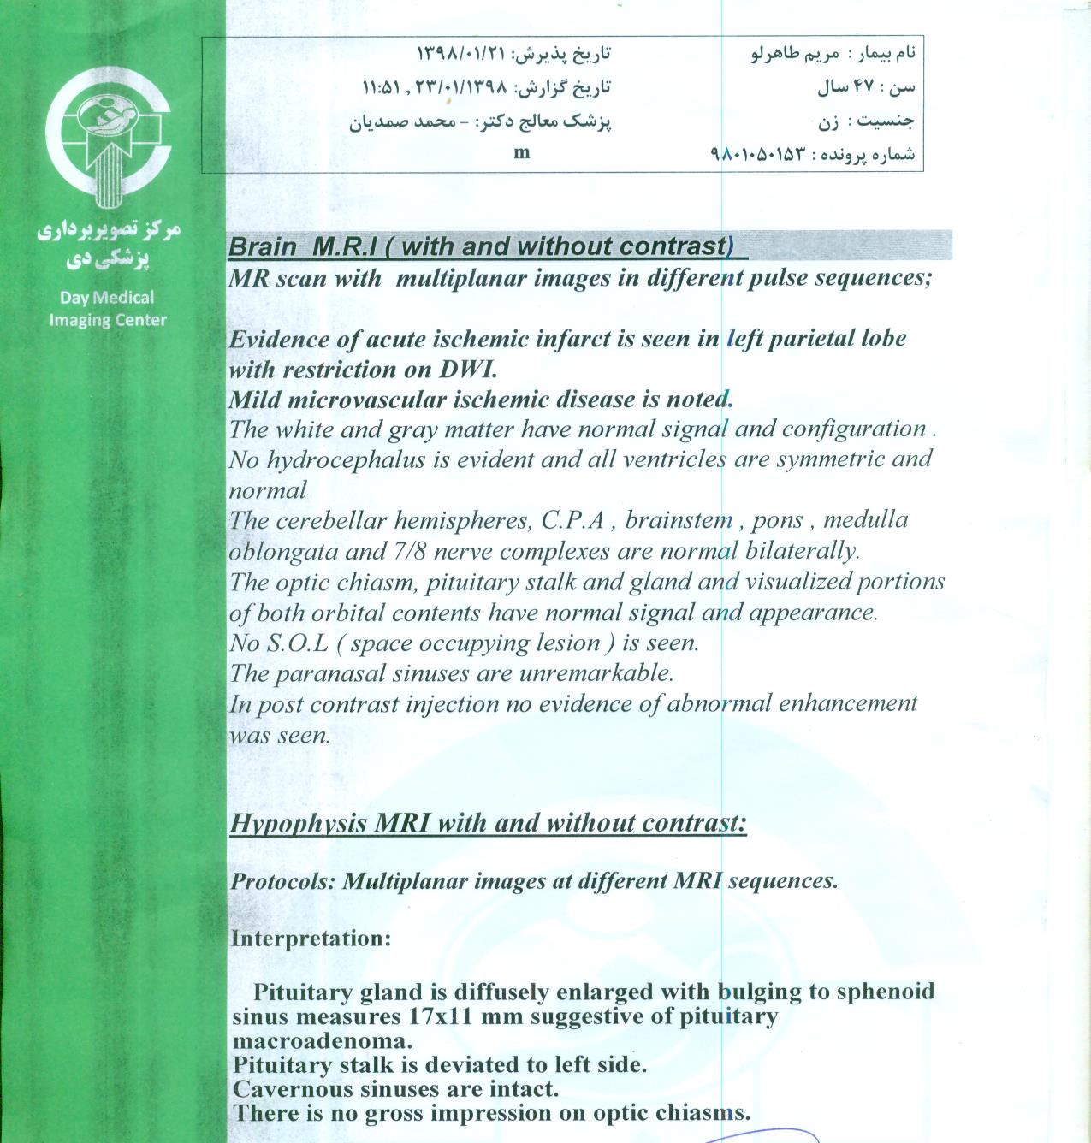

Slide 40
Problem list
A 48-year-old woman
Generalized weakness ,Visual Impairment , Irritability And paranoid psychosis
Recent Diabetes mellitus
Recent hypertension
Headache
Proximal myopathy
Easy bruising
Menstruation irregularity
Depression
Weight loss : 7 kg in 2.5 months
Hypokalemia, dyslipidemia
24-h urinary free cortisol excretion increased above normal (3x)

Slide 41
Problem list
Dexamethasone overnight test (plasma cortisol > 50 nmol/L at 8-9 a.m. after 1 mg dexamethasone at 11 p.m.)
High dose dexamethasone test (cortisol suppression >50% after q6h 2 mg DEX 2 days (565.5)
Brain MRI : Mucosal thickening of left sphenoid sinus; seller expansion & bulging is present, hypophysis adenoma 16x11 mm is present.

Slide 42
Diagnosis
Cushing disease
Plan
Trans sphenoidal surgery

Slide 43
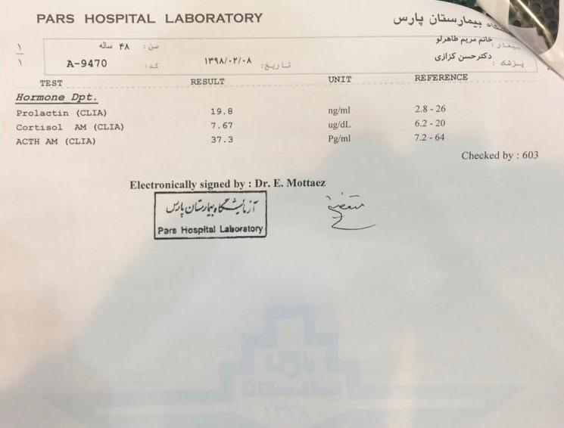

Slide 44
Thanks For Your Attention

