Slide 1
IN THE NAME OF GOD

Slide 2
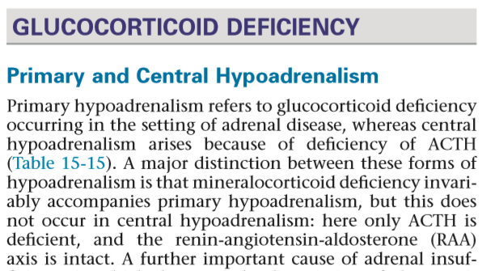

Slide 3
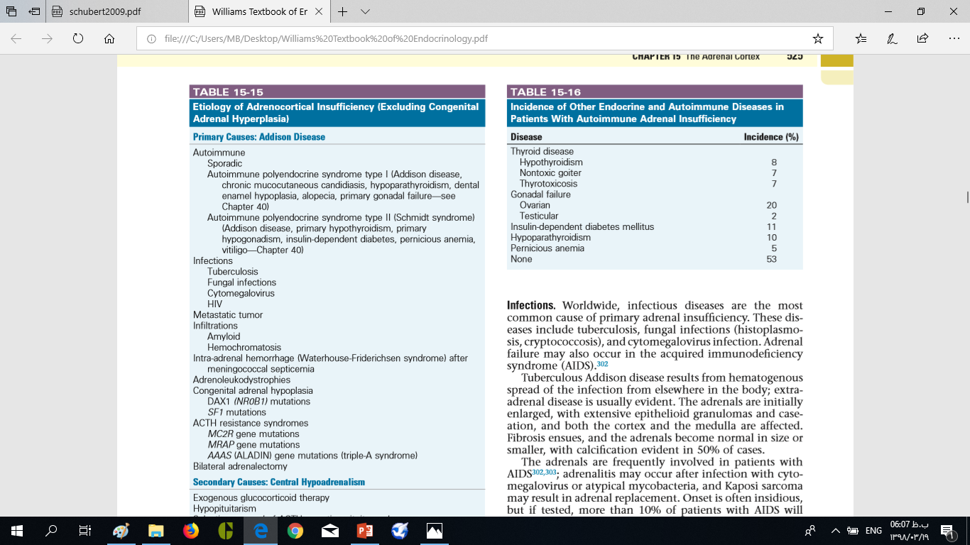

Slide 4
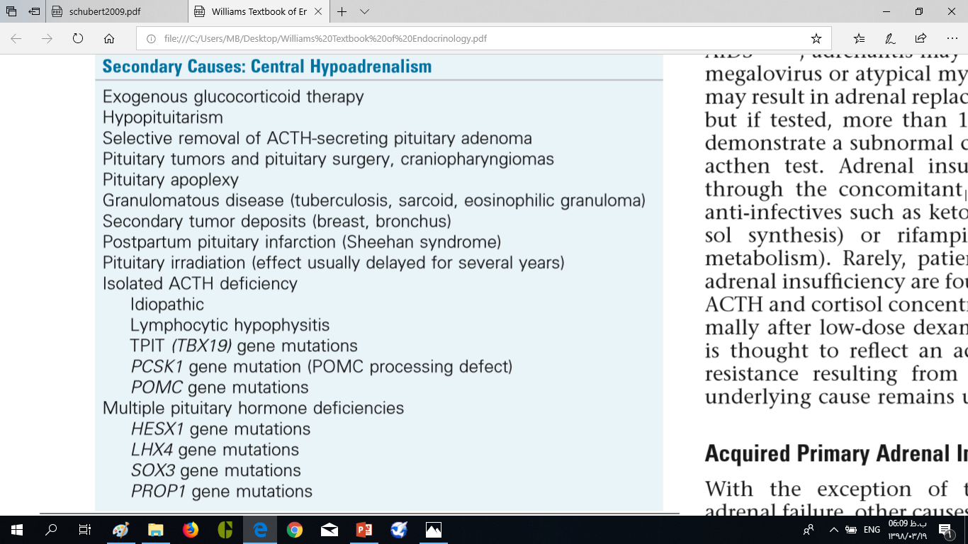

Slide 5
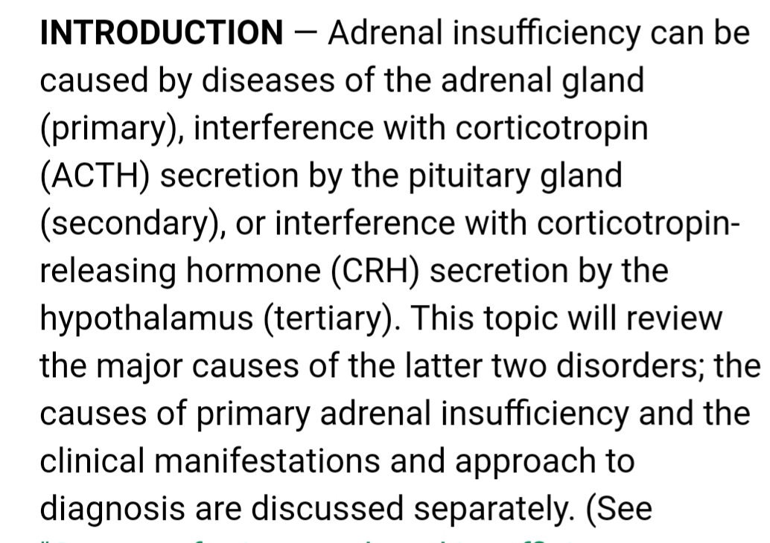

Slide 6
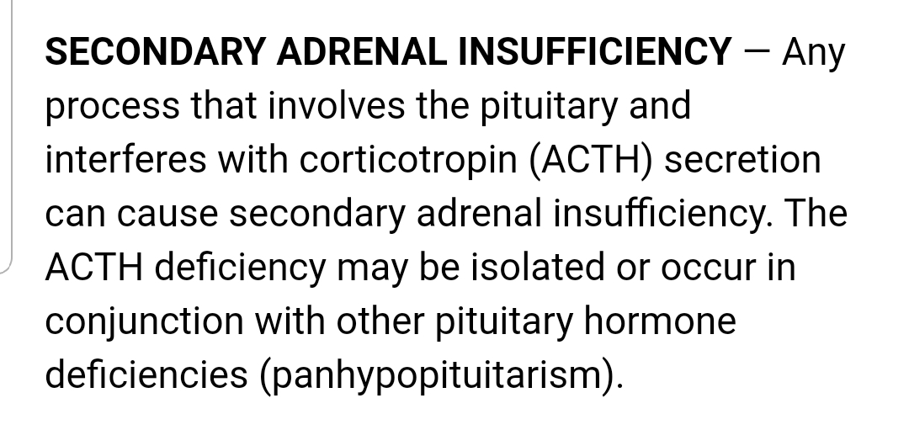

Slide 7
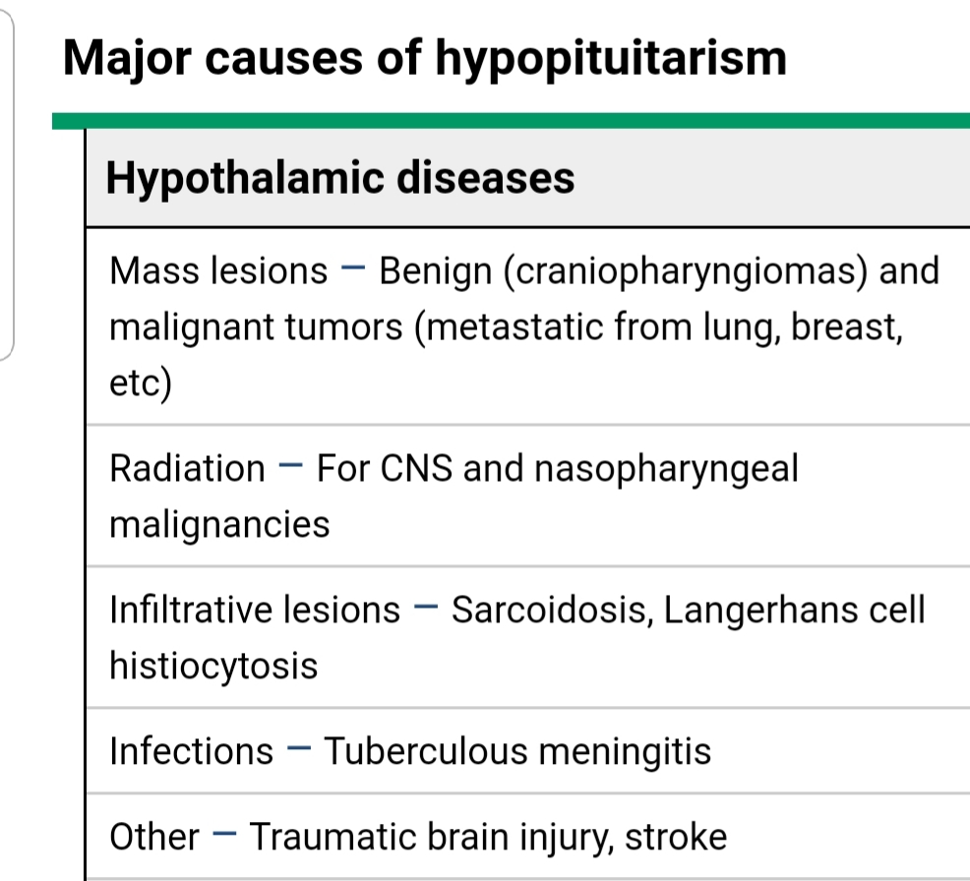

Slide 8
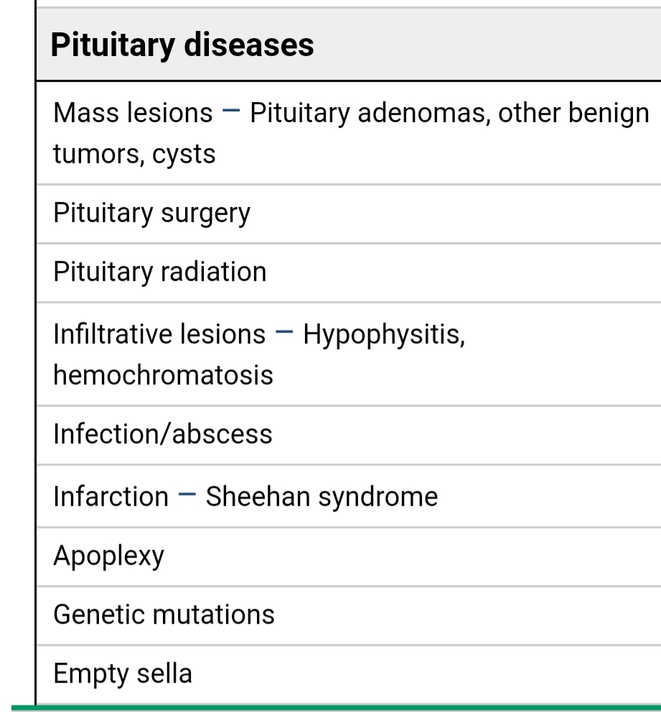

Slide 9
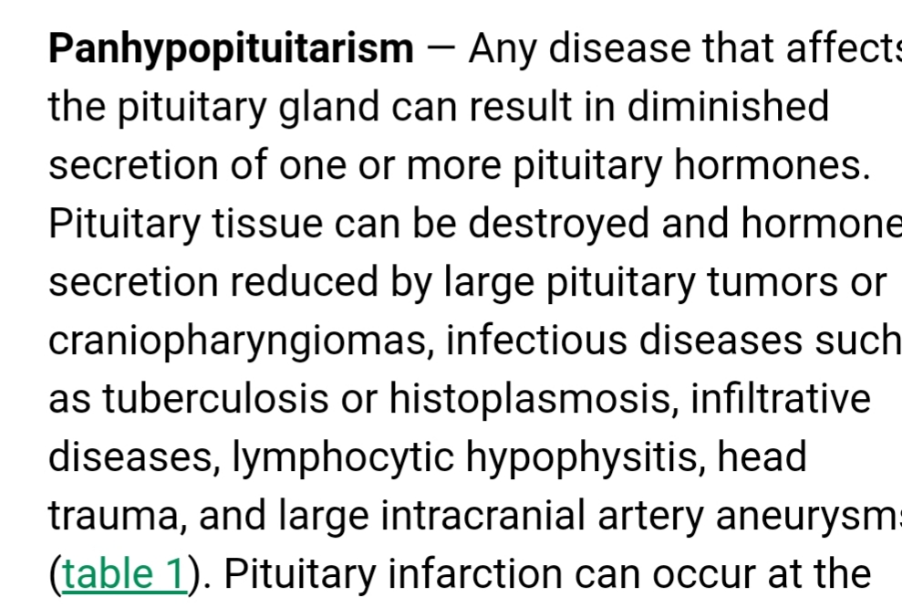

Slide 10
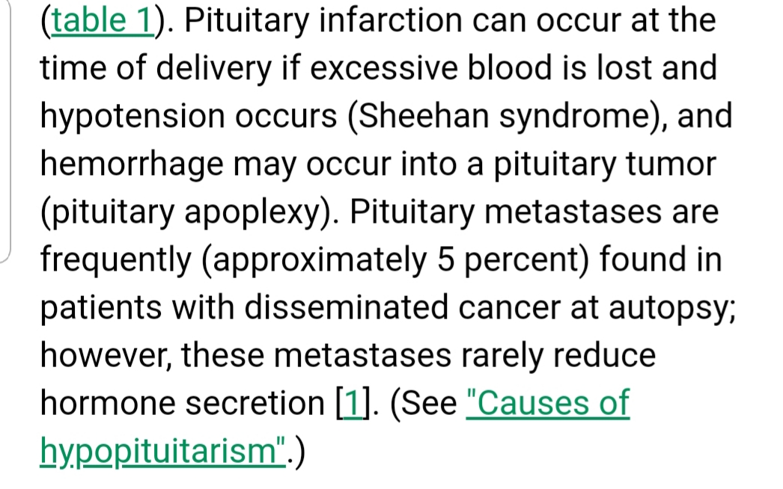

Slide 11
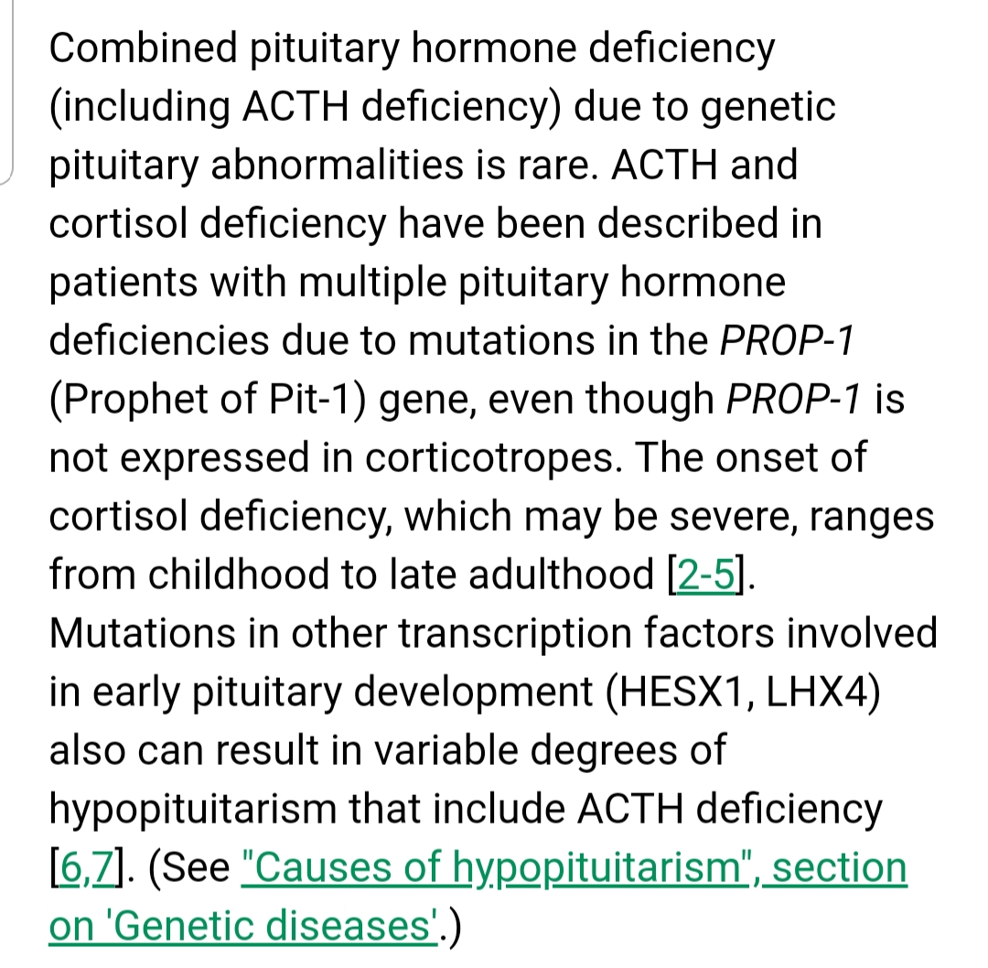

Slide 12
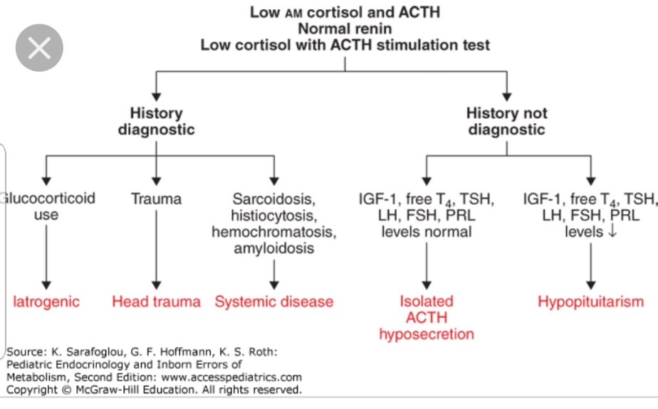

Slide 13
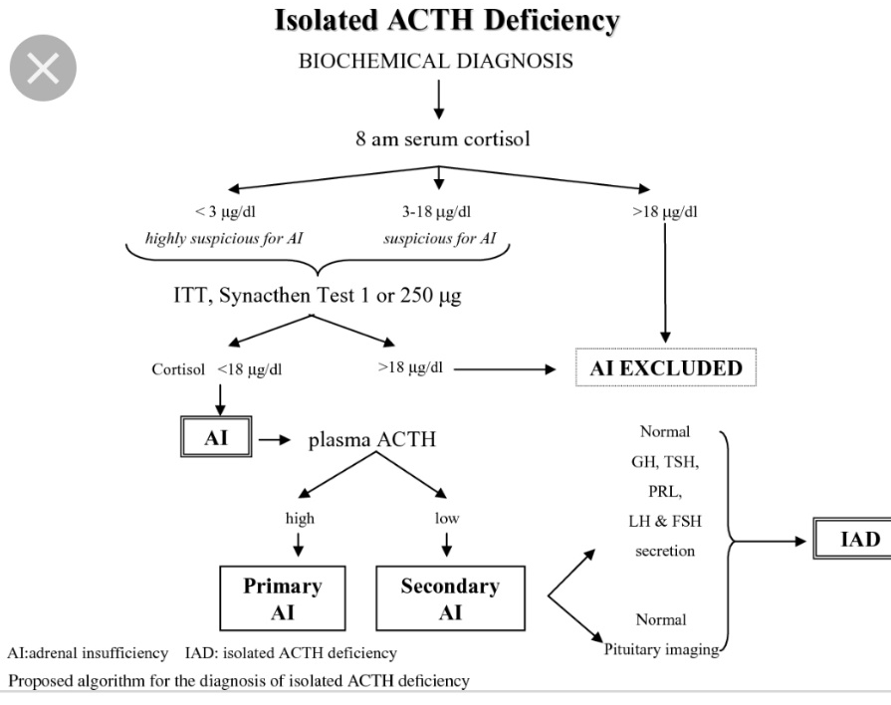

Slide 14
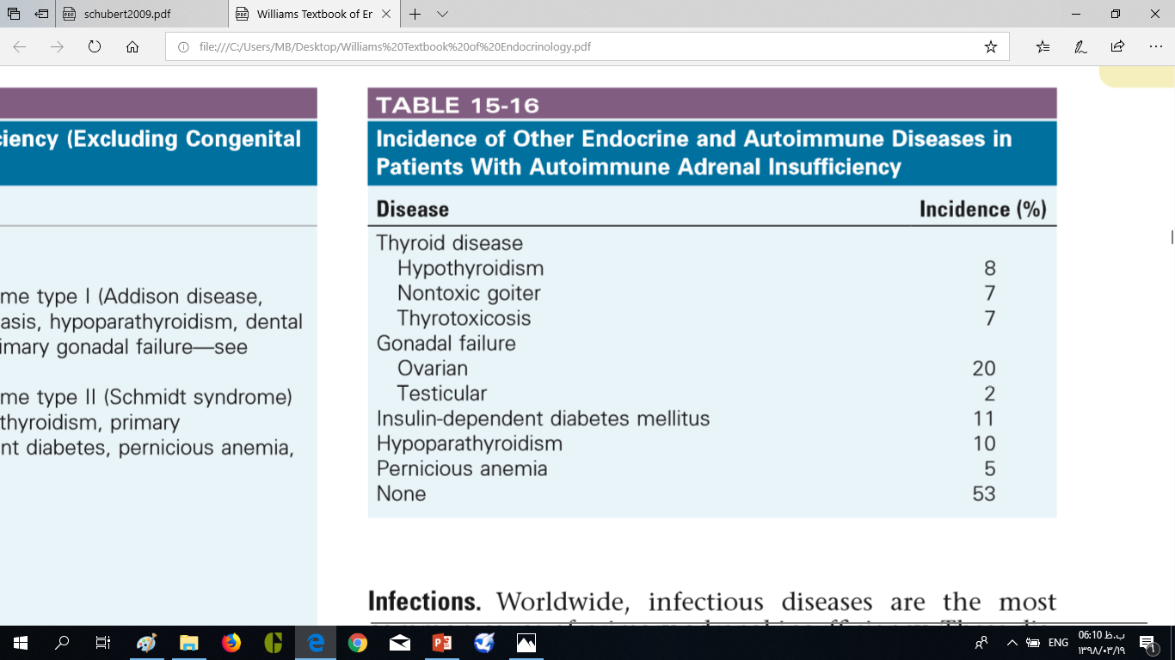

Slide 15
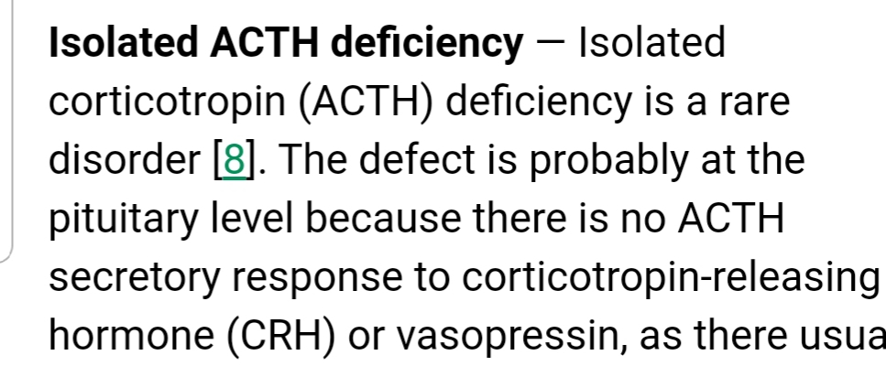

Slide 16
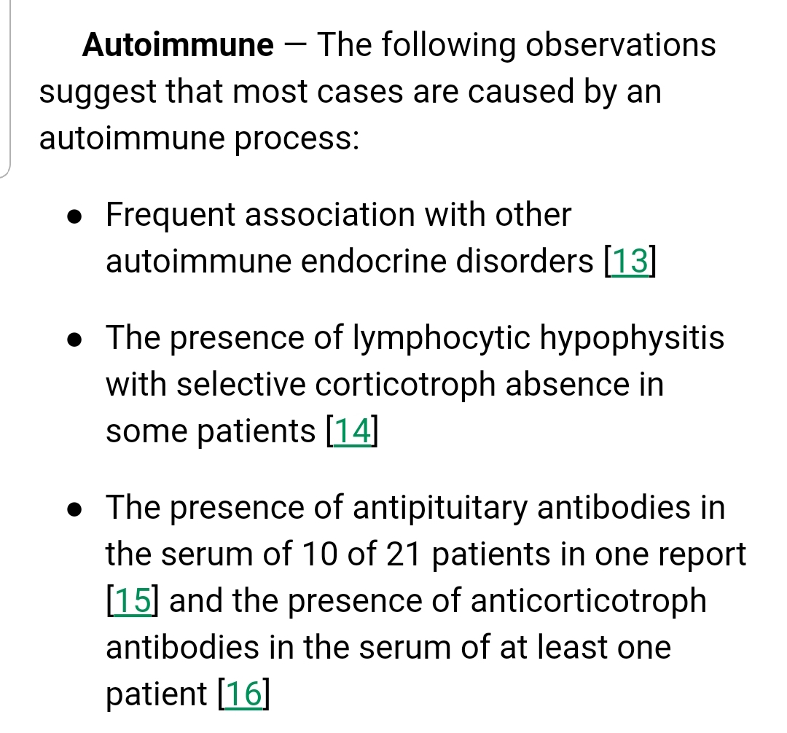

Slide 17
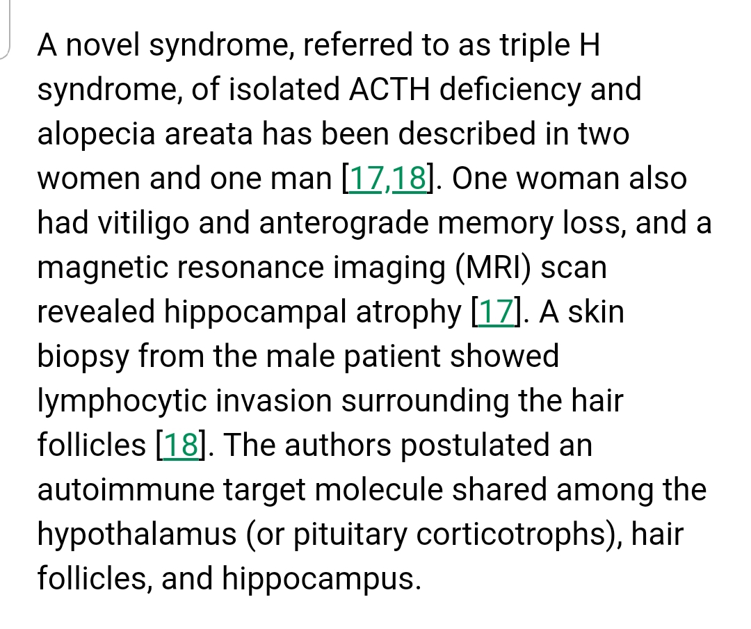

Slide 18
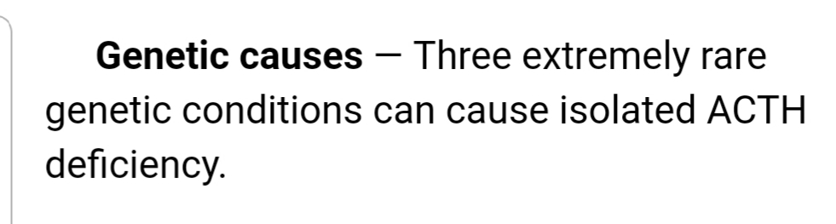

Slide 19
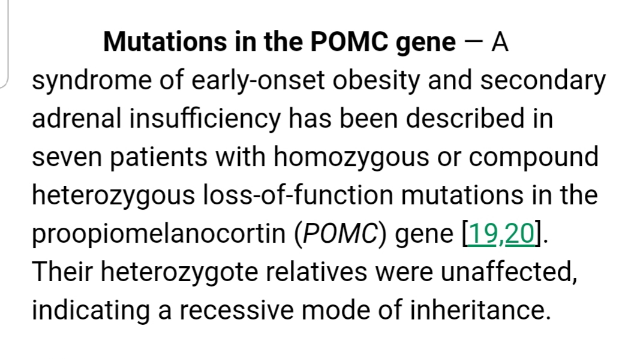

Slide 20
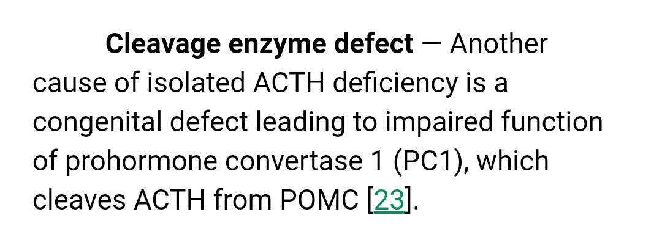

Slide 21
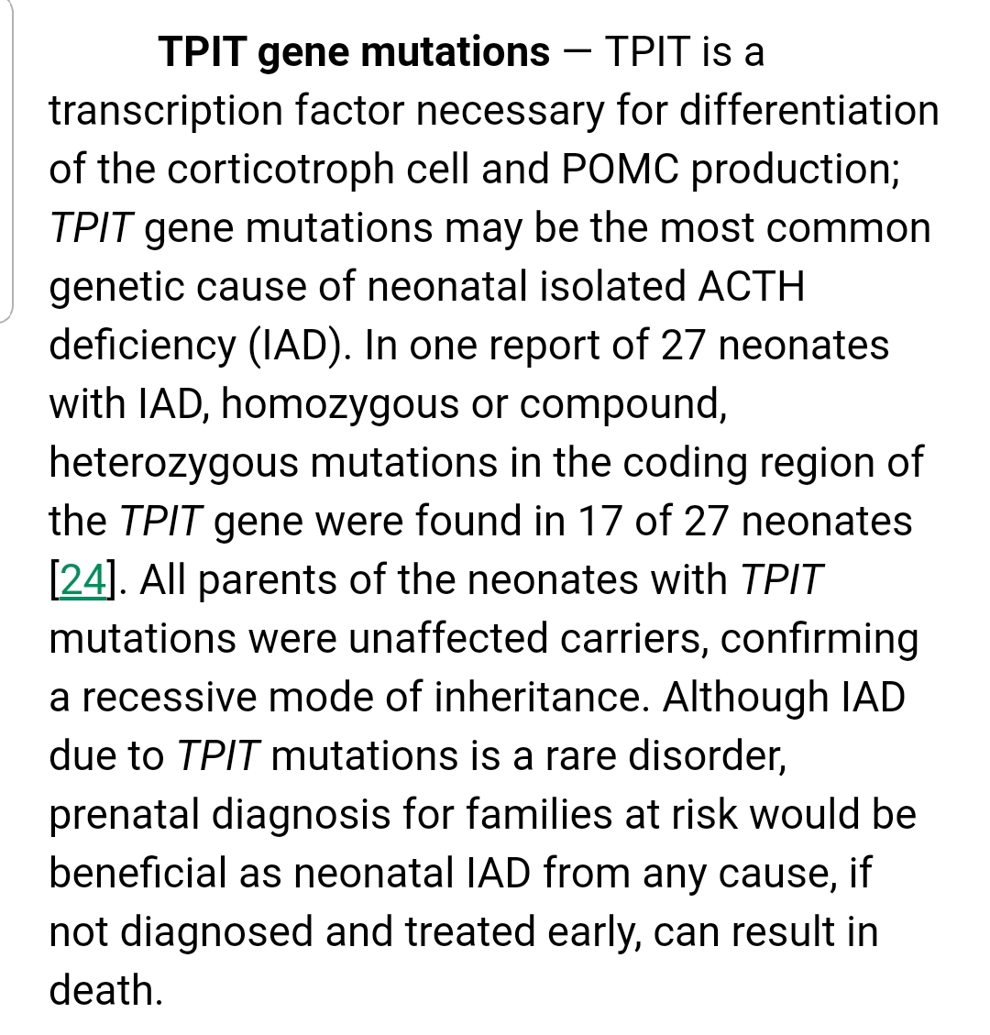

Slide 22
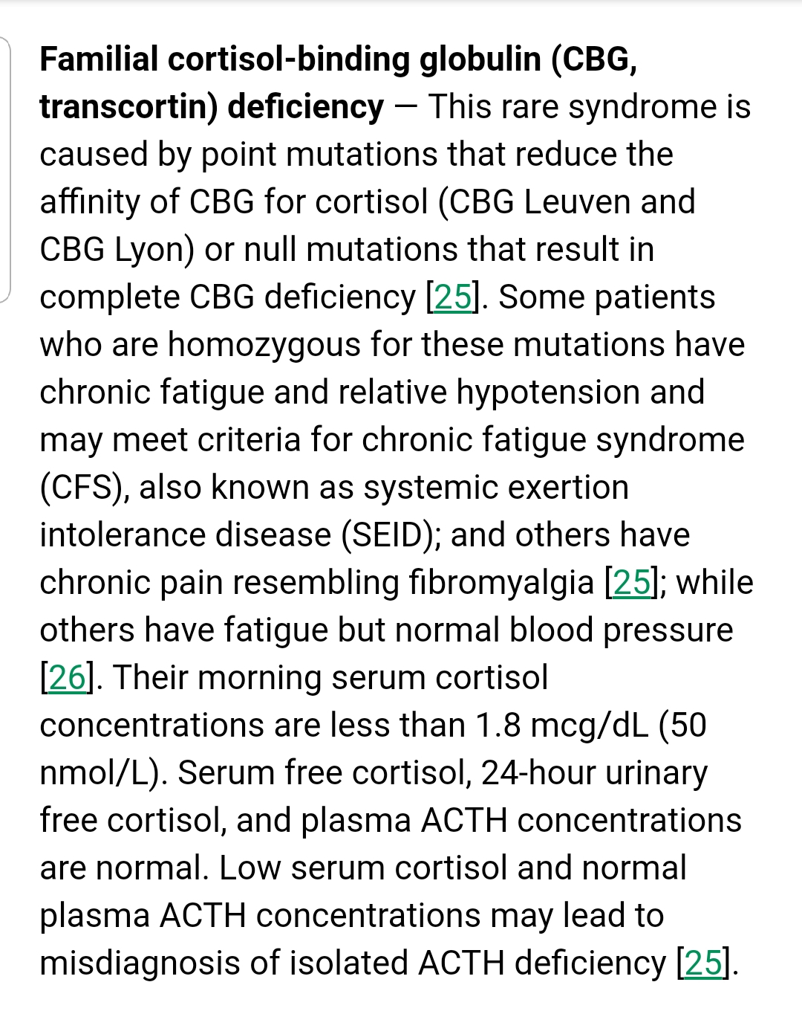

Slide 23
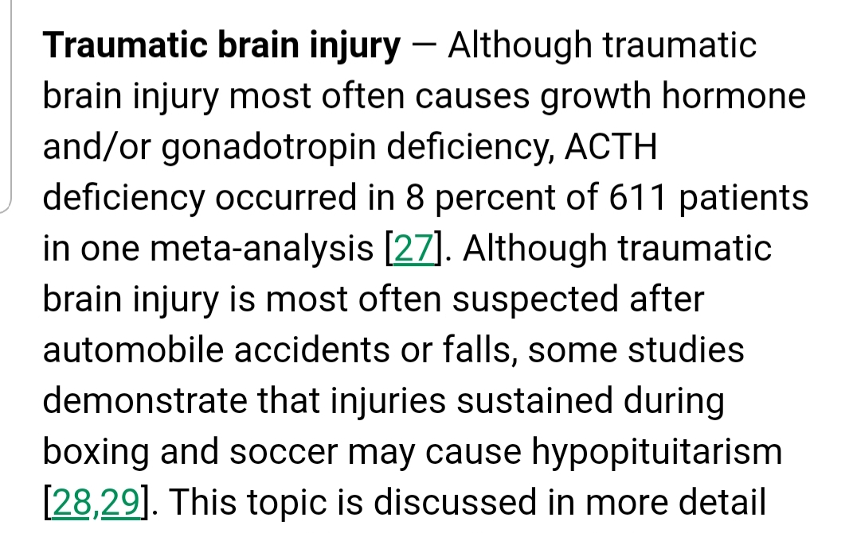

Slide 24
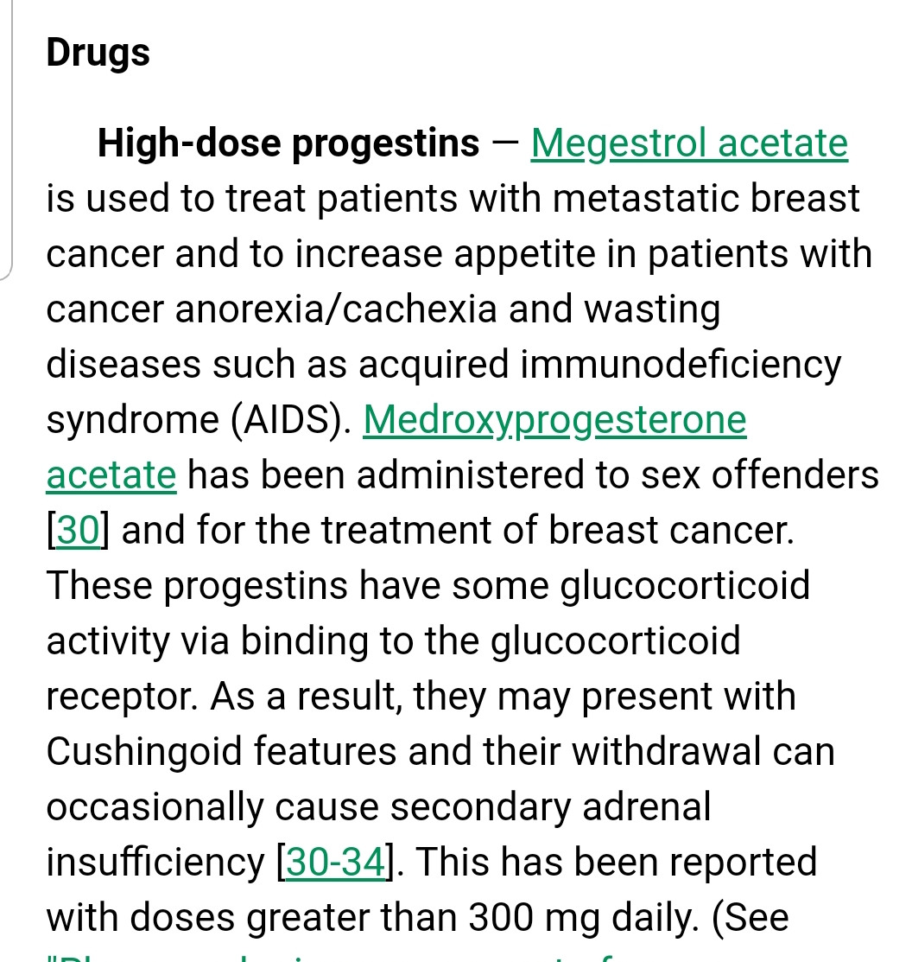

Slide 25
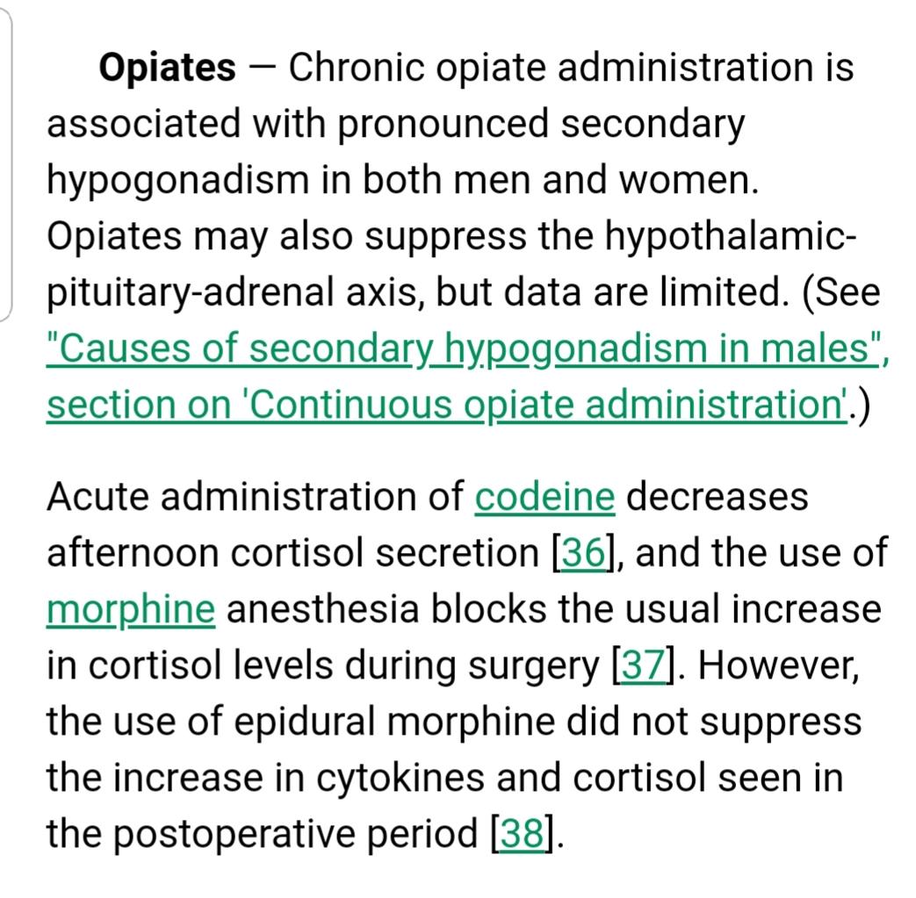

Slide 26
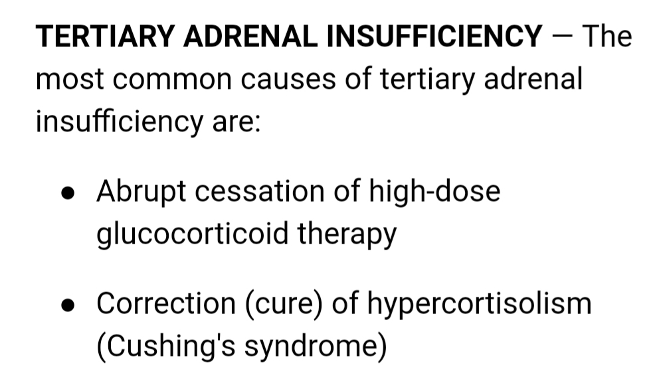

Slide 27
The mean age at disease onset of patients with isolated ACTH deficiency is 50 years and the male to female is 1.2–3.6. In some instances, isolated ACTH deficiency is concurrent with primary hypothyroidism and Hashimoto’s disease.

Slide 28
Isolated adrenocorticotropic hormone deficiency (IAD) is a rare disorder, It is being recognized with increasing frequency in the last years. A genetic origin may come into play in neonatal or childhood. In adults, IAD may appear after a traumatic injury or a lymphocytic hypophysitis (LYH), the latter possibly due to autoimmune etiology.

Slide 29
Isolated ACTH deficiency primarily presents with symptoms of adrenal insufficiency due to lack of ACTH secretion, along with general fatigue, loss of appetite, nausea, vomiting and skin dryness. However, when patients have psychological symptoms such as apathy and depression in addition to the above, the condition can be mistakenly diagnosed as a mental disorder. Thus, diagnosis on the basis of clinical symptoms is not necessarily easy.

Slide 30
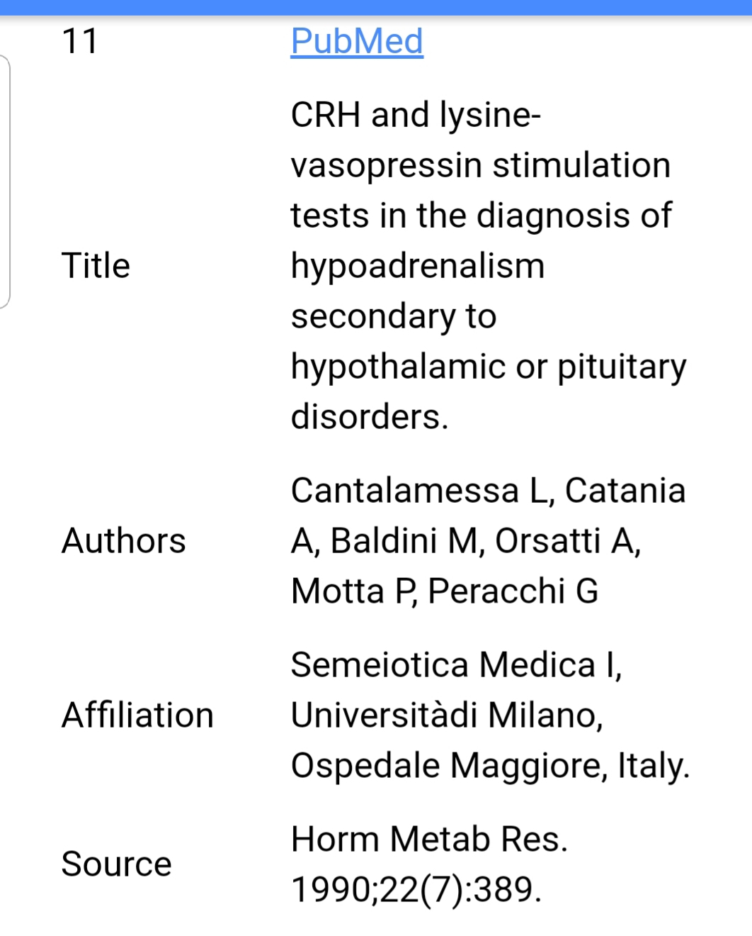
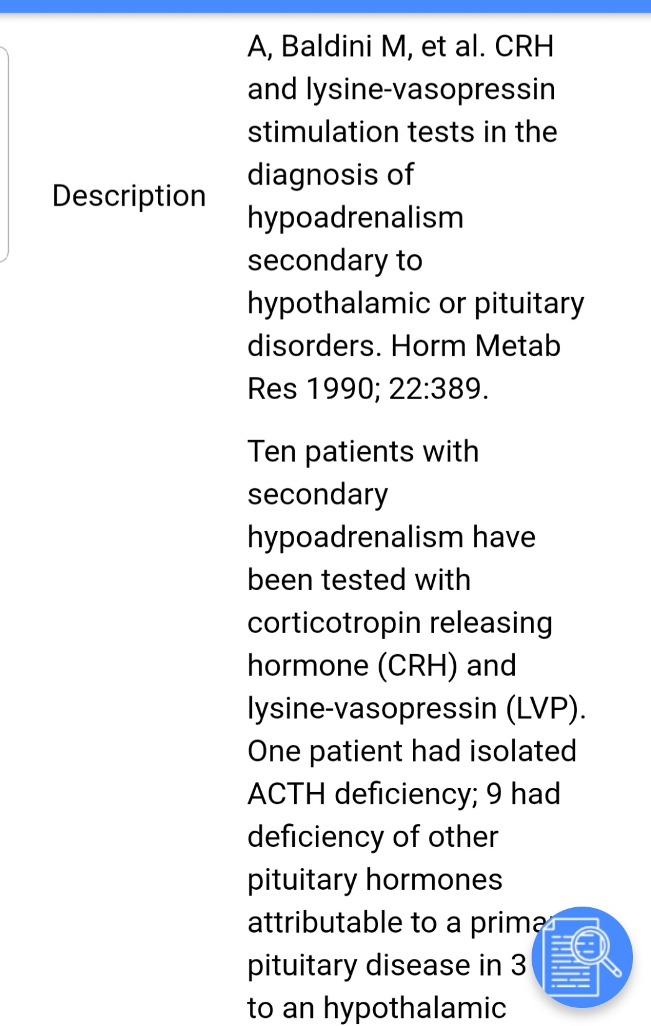

Slide 31
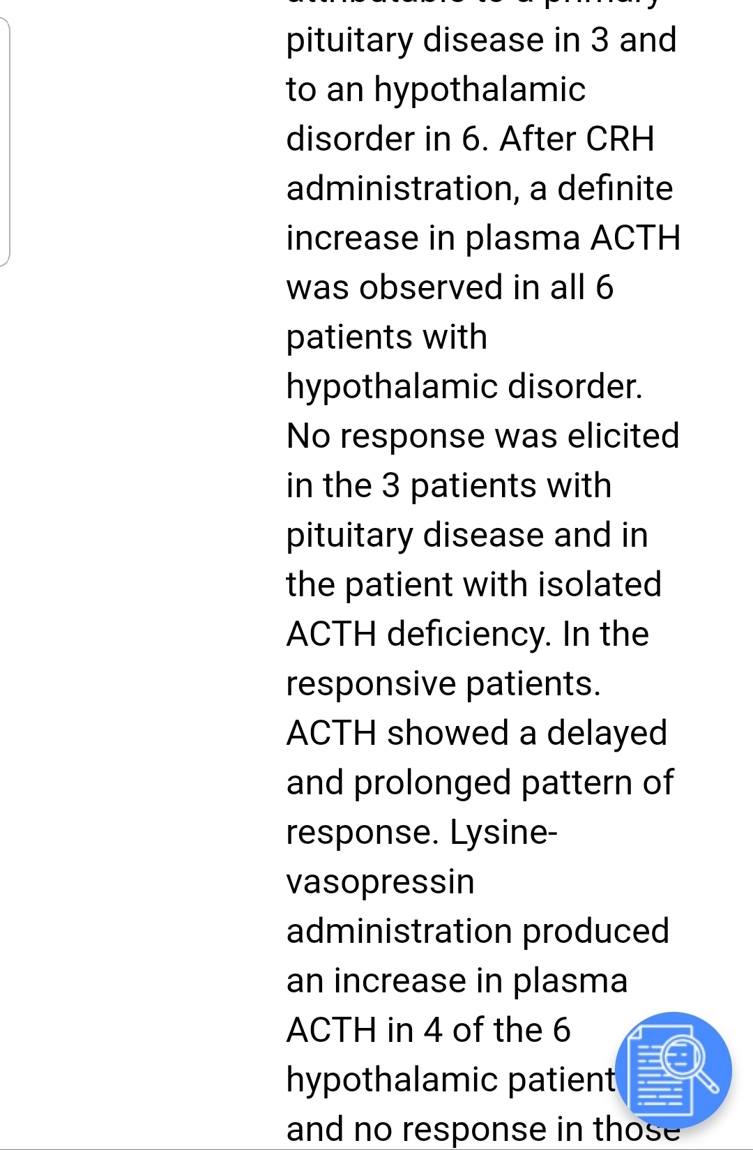

Slide 32
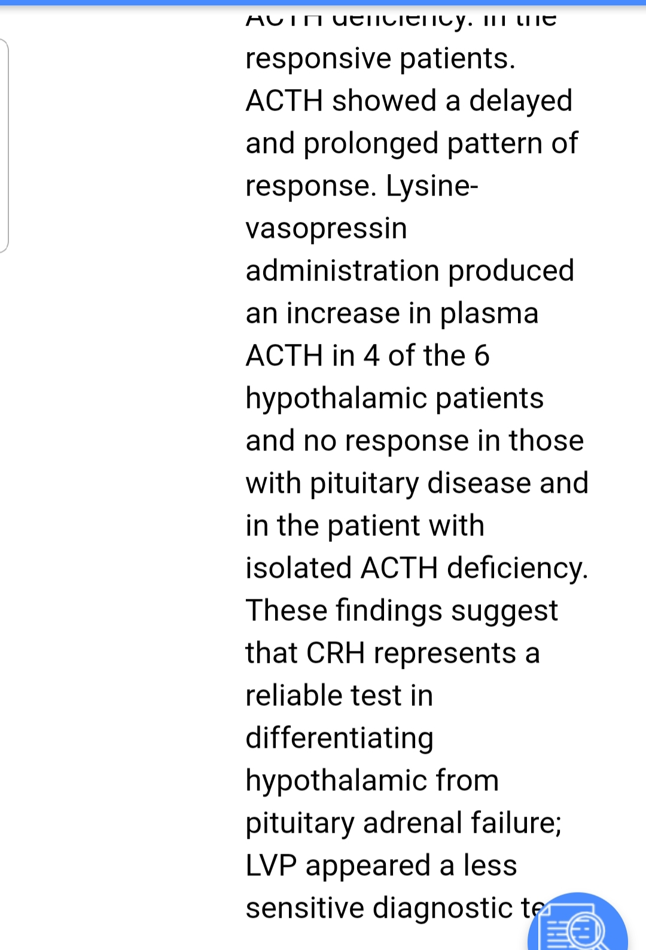

Slide 33
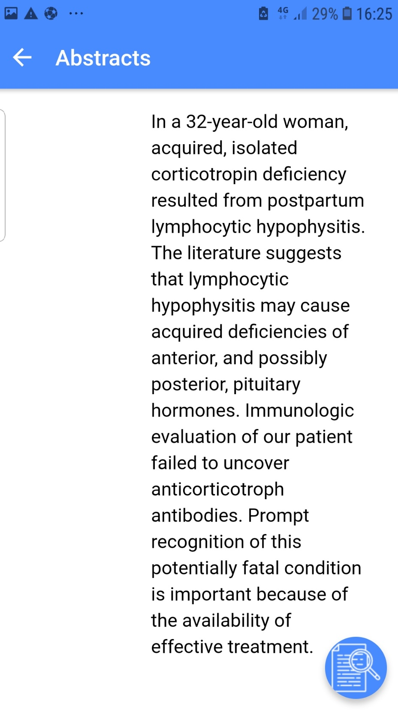
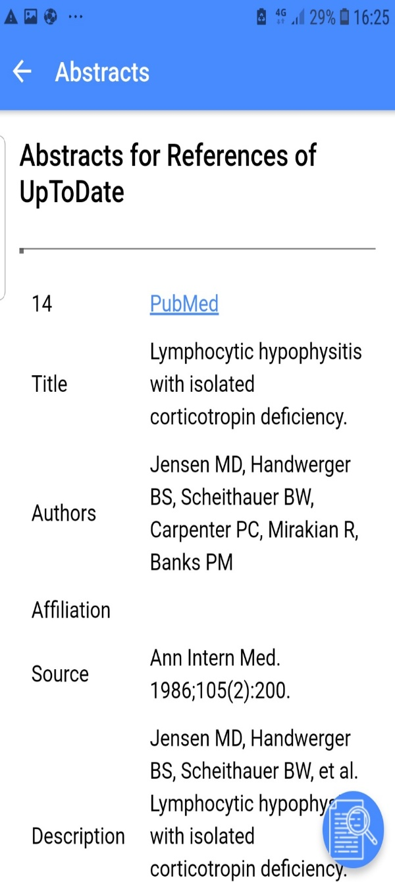
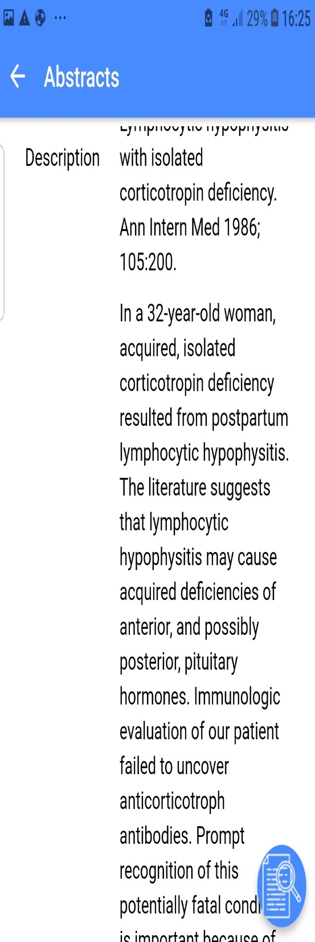

Slide 34
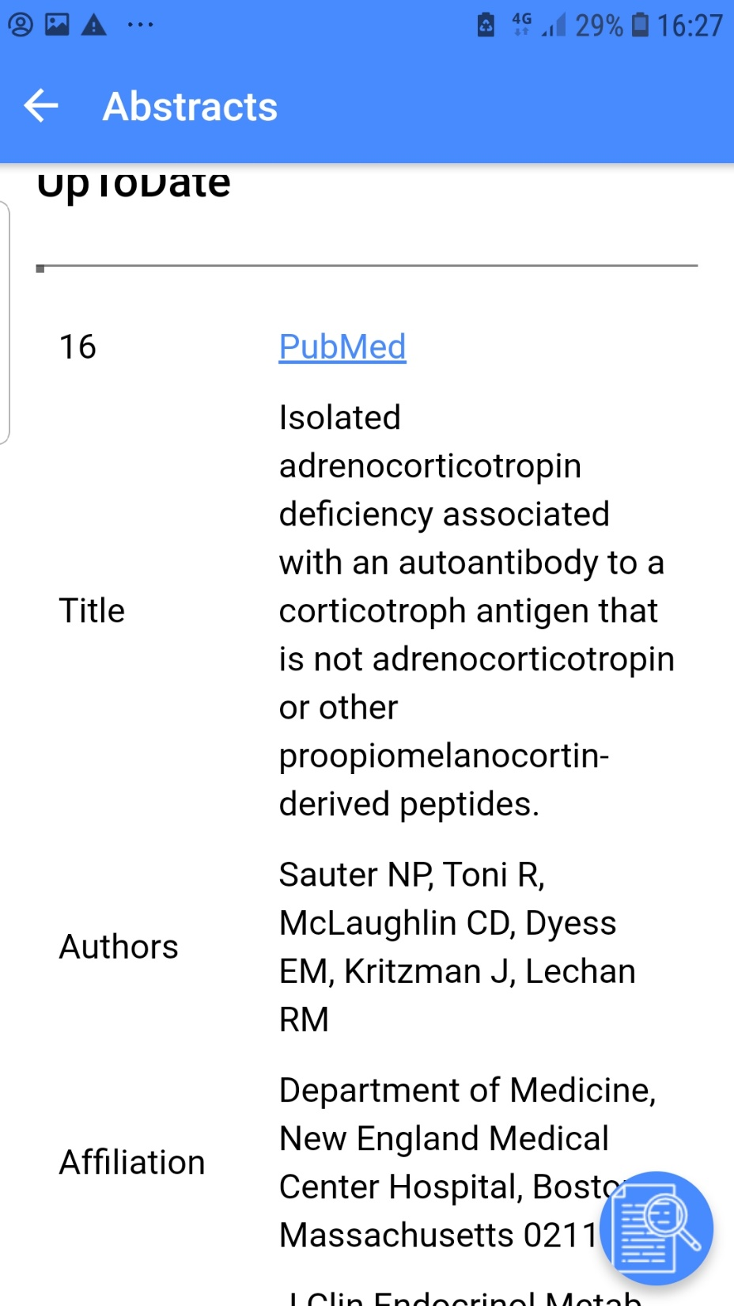
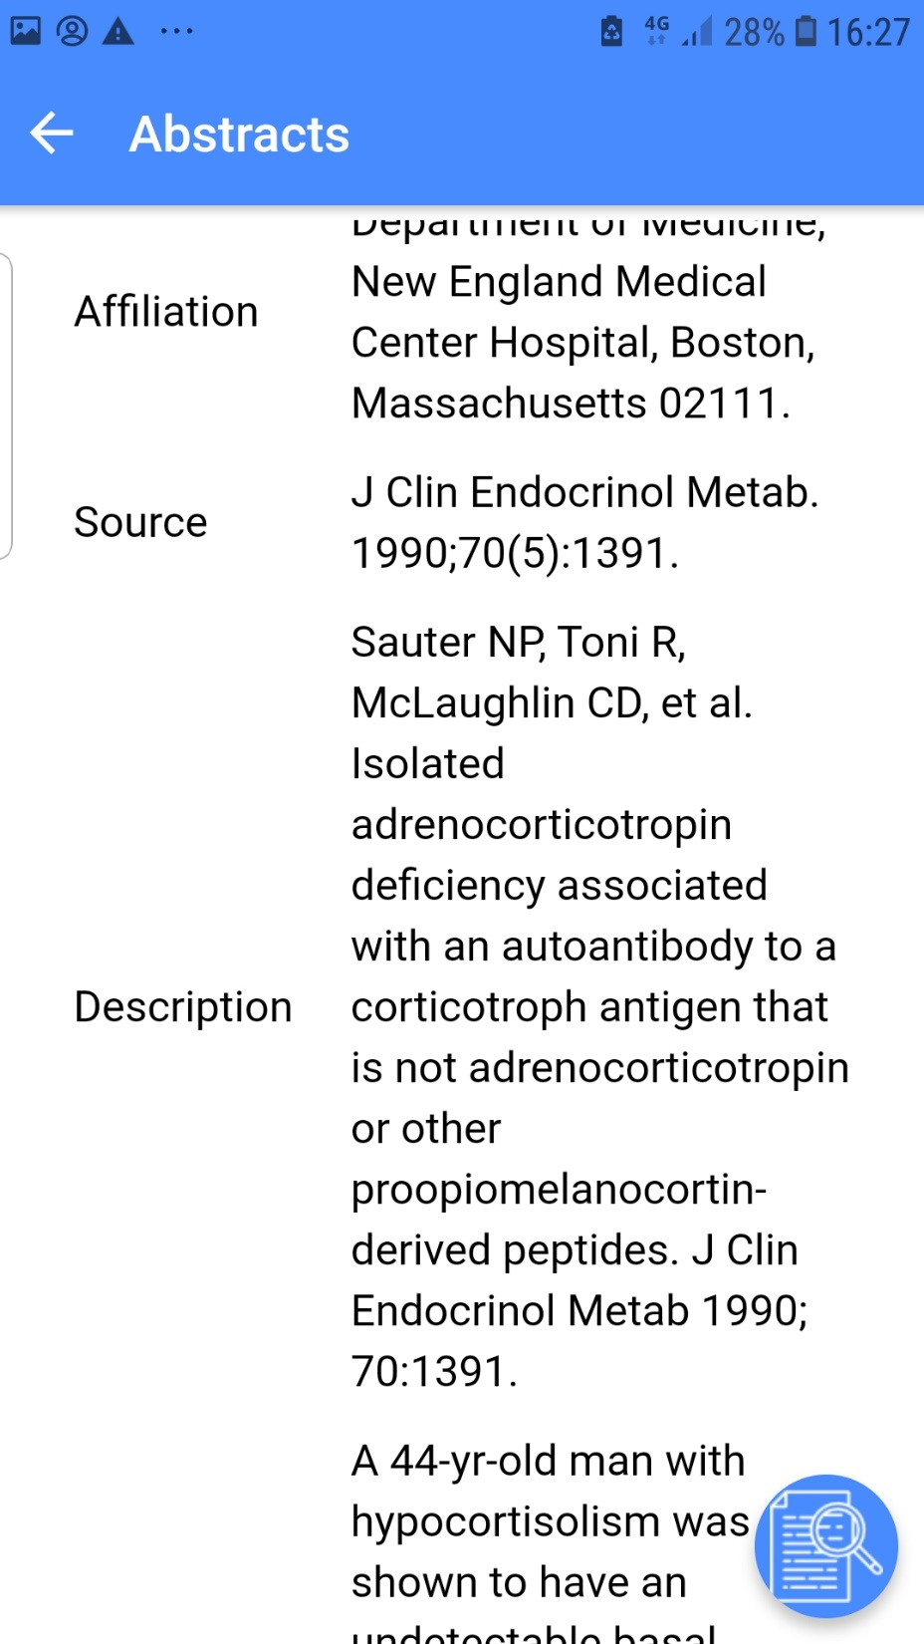

Slide 35
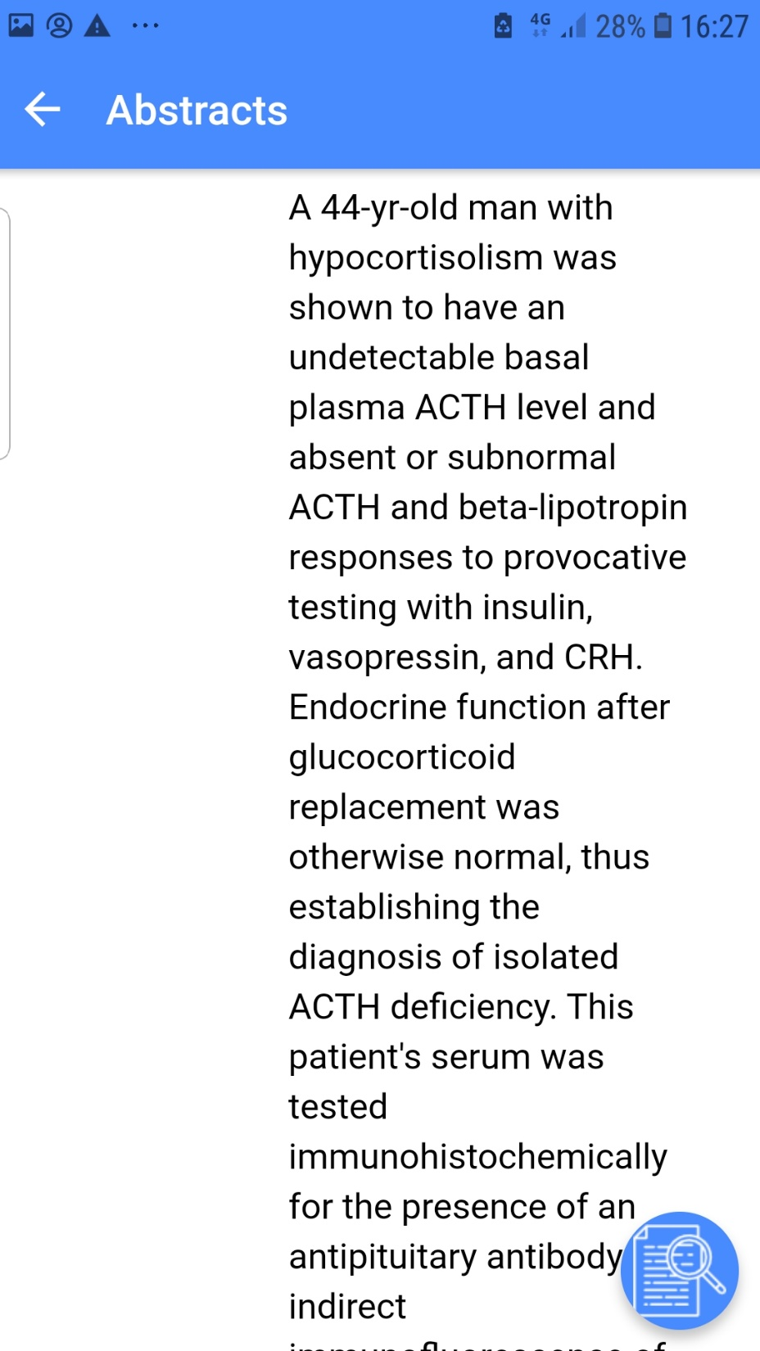

Slide 36
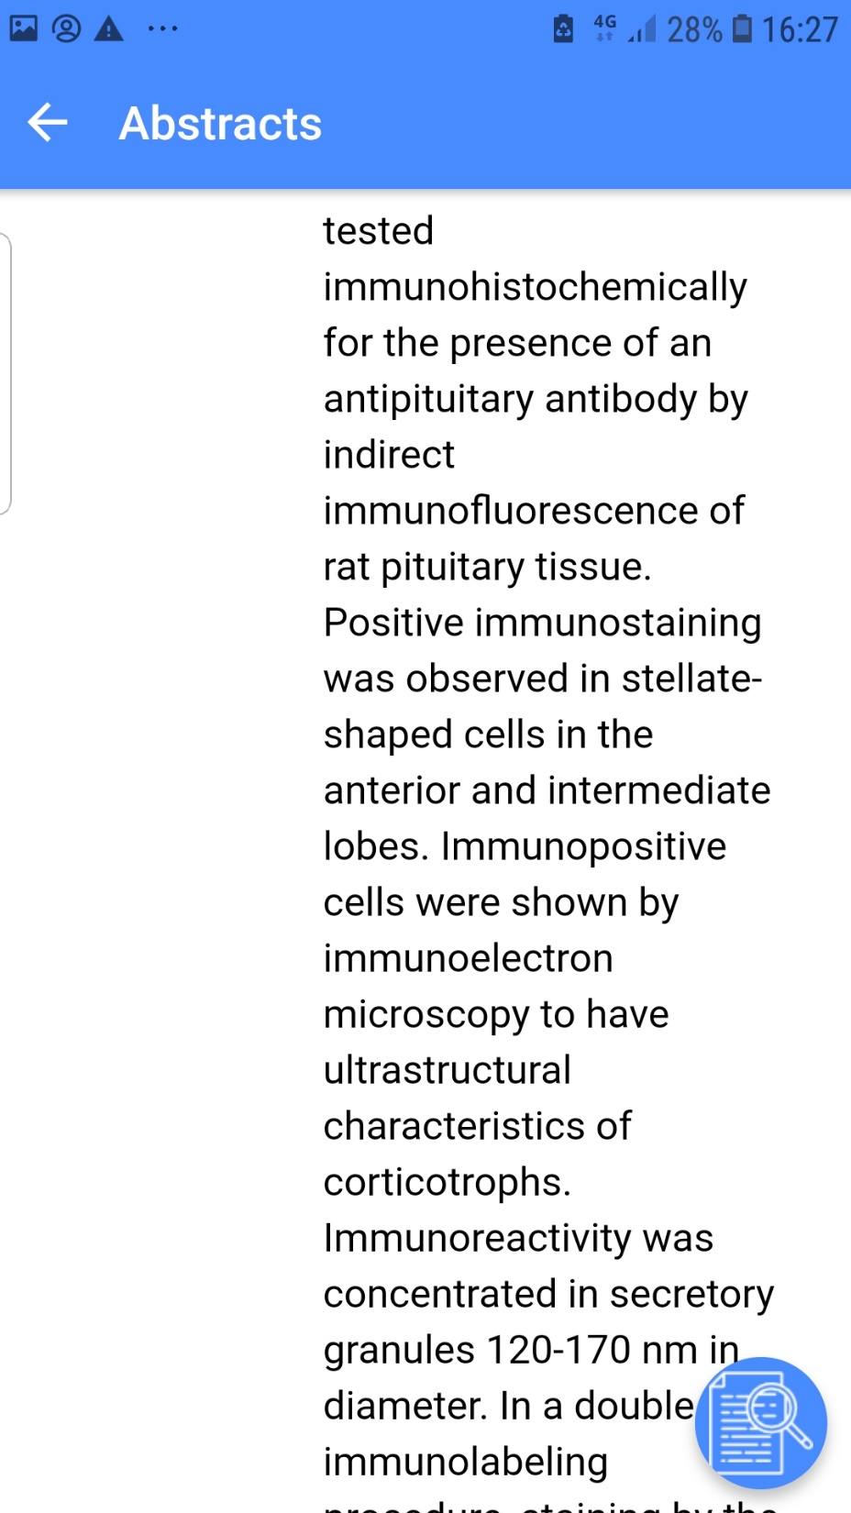

Slide 37
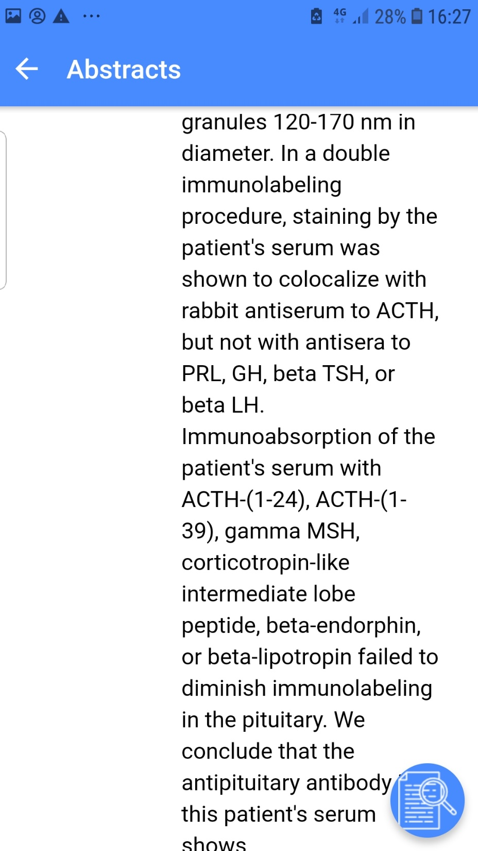

Slide 38
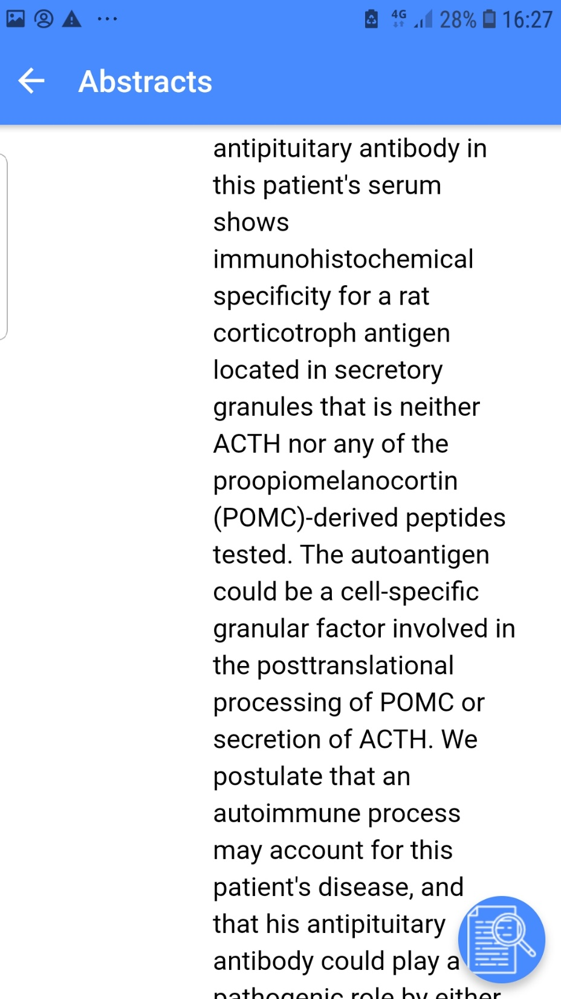

Slide 39
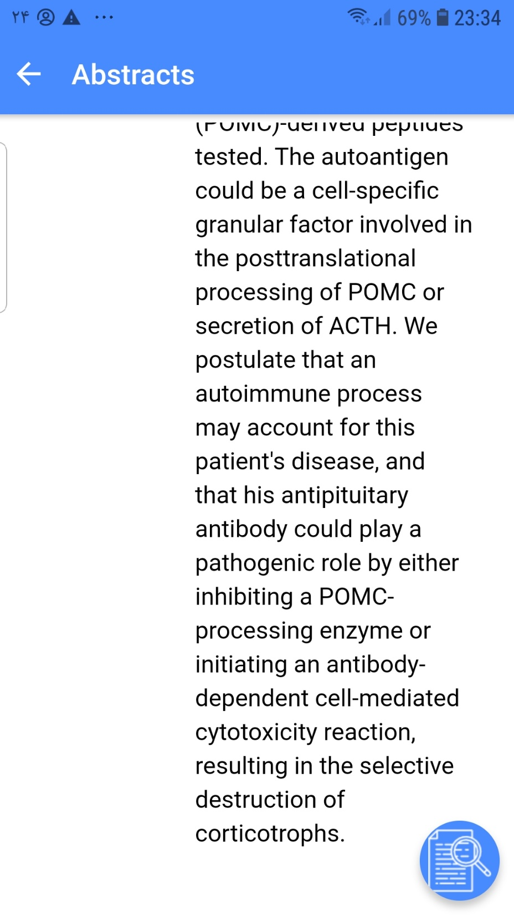

Slide 40
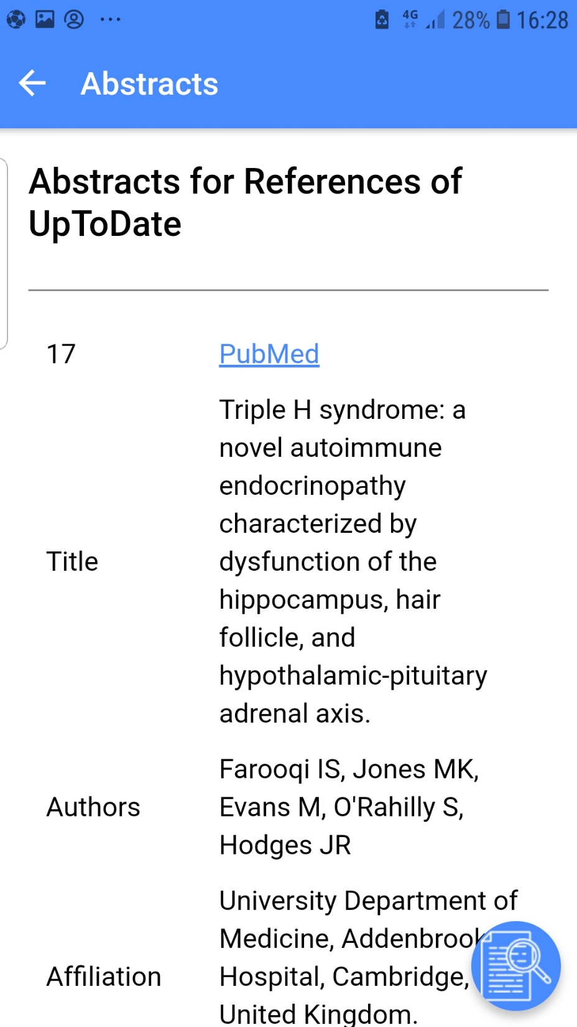
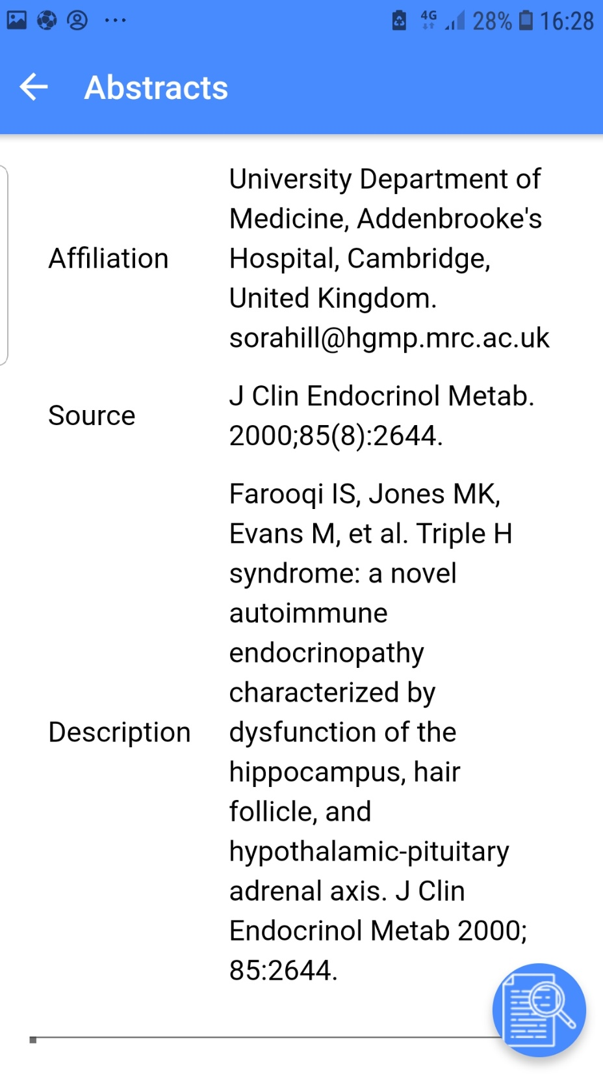

Slide 41
Secondary Hypoadrenalism
Inherited Central Hypoadrenalism
the prevalence of central hypoadrenalism is 125 to 280 per million, which is likely to be an underestimate considering the use of therapeutic corticosteroids in the general population. It occurs in up to one third of patients with pituitary disease. central hypoadrenalism is associated with increased mortality.
T

Slide 42
By contrast, isolated ACTH deficiency is rare, and the diagnosis is difficult to make. It may occur in patients with lymphocytic hypophysitis
A rare but fascinating cause relates to a defect in the normal post-translational processing of POMC to ACTH by the prohormone convertase enzymes (PC1 and PC2). Such patients may have more generalized defects in peptide processing (e.g., cleavage of proinsulin to insulin) giving rise to diabetes mellitus.

Slide 43
Fasting hypoglycemia occurs because of loss of the gluconeogenic effects of cortisol. It is rare in adults unless there is concomitant alcohol abuse or additional GH deficiency. However, hypoglycemia is a common presenting feature of ACTH/adrenal insufficiency in childhood.

Slide 44
Acta Endocrinol (Copenh). 1982 Apr;99(4):573-6.
Isolated ACTH deficiency and primary hypothyroidism.
Miller MJ, Horst TV.
Abstract
A patient presented with severe primary hypothyroidism and secondary adrenal insufficiency due to the isolated deficiency of ACTH. The diagnostic evidence suggests that both are of an autoimmune aetiology. Acquired isolated or unitrophic ACTH deficiency is a rare but definite cause of adrenal insufficiency. Additional case reports and autopsy studies describing acquired isolated ACTH deficiency associated with autoimmune thyroid disease have appeared in the literature suggesting that the association is more than coincidental. Combined thyroid and adrenal failure should not always be considered to be the result of combined end organ failure. Unitrophic isolated ACTH deficiency may coexist with primary hypothyroidism.

Slide 45
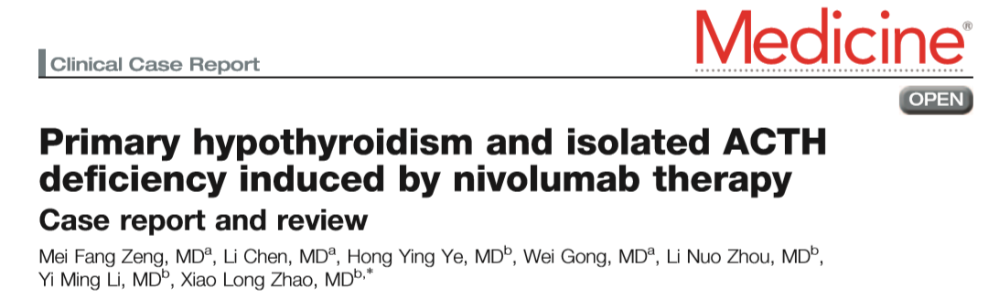
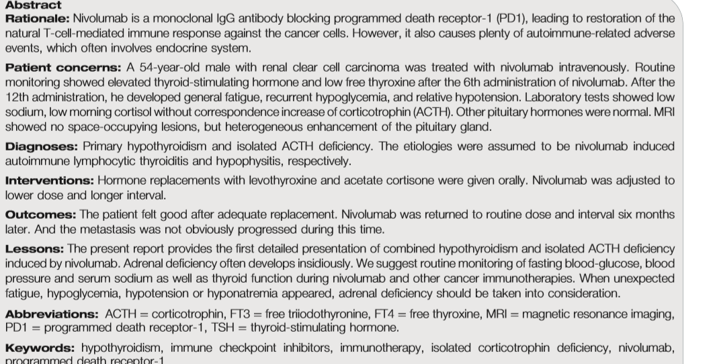

Slide 46
In our case, nivolumab was efﬁcacious, but caused primary hypothyroidism 2 months later, and then induced isolated ACTH deﬁciency after another 4 months. Before anti-PD1 therapy, the function and ultrasonography of thyroid was normal. Therefore, the abnormal change of thyroid was thought to be autoimmune lymphocytic thyroiditis induced by nivolumab. The etiology of isolated ACTH deﬁciency is most often hypothesized as lymphocytic hypophysitis or traumatic injury in adults . the order of hormone deﬁciency speciﬁc to hypophysitis is as follows: ACTH>TSH>luteinizing hormone/follicle-stimulating hormone > prolactin>growth hormone. Until now, all reported cases of nivolumab-induced hypophysitis were focused on isolated ACTH deﬁciency. It is likely that corticotrophin cells are more vulnerable to nivolumab induced autoimmune activation.

Slide 47
ISOLATED ADRENOCORTICOTROPIC HORMONE (ACTH) DEFICIENCY ASSOCIATED WITH HASHIMOTO'S DISEASE
Emine Binnetoğlu, Mehmet Aşık, Hacer Şen, Fahri Güneş, Erdem Akbal, Zeliha Tekeli, Betül Kızıldağ, Kubilay Ukinç
Introduction
Isolated ACTH deficiency has rare association with Hashimoto’s disease which is characterized by autoimmune origin. This suggests the possibility of common autoimmune process affecting both the pituitary and the thyroid gland. We report a case of IAD with Hashimoto’s disease in a patient who presented with anorexia,nausea,vomiting and weight loss.

Slide 48
Case report
A 84 year-old man presented with anorexia,nausea,vomiting and weight loss last 3 months without any apparent cause. His endoscopy revealed a Mallory-weiss tear in esophagus sclerothrapy was performed. The laboratory test established hypothyroidism with plasma levels of free T3 of 1.89 pg/ml ( 1.71-3.71) , free T4 of 0.47ng/ml (0.7-1.48) and high TSH of 19.2 mcIU/ml ( 0.35-1.94). The autoimmune antibodies were positive and the patient's level of cortisol was found 1.22 mcg/dl. ACTH levels were determined as 3.4 pg/ml. The patient was diagnosed with secondary adrenocortical insufficiency. We examined the other pituitary hormones were in normal limits. The magnetic resonance of pituitary imaging was normal. Hydrocortisone and L- thyroxine supplemention improved his symptoms.

Slide 49
Conclusion
This case is educational because , isolated ACTH deficiency is a rare cause of adrenal insufficiency which can associate with Hashimoto’s thyroidis that may present with severe digestive symptoms such excessive vomitting.

Slide 50
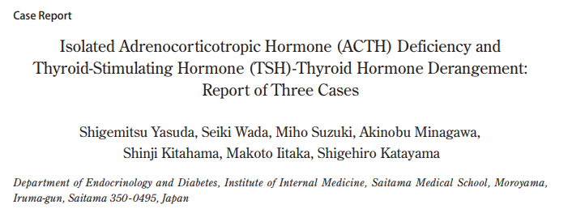
Introduction
a considerable number of patients with isolated ACTH
deficiency have been proven to possess circulating
auto-antibodies against pituitary acells, this disease is
presumed to be caused by an autoimmune mechanism.
We have previously reported that the abnormality
in the pituitary-thyroid axis is transient, and can be
reversed by glucocorticoid replacement 5). A literature
survey revealed that interference of thyroid hormone
synthesis and/or secretion by glucocorticoid deficiency
is the major cause of the thyroid dysfunction, rather
than autoimmune thyroid disease. However, we
have also noticed that a considerable number of cases
are accompanied by severe hypothyroidism due to
Hashimoto’s thyroiditis or primary hypothyroidism.
Here we describe three cases of isolated ACTH
deficiency experienced recently at our hospital and
discuss the possible relationship between ACTH
deficiency and the TSH-thyroidal axis.

Slide 51
To date, several interactions between
glucocorticoid and the pituitary-thyroid axis have
been reported. It is suggested that the physiological
concentration of glucocorticoid has a suppressive
effect on TSH secretion. Glucocorticoid deficiency
may therefore be one of the causes of the increased
basal TSH level in isolated ACTH deficiency.

Slide 52
In a review of 103 reported cases with isolated ACTH deficiency, we found that 12.6 % of the patients were positive for anti-thyroid antibodies.

Slide 53
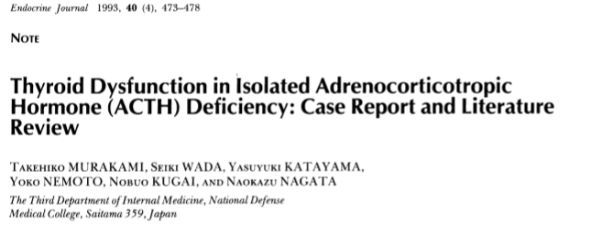
Abstract.
a 56-year-old woman, developed somnolence and hypoglycemia due to isolated ACTH deficiency. Both free T3 and free T4 were decreased, and basal as well as TRH-stimulated TSH levels were abnormally high. Plasma thyroglobulin was increased and no anti-thyroid antibodies were detected. All thyroid related physical and biochemical abnormalities disappeared after hydrocortisone replacement. A review of the literature on 103 cases disclosed that more than half the cases with isolated ACTH deficiency had a high plasma level of TSH, basal and/or TRH-induced, while the antithyroid antibodies were reported to be positive in only 13 cases. In more than 70% of such cases, the abnormality in the pituitary-thyroid axis was transient and was reversed by glucocorticoid replacement. Our case and cases in the literature indicate that the interference of thyroid hormone synthesis and/or secretion by glucocorticoid deficiency per se is the major cause of thyroid dysfunction rather than associated autoimmune thyroid disease.

Slide 54
SINCE Steinberg et al. first reported isolated ACTH deficiency in 1954 , more than 200 cases have been reported in Japan, and many cases are known to accompany thyroid hormone abnormalities . A considerable number of patients with isolated ACTH deficiency have been proven to possess circulating autoantibodies to pituitary cells, and the disease is presumed to be induced, at least partly, by an autoimmune mechanism. Although thyroid dysfunction encountered frequently in this disorder has been generally believed to be caused by associated autoimmune abnormalities Topliss and Mashito disclosed that cortisol deficiency itself could affect the pituitary-thyroid axis.

Slide 55
Case Report
A 56-year-old woman was first admitted to our hospital because of loss of consciousness and muscle rigidity. Before admission, she had com
plained of general fatigue and poor appetite, and had lost 14 kg in weight over the preceding 5 months.

Slide 56
Discussion
The case presented here was diagnosed as one of isolated ACTH deficiency, according to the typical endocrinological findings and positive tests for the autoantibodies to pituitary cells as well as the demonstration of empty sella. We presumed that empty sella would be related to the destruction of pituitary cells by an autoimmune mechanism as proposed by Richtmeier et al.

Slide 57
From our literature survey, cases with increased basal TSH or TSH hyperresponsive to TRH comprised about one-half of the cases of isolated ACTH deficiency. In this review of 103 cases, only 13 cases (12.6%) were documented to be positive in antithyroid antibodies. although one investigator has reported about a 20-30% frequency of positive autoantibody to thyroid .

Slide 58
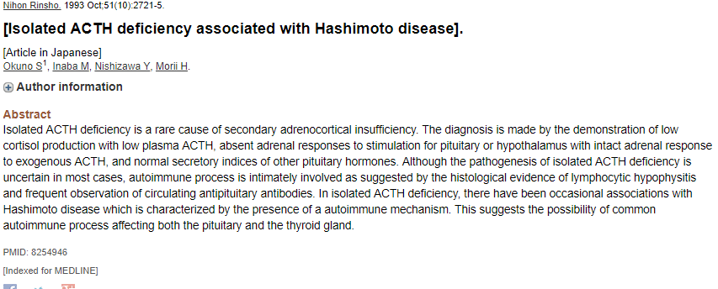

Slide 59
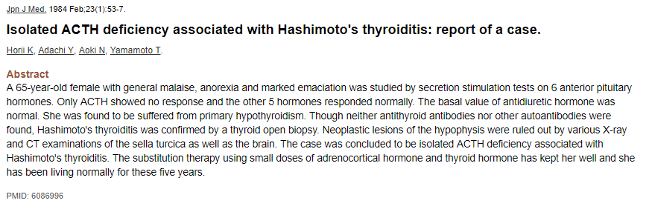

Slide 60
Late-onset isolated ACTH deficiency
Disease definition
Late-onset isolated ACTH deficiency is a rare, acquired, pituitary hormone deficiency characterized by secondary adrenal insufficiency, with normal secretion of anterior pituitary hormones, except for ACTH. Patients present with weakness, fatigue, weight loss, anorexia, vomiting/nausea, hypoglycemia, and abnormally low serum ACTH and cortisol levels. Association with autoimmune disease such as Hashimoto's thyroiditis has been described.

Slide 61
Endocrine Abstracts (2007) 13 P112
Atypical presentation of isolated ACTH deficiency VR Nagareddy, CM Thomas, Saran Balaguruswamy, Vikas Gupta, PJ Weston & Sailaja Mannemela
A 36 year old gentleman presented to Accident and Emergency with 2 day history of generalised headache associated with dizziness. No significant previous medical history.

Slide 62
Long synacthen test showed suboptimal response with peak cortisol 516 nmol/l. Insulin stress test showed no response of cortisol to hypoglycaemia. Chest x-ray and MRI Brain including pituitary was normal. Further 2 repeat samples after 1 week were also normal. He is currently on 20 mg hydrocortisone daily in 2 divided doses of 15 and 5 mg.
Discussion: Isolated ACTH deficiency is very rare and usually presents with symptoms similar to Adrenal insufficiency. Case that is reported above is very atypical presentation and it is likely that it is diagnosed at early stage before developing classical symptoms.

Slide 63
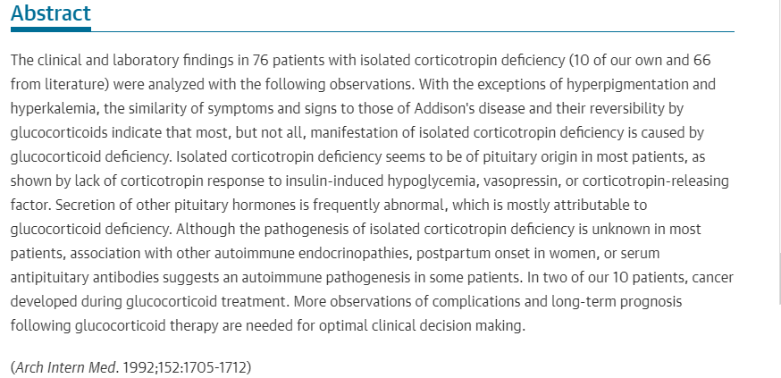

Slide 64
An immunofluorescence study using unfixed cryostat sections of rat pituitary glands was carried out on sera from 34 patients with Hashimoto's thyroiditis, 28 patients with Graves' disease, 10 patients with thyroid adenoma and 50 healthy subjects. After absorption of sera with rat liver tissues, 19 of 34 patients retained reactivity to anterior pituitary cell antibodies (PCA, 55.8%). On the other hand, immunofluorescence in anterior pituitary cells was faint and detected in only 2 of 28 patients with Graves' disease (7.1%) after absorption of their sera with rat liver aceton powder. PCA were detected neither in the sera of patients with thyroid adenoma nor in the healthy subjects.
The present study suggests that PCA were considerably more prevalent in Hashimoto's thyroiditis than in Graves' disease.
Anterior Pituitary Cell Antibodies Detected in Hashimoto's Thyroiditis and Graves' disease
ISAO KOBAYASHI, TOSHIHIKO INUKAI, MASAKI TAKAHASHI, AKIRA ISHII, KIHACHI OHSHIMA, MASATOMO MORI, YOHNOSUKE SHIMOMURA, SETSUO KOBAYASHI, ATSUSHI HASHIMOTO, MASAHIKO SUGIURA

Slide 65
Neurological symptoms in a patient with isolated adrenocorticotropin deficiency: case report and literature review
Yukihiro GotoEmail author, Kazunori Tatsuzawa, Kazuyasu Aita, Yuichi Furuno, Takuya Kawabe, Kei Ohwada, Hiroyasu Sasajima and KatsuyoshiBMC Endocrine Disorders201616:2 https://doi.org/10.1186/s12902-015-0082-6© 2016
Case presentation
A 69-year-old female with a complaint of difficulty walking and suspected to have iNPH at a prior hospital was referred to our department. For the prior three years, she had suffered from a progressive gait disturbance. Magnetic resonance imaging (MRI) revealed global ventricular dilatation. The patient developed progressively worsening fatigue during hospitalization. Her symptoms resembled those of hypothalamic-pituitary tumor patients. Serum ACTH and cortisol levels were low. While corticotrophin releasing hormone stress tests showed no response, other stress tests using thyrotropin releasing hormone, luteinizing hormone releasing hormone, and growth hormone releasing hormone yielded normal responses, indicating a diagnosis of isolated ACTH deficiency. We initiated corticosteroid therapy, and her gait disturbance improved promptly.
Conclusion
Isolated ACTH deficiency may have major significance to the differential diagnosis of iNPH. Early consideration of this entity is anticipated to facilitate making an early diagnosis.

Slide 66
During the past decade, LYH has been recognized increasingly as a cause of hypopituitarism, although its precise incidence remains unclear. It occurs particularly in women during late pregnancy and the post-partum period.[3] There is a spectrum of clinical forms. At one extreme, patients may present with symptoms of an expanding pituitary mass and required surgical decompression. At the other, patients may present with varying degrees of hypopituitarism and have normal radiology.[3]
In this report, we describe an unusual case of a 22-year-old female, who developed an isolated adrenocorticotropin (ACTH) deficiency probably secondary to LYH. Then, we discuss potential mechanisms involved in the pathogenesis of this entity.

Slide 67
Autoimmune IAD or LYH is suggested if it is associated with other autoimmune endocrinopathies, postpartum onset in women, or serum antipituitary antibodies. Autoimmune disorders include Graves’ disease, Crohn's disease, Hashimoto's thyroiditis, myasthenia gravis, type 1 diabetes mellitus, and autoimmune adrenalitis.

Slide 68
Antipituitary antibodies have been detected in 30% of patients with LYH but their pathogenetic and diagnostic roles need to be clarified. In several patients with biopsy-proven autoimmune, hypophysitis pituitary auto antibodies were not detected, and the presence of such auto antibodies is not specific of pituitary autoimmunity, as has been described in patients with Cushing's disease, empty sella turcica and celiac disease. In our patient, antipituitary antibodies against corticotroph cells antigens were not assessed and screening tests for other autoimmune diseases were negative.

Slide 69
Introduction: Isolated ACTH deficiency has rare association with Hashimoto’s disease which is characterized by autoimmune origin. This suggests the possibility of common autoimmune process affecting both the pituitary and the thyroid gland. We report a case of IAD with Hashimoto’s disease in a patient who presented with anorexia, nausea, vomiting and weight loss.
Endocrine Abstracts (2013) 32 P263 | DOI: 10.1530/endoabs.32.P263
Isolated ACTH deficiency associated with Hashimoto's disease
Emine Binnetoğlu1, Mehmet Aşık1, Hacer Şen1, Fahri Güneş1, Erdem Akbal1, Betül Kızıldağ2 & Kubilay Ukinç1

Slide 70
Case report: A 84 year-old man presented with anorexia, nausea, vomiting and weight loss for the last 3 months. His endoscopy revealed a Mallory-Weiss tear in esophagus. Sclerotherapy was performed. The laboratory test established hypothyroidism with plasma levels of free T3 of 1.89 pg/ml (1.71–3.71), free T4 of 0.47 ng/ml (0.7–1.48) and high TSH of 19.2 μIU/ml (0.35–1.94). The autoimmune antibodies were positive and the patient’s level of cortisol was found 1.22 μg/dl. ACTH levels were determined as 3.4 pg/ml. The patient was diagnosed with secondary adrenocortical insufficiency. We examined the other pituitary hormones such as FSH, LH, prolactin and GH which were in normal limits. The magnetic resonance of pituitary imaging was normal. Hyrocortisone and L-thyroxine supplemention improved his symptoms.
Conclusion: Isolated ACTH deficiency is a rare cause of adrenal insufficiency which can be associated with Hashimoto’s thyroiditis that may present with severe gastrointestinal symptoms such excessive vomitting.

Slide 71
Introduction
Association of IAD with Hashimoto’s disease (HD), which is characterized by autoimmune origin, is rare. This suggests the possibility of common autoimmune process affecting both the pituitary and the thyroid glands.
Here, we report two cases of IAD with HD in two patients who presented with anorexia, nausea, vomiting, and weight loss.
Turkish Journal of Endocrinology and Metabolism Official Journal of Society of Endocrinology and Metabolism of Turkey ANA SAYFA,DERGİ HAKKINDA ,SON SAYI
Isolated Adrenocorticotropic Hormone Deficiency (ACTH) Associated with Hashimotos Disease

Slide 72
Case Reports
Patient 1
A 84 year-old man presented with anorexia, nausea, vomiting and an unintentional weight loss of 13 kg in the past 3 months. His physical examination was normal. Endoscopy revealed a Mallory-Weiss tear in the esophagus, thus, sclerotherapy was performed Colonoscopy was unremarkable. Blood tests revealed a low level of sodium (129 mEq/l) and a potassium level within the normal range.
Laboratory tests showed hypothyroidism with plasma levels of free T3 of 1.89 pg/ml (1.71-3.71), free T4 of 0.47ng/ml (0.7-1.48) and high TSH of 19.2 mcIU/ml (0.35-1.94). The autoimmune antibodies were positive ((anti-TPO: 538 IU/ml (0-35), anti-TG :537 IU7ml (0-40)) and the cortisol level was found to be 1.22 mcg/dl. Adrenal insufficiency was considered because of the presenting symptoms (sodium was low at 120mEq/l with normal potassium and cortisol was found to be1.22 mcg/dl). Measurement of ACTH level was done for differential diagnosis between primary and secondary adrenocortical insufficiency, ACTH levels were determined as 3.4 pg/ml. The patient was diagnosed with secondary adrenocortical insufficiency. Due to advanced age, we did not perform insulin tolerance test (ITT) to confirm the diagnosis.

Slide 73
Pituitary magnetic resonance imaging was normal. Hydrocortisone and L-thyroxine treatment was administered to the patient who received the diagnosis of IAD and hypothyroidism. The clinical and electrolyte abnormalities improved after the treatment.

Slide 74
Patient 2
A 45 year-old man presented with anorexia, nausea, vomiting. He had the complaint of fatigue for the past 3-4 years. His physical examination was normal. The patient had hypothyroidism but he did not receive any treatment for the past 2 years.
The diagnosis of hypothyroidism was confirmed based on the laboratory tests which revealed plasma levels of free T3 of 2.41 pg/ml (1.71-3.71), free T4 of 0.46 ng/ml (0.7-1.48) and TSH of 47.67 mcIU/ml (0.35-1.94). The autoimmune antibodies were positive ((anti-TPO: 233 IU/ml (0-35), anti-TG: 309.2 IU7ml (0-40)) and cortisol level was found to be 0.29 mcg/dl.

Slide 75
Measurement of ACTH was performed for differential diagnosis between primary and secondary adrenocortical insufficiency, The ACTH level was determined to be 5.59 pg/ml. The patient was diagnosed with secondary adrenocortical insufficiency. The levels of the other pituitary hormones were as follows: FSH: 3.26 mIU/ml (1.38-13.58), LH: 13.09 mIU/ml (1.7-8.6), prolactin: 40.35 ng/ml (2.58-18.12), GH: 0.05 ng/ml, total testosterone: 6.74 ng/ml (1.56-5.63).
Insulin-induced hypoglycemia test was performed. When the patient’s blood glucose was 38 mg/dl, the cortisol level was measured as 0.41 ug/dl. Cortisol responce was insufficient.
Pituitary magnetic resonance imaging was normal. The patient, who received the diagnosis of IAD and hypothyroidism, was treated with hydrocortisone and L- thyroxine.

Slide 76
Discussion
IAD accounts for only a small part of secondary adrenal insufficiency.
The etiology of IAD is still unknown but an autoimmune mechanism was accused of in some cases. The authors reported the possibility of the presence of an autoimmune process in IAD due to the high incidence of autoimmune disorders in patients with secondary adrenal failure . However, in this large series, which reported a high prevalence of autoimmune diseases in patient with IAD, any specific antibodies loss of ACTH function were not detected .

Slide 77
THE END

