Slide 1
Hypo gonadotropic Hypogonadism

Slide 2
Secondary hypogonadism is usually associated with similar decreases in sperm and testosterone production.
Secondary hypogonadism is less likely to be associated with gynecomastia.

Slide 3
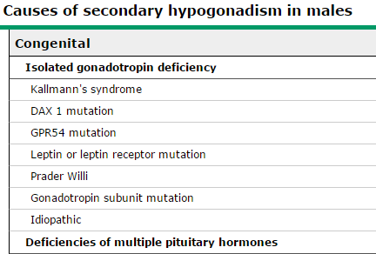

Slide 4
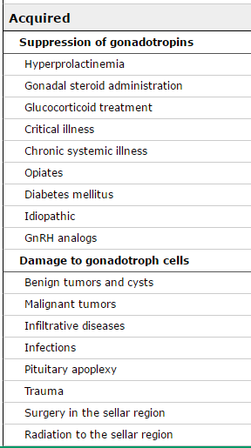

Slide 5
CONGENITAL ABNORMALITIES
Sexual differentiation in all of these disorders is normal male .
Phallic development during the third trimester is subnormal .
Childhood growth is normal if gonadotropin deficiency is an isolated event .
Pubertal development is incomplete or even absent, depending upon the degree of gonadotropin deficiency.

Slide 6
Eunuchoid proportions result when epiphyseal closure is delayed because of subnormal serum testosterone and its conversion to estradiol. An exception is if growth hormone is also subnormal .
Midline defects (ie, cleft lip/palate) , unilateral renal agenesis ,uni or bilateral cryptorchidism , syndactyl or other skeletal abnormalities hyposmia or anosmia .

Slide 7
TREATMENT
To develop secondary sex characteristics
To build and sustain normal bone and muscle mass
To restore fertility

Slide 8
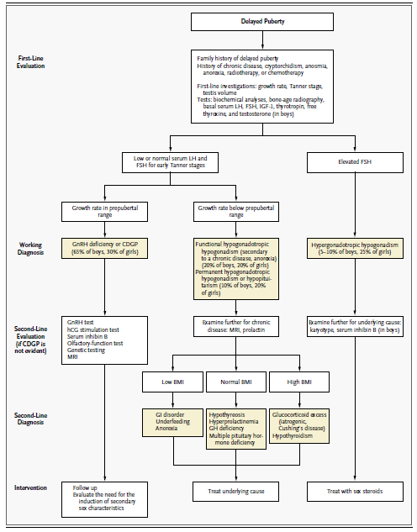

Slide 10
