Slide 1



Slide 2
Adrenal tumors
Clinical laboratory & pathology aspects
Maryam Tohidi
Associate professor of anatomical & clinical pathology
Research Institute for Endocrine Sciences
Shahid Beheshti University of Medical Sciences
June 2019
Tehran, Iran

Slide 3
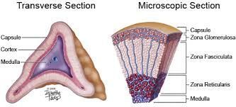
Important questions in approaching to an adrenal mass
Is the mass a hormonally active tumor? (∼80% non-functional)
  Cortisol
  Aldosterone
  Hormones of adrenal medulla
Is the mass a benign/malignant tumor?
Does the patient have a history of previous malignancy?

Slide 4
Laboratory evaluation for cortisol-producing adrenal tumor

Slide 5
  Principles of laboratory tests
Failure to discontinue the production of cortisol, despite the absence of ACTH stimulation
  1-mg overnight dexamethasone suppression test
  low dose dexamethasone suppression test
Loss of a normal diurnal pattern
  midnight/late-night salivary cortisol
III. Excess production of cortisol
  24-hour urinary free cortisol (UFC test)

Slide 6
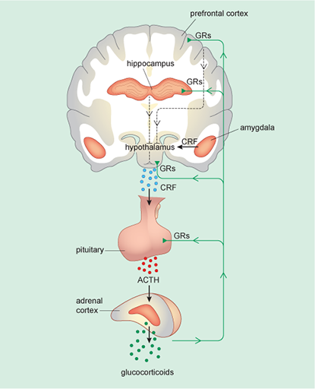
  1-mg dexamethasone suppression test
Test protocol:
Taking 1 mg of dexamethasone orally between 11pm-12 midnight
Blood sampling:
following morning between 8 and 9 am
Interpretation (abnormal response)
Original criterion: failure to suppress to <5 μg/dL (138 nmol/L)
Revised criterion: failure to suppress to <1.8 μg/dL (50 nmol/L)
providing > 95% sensitivity and 80% specificity, and serves to minimize the number of false-positive results
A low or suppressed level of ACTH or a low DHEAS further supports the diagnosis.

Slide 7
  Challenges in 1-mg dexamethasone suppression test
False-positive overnight DST
1% of healthy individuals
13% of obese patients
50% of women on estrogens
25% of hospitalized and chronically ill patients
A high false positive rate (up to 30%)
Dexamethasone was taken too early
Medications that accelerate the metabolism of dexamethasone (phenobarbital, phenytoin, carbamazepine, lithium, diphenylhydantoin, primidone, ethosuximide, rifampicin …) (cytochrome P450 system, hepatic CYP3A4)
Malabsorption
Alcoholism / alcohol withdrawal
Morbid obesity / weight loss
Pregnancy and drugs such as estrogen (increase serum CBG)
Stress

Slide 8
  Challenges in 1-mg dexamethasone suppression test
False negative results
Liver disease
Medications (reported)
  High dose of benzodiazepines
  Indomethacin
  Methadone
  Ketokonazol

Slide 9

  Challenges in 1-mg dexamethasone suppression test
III. Missing time protocol of the test
Elimination half life of Dexamethasone: 190 min
  the time it takes for the concentration of the drug in the plasma or the total amount in the body to be reduced by 50%.
Biologic half life of Dexamethasone: at lest 36 hours
- refers to the duration of effect.

Slide 10
  Salivary midnight/late-night cortisol
Advantages
  Simple & accurate
  A high diagnostic sensitivity and specificity
  An excellent correlation with the plasma free cortisol levels
  Little concern about degradation during transport due stability of salivary cortisol levels
  CBG is not present in saliva; the results may be more useful in situations in which CBG concentration is altered.
  It performs slightly better than the 24-hour UFC in distinguishing patients with Cushing’s syndrome from obese subjects.
Interpretation:
abnormal response: elevated night time cortisol levels
Several studies have shown that elevated night time cortisol levels appear to be the earliest and most sensitive markers for Cushing syndrome (with sensitivity and specificity approaching 90% to 95%).

Slide 11
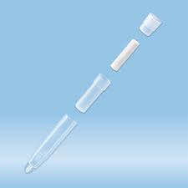
  Test protocol Salivary night cortisol
Not appropriate for shift workers & irregular sleep pattern
Collecting the saliva on a day that is “typical”, not troublesome.
Collecting of a specimen of saliva at bed time at home (11PM- midnight)
Not to brush teeth before collecting the sample to avoid gum bleeding
Not to eat or drink at least 30 minutes before collecting the sample
Not to eat anything with caffeine (coffee, tea, chocolate) for 2 hours before the collection
Not to consume alcohol 12 hours prior to collection
It is better to avoid tobacco on the day of specimen collection
Rinse mouth thoroughly with water 10 minutes prior to collection
Collecting the sample:
method 1: chewing on a cotton swab for 2 to 3 min or until the swab is saturated
method 2: passively drooling directly into a test tube
Not to touch the swab before & after specimen collection
Putting the cap back on the tube tightly.
Sending the samples to the laboratory next day of collection

Slide 12
  Challenges in salivary midnight/late-night cortisol
Incorrect sample collection
Different normative values according to the reference laboratory
Results should be interpreted with caution in those who may have blunting of their circadian rhythm
  shift workers
  patients with depression
  critical illness
Falsely elevated results may be seen in:
  ● smokers ● users of chewing tobacco
  in these cases refraining from use for 24 hours prior to collection is recommended.

Slide 13
Urine free cortisol (UFC)
Not affected by factors that influence CBG
An integrated measure of total cortisol secretion over 24 hours
Interpretation:
A UFC > 4 times the normal value is considered diagnostic of Cushing syndrome
Up to 3-fold elevation of UFC can be associated with pseudo-Cushing syndrome
  Chronic anxiety
  Depression
  Alcoholism
  Obesity
  Certain medications

Slide 14
Challenges in urine free cortisol (UFC)
Incorrect sample collection
Improper or inadequate preservative (e.g. Boric acid) in the collecting bottle
Falsely elevated levels in:
  Starvation
  Use of topical steroids
  Hydration in the form of water loading
  Pseudo- Cushing syndrome

Slide 15
Laboratory evaluation for pheochromocytoma

Slide 16
Catecholamine-producing tumors
Pheochromocytoma: from chromaffin cells of adrenal medulla
Paraganglioma from chromaffin cells of extra-adrenal origin

Slide 17
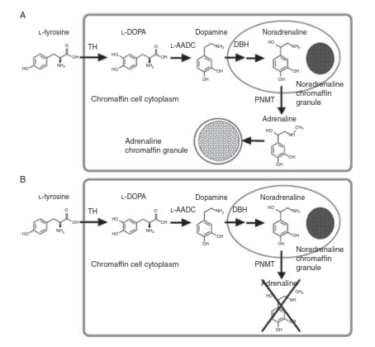
Chromafﬁn cells of adrenal medulla
Sympathetic nerve cells

Slide 18
Catecholamine-producing tumors
The catecholamines are metabolized by either catechol-O-methyl transferase (COMT) or monoamine oxidase (MAO).
COMT is present in adrenal chromaffin cells and in tumors derived from these cells not in sympathetic nerves.
The products of COMT, metanephrine and normetanephrine, serve as specific markers of chromaffin tumors.

Slide 19
Tests for evaluation of pheochromocytoma
Endocrine Sociey clinical practice guideline (JCEM, 2014)
I. Initial biochemical testing for phechromocytoma/paragangliomas should include measurements of:
  plasma free metanephrines (NIH study established excellent sensitivity of 97%)
  or
  urinary fractionated metanephrines (Sensitivity 97% & specificity 91% with MS method )
There is no data regarding superiority of one test to the other with same assay method. So measurements of fractionated metanephrines remain recommended as initial screening tests.

Slide 20
Tests for evaluation of pheochromocytoma
Endocrine Sociey clinical practice guideline (JCEM, 2014)
II. It is suggested using liquid chromatography/mass spectrometric or electrochemical detection methods rather than other laboratory methods to establish a biochemical diagnosis of phechromocytoma/paragangliomas.
Several studies & inter-laboratory quality assurance programs establishing that:
Immunoassays suffer from imprecision compared with LC-ECD and LC-MS/MS.
Immunoassays substantially underestimate plasma concentrations of metanephrine and normetanephrine.

Slide 21
Tests for evaluation of pheochromocytoma
A plasma metanephrine level exceeding 3-4 times normal is highly diagnostic for a pheochromocytoma. (sensitivities range from 77% to 97%, with specificities from 69% to 98%.)
Suggested upper cut-off reference levels for plasma metanephrine: 0.45 nmol/L.
A 24-hour urine total metanephrine level above 1,800 µg in the appropriate clinical setting is almost always diagnostic for a pheochromocytoma.
Compared to urinary measurements, plasma levels are associated with higher false positive rate.

Slide 22
Challenges in plasma free metanephrines
Effect of sampling position on results
  Higher concentrations of plasma metanephrines in upright positions of blood sampling than in supine positions.
  Upper limit of reference values determined in the seated position are up to 2-fold higher than those of supine position.
  Drawing blood in the seated position would result in a 2.8-fold increase in false-positive results.
For measurements of plasma metanephrines, we suggest drawing blood with the patient in the supine position and use of reference intervals established in the same position.
In condition of a positive result in seated position, the test should be repeated in the supine position (at least 30 minutes).

Slide 23
Challenges in plasma or urine metanephrines
II. Pre-analytical considerations
  Patients should abstain from caffeinated beverages and alcohol for 24 hours before testing for plasma free metanephrines.
  Interfering medication should be avoided at least 5 days before testing.
  From antihypertensive medications following drugs can be
  used without fear of causing false-positive results:
  angiotensin-converting enzyme inhibitors (ACEIs)
  angiotensin receptor blockers
  selective α-adrenoceptor blockers (e.g., prazosin)

Slide 24
Challenges in plasma or urinary metanephrines
III. False positive results
A. Medications interfering with measurement
A-1. Medications directly interfering measurement methods (eg, acetaminophen, mesalamine, sulfasalazine in LC-ECD methods)
A-2. Medications interfering the disposition of catecholamines (eg, tricyclic antidepressants)
B. Physiological stress associated with extreme illness, as in intensive care settings
C. Laboratory errors
In such situations, confirmatory testing after exclusion of these sources of false-positives is useful.

Slide 25
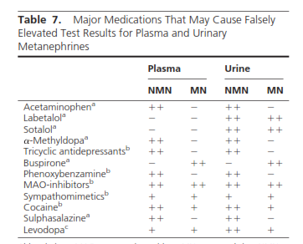

Slide 26
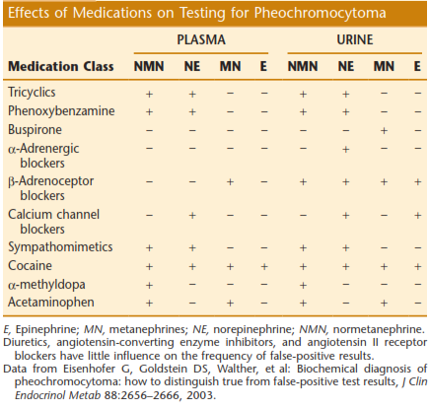

Slide 27
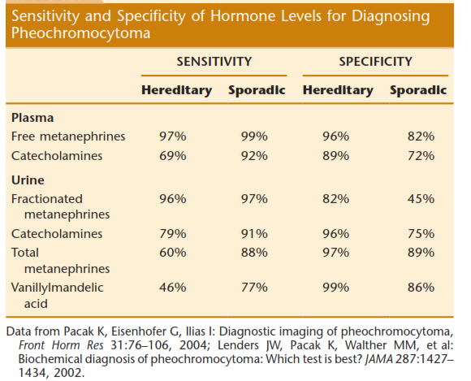

Slide 28
Tests for evaluation of pheochromocytoma
Endocrine Sociey clinical practice guideline (JCEM, 2014)
It is recommend that all patients with positive test results should receive appropriate follow-up according to the extent of increased values and clinical presentation & based on clinical judgment:
additional comprehensive biochemical tests
wait and retest approach
imaging studies

Slide 29
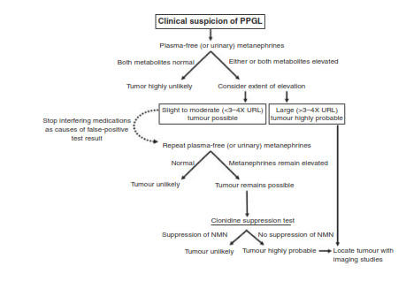
A van Berkel et al. Biochemical diagnosis of phaeochromocytoma and paraganglioma. European Journal of Endocrinology (2014).

Slide 30
Tests for evaluation of pheochromocytoma
Traditional tests: 24- hour urine collection for:
Catecholamines
Total metanephrines
VMA
Urinary measurements have a higher false-negative rate.

Slide 31
Pre-analytical consideration for urine VMA test
Taking tea, coffee, caffeine, chocolate, vanilla, banana & anti- HTN medication should be avoided from 3 days before test.
Consultation with clinician regarding change in medication is mandatory.

Slide 32
Chromogranin A (CgA)
Chromogranin A (CgA) is a protein that is stored and secreted along
with the catecholamines from the adrenal medulla and sympathetic nervous system.
Elevated in more than 80% of pheochromocytomas, but it is not specific for this disorder, being secreted by other chromaffin tissues.
A relatively high sensitivity of 86% & poor diagnostic specificity.
Mild degrees of renal impairment (e.g., CrCl < 80 mg/mL/min) can lead to significant increases in serum concentration of CgA.
Its major use is in postoperative monitoring for tumor recurrence.

Slide 33
Laboratory evaluation for aldosteronoma

Slide 34
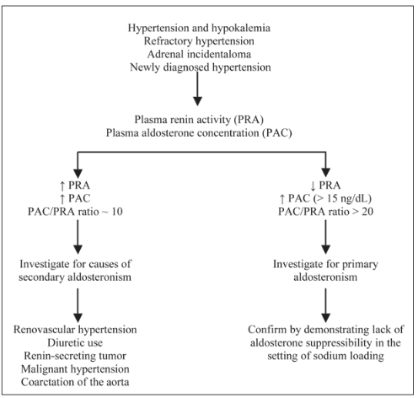

Slide 35
Pre-analytical considerations & interference
The ARR is most sensitive when blood samples are collected in the morning, after patients have been out of bed for at least 2 hours and have been seated for 5 to 15 minutes.
Before screening, it is necessary to withhold spironolactone and eplerenone (mineralocorticoid receptor blockers) for 4 to 6 weeks.
β-adrenergic blocking agents and clonidine suppress PRA and thus may cause false-positive results.
Diuretics often lead to hypokalemia, and inhibition of the renin-angiotensin system is seen with ACE inhibitors and angiotensin II receptor blockers (ARBs).
Thiazide diuretics, calcium channel blockers (dihydropyridines), ACE inhibitors, and ARBs can actually improve the diagnostic discriminatory power of the ARR.

Slide 36
Adrenal tumors pathology aspects

Slide 37
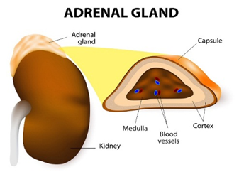
Introduction
The adrenal gland is a complex endocrine organ, composed of two parts:
of mesodermal origin: cortex
of neuroectodermal origin: medulla
Adrenal tumors adrenocortical neoplasms
lesions of adrenal medulla

Slide 38
Adrenocortical neoplasms
Traditionally, adrenocortical neoplasms have been divided into:
Adenomas
Carcinomas
an intermediate (“borderline”) group for which the distinction is difficult and to some extent arbitrary

Slide 39
Adrenocortical adenoma
The most common primary adrenal lesion
Classification based on hormone production:
  functioning (aldosterone, cortisol, or sex hormones)
  nonfunctioning
  Clinical presentation:
  symptoms of a hormonal secretory product with subsequent identification on CT scan
incidentally at the time of imaging for other reasons

Slide 40
Morphologic features of adrenocortical adenoma
usually solitary
characteristically small, rarely exceeding 5 cm in greatest diameter or 50 g
well circumscribed and typically encapsulated
solid homogeneous yellow to tan cut surface
central hemorrhage in larger tumors
Rosai & Ackerman,s Surgical pathology, 2018

Slide 41

Microscopic features of adrenocortical adenoma
Architecture: organized in nests or cords that are associated with a rich capillary vasculature or sinusoidal network.
Cytomorpholigy: clear to lightly eosinophilic cells, filled with small lipid vacuoles
occasional bizarre nuclear forms
mitoses are exceptionally rare or absent
  IHC: Synaptophysin (+)
  Melan-A (+)
  SF-1 (+)

Slide 42
Adrenocortical carcinoma
Relatively uncommon
Bimodal age distribution: first & 5th decades of life
  Clinical presentation:
  Asymptomatic (incidentally detected)
  Symptoms of local mass effect
  Symptoms of metastatic disease
  Symptoms of excess steroid production
  Fever in highly necrotic carcinomas

Slide 43

Morphologic features of adrenocortical carcinoma
usually solitary
weigh more than 10 g
A capsule may be present around carcinomas, but this is often infiltrated by tumor.
variegated cut surface, with soft and friable consistency
Frequent necrotic and hemorrhagic areas
invasion of major veins is a frequent finding in carcinoma

Slide 44
Microscopic features of adrenocortical carcinoma
a wide range of differentiation
undifferentiated neoplasms: giant cells with abundant acidophilic cytoplasm and bizarre hyperchromatic nuclei, sometimes multiple
IHC: the same cortical lineage markers as adenomas (i.e. inhibin, Melan-A, and SF-1) but with lower sensitivity

Slide 45
Differential diagnosis (D.D)
(1) between adrenocortical adenoma and carcinoma
(2) between adrenocortical carcinoma and renal cell carcinoma
(3) between adrenocortical and adrenomedullary tumors

Slide 46
Differential diagnosis between adenoma and carcinoma
Weiss criteria for the classification of adrenal cortical neoplasms
Tumor necrosis
Mitotic rate >5 mitoses per 50 high-power fields
Atypical mitoses
High nuclear grade (Fuhrman criteria for grade III or IV)
Diffuse architecture
<25% clear cells
Invasion of venous structures
Invasion of sinusoidal structures
Invasion through the capsule
The presence of ≥3 of these criteria correlates with malignant potential

Slide 47
Weiss criteria
Most widely used
Proven by independent observers both in adults and in children
These schemes may not be entirely applicable to following adrenocortical tumors:
  oncocytic type
  myxoid type
  childhood

Slide 48
Lin-Weiss-Bisceglia criteria for classification of neoplasms
Invasion of venous structures
Mitotic rate >5 mitoses per 50 high-power fields
Atypical mitoses
Minor criteria
Size >10 cm and/or weight >200 g
Tumor necrosis
Invasion of sinusoidal structures
Invasion through the capsule
The presence of one major criterion correlates with adrenal cortical carcinoma
The presence of 1–4 minor criteria has a weaker correlation, and the term “adrenal cortical neoplasm of uncertain malignant potential” has been suggested.
For oncocytic tumors, the WHO recommends the Lin-Weiss-Bisceglia criteria.

Slide 49
A 32 y/o woman with right adrenal mass (incidentaloma)
Dx: adrenal cortical neoplasm of uncertain malignant potential” has been suggested.
Tumor size: 13*11*7 cm
Tumor weight: 660 gr
Venous invasion: not identified
Tumor extension: invasion through the adrenal capsule
No lymph node submitted
Extra-adrenal extension: Not identified
Tumor necrosis: identified
Mitotic rate: < 5 mitoses per 50 HPF
Atypical mitose: Not identified
Clear cell: Less than 25% of tumoral tissue
Architecture: Separate sheet
Invasion to sinusoidal structures: Not identified

Slide 50
Case: A 32 y/o woman with right adrenal mass (incidentaloma)
Ancillary studies:
Melan- A: Positive
Ki-67: Positive in 7% of tumoral cells
Chromogranin: Negative
S-100: Negative
Inhibin: Negative
PAX- 8: Negative

Slide 51
Special techniques for differential diagnosis
Ki-67 IHC
Ki-67 proliferation rates of adenomas are typically less than 5%
Reticulin stain
Abnormal reticulin in adrenocortical carcinoma
Recent IHC markers
  matrix metalloproteinase type 2
  insulin-like growth factor (IGF2)

Slide 52
From many parameters, none—short of detection of metastases—discriminates in an absolute fashion between adenomas and carcinomas, particularly in pediatric cases.
The pathologist and the clinician should accept the fact that a sharp distinction between adenomas and carcinomas may be impossible at the practical level.
It may be more honest and accurate to designate the tumors as adrenocortical neoplasms, followed by an estimate of the risk of the tumor recurring or metastasizing on the basis of all the evaluable parameters, a list which is rapidly expanding.
The alternative is to have an intermediate category designated as borderline or of uncertain malignant potential.

Slide 53
Prognosis based on microscopic findings
Proliferative activity seems to be the pathologic feature of greatest prognostic significance.
Two grade system:
  low-grade carcinomas have < 20 mitotic figures per 50 HPFs
  high-grade carcinomas ≥20
Proliferation rate as determined by Ki-67 and/or the combination of morphology (necrosis and mitotic count >5 per 50 HPFs) have been validated as highly predictive of outcome in carcinomas.

Slide 54
Staging
ENSAT | AJCC | Stage grouping | Stage description
I | I | T 1 N 0 M 0 | The tumor is ≤ 5 cm in size and it has not grown into tissues outside the adrenal gland (T1). It has not spread to nearby lymph nodes (N0) or distant sites (M0).
II | II | T 2 N 0 M 0 | The tumor is > 5 cm in size and it has not grown into tissues outside the adrenal gland (T2). It has not spread to nearby lymph nodes (N0) or distant sites (M0).
ENSAT: European Network for the Study of Adrenal Tumors
AJCC: American Joint Committee on Cancer

Slide 55
ENSAT | AJCC | Stage grouping | Stage description
III | III | T 1 N 1 M 0 | The tumor is ≤ 5 cm in size and it has not grown into tissues outside the adrenal gland (T1). The cancer has spread to nearby lymph nodes (N1) but not to distant sites (M0).
 |  | OR
 |  | T 2 N 1 M 0 | The tumor is > 5 cm in size and it has not grown into tissues outside the adrenal gland (T2). The cancer has spread to nearby lymph nodes (N1) but not to distant sites (M0).
 |  | OR
 |  | T 3 Any N M 0 | The tumor is growing in the fat that surrounds the adrenal gland. The tumor can be any size (T3). It might or might not have spread to nearby lymph nodes (Any N). It has not spread to distant sites (M0).
 |  | OR
 |  | T4 Any N M0 | The tumor is growing into nearby organs, such as the kidney, pancreas, spleen, and liver or large blood vessels (renal vein or vena cava). The tumor can be any size (T4). It may or may not have spread to nearby lymph nodes (Any N). It has not spread to distant organs (M0).

Slide 56
Staging
ENSAT | AJCC | Stage grouping | Stage description
IV | IV | Any T Any N M1 | The cancer has spread to distant sites like the liver or lungs (M1). It can be any size (Any T) and may or may not have spread to nearby tissues (Any T) or lymph nodes (Any N).

Slide 57
D.D. between cortical neoplasm & medullary tumors
can be very difficult
IHC staining
  inhibin, Melan-A, SF-1, and calretinin positivity in adrenocortical neoplasm
  chromogranin reactivity in adrenomeduulary tumors
  Synaptophysin is of no help since it stains both tumor types.
  GATA3 shows nuclear expression in approximately 70% of pheochromocytomas, while only rarely positive in adrenal cortical carcinoma.
  It should be remembered that GATA3 reactivity is seen in many metastatic carcinomas.

Slide 58
Thank you for attention

