Slide 2
Endocrine Grand Rounds Case 08-11-97: A 37-year-old man with “longstanding headache” and “loss of vision in the left eye”
Dr. S Sadeghi and Dr. M Takyar

Slide 3
Medical History and Physical Examination

Slide 4
Chief Complaint and HPI
CC: “longstanding headache” and “loss of vision in the left eye”
HPI: Our patient is a 37-year-old man who has been suffering from severe headaches started almost 7 years ago and have aggravated significantly over the past two weeks (the usual dose of opioid would not control the pain anymore and has forced the patient to seek medical attention).
Location: Frontal.
Intensity: The pain is rated as “severe” (8-9/10).His activities had become very limited and he would have to leave work to lie down after a few hours of being active almost everyday.
Quality: Sharp.
Onset: Started 7 years ago and has aggravated over the past two weeks.
Precipitating factor: None elicited.
Progression: Has been stably severe since it started.
Radiation: None
Alleviating factors: Initially Ibuprofen; more recently methadone.
Aggravating factors: No specific factors identified.
Associated symptoms: No nausea/vomiting. No weight changes. High BP (since 5 years ago). Blurred vision (3 years). Pain in the eyes (3 months/mostly in the left eye). Gradual loss of vision (first left eye and then the right eye).

Slide 5
HPI (Course of the illness)
First sought medical attention due to severe frontal headache.
MRI was done → No abnormal findings.
Started taking pain medications (Ibuprofen → up to 20 tablets/day)
+ High BP → no documentations available.
A few ER admissions (SBP=230), but
no regular medical visits and medications.
1 year ago started regular use of HTN medications (Losartan, 50mg, BD)
+ Blurred vision (more in the left eye)→ According to patient’s wife:
Ophthalmology/Optometry → both eyes 2/10 (Neurology consult recommended but not done)
+ Decreased libido → decreased frequency of intercourse (total loss of libido over the past two months).
+ Left eye pain and diplopia + gradual loss of lateral vision in the left eye.
+ Loss of lateral vision in the right eye →current admission
1390
1392
1394
06/1397
08/1397
10/1397

Slide 6
Past Medical, Family, Drug, and Social Hx
Past Medical/Surgical Hx:
HTN
Hx of head trauma (?)
Family Hx: HTN in mother; no family Hx of aneurysms or hemorrhagic CVA
Drug Hx:
Losartan (50mg, BD)
Methadone (20mg, Daily)
Atorvastatin (40mg, Daily)
Ibuprofen (20 tablets everyday)
Social Hx:
Middle class family. Married with one 14-year-old son.
Education → High-school diploma
Occupation → chef
Smoker (30 pack-year)
Opium abuse for 15 years (until 7 years ago). Also → sniffed heroin

Slide 7
Review of Systems
Constitutional symptoms: Negative (Lack of energy, unexplained weight gain or weight loss, loss of appetite, fever, night sweats, pain in jaws when eating, scalp tenderness, prior diagnosis of cancer).
Ears, nose, mouth, throat: Negative (Difficulty with hearing, sinus problems, runny nose, post-nasal drip, ringing in ears, mouth sores, loose teeth, ear pain, nosebleeds, sore throat, facial pain or numbness).
Cardiovascular: Negative (Irregular heartbeat, racing heart, chest pains, swelling of feet or legs, pain in legs with walking).
Respiratory: Negative (Shortness of breath, night sweats, prolonged cough, wheezing, sputum production, prior tuberculosis, pleurisy, oxygen at home, coughing up blood, abnormal chest x-ray).
Gastrointestinal: Negative (Heartburn, constipation, intolerance to certain foods, diarrhea, abdominal pain, difficulty swallowing, nausea, vomiting, blood in stools, unexplained change in bowel habits, incontinence).
Genitourinary: Negative (Painful urination, frequent urination, urgency, prostate problems, bladder problems, impotence).

Slide 8
Review of Systems
Musculoskeletal → Negative.
Integumentary: Negative (Persistent rash, itching, new skin lesion, change in existing skin lesion, hair loss or increase, breast changes).
Neurological: (Frequent headaches, double vision, weakness, change in sensation, problems with walking or balance, dizziness, tremor, loss of consciousness, uncontrolled motions, episodes of visual loss).
Psychiatric: Negative (Insomnia, irritability, depression, anxiety, recurrent bad thoughts, mood swings, hallucinations, compulsions).
Endocrine: Negative (Intolerance to heat or cold, menstrual irregularities, frequent hunger/urination/thirst).
Hematologic/Lymphatic: Negative (Easy bleeding, easy bruising, anemia, abnormal blood tests, leukemia, unexplained swollen areas).
Allergic/Immunologic: Negative (Seasonal allergies, hay fever symptoms, itching, frequent infections).

Slide 9
Physical Examination
GENERAL APPEARANCE: 37 y/o male who is awake and alert.
BMI=36.3 kg/m2
VITALS → PR: 75/min, BP: 140/90 mmHg, RR: 16/min, oT: 36.3
HEENT
NECK
BREASTS
THORAX & BACK
LUNGS
HEART
ABDOMEN

Slide 10
Physical Examination
EXTREMITIES
SKIN
LYMPH NODES
NEUROLOGIC:
Lack of vision in the lateral field of the right eye.
Cranial nerves → normal.

Slide 11
Work-up

Slide 12
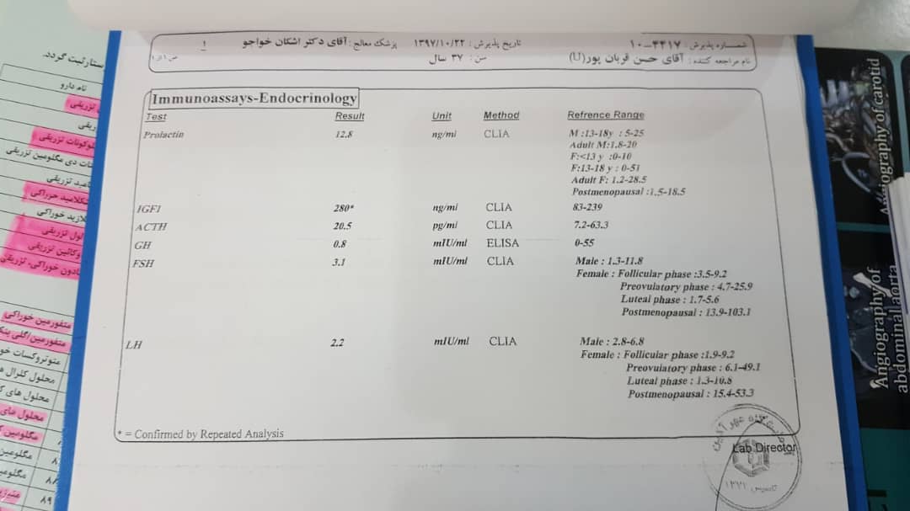
Laboratory Data
22/10/1397:
Prolactin= 12.8ng/ml (1.8-20)
IGF1= 280ng/ml (83-219)
ACTH= 20.5pg/ml (7.2-63.3)
GH= 0.8mIU/ml (0-55)
FSH= 3.1mIU/ml (1.3-11.8)
LH= 2.2mIU/ml (2.8-6.8)

Slide 13
Laboratory Data
28/10/1397:
FBS= 115mg/dl

Slide 14
Laboratory Data
29/10/1397:
Testosterone= 0.43 ng/ml
(2.5-8.4)
GH Basal= 0.06 ng/ml
(0.1-2.5)

Slide 15
Laboratory Data
02/11/1397:
CBC → Normal
Biochem → Normal

Slide 16
Laboratory Data
02/11/1397:

Slide 17
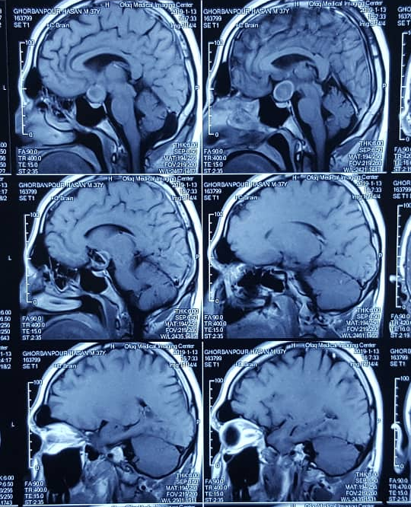
Brain Imaging

Slide 18
Brain Imaging

Slide 19
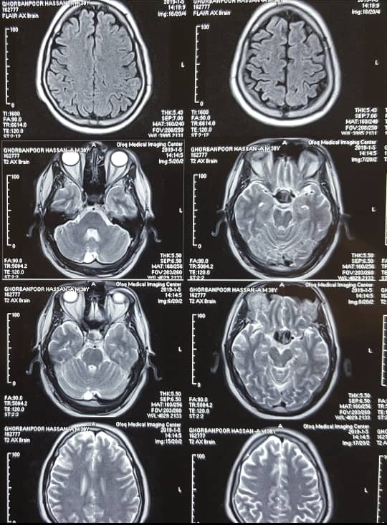
Brain Imaging

Slide 20
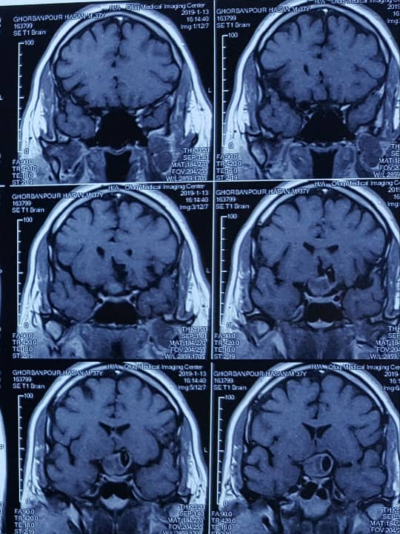
Brain Imaging

Slide 21
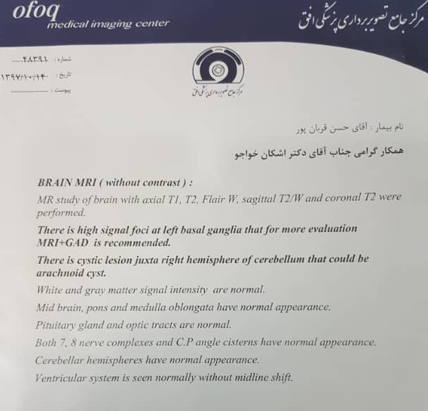
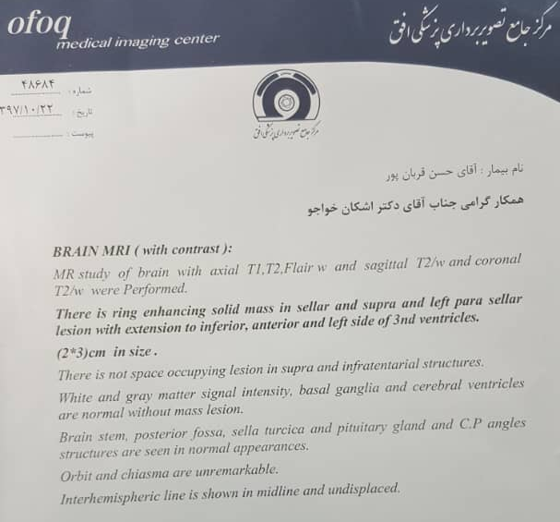
Imaging

Slide 22
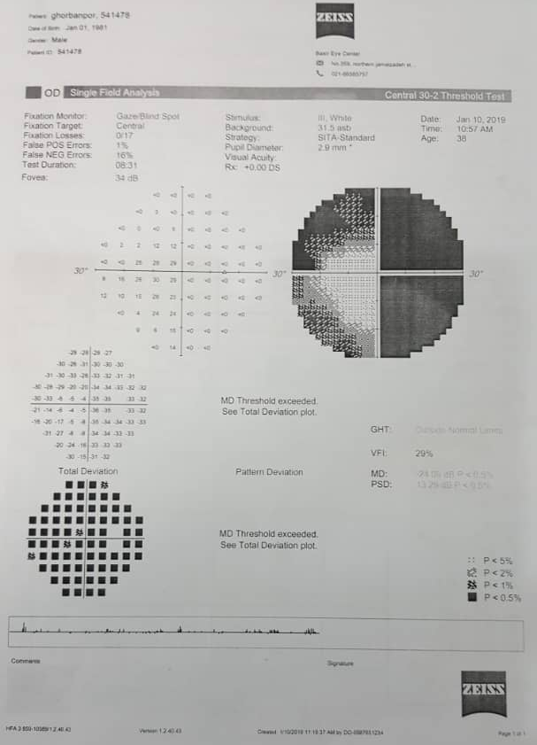
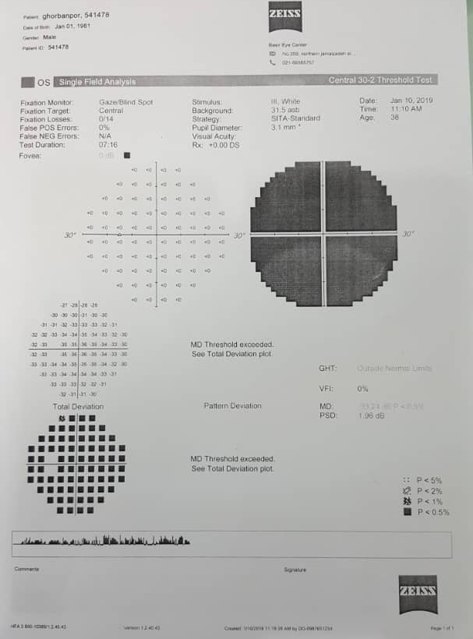
Perimetry

Slide 23
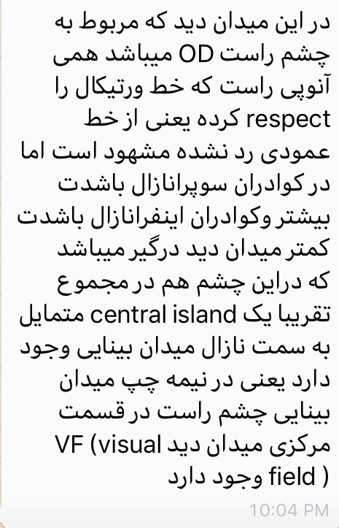
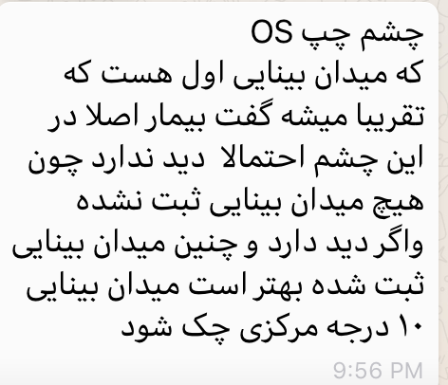
Perimetry Report

Slide 24
The current admission
The patient was scheduled to go under operation for pituitary microadenoma and was taken to the OR.
In the OR, upon re-assessing the MRI and suspecting the presence of an aneurysm the operation was cancelled.
Angiography of the brain was indicated and done.
On 1/11/1397 → he underwent craniotomy for aneurysm operation.

Slide 25
Post-op
Treatment with hydrocortisone 100mg TDS was started after surgery.
He is currently scheduled to be discharged on 50mg prednisolone BD.

