Slide 1
Ambiguous Genitalia in a Young Man a case report
Presented by: B Rezvankhah M.D
March 2017

Slide 2
Approximately 1 in every 4500 babies has atypical (ambiguous) genitalia
DSDs can present in many other ways, such as karyotype-phenotype discordance prenatally; bilateral hernia or associated syndromic features (e.g., renal) in childhood; virilization,absent puberty, or primary amenorrhea in teenage years;or even later in life with infertility.
Majority of virilized 46,XX infants will prove to have congenital adrenal hyperplasia (CAH) but only 50% of 46,XY individuals will receive a specific diagnosis.
A specific molecular diagnosis is only possible in 20% of cases.

Slide 3
Hypospadias:
Estimated birth prevalence of 3 to 4 cases per 1000 live births,
The cause is unknown in most cases,
There is a familial clustering of cases in hypospadias, with a 7% incidence of one or more additional affected family members,
It is associated with increased maternal age, multiple births, maternal exposure to diethylstilbestrol in utero, paternal subfertility, maternal vegetarian diet, maternal smoking, assisted reproductive techniques, paternal exposure to pesticides, and fetal growth restriction,
Idiopathic hypospadias is remarkably associated with low birth weight.

Slide 4
Cryptorchidism:
Presents the most common congenital abnormality in boys, affecting 2% to 9% of term infants,
There is a strong association with low birth weight, disorders of the pituitary-gonadal axis,and a number of syndromes, but in the majority of situations the cause of maldescent is unknown.

Slide 6
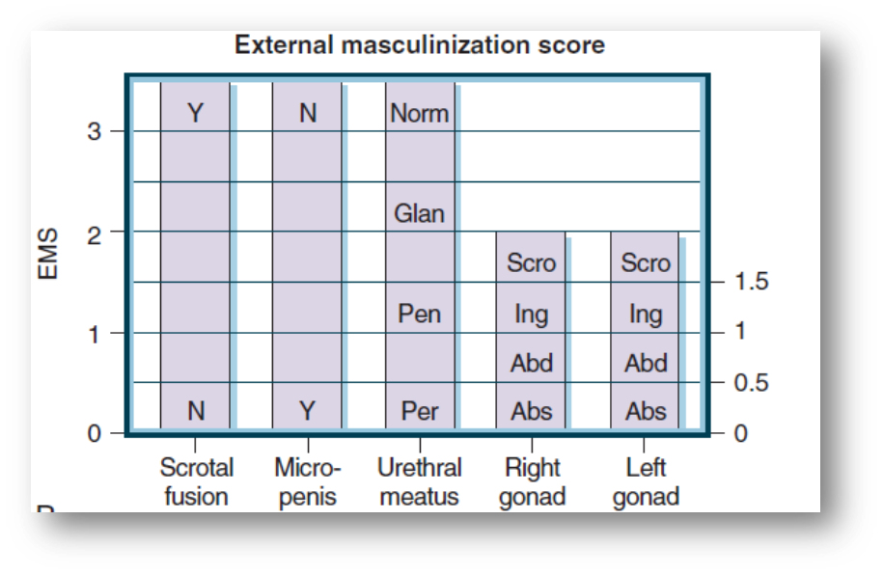

Slide 7
Approach to the Neonate With Atypical Genitalia
BASIC approach: Bonding,
Adrenal insufficiency,
Sex assignment,
Imaging,
Cytogenetics

Slide 8
The recent change has happened in attitude toward clinical management of DSD patients, with increased emphasis on a conservative approach, and the delay of irreversible surgery until adulthood.
This approach has created doubt concerning the optimal approach with regard to gonads at risk for malignant transformation.

Slide 9
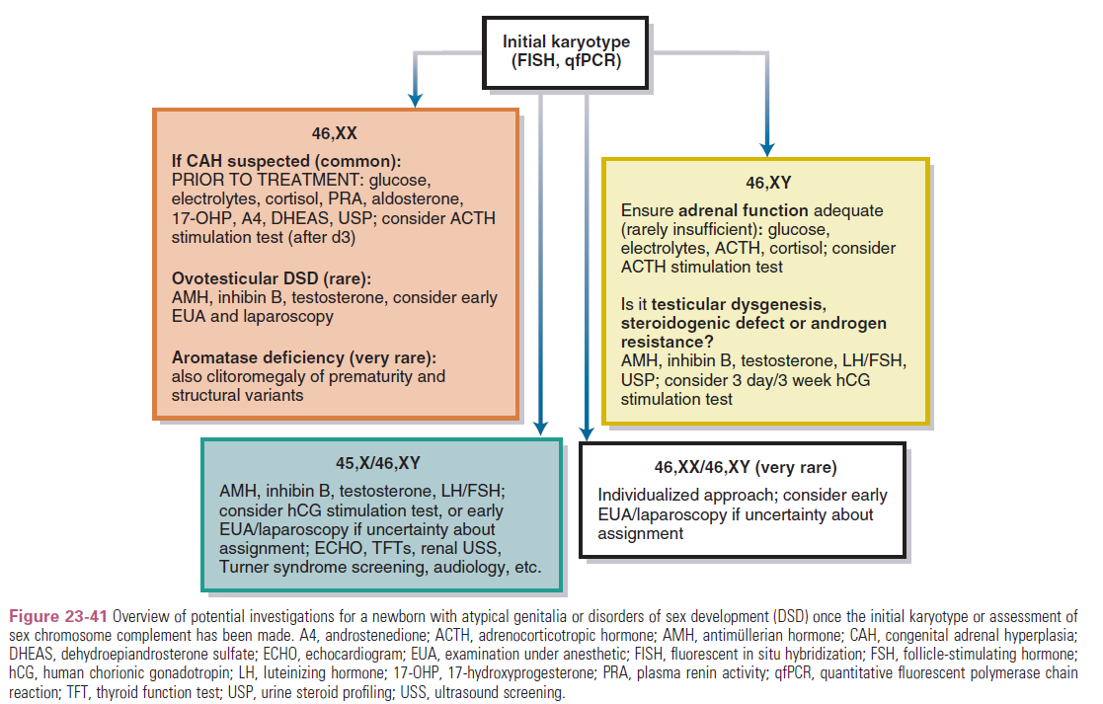

Slide 10
Disorders of Sex Development(DSDs)
Following a consensus statement in 2006, the term ‘disorders of sex development’ (DSD) was introduced to replace all previously used terms and defined as a ‘congenital condition in which development of chromosomal, gonadal or anatomical sex is atypical.

Slide 11
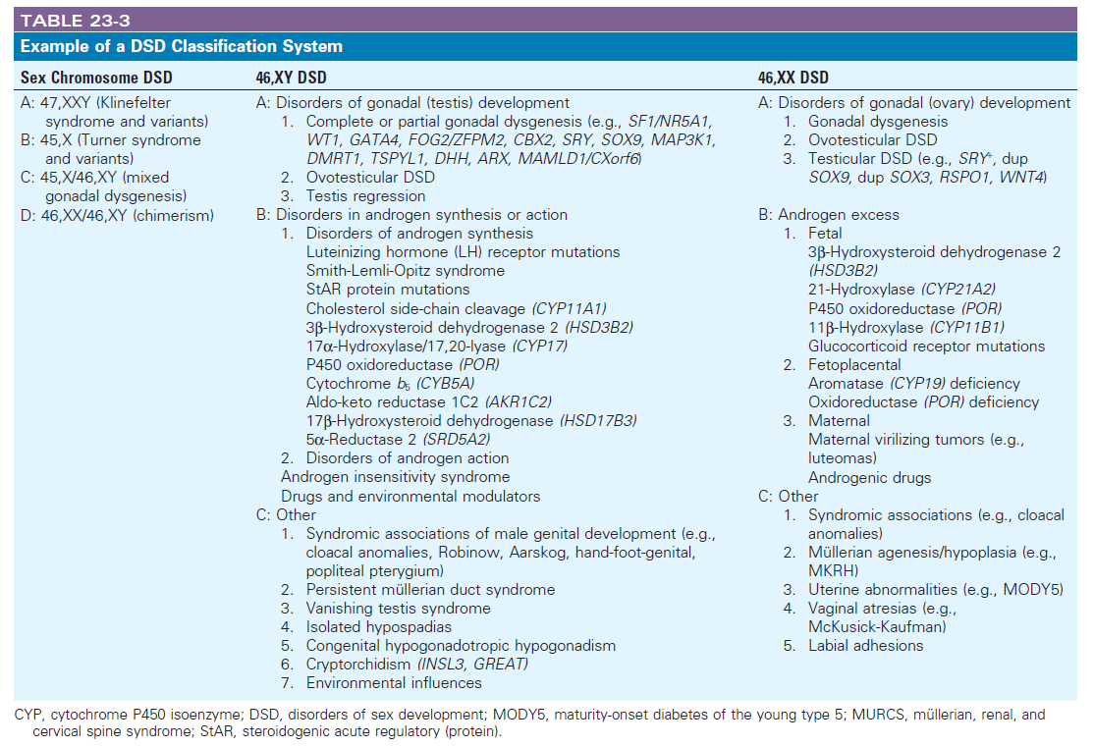

Slide 13
DDx
Partial 46,XY gonadal dysgenesis
Ovotesticular DSD
45,X/46,XY Mosaicism and Variants

Slide 14
Complete and partial 46,XY gonadal dysgenesis
The complete form is characterized by female external and internal genitalia, lack of secondary sexual characteristics, normal or tall stature without somatic stigmata of Turner syndrome and the presence of bilateral dysgenetic gonads.
The partial form of this syndrome is characterized by impaired testicular development that results in patients with ambiguous external genitalia with or without Mullerian structures.
Similar phenotypes can also result from a 45,X/46,XY karyotype.

Slide 15
Gonadal Dysgenesis Associated with Syndromic Phenotype
DSD 46,XY due to underexpression of WT1:
WAGR syndrome→ Wilms’ tumour, aniridia, genitourinary abnormalities,mental retardation and obesity
Denys-Drash syndrome→ Early-onset renal failure (diffuse mesangial sclerosis) and Wilms’ tumour development in the first decade of life
Frasier syndrome→Female to ambiguous external genitalia,Renal failure in the second decade of life, streak gonads and high risk of gonadoblastoma development

Slide 16
Persistent MÜLLERIAN Duct Syndrome→
The development of female internal genitalia in a male individual due to the incapacity of Sertoli cells to synthesize or secrete bioactive anti-Müllerian hormone (AMH) or to alterations in the hormone receptor.
Affected patients present a male phenotype, usually along with bilateral cryptorchidism and inguinal hernia. Leydig cell function is preserved, but azoospermia is common due to the malformation of ductus deferens or agenesis of epididymis.

Slide 17
Clinical Endocrinology 2008

Slide 18
Ovotesticular Disorders of Sex Development
Definition requires the presence of ovarian tissue (containing follicles) and testicular tissue in the same or the opposite gonad.
Around 1% of babies referred because of atypical genitalia.
The molecular basis of this disorder is not known. Rare genetic causes include SRY translocation (although usually this causes 46,XX testicular DSD), RSPO1 mutations (in association with palmar-plantar hyperkeratoderma and skin tumors), and chromosomal alterations that cause upregulation of expression of SOX9 (chromosome 17q24).

Slide 19
Clinical manifestation:
Ambiguous genitalia
Significant hypospadias
Cryptorchidism is common, but at least one gonad is palpable, usually in the labioscrotal fold or inguinal region, and often associated with an inguinal hernia.
hemiuterus or rudimentary uterus is often present on the side of the ovary or ovotestis.
Breast development at the time of puberty
Menses occurs in a significant proportion of cases, and ovulation and pregnancy have been reported in a number of patients with a 46,XX karyotype, especially when an ovary is present.

Slide 20
progressive androgenization can occur in girls with testicular tissue, which can result in voice changes and clitoral enlargement during adolescence.
In males can experience significant estrogenization at the time of puberty and may have cyclic hematuria if a uterus is present.
Spermatogenesis is rare, and interstitial fibrosis of the testis is common. Fertility requires Y chromosomal genes other than SRY, so boys with 46,XX ovotesticular DSD will be infertile.
The prevalence of gonadoblastom or germinoma arising in the testicular tissue of patients with 46,XX ovotesticular DSD has been estimated at 3% to 4%.

Slide 21
45,X/46,XY Mosaicism & Variants(mixed gonadal dysgenesis)
Defined in individuals who typically have a differentiated gonad on one side and a streak gonad or streak testis (usually intra-abdominal) on the other side.
The classic form of this condition is associated with 45,X/46,XY mosaicism,but 45,X/47,XYY or 45,X/46,XY/47,XYY mosaic karyotypes have also been reported.
The 45,X/46,XY karyotype represents a wide spectrum of phenotypes, from Turner females to phenotypically normal males with varying degrees of genital ambiguity.
In addition to severe cases described , a 45,X/46,XY mosaic karyotype can be associated with a male phenotype and apparently normal testis development.

Slide 22
…
The 45,X/46,XY karyotype is rare with an estimated incidence rate of less than 1/15,000 live births.
It may be due to loss of the Y chromosome through anaphase lag or to interchromosomal rearrangements with final loss of a structurally abnormal Y chromosome.
Ambiguous genitalia is the most common presentation for individuals with a 45X/46XY karyotype accounting for about 60%.
Chang et al 95% of prenatally diagnosed cases will be born as phenotypically normal males.

Slide 23
…
High gonadotropin levels have,been described in male and female patients, as well as low levels of testosterone in male patients, both regardless of genital ambiguity.
Müllerian structures may be present in the most severe cases because of impaired AMH production by Sertoli cells.
The presence of a hemiuterus and fallopian tube on the side of the most severely affected gonad in some cases provides important evidence for the paracrine actions of AMH on developing müllerian structures.

Slide 24
…
Gonadal phenotypes range from streak gonads through dysgenetic testes to testes with normal histologic architecture.
In rare cases,ovarian-like stroma and sparse primordial follicles may be present.
Furthermore, 45,X/46,XY patients often present with short stature.
Approximately 40% of children have additional, clinical features reminiscent of Turner syndrome.

Slide 25
The risk of gonadal malignancy in individuals with 45,X/46,XY mosaicism and its variants has been described to be 10–15%.
However, in clinical practice, histological examination of prophylactically removed gonads in Turner girls with 45,X/46,XY suggests a much lower incidence,whereas no data are available for boys with 45,X/46,XY
This has been related to the presence and aberrant expression of the testis-specific protein on Y (TSPY) gene, proximal on Yp.
Gonadal malignancy risk in males seemed to be greatest in individuals with the most pronounced sexual ambiguity.

Slide 26
(J Clin Endocrinol Metab, 2012)

Slide 28
It seems that a normal male genital phenotype at birth is a good predictor of sufficient testicular function to allow for full puberty, whereas males born with ambiguous genitalia may enter puberty spontaneously but subsequently need HRT
All males with hormone values available during and after puberty had low testosterone levels. We found no distinct difference between the hormone levels of the male that did not experience puberty and those that did.
The most noteworthy part of this observation is that even male patients with rather ambiguous genitalia have a good chance of Leydig cell function and thus spontaneous puberty.
The prevalence of growth retardation in our patients was high, especially when compared with their genetic potential.

Slide 29
(J Clin Endocrinol Metab,2011)

Slide 30
Interventions: Patients (n =48) were divided into three groups, based on the EMS. Gonadal histology and tumor risk were assessed on paraffin-embedded samples (n=87) by morphology and immunohistochemistry on the basis of established criteria.
Main Outcome Measures: Gonadal differentiation and tumor risk in the three clinical groups were measured. Clinical outcome in patients with at least one preserved gonad was also measured.
Results: Tumor risk in the three groups was significantly related to the gonadal differentiation pattern (P0.001). In boys, hormone production was sufficient and was not predicted by the EMS.

Slide 32
The finding of ovarian follicles was rare in 45,X/46,XY mosaicism (one of 87 samples), even from tissue removed at a very young age.
Tumor risk was significantly reflected by the clinical phenotype in our series and revealed to be very high (12 out of 23) in cases with an ambiguous phenotype. This group had the highest prevalence of UGT (5 out of 23), which has been recognized as the precursor lesion for gonadoblastoma.
Risk of tumor development is probably higher in inguinal than in abdominal gonads due to early apoptosis of germ cells in the latter position.

Slide 34
Which one is more probable for our patient?

Slide 36
Classic approach to a male with 45X/46XY
Testosterone can sometimes be given to promote phallic growth in infancy.
Hypospadias repair is usually offered as a two-stage procedure.
Gonads that cannot be placed within the scrotum are usually removed.
Gonads that can be secured within the scrotum need careful monitoring by palpation and biopsy in adolescence to assess for carcinoma in situ.
Some studies have suggested that regular testicular ultrasound in adolescence can be used to detect changes such as microlithiasis.
Puberty should be carefully monitored;in some cases, testosterone supplementation is needed.

Slide 37
What to do for our patient?
Removal of remain testis
Use of testicular prosthesis
Prescription of testosterone
No need for karyotype
Searching for stigmata of Turner Syndrome

Slide 38
Thanks for your kind attention

