Slide 1
Prognosis of Differentiated Thyroid Cancer
F. Hosseinpanah
Obesity Research Center
Research Institute for Endocrine sciences
Shahid Beheshti University
of Medical Sciences
June 12, 2014
Tehran

Slide 2
Agenda
Definitions
Staging
Prognostic scoring system
Prognostic nomogram
Conclusions

Slide 3
Definitions
Prognosis: the prediction of the future course of events following the onset of disease.
can include death, complications, remission/recurrence, morbidity, disability and social or occupational function.
Prognostic factors: factors associated with a particular outcome among disease subjects.
examples includes age, co-morbidities, tumor size, severity of disease etc.

Slide 4
Prognostic factor vs risk factor
“Risk” or “risk factor” refers to the effect of an exposure or other factor on the development of disease
“Prognosis” or “prognostic factor” refers to the influence of a factor on survival or development of another outcome

Slide 5
Prognostic or Risk Factors?
Onset of Acute MI
Well
Sick
Risk
Prognosis
Outcome
Risk Factors:
Primary Prevention
Prognostic Factors:
Secondary/Tertiary Prevention
older age
male
smoker
hypertension
inactivity
LDL increased
HDL decreased
older age
female
smoking
hypotension
anterior infarction
congestive heart failure
ventricular arrhythmia

Slide 6
Which design?
Cohort studies represent the best design for answering prognosis questions
Randomized trials can also serve as a source of prognostic information

Slide 7
What is role of staging systems?
To Permit prognostication for an individual patient with DTC
To Tailor decisions regarding postoperative adjunctive therapy, including RAI therapy and TSH suppression, to assess the patient’s risk for disease recurrence and mortality
To Make decisions regarding the frequency and intensity of follow-up, directing more intensive follow-up towards patients at highest risk
To Enable accurate communication regarding a patient among health care professionals and also allow evaluation of differing therapeutic strategies applied to comparable groups of patients in clinical studies

Slide 8
Prognostic Tools
Staging and prognostic scoring
Prognostic nomogram

Slide 9
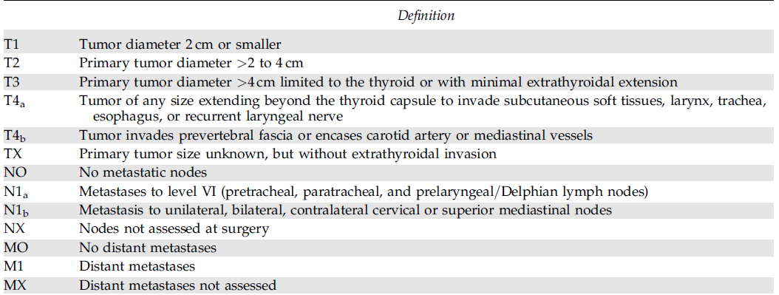
Scoring method for Tumor-Node-Metastasis (TNM) Sixth edition
AJCC Cancer Staging Manual, Sixth Edition (2002) published by Springer-Verlag, Inc., New York

Slide 10
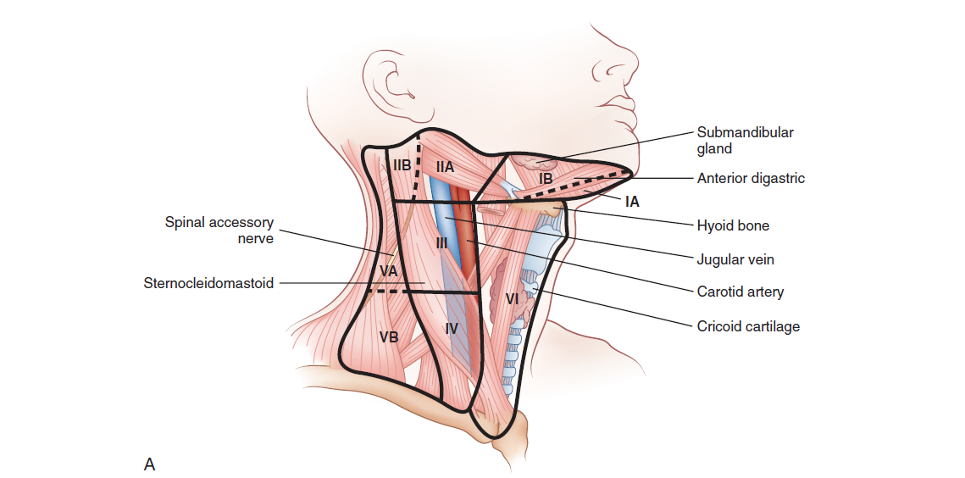

Slide 11
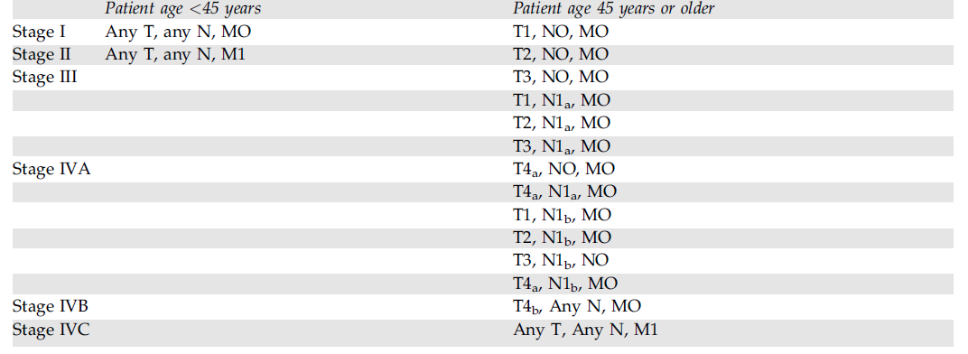
Stages

Slide 12
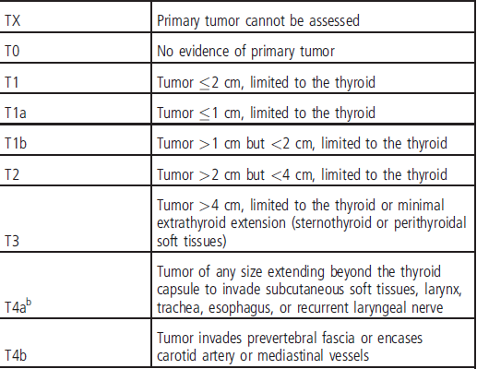
Scoring method for Tumor-Node-Metastasis (TNM) Seventh edition
American Joint Committee on Cancer. AJCC callcer stagillg mallllal, 7th ed. New York, NY:Springer, 2010.

Slide 13
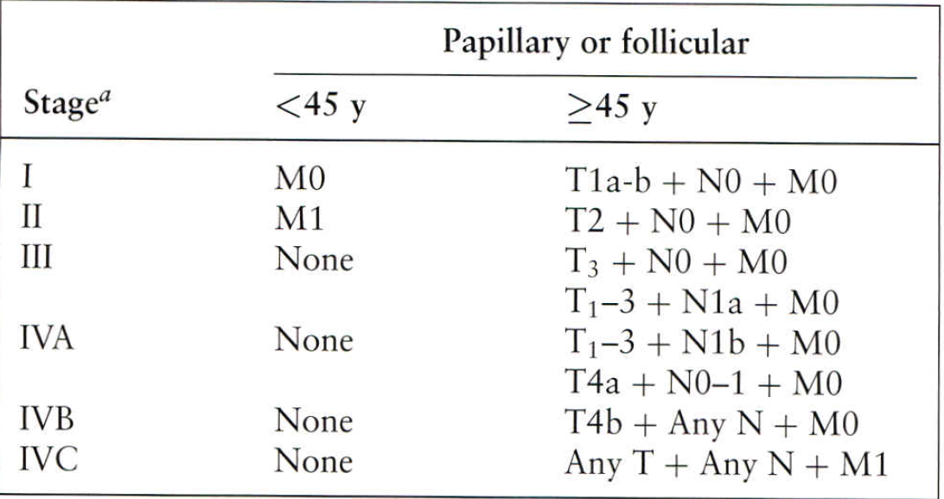
Scoring method for Tumor-Node-Metastasis (TNM) Seventh edition
American Joint Committee on Cancer. AJCC callcer stagillg mallllal, 7th ed. New York, NY:Springer, 2010.

Slide 14
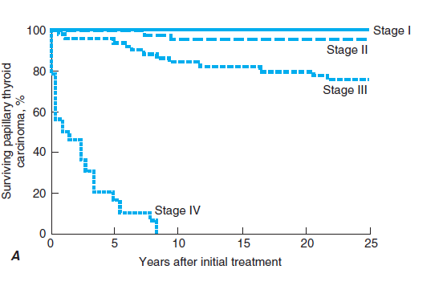
Papillary cancer, cohort of 1851 patients. I, 1107
(60%); II, 408 (22%); III, 312 (17%); IV, 24 (1%)

Slide 15
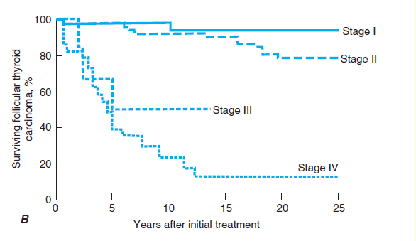
Follicular cancer, cohort of 153 patients. I, 42 (27%); II, 82
(54%); III, 6 (4%); IV, 23 (15%)

Slide 16
DTC: Initial Disease Stage Predicts OVERALL SURVIVAL
Stage I
100%
75% of all tumors
Stage II
80%
60%
Stage III
Survival
40%
25% of all tumors
20%
Stage IV
0%
p<0.001
0
2
4
6
8
10
12
14
Years
Jonklaas J et al. Thyroid. 2006, 16(12): 1229-1242.
Notes:
16
Minute 03, Second 00

Slide 17
Prognostic Scoring
EORTC
AMES
AGES
MACIS
…

Slide 18
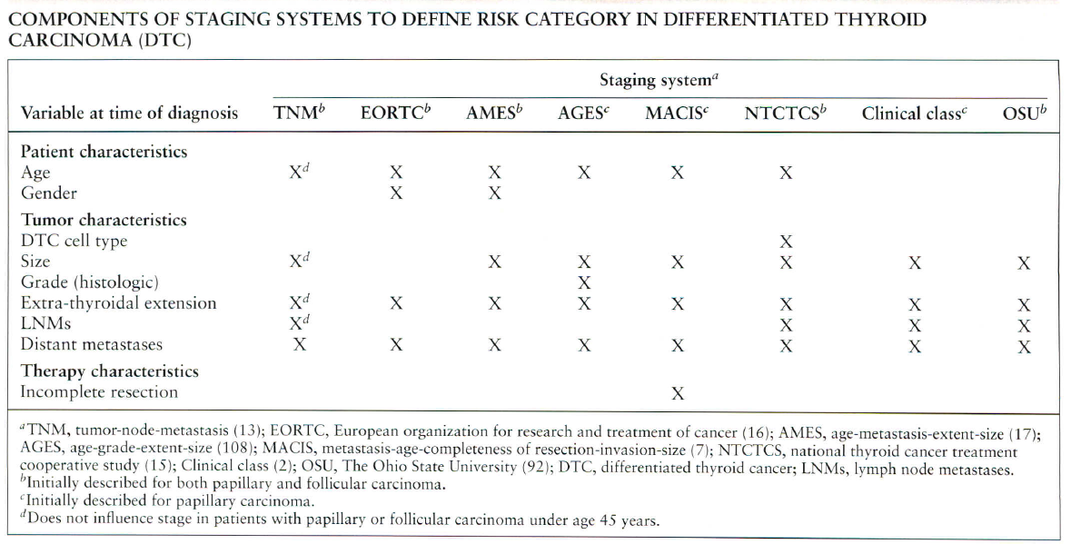

Slide 19
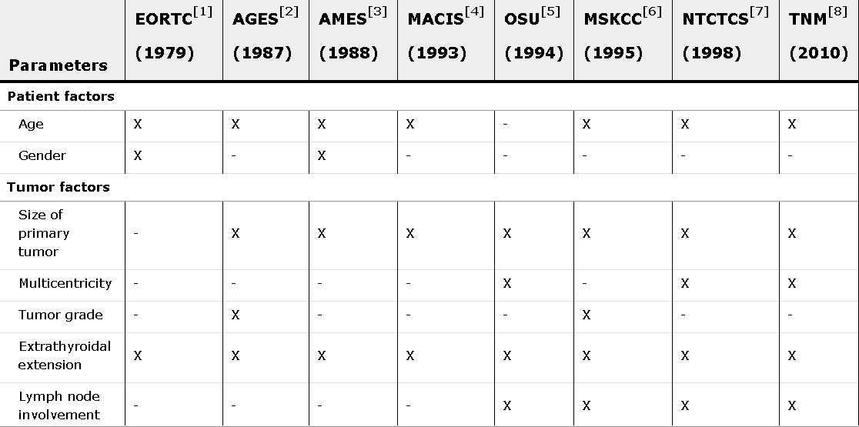

Slide 20
AGES prognostic risk groups index
Age
Tumor grade
Tumor extend
Tumor size
Surgery. 1987;102:1088-1095

Slide 21
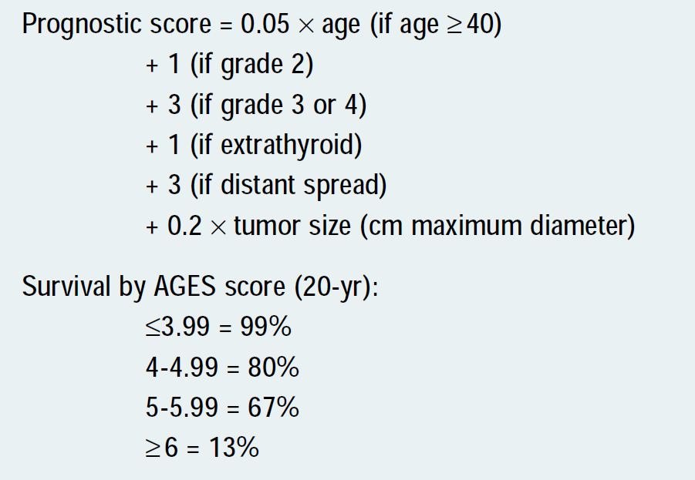
AGES prognostic risk groups index

Slide 22
AMES prognostic risk groups index
Age
Distant metastases,
Extent of the primary tumor
Size
Surgery. 1988;104:947-953.

Slide 23
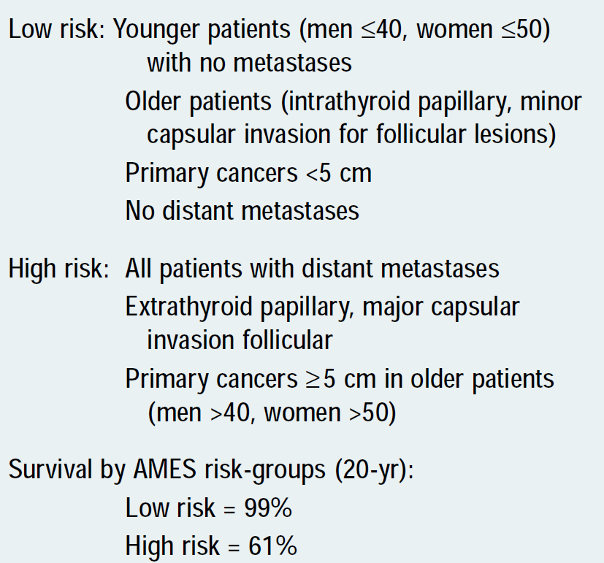
AMES prognostic risk groups index

Slide 24
MACIS prognostic model
Metastasis
Age
Completeness of resection
Invasion
Size
Surgery 1993;114(6):1050-1057

Slide 25
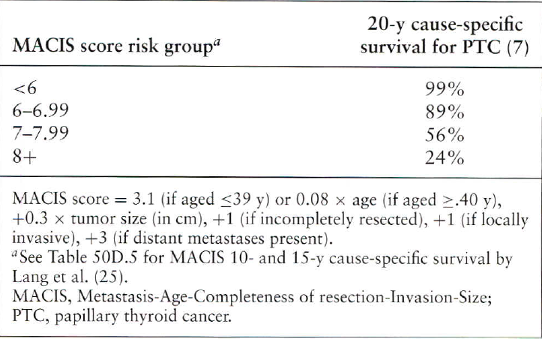
MACIS prognostic model

Slide 26
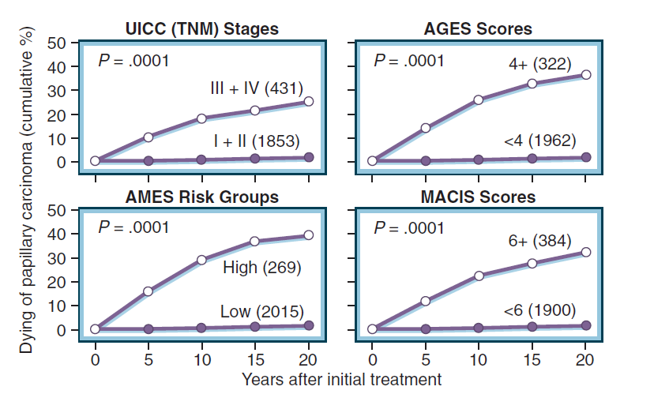
Minimal risk group %
81%
86%
88%
83%

Slide 27
CSM rates at 20 years
25%
36%
39%
32%

Slide 28
An unusual natural history!
Cervical nodal metastases in young patients with papillary thyroid cancer do not influence mortality
young patients are more likely to have cervical lymph node metastases than middle-aged patients, they are more likely to have cervical nodal and local recurrences than middle-aged patients, but they are not likely to die despite nodal disease

Slide 29
Clinico-pathologic staging system
low Risk (papillary thyroid cancer confined to the thyroid)
Intermediate Risk (regional metastases, worrisome histologies, extrathyroidal extension, or vascular invasion)
High risk (gross extrathyroidal extension or distant metastases) of recurrence
Thyroid. 2009;19(11):1167

Slide 30
Low Risk
All of the following are present:
No local or distant metastases
All macroscopic tumor has been resected
No invasion of locoregional tissues
Tumor does not have aggressive histology (eg, tall cell, insular, columnar cell carcinoma, Hurthle cell carcinoma, follicular thyroid cancer)
No vascular invasion
No ¹³¹I uptake outside the thyroid bed on the post-treatment scan, if done

Slide 31
Intermediate Risk
Any of the following is present:
Microscopic invasion into the perithyroidal soft tissues
Cervical lymph node metastases or ¹³¹I uptake outside the thyroid bed on the post-treatment scan done after thyroid remnant ablation
Tumor with aggressive histology or vascular invasion (eg, tall cell, insular, columnar cell carcinoma, Hurthle cell carcinoma, follicular thyroid cancer)

Slide 32
High Risk
Any of the following is present:
Macroscopic tumor invasion
Incomplete tumor resection with gross residual disease
Distant metastases

Slide 33
Clinico-pathologic staging system
In a retrospective analysis of 588 patients assigned an ATA risk after initial treatment, persistent structural disease or recurrence was identified at 2 years in 3, 21, and 68% of low-, intermediate-, and high-risk patients, respectively
Thyroid. 2009;19: 1167–1214.

Slide 34
Staging
TNM and MACIS* for prediction of disease specific mortality
Clinico-pathological staging system for prediction of recurrence
*MACIS : metastasis, patient age, completeness of resection, local invasion, and tumor size

Slide 35
RECOMMENDATION 31
Because of its utility in predicting disease mortality, and its requirement for cancer registries, AJCC=UICC staging is recommended for all patients with DTC
The use of postoperative clinico-pathologic staging systems is also recommended to improve prognostication and to plan follow-up for patients with DTC. Recommendation rating: B
THYROID,Volume 19, Number 11, 2009

Slide 36
Prognostic Nomograms
J Clin Oncol.2013;31:468–474
J Clin Endocrinol Metab 98: 4768–4775, 2013

Slide 37
Prognostic Nomograms
Nomograms combine multiple independent variables to predict an outcome using the prognostic weight of each variable in calculating the probability of such an outcome
Unlike a scoring method, a nomogram provides more accurate prediction for individual patients, based on statistical modeling.
An ideal nomogram should be reliable, widely applicable, and also easy to use

Slide 38
Aim : To build prognostic nomograms to predict individualized risks of relapse and death of thyroid cancer within 10 years of diagnosis based on patients’ prognostic factors.
J Clin Endocrinol Metab 98: 4768–4775, 2013

Slide 39
Methods
Setting: This study was performed at CancerCare Manitoba, the sole comprehensive cancer center for a population of 1.2 million.
Participants : A population-based cohort of 2306 consecutive thyroid cancers observed in 2296 patients in the province of Manitoba, Canada, during 1970 to 2010
Outcomes : Discrimination (concordance index) and calibration curves of nomograms
Length of F/U: A median of 126 months

Slide 41
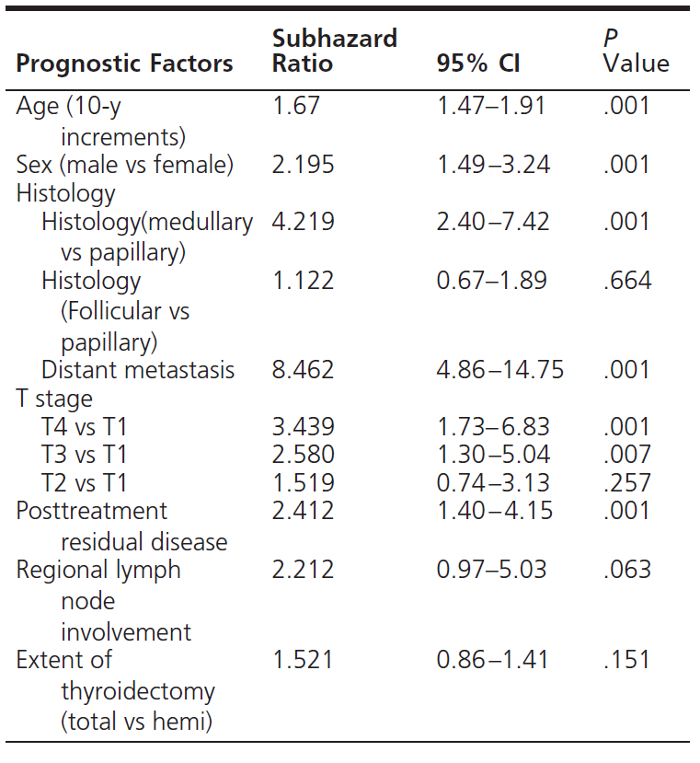
Prognostic factor influencing “Death”

Slide 42
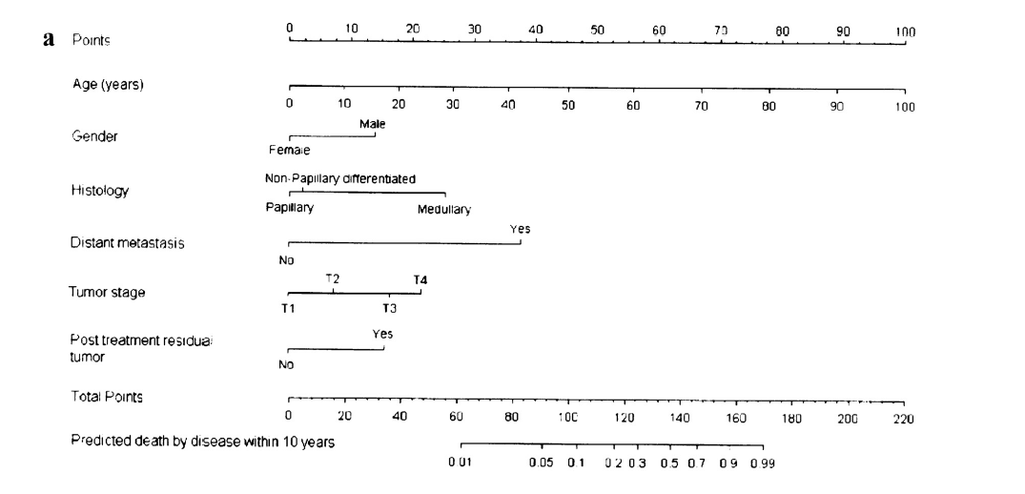
Thyroid cancer prognostic nomograms to predict risk of “Deaths”

Slide 43
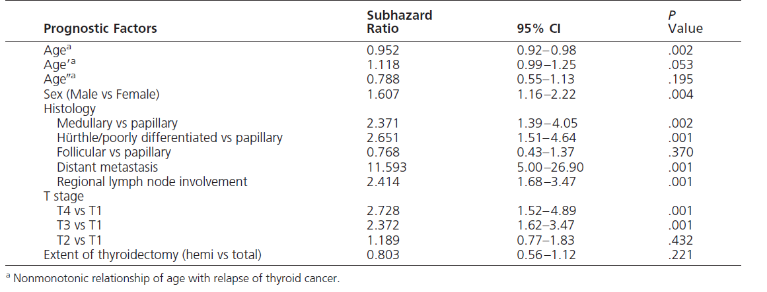
Prognostic factor influencing “Relapse”

Slide 44
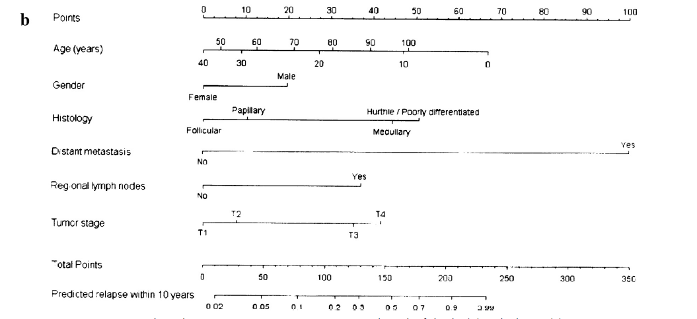
Thyroid cancer prognostic nomograms to predict risk of “Relapse”

Slide 45
Model discrimination
The concordance indices for prediction of thyroid cancer–related deaths and relapses were 0.92 and 0.76, respectively

Slide 46
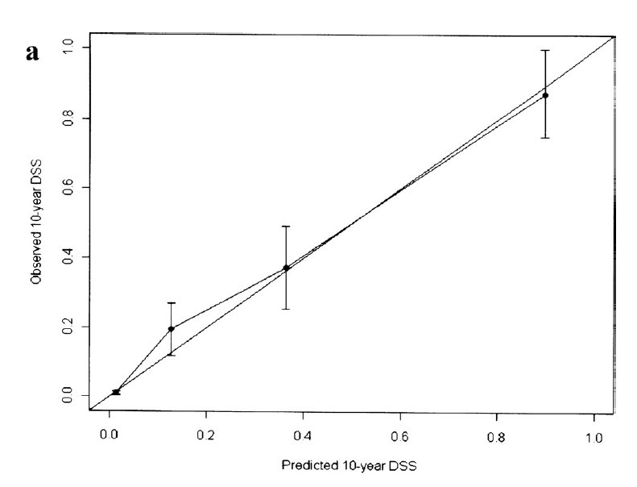
The calibration curves were very close to the diagonals

Slide 47
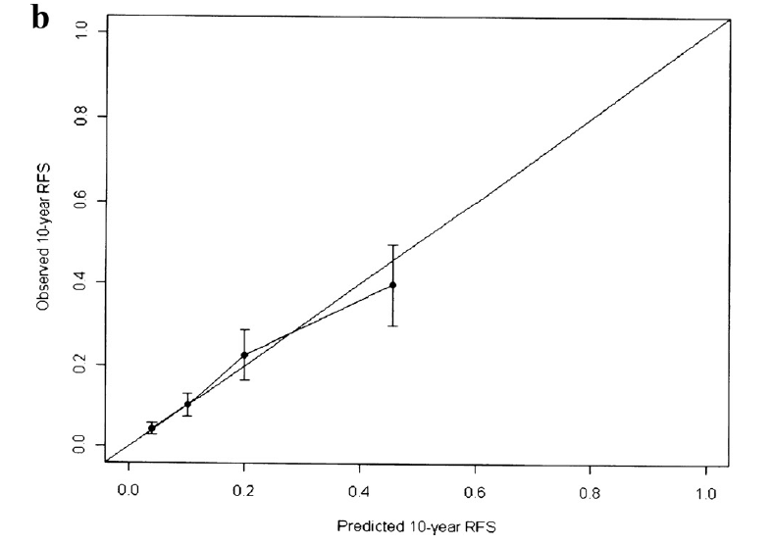
The calibration curves were very close to the diagonals

Slide 48
Independent prognostic variables outside of staging systems
Serum TSH
BRAF mutation
Fluorodeoxyglucose PET and radioiodine avidity
Serum Tg
Post-ablation 1-131 whole body scan

Slide 49
Controversial prognostic variables
Graves' Disease
lymphocytic infiltration of the thyroid gland and/or tumor
Tumor multifocality
Gender
Lymph node metastasis
Vascular invasion

Slide 50
Conclusion
Most papillary cancers are identified in the early stages (>80% stages I or II) and have an excellent prognosis
In general, well-differentiated PTC has an excellent prognosis, with a 5-year survival rate of greater than 97%
Mortality rates associated with FTC are less favorable than those for PTC, in part because a larger proportion of patients present with stage IV disease

Slide 51
Conclusion..
TNM classification system is recommended for thyroid cancer because it provides a useful shorthand method to describe the extent of the tumor
Numerous prognostic scoring system were developed, but no scheme has demonstrated clear superiority
Among staging system, MASIC and TNM seems to have the strongest ability to predict DTC-related mortality

Slide 52
Conclusion..
Staging systems predict patients at high risk for death from thyroid cancer, however there is a striking disconnect between staging for mortality and the ability to predict tumor recurrence, especially in young patients
Clinico-pathologic staging developed by ATA has strong ability to predict recurrence

Slide 53
Conclusion..
Quantitative estimation of the clinical prognosis for an individual patient; using “Prognostic nomograms” is a new and promising tool in this field

Slide 54
Thank you
For your attention
1
54

