Slide 2
case study
prepared by dr fatemeh kokabeh
15/1/1401

Slide 3
ID:
21 year old woman
born and live in one of the villages of Hamedan
source of history : patient , unreliable
ejucation: deploma
The chief complaints are nausea and vomiting and oral intake intolerance

Slide 4
patient history:
Patient: 21-year-old diabetic and pregnant woman with chief complaints of nausea and vomiting and intolerance to po. The patient referred to Taleghani Emergency Department on 13/12/1400.
The patient was a 21-year-old pregnant woman (11W+4d ) and G1P0A0 with a history of type 1 who had been receiving insulin treatment for 6 years.
The patient's problems had been started about one month ago, so that she had two recent hospitalizations in the ICU of Hamedan.
First admission: with diagnosis of hyperemesis Gravidarum . (30/11/1400)(_6/12/1400)
Second hospitalization: with diagnosis of dka and hyperemesis Gravidarum.(9/12/1400_13/12/1400) and discharge with personal consent

Slide 5
Ros:
GIB :neg
nausea and vomiting +
Vague abdominal pain occasionally +
Loss of consciousness :neg
Weakness +
headache +
FH:
neg

Slide 6
DH:
lns lantus 10 u every night which had become Levemir 8 units since two weeks ago
novorapied 8 TDS
plasil PRN

Slide 7
patient history:
PMH: DM-1 and History of two recent hospitalizations
physical examination:
21 year old female
weight:61 heieght:160 BMI: 23
BP: 95/60 HR :100 RR:30 BT:37/2
Dry mucosa and decreased skin turgor
ill
orthostatic change were not recorded in the file
Eye examination was not performed
heart examination without murmur and extra sound
Normal lung examination
muscle force normal
neuropathy neg

Slide 8
patient history:
Patient labs after receiving one liter of normal saline and vial glucose 50% :
Na | 130
K | 3/5
PH | 7/2
HCO3 | 11/3
pco2 | 28/6
creatinine | 0/8
BUN | 8
Mg | 1/8
P | 2/3
ca | 8/1

Slide 9
patient history:
Patient labs after receiving one liter of normal saline and vial glucose 50% :
WBC | 5/2
HB | 10
pLT | 145
Amylase | 45
lipase | 51
keton u/a | +++
WBCU/a and nitrate | neg
PRO UA | neg
GLu UA | ++++

Slide 10
patient history:
Patient labs after receiving one liter of normal saline and vial glucose 50% :
AST | 23
ALT | 15
ALKP | 279
LDH | 322
TSH | 1/4
Bs | 250

Slide 11
The following actions were performed during contact with the endocrinologist:
1-serum DW5% 200cc/h ++ serum HS 300 cc/h +20 cc kcl Inside each liter of serum Half saline
2- ins regular 6 u stat iv and 6 u /h inf
3-BS check every hour
4- k and VBG check every 2-4 hour
5- ICU admission
8 pm

Slide 12
During the follow-up BS chart: Within 12 hours until exiting DKA
60-145-252-209-103-87-180-122-97-53--229-246-180-176
Held insulin then continued 4u/h
After taking an insulin bolus
Exit DKA
VBG:ph:7/38
Hco3:18/3
Pco2:32
8 AM
Based on these BS, the DW infusion was increased or decreased

Slide 13
BS | 145 | 209 | 87 | 53 | 176 | 130
VBG | PH:7/26 HCO3: 11/7 pco2:26 | 7/23 11/8 28 | 7/26 15/2 28 | 7/29 15/2 30 | 7/36 15/9 28 | 7/38 18 32
HbA1c ? ? Even before pregnancy and unwanted pregnancy

Slide 14
questions
Diagnosis and definition of the disease and who is at risk?
What will be the diagnosis, etiology, physiopathology, evaluation ,management, treatment, and prognosis of this disease?
What were the mistakes made in this approach to this patient?
About the complications of recurrent hyperglycemia in infants of diabetic mothers?

Slide 15
questions
Diagnosis and definition of the disease and who is at risk?
What will be the diagnosis, etiology, physiopathology, evaluation ,management, treatment, and prognosis of this disease?
What were the mistakes made in this approach to this patient According to the said information above ?
About the complications of hypo and recurrent hyper in infants of diabetic mothers?

Slide 16
Diagnosis and definition of the disease and who is at risk?
DX: euglycemic DKA (EDKA)
definitions: PH< 7/3
Hco3<18
AND
ketosis
BS <200_250
Harman, Megan L., et al. "Euglycemic Diabetic Ketoacidosis in a Pregnant Woman With Severe COVID-19: A Case Report." Cureus 14.1 (2022).
pancreatitis
they are low caloric intake
pregnancy
fasting or starvation
cocaine intoxication, prolonged vomiting or diarrhea , insulin pump use and of late use of SGLT2 inhibitors like empagliflozin, canagliflozin and so forth
COVID 19 with or with out DM
Alcohol consumption and chronic liver disease
Previous use of insulin
Glycogen storage disorders

Slide 17
questions
Diagnosis and definition of the disease and who is at risk?
What will be the diagnosis, etiology, physiopathology, evaluation ,management, treatment, and prognosis of this disease?
What were the mistakes made in this approach to this patient?
About the complications of hypo and recurrent hyper in infants of diabetic mothers?

Slide 18
Objectives:
Describe the pathophysiology involved in euglycemic diabetic ketoacidosis.
Outline and explain the important therapeutic interprofessional team interventions for euglycemic diabetic ketoacidosis.
Differential Diagnosis
Complications
Prognosis

Slide 19
pathophysiology
Carbohydrate deficiency or carbohydrate starvation
Decreased insulin and increased glucagon
increased glucagon
Reduce intake
and dehydration
Lipolysis and production of pneumatic ketones
Impaired glycogenogenesis due to insulin deficiency
glucosuria
and regular consumption of insulin

Slide 20
pathophysiology
pregnancy =hypoinsulinemia +increase cortisol and Placental lactogen= Insulin resistance
A low carb condition for example Periods of vomiting or hyperemesis gravidarum
And respiratory alkalosis due to progesterone and bicarbonate excretion
euglycemic DKA

Slide 21
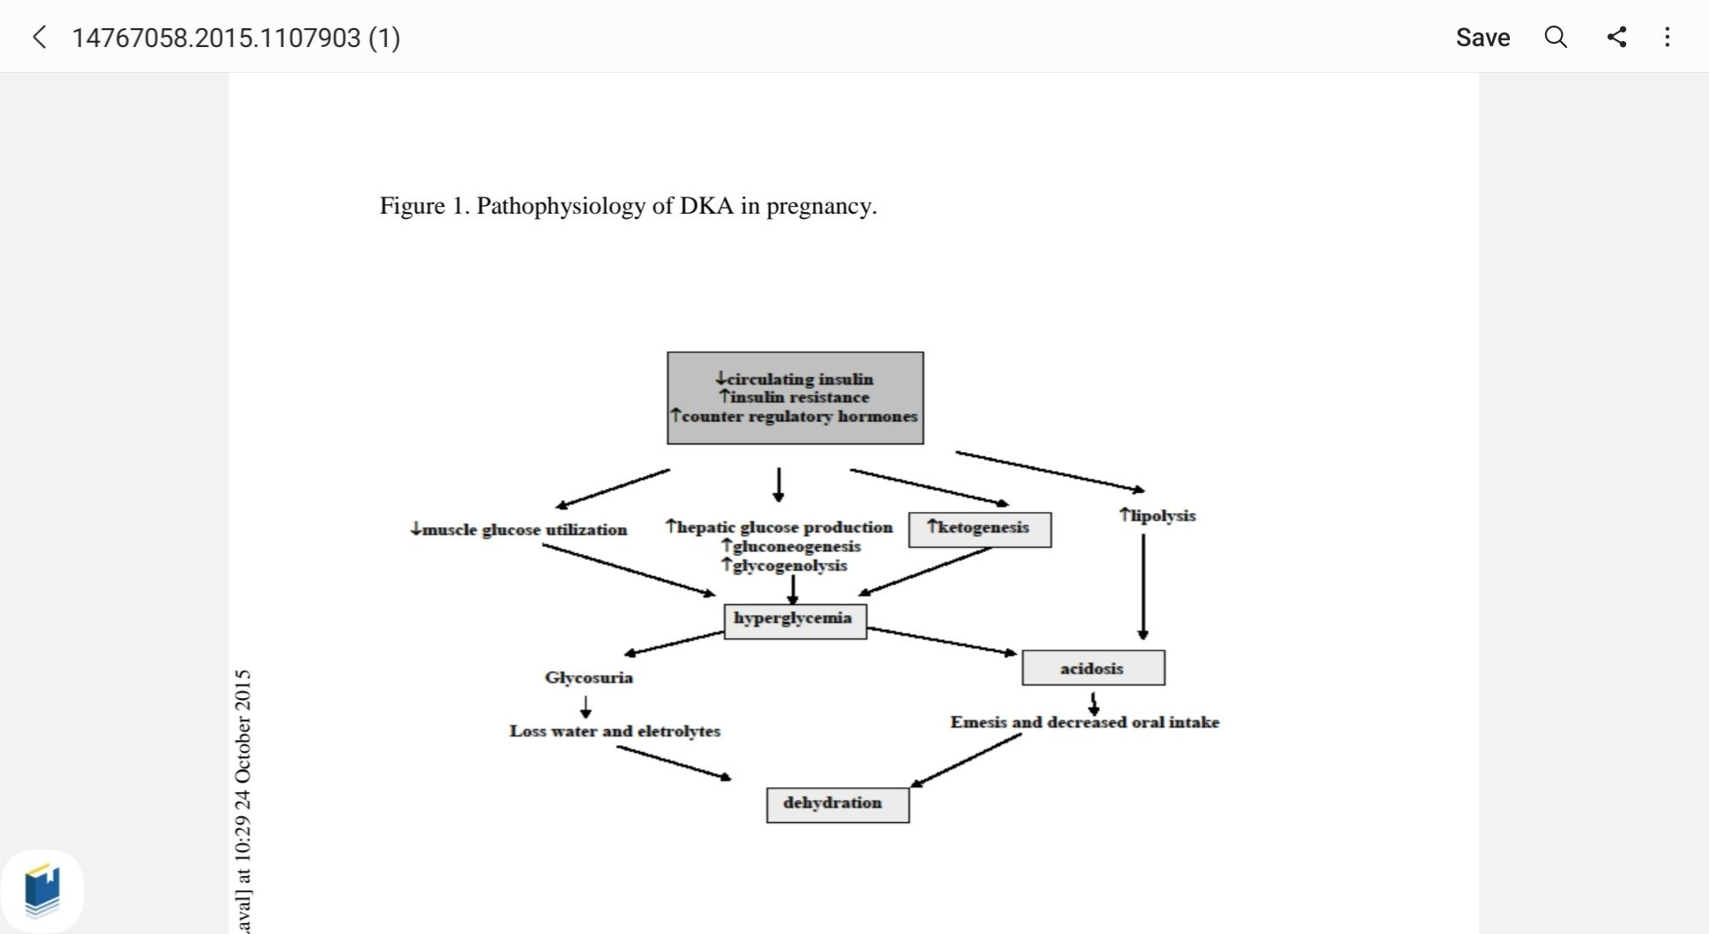
pathophysiology
pregnancy =hypoinsulinemia +increase cortisol and Placental lactogen= Insulin resistance
A low carb condition for example Periods of vomiting or hyperemesis gravidarum
And respiratory alkalosis due to progesterone and bicarbonate excretion
euglycemic DKA

Slide 22
Epidemiology
Approximately 2.6% to 3.2% of DKA admissions are euglycemic
The overall incidence of DKA occurrence during pregnancy is difficult to ascertain
numerous articles have reported incidence between 0.5% and 10% of all diabetic

Slide 23
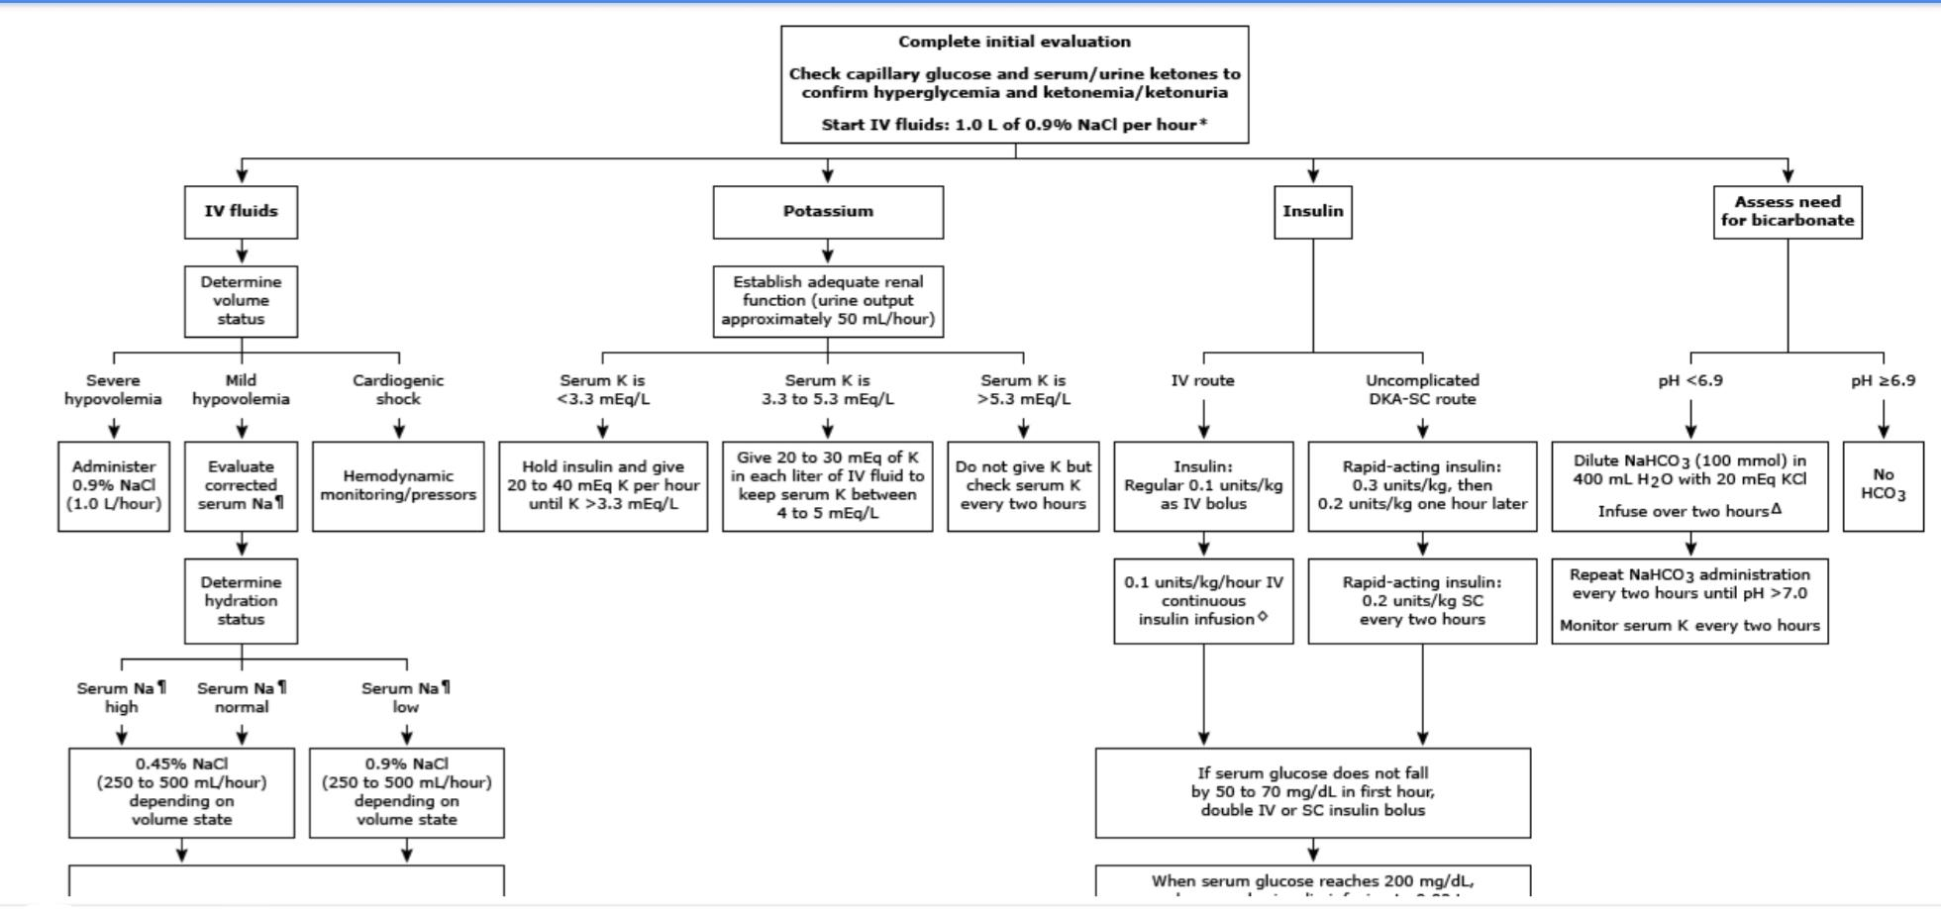
Treatment / Management

Slide 24
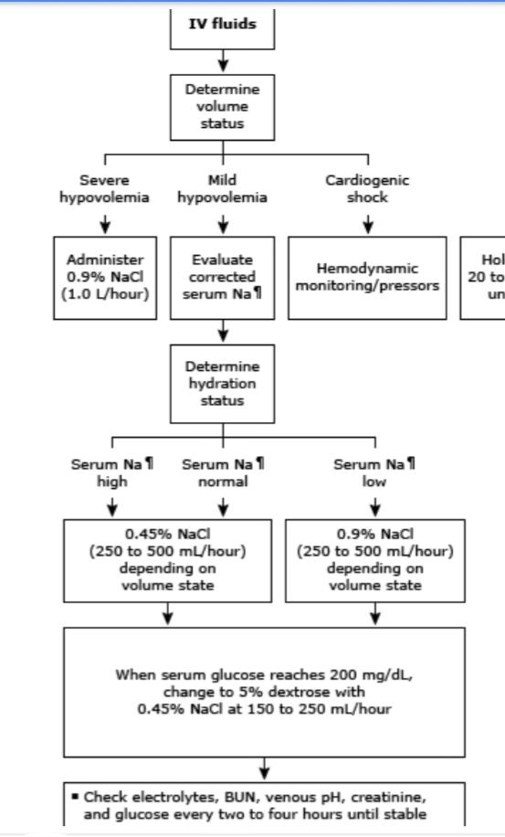
Treatment / Management

Slide 25
Treatment / Management
but euglycemic dka ??
hs or NS +2 vial glu 50% 250_500cc /h
These patients require higher percentage dextrose fluids (10 or 20%) to facilitate larger amounts of insulin administration to correct the severe acidosis while maintaining normal blood glucose levels.
Sathyanarayanan, Swaminathan Perinkulam1; Hamid, Khizar1; Taggart, Kari2; Gibbons, Kyle2; Jamous, Fady2 448: WHEN THE MACHINE FAILS: A DIFFERENT APPROACH TO EUGLYCEMIC DIABETIC KETOACIDOSIS TREATMENT, Critical Care Medicine: January 2022 - Volume 50 - Issue 1 - p 214
doi: 10.1097/01.ccm.0000808116.83470.de

Slide 26
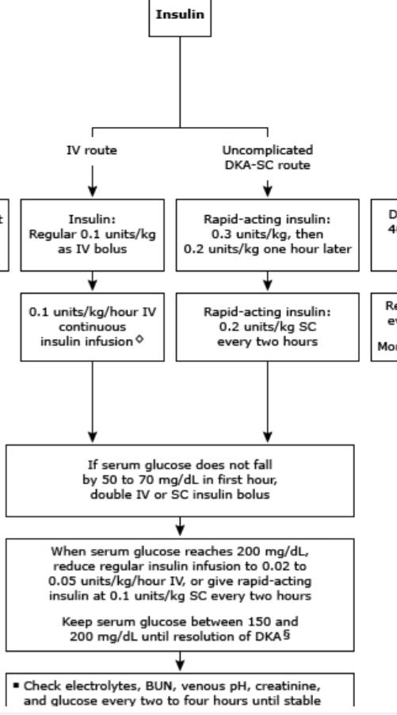
Treatment / Management

Slide 27
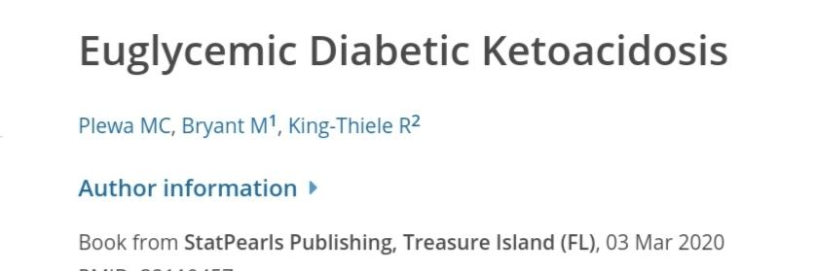
Treatment / Management
but euglycemic dka ??
Plewa, Michael C., Michael Bryant, and Robin King-Thiele. "Euglycemic diabetic ketoacidosis." (2020).

Slide 28
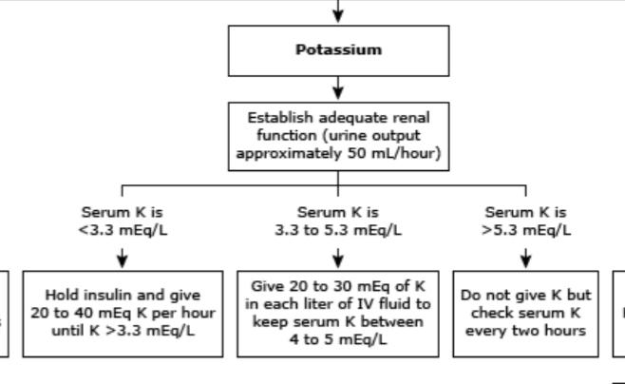
Treatment / Management

Slide 29
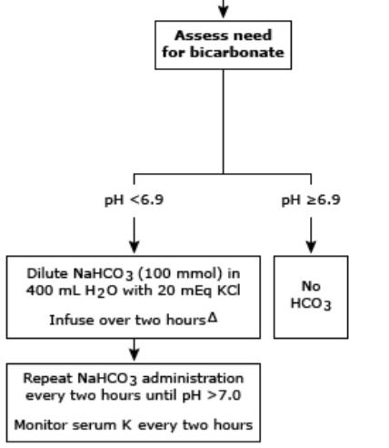
Treatment / Management

Slide 30
prognosis:
Most patients with EDKA recover well with prompt recognition and treatment. Delayed diagnosis and inadequate treatment, especially involving hydration without dextrose/insulin infusion, can lead to persistent acidosis, vomiting, and prolonged hospitalization. Prognosis is worse for small children and pregnant women. Rarely, severe cases, respiratory failure, hypovolemic shock, coma, and death. Death is rare in most EDKA cases; however, pregnant women are at greater mortality risk than the general population.
Plewa, Michael C., Michael Bryant, and Robin King-Thiele. "Euglycemic diabetic ketoacidosis." (2020).

Slide 31
DDX :
Rule out the followings before diagnosing euglycemic DKA:
aka (alcoholic ketoacidosis)
lactic acidosis
Drug poisoning
RF
Take paraldehyde

Slide 32
complication:
Euglycemic DKA can result in persistent vomiting, dehydration, hypoglycemia, hypovolemic shock, respiratory failure, cerebral edema, coma, seizures, infection, thrombosis, myocardial infarction, and death. Maternal EDKA can increase the rate of fetal (up to 9%) and maternal mortality.

Slide 33
questions
Diagnosis and definition of the disease and who is at risk?
What will be the diagnosis, etiology, physiopathology, evaluation ,management, treatment, and prognosis of this disease?
What were the mistakes made in this approach to this patient?
About the complications of hypo and recurrent hyper in infants of diabetic mothers?

Slide 34
our mistakes:
Inadequate hydration and selection of normal saline Huff saline
1_
2_Initiation of high-dose insulin, which causes recurrent hypoglycemia

Slide 35
questions
Diagnosis and definition of the disease and who is at risk?
What will be the diagnosis, etiology, physiopathology, evaluation ,management, treatment, and prognosis of this disease?
What were the mistakes made in this approach to this patient?
About the complications of hypo and recurrent hyper in infants of diabetic mothers?

Slide 36
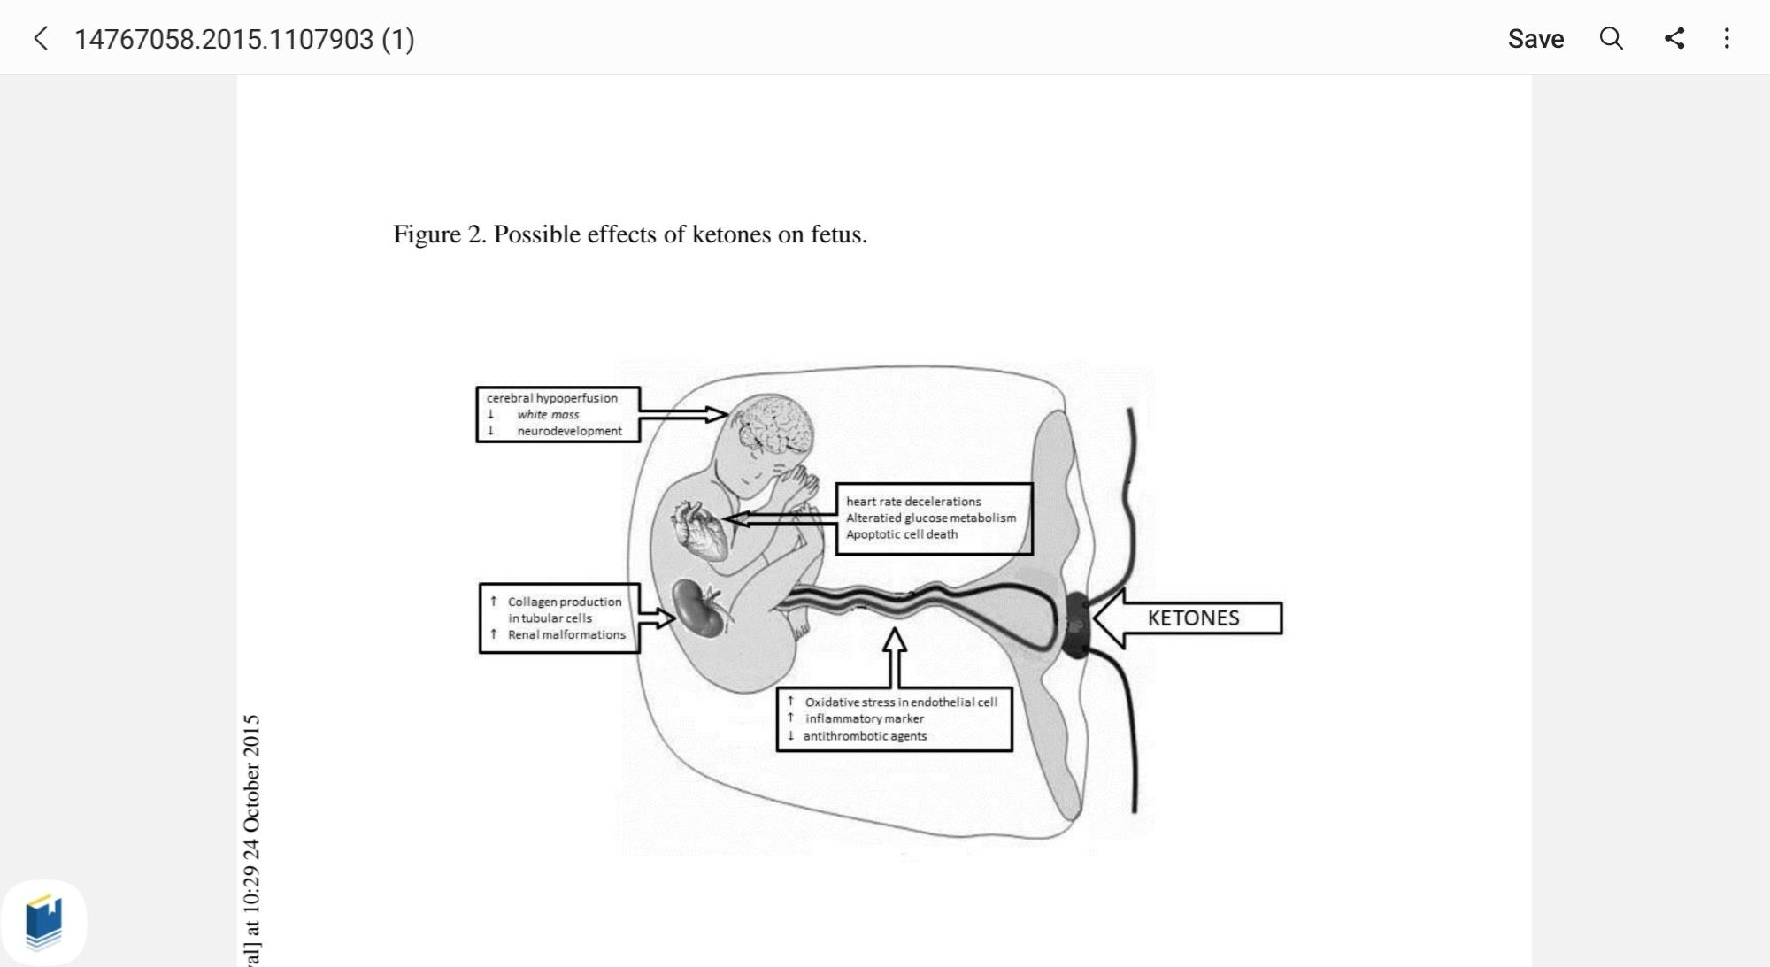
Frequent DKA complications
Pages 2889-2895 | Received 21 Sep 2015, Accepted 11 Oct 2015, Accepted author version posted online: 13 Oct 2015, Published online: 23 Nov 2015

Slide 37
Conclusion
Women with pregestational diabetes should be educated about the risk of DKA before
conception as well as during pregnancy. In particular they should be instructed about the
importance of compliance with diet, exercise, measurements and recordings of glucose
values and therapy (expecially insulin dose and device as insulin pumps). In addition, they
need to be educated about precipitating factors, signs and symptoms of DKA.
All diabetic pregnant women have to know that if glucose levels are higher than 200 mg
necessary to check blood β-OHB and, if positive, they have to contact their physician.
It is important to bear in mind the euglycemic ketoacidosis, even in non-diabetic pregnant women, because early diagnosis and prompt treatment of this condition could reduce the adverse fetal and maternal outcomes

Slide 38
Thank u for attention

