Slide 1
Metformin in T2DM
BY:
Dr. Majid Valizadeh
Research institute for endocrine sciences

Slide 2
Outlines:
Case Presentation
Pathophysiology of T2DM
Glycemic control and Diabetes complications
Focus on Biguanides
Cardiovascular effects
Metformin for DM prevention
Take home message

Slide 3
Case Study
خانم 50 ساله بدون علامت در آزمایشات غربالگری:
FBS: 145 mg/dl
FBS: 130 mg/dl
Hb A1c: 7.5%
PE: BP: 130/80, BMI: 30 Kg/m2
Normal Lipid and Creatinin (eGFR)
داشته که برای وی علاوه بر اقدامات غیردارویی قرص متفورمین 500 میلی گرم روزانه 2 بار شروع شده،
چرا متفورمین در خط اول درمان قرار دارد؟
آیا این دارو اثرات مفید قلبی-عروقی نیز دارد؟

Slide 4
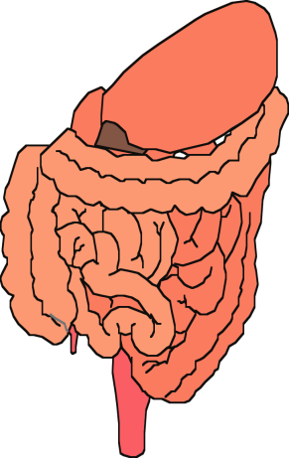
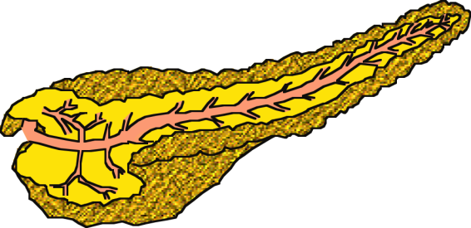


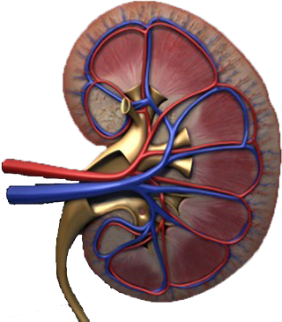
Multiple, Complex Pathophysiological Abnormalities in T2DM
pancreatic
insulin
secretion
incretin
effect
pancreatic
glucagon
secretion
_
?
gut
carbohydrate
delivery &
absorption
HYPERGLYCEMIA
_
+
peripheral
glucose
uptake
hepatic
glucose
production
renal glucose excretion
Adapted from: Inzucchi SE, Sherwin RS in: Cecil Medicine 2011
Notes:
This slide provides a broad overview of the main pathophysiological defects in type 2 diabetes. Insulin resistance is demonstrated in peripheral tissues, such as skeletal muscle and adipocytes. The pancreas develops relative insulin secretory failure and is no longer provide the amount of insulin required for normal glucose. The pancreas also demonstrates a failure of the normal suppression of glucagon after meals. This may be mediated through abnormalities in the incretin axis. Hepatic glucose production is also increased. Renal glucose output is set at a higer threshold than normal. Many of these defects may be influenced by abnormal central control of metabolism.

Slide 5
Multiple, Complex Pathophysiological Abnormalities in T2DM
GLP-1R
agonists
Insulin
pancreatic
insulin
secretion
incretin
effect
Glinides
S U s
DPP-4
inhibitors
Amylin
mimetics
pancreatic
glucagon
secretion
_
DA agonists
?
A G I s
gut
carbohydrate
delivery &
absorption
HYPERGLYCEMIA
Metformin
_
T Z D s
Bile acid
sequestrants
+
peripheral
glucose
uptake
hepatic
glucose
production
renal glucose excretion
Adapted from: Inzucchi SE, Sherwin RS in: Cecil Medicine 2011
Notes:
Anti-hyperglycemic drugs for patients with T2DM are targeted at one or more of the pathophysiological abnormalities of this disease. On this slide, the main sites of action of the currently available 12 individual drug classes is depicted. Combination glucose-lowering therapy has become a standard treatment strategy when patients do not adequately respond to a single agent (often metformin.)

Slide 6
Relative Risk of Progression of Diabetic Complications
RELATIVE RISK
Mean A1C
        DCCT Research Group, N Engl J Med 1993, 329:977-986.

Slide 7
Macrovascular Complications as the most important cause of mortality
UKPDS
ADVANCE
VADT
ACCORD
Glycemic control per se doesn't decrease CVD outcome

Slide 8
Glycemic Control and Diabetes Complications
Diabetic patients are at high risk for cardiovascular events
The most important cause of mortality
  and evaluation/treatment of all cardiovascular risk factors is essential
Simply focusing on glycemic control
  will not have a major impact to reduce cardiovascular risk
We favor a therapeutic approach based not only on the drug’s glucose-lowering efficacy/durability but also on its effect on:
  weight, blood pressure, lipids
  Cardiovascular protection
  Side effect profile, especially hypoglycemia
ADA Diabetes Self-Study Series, Challenges in Type 2 Diabetes Mellitus Management: Self-Assessment Program
Current Status of the Treatment of Type 2 Diabetes
© 2014 American Diabetes Association
Glycemic Control and Chronic Diabetes Complications; p26
Pathophysiologic Approach to Therapy in Patients With Newly Diagnosed Type 2 Diabetes; p48

Slide 9
Primary Objectives of Effective Management
Diagnosis
lGæde P, Vedel P, Larsen N, Jensen GVH, Parving H-H, Pedersen O. Multifactorial intervention and cardiovascular disease in patients with type 2 diabetes. N Engl J Med. 2003;348:383-393.
A1C
%
9
8
7
Reduction
of both
micro- and macro-
vascular
event
rates
…by 75%!
SBP
mm Hg
145
130
LDL
mg/dL
140
100
45
50
55
60
65
70
75
80
85
90
Patient Age
Notes:
Key Points
The primary objectives of effective diabetes management are to reduce A1C to as near-normal levels (ie, 4%–6%) as is possible and safe, to lower systolic blood pressure to <130 mm Hg, and to decrease LDL cholesterol to <100 mg/dL
Achieving target levels of A1C, systolic blood pressure, and LDL cholesterol may reduce the risk of the micro- and macrovascular complications of diabetes by up to 75%
As illustrated in this slide, the objectives of effective diabetes management are to reduce A1C to as near-normal levels as is possible and safe (ie, 4%–6%), lower systolic blood pressure to <130 mm Hg, and to decrease LDL cholesterol to <100 mg/dL. Evidence suggests that achieving these target levels can reduce the risk of both microvascular and macrovascular complications of diabetes by >75%.¹
Most recently, the Steno-2 Study followed 160 patients with type 2 diabetes and microalbuminuria over 7.8 years to determine the effect of intensive treatment on long-term CV and microvascular outcomes. Researchers found that target-driven, intensive treatment consisting of stepwise diet, exercise, and pharmacotherapy for glycemia, microalbuminuria, lipids, and blood pressure resulted in a decreased risk of CV and microvascular events of about 50%. Control group members received conventional treatment in accordance with national guidelines. However, factors leading to diminished degrees of separation between the intensive treatment and control groups (eg, more than 50% of control group members were referred for specialist treatment during the course of the study) led the authors to estimate that the actual risk reduction associated with intensive versus conventional therapy may be even greater than that observed.²
References
American Diabetes Association. Clinical Practice Recommendations. Implications of the United Kingdom Prospective Diabetes Study. Diabetes Care. 2003;26(suppl 1):S28-S32.
Gæde P, Vedel P, Larsen N, Jensen GVH, Parving H-H, Pedersen O. Multifactorial intervention and cardiovascular disease in patients with type 2 diabetes. N Engl J Med. 2003;348:383-393.

Slide 10
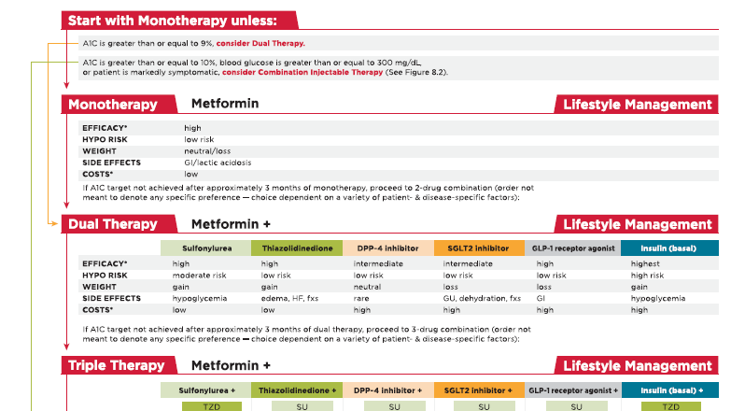

Slide 11
Life style changes in Diabetes :
Nutrition Therapy
increased Physical activity
Behavioral changes
ADA Diabetes Self-Study Series, Challenges in Type 2 Diabetes Mellitus Management: Self-Assessment Program
Current Status of the Treatment of Type 2 Diabetes
© 2014 American Diabetes Association
Medical Nutrition Therapy; p11

Slide 12
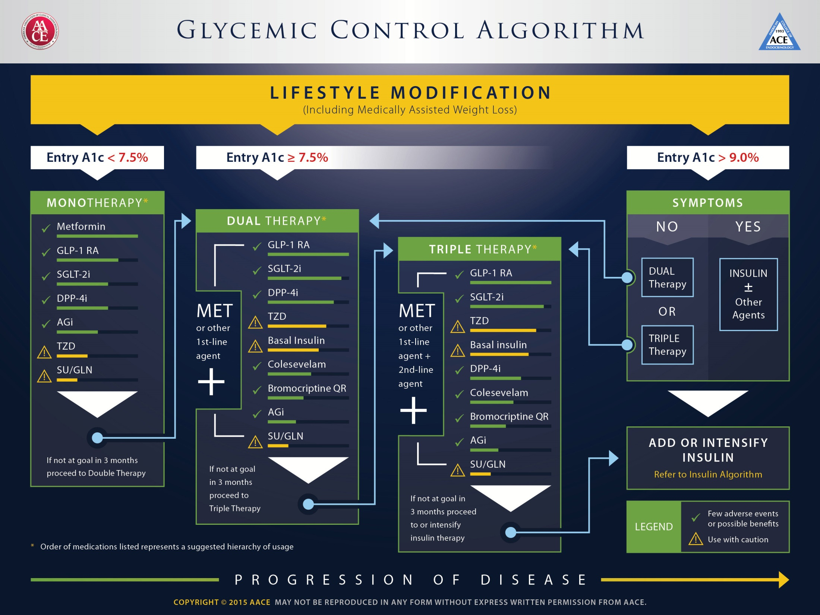

Slide 14
Metformin
DM Treatment
DM Prevention
PCO
GDM
  Pharmacology
  Efficacy
  side effects

Slide 15
Metformin benefits
Glycemic efficacy
Absence of weight gain and hypoglycemia
General tolerability
Favorable cost

Slide 16
Expected HbA_{1c} reduction according to intervention
Intervention | Expected ↓ in HbA_{1c} (%)
Lifestyle interventions | 1 | to | 2%
Metformin | 1 | to | 2%
Sulfonylureas | 1 | to | 2%
Insulin | 1.5 | to | 3.5%
Glinides | 1 | to | 1.5%¹
Thiazolidinediones | 0.5 | to | 1.4%
α-Glucosidase inhibitors | 0.5 | to | 0.8%
GLP-1 agonist | 0.5 | to | 1.0%
Pramlintide | 0.5 | to | 1.0%
DPP-IV inhibitors | 0.5 | to | 0.8%
Nathan DM, et al. Diabetes Care 2009;32:193-203.
Notes:
16

Slide 17
GLYCEMIC EFFICACY
Monotherapy
Combination therapy
  sulfonylureas, insulin, glinides, alpha-glucosidase inhibitors, thiazolidinediones (TZDs), sodium-glucose cotransporter 2 (SGLT2) inhibitors, glucagon-like peptide-1 (GLP-1) agonists, and dipeptidyl peptidase 4 (DPP-4) inhibitors.

Slide 18
MECHANISM OF ACTION
decrease hepatic glucose output ( inhibiting gluconeogenesis)
increases insulin-mediated glucose utilization in peripheral tissues (such as muscle and liver)
antilipolytic effect that lowers serum free fatty acid concentrations, thereby reducing substrate availability for gluconeogenesis
decrease food intake and body weight

Slide 19
WEIGHT LOSS & lipid-lowering activity
In those who are obese, metformin promotes modest weight reduction or at least weight stabilization
↓Triglyceride and free fatty acid concentrations,
↓ LDL (a small )
↑ HDL (very modest )

Slide 20
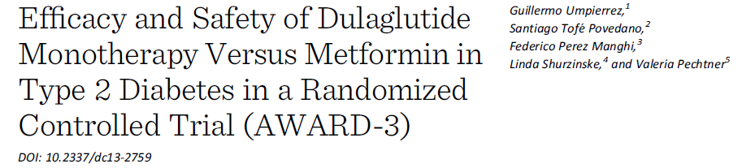
This 52-week double-blind study randomized patients to subcutaneous dulaglutide 1.5 mg, dulaglutide 0.75 mg, or metformin.
Patients (N = 807)
Compared with metformin, decrease in
weight was similar with dulaglutide 1.5 mg and smaller with dulaglutide 0.75 mg

Slide 21
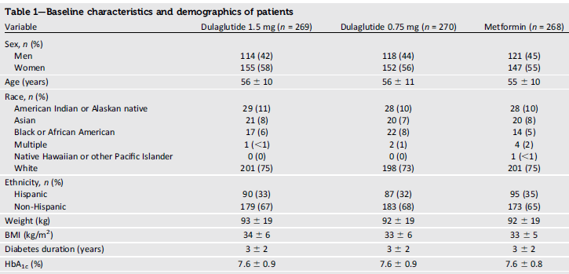

Slide 22
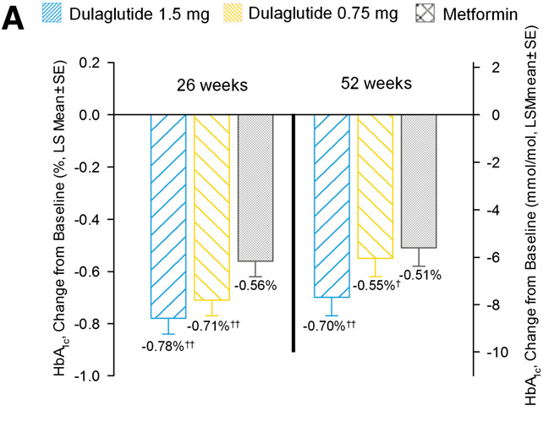

Slide 23
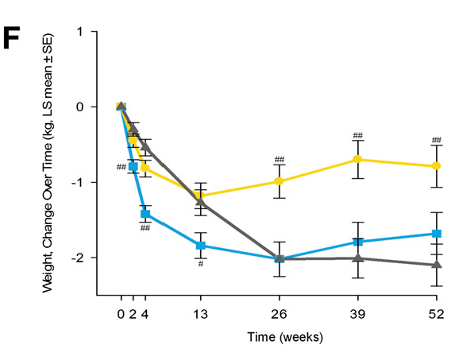

Slide 24
The Diabetes Prevention Program Research Group

Slide 25
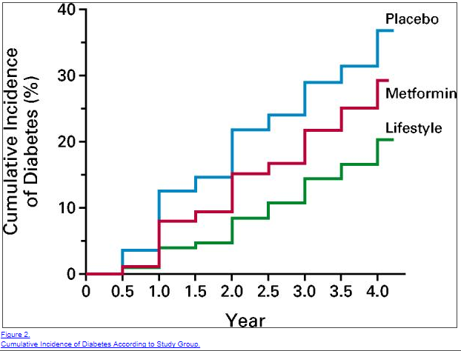

Slide 26
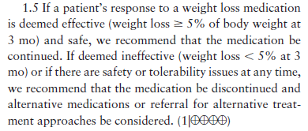

Slide 27
پوشش بیمه | قیمت (تومان) | تعداد | نام دارو
√ | 7500 (19500) | 100 | متفورمین
√ | 4000 | 100 | گلی بن کلامید
√ | 11000 (19000) | 100 | گلی کلازید
√ | 5500 | 100 | ریپگلیناید
√ | 9000 | 100 | ریپگلیناید
√ | 13000 | 100 | ریپگلیناید
● | 32-40-48000 | 100 | گلوتازون (15-30-45)
● | 22-34000 | 100 | آکاربوز
● | 30000 | 30 | زیپتین 50
√ | 12000 | 1 ویال | NPH
√ | 12000 | 1 ویال | Regular
● | 20000 | 100 عدد | سرنگ

Slide 28
Effectiveness
safety profiles
Side effects
Cost
Patient satisfaction
.extraglycemic effect.

Slide 29
Cardiovascular benefits ?!

Slide 30
CARDIOVASCULAR EFFECTS
Metformin does not have adverse cardiovascular effects,
It appears to decrease CV events in certain populations!

Slide 31
In the United Kingdom Prospective Diabetes Study (UKPDS)
obese patients who were assigned initially to receive metformin rather than sulfonylurea or insulin therapy had a decreased risk of the aggregate diabetes-related endpoint (included both macrovascular and microvascular complications) and all-cause mortality .
During the post-interventional observation period of the UKPDS, reductions in the risk of macrovascular complications were maintained in the metformin group.

Slide 32
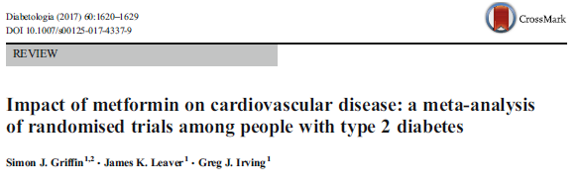
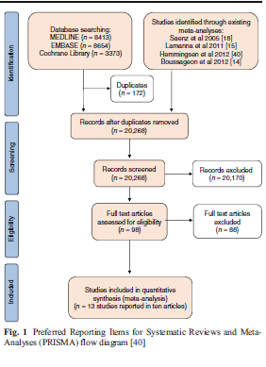
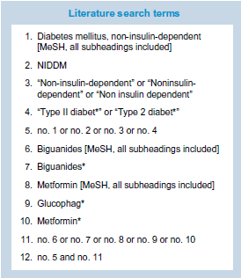

Slide 34
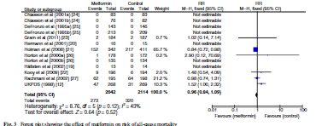
Risk of bias summary effect of Met. On all cause mortality

Slide 35
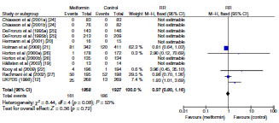
effect of Met. On Cardiovascular death

Slide 36
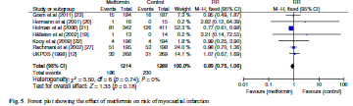
effect of Met. On risk of MI

Slide 37
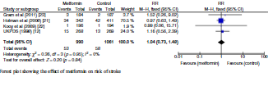
Effect of Met. On risk of stroke

Slide 38
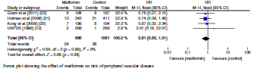
effect of Met. On risk of peripheral vascular disease

Slide 39
Conclusion
Metformin monotherapy appears safe and, while there is a suggestion of benefit, there remains uncertainty about whether it reduces risk of cardiovascular disease.
According to our review it is possible that metformin reduces risk of all-cause mortality by up to 16% but it could increase risk of stroke by up to 48%.

Slide 40
Conclusion
In contrast to some newer treatments, cardiovascular endpoint trial data for metformin are largely derived from:
  small studies
  among relatively young,
  overweight/obese,
  North American and Northern European patients with poorly controlled diabetes.

Slide 41
CANCER INCIDENCE
Observational studies
  reduced risk of all cancers (relative risk [RR] 0.61, 95% CI 0.54-0.70
    colorectal cancer (RR 0.64, 95% CI 0.54-0.76)
    lower cancer mortality (RR 0.66, 95% CI 0.49-0.88)
Clinical Trials
  Did not defined as outcome
  Short duration (< 4 Y)

Slide 42
SIDE EFFECTS
Gastrointestinal :
  metallic taste in the mouth
  mild anorexia
  Nausea
  abdominal discomfort,
  soft bowel movements or diarrhea
5% of study subjects discontinue metformin because of the gastrointestinal side effects

Slide 43
Vitamin B12 deficiency :
reduces intestinal absorption of vitamin B12 in up to 30 % of patients
lowers serum vitamin B12 concentrations in 5 to 10 %
only rarely causes megaloblastic anemia
peripheral neuropathy may precede the development of megaloblastic anemia

Slide 44
Lactic acidosis
incidence 9 cases per 100,000 person-years of exposure
Symptoms of lactic acidosis are nonspecific and may include anorexia, nausea, vomiting, abdominal pain, lethargy, hyperventilation, and hypotension.
Serum lactate concentrations are usually < 2 mmol/L in patients taking metformin, values that are not clinically important

Slide 45
CONTRAINDICATIONS
Impaired renal function (estimated glomerular filtration rate [eGFR] <30 mL/min)
Concurrent active or progressive liver disease
Active alcohol abuse
Unstable or acute heart failure at risk of hypoperfusion and hypoxemia
Past history of lactic acidosis during metformin therapy
Decreased tissue perfusion or hemodynamic instability due to infection or other causes

Slide 46
Monitoring
serum creatinine annually
hemoglobin, hematocrit, and red cell indices at diagnosis and at other times if the patient develops symptoms suggestive of anemia, neuropathy, or deteriorating renal function.
If anemia is present, vitamin B12 and folate should be measured

Slide 47
Take home message
Metformin is:
  cheap, widely available
  safe, backed by pharmaco-epidemiological and anecdotal evidence following up to 60 years of regular use in practice
  appears more likely to reduce risk of cardiovascular disease than increase it. Albeit, the latter assessment is based on a few small trials, with notable limitations, among an unrepresentative subset of patients.
.

Slide 48
Take home message:
Newer agents that could potentially be used early in the course of the disease are now available, and are backed by data from recent rigorous cardiovascular endpoint trials.
    However, they remain very expensive
    lack data on long-term use

Slide 49

از توجه شما متشکرم

Slide 50
Case Study
خانم 50 ساله، در آزمایشات غربالگری:
FBS: 145 mg/dl
FBS: 130 mg/dl
Hb A1c: 7.5%
PE: BP: 130/80, BMI: 30 Kg/m2
Normal Lipid and Creatinin
داشته که برای وی علاوه بر اقدامات غیردارویی قرص متفورمین 500 میلی گرم روزانه 2 بار شروع شده، یک هفته بعد با شکایت از تهوع و سوزش سر دل مراجعه کرده اتوصیه شما چیست؟

Slide 51



ADA-EASD Position Statement Update:
Management of Hyperglycemia in T2DM, 2015
3. ANTI-HYPERGLYCEMIC THERAPY
Therapeutic options: Lifestyle
  Weight optimization
  Healthy diet
  Increased activity level
Diabetes Care 2012;35:1364–1379; Diabetologia 2012;55:1577–1596
Notes:
Non-pharmacological options are critically important – they are cost effective and have no side effects, per se. Patients with T2DM should become more physically active, eat a healthy diet and try to optimize body weight. These efforts will result in less insulin resistance, with better blood glucose control the result. There are also additional health benefits from such interventions.

Slide 52
کاهش دوز و شروع تدریجی
تغییر برند (Glucophage)
استفاده از فرآورده های Extended release

Slide 53
DOSING
We begin with 500 mg once daily with the evening meal and, if tolerated, add a second 500 mg dose with breakfast.
The dose can be increased slowly (one tablet every one to two weeks) as necessary
The usual effective dose is 1500 to 2000 mg/day

Slide 54
3 ماه بعد:
DH: Metformin 500 BD
BP: 120/80, BMI: 29 Kg/m2:
FBS: 110 mg/dl
Hb A1c: 6.9%

Slide 55
بررسی از نظر عوارض میکرو واسکولر
  معاینه چشم
  بررسی میکروآلبومین ادرار
  ارزیابی نوروپاتی

Slide 56
Case Study
خانم 65 ساله، با سابقه بیماری عروق کرونر که یکبار بالون شده و Stent گذاری گردیده
DH: متورال 25 میلی گرم 2 بار در روز + آسپرین 80 + آتورواستاتین 20 میلی گرم
BP: 130/80, W: 78 Kg, BMI: 28 Kg/m2
FBS: 150 mg/dl , Hb A1c: 8.0%
Creatinin: 1.6 mg/dl
LDL: 70 mg/dl
توصیه شما؟

Slide 57
Targeted Hb A1c?
eGFR: 52 ml/hr
( 140 – age) Weight /72 * Creatinin

Slide 58
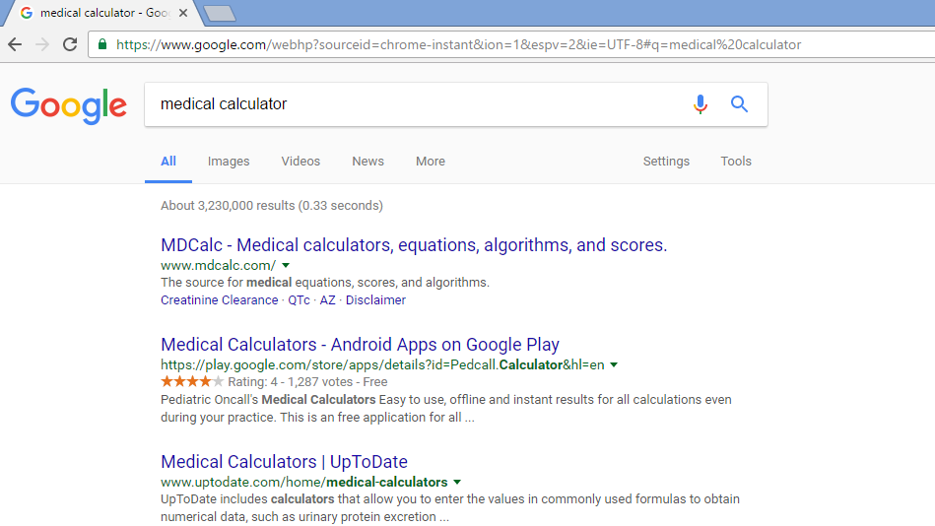

Slide 59
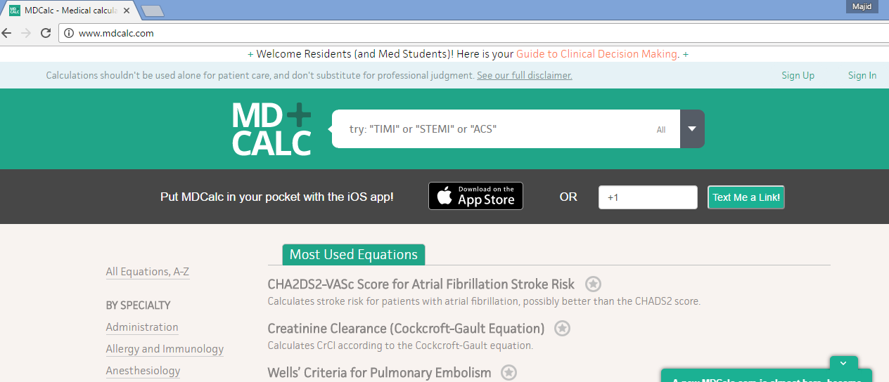

Slide 60
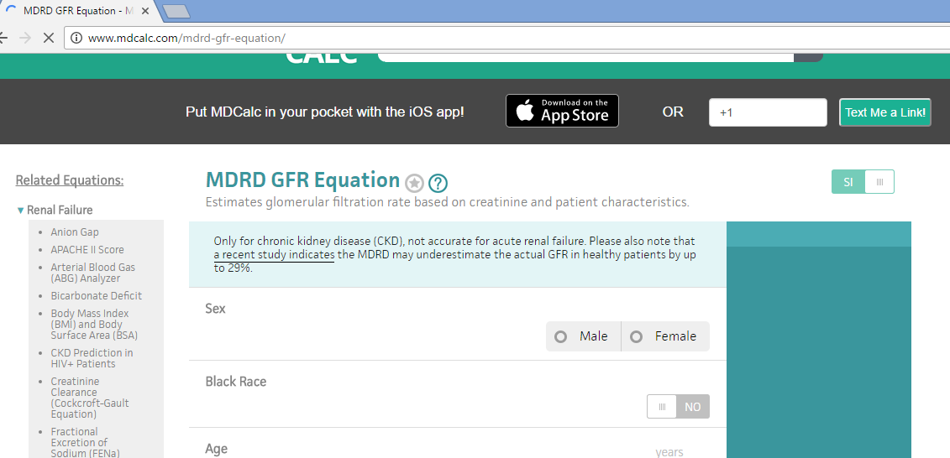

Slide 61


Slide 62
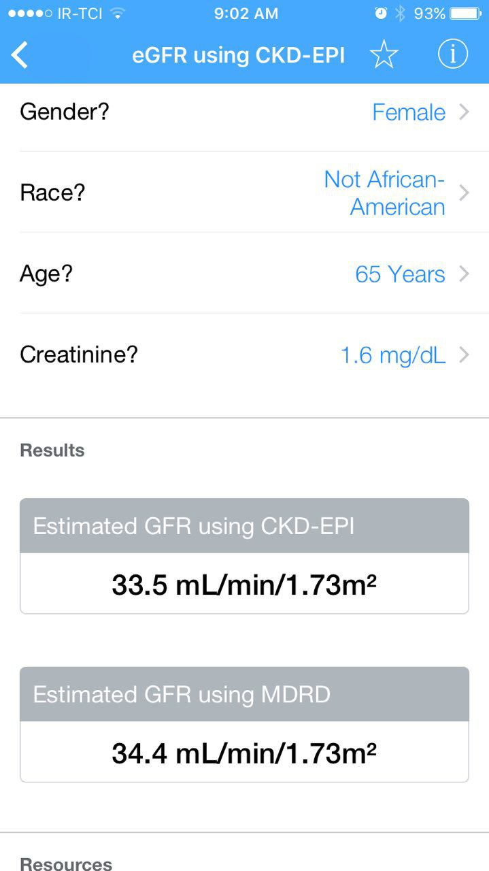

Slide 63
Metformin and CKD
Improved clinical outcomes with metformin have been reported in observational studies of patients with diabetes, heart failure and renal impairment (eGFR 45 to 60 mL/min)
The use of metformin is contraindicated in patients with an eGFR <30 mL/min
The initiation of metformin is not recommended in patients with an eGFR between 30 and 45 mL/min

Slide 64
Oral Class | Mechanism | Advantages | Disadvantages | Cost
Biguanides | Activates AMP-kinase (?other) ↓ Hepatic glucose production | Extensive experience No hypoglycemia Weight neutral ? ↓ CVD | Gastrointestinal Lactic acidosis (rare) B-12 deficiency Contraindications | Low
Sulfonylurea | Closes K_{ATP} channels ↑ Insulin secretion | Extensive experience ↓ Microvascular risk | Hypoglycemia ↑ Weight Low durability ? Blunts ischemic preconditioning | Low
Meglitinides | Closes K_{ATP} channels ↑ Insulin secretion | ↓ Postprandial glucose Dosing flexibility | Hypoglycemia ↑ Weight ? Blunts ischemic preconditioning Dosing frequency | Mod.
TZDs | PPAR-g activator ↑ Insulin sensitivity | No hypoglycemia Durability ↓ TGs (pio) ↑ HDL-C ? ↓ CVD events (pio) | ↑ Weight Edema/heart failure Bone fractures ↑ LDL-C (rosi) ? ↑ MI (rosi) | Low
Table 1. Properties of anti-hyperglycemic agents
Diabetes Care 2015;38:140-149;
Diabetologia 2015;58:429-442
Notes:
Here are some of the older oral drug classes used in T2DM. The table describes the mechanism of action of each class, its advantages, disadvantages and cost. Less commonly used classes are denoted in grey font.

Slide 65
Effects of Agents Available for T2D
Q4. How are glycemic targets achieved for T2D?
 | Met | GLP1RA | SGLT2I | DPP4I | TZD | AGI | Coles | BCR-QR | SU/ Glinide | Insulin | Pram
FPG lowering | Mod | Mild to mod* | Mod | Mild | Mod | Neutral | Mild | Neutral | SU: mod Glinide: mild | Mod to marked (basal insulin or premixed) | Mild
PPG lowering | Mild | Mod to marked | Mild | Mod | Mild | Mod | Mild | Mild | Mod | Mod to marked (short/ rapid-acting insulin or premixed) | Mod to marked
AGI = α-glucosidase inhibitors; BCR-QR = bromocriptine quick release; Coles = colesevelam; DPP4I = dipeptidyl peptidase 4 inhibitors; FPG = fasting plasma glucose; GLP1RA = glucagon-like peptide 1 receptor agonists; Met = metformin; Mod = moderate; PPG = postprandial glucose; SGLT2I = sodium-glucose cotransporter 2 inhibitors; SU = sulfonylureas; TZD = thiazolidinediones.
*Mild: albiglutide and exenatide; moderate: dulaglutide, exenatide extended release, and liraglutide.
Continued on next slide

Slide 66
ADA-EASD Position Statement Update:
Management of Hyperglycemia in T2DM, 2015
Patient-Centered Approach
“...providing care that is respectful of and responsive to individual patient preferences, needs, and values - ensuring that patient values guide all clinical decisions.”
Gauge patient’s preferred level of involvement.
Explore, where possible, therapeutic choices. Consider using decision aids.
Shared Decision Making – a collaborative process between patient and clinician, using best available evidence and taking into account the patient’s preferences and values.
Final decisions regarding lifestyle choices ultimately lie with the patient.
Diabetes Care 2012;35:1364–1379; Diabetologia 2012;55:1577–1596
Notes:
There is increasing emphasis on ‘patient-centeredness’ in chronic disease management. This has been described by the Institute of Medicine as “providing care that is respectful of and responsive to individual patient preferences, needs, and values – ensuring that patient values guide all clinical decisions.” Shared decision making (SDM) is a key component of patient-centered care. This is of particular importance in those conditions, like diabetes, that necessitate patient involvement in lifestyle changes.

Slide 68
Anti-hyperglycemic therapy in T2DM: General recommendations
Diabetes Care 2015;38:140-149; Diabetologia 2015;58:429-442
Notes:
Potential sequences of antihyperglycemic therapy for patients with type 2 diabetes are displayed, the usual transition being vertical, from top to bottom (although horizontal movement within therapy stages is also possible, depending on the circumstances). The figure denotes relative glucose lowering efficacy, risk of hypoglycemia, effect on body weight, other side effects and approximate relative cost for each drug class.
In most patients, begin with lifestyle changes; metformin monotherapy is added at, or soon after, diagnosis, unless there are contraindications.

Slide 70
Expected HbA_{1c} reduction according to intervention
Intervention | Expected ↓ in HbA_{1c} (%)
Lifestyle interventions | 1 | to | 2%
Metformin | 1 | to | 2%
Sulfonylureas | 1 | to | 2%
Insulin | 1.5 | to | 3.5%
Glinides | 1 | to | 1.5%¹
Thiazolidinediones | 0.5 | to | 1.4%
α-Glucosidase inhibitors | 0.5 | to | 0.8%
GLP-1 agonist | 0.5 | to | 1.0%
Pramlintide | 0.5 | to | 1.0%
DPP-IV inhibitors | 0.5 | to | 0.8%
Nathan DM, et al. Diabetes Care 2009;32:193-203.
Notes:
70

Slide 72
بیمار 3
آقای 60 ساله با شکایت تشنگی، پرادراری، ناکتوری (3 بار در طول شب)از 4 هفته پیش مراجعه کرده/ 2 کیلوگرم ↓ وزن
FBS: 300 mg/dl BS: 450 mg/dl Hb A1c:9%
Creatinin: 1.2 mg/dl
BP: 110/80, BMI: 25 Kg/m2
اقدام بعدی؟

Slide 73
OHA or Insulin?
  Catabolic Sign
  Severity of Symptoms
Glucose Toxicity
Monotherapy or combination (Dual ) Therapy
Which of them?

Slide 74
Metformin intolerance or
contraindication
HbA1c ≥9%
Uncontrolled hyperglycemia (catabolic features,
BG ≥300-350 mg/dl, HbA1c ≥10-12%)
Diabetes Care 2015;38:140-149; Diabetologia 2015;58:429-442
Notes:
Potential sequences of antihyperglycemic therapy for patients with type 2 diabetes are displayed, the usual transition being vertical, from top to bottom (although horizontal movement within therapy stages is also possible, depending on the circumstances). The figure denotes relative glucose lowering efficacy, risk of hypoglycemia, effect on body weight, other side effects and approximate relative cost for each drug class.
In most patients, begin with lifestyle changes; metformin monotherapy is added at, or soon after, diagnosis, unless there are contraindications.

Slide 76
Tab Metformin 500 mg BD
Tab Gliclazide 40 mg/d
Close Monitoring & patient warning
Next visit: Lab test after 1-2 Weeks

Slide 77
بیمار 4
خانم 50 ساله، سابقه 2 ساله دیابت
DH: Metformin 2000 gr/d
PE: BP: 130/80, BMI: 32 Kg/m2
FBS: 155 mg/dl
BS: 210 mg/dl
Hb A1c: 7.9%
اقدام بعدی شما چیست؟

Slide 78
Anti-hyperglycemic therapy in T2DM: General recommendations
Diabetes Care 2015;38:140-149; Diabetologia 2015;58:429-442
Notes:
Potential sequences of antihyperglycemic therapy for patients with type 2 diabetes are displayed, the usual transition being vertical, from top to bottom (although horizontal movement within therapy stages is also possible, depending on the circumstances). The figure denotes relative glucose lowering efficacy, risk of hypoglycemia, effect on body weight, other side effects and approximate relative cost for each drug class.
In most patients, begin with lifestyle changes; metformin monotherapy is added at, or soon after, diagnosis, unless there are contraindications.

Slide 79
Anti-hyperglycemic therapy in T2DM:
Avoidance of weight gain
Diabetes Care 2015;38:140-149; Diabetologia 2015;58:429-442

Slide 80
Tab Metformin 500 mg BD
Tab sitagliptin 50-100 mg/d
  SU or Meglitinides
  Glutazones
  Glp 1 Agonists

Slide 81
بیمار 5
خانم 75 ساله با سابقه دیابت از 6 سال پیش ، ظرف یکماه اخیر 6 بار افت قندخون داشته که یکبار منجر به بیهوشی وی گردیده تنها زندگی می کند
DH: Metformin 500 mg BD/ Glibenclamide 5 mg BD
BP: 130/80, W: 48 Kg/
FBS: 70 mg/dl, Hb A1c: 5.5% Creatnin: 1 mg/dl
توصیه شما چیست؟

Slide 82
Targeted Hb A1c?
eGFR: 37 ml/min

Slide 83
Effects of Agents Available for T2D
Q4. How are glycemic targets achieved for T2D?
 | Met | GLP1RA | SGLT2I | DPP4I | TZD | AGI | Coles | BCR-QR | SU/ Glinide | Insulin | Pram
NAFLD benefit | Mild | Mild | Neutral | Neutral | Mod | Neutral | Neutral | Neutral | Neutral | Neutral | Neutral
Hypo-glycemia | Neutral | Neutral | Neutral | Neutral | Neutral | Neutral | Neutral | Neutral | SU: mod to severe Glinide: mild to mod | Mod to severe* | Neutral
Weight | Slight loss | Loss | Loss | Neutral | Gain | Neutral | Neutral | Neutral | Gain | Gain | Loss
AGI = α-glucosidase inhibitors; BCR-QR = bromocriptine quick release; Coles = colesevelam; DPP4I = dipeptidyl peptidase 4 inhibitors; GLP1RA = glucagon-like peptide 1 receptor agonists; Met = metformin; Mod = moderate; NAFLD, nonalcoholic fatty liver disease; SGLT2I = sodium-glucose cotransporter 2 inhibitors; SU = sulfonylureas; TZD = thiazolidinediones.
*Especially with short/ rapid-acting or premixed.
Continued from previous slide

Slide 84
Effects of Agents Available for T2D
Q4. How are glycemic targets achieved for T2D?
 | Met | GLP1RA | SGLT2I | DPP4I | TZD | AGI | Coles | BCR-QR | SU/ Glinide | Insulin | Pram
Renal impair-ment/ GU | Contra-indicated in stage 3B, 4, 5 CKD | Exenatide contra-indicated CrCl <30 mg/mL | GU infection risk | Dose adjust-ment (except lina-gliptin) | May worsen fluid retention | Neutral | Neutral | Neutral | Increased hypo-glycemia risk | Increased risks of hypo-glycemia and fluid retention | Neutral
GI adverse effects | Mod | Mod* | Neutral | Neutral* | Neutral | Mod | Mild | Mod | Neutral | Neutral | Mod
CHF | Neutral | Neutral | Neutral | Neutral† | Mod | Neutral | Neutral | Neutral | Neutral | Neutral | Neutral
CVD | Possible benefit | Neutral | Neutral | Neutral | Neutral | Neutral | Neutral | Safe | ? | Neutral | Neutral
Bone | Neutral | Neutral | Bone loss | Neutral | Mod bone loss | Neutral | Neutral | Neutral | Neutral | Neutral | Neutral
AGI = α-glucosidase inhibitors; BCR-QR = bromocriptine quick release; Coles = colesevelam; CHF = congestive heart failure; CVD = cardiovascular disease; DPP4I = dipeptidyl peptidase 4 inhibitors; GI = gastrointestinal; GLP1RA = glucagon-like peptide 1 receptor agonists; GU = genitourinary; Met = metformin; Mod = moderate; SGLT2I = sodium-glucose cotransporter 2 inhibitors; SU = sulfonylureas; TZD = thiazolidinediones.
*Caution in labeling about pancreatitis.
†Caution: possibly increased CHF hospitalization risk seen in CV safety trial.
Continued from previous slide

Slide 85
Anti-hyperglycemic therapy in T2DM:
Avoidance of hypoglycemia
Diabetes Care 2015;38:140-149; Diabetologia 2015;58:429-442

Slide 86
بیمار 6
آقای 48 ساله با سابقه دیابت از 10 سال پیش
بدون عوارض
DH: Metformin 500 TDS, Glibenclamide 5 BD, Atorvastatin 20/d, Losar 25 BD
BP: 130/80, BMI: 34 Kg/m2
FBS: 160 mg/dl, BS: 220 , Hb A1c: 8%

Slide 87
Metformin intolerance or
contraindication
HbA1c ≥9%
Uncontrolled hyperglycemia (catabolic features,
BG ≥300-350 mg/dl, HbA1c ≥10-12%)
Diabetes Care 2015;38:140-149; Diabetologia 2015;58:429-442
Notes:
Potential sequences of antihyperglycemic therapy for patients with type 2 diabetes are displayed, the usual transition being vertical, from top to bottom (although horizontal movement within therapy stages is also possible, depending on the circumstances). The figure denotes relative glucose lowering efficacy, risk of hypoglycemia, effect on body weight, other side effects and approximate relative cost for each drug class.
In most patients, begin with lifestyle changes; metformin monotherapy is added at, or soon after, diagnosis, unless there are contraindications.

Slide 89
بیمار 7
آقای 48 ساله با سابقه دیابت از 10 سال پیش
بدون عوارض
DH: Metformin 500 TDS, Glibenclamide 5 BD, Atorvastatin 20/d, Losar 25 BD
BP: 130/80, BMI: 34 Kg/m2
FBS: 140 mg/dl, BS: 280 , Hb A1c: 8%

Slide 90
Effects of Agents Available for T2D
Q4. How are glycemic targets achieved for T2D?
 | Met | GLP1RA | SGLT2I | DPP4I | TZD | AGI | Coles | BCR-QR | SU/ Glinide | Insulin | Pram
FPG lowering | Mod | Mild to mod* | Mod | Mild | Mod | Neutral | Mild | Neutral | SU: mod Glinide: mild | Mod to marked (basal insulin or premixed) | Mild
PPG lowering | Mild | Mod to marked | Mild | Mod | Mild | Mod | Mild | Mild | Mod | Mod to marked (short/ rapid-acting insulin or premixed) | Mod to marked
AGI = α-glucosidase inhibitors; BCR-QR = bromocriptine quick release; Coles = colesevelam; DPP4I = dipeptidyl peptidase 4 inhibitors; FPG = fasting plasma glucose; GLP1RA = glucagon-like peptide 1 receptor agonists; Met = metformin; Mod = moderate; PPG = postprandial glucose; SGLT2I = sodium-glucose cotransporter 2 inhibitors; SU = sulfonylureas; TZD = thiazolidinediones.
*Mild: albiglutide and exenatide; moderate: dulaglutide, exenatide extended release, and liraglutide.
Continued on next slide

Slide 91
Metformin intolerance or
contraindication
HbA1c ≥9%
Uncontrolled hyperglycemia (catabolic features,
BG ≥300-350 mg/dl, HbA1c ≥10-12%)
Diabetes Care 2015;38:140-149; Diabetologia 2015;58:429-442
Notes:
Potential sequences of antihyperglycemic therapy for patients with type 2 diabetes are displayed, the usual transition being vertical, from top to bottom (although horizontal movement within therapy stages is also possible, depending on the circumstances). The figure denotes relative glucose lowering efficacy, risk of hypoglycemia, effect on body weight, other side effects and approximate relative cost for each drug class.
In most patients, begin with lifestyle changes; metformin monotherapy is added at, or soon after, diagnosis, unless there are contraindications.

Slide 93
Road Map
Background:
  Importance of glycemic control
  Glycemic goals
Overview of the pathogenesis of T2DM
Therapy of Type 2 Diabetes
  Oral hypoglycemic agents
Real life cases
Cases discussion according ADA/EASD consensus & AACE Guideline
Take home message

Slide 94
Take home message
Not only glucose centric (HTN, Dyslipidemia)
Management of DM patients must be individualized for each patients
Financial constrains need to be considered to avoid the pitfalls of nonadherence & poor follow up

Slide 95
Take home message
Avoid combination therapy with drugs that have Same pathophysiologic mechanism
Efficacy of the third antidiabetic agents decrease when added to dual therapy

Slide 97
از توجه شما متشکرم

Slide 98
9. Control of Glucose – ACCORD Trial
Tight versus not so tight control of glucose:
the ACCORD Trial?
ADA Diabetes Self-Study Series, Challenges in Type 2 Diabetes Mellitus Management: Self-Assessment Program
Current Status of the Treatment of Type 2 Diabetes
© 2014 American Diabetes Association
Rationale for Management of Hyperglycemia; p6

Slide 99
Control of Glucose – ACCORD Trial
The intensive glycemic control arm of ACCORD, conducted in patients with type 2 diabetes and established cardiovascular disease or multiple risk factors
  did not demonstrate a significant benefit of more intensive glycemic therapy aimed at lowering A1C to ≤6.5% or <6%
ACCORD study was stopped early
  due to an increase in mortality in the more intensively treated arm
The reasons for the lack of results in these intensive glycemic control studies is uncertain
  but seem likely related to the specific strategies for intensive glucose lowering used in the populations studied
  as well as perhaps the duration of the trials
ADA Diabetes Self-Study Series, Challenges in Type 2 Diabetes Mellitus Management: Self-Assessment Program
Current Status of the Treatment of Type 2 Diabetes
© 2014 American Diabetes Association
Rationale for Management of Hyperglycemia; p6

Slide 100
Control of Glucose – ACCORD Trial
Intensive glycemic control initiated in type 2 diabetic patients with far advanced cardiovascular disease
  is not beneficial in reducing additional cardiovascular events
Such results are not surprising as intensive glycemic control decreases the onset and progression of retinopathy, nephropathy, and neuropathy
  but has little or no beneficial effects on proliferative retinopathy, diabetic nephropathy with decreasing glomerular filtration rate
  or diabetic neuropathy after the neurons are degenerated
ADA Diabetes Self-Study Series, Challenges in Type 2 Diabetes Mellitus Management: Self-Assessment Program
Current Status of the Treatment of Type 2 Diabetes
© 2014 American Diabetes Association
Glycemic Control and Chronic Diabetes Complications; p26

Slide 101
Control of Glucose – ACCORD Trial
ACCORD subanalyses showed that individuals with no preexisting cardiovascular disease or those who at study entry had A1C ≤ 8.0%
  did have a statistically significant reduction in cardiovascular events with intensive glycemic control
Intensive glucose lowering increased the risk of cardiovascular disease and total mortality in younger participants
  whereas it had a neutral effect in older participants
The intensive to standard relative risk of severe hypoglycemia was similar in both age subgroups
  with higher absolute rates in older participants within both treatment arms
ADA Diabetes Self-Study Series, Challenges in Type 2 Diabetes Mellitus Management: Self-Assessment Program
Current Status of the Treatment of Type 2 Diabetes
© 2014 American Diabetes Association
Glycemic Control and Chronic Diabetes Complications; p26
Landmark Clinical Trials; p73

Slide 102
Control of Glucose – ACCORD Trial
In a substudy of the ACCORD study, there were no differences in cognitive outcomes between intensive and standard glycemic control
  although there was significantly less of a decrement in total brain volume by magnetic resonance imaging in participants in the intensive arm
ADA Diabetes Self-Study Series, Challenges in Type 2 Diabetes Mellitus Management: Self-Assessment Program
The Basis of Insulin Action, Initiation and Optimization of Basal Insulin, and Intensification of Insulin Therapy in Type 2 Diabetes
c 2014 American Diabetes Association
Assessment of Common Comorbid Conditions; p26

