Slide 1
Iodine during Infancy
Hengameh Abdi, MD
Endocrine Research Center
Research Institute for Endocrine Sciences
Shahid Beheshti University of Medical Sciences
8 December 2016

Slide 2
Outlines
Impact of iodine deficiency on infants
Outcomes of iodine supplementation in infants
Iodine requirement during breastfeeding
The first randomized clinical trial regarding iodine supplementation during lactation
Conclusions

Slide 3
Iodine Deficiency Disorders in Infants and Children
Infants are at high risk for iodine deficiency because their requirements per kilogram body weight for iodine and thyroid hormone are much higher than at any other time in the life cycle.
Infants may be at particularly high risk for iodine deficiency during the weaning period.
Andersson M, et al. J Clin Endocrinol Metab 2010; 95: 5217-5224.

Slide 4
Iodine Deficiency Disorders in Infants and Children
Goiter and hypothyroidism
Impaired cognitive function
Impaired psychomotor development
Attention deficit and hyperactivity disorders
Autism
Increased mortality
Cao XY, et al. N Engl J Med 1994; 331:1739–1744.
Stagnaro-Green A, et al. Thyroid 2011; 21(10): 1081-1125

Slide 5
Iodine Deficiency and Intelligence Quotient (IQ)
The brain and pituitary T3 level appears to be very sensitive to iodine deficiency as its level falls below the normal level even in mild or moderate iodine deficiency.
Several meta-analyses have concluded iodine deficient populations have 13.5, 8-10, 8.7-12.5 and 6.9-10.2 IQ points lower than iodine replete populations.
Bleichrodt N, Born PM. The Damaged Brain of Iodine Deficiency: New York, NY, USA, 1994; pp. 195–200.
Verhoef H, et al. Micronutrient Deficiencies in the First Months of Life: Basel, Switzerland, 2003; pp. 327–357.
Qian M, et al. Asia Pac. J. Clin. Nutr. 2005; 14, 32–42.
Bougma K, et al. Nutrients 2013; 5, 1384-1416.

Slide 6
Iodine Supplementation in Infants and Children
Heterogeneous and low-quality trials.
Outcome | Effect of iodine
Goiter
Physical development
Mental development, psychomotor and cognitive performance | ?
Mortality
Angermayr L, Clar C. Cochrane Database Syst Rev. 2004;(2):CD003819.

Slide 7
Iodised salt and iodine supplements for prenatal and postnatal growth
There is a gap in the evidence base with no existing, up-to-date systematic reviews on the effects of all forms of iodine supplementation/fortification in all of the relevant population groups on relevant growth and growth-related outcomes. A new systematic review examining this question will assist in addressing this gap.
A review is ongoing.
Farebrother J, et al. Nutr J 2015; Sep 2;14: 89.
Farebrother J, et al. BMJ Open 2015; 5: e007238.

Slide 8
Increased Iodine Requirement during Lactation
Infant supply of iodine:
In the first 6 months of life: exclusively from breast or formula milk.
Thereafter: from breast milk/formula and complementary foods.
Iodine content of breast milk:
Concentration of iodine in human milk: 20–50 times > plasma
Constitutional and environmental factors
Iodine concentration in human milk is approximately 200–400 μg/l in colostrum, but decreases during the next few weeks.
Azizi F, et al. Clin Endocrinol 2009; 70: 803-809.

Slide 9
Iodine Requirement during Lactation
Milk production: 0.5-1.1 l/day
In conditions of iodine sufficiency, iodine content of breast milk is 150–180 μg/l.
Median breast milk iodine in Iran:
Gorgan, 2005: 117 μg/l
Tehran, 2007: 148 μg/l
Loss of iodine into breast milk: 75-200 μg/day
Basal iodine requirement: 150 μg/day
Iodine requirement during breastfeeding: 225-350 μg/day
Azizi F, et al. Clin Endocrinol 2009; 70: 803-809.
Delange F. Int J Endocrinol Metab 2004; 2: 1-12.

Slide 10
Recommended Iodine Intake (micrograms/day)
Subjects | IOM (2001) | WHO (2005)
Pregnant women | 160 (EAR) 220 (RDA) | 250
Lactating women | 209 (EAR) 290 (RDA) | 250
Infants 6-12 months | 110 (AI) | 90
Infants 7-24 months | 130 (AI) | 90
IOM: Institute of Medicine
WHO: World Health Organization
EAR: Estimated Average Requirement
RDA: Recommended Dietary Allowance
AI: Average Intake
Azizi F, et al. Clin Endocrinol 2009; 70: 803-809.

Slide 11
The median urinary iodine concentration for classification of the iodine status of pregnant and lactating women and children
Subjects | UIC (µg/l) | Category
Pregnant women | <150 150–249 250–499 ≥ 500 | Insufficient Adequate More than adequate Excessive
Lactating women | < 100 ≥ 100 | Insufficient Adequate
Children < 2 years old | < 100 ≥ 100 | Insufficient Adequate
WHO, United Nations Children’s Fund, and ICCIDD. 3rd ed. Geneva, Switzerland: 2007.
Azizi F, et al. Clin Endocrinol 2009; 70: 803-809.

Slide 12
Iodine Supplementation during Lactation
American Thyroid Association (ATA) recommends that all pregnant and lactating women should ingest a minimum of 250 µg iodine daily. (Level A-USPSTF)
In North America: 150 µg as iodine supplement (potassium iodide). (Level B-USPSTF)
The addition of 150 µg of potassium iodide does not pose a risk, even for women who are iodine replete.
No trials to date have specifically examined the effects of iodine supplementation in lactation.
Stagnaro-Green A, et al. Thyroid 2011; 21(10): 1081-1125
.

Slide 13
The First RCT during Lactation
The effects of two types of iodine supplementation on iodine nutrition status of lactating mothers and breast-fed infants and comparing to formula-fed infants: from birth to one year.
Nazeri P, et al. PhD by Research Thesis 2016: Unpublished.
.

Slide 14
Nazeri P, et al. PhD by Research Thesis 2016: Unpublished.
.

Slide 15
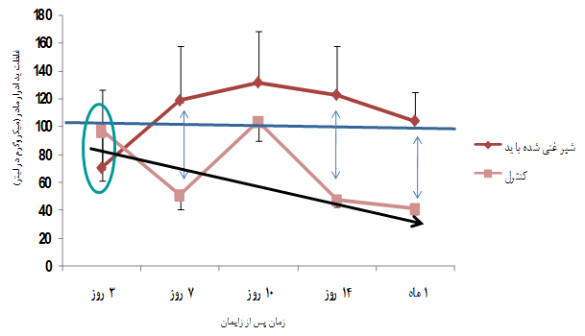
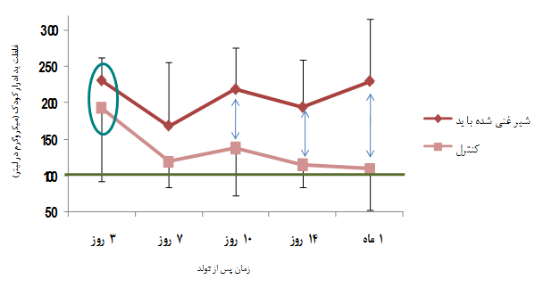
Nazeri P, et al. PhD by Research Thesis 2016: Unpublished.
.

Slide 16
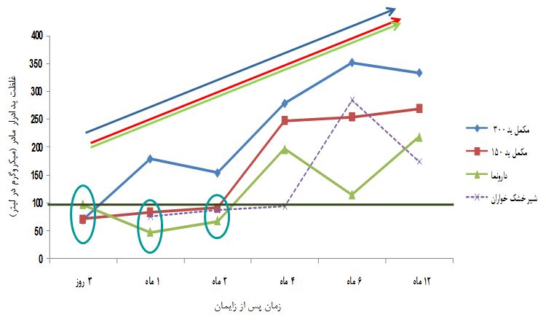
Nazeri P, et al. PhD by Research Thesis 2016: Unpublished.
.

Slide 17
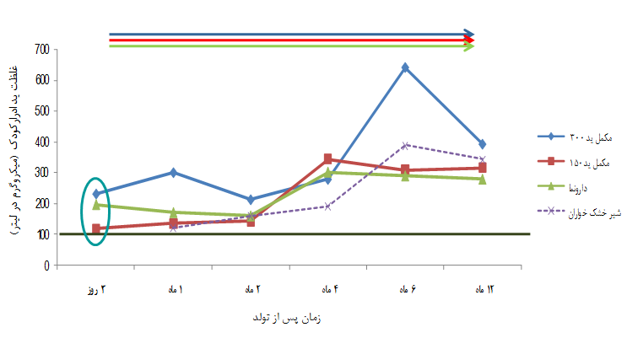
Nazeri P, et al. PhD by Research Thesis 2016: Unpublished.
.

Slide 18
Conclusions
Iodine deficiency during infancy is associated with significant adverse outcomes especially regarding neurodevelopment.
Studies considering iodine supplementation during infancy are limited and poor-designed.
Limited trials have specifically examined the effects of maternal iodine supplementation in lactation.
Presently, many medical societies recommend ingestion of minimum of 250 μg iodine daily during pre-conception, pregnancy and breastfeeding.

Slide 19
Thanks for your attention!

