Slide 1
In the Name of God
Case Presentation
By:A.Saffarian.MD
B.Rezvankhah.MD

Slide 2
ID: A 34 y-o ♀,elementary school education, married,living in Kashmar
CC: Dizziness & Fatigue & Hypoglycemia

Slide 3
A young woman known case of diabetes mellitus (under treatment with insulin) for 10 month ago, was admitted in emergency department with complaint of dizziness while changing position and hypoglycemic episodes for two month.
Hypoglycemia often happens postprandially (20 minutes after meals); she also complains about early satiety but not other concomitant symptoms like nausea ,vomiting or abdominal pain or diarrhea. She has been suffering significant weight loss (over 15 kg) since the diagnosis of DM.

Slide 4
She has had several medical visits for these problems and it has been found to have low blood pressure(SBP~ 60-70 mmHg) and low BS level(BS50-60 mg/dl)
Moreover She has a Hx of amenorrhea since 95/7 with no complaint about hot flashes, vaginal dryness, joint pain…. It had been prescribed to inject 2 MPA for this problem one month earlier but there was no response to injection.

Slide 5
PMH:
DM was diagnosed in 95/5 with the first presentation as DKA & comatose state following pneumonia that resulted in ICU admission for 5 days. She also had hair loss (alopecia totalis) and onycholysis in concurrent with diagnosis of DM.
She had a Hx of Graves disease in her 2nd pregnancy which was treated by Iodine ablation 8 months after delivery and ended in Hypothyroidism.

Slide 6
DH:
Insulin lantus 30 u sc QHS
Insulin apidra (6 u morning. 6 u afternoon. 6 u evening)
Levothyroxin (550 µg/week)
FH: Mother: DM & Hypothyroidism
Her father passed away because of MI
Her parents are not relatives
Social Hx: she has elementary school education & has 3 children.
She has 2 brothers & two sisters that all are married and have children.

Slide 7
ROS:
13 kg weight loss in 5 month
Headache (-), diplopia (-),
hot flashes (-), vaginal dryness (-), vaginal discharge (-)
decreased libido, decreased size of breasts
Arthralgia (-), mucosal trash (-),

Slide 8
PH/E: A young woman who seems ill but has no distress, she was alopecic, there was no evidence of hyperpigmentation in sun exposured skin or vitiligo
Weight: 47 kg BMI: 19
BP: Supine:90/70 Upright:75/60 PR:80 T:37
H&N: alopecia totalis,mild conjunctivitis & proptosis,periorbital edema
Anisocoria due to injury in chilhood
Increased wrinkling, Poor dental hygiene ,no buccal hyperpigmentation.
Thyroid has Nl size & consistency

Slide 9
Chest: normal chest expansion. Normal breath and heart sounds.
Abdomen: c/s scar with no pigmentation.
No hepatosplenomegaly.
Extremities: nail pitting in hand digits and onycholysis in foot digits, shin spot
Vibration sensation -> intact
Pressure sensation -> intact

Slide 10
3/3 | WBC
3/6 | RBC
11 | Hb
86 | MCV
256000 | Plt
13 | BUN
0/6 | Cr
134 | Na
4/3 | K
16 | AST
31 | ALT
248 | ALKP
8.4 | Ca
4.6 | Ph
45 | Fe
230 | TIBC
200 | Ferritin
8/1 miu/ml | TSH
21 mcg/dl | T4
1/4 miu/ml | FSH
0/4 miu/ml | LH
120 miu/ml | Prolactin
27 pg/ml | PTH
7.4 | HbA1C

Slide 11
Peripheral blood smear:
Macrositosis
Polychromasia
Platelet aggregation

Slide 12
According to hypotension & hypoglycemia episodes & accompanying two other autoimmune diseases prednisolone(5 mg/d) & Fludrocortisone (0.1 mg/d) started.

Slide 13
Before Prednisolone prescription:
Cortisol 8 am: 6 mcg/dl
ACTH: 15.1 pg/ml
Cosyntropin Stimulation Test (Under usage of PRN (5 mg/d) for 3 days):
Cortisol 30 min: 10.4 mcg/dl
Cortisol 1 h: 14.3 mcg/dl

Slide 14
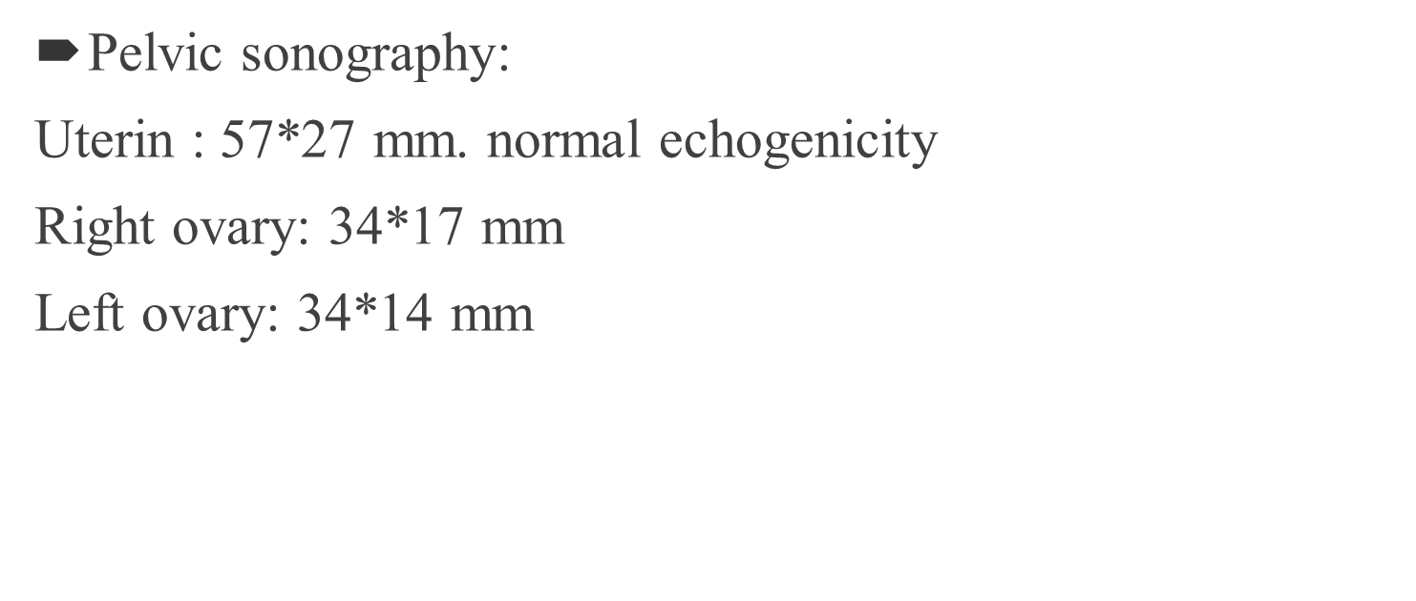
Upper GI Endoscopy:
Esophagus: was full of secretion
Stomach: was full of food, some erosion seen in antrum.
Duodenum: bulb and D2 were normal.

Slide 15
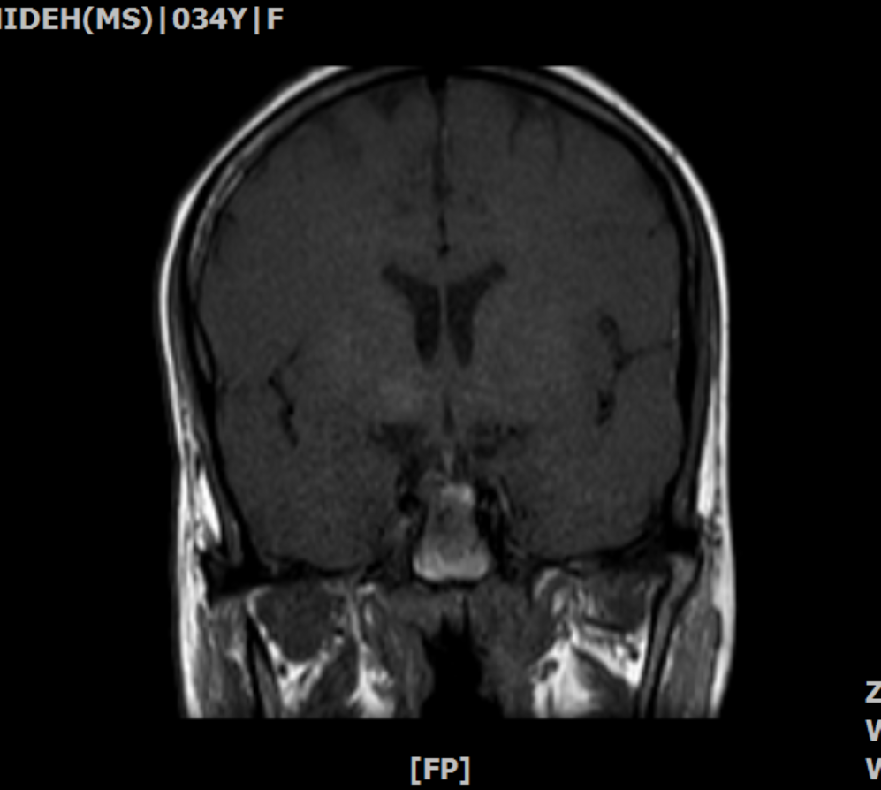

Slide 16
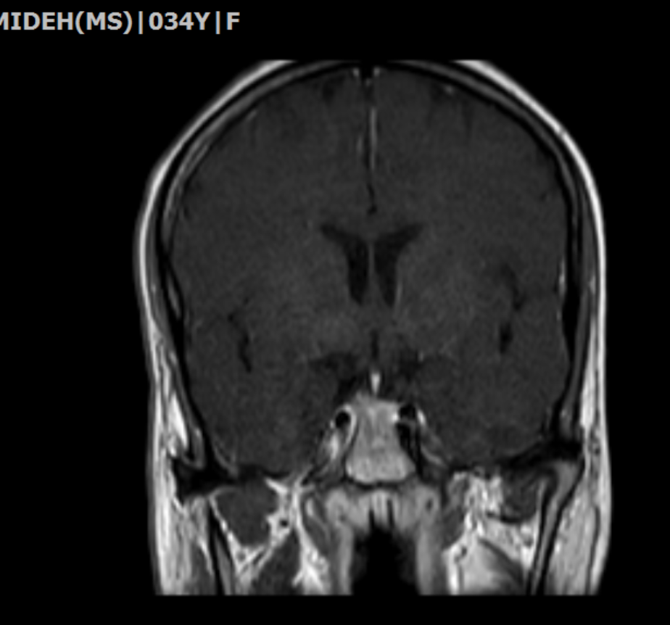

Slide 20
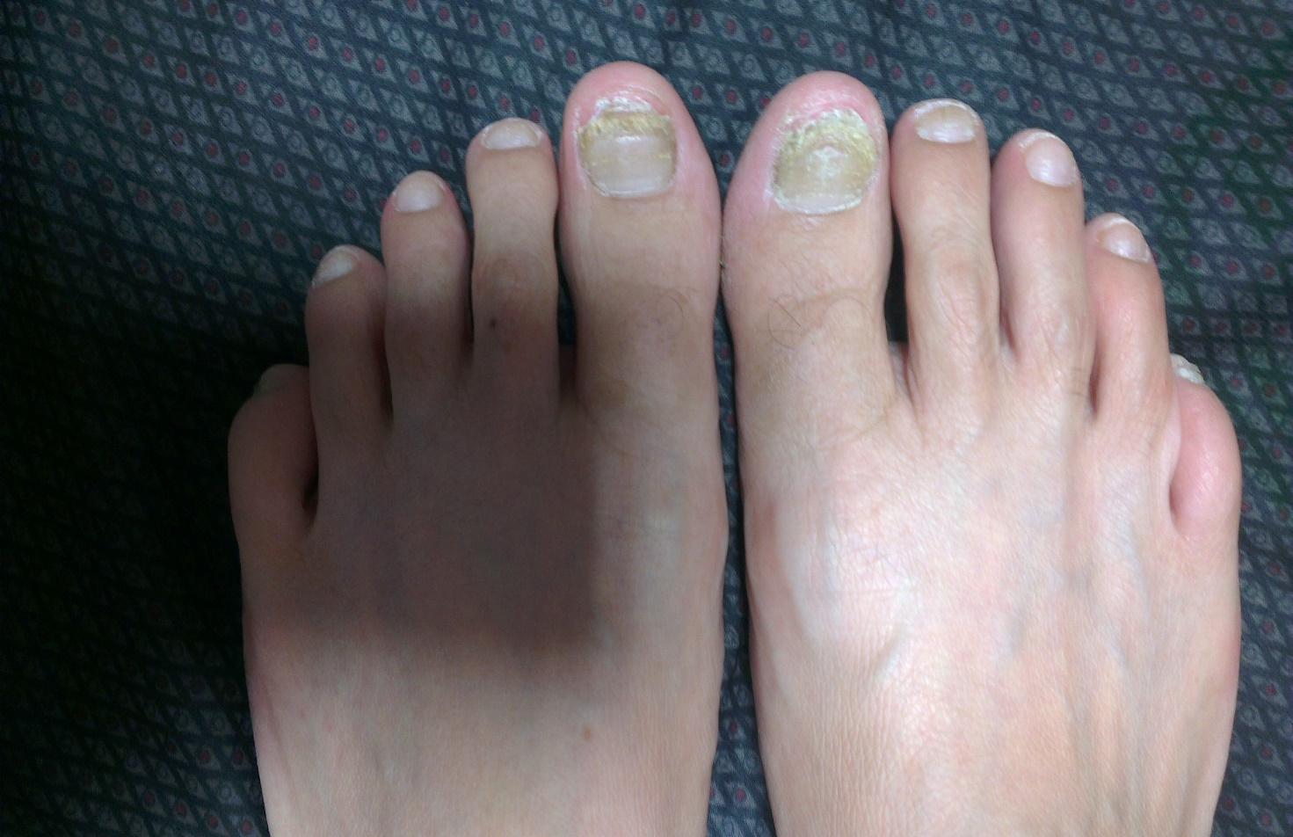

Slide 22
Problem List:
Graves disease diagnosed 15 years ago and hypothyroidism following treatment,
DM with first presentation of DKA since 95/5,
Hair loss & nails deformities since 95/5,
Amenorrhea since 95/7,
Hypotension & hypoglycemia for 2 month.

