Slide 2
A 63-year-old female with History of osteoporosis & renal stone
Elevated PTH & High normal calcium
S.H.R Ghafelehbashi M.D
Shahid Beheshti medical university
23 October 2017

Slide 3
Present illness
A 63-year-old female, married, retired insurance agent. She is a known case of osteoporosis and renal stone from 12 years ago, and mild asthma from 5 years ago, visited by endocrinologist due to aortic valve and coronary calcification that detected on cardiac assessment.
Diagnosis of low bone density was made by the rheumatologist based on a BMD that was done at the age of 49 ( two years after menopause ). The BMD was performed at the request of the patient due to a positive family history of osteoporosis (her mother).
The patient was under different medical treatment (such as Bisphosphonates, raloxifene, strontium ranelate).

Slide 4
Present illness
Patient’s BMD (T-Score)
Age | Femoral Neck | Lumbar | Radius | Densitometer
49 | -1.93 | -2.45 | -
51 | -2.3 (0.601 gr/cm²) | -3.7 (0.683 gr/cm²) | - | Hologic
52 | -2 | -3.11 | -
55 | -2.3 | -3.6 | -
59 | -2.8 (0.545 gr/cm²) | -3.5 (0.714 gr/cm²) | -
62 | -3.2 (0.495 gr/cm²) | -3.6 (0.648 gr/cm²) | -3.9 ( R ) -2.7 ( L ) | Hologic
63 | -2.9 (0.542 gr/cm²) | -3.4 (0.725 gr/cm²) | -2.5 ( L ) (0.428 gr/cm²) | Hologic

Slide 5
Present illness
At the request of the patient (1395/2/11 ), cardiovascular assessment was done by CT-Angiography (coronary) & Echocardiography & Carotid Doppler study
Echocardiography
LVEF :70 % ;Thickened Aortic valve & Mild AI (Calcific) ;other finding :NL
Carotid Doppler
Normal
CT-Angiography
Normal coronary arteries
Calcium Scoring (Agateston): 176 ( Moderate Risk )
LAD: multiple calcified plaques at the proximal third without significance

Slide 6
Present illness
Patient insisted on being visited by an endocrinologist; happened 16 months ago (95/3)
Lab test
Neck sonography
Parathyroid scan

Slide 7
Present illness
Normal lab findings
----------------------------------
FBS, Hb A1c
CBC ( Eosinophil 11 % ), ESR
Cr (0.8 mg/dl)
Na ; K; P; Alkp; Vit D (>20 ng/ml);
Albumin
LFT
TFT
HDL
Serum Vit B12
Homocysteine
LP (a)
Abnormal lab findings
-------------------------------
LDL ( 181,165,158,177 mg/dl);
Uric Acid (5.8 mg /dl [5.7]) ;
TG(215 mg/dl)
Urine collection 24 h ( 1396/7/27)
----------------------------------------------
Vol : 1800 cc
Cr : 756 mg
Ca :158mg (50 -300 mg)
Uric acid , Citrate : Normal
Oxalate : 15 mg (4-31)
FE Ca = 0.017
eGFR ≈ 65 ml/min

Slide 8
Date | Lab. Name | Ca (mg/dl) | PTH (pg/ml)
1395/2/13 | پارس | 9.5 | 75 [68.3]
1395/3/17 | پارس | 10.3 [10.2] | 76
1395/4/6 | قائم مقام | 9.7 [10.5] | 105 [65]
1395/8/3 | چیذر | 9.8 | 117 [65]
1395/8/26 | مرکزی پاتوبیولوژی | 10.1 [10.2] | 25.7 [36.8]
1395/9/7 | چیذر | 9.6 | 80
1395/9/30 | چیذر | 9.7 | 83
1395/10/30 | چیذر | 10.2 [10.5 ] | 113
1395/11/21 | چیذر | 9.9 | 89
1396/1/22 | پارس | 9.7 | 90
1396/3/8 | چیذر | 10.4 [10.5] | 168
1396/3/18 | نیکان | 7.6 | 72.6 [65] iPTH
1396/3/20 | چیذر | 9.5 [10.5 ] | 89
1396/4/1 | چیذر | 9.7 | 112
1396/5/11 | چیذر | 9.8 | 109
1396/7/27 | پارس | 10.1 [10.2] | 93.2

Slide 9
Present illness
Neck Sonography (1395/4/13)
-----------------------------------------------------------------------------------------------------------------------------------
R & L Lobes :Normal size ; Normal echo
Doppler Study :Normal
No LAP
No Parathyroid Adenoma
Nodule in left thyroid lobe (13 mm ; Isoecho; With Halo ; Without Micro calcification )
↓
FNA ( Sonography Guided )
↓
Benign (consistent with benign nodular hyperplasia)

Slide 10
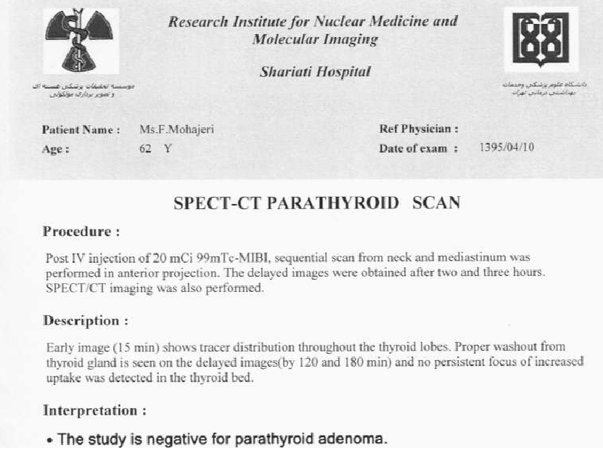
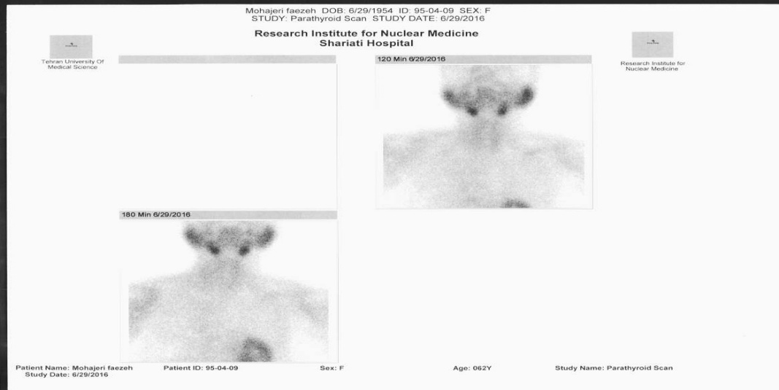
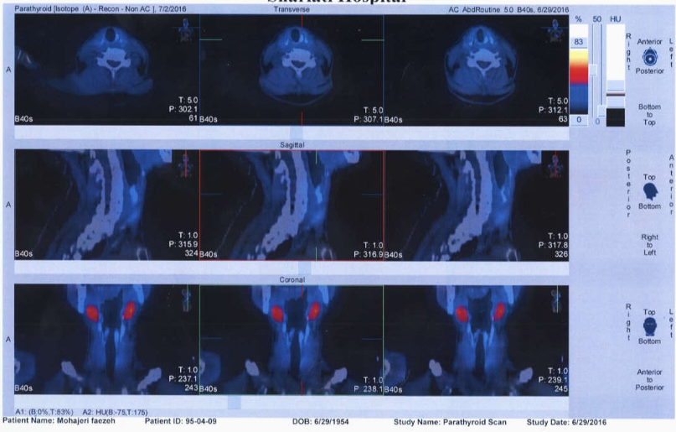
Present illness
SPECT / CT Parathyroid ( ^{99m}TC sestamibi ) Scan (1395/4/10 )
The study is negative for parathyroid adenoma

Slide 11
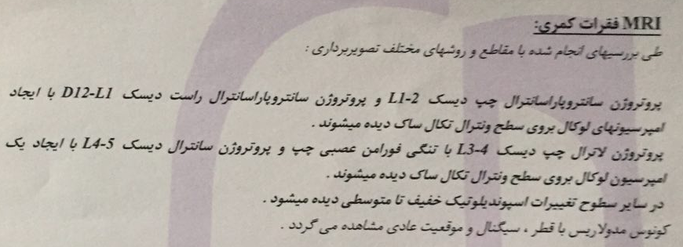
Present illness
Surgery Recommended by the Endocrinologist (Refused by patient) .
Alendronate 70 mg/week was continued(not used by the patient)
(95/11)
The patient complaint from LBP at night with radiation to both lower limb and in Lumbosacral MRI : Disk protrusion L1-L2 & T12-L1 & L3-L4 & L4-L5

Slide 12
Present illness
Recent medical treatments
------------------------------------
Bisphosphonate discontinued from ≈ 2 years ago
Vit D 50,000 monthly (8 months)
Prolia (denosumab 60 mg) (1396/3) one injection
Cinacalcet 30 mg ( 5 days from 1396/3/12) → Carpopedal spasm, Ca =7.6 mg/dL, Mg =1.5 mg/dL, P = 4.9 mg/dL
treatment with IV Calcium
She had a normal and active daily life without any complaint.

Slide 13
Past medical history
Growth & Development :Normal
Hospitalization / Surgery :NVD; Bunion(55-year-old)
Bone Fx :Foot Fx at the age of 18
Menopause : 47 years
Osteoporosis : From 12 years ago
Renal Stone : 50-year-old(stone pass through spontaneously) ;55 year old (Ureter stone 1 cm → ESWL); some small renal stone(<4mm)
Asthma : 5 years ago ;SYMBICORT 160 (Irregular use)
Discopathy : 8 months ago ; No medical treatment
Hyperlipidemia : No medical treatment
Negative History For : DM ;HTN; PUD ; IHD ;Menstrual Disorders ; Pancreatitis ; Gout ; Pseudo Gout ; Anemia ; Articular disease ; Ocular Problems ,…
Habits: Negative (Smoking ,Alcohol ,Opium )

Slide 14
Drug history
SYMBICORT (budesonide and formoterol) : 160 (5 years ago; irregular use)
Actonel (risedronate) Dosage ? ≈1-2 years
EVISTA (raloxifene ) 60 mg ≈2 years
Fosamax (Alendronate) 70 mg/week (2 episode ; D/C 2 years)
Protos (Strontium ranelate) ? ≈1 years
Vit D3 : 50,000 / Monthly (8 months)
Prolia (denosumab 60 mg) (1396/3)
Cinacalcet 30 mg /day (5 days )
Negative history for : Diuretic , Lithium, PPI, Statin

Slide 15
Family history
Father : IHD, PAD , No Renal stone, Osteoporosis ?
Mother : 83 y/o ; Osteoporosis ; Normal PTH , Renal stone , HLP
Sisters:
1 ) 65 y/o; Osteoporosis ; Renal stone; PTH : 73 pg/mL ; Ca : 9.5 mg/dl ; HLP
2 ) 58 y/o; Osteoporosis ; Renal stone; Ca, P , Alkp :NL ; PTH ?
3 ) 51 y/o; Osteoporosis ; Renal stone; Ca :8.5 mg/dl, PTH : 85 pg/ml , Vit D : 3 ng/ml ; HLP
Daughter ) 14 y/o female : Ca : 10 mg/dl , PTH :71 pg/ml, Vit D : 8 ng/ml
Offspring : : No lab data available
Second degree : Osteoporosis, Renal stone

Slide 16
Review of systems
Negative : Weakness , Fatigue , Constipation , Anorexia , Nausea , Vomiting , Memory loss , Abdominal Pain , Polydipsia , Polyuria ,Myalgia , Depression , Paresthesia , Bone pain , Weight Loss , Jaw pain ,Chest pain, Dyspnea, Hematuria
Physical Exam
Weight : 55 kg ; Height :1.58 cm ; BMI :22 kg/m² ;BP (R/L):120/80 , 110/80 ; HR = 78 /min (Regular) ;
General appearance : Normal (oriented & cooperative); Normal mental status
Skin & nail :Normal
Head & Neck : Jaw tenderness -;LAP - ; one nodule in left lobe of thyroid (1 cm) ; JVP :Normal; Cyanosis -;
Neurologic :DTR (2+ symmetric) , Cranial nerves :Normal
Thorax :Bone Tenderness - ;Heart & Lung Auscultation : Discrete expiratory wheeze; Cardiac murmur :-
Abdomen :Normal (No Distention, Mass, Tenderness,…)
Extremity & Joints : Force (Prox. & Distal ): 5/5 ; Pulse :Full & Symmetric; Bone Tenderness - ;Sensory : Normal
; clubbing -;
Gait : Normal

Slide 17
Problem list
Osteoporosis
Renal Stone ( Recurrent )
Thyroid Nodule
Hyperlipidemia
Elevated PTH with High normal Ca
Family history (First and second degree) of osteoporosis & renal stone

Slide 18
Questions
-----------------
The patient’s diagnosis ?
The appropriate treatment ? (Based on Dx )
Familial disease ? After R/O secondary causes of HPT in the patient’s family

Slide 19
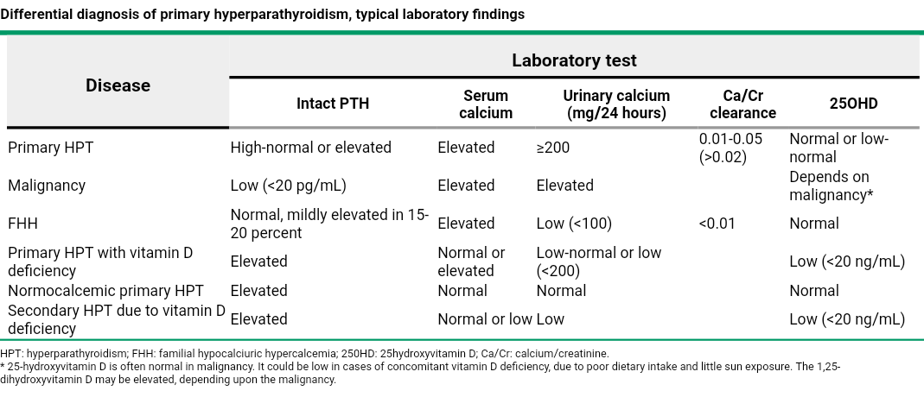

Slide 20
Primary Hyperparathyroidism (PHPT)
Normocalcemic Primary Hyperparathyroidism(NCPHPT)
NCPHPT :
Patients with
elevated PTH and
consistently normal serum calcium levels,
in whom secondary causes of hyperparathyroidism have been excluded.
The Journal of Clinical Endocrinology & Metabolism 92(8):3001-3005,May 2007

Slide 21
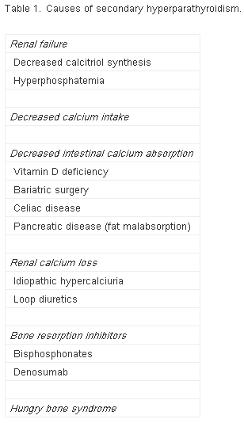

Slide 22
consistently normal serum calcium ?
Date | Lab. Name | Ca (mg/dl) | PTH (pg/ml)
1395/2/13 | پارس | 9.5 | 75 [68.3]
1395/3/17 | پارس | 10.3 [10.2] | 76
1395/4/6 | قائم مقام | 9.7 | 105
1395/8/3 | چیذر | 9.8 | 117 [65]
1395/8/26 | مرکزی پاتوبیولوژی | 10.1 [10.2] | 25.7 [36.8]
1395/9/7 | چیذر | 9.6 | 80
1395/9/30 | چیذر | 9.7 | 83
1395/10/30 | چیذر | 10.2 [10.5 ] | 113
1395/11/21 | چیذر | 9.9 | 89
1396/1/22 | پارس | 9.7 | 90
1396/3/8 | چیذر | 10.4 [10.5] | 168
1396/3/18 | نیکان | 7.6 | 72.6 [65] iPTH
1396/3/20 | چیذر | 9.5 [10.5 ] | 89
1396/4/1 | چیذر | 9.7 | 112
1396/5/11 | چیذر | 9.8 | 109
1396/7/27 | پارس | 10.1 [10.2] | 93.2

Slide 23
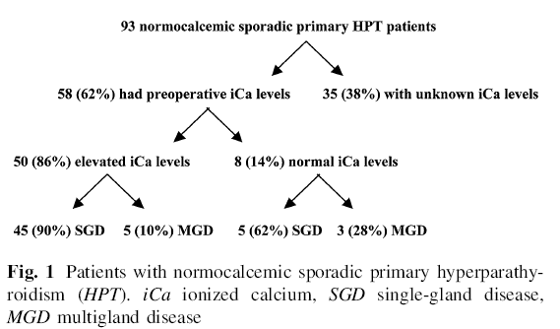
Role of Ionized calcium
World journal of surgery; 2012
A total of 771 patients with sporadic PHPT underwent
parathyroidectomy during 9-year(1999 – 2008) period. Among them, 93 (12%) had serum calcium levels that were within the normal range during the 3 months prior to surgery.
Conclusion: Most patients with apparent Normocalcemic PHPT have elevated ionized calcium levels.

Slide 24
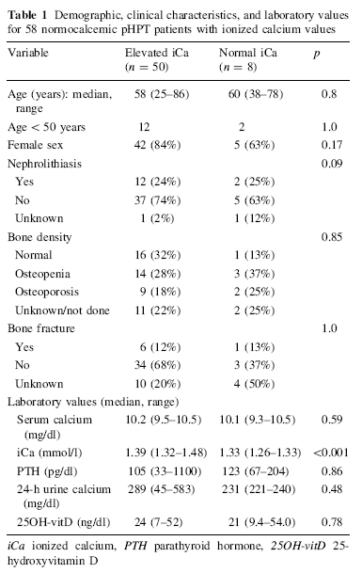
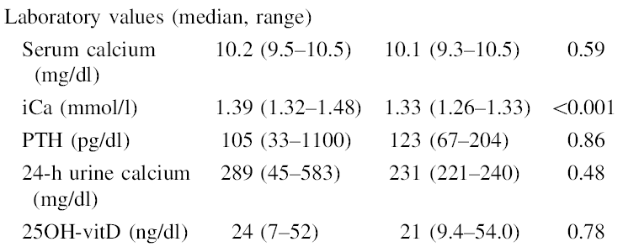

Slide 25
Natural history / Disease characteristics
ENDOCRINE PRACTICE Vol 22 No. 3 March 2016
Hypothesis
NCPHPT may be the initial form of hypercalcemic hyperparathyroidism (HCPHPT) in some cases.
Methods
Patients were referred to the tertiary endocrine center primarily for suspected endocrine disorder, decrease in bone mineral density, and hypercalcemia from January 1, 2008 to December 31, 2013, but the patients were observed until the end of 2014.
During the 6 years of follow-up, 15,343 new patients were examined at the outpatient clinic in total, and serum PTH levels were assessed in 1,180 patients (Based on a questionnaire which focused on possible suspicion of PHPT ). Pathologically elevated serum PTH levels were found in 307 cases.

Slide 26
15,343 new patients referred to tertiary endocrine center 2008 – 2013 (6 years) ,2014
Questionnaire
suspicion of PHPT
PTH levels were assessed in 1,180 patients
PTH > (66.95 pg/mL)
Elevated serum PTH levels were found in 307 cases
Exclude : Secondary HPT & PPI, THZ, Lithium
218 patients (187 Normocalcemic, 31 Hypercalcemic)
151( 81 %) Persistent Normocalcemic, 36 ( 19 % ) changed into hypercalcemic
Serum total calcium > 10.4 mg/dL OR Serum ionized calcium > 5.28 mg/dL
The subjective patient complaints, biochemical results, imaging, and treatment outcomes were analyzed separately for both groups.

Slide 27
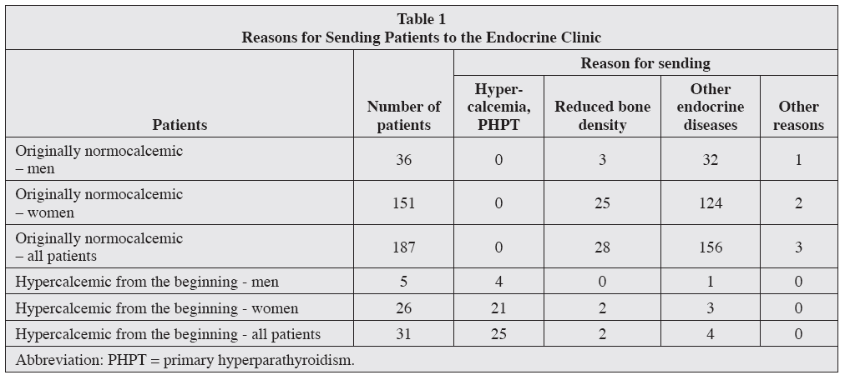

Slide 28
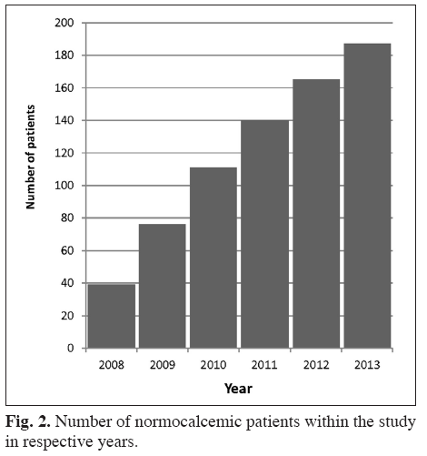
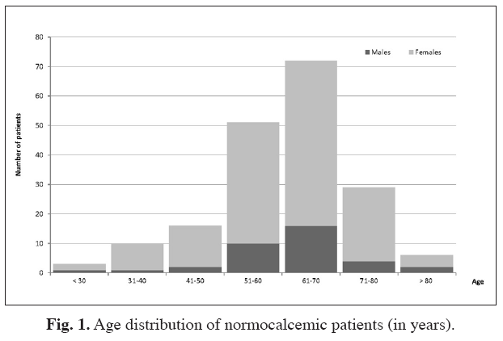

Slide 29
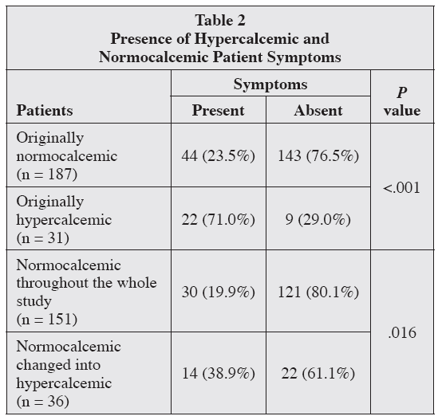
Patients’ Health Complaints
Symptoms
bone diseases (osteoporosis, history of bone fractures, arthralgia),
renal diseases (nephrolithiasis, nephrocalcinosis, renal insufficiency)
gastrointestinal symptoms (abdominal pain, gastric hyperacidity, nausea, vomiting, constipation)
neuromuscular disorders (fatigue, weakness, myalgia, paresthesias),
emotional and cognitive problems (anxiety, depression, mood and sleep disturbances, memory loss),
Hypertension
cardiovascular diseases
The most common problems of normocalcemic patients included fatigue (14%), indigestion (6%), mood disorders (6%), and musculoskeletal pain (2% of normocalcemic patients).

Slide 30
Serum PTH Levels
Differences in serum PTH levels in normocalcemic patients who remained permanently normocalcemic and those who became hypercalcemic during the observation were not statistically significant.
Transition from Normocalcemic to Hypercalcemic
Normocalcemic → Normocalcemic : Mean baseline calcium (9.52 mg/dL)
(P<.01)
Normocalcemic → Hypercalcemic : Mean baseline calcium (9.84 mg/dL).
-----------------------------------------------------------------------------------------------------------------------------------
In 36 patients who Normocalcemic → Hypercalcemic
24 (67%) became hypercalcemic within 2 years
10 (28%) became hypercalcemic within 2 to 4 years
2 (5%) after more than 4 years
-----------------------------------------------------------------------------------------------------------------------------------
Without treatment, none of the hypercalcemic patients reverted to normocalcemic during the follow-up period.
Our case
9.9 mg/dl [10.2]
9.84 mg/dl [10.5]

Slide 31
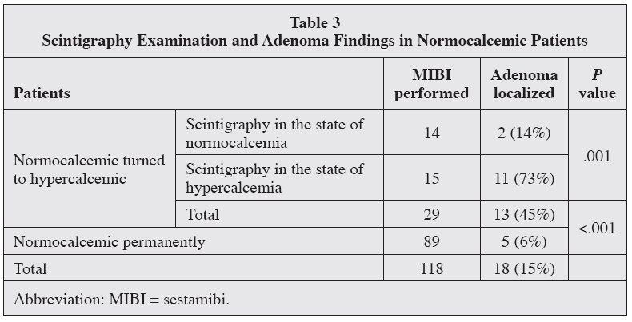
Imaging
Scintigraphy was performed in all 31 patients hypercalcemic at the onset, and adenoma was found in 21 (68%).

Slide 32
Comorbidities
Of the 187 originally Normocalcemic PHPT patients, another endocrine disease was present in 142 (76%).
Thyroid diseases were the most common (mainly nodular goiter and primary hypothyroidism).
Pituitary disorders were frequent as well.
Diabetes mellitus was diagnosed in 24 of 187 (13%) patients.
Reduced bone density was detected in 79 of 187 (42%)
Arterial hypertension in 88 of 187 (47%)
Ischemic heart disease in 75 of 187 (40%)
History of nephrolithiasis in 8 of 187 (4%) patients.
HLP ?

Slide 33
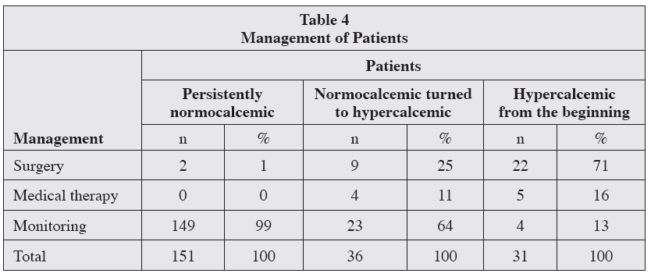
Therapy
Persistently normocalcemic patients were only monitored,and surgery was generally not recommended.
Exception in 5 NCPHPT patients. These patients had nodular goiter in addition to NCPHPT, and they were indicated for thyroidectomy. Adenoma was detected using MIBI, and their serum PTH values exceeded (103.7 pg/mL). After detailed explanation given to the patients and considering the situation, the surgeon tried to perform parathyroidectomy during thyroidectomy. The effort to localize and remove the adenoma was successfulin 2 patients; adenoma was histologically confirmed in both of the cases. More than 5 years after the surgery, serum PTH and serum calcium levels
are now normal in both patients, and neither of them report any complaints.

Slide 34
Therapy
Long-term medical treatment was given to 4 of the originally normocalcemic patients who became hypercalcemic:
cinacalcet was applied in 1 patient and
bisphosphonates in 3 patients, with the finding of significantly reduced bone density.
After 1 year of the treatment,the serum calcium level was found to be normal in all these patients. However, serum PTH did not normalize in any of them.

Slide 35
Indication for surgical treatment of NCPHPT patients
Patient is to undergo thyroidectomy
If patients suffer from diseases that could be regarded as a complication of PHPT (nephrolithiasis or osteoporosis)
If patients report complaints that are nonspecific but frequently occur in PHPT patients.
The decision on surgical treatment of a NCPHPT patient will also be positively influenced by
repeated finding of serum calcium levels near the upper limit of normal
Proven adenoma
Age under 50 years
Patient’s active interest in surgical treatment
A high probability that surgery will be carried out by an experienced surgeon.

Slide 36
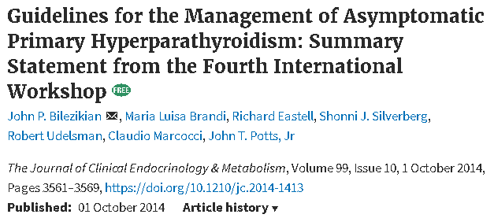
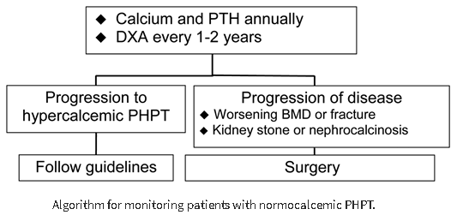

Slide 37
CONCLUSION
NCPHPT
NCPHPT Hypercalcemic( in 4 years; mostly within 2 years)
80% 20%
NCPHPT is not a negligible disease. In comparison with the normal population, NCPHPT patients are more frequently affected by nephrolithiasis, osteoporosis, arterial hypertension, and diabetes.
NCPHPT should be monitored long term, and in some cases of normocalcemia, surgical treatment may also be beneficial.

Slide 38
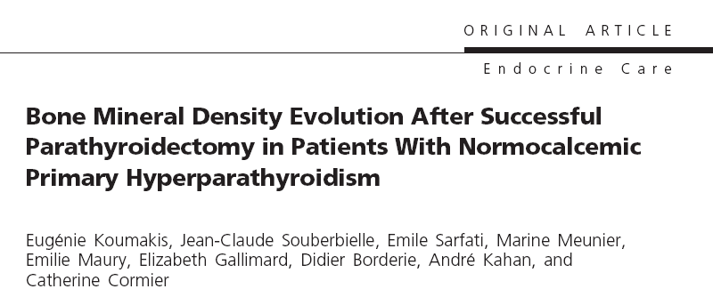
J Clin Endocrinol Metab, August 2013, 98(8):3213–3220
Design: longitudinal cohort study.
Patients: We included 60 PHPT patients (mean age 64.0 10.1 years), successfully treated by PTX
by the same surgeon. Two groups were individualized according to baseline serum total (albumin
corrected) calcium: 39 patients with normal baseline serum total calcium (normocalcemic group)
and 21 patients with hypercalcemia at baseline (hypercalcemic group).
Main Outcome Measure: BMD changes 1 year after PTX were measured.

Slide 39
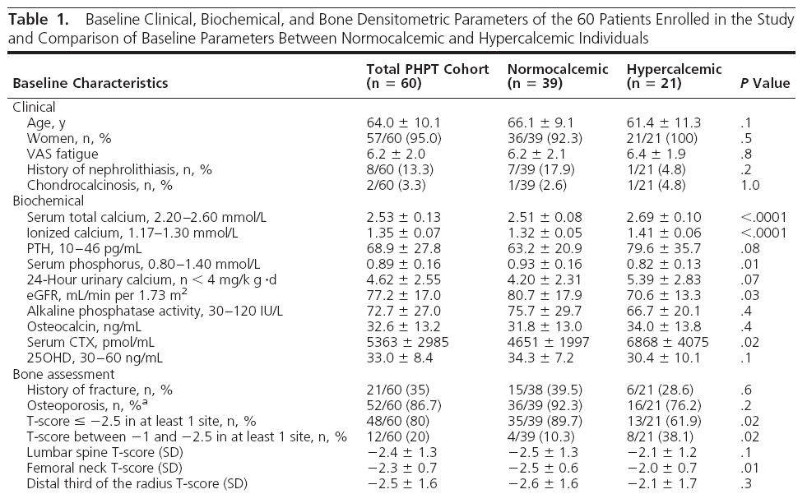

Slide 40
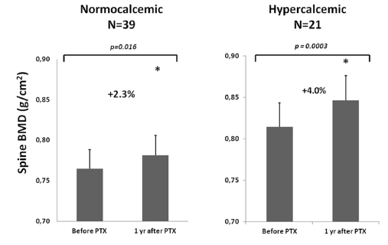
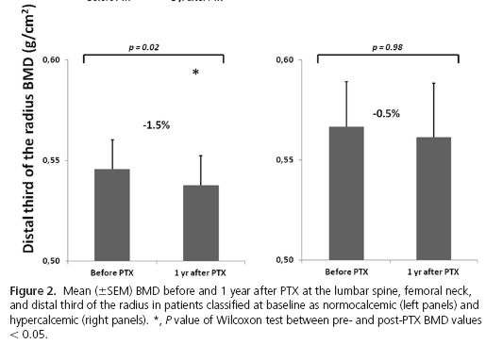
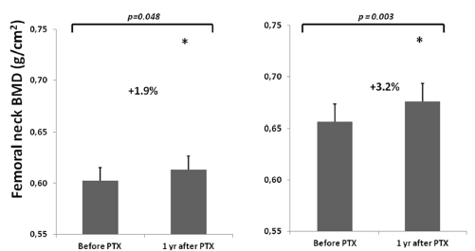

Slide 41
Conclusion
our results indicate for the first time that successful PTX in NCPHPT with osteoporosis at presentation is followed by mild but significant BMD improvement at the spine and hip at 1 year, comparable with that observed in hypercalcemic PHPT, suggesting that PTX may also be beneficial in NCPHPT.

Slide 42
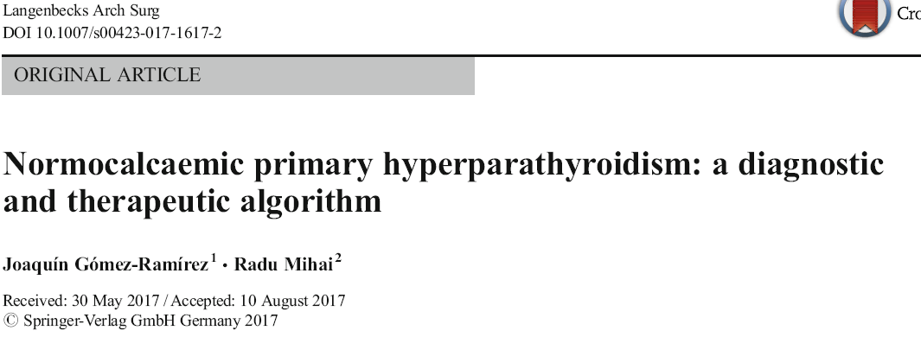
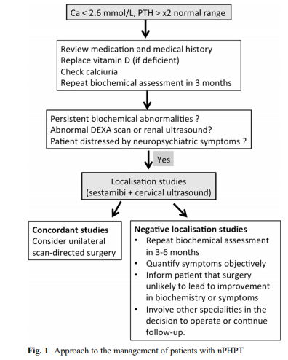
Ca <10.4 mg/dl

Slide 43
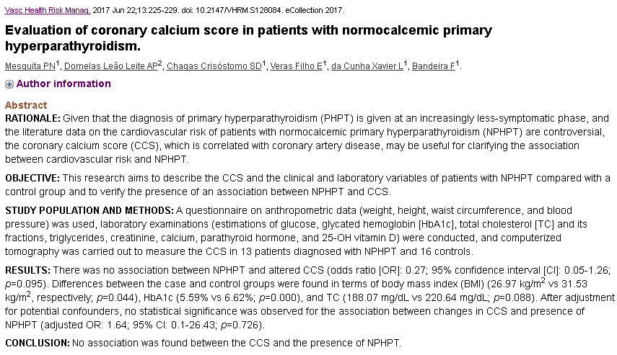

Slide 44
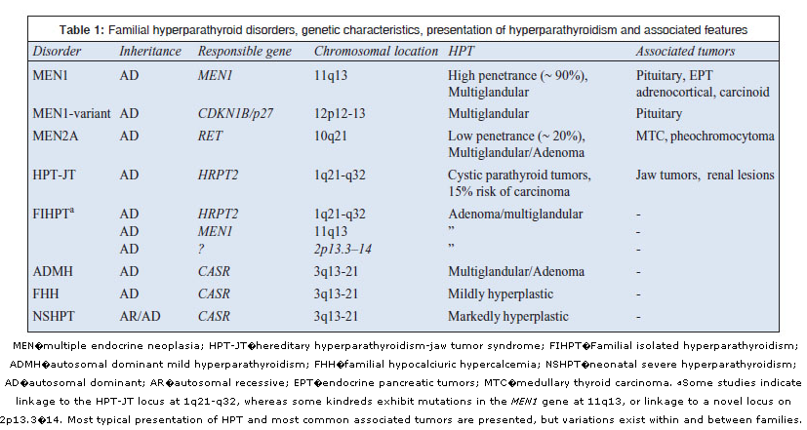

Slide 45
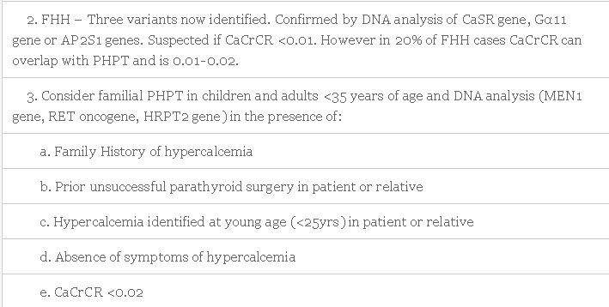

Slide 46
Summary
Surgery Acceptance (Yes)
---------------------------------
PHPT
Osteoporosis →surgery
NCPHPT
Renal stone
Osteoporosis
Improvement BMD after surgery → Surgery
Surgery Acceptance (No)
---------------------------------
Bisphosphonates, Denosumab
Close monitoring : PTH, Calcium, BMD, Creatinin(GFR)
Lipid lowering agents, Vit D >20 ng/ml
Reassessment for PTH and Calcium in the patient’s family (normal serum level of Vit D)
Genetic tests (Elevated PTH / Ca)

