Slide 1
OADs in GDM
Alireza Amirbaigloo, M.D.

Slide 2
Glyburide has replaced insulin as the more common pharmacotherapy for GDM over the past decade in US.
Obstet Gynecol 2014;123:1177–84

Slide 3
Obstet Gynecol 2014;123:1177–84

Slide 4
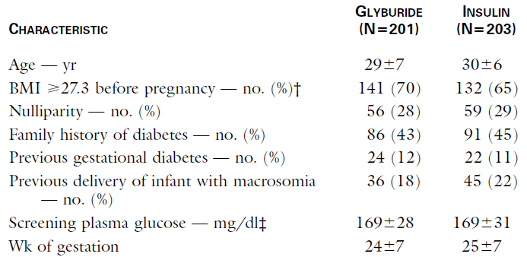

Slide 5
N Engl J Med 2000;343:1134-8

Slide 6
Four women in the glyburide group and 41 women in the insulin group had blood glucose concentrations below 40 mg/dL (P=0.03)
Eight women in the glyburide group (4 percent) required insulin therapy
cord-serum insulin concentrations were similar in the two groups, and glyburide was not detected in the cord serum of any infant
N Engl J Med 2000;343:1134-8

Slide 8
Stillborn Infants | 4 (8%) | 0 | 1 (2.3%)
Neonatal Deaths | 1 (2.2%) | 1 (1.5%) | 0

Slide 9
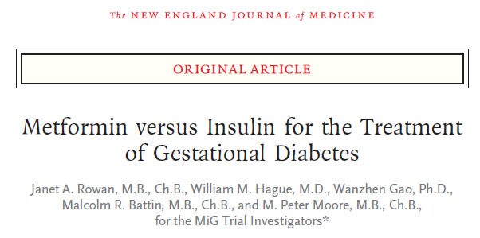
N Engl J Med 2008;358:2003-15

Slide 10
N Engl J Med 2008;358:2003-15

Slide 11
Of the 363 women assigned to metformin, 46.3% received supplemental insulin (1)
Metformin passes placenta. Fetal serum levels are comparable with maternal values (2)
(1) N Engl J Med 2008;358:2003-15
(2) Fertil Steril 2005; 83:1575– 8

Slide 12
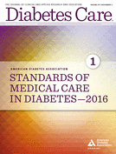
Preferred medications in gestational diabetes mellitus are insulin and metformin. A
Diabetes Care Volume 39, Supplement 1, January 2016

Slide 13
More recently, several meta-analyses and large observational studies have suggested that glyburide may be inferior to insulin and metformin
Metformin may be preferable to insulin for maternal health if it suffices to control hyperglycemia

Slide 17
Maternal Outcomes

Slide 18
Neonatal Outcomes

Slide 19
metformin was associated with:
lower maternal weight gain (WMD: -1.49kg, 95%CI: -2.26 to -0.31)
shorter gestational age (WMD: -0.16 weeks, 95%CI: -0.30 to -0.03)
increased incidence of prematurity (OR: 1.63, 95%CI: 1.07 to 2.48)

Slide 20
glyburide was associated with:
higher neonatal birth weight (WMD: 130.68g, 95%CI: 55.98 to 205.38)
increased incidence of neonatal hypoglycemia(OR: 2.64, 95%CI: 1.59 to 4.38)
increased incidence of macrosomia (OR: 3.09, 95%CI: 1.59 to 6.04)

Slide 23
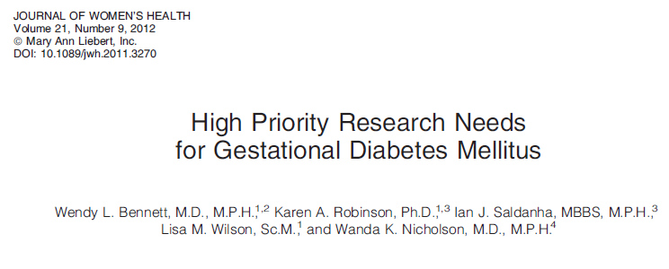

Slide 24
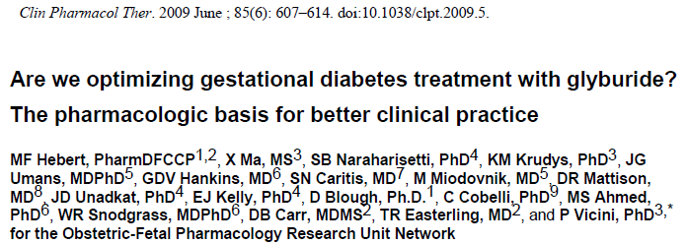
Average glyburide umbilical cord to maternal plasma concentration ratio at the time of delivery was 0.7 ± 0.4.

Slide 25
Obstet Gynecol 2015;125:583–8

Slide 26
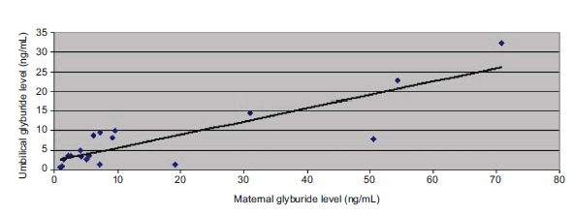

Slide 27
Seventy-nine percent of cord samples (15/19) had glyburide levels less than 10 ng/mL (the limit of detection reported in earlier studies) and 37% (7/19) were higher than the corresponding maternal samples
The limit of detection for glyburide was 0.25 ng/mL
Obstet Gynecol 2015;125:583–8

Slide 28
NICE Guidelines
Offer metformin to women with gestational diabetes if blood glucose targets are not met using changes in diet and exercise within 1–2 weeks
Offer addition of insulin to the treatments of changes in diet, exercise and metformin for women with gestational diabetes if blood glucose targets are not met
NICE guideline Published: 25 February 2015

Slide 29
Offer immediate treatment with insulin, to women with gestational diabetes who have a fasting plasma glucose level of 126 mg/dL or above at diagnosis
Consider immediate treatment with insulin, for women with gestational diabetes who have a fasting plasma glucose level of between 110 and 126 mg/dL if there are complications such as macrosomia or hydramnios
NICE guideline Published: 25 February 2015

Slide 30
Consider glibenclamide for women with gestational diabetes in whom blood glucose targets are not achieved with metformin but who decline insulin therapy or who cannot tolerate metformin
NICE guideline Published: 25 February 2015

Slide 32
Given that failure rates range from 4% to 37%, patient characteristics should be considered :
Fasting level on OGTT ≥110 mg/dL
Multiparous pregnancy
Older maternal age
Lower education level (<9 years of school)
English as a secondary language or failure to speak English

Slide 33
Metformin Failure
Given the failure rates range from 10% to 46%, patient characteristics should be considered when trying metformin
BMI ≥35
Plus those mentioned for parameters predicting glyburide failure

Slide 34
One group was assigned to insulin therapy (n = 27), a second group was assigned to glyburide therapy (n = 24) and a third group was assigned to acarbose therapy (n = 19)
Glucose control was not achieved in five (20.8%) of the patients using glyburide and in eight (42.1%) of patients using acarbose

Slide 37
Postpartum management
If therapy is needed to control maternal blood glucose levels, metformin, glyburide, glipizide, and insulin are considered preferred therapies in breastfeeding women
While these medications may be excreted in milk, the risks to the infant are considered low
Drugs in Context 2015; 4: 212282

Slide 38
All other medications utilized to manage type 2 diabetes have very limited or no human data available in lactation and are not recommended in breastfeeding
Some clinicians will recommend periodically assessing infant blood glucose levels while the mother is taking medications to ensure that the infant is not experiencing hypoglycemia
Drugs in Context 2015; 4: 212282

Slide 39
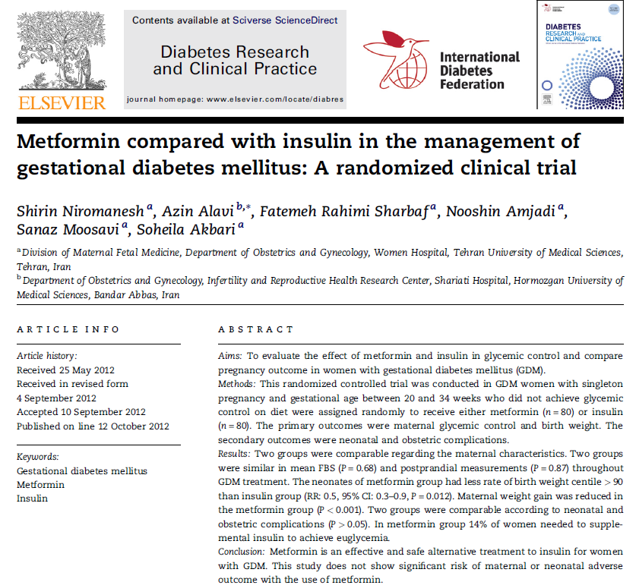

Slide 40
Plasma Glucose Levels

Slide 41
Obstetric Outcomes

Slide 42
Neonatal Outcomes

