Slide 2
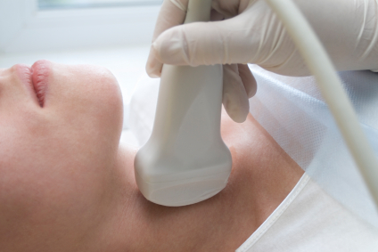
Thyroid
Ultrasonography
H. Delshad M.D
Endocrinologist
Research Institute for Endocrine Sciences

Slide 3
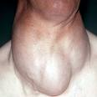
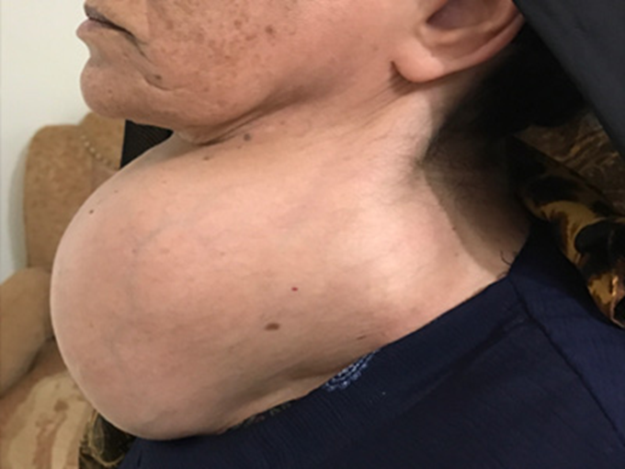
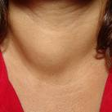
Thyroid Nodules

Slide 4
Thyroid Nodules
►Palpable thyroid nodules are found in 4-7% of the population
►Non-palpable thyroid nodules are found in approximately 50%
of persons over 60 yrs
►The vast majority of thyroid nodules are benign (malignancy 2-5%)
►Ultrasound can help determine which nodules are suspicious but
a biopsy is needed for a definitive diagnosis
►A low TSH followed by a 123I scan may define a nodule as "hot"
or functioning, and virtually always benign in which case an
ultrasound may be unnecessary

Slide 5
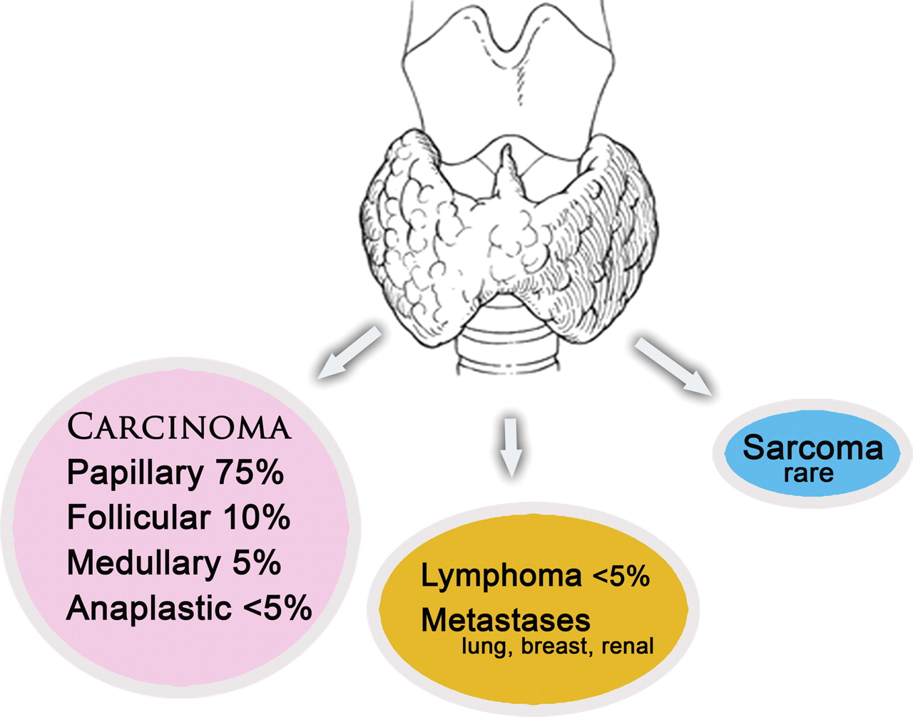
TYPES OF THYROID NODULES
Colloid Nodules
Hashimoto thyroiditis
Hemorrhagic Cysts
Colloid Cysts
Follicular Adenomas
Hurthle cell Adenomas
Notes:
Figure 1. Drawing shows the thyroid gland and the frequency of occurrence of the different pathologic types of thyroid malignancy.

Slide 6
key point
No single noninvasive test can reliably distinguish benign from malignant nodules.

Slide 7
Which nodule needs FNA?
 | FNA | Monitor without FNA
ATA Guideline 2017 | •Any Nod. > 5 mm with a high risk Hx. and suspicious features • Nod. With cervical lymphadenopathy • Nod. > 1 Cm with microcalcification • All solid hypoechoic > 1.0 Cm •All iso-or hyperechoic > 1.0 -1.5Cm •Systic-solid > 1.5 – 2.0 Cm with suspicious features or > 2.0 Cm | • Nod.< 5.0 mm, even with suspicious • Nod. < 10 mm without clinical risks or microcalcification • Pure cystic nodules •Spongiform nodules < 2.0 Cm •Complex cyst < 1.5 – 2.0 Cm, even with suspicious featurs

Slide 8
US features of thyroid nodules
♣ Size ♣ Shape
♣ Echogenicity ♣ Contour
♣ Calcification ♣ Architecture
♣ Margins ♣ Multiplicity
♣ Vascularity ♣ Elasticity

Slide 9
Size of the Nodule
AACE and ATA guidelines :
# Practical threshold : 1 – 1.5 cm
Papini et al. :
# 195 solitary nodules , 8-15mm & 207 MNG
Cancer prevalence was similar in nodules greater or
smaller than 10 mm.
Frates et al. :
# No significant difference in the rate of malignancy in
1039 solid nodules by size.

Slide 10
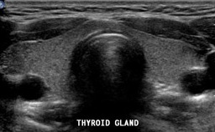
Echogenicity
Transverse gray-scale mode of a normal thyroid gland
which is uniformly Echogenic relative to overlying strap
musculature

Slide 11
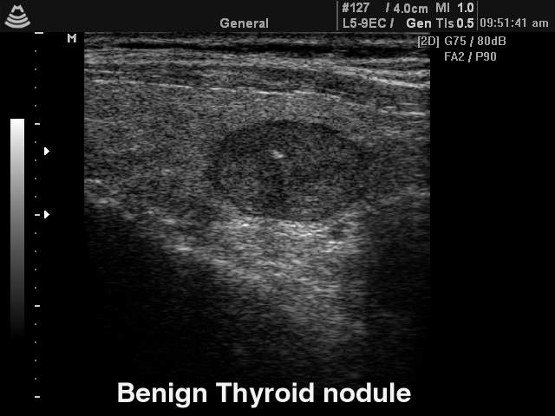


Echogenicity
Isoechoeic
Hypoechoeic Hyperechoeic
Cystic & solid

Slide 12
Echogenicity
Hyperplastic Nodules
● Most often Isoechoic
● Can also be Hyperechoeic
● Commonly undergo cystic
& hemorrhagic degeneration

Slide 13
Benign Nodules
B: Isoechoic nodule with a central cystic
area , surronded by a smooth, thin halo
A : Hypoechoic solid nodule with a regular
margin and thin halo

Slide 14
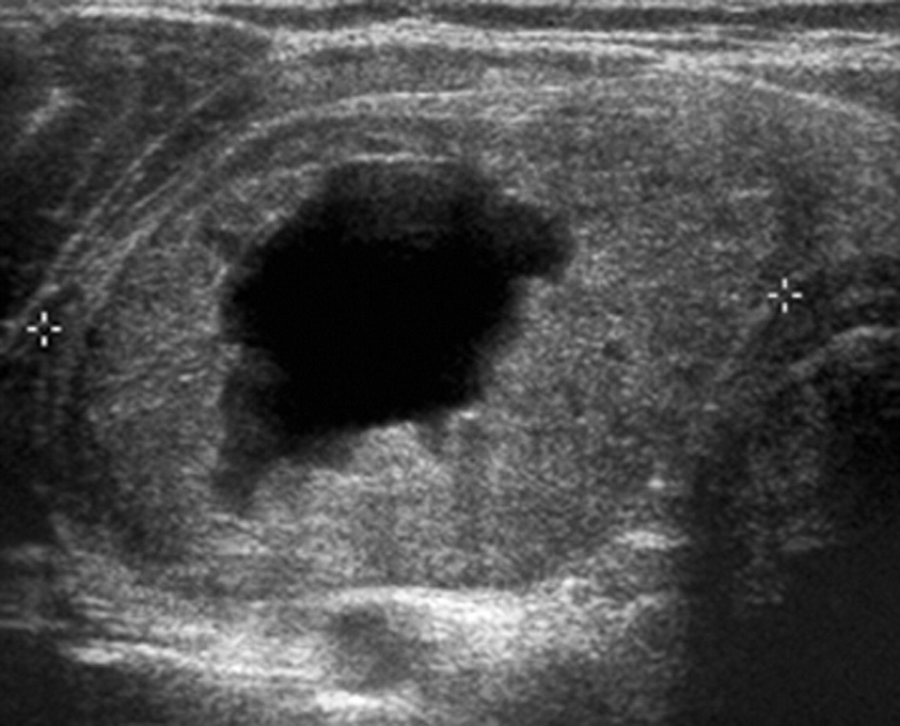
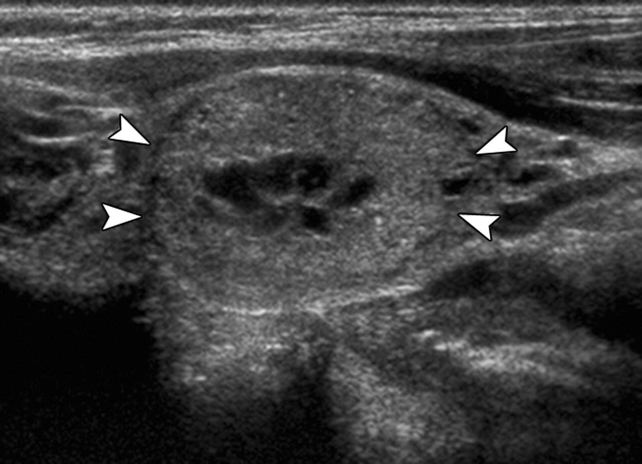
Benign Nodules
Predominantly solid Isoechoic nodule with cystic degeneration ,
which proved to be benign at cytologic examination.
Notes:
US images of thyroid nodules of varying parenchymal composition (solid to cystic). (a) Sagittal image of solid nodule (arrowheads), which proved to be papillary carcinoma. (b) Sagittal image of predominantly solid nodule (arrowheads), which proved to be benign at cytologic examination. (c) Transverse image of mixed solid and cystic nodule (calipers), which proved to be benign at cytologic examination. (d) Sagittal image of predominantly cystic nodule (calipers), which proved to be benign at cytologic examination. (e) Sagittal image of cystic nodule (arrowheads). FNA of this presumed benign lesion was not performed because the nodule appears entirely cystic.

Slide 15
Echogenicity
Malignant Nodules: Most are Hypoechoic
● Chan et al. Study (2003):
- 86% of PTC were Hypoechoeic
● Jun P et al. Study (2005) :
- 78% of PTC were Hypoechoeic
- 12% Isoechoeic
- 9% Mixed echogenicity
- 1% Hyperechoeic
Hypoechogenicity is a sensitive sign but is not specific
30% - 80% of benign nodules are also Hypoechoeic

Slide 16
Echogenicity
Hypoechoic solid nodules:
- 87 % sensitivity & 15 – 30 % specificity
for detection of malignancy
Marked hypoechogenicity :
- Very suggestive of malignancy

Slide 17
Hypoechoeic
Malignant Nodules
Papillary Cell Carcinoma

Slide 18
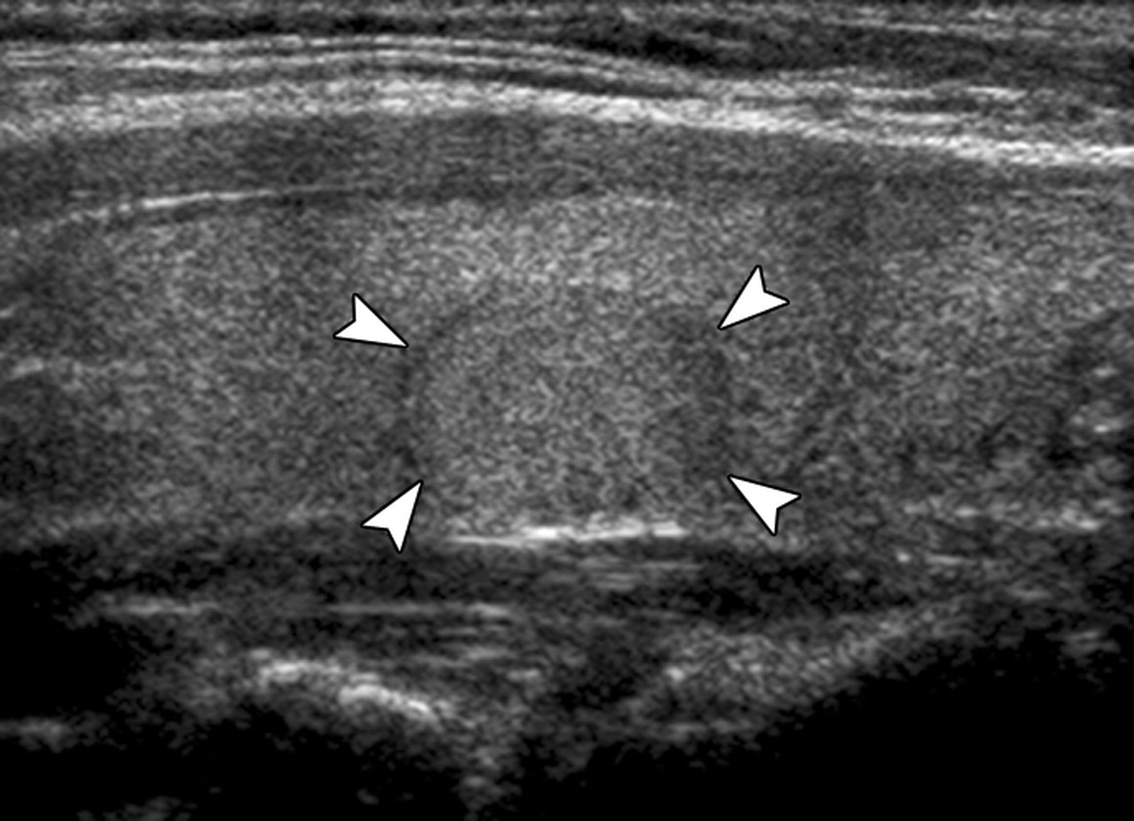
Isoechoeic Malignant Nodules
Isoechoic solid nodule, which proved to be
papillary carcinoma.
Notes:
US images of thyroid nodules of varying parenchymal composition (solid to cystic). (a) Sagittal image of solid nodule (arrowheads), which proved to be papillary carcinoma. (b) Sagittal image of predominantly solid nodule (arrowheads), which proved to be benign at cytologic examination. (c) Transverse image of mixed solid and cystic nodule (calipers), which proved to be benign at cytologic examination. (d) Sagittal image of predominantly cystic nodule (calipers), which proved to be benign at cytologic examination. (e) Sagittal image of cystic nodule (arrowheads). FNA of this presumed benign lesion was not performed because the nodule appears entirely cystic.

Slide 19
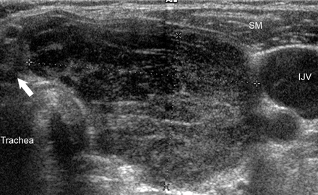
B cell Lymphoma of the thyroid
A large heterogenous mass with marked Hypoechogenicity

Slide 20
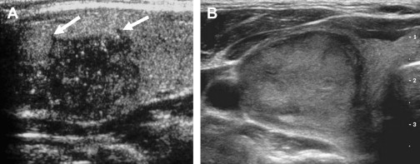
US Features & Tumor Histology
PTC
More likely to be solid ,
Hypoechoic and lack a halo
FTC
Most commonly have halo,
which is irregular and are
Iso- to Hyperechoic

Slide 21
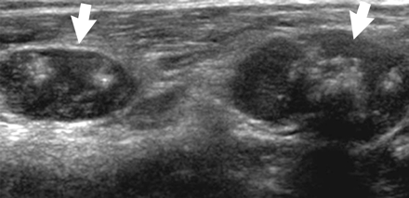
MTC
calcified nodal metastases

Slide 22


Malignant Nodules
Multifocal PTC with two discrete
Hyper. and Hypoechoic nodules

Slide 23
Calcification
Have been found in PTC , MTC & Anaplastic thyroid cancers
Microcalcification
Coarse Calcification
Peripheral Calcifica.

Slide 24
Microcalcification
One of the most specific US features
Specificity : 85 – 95 %
Positive predictive value: 42 – 95 %
Psammoma bodies , most commonly in papillary carcinoma
Panctate hyperechoic foci without acoustic shadowing

Slide 25
Calcification
Chan BK et al. (2003 ) , in one series of PTC
- Microcalcification : 42%
- Coarse calcification : 9.1%
- Peripheral calcification : 1.8%
Coarse central calcification is a common feature of MTC
Egg-shell calcification is considered a benign finding but have been reported in thyroid cancers

Slide 26
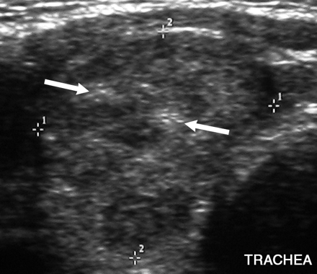
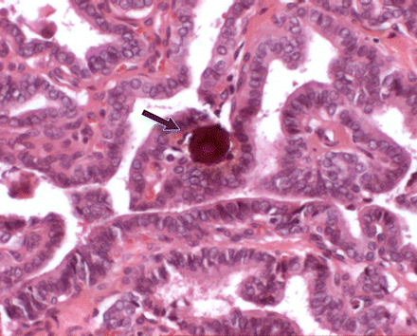
Microcalcification
Right lobe of the thyroid with punctate
Echogenic foci without posterior acoustic
shadowing
Photomicrograph of a psammoma body,
A round laminar crystalline calcification

Slide 27
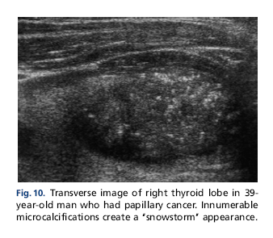
Microcalcification
Papillary Cell Carcinoma

Slide 28
Coarse Calcification
Large irregularly shaped
Post acoustic shadow
Secondary to tissue necrosis
Commonly present in MNG
Coarse with microcalcification :
most common in MTC

Slide 29
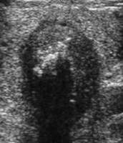
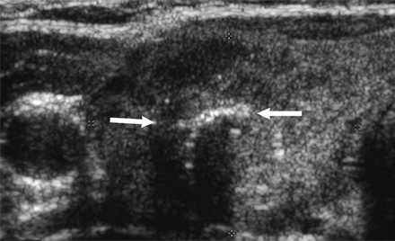
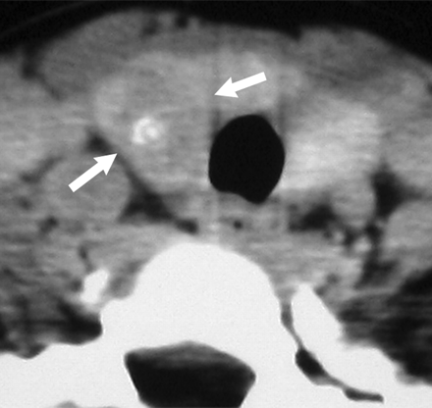
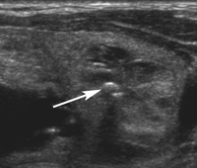
Coarse Calcification
Medullary carcinoma
Medullary carcinoma
A large nodule with coarse calcification
and posterior acoustic shadowing
Benign hyperplastic nodule

Slide 30
Peripheral Calcification
Most common in MNG
May be seen in malignancy

Slide 31
Peripheral Calcification
Complete thin rim of cal.
(Benign nodule )
Incomplete thin rim of cal.
( Hemorrhagic cyst )

Slide 32
Margins
ILL Defined ( >50% of the border is not clearly demonstrated) and irregular margin suggest malignant infiltration
Encapsulated papillary car. & minimally invasive follicular car: well demarcated
15 – 59 % of Benign Nodule : poorly defined margins

Slide 33
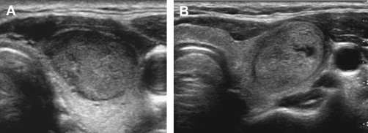
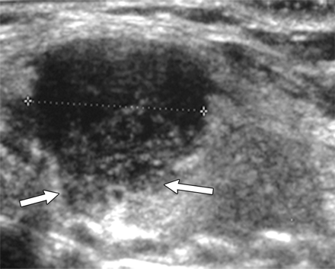
MARGINS
Hyperplastic benign Nodule
Encapsulated Papillary Carcinoma
PTC

Slide 34
Margin : HALO
Halo : Hypoechoic rim around nodule
Completely uniform halo : highly suggestive of benignity (specificity = 95%)
Halo is absent in more than 50 % of all benign nodules
Complete or incomplete halo is present in 10 – 24 % of papillary carcinoma

Slide 35
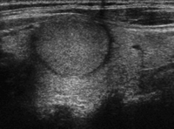
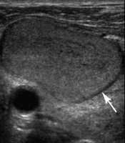
Margin : HALO
Benign Follicular Adenoma
Benign Nodule
with a Hypoechoic Halo
Isoechoic Nodule with complete Halo

Slide 36
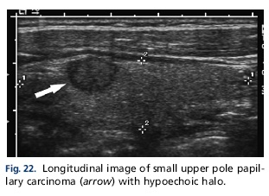
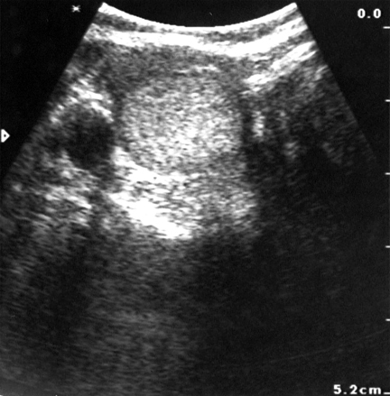
Margin : HALO
Papillary Cell Carcinoma
Follicular Cell Carcinoma
A solid mass in the thyroid, with a completely surrounding halo.

Slide 37
Papillary & Anaplastic Carcinoma
Poorly defined
Hypoechogenicity
Irregular margins
Without Halo

Slide 38
Vascularity
Intrinsic hypervascularity :
The most common pattern in thyroid cancer(70%)
50% of hypervascular solid nodules: Are benign.
Perinodullar vascularity : More characteristic of benign nodules
22% of nodules with peripheral vascularity: Malignant
A completely avascular nodule is very unlikely to be malignant

Slide 39
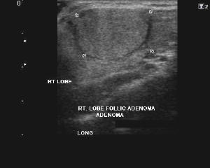
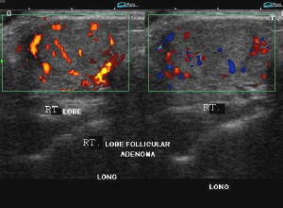
Vascularity
Benign Follicular Adenoma of the Thyroid
A large, solid, homogenous nodule with a hypoechoic
halo around the lesion.
The lesion is solitary, shows no
cystic areas and has a rim of
vessels.

Slide 40
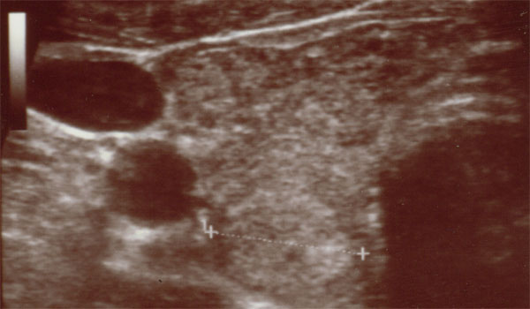
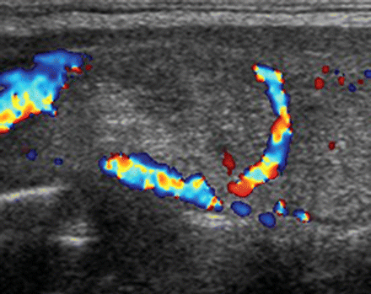
Vascularity
Follicular Adenoma
Round Iso-echoic nodule with perinodular vascularity

Slide 41
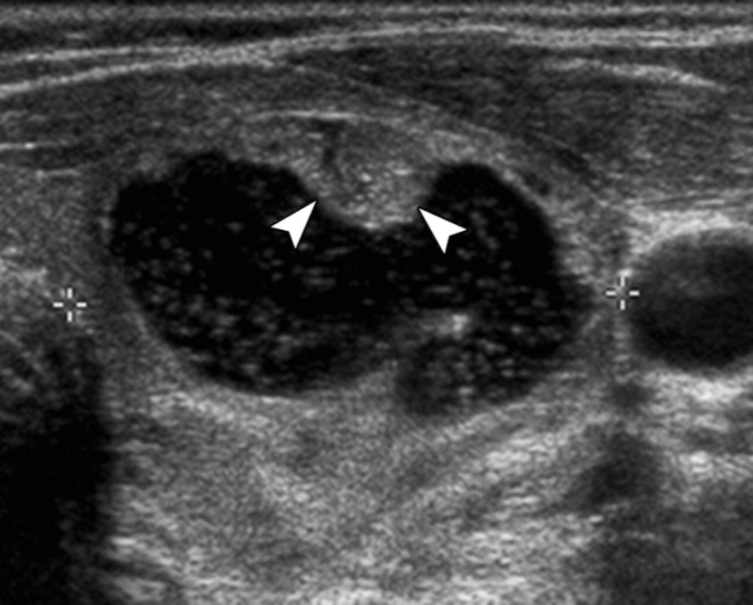
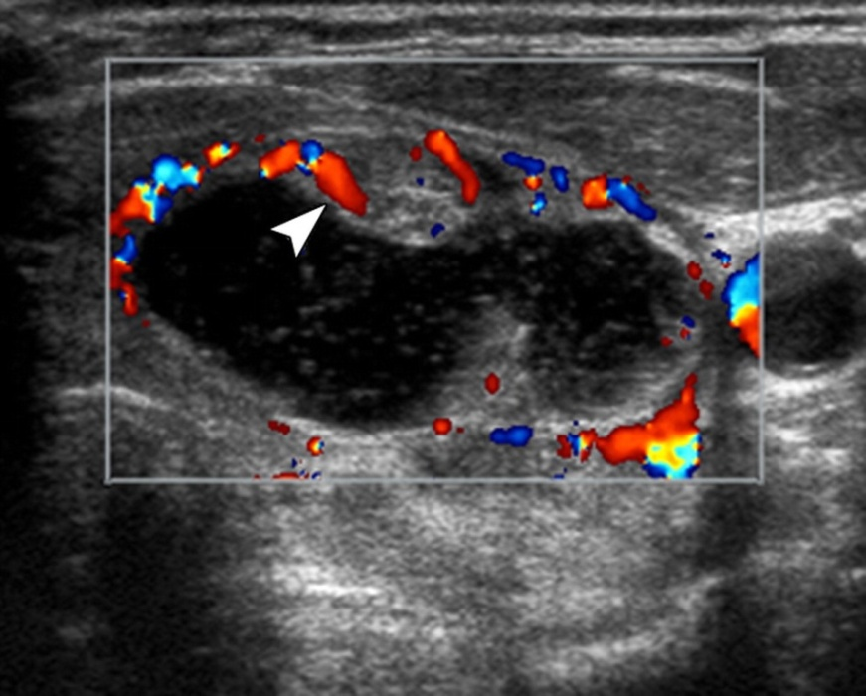
Vascularity
predominantly cystic nodule
with small solid-appearing
mural component
Color Doppler mode demonstrates
flow within mural component
. The lesion was benign at cytologic examination.
Notes:
Transverse US images of mostly cystic thyroid nodule with a mural component containing flow. (a) Gray-scale image shows predominantly cystic nodule (calipers) with small solid-appearing mural component (arrowheads). (b) Addition of color Doppler mode demonstrates flow within mural component (arrowheads), confirming that it is tissue and not debris. US-guided FNA can be directed into this area. The lesion was benign at cytologic examination.

Slide 42
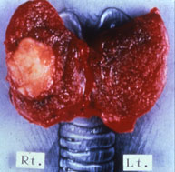
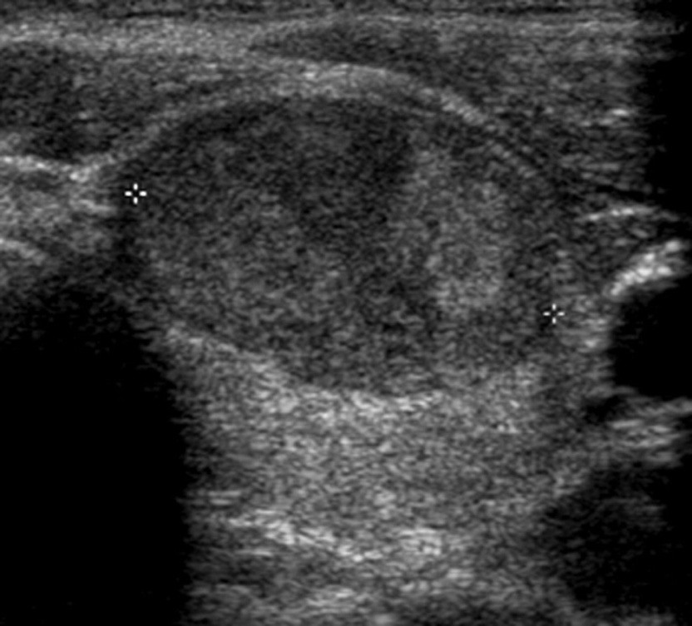
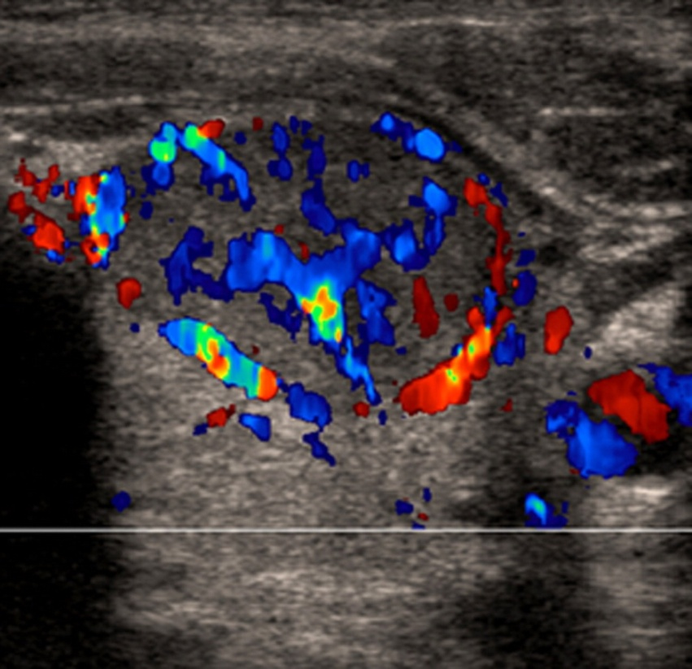
Vascularity : PTC
Color Doppler mode shows
marked internal vascularity,
indicating increased likelihood
that nodule is malignant
Solid Hypoechoic Thyroid Nodule
Notes:
Role of color Doppler US. (a) Transverse gray-scale image of predominantly solid thyroid nodule (calipers). (b) Addition of color Doppler mode shows marked internal vascularity, indicating increased likelihood that nodule is malignant. This was a papillary carcinoma.

Slide 43
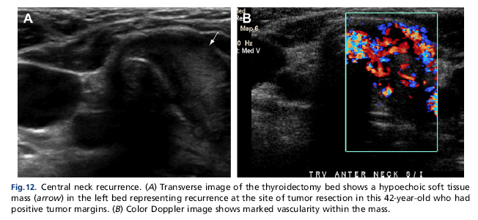
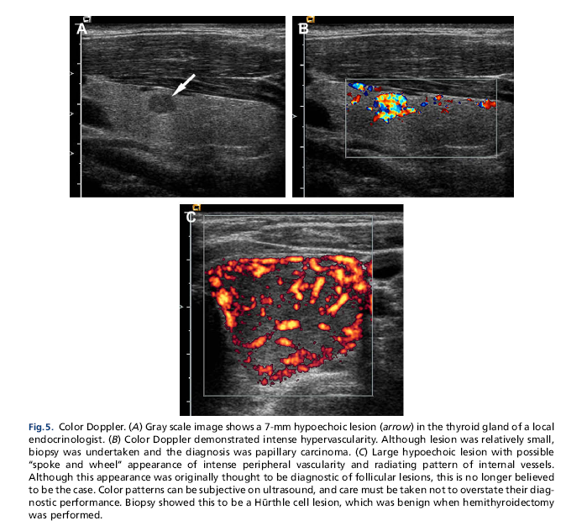
Vascularity : PTC
Hypoechoeic ill defined mass Marked vascularity within the mass
Small hypoechoeic nodule
Intense hypervascularity

Slide 44
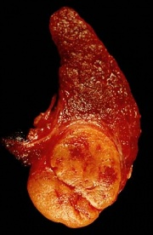
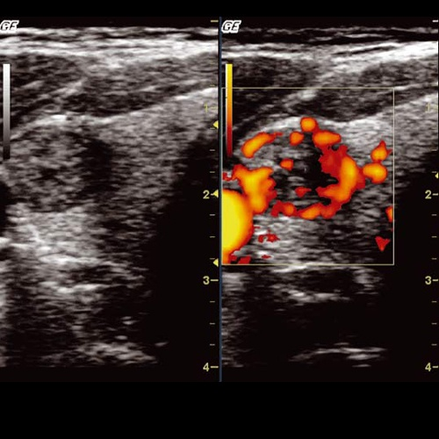
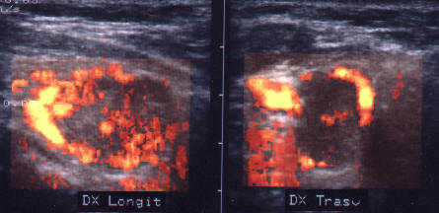
Vascularity: FTC
Hypoechoic nodule with irregular borders, Peripheric and internal vascularization

Slide 45
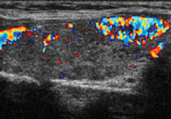
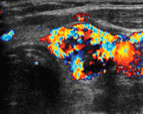
Vascularity
Hypervascular Nodule.
Papillary Carcinoma
Follicular Adenoma

Slide 46
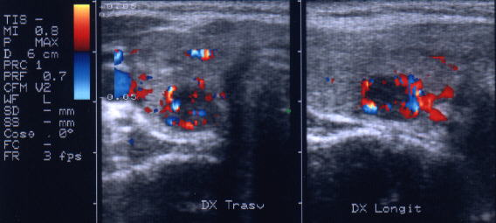
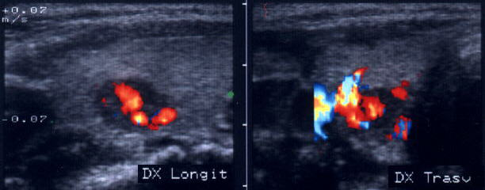
Vascularity : MTC
Little nodule in the middle
of the right lobe
Very hypoechoic structure
Rich internal vascularization

Slide 47
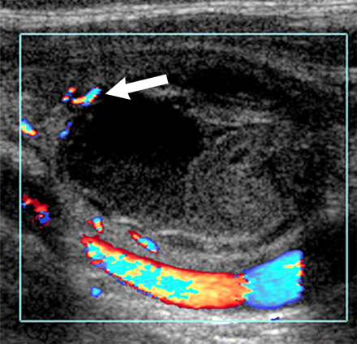
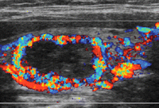
VASCULARITY
Hurthle cell carcinoma with
peripheral vascularity
Hyperplastic Nodule shows "ring of fire," or Peripheral Hypervascularity

Slide 48
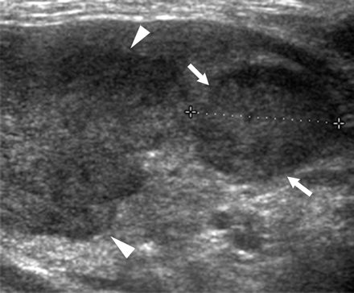
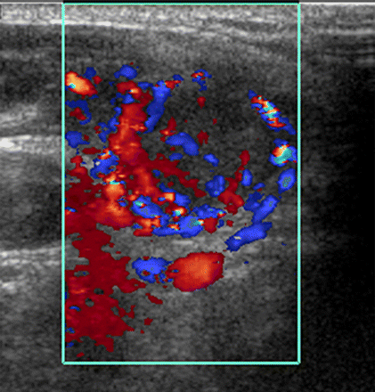
Renal cell carcinoma metastases to the thyroid
A round hypoechoic nodle and
an irregular-shaped hypoechoic nodule
Round nodule with increased
internal vascularity
Notes:
48

Slide 49
Multiplicity & Growth
The presence of multiple nodules does not make thyroid carcinoma less likely
In MNG ,each nodule should be scrutinized for suspicious features and selected for FNA
Both benign and malignant nodules can increase or decrease in size

Slide 50
Cystic change
A cystic component may be seen in 13% -
26% of thyroid cancers.
Predominantly cystic nodules are virtually
never cancer .
Honeycomb appearance virtually always
correlate with benign cytology.

Slide 51
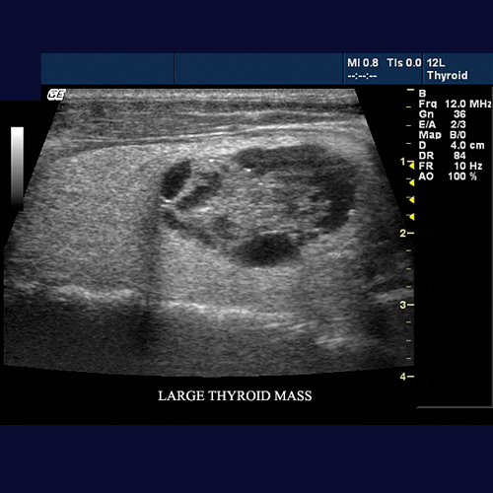
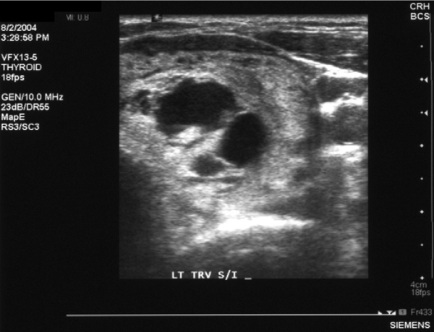
Cystic change
Colloid nodule that has solid and cystic components

Slide 52


Anaplastic Thyroid Carcinoma
An advanced tumor with central cystic
degeneration
CT image shows a large tumor that
has invaded the prevertebral muscle

Slide 53


Hurthle cell carcinoma
Partially cystic , with solid internal projections,

Slide 54
US of
Thyroid
Nodules
CONCLUSIONS

Slide 55
Thyroid Carcinoma
No sonographic finding is characterized of any type of thyroid carcinoma
The US appearance is highly variable
Appears as a solid , partially cystic or largely cystic mass
Hypoechoic relation to normal thyroid
Calcification : 50 – 60%
Hypervascularity

Slide 56
US Features Suggestive of a Benign Thyroid Tumor
Normal or hyperechogenicity
Coarse calcification
Thin , well-defined halo
Regular margin
Lack of invasive growth
No regional lymphadenopathy
Low intra-nodular flow

Slide 57
US Features of Thyroid Malignancy
Value and Limitation
Microcalcification
Marked Hypoechogenicity
Irregular margin
Absence of a hypoechoic halo
Vascularity
Lymphadenopathy & local invasion

Slide 58
US Features & malignancy
Individual sonographic features have limited utility in predicting malignancy
70% of benign nodules have one sonographic predictor of malignancy
Some series have explored the association of combinations of features with cancer risk
As the specificity of a combination increases, the sensitivity decreases

Slide 59
US Features & malignancy
Hypoechoic with microcalcification:
4% of benign & 30% of malignant nodules
• Combination of solid , hypoechoic features maximizes sensitivity and specificity and identifies approximately 70% of all thyroid cancers

Slide 60
Local Invasion & Lymph node Metastases
Highly specific signs of thyroid malignancy
Common with Anaplastic Car. , Lymphoma , Sarcoma

Slide 61
Sensitivity , specificity & predictive value of US imaging of non-palpable thyroid nodles
 | Hypoechoic | Hypoechoic Blurred margins | Hypoechoic Intranodular vascularizatvion | Hypoechoic Micro- calcification
Sensitivity | 87 % | 74 % | 61 % | 26 %
Specificity | 48 % | 88 % | 86 % | 96 %
Predictive value | 11 % | 39 % | 26 % | 36 %
Data from Papini et al , 2002

