Slide 1
Medical treatment of hirsutism
A Amouzegar,MD
Research Institute For Endocrine Sciences

Slide 2
Agenda
Ovarian suppression drugs
Antiandrogens
Other drugs( insulin sensitizers)
Definition of response to therapy
Conclusion

Slide 3
Weaknesses and strengths of studies
Small number of studies and their small sizes
The potential for publication bias
Low-quality studies
The majority of RCTs had important methodological shortcomings (e.g. no blinding)
Group differences in baseline hirsutism scores
The overall quality of the evidence supporting the treatment of hirsutism is low

Slide 4
Approach
The first step in the management of hirsute women is:
To review their diagnosis (most commonly polycystic ovary syndrome)
Their goals and expectations
The degree of distress caused by the hirsutism

Slide 5
Treatment options
Pharmacological therapy or direct hair removal methods
The choice between these options depends on
(a) Patient preferences
(b) The extent to which the area of hirsutism that affects
(c) Access to and affordability

Slide 6
Pharmacological treatment
Ovarian supression
Ocs
GnRH
Antiandrogen therapy
Insulin lowering drugs ( Metformin, TZDs)

Slide 7
Ovarian Suppression
There are two ways to suppress ovarian androgen secretion
Gonadotropin suppression with a combination of estrogen and progestin
Gonadotropin suppression using a long-acting GnRH agonist

Slide 8
Pharmacological treatments
Monotherapy for Ocs:
For the majority of women, OCPs were recommend to treat patient-important hirsutism
Because of its teratogenic potential, recommendation is against antiandrogen monotherapy unless adequate contraception is used
J Clin Endocrinol Metab. 2008 Apr;93(4):1105-20. doi: 10.1210/jc.2007-2437

Slide 9
Trials of OCPs versus antiandrogens
In the only RCT comparing an OCP to an antiandrogen (finasteride), the OCP contained low dose antiandrogen (CPA 2 mg) showed that there was no significant difference in hirsutism score between the finasteride group and the OCP group
(–2.5; 95% CI, –5.4 to –0.4) after 9 mo of treatment
J Endocrinol Invest 1998 21:348-52

Slide 10
Mechanism of action
OC therapy reduces hyperandrogenism via a number of mechanisms including:
Suppression of LH secretion and ovarian androgen secretion
Stimulation of hepatic production of SHBG, reducing serum free androgen concentrations
A slight reduction in adrenal androgen secretion
A slight blockage in the binding of androgens to their receptor

Slide 11
Definition
Pills containing less than 50 µg of EE are called “low-dose” OCs
Virtually all low-dose OCs contain 35 µg EE, and the dose of synthetic progestin ranges between 0.1 and 3 mg
EE has stronger effects than natural estradiol on hepatic metabolism, including synthesis of SHBG, lipoproteins, angiotensinogen, and some estrogen-dependent clotting factors

Slide 12
Currently Available Low-Dose Combined OC Pills According to Type of Progestin and EE Dose

Slide 13
Cont’d
Metabolic effects of estrogen in OCs are modulated by the type of the progestin included
OCs containing third-generation progestins as well as drospirenone and cyproterone acetate have reduced metabolic side effects
BMJ. 2009;339:b2921

Slide 14
Cont’d
Synthetic progestins used in first- and second-generation OCs are chemically related to testosterone
Androgenic side effects: oily skin, acne, and hirsutism
CA has the highest antiandrogenic effect
Antiandrogenic potency of drospirenone is approximately 40% of the potency of CA
Pract Res Clin Endocrinol Metab. 2013;27:13–24

Slide 15
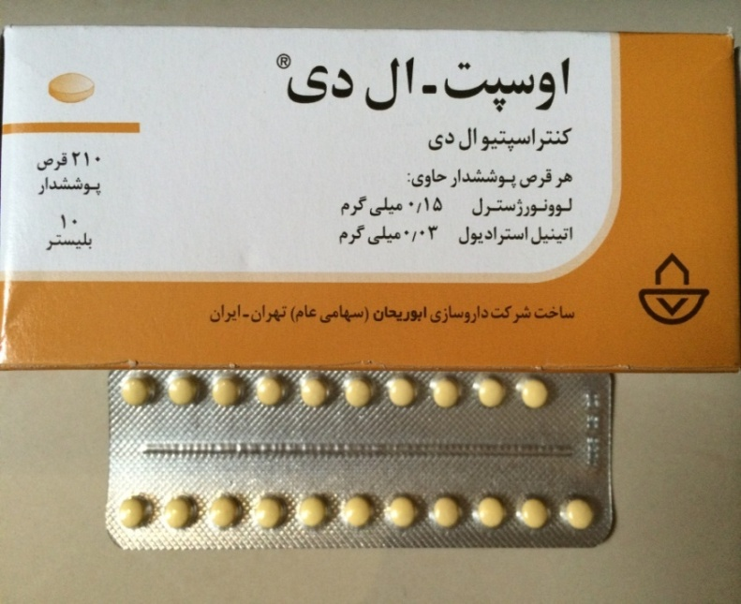
Second generation

Slide 16
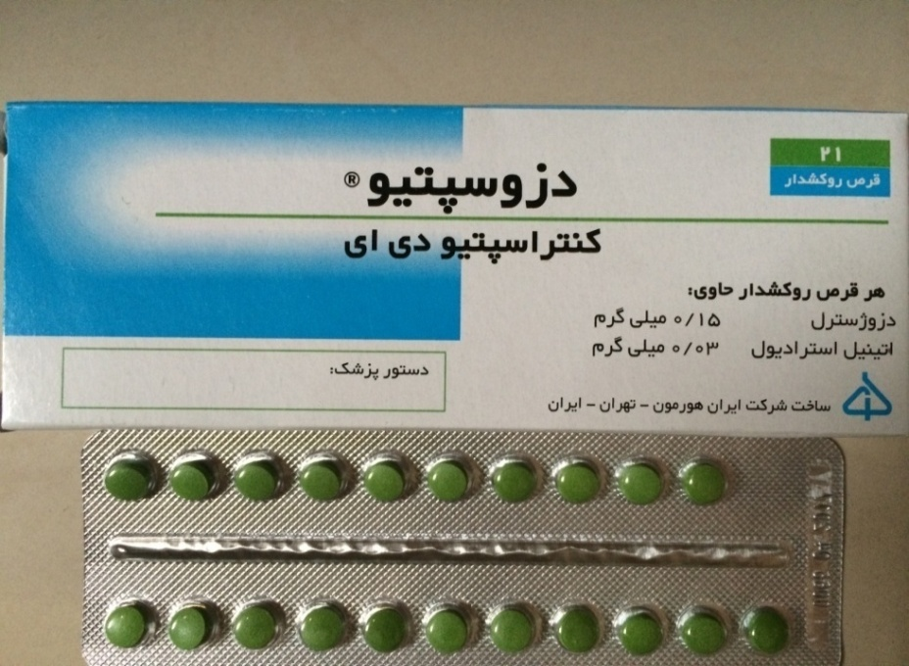
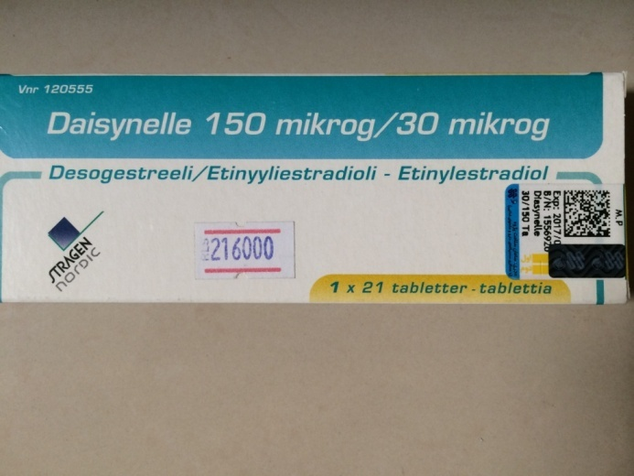
Third generation

Slide 17
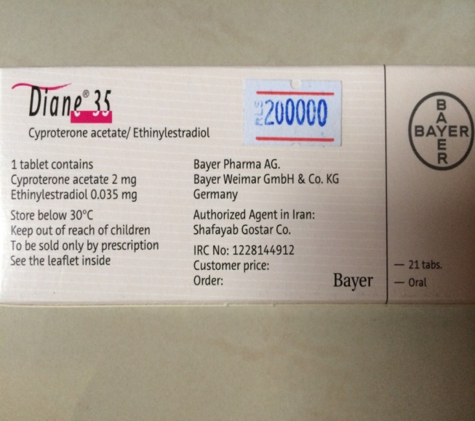
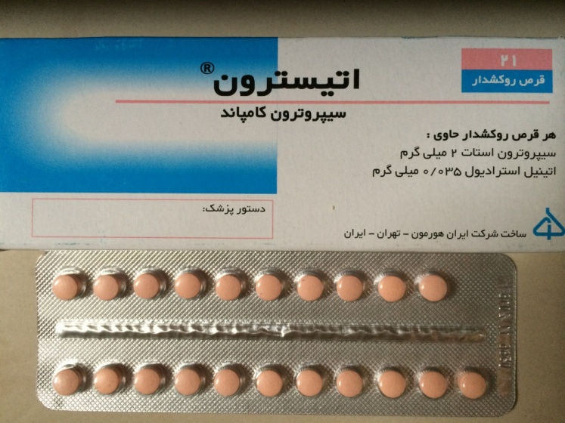
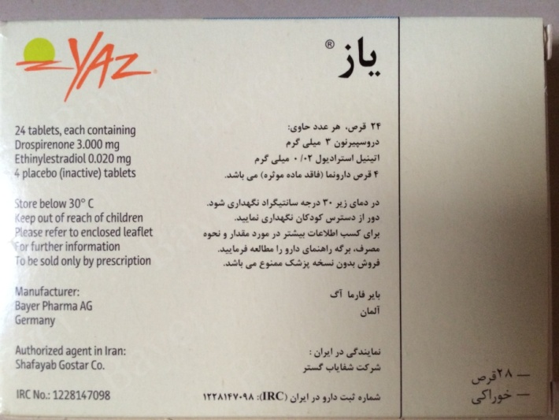
Antiandrogen

Slide 18
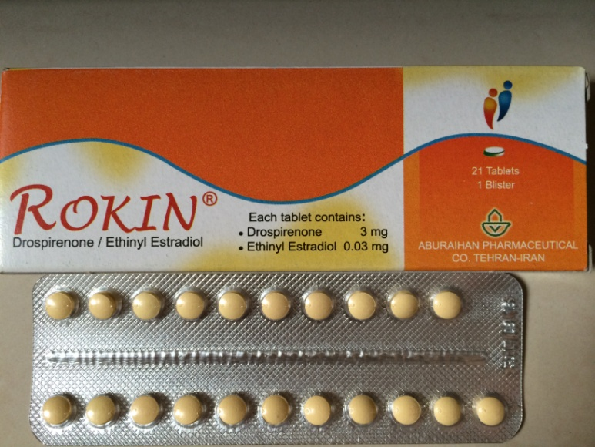
Antiandrogen

Slide 19
Side effects
Known risks of increased DVT thrombosis and breast cancer
For this reason, many clinicians opt for the safer, but less effective, lower dose contraceptive pills
BMJ. 2009;339:b2921

Slide 20
Absolute and relative contraindications to the use of low-dose OCs according to the WHO guideline
6 weeks postpartum if breastfeeding
Smoker over the age of 35 y (≥15 cigarettes per day)
Hypertension (systolic ≥ 160 mm Hg or diastolic ≥ 100 mm Hg)
History of deep venous thrombosis/pulmonary embolism
Current deep venous thrombosis/pulmonary embolism
Major surgery with prolonged immobilization
Known thrombogenic mutations (eg, Factor V Leiden, prothrombin mutation, protein S, protein C, and antithrombin deficiencies)
a Current case and history of ischemic heart disease
Stroke (history of cerebrovascular accident)
Complicated valvular heart disease
Systemic lupus erythematosus with positive antiphospholipid antibodies
Migraine headache with focal neurological symptoms
Current breast cancer
Diabetes with nephropathy/retinopathy/neuropathy
Other vascular disease or diabetes of> 20-y duration
Active viral hepatitis
Severe cirrhosis
Liver tumors

Slide 21
Selected relative contraindication
Smoker over the age of 35 y (<15 cigarettes per day)
Adequately controlled hypertension
Hypertension (systolic 140–159 mm Hg, diastolic 90–99 mm Hg)
Migraine headache over the age of 35
Current gallbladder disease
Past OC-related history of cholestasis
Mild cirrhosis
Use of drugs that affect liver enzymes
Anticonvulsant therapy
Antiretroviral therapy

Slide 22
Choice of pill
We typically choose an OC that contains a progestin with low androgenicity (or a progestin that has antiandrogenic properties such as CPA)
In theory, OCs containing levonorgestrel, the most androgenic progestin, should be avoided because of concerns that they would worsen hirsutism
There is no definitive evidence for any difference in efficacy of various Ocs
J Clin Endocrinol Metab. 2013;98:4565–4592
ESHRE/ASRM-Sponsored 3rd PCOS Consensus Workshop Group. Fertil Steril. 2012;97:28–38.e25.

Slide 23
How to start an OC
A careful history of past and present medical conditions
Any drug use
Family history
Focused physical examination
Specifically, information regarding migraine and CVD risk factors (smoking, hypertension, obesity, dyslipidemia, thrombophilia, previous VTE
Breast examination, pelvic and genital exam, and cervical cytology screening are not routinely recommended

Slide 24
Suboptimal response
Add antiandrogen to OC — If the patient is not satisfied with the degree of improvement in her hirsutism after six months of monotherapy with an OC, we suggest adding an antiandrogen

Slide 25
Antiandrogens
Spironolactone
Cyproterone acetate
Finasteride
Flutamide

Slide 26
Antiandrogens
Antiandrogens appear to be as effective as OCs for hirsutism.
It has been suggested that not using them as monotherapy, because of the potential adverse effects on a developing male fetus in utero.
Head-to-head comparisons of individual antiandrogens were not available, antiandrogens are more effective than placebo, and there did not appear to be important differences among them compared with placebo.
Clin Endocrinol (Oxf). 2000 May;52(5):587-94.
J Clin Endocrinol Metab. 2008 Apr;93(4):1153-60

Slide 27
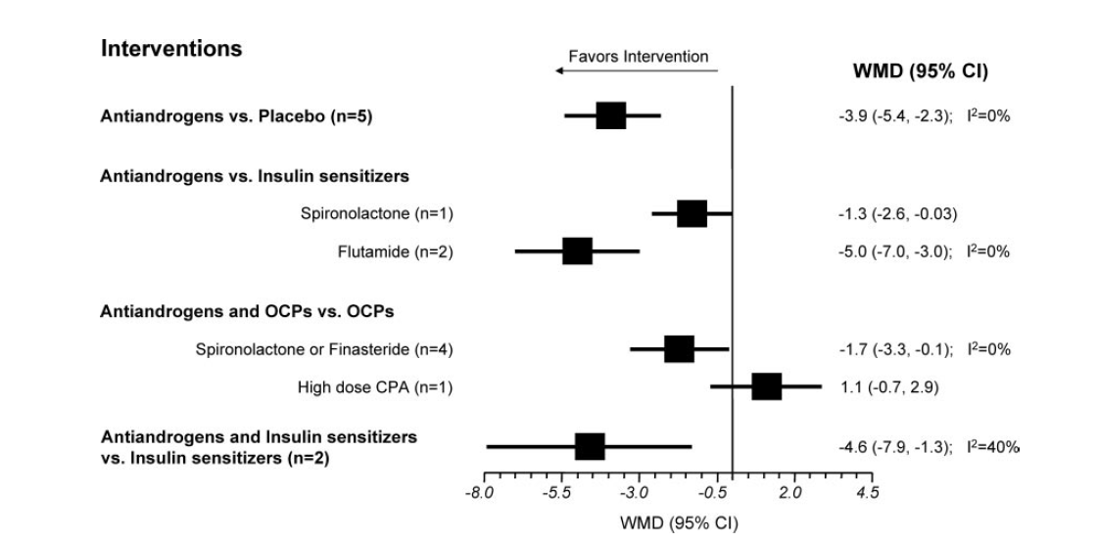
effect of antiandrogens on hirsutism
-3.7;-6.8 to – 0.6 I2=80%
-0.8;-2.3 to – 0.7 I2=32%
J Clin Endocrinol Metab. 2008 Apr;93(4):1135-4

Slide 28
Spironolactone
An aldosterone antagonist, exhibits dose-dependant competitive inhibition of the androgen receptor as well as inhibition of 5-α reductase activity
Is generally well tolerated, but may have a dose-dependent association with menstrual irregularity unless an OCP is used concomitantly
It may rarely result in hyperkalemia, increased diuresis and occasionally postural hypotension and dizziness
As with all antiandrogens, there is the danger of fetal male pseudohermaphroditism if used in pregnancy
NNT : 3 women need to be treated with spironolactone, (flutamide, or finasteride) for one of notice any improvement

Slide 29
Cyproterone acetate
Is a progestogenic compound with anti-androgen activity by virtue of its effects in inhibiting the androgen receptor and to a lesser degree in inhibiting 5-α reductase activity.
It also suppresses serum gonadotropin and androgen levels.
Data showed that it is more effective than placebo, but not better than any other anti-androgen
Is administered for the first 10 days (days 5–15) of the cycle
Doses of 50–100 mg/day of CPA are often prescribed until the maximal effect is obtained.
Is generally well tolerated, but there are dose-dependant metabolic effects similar to those of higher doses of Ocs.
Cochrane Database Syst Rev. 2003;

Slide 30
Flutamide
Is a pure antiandrogen
It is a competitive inhibitor of androgen action at the androgen receptor
Several studies show to be as effective as spironolactone
The usual dose ranges from 250–750 mg/d
Flutamide has been associated with hepatic toxicity that can be severe
Some deaths have been reported; for that reason, it is not often used

Slide 31
Finasteride
Finasteride is an inhibitor of type II 5-α reductase
Its clinical efficacy is similar to the other antiandrogens.
Standard doses range between 5 and 7.5 mg/d
There are no reported serious complications.

Slide 32
Choice of antiandrogen
Since they all appear to be effective for hirsutism, the choice of drug depends upon its availability, cost, side effects, and potential toxicity.
We prefer spironolactone as clinical trials have shown consistent benefit, and it is considered to be safe.

Slide 33
Insulin-lowering drugs
The place of insulin reduction therapies in treating hirsutism, particularly in the absence of the menstrual or metabolic disturbances typically seen in conjunction with PCOS, is controversial
Meta-analysis of 8 metformin trials found no significant reduction in Ferriman-Gallwey scores with metformin when compared with placebo
J Clin Endocrinol Metab. 2008 Apr;93(4):1135-42.

Slide 34
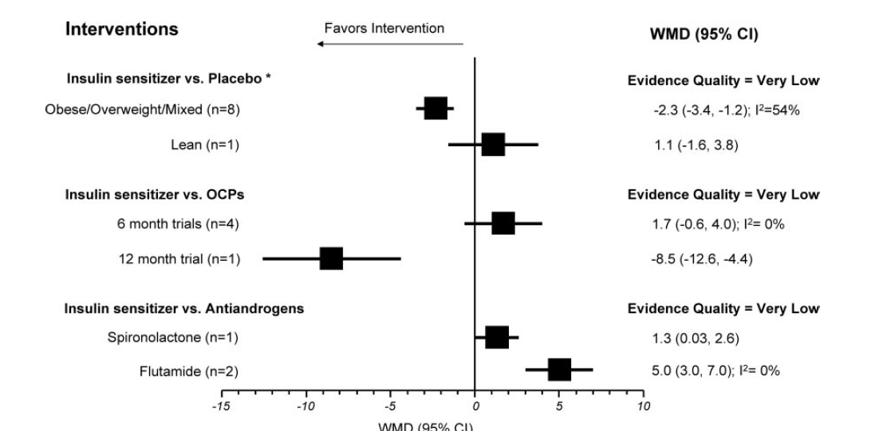
Overall summary of random-effects metaanalyses of RCTs of insulin sensitizers
WMD of 1.5; CI, (-2.8 to -0.2), (I2 75%).
JCEM 2008 Apr;93(4):1135-42

Slide 35
Insulin lowering Vs Antiandrogens
Metaanalysis showed the antiandrogen group had significantly lower hirsutism scores than the metformin group (3.7; CI, 6.8 to 0.6)
but with large inconsistency across studies (I=80%)
Flutamide NNT = 2
Spironolactone trial NNT = 5
J Clin Endocrinol Metab. 2008 Apr;93(4):1135-42

Slide 36
Monitoring
We suggest a trial of at least 6 mo before
Making any changes in dose
Adding a medication
Switching to a new medication
The patient's assessment of her response to therapy is the most important outcome
At each F/U visit, the patient should be asked whether she has noted any decreased need for cosmetic methods (shaving, plucking, waxing) to manage her hirsutism
In addition, we do try to obtain a Ferriman-Gallwey score at baseline and at each follow-up visit ( However, as noted, the score is unreliable in women who routinely use cosmetic hair removal methods)

Slide 37
Cont’d
Routine monitoring of serum androgens to assess the response to drug therapy is not recommended
However, if there is progression of hirsutism during therapy, repeat biochemical evaluation is warranted

Slide 38
Conclusion
For the majority of women, we recommend OCS to treat patient-important hirsutism
Because of its teratogenic potential, we recommend against antiandrogen monotherapy unless adequate contraception is used
For women who cannot or choose not to conceive, we suggest the use of either OCPs or antiandrogens

Slide 39
Cont’d
We suggest against the use of flutamide therapy
We suggest against using insulin-lowering drugs as therapy for hirsutism
For all pharmacological therapies, we suggest a trial of at least 6 mo before making changes in dose, changing medication, or adding medication

