Slide 1
IN THE NAME OF ALLAH

Slide 2
A 35 -year-old woman with cushing disease and normal pituitary imaging

Slide 3
Present illness
A35-year-old woman with 3-year history of cushings syndrome,
She was referred to a physician in mashhad with below symptoms
weight gain
Acne
hypertichosis
Depression

Slide 4
Present illness(examination finding)
Centripetal obesity
moon face
Fat deposition over the thoracocervical spine
Fat deposition in the supraclavicular region
Regular menstruation
Easy bruising(-)
Proximal Myopathy(-)
purple striae(-)

Slide 5
Present illness(examination finding)
Hypertension(-)
BMI:27
PMH:(-)
DH:(-)
FH: cushing syndrome in her cousin(30 y ago)

Slide 6
Serum cortisol:32ug/dl

Slide 11
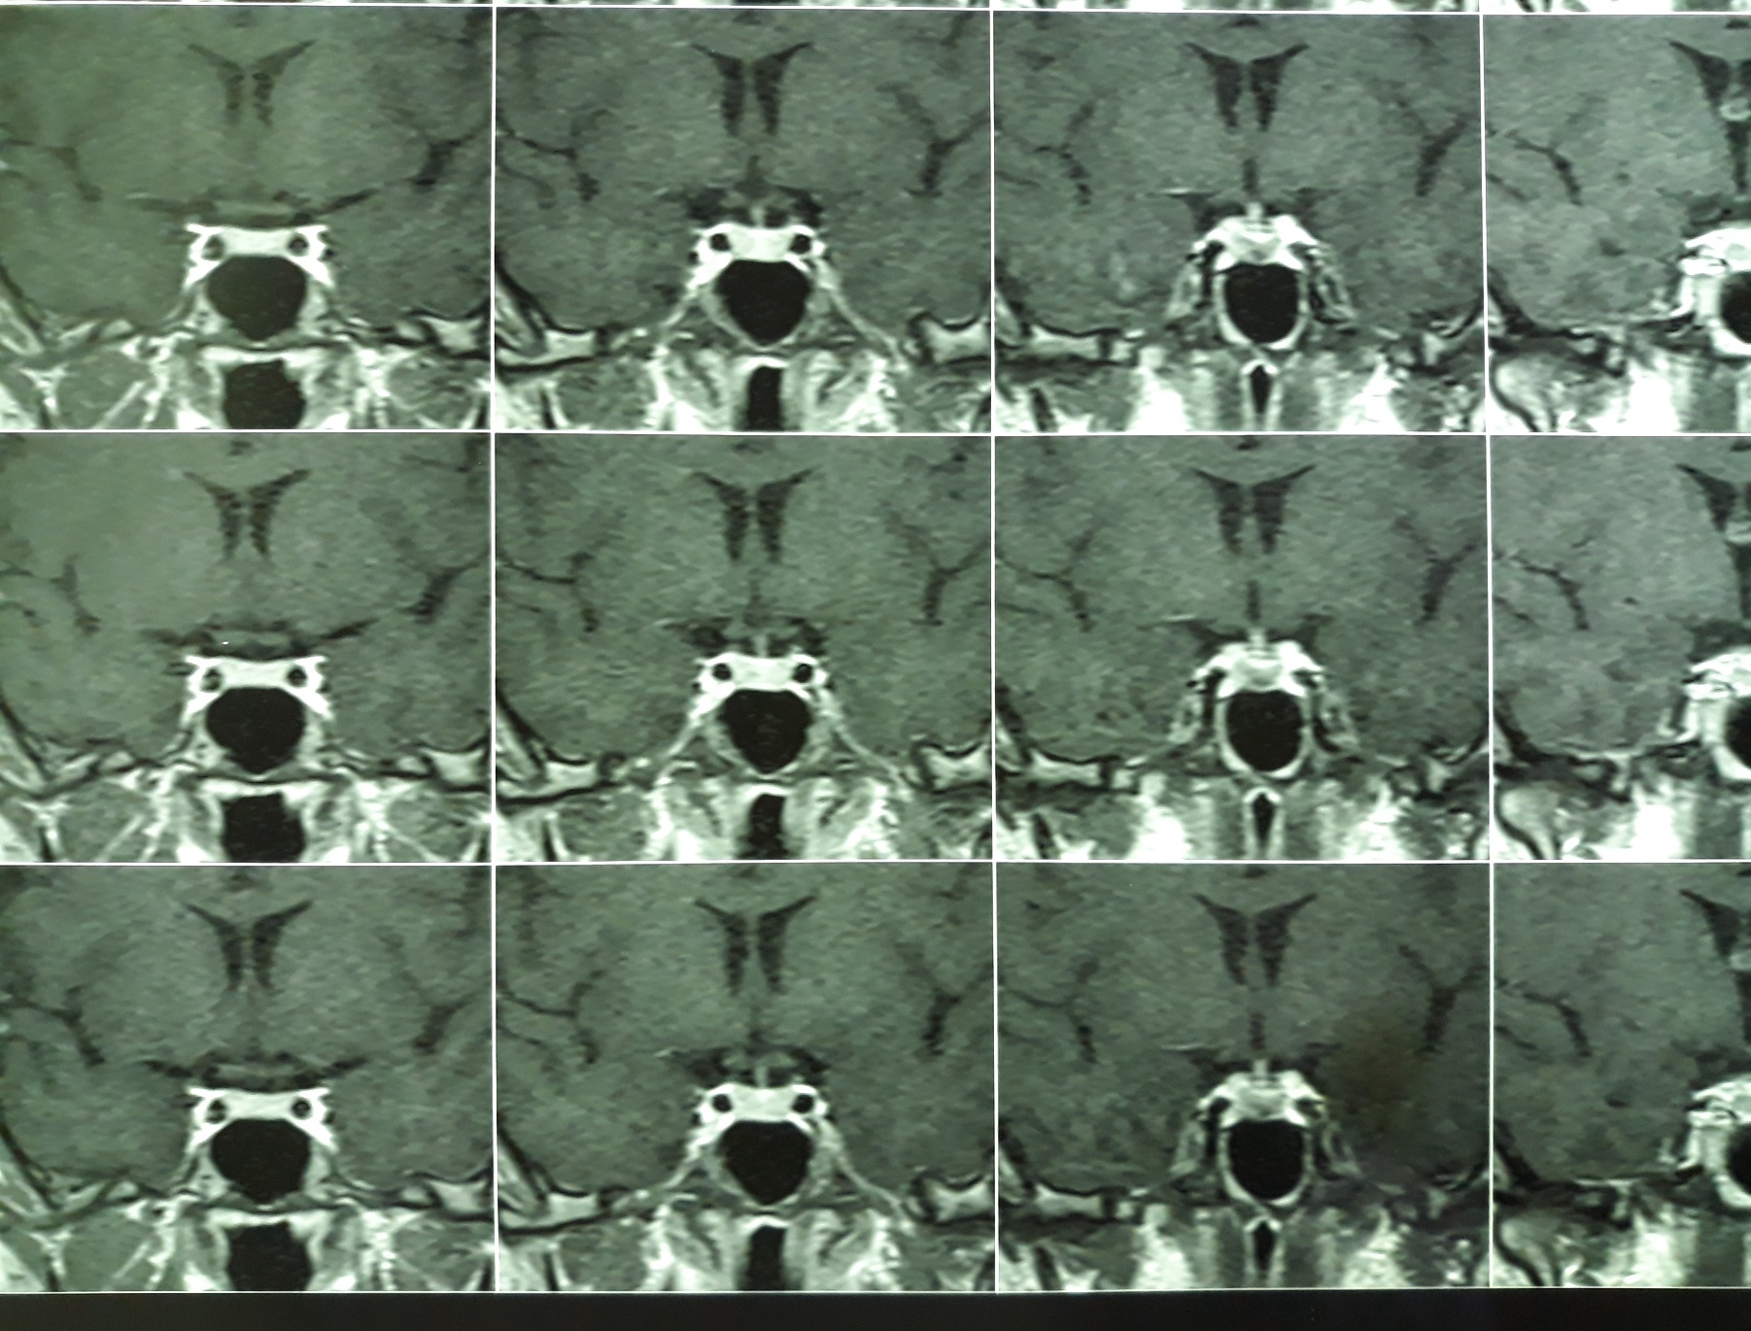
MRI:

Slide 12
start treatment with ketoconazole(3.93)
She had taken ketoconazole for 3years
She referred to the mashhad physician during this period

Slide 13
)
date | cortisol(ug/dl | UFC(ug/24h) | Weight(kg) | MRI | ketoconazol | lft
8. 93 | 2.2 |  | 71 | 4mm | 200mg/d | N
2.94 | - | 262 | - | - | 200mg/bd | N
8.94 | 5.1 | 10 | 68 | 2mm | 200mg/d | N

Slide 14
She stopped taking medication last year (12.96)and her symptom recurred.
Centripetal obesity
moon face
Regular menstruation
Easy bruising(-)
Proximal Myopathy(-)
purple striae(-)
BMI:27kg/m2 BP:120/80

Slide 16
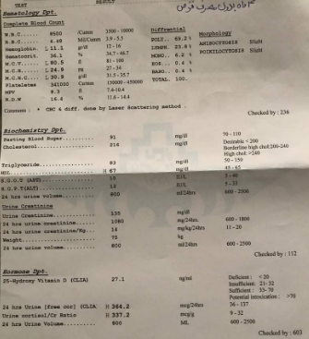

Slide 20
