Slide 1
Iodine Supplementation during Pregnancy

Slide 2
Impact of iodine supplementation in mild to moderate iodine deficiency: Systematic review and meta analysis
In this systematic review:
Search in Medline and Cochran library
Relevant published articles between 1966-2013
English language
Relevant key terms including: iodine deficiency, iodine supplementation, mild, moderate, pregnancy, etc.)
Randomized controlled trials
Observational studies including: quasi-randomized trials, prospective cohort, and case-control studies
Taylor P N, et al. Euro J Endocrinol 2014; 170: R1-R15

Slide 3
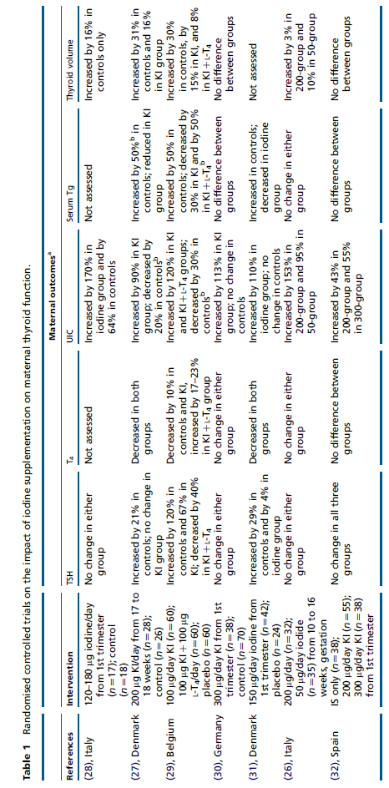
Impact of iodine supplementation in mild to moderate iodine deficiency: Systematic review and meta analysis (Cont’d)
Iodine supplementation improves some maternal thyroid indices
Taylor P N, et al. Euro J Endocrinol 2014; 170: R1-R15

Slide 4
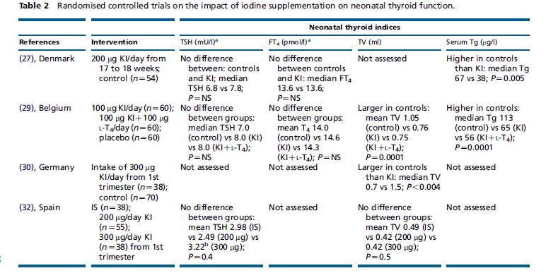
Impact of iodine supplementation in mild to moderate iodine deficiency: Systematic review and meta analysis (Cont’d)
Taylor P N, et al. Euro J Endocrinol 2014; 170: R1-R15

Slide 5
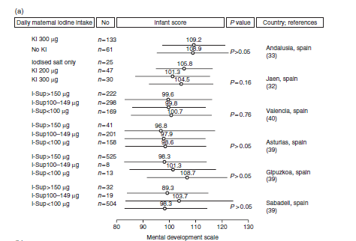
Impact of iodine supplementation in mild to moderate iodine deficiency: Systematic review and meta analysis (Cont’d)
The effect of maternal iodine supplementation on neurodevelopmental indices in the child
Taylor P N, et al. Euro J Endocrinol 2014; 170: R1-R15

Slide 6
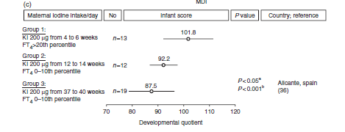
Impact of iodine supplementation in mild to moderate iodine deficiency: Systematic review and meta analysis (Cont’d)
The effect of maternal iodine supplementation on neurodevelopmental indices in the child (Cont’d)
Taylor P N, et al. Euro J Endocrinol 2014; 170: R1-R15

Slide 7
Apparent insufficiency of iodine supplementation in pregnancy
This cross sectional study conducted in New York City.
365 pregnant women including:
182 pregnant women took supplements containing 150 µg potassium iodide daily (Group A)
183 pregnant women took no supplements (Group B)
Clinical assessments:
Urinary iodine concentration (UIC)
Pessah-Pollack R, et al. Euro J Women Health 2014; 23: 51-56.

Slide 8
Apparent insufficiency of iodine supplementation in pregnancy (Cont’d)
Percentage of pregnant women with different levels of urinary iodine concentration
Odds ratio adjusted for age and race
Pessah-Pollack R, et al. Euro J Women Health 2014; 23: 51-56.

Slide 9
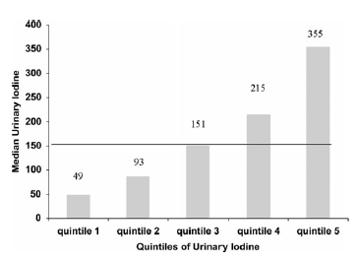
Apparent insufficiency of iodine supplementation in pregnancy (Cont’d)
Median UIC of pregnant women in New York City
50 % of pregnant women had UIC less than 150 µg/L
Pessah-Pollack R, et al. Euro J Women Health 2014; 23: 51-56.

Slide 10
Dairy product intake & Iodine status

Slide 11
Some subgroups of reproductive age women in the US may by at risk for iodine deficiency
This study conducted in the United State, using NHANES from 2001-2006.
Participants of this study including:
326 pregnant women
53 lactating women
1437 non-pregnant, non-lactating women
Clinical and dietary assessments:
Urinary iodine concentration (UIC)
Dairy intakes using 24 hr dietary recall
Perrine CG, et al. J Nutr 2010; 140: 1489-94.

Slide 12
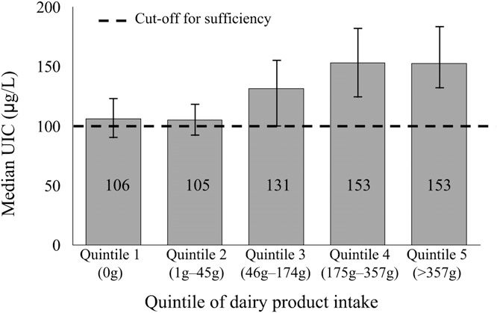
Some subgroups of reproductive age women in the US may by at risk for iodine deficiency (Cont’d)
The UIC of non-pregnant, non-lactating women by quintiles of dairy product intake
Perrine CG, et al. J Nutr 2010; 140: 1489-94.

Slide 13
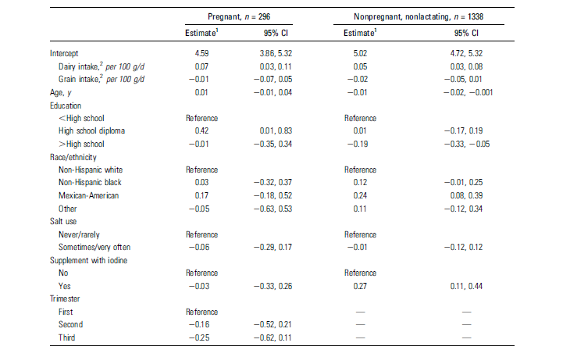
Some subgroups of reproductive age women in the US may by at risk for iodine deficiency (Cont’d)
The association of UIC and related factors
Pregnant women and non-pregnant and non-lactating women who do not consume dairy products may be at risk for iodine deficiency
Perrine CG, et al. J Nutr 2010; 140: 1489-94.

Slide 14
Iodine Fortification of Cow Milk by Feeding Potassium Iodide

Slide 15
Iodine in raw and pasteurized of dairy cows fed different amount of potassium iodide
This Interventional study conducted in Iran.
Sixteen Holstein cows were assigned to four treatments for 8 weeks:
Control diet
2.5, 5, and 7.5 KI/Kg dry matter
Biochemical assessments:
Iodine content of blood, urine, raw and pasteurized milk
Norouzian MA, et al. Biol Trace Elem Res 2011; 139: 160-167.

Slide 16
Iodine in raw and pasteurized of dairy cows fed different amount of potassium iodide (Cont’d)
Iodine concentration of blood, urine, raw and pasteurized milk samples
Iodine (μg/L) | Treatment (mg/Kg DM)
 | 0 | 2.5 | 5 | 7.5
Urine | 59.5 | 364.2 | 601.7 | 681.9
Blood | 177.37 | 326.8 | 339.6 | 381.4
Raw milk | 142.6 | 419.8 | 535.1 | 538.7
Pasteurized milk | 67.43 | 306.9 | 367.5 | 466.8
Iodine reduction by pasteurization process was 27.4%
Norouzian MA, et al. Biol Trace Elem Res 2011; 139: 160-167.

Slide 17
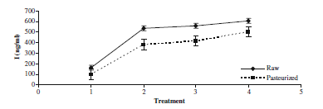
Iodine in raw and pasteurized of dairy cows fed different amount of potassium iodide (Cont’d)
The effect of heating pasteurization process on milk iodine concentration
1: basal diet (no potassium iodide, 2,3, and 4: diets supplemented by 2.5, 5, and 7.5 KI/Kg dry matter
Norouzian MA, et al. Biol Trace Elem Res 2011; 139: 160-167.

