Slide 1
Agenda:
TZDs Overview
Pioglitazone and Diabetes
Rosiglitazone and Diabetes
Pioglitazone vs. Rosiglitazone
TZDs Fracture Data
TZDs and Cancer
Summary.

Slide 2
Pioglitazone [Actos] : 15/30/45 mg
Rosiglitazone [Avandia]: 4mg/bid
Troglitazone (Rezulin) : Withdrawn from the U.S market in 2000 due to hepatotoxicity.
Action: Decrease in insulin resistance at peripheral sites and in the liver that results in increased insulin-dependent glucose disposal and decreased hepatic glucose output.
Peak Concentration : 2 to 4 hours
Initial Response : 4 weeks
Selective binding at the peroxisome proliferator activated receptor- gamma (PPAR-γ),which is found in adipose tissue, skeletal muscle, pancreatic beta-cells, vascular endothelium ,macrophages and the liver.

Slide 3
Troglitazone and Rosiglitazone : purely PPAR-γ agonists
Pioglitazone : some PPAR-α effects expressed mostly in liver, heart, skeletal muscle and vascular walls.This may account for the different effects on lipids.
Dual PPAR (α&γ)agonists: Muraglitazar(FDA-approved ; Cardiac Safety?)
Reported Adverse Effects:
Weight gain : dose-dependent and time-dependent
fluid retention & proliferation of new adipocytes
Fluid retention : more prominent with concomitant insulin therapy
PPAR-gamma stimulation of sodium reabsorption by the collecting tubule cells
Decreased bone density,Hepatotoxicity ,Macular edema and Eczema.

Slide 4
Dose adjustment : NOT necessary in
renal insufficiency or elderly
Should not be used in:
active liver disease or serum ALT > 2.5 times
Interactions:
Hyperglycemia : with atorvastatin, rifampin, licorice
Hypoglycemia : with eucalyptus ,ketoconazole ,psyllium

Slide 5
DREAM trial
A decrease in diabetes in subjects with IFG or IGT who were treated with rosiglitazone was reported.
Metformin and thiazolidinediones had similar efficacy as monotherapy.
The cost and side effects of thiazolidinediones make them less appealing as initial therapy and do not suggest for diabetes prevention.

Slide 6
Pioglitazone for type 2 diabetes mellitus
Richter B, Bandeira-Echtler E, Bergerhoff K, Clar C, Ebrahim SH. Cochrane Database of Systematic Reviews 2006, Issue 4. Art. No.: CD006060. DOI: 10.1002/14651858.CD006060.pub2.

Slide 7
Objectives
To assess the effects of pioglitazone in the treatment of type 2 diabetes.
Selection criteria
RCTs in adult people with type 2 diabetes mellitus and a trial duration of at least 24 weeks.
22 trials , randomised approximately 6200 people

Slide 8
Results
No convincing evidence that patient-oriented outcomes like mortality, morbidity, adverse effects, costs and health-related quality of life are positively influenced by this compound.
HbA1c : not demonstrate clinically relevant differences to other oral antidiabetic drugs.
Occurrence of oedema was significantly raised.

Slide 9
Conclusion
Until new evidence becomes available, the benefit-risk ratio of pioglitazone remains unclear.

Slide 10
Rosiglitazone for type 2 diabetes mellitus
Richter B, Bandeira-Echtler E, Bergerhoff K, Clar C, Ebrahim SH.Cochrane Database of Systematic Reviews 2007, Issue 3. Art. No.: CD006063. DOI: 10.1002/14651858.CD006063.pub2.

Slide 11
Objectives
To assess the effects of rosiglitazone in the treatment of type 2 diabetes.
Selection criteria
RCTs in adult people with type 2 diabetes mellitus and a trial duration of at least 24 weeks.
18 trials, randomised 3888 people

Slide 12
Results:
No evidence that patient-oriented outcomes like mortality, morbidity, adverse effects, costs and health-related quality of life are positively influenced by this compound.
HbA1c as a surrogate endpoint did not demonstrate clinically relevant differences to other OADs
Occurrence of oedema was significantly raised (OR 2.27, 95% confidence interval : 1.83 to 2.81)
ADOPT - A Diabetes Outcomes Progression Trial indicated increased cardiovascular risk.
Persons taking rosiglitazone had a mean glycosylated hemoglobin (HbA1C) after 4 years that was 0.42% lower than those in the glyburide arm, but the rate of MIs was higher in the rosiglitazone arm—1.8% as opposed to 1.2% with glyburide.

Slide 13
conclusions
New studies should focus on patient-oriented outcomes to clarify the benefit-risk ratio of rosiglitazone therapy.
Safety data and adverse events of all investigations (published and unpublished) should be made available to the public.

Slide 14
Reported Effects of TZDs on Bone Metabolism
Inhibited bone formation and mineralization (Johnson et al., 1999)
Decreased osteoblastogenesis, increased bone marrow adiposity in men and women (Okazaki et al., 1999; Watanabe et al., 2003)
Induced bone loss in older diabetic women (Schwartz et al., 2006)
Decrease in bone osteoblast markers pro-collagen type-1 N-terminal pro-peptide (P1NP) and osteocalcin, but no change in type 1 collagen N-telopeptide (NTX) (Grey et al., 2007)
ADOPT trial reported a higher risk of fractures in diabetic women randomized to rosiglitazone compared to metformin and glyburide (Kahn et al., 2006)

Slide 15
Effects of Thiazolidinediones on Aromatase Activity
Inhibitory effects on aromatase enzyme activity by interfering with the androgen substrate binding to aromatase (Seto-Young et al., 2007; Avtanski et al., 2007)
Reduced estrogen biosynthesis in human granulosa cells (Seto-Young et al., 2007; Avtanski et al., 2007)

Slide 16
Hypothesis
TZDs may inhibit aromatase enzyme activity in human granulosa cells, possibly leading to reduced estrogen synthesis and consequently increased risk of osteoporosis.

Slide 17
Arch Intern Med. 2008;168(8):820-825

Slide 18
The association between the use of thiazolidinediones or other oral antidiabetic drugs and the risk of fracture.
A nested case-control analysis uses 1020 case patients with an incident low-trauma fracture aged 30 to 89 years with an incident fracture diagnosis between January 1994 and December 2005 and 3728 matched controls.
Assessed the odds ratios (ORs) of having a fracture associated with the use of rosiglitazone maleate, pioglitazone hydrochloride, other oral antidiabetic agents, or insulin.

Slide 19
Results
After adjustment for age, body mass index, other antidiabetic drugs, comedication, and comorbidities:
Rosiglitazone (OR, 2.38; 95% CI, 1.39-4.09)
pioglitazone (OR, 2.59; 95% CI, 0.96- 7.01)
predominantly hip and wrist fractures
The association was independent of patient age and sex and tended to increase with thiazolidinedione dose.
No altered relative fracture risk with other OADs

Slide 20
Conclusion
Possible association between long-term use of thiazolidinediones and fractures, particularly of the hip and wrist, in patients with diabetes mellitus.

Slide 21
Long-term use of thiazolidinediones and fractures in type 2 diabetes: a meta-analysis
Yoon K. Loke MBBS MD, Sonal Singh MD MPH, Curt D. Furberg
CMAJ 2009;180(1):32-9 MD PhD

Slide 22
Selected long-term (≥ 1 year) RCTs involving patients with type 2 diabetes and controlled observational studies that described the risk of fractures or changes in bone density with thiazolidinediones.
Calculated pooled odds ratios (ORs) for fractures and the weighted mean difference(WMD)in bone density.

Slide 23
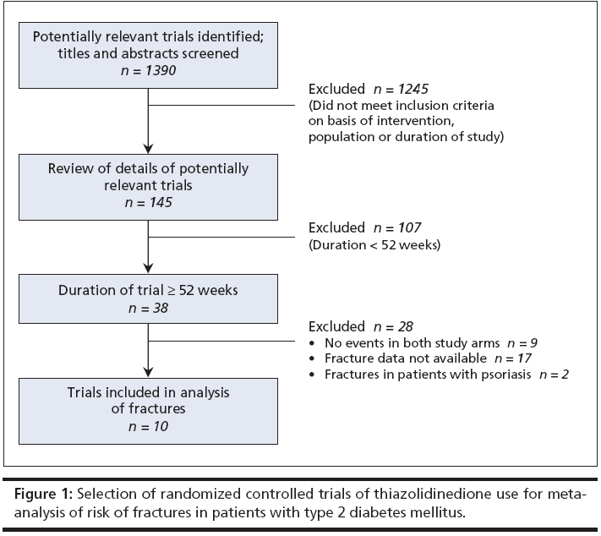
10 randomized controlled trials involving 13715 participants and 2 observational studies involving 31 679 participants.

Slide 24
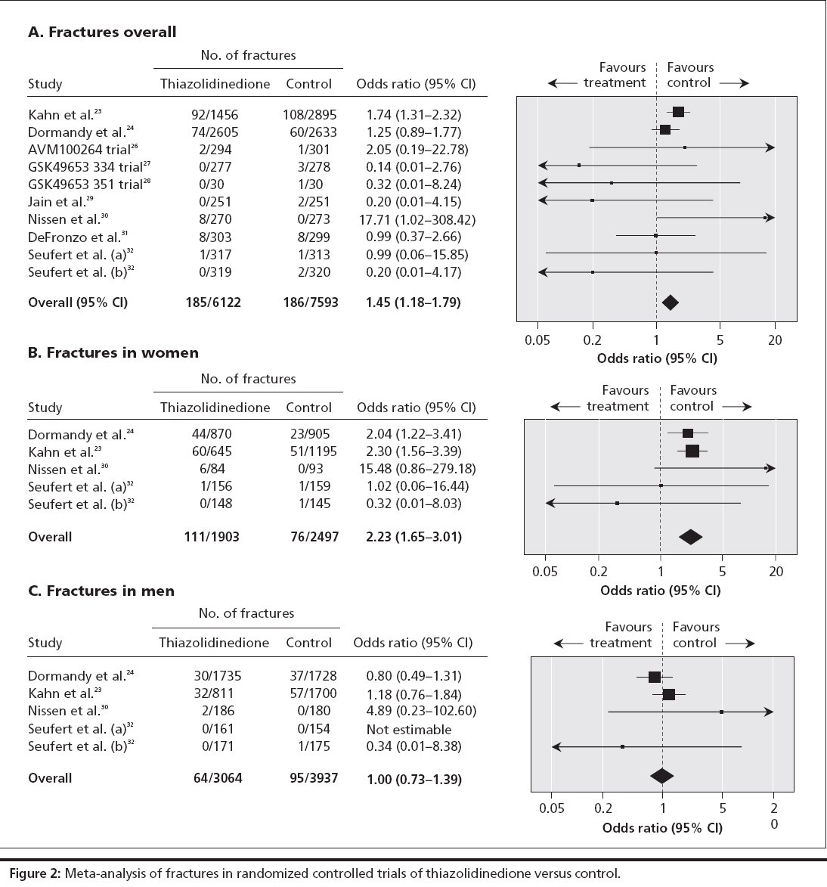

Slide 25
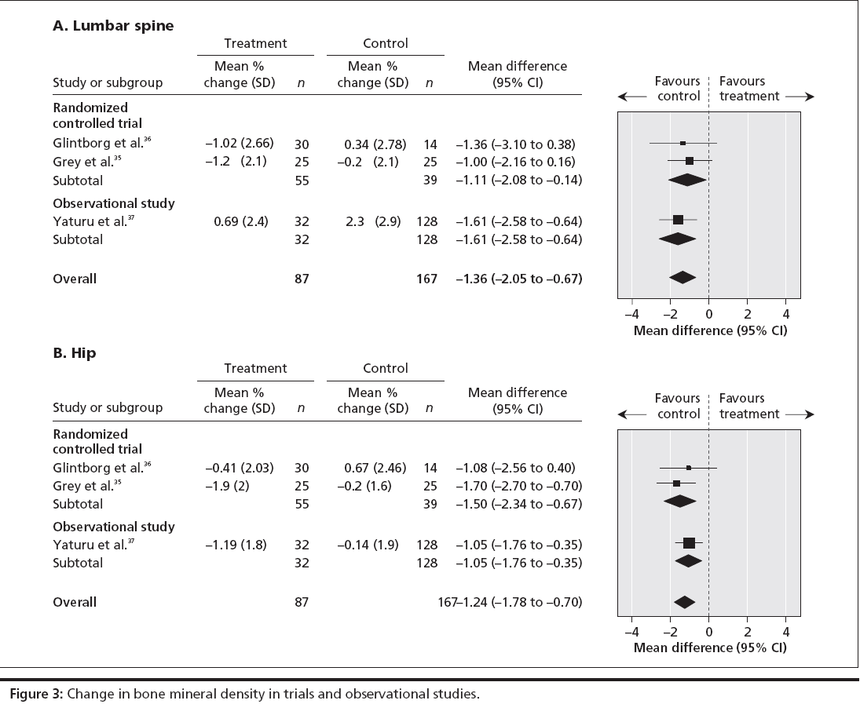

Slide 26
Results
Rosiglitazone and pioglitazone were associated with a significantly increased risk of fractures overall in the 10 randomized controlled trials (OR 1.45, 95% confidence interval [CI] 1.18–1.79; p < 0.001).
Five randomized controlled trials showed a significantly increased risk of fractures among women (OR 2.23, 95% CI 1.65–3.01; p < 0.001) but not among men (OR 1.00, 95% CI 0.73–1.39; p = 0.98).
The 2 observational studies demonstrated an increased risk of fractures associated with rosiglitazone and pioglitazone.
Bone mineral density in women exposed to thiazolidinediones was significantly reduced at the lumbar spine (weighted mean difference –1.11%, 95% CI –2.08% to –0.14%; p = 0.02) and hip (weighted mean difference –1.24%, 95%CI –2.34% to –0.67%; p < 0.001) in 2 randomized controlled trials.

Slide 27
Interpretation
Long-term thiazolidinedione use doubles the risk of fractures among women with type 2 diabetes, without a significant increase in risk of fractures among men with type 2 diabetes.
For every 20 women in their 70s with type 2 diabetes who took thiazolidinediones for at least one year, one of them has a chance of suffering a fracture. In women in their mid-50s, the figure equals one fracture in every 55 women.

Slide 28
Cohort study of pioglitazone and cancer incidence in patients with diabetes Diabetes care, 34 : 923-929,2011

Slide 29
10 most common sites (prostate, female breast, lung/bronchus, endometrial, colon, non-Hodgkin lymphoma [NHL], pancreas, kidney/renal pelvis, rectal, and melanoma)
Cohort study of 252,467 patients
age ≥ 40 & max F/U duration six years

Slide 30
Hazard ratio (HR) for each cancer associated with ever use of pioglitazone ranged from 0.7 to 1.3, with all CIs including 1(HR 1.3 [95% Cl 0.9-2.0]) and NHL (1.3 [1.1 – 1.8]) and a decreased risk of kidney/renal pelvis cancers (0.7 [0.4-1.1])

Slide 31
Conclusion
No clear evidence of an association between use of pioglitazone and risk of the incident cancers

Slide 32
Risk of bladder Cancer among diabetic patients treated with pioglitazone Interim report of a longitudinal cohort study Diabetes care,22,2011

Slide 33
Preclinical in vivo studies :
possible increased risk of bladder cancer with pioglitazone
193,099 patient ≥ 40 years of age
prior bladder cancer was excluded

Slide 34
Pioglitazone group : 30,173 patients
90 cases of bladder cancer among pioglitazone users
791 cases of bladder cancer among nonioglitazone users
Pioglitazone : not associated with risk of bladder cancer:
Hr 1.2 [95% CI: 0.9-1.5]
≥ 24months of therapy : increased risk (1.4 [1.03-2.0])

Slide 35
Conclusions
Short-term use of pioglitazone
not associated with an increased incidence of bladder cancer
use for more than 2 years, weakly associated with increased risk.

Slide 36
Thiazolidinediones : A possible second step option in the algorithm for management of patients with type II diabetes who are not well controlled on diet/lifestyle/metformin, as an alternative to insulin (most effective) and sulfonylureas (cheapest)
TZDs : Similar effects on glycemic control. Provide equivalent improvements in markers of insulin resistance and inflammation
TZDs: Minimal or neutral effect on systolic and diastolic BPs
The risk of heart failure is a class effect
Benefits on a surrogate measure such as HbA1C should be balanced against their complex actions elsewhere in the body, including a doubling of the risk of bone fractures among women, which may negate any potential gain.

Slide 37
Rosiglitazone is not approved for use alone, or with a sulfonylurea drug, except when metformin is contraindicated.
Rosiglitazone is not indicated in combination with Insulin or as triple therapy for patients with type II diabetes mellitus.
Rosiglitazone is not indicated for patients with heart failure or Hx of heart failure.
Rosiglitazone has minimal or no effect on coronary events,AMI,all-cause mortality and CV-mortality.

Slide 38
Increased caution with the use of rosiglitazone,especially in patients with CHF
Any potential cardiovascular benefits must be weighed against the increased risk of heart failure.
Patients with type 2 diabetes should probably not be started on rosiglitazone.
Most randomized trials found that pioglitazone produces a more favorable lipid profile .
Pioglitazone may be considered, but concerns about side effects(weight gain, fluid retention and heart failure) persist.
Except for CHF;other cardiac outcomes are better with pioglitazone.

