Slide 1
In the Name of God

Slide 2
Bariatric surgery in adolescent
z.Zarghamifard
General surgeon & fellowship of mis

Slide 3
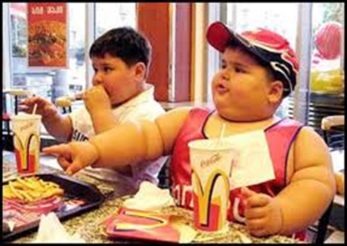
Bariatric surgery in adolescent
Preliminary data: safe & effective
Periop complication rate: similar or better than adults
Increasing number of surgeries
75% of obese adults were obese adolescents

Slide 4
Comorbid diseases of childhood obesity
Glu impairment:
Ins resistance
DM II
Cardiac disorders:
L ventricular hypertrophy
HTN
Psychological disorders:
Increased risk of depression in adolescence & adulthood

Slide 5
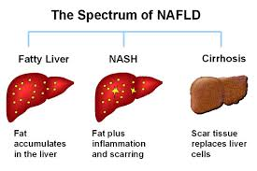
Comorbid diseases of childhood obesity
Liver disease: NAFLD & NASH
Closed link to obesity & insulin resistance
Cirrhosis in 25% of adults
In Xanthakos study(41 p/BMI:59/RYGB) in liver Bx:
24% NAFLD/ 7% fibrosis/ 20% NASH
In comparision with adults:
lower rate of NASH in adolescent
Not strong correlation between histopathology & clinical features(metabolic dis)
Improvement of liver dis by bariatric surg

Slide 6
Comorbid diseases of childhood obesity
Obstructive sleep apnea (OSA):
In 46% of obese children
No treatment: chronic fatigue:
Significant functional impairment
Personality change & poor education
Increased risk of HTN/ cardiac dysfunction & sudden death
Improvement of OSA by surgery

Slide 7
Adolescent bariatric care model
Early guideline: in 2004
Multidisciplinary approach
Team:
Surgical specialist
Medical specialist
Dietician
Psychiatric or psychologist
Exercise physiologist/physical therapist for safe physical activity education
Bariatric program coordinator: for preop & postop Tx
Social worker: not mondatory

Slide 8
Patient selection
BMI≥35 with major comorbid dis:
DM II
Pseudotumor cerebri
Severe NASH
Mod to severe OSA(apnea-hypopnea index>15)
BMI≥40 withg less severe comorbidity
Glu intolerance
HTN
Dyslipidemia
Impaired W-related quality of life
Mild to moderate OSA(apnea- hypopnea index>5)

Slide 9
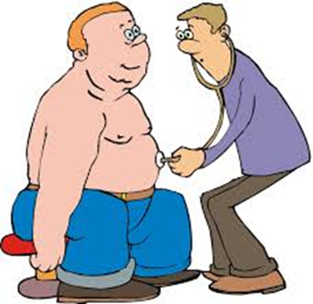
Patient selection
Psychosocial maturity level:
understanding risk & benefits
Support mechanism:
By parents or …
Decision of team

Slide 10
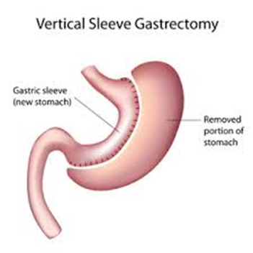
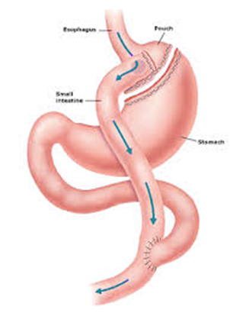
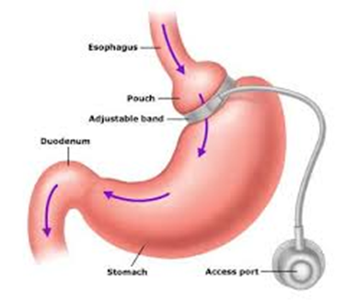
Type of surgery
No consensus
Overalll results: comparable or better than adults
Most commonly:
RYGB
LAGB
VSG

Slide 11
RYGB in adolescents
1960 for adults & 1970 for adolescents
Similar or better results than adults
Long term nutrition & metabolic outcomes??
Current literature:
RYGB is safe & efficacious

Slide 12
LAGB in adolescents (adjustable gastric banding)
FDA not approved
Increased incidence(2007-2009 study)
Complication similar to adults, commonly:
Band slippage
Nutritional deficiency (iron & mild hair loss)
8-10% reoperation & band removal
No death
Weight loss: 28% reduce in BMI vs 3% in changed life style
Resolution of HTN & DM II in many cases
Improvement of quality of life

Slide 13
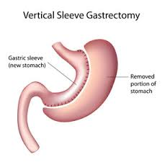
VSG in adolescents (vertical sleeve gastrectomy)
Increased incidence in past years
Less severe complications
No death
Significant W loss
Complete resolution of many cases of:
HTN ins resistance
Dyslipidemia
DM II
simplicity

Slide 14
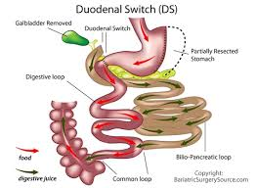
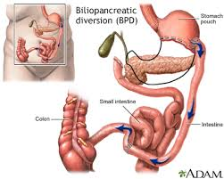
Malabsorptive techniques in adolescents
There is reported cases
Malabsorption especially protein
High rate of reoperation
Complex technique

Slide 15
Bariatric surgery in adolescents
Recommended
But
We need more study

Slide 16
THANKS

