Slide 1
Resistant Hyperprolactinemia
A.H. Ghanooni M.D.
Fellow of Endocrinology
Farvardin 96

Slide 2
Agenda
Definition of Dopamine Agonist Resistance
Mechanisms of Dopamine Agonist Resistance
Prevalence of resistant hyperprolactinemia
therapeutic strategy in resistant hyperprolactinemia

Slide 3
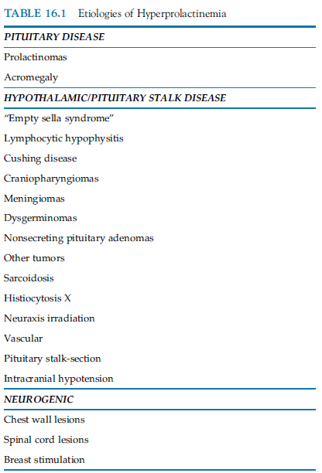
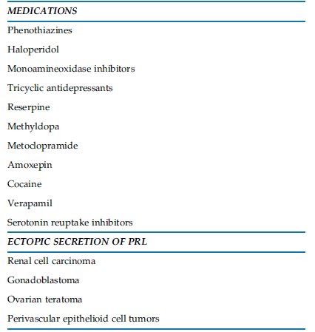
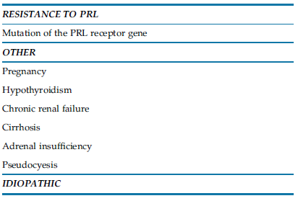

Slide 4
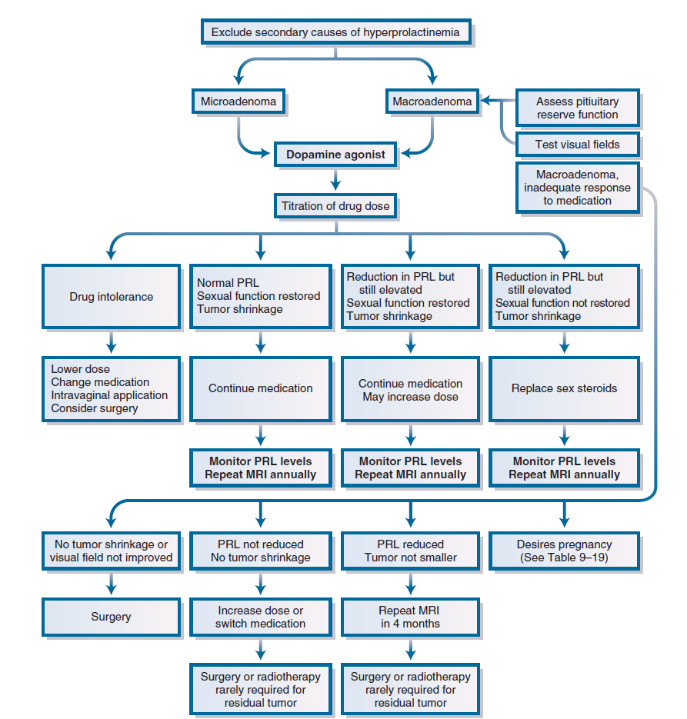

Slide 5
Agenda
Definition of Dopamine Agonist Resistance
Mechanisms of Dopamine Agonist Resistance
Prevalence of resistant hyperprolactinemia
therapeutic strategy in resistant hyperprolactinemia

Slide 6
Definition of Dopamine Agonist Resistance
varying definitions throughout the literature :
failure to normalize prolactin levels,
Or failure to reduce prolactin levels sufficiently to achieve ovulation,
Or failure to enable a 50% reduction of hyperprolactinemia
The pituitary fourth edition S. Melmed 2017

Slide 7
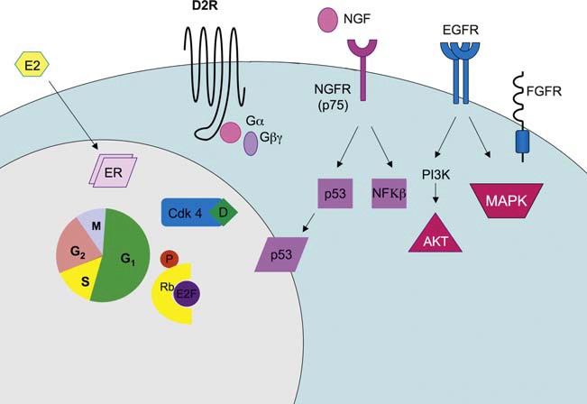
Mechanisms of Dopamine Agonist Resistance
Lactotroph cell

Slide 8
Mechanisms of Dopamine Agonist Resistance
reduction in D2R expression, but not altered binding affinity.
disruptions in autocrine growth factor signaling mediated by nerve growth factor may accompany or lead to D2R down-regulation.
A reduced proportion of short to long D2R isoforms may also contribute to reduced dopamine agonist responsiveness.
decrease in the G protein that couples the D2 receptor to adenyl cyclase, further decreasing the ability of dopamine to inhibit PRL secretion

Slide 9
Agenda
Definition of Dopamine Agonist Resistance
Mechanisms of Dopamine Agonist Resistance
Prevalence of resistant hyperprolactinemia
therapeutic strategy in resistant hyperprolactinemia

Slide 10
Prevalence of Dopamine Agonist Resistance
estimated prevalence of DA resistance is approximately 24% for bromocriptine and 11% for cabergoline
is more frequent in cases of macroprolactinomas (36%),
is characteristic of invasive tumors and male gender.
The pituitary fourth edition S. Melmed 2017

Slide 11
122 patients (72 women and 50 men)
primarily treated with CAB for at least 1 year
Main outcome measures were serum prolactin (PRL) and tumor size.
Results: Normalization of PRL was obtained in 115 out of the 122 patients (94%).
Most tumors (98/119 assessable cases, 82%) showed a signiﬁcant shrinkage during CAB treatment.

Slide 12
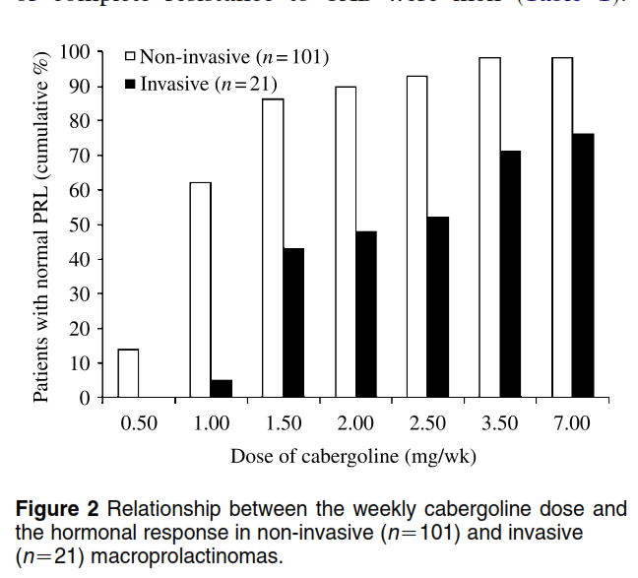
The majority of patients (96/115, 83%) were controlled with a CAB dose ≤1.5 mg/week.
Most of the other patients (19/26) had only a partial resistance, responding to a further increase of the CAB dose. Beyond the dose of 3.5 mg/week, there was no clear advantage in further increasing the dose instead of continuing the treatment at the same dose.

Slide 15
Key Messages
Complete resistance to cabergoline is rare.
In macroprolactinoma, 96 (79%) achieved normal PRL levels with standard doses of cabergoline (0.5-1.5 mg/week),
19 (15%) required higher doses (2.0-7.0 mg/week),
and only 7 (6%) could not achieve medical control.
About 20% of patients, mainly men and/or those with invasive tumors will require a higher dose of CAB.
Thus, “partial” resistance can often be overcome by increasing the dose stepwise to maximal tolerable doses.

Slide 16
How to start Cabergoline?... How much longer?...
The recommended regimen for cabergoline treatment is to start with a dose of 0.25–0.5 mg, once or twice a week,
escalating it at 1–3 monthly intervals depending on the serum prolactin levels.
Therapy with cabergoline is continued for at least 2 years after the normalisation of prolactin and disappearance of the tumour.

Slide 17
Witch dose of Cabergoline is maximum?
0.5 mg/week to 2.0 mg/week, a few will require doses of 3.5 mg or even more to be controlled (The Pituitary 2017)
Doses of medication are either increased gradually, as tolerated. (Williams 2016)
maximum of 1 mg twice weekly for cabergoline (UpToDate 2017)

Slide 18
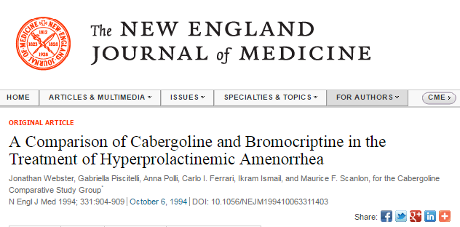
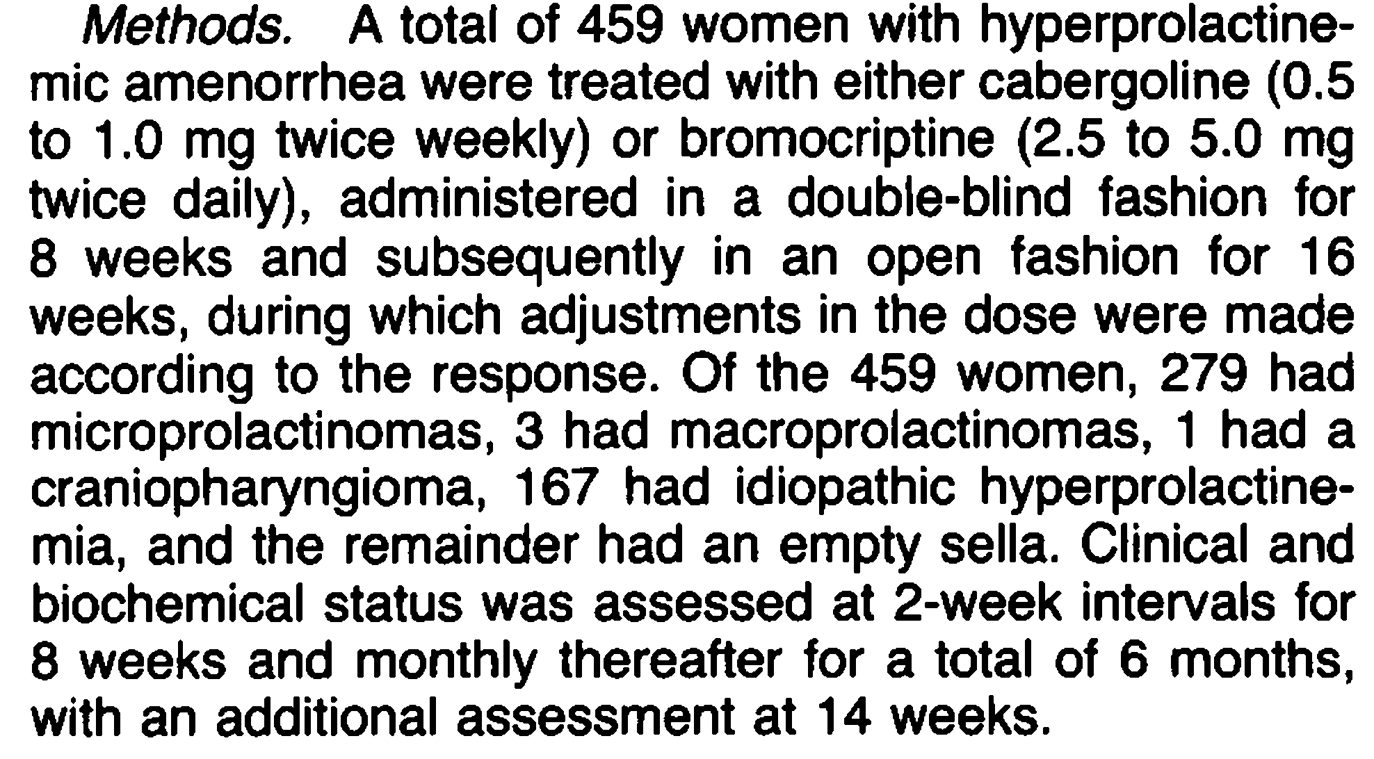

Slide 19
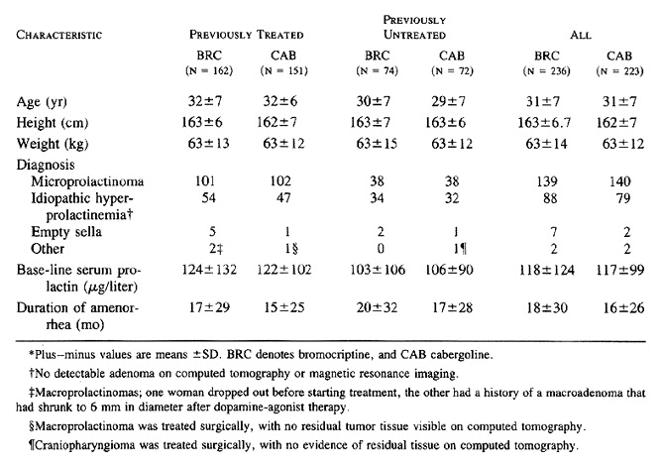

Slide 20
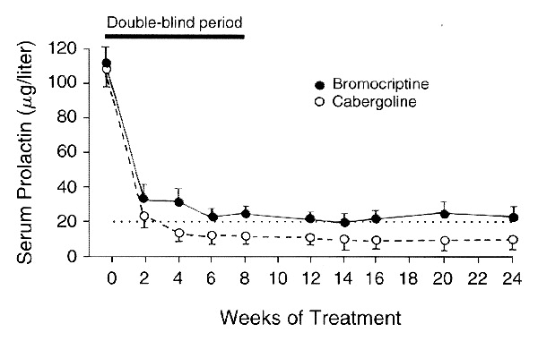

Slide 21
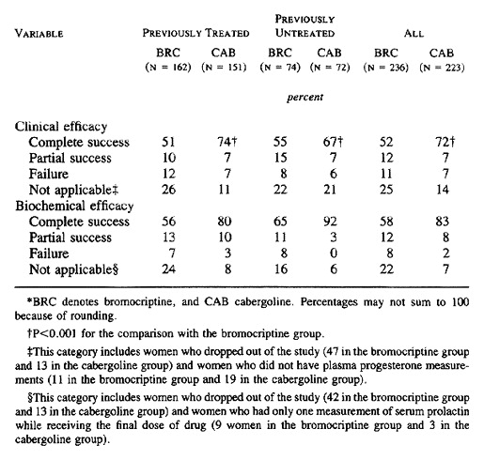

Slide 22
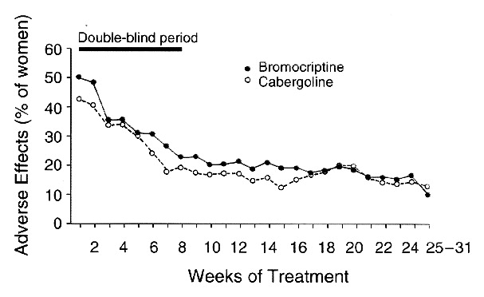

Slide 23
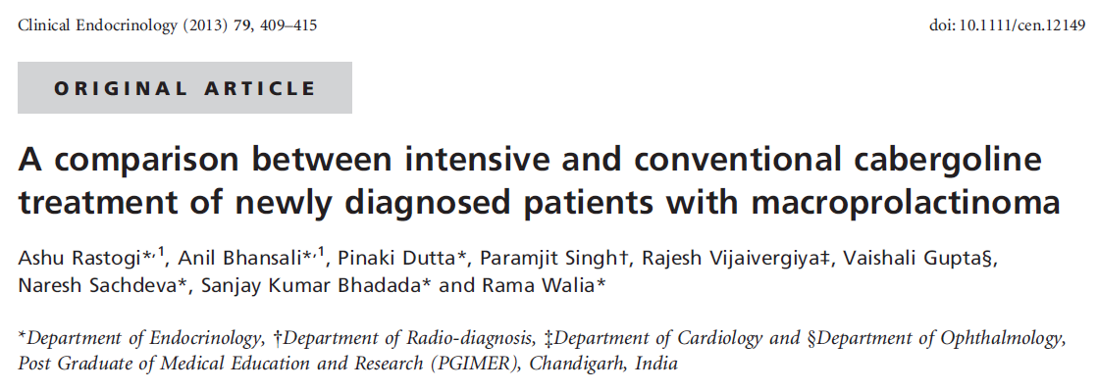
Prospective, randomized
38 patients (19 in each group) with macroprolactinoma
mean follow-up of 64.3 weeks
conventional (4 weekly escalation by 0.5 mg per week, group A) or intensive (weekly increase by 1 mg per week followed by 4 weekly escalation, group B) treatment with cabergoline.
Outcome : normoprolactinemia and tumor shrinkage of >50%

Slide 24
Cabergoline was started at a conventional dose of 0.5 mg once a week (group A), increasing every 4 weeks by 0.5 mg per week until serum prolactin was normalised. If prolactin levels normalized, but the reduction in tumour volume was <10% from the previous imaging, cabergoline doses were further increased until the composite end-point was achieved and were planned to continue on a maintenance dose for atleast 2 years of therapy. The maintenance dose was defined as the dose at which the patient achieved composite end-point in both the groups. The maximum dose of cabergoline in this group was 6 mg (05–60 mg). A 10% cut-off was taken as a marker of response because of intra-individual and inter-individual variability in reporting of tumour dimensions is <10%.
In the intensive treatment group(group B), cabergoline was started at a dose of 0.5 mg twice a week and the dose was increased each week by 1 mg for 4 weeks and then by a further 1 mg per week every month thereafter, until serum prolactin was normalised. If prolactin normalized before 4 weeks, the dose at which prolactin first normalized was continued till the end of the fourth week, at which time the first follow-up imaging was performed. If serum prolactin normalised without significant shrinkage of tumour, the cabergoline dosage was increased, until the composite end-point was achieved. The ceiling dose of cabergoline was taken as 12 mg per week (10–120), based on the previous studies.

Slide 25
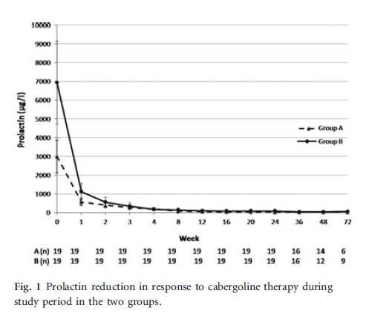
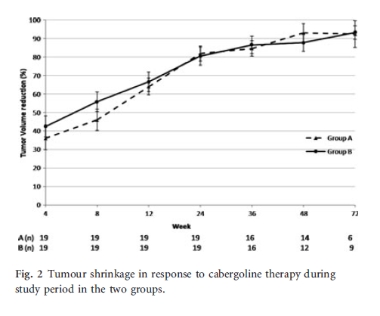
Results : (22%) achieved the composite end-point in group B (18/19) as compared to the group A (14/19) (P = 0.18).
The duration of cabergoline treatment required to achieve the composite end-point was 13.1 weeks vs 19.3 weeks (P = 0.34) in the group A and B, respectively.

Slide 26
Key Message

Slide 28
Agenda
Definition of Dopamine Agonist Resistance
Mechanisms of Dopamine Agonist Resistance
Prevalence of resistant hyperprolactinemia
therapeutic strategy in resistant hyperprolactinemia

Slide 29
Therapeutic strategy in resistant hyperprolactinemia
switching to another dopamine agonist
Increasing the dose stepwise to maximal tolerable doses.
To overcome “partial “ resistance cases

Slide 30
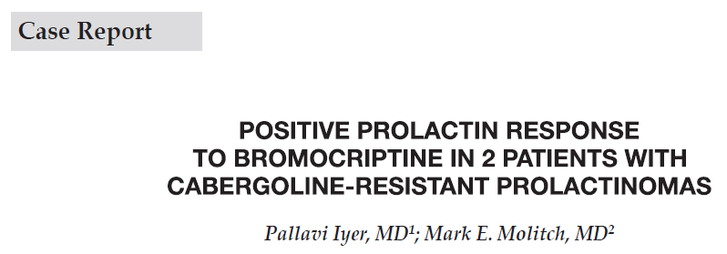

Slide 31
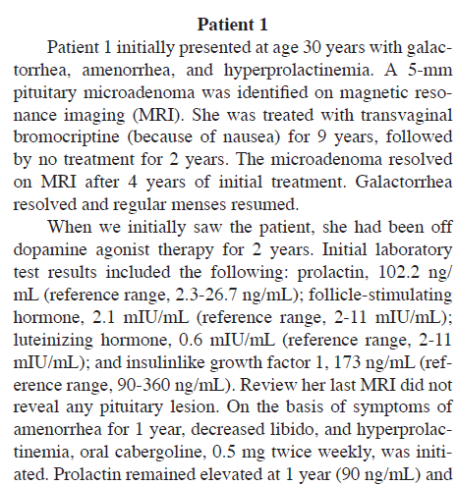
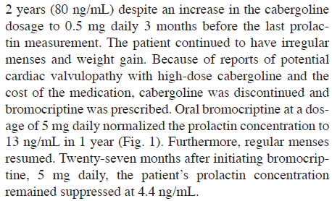

Slide 32
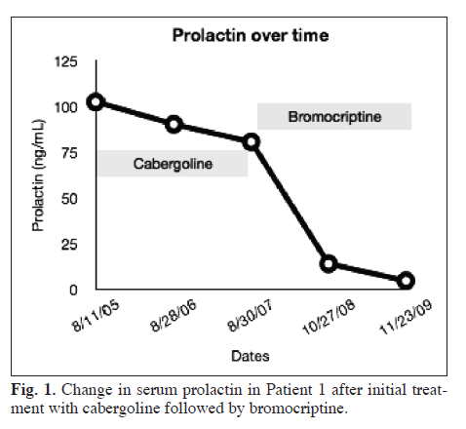
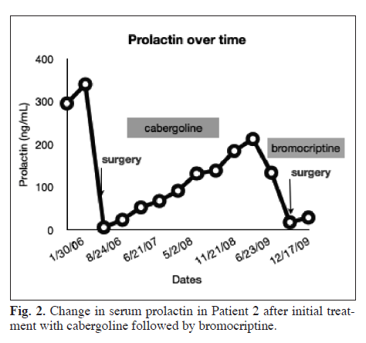

Slide 33
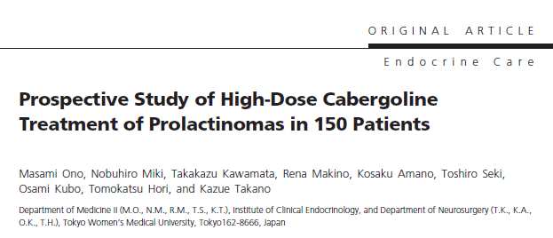
122 women and 28 men (93 microadenomas and 57 macroadenomas).
participants were separated into 3 gorups :
untreated (group U; n=60),
intolerant (group I; n=64),
resistant (group R; n=26)

Slide 34
Group U consisted of 60 previously untreated patients.
Group I consisted of 64 patients who had shown intolerance to other dopamine agonists.
Group R consisted of 26 patients who had shown resistance to other dopamine agonists.
Patients in group I had a history of taking bromocriptine or terguride for 7 wk to 12 months but because of side effects could not continue to take a minimal effective dose of either drug every day.
Patients in group R were those in whom bromocriptine failed to normalize hyperprolactinemia despite long-term (more than 6 months) treatment with high doses ranging from 15 to 75 mg/d.

Slide 35
Results: Cabergoline normalized hyperprolactinemia in all patients except one.
The proportion of prolactin normalization in both groups U and I was 83% at 3 months and 95%at 6 months.
By contrast, that in group R was 35% at 3 months and 58% at 6 months.
Mean cabergoline dose in milligrams per week at the time of prolactin normalization was:
2.0± 0.3 in group U
0.9 ± 0.1 in group I
5.2 ± 0.6 in group R
Prolactin normalization rate at the 3mg/wk dose was 84% overall but only 35% in group R.

Slide 36
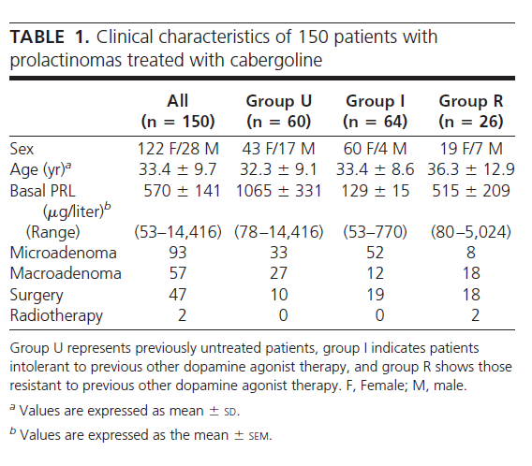

Slide 37
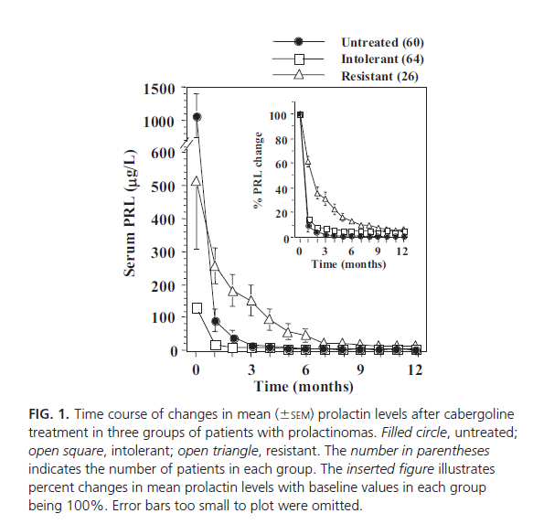

Slide 38
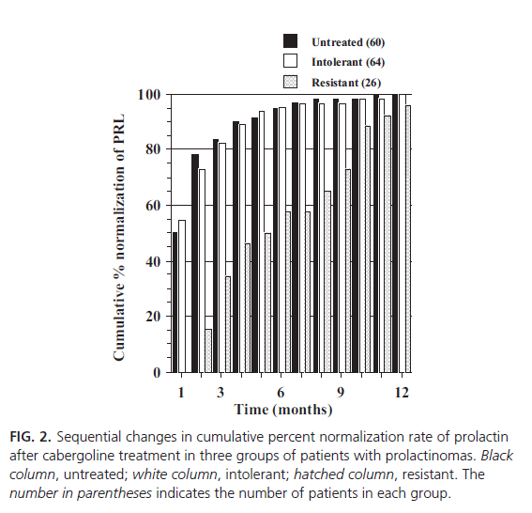

Slide 39
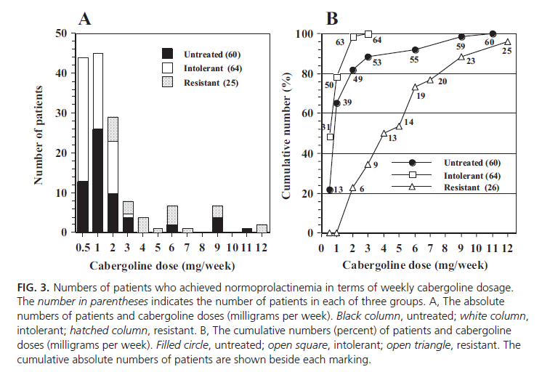

Slide 40
Therapeutic strategy in resistant hyperprolactinemia
Increasing the dose stepwise to maximal tolerable doses.
To overcome “partial “ resistance cases
In the absence of symptoms of intolerance, maintaining maximal doses at 3.5 mg/week may in the long term lead to hormonal control in half of patients after a time interval of several months.
As long as adverse effects with higher doses do not develop, dose escalations are reasonable, with the expectation that dose reduction will be attempted in the future, and patients are informed of the potential association with cardiac valvular fibrosis as reported in patients taking very large doses of cabergoline.
The Pituitary fourth edition 2017

Slide 41
Two Question…?
What dose level of Cabergoline is significant for cardiac valvular fibrosis?
Is it necessary to assess all patient receiving any dose of Cabergoline ?

Slide 42
Answer …!!
With conventional doses of cabergoline, i.e. ≤2 mg/week there does not appear to be any increased risk of cardiac valve abnormalities.
it is uncertain at what dose level these valve effects become significant.
It is prudent to assess all patient receiving >2 mg/week with an echocardiogram on a yearly basis.
it is reasonable to perform the first echocardiogram at the time of initiation of a dose >2 mg/ week, so that future echocardiograms can then be used to evaluate for changes.
Mark E. Molitch. Management of medically refractory prolactinoma. J Neurooncol. 2013

Slide 43
Therapeutic strategy in resistant hyperprolactinemia
Surgery
Accepted indications include:
unstable neurological dysfunction associated with pituitary apoplexy
other acute complications such as CSF leak, which may sometimes result from a dramatic tumor reduction under medical therapy
failure of medical therapy to adequately reduce PRL levels to alleviate hypogonadism
persistent tumor growth despite adequate medical therapy
pregnancy-related tumor expansion with neuroophthalmologic deficits refractory to medical therapy
in preparation for a planned pregnancy following a previous pregnancy complicated by worrisome pituitary tumor enlargement.
young patients with a high likelihood of complete tumor resection and who do not wish to take prolonged medical treatment, and patients with predominantly cystic tumors, although this last indication is debated.
The Pituitary fourth edition 2017

Slide 45
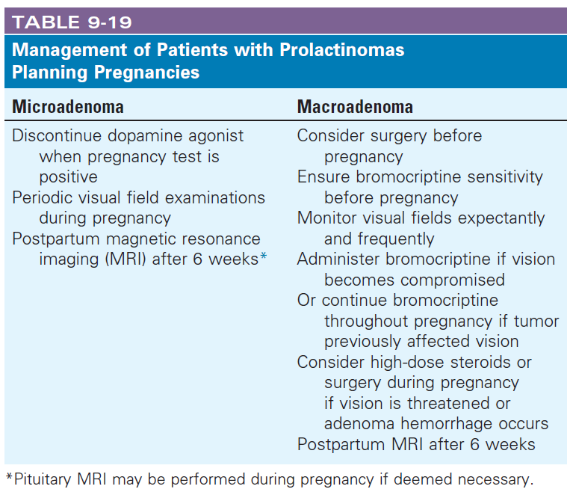

Slide 46
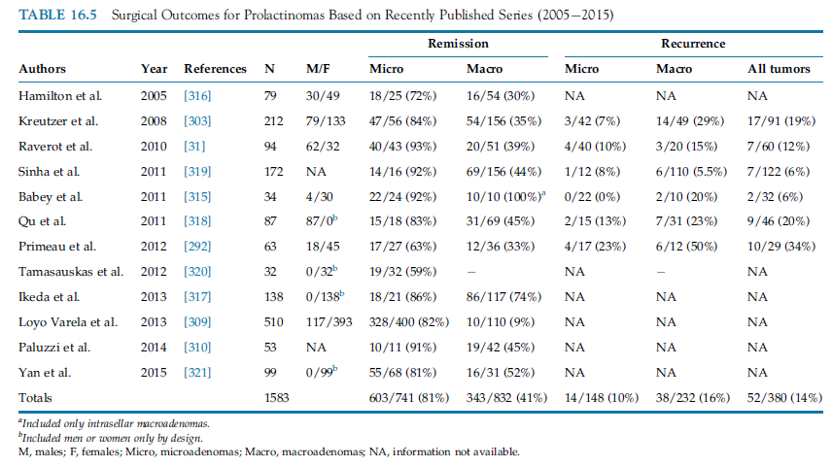

Slide 47
Therapeutic strategy in resistant hyperprolactinemia
Radiotherapy
For patients who :
fail surgical treatment &
aggressive prolactinomas
Although radiotherapy may rapidly control tumor growth, it may require up to 20 years (a mean of 7.3 years after treatment) for maximal antisecretory effects to be achieved
normalization of hyperprolactinemia occurs in only one-third of the cases.
The Pituitary fourth edition 2017 &
Gillam MP et al. Advances in the treatment of prolactinomas. Endocr Rev 2006;27(5):485534.

Slide 48
Therapeutic strategy in resistant hyperprolactinemia
The others
If fertility is a major concern, induction of ovulation is possible in hyperprolactinemic patients even without lowering PRL levels, using clomiphene citrate, gonadotropins, and pulsatile GnRH therapy.

Slide 49
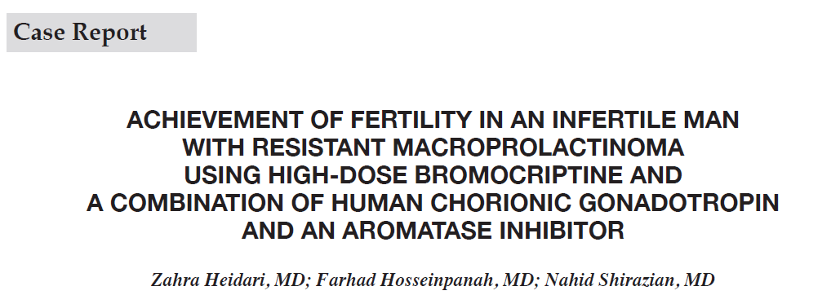

Slide 50
a 36-year-old infertile man who failed to attain a normal serum testosterone level and fertility with use of either bromocriptine or cabergoline treatment.
Testosterone replacement or hCG therapy in this patient resulted in an increase in serum prolactin levels, which declined after discontinuation of this therapy.
The combination of high doses of bromocriptine, hCG, and an aromatase inhibitor facilitated near-normalization of serum prolactin levels, shrinkage of the macroprolactinoma, recovery of serum testosterone levels, sexual function, and sperm count, and achievement of fertility.

Slide 52
Therapeutic strategy in resistant hyperprolactinemia
The others
Pergolide:
an ergot derivative dopamine agonist
used primarily for the treatment of Parkinson disease.
At the high dose used for Parkinson disease (>3 mg/day), pergolide was associated with an increased risk of valvular heart disease.
In the United States, pergolide was voluntarily withdrawn from the market in March 2007 due to this risk.
Much lower doses were used for hyperprolactinemia.

Slide 53
Therapeutic strategy in resistant hyperprolactinemia
The others
Quinagolide:
a nonergot dopamine agonist
is available in some countries but not the United States.
The starting dose is 0.075 mg once a day, which can be increased to twice a day and a maximum total daily dose of 0.9 mg.
it is not an ergot derivative so valvular heart disease is not a concern.
Quinagolide appears to have equivalent therapeutic effects to cabergoline in reducing serum prolactin and adenoma size.
J Clin Endocrinol Metab 1991; 72:1136. & Clin Endocrinol (Oxf) 2000; 53:53.

Slide 54
Therapeutic strategy in resistant hyperprolactinemia
The others
Temozolomide:
an alkylating agent that induces DNA damage to disrupt gene transcription
to treat aggressive pituitary tumors in patients who have failed to respond to other therapies or who have evidence of pituitary carcinoma
methylguanine- DNA methyltransferase (MGMT) may interfere with drug efficacy,
response to temozolomide may sometimes be predicted by low tumor staining for MGMT, but this approach is not uniformly accepted.

Slide 55
Conclusion
estimated prevalence of DA resistance is approximately 24% for bromocriptine and 11% for cabergoline
is more frequent in cases of macroprolactinomas (36%), invasive tumors and male gender
“partial” resistance can often be overcome by increasing the dose stepwise to maximal tolerable doses
As long as adverse effects with higher doses do not develop, dose escalations are reasonable

Slide 56
Conclusion
It is prudent to assess all patient receiving >2 mg/week with an echocardiogram on a yearly basis.
The resistant prolactinoma is also a potential indication for transsphenoidal neurosurgery.
For patients who fail surgical treatment and harbor aggressive prolactinomas, radiation therapy may be a last option.

