Slide 1
Growth hormone deficiency in adults
Marjan Khayamzadeh .M.D.

Slide 2
agenda
Etiology
Clinical manifestation
Diagnosis(stimulation test cut points)
Transion period
GHtherapy(doses,monitoring,benefits, adverse events)

Slide 3
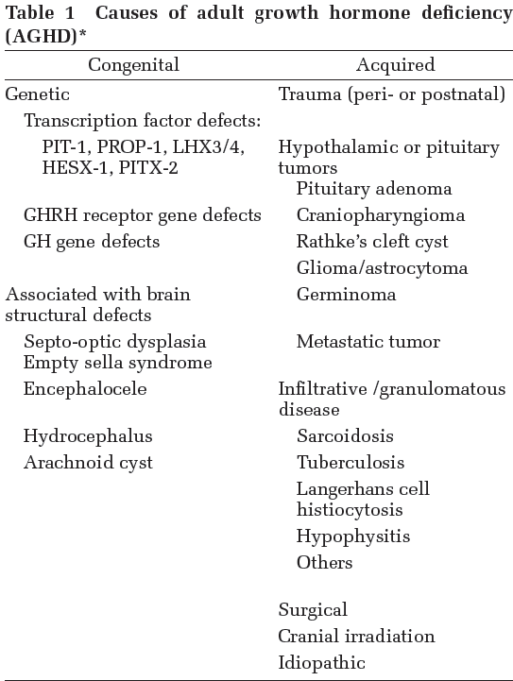

Slide 4
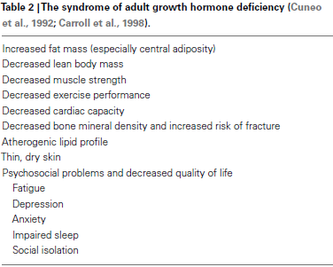

Slide 5
diagnosis
lack of a single biological end-point, such as growth failure
secreted episodically in a pulsatile pattern and modified by age, gender, and body mass index (BMI)
Disease State Clinical Review, Endocr Pract. 2016;22

Slide 6
insulin-like growth factor 1 (IGF-1) and IGF-binding protein 3 (IGFBP-3) have also shown poor diagnostic value due to overlap
between healthy and GH-deficien individuals, particularly in adults over 40 years.
random GH and IGF-1 levels cannot be used alone, GH stimulation tests are required to confirm the diagnosis.
Disease State Clinical Review, Endocr Pract. 2016;22

Slide 7
The GH Research Society has mandated that utilizing one reliable GH stimulation test is sufficient , with the exception for the need
of a GH stimulation test in patients who meet criteria that predict GHD with high specificity:
A)patients with organic pituitary disease and three or more pituitary hormone deficits and low serum IGF-1 levels.
B)patients with congenital/genetic GHD
Disease State Clinical Review, Endocr Pract. 2016;22

Slide 8
trnsition period
The transition from pediatric to adult care is an appropriate time for reassessment of GH status.
Patients with a high likelihood of having permanent GHD are those who have MPHD and a serum IGF-I concentration below the normal range (off GH therapy) if associated with one or more of the following:
J Clin Endocrinol Metab, June 2011, 96(6):1587–1609

Slide 9
1) a radiologically confirmed congenital
anomaly in the sellar or suprasellar region;
2)known acquired hypothalamic-pituitary disease, e.g. craniopharyngioma;
3) previous surgery for lesions directly
affecting the hypothalamic-pituitary region
J Clin Endocrinol Metab, June 2011, 96(6):1587–1609

Slide 10
or radiotherapy for malignant disease that included a high dose of irradiation to the hypothalamic-pituitary region
4) a proven genetic/molecular defect involving the capacity to secrete GH.
If children in these categories have a low IGF-I level on no GH treatment, this generally suffices to document continuing GHD.
J Clin Endocrinol Metab, June 2011, 96(6):1587–1609

Slide 11
Those children with idiopathic GHD, either isolated or with one additional hormone deficit, are less likely to have permanent GHD and should be retested in early adulthood using the stimulation tests.
Testing should be conducted after discontinuation of GH treatment for at least 1 month to avoid possible suppression
of endogenous responses.
J Clin Endocrinol Metab, June 2011, 96(6):1587–1609

Slide 12
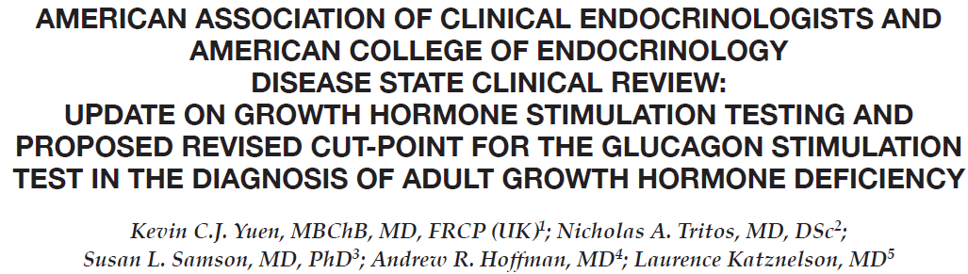

Slide 13
itt
gold-standard test for evaluation of adult GHD
its safety concerns hamper wider use in the United States
IV insulin 0.05-0.15 U/kg.
Record neuroglycopenic symptoms.
Blood sampling: fasting,and 20, 30, 40, and 60 min after a hypoglycemia is achieved.

Slide 14
Interpretation of GHD:
GH <3-5 mg/L at every time point after a hypoglycemia is achieved.
Contra-indications:
epilepsy, cardiovascular disease, pregnancy,
age >65 years.
PPV 93%, sensitivity 96% and specificity 92%.

Slide 15
GHRH-arginine
Bolus dose of IV GHRH 1 mg/kg (maximum 100 mg) at baseline, followed by IV arginine infusion 0.5 g/kg (maximum 30 g) over 30 min.
Blood sampling − 0,30, 60, 90, and 120 m
BMI-dependent cutpoints:
- BMI <25 kg/m2, ≤11mg/L at every time point
- BMI 25-30 kg/m2, ≤8mg/L at every time point
- BMI ≥25 kg/m2, ≤4mg/L at every time pointin.

Slide 16
May yield false negative results in hypothalamic GHD.
PPV 92%, sensitivity 95%,and specificity 91%.

Slide 17
ARGININE
30 g arginine HCl (10% solution) infused over
30 min. Measure GH at 30-min intervals for 2.5 h
Cutpoints:GH ≤0.4 mg/L at every time point.
Weak GH secreatagogue.Requires very low
GH cut-points to achieve optimal specificity.
PPV 92%, sensitivity 87%,and specificity 91%.

Slide 18
glucagon
1 mg (1.5 mg if >90 kg) IM.
Measure GH every 30 min for 4h.
GH ≤3 mg/L at every time point.
Questionable diagnostic accuracy in subjects with high BMIs and glucose intolerance.
Requires lower BMI-dependent GH cut-points to achieve optimal specificity.
Sensitivity and specificity 100% in lean subjects.

Slide 19
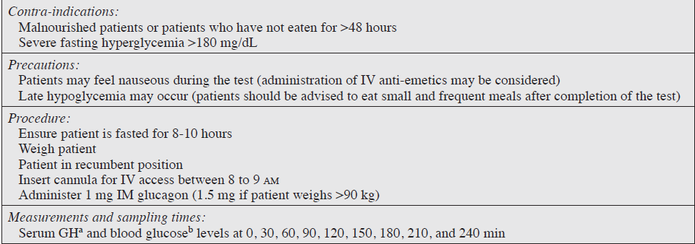

Slide 20
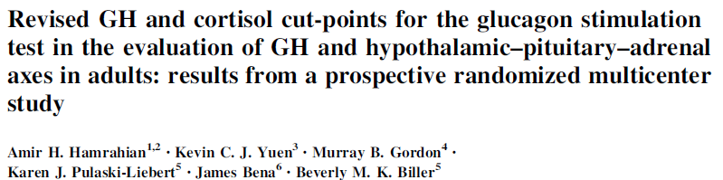

Slide 21
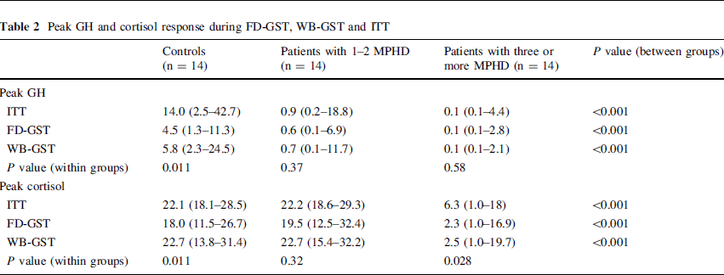

Slide 22
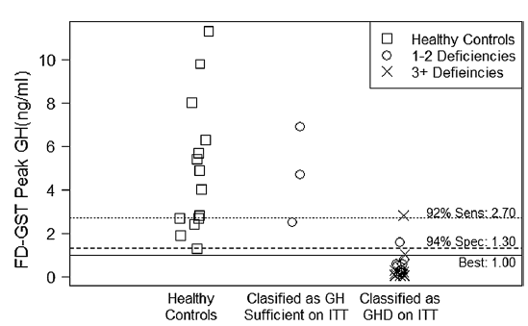

Slide 23
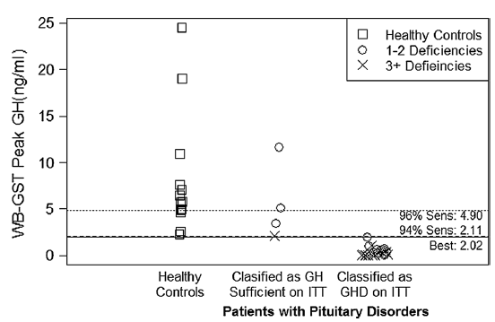

Slide 24
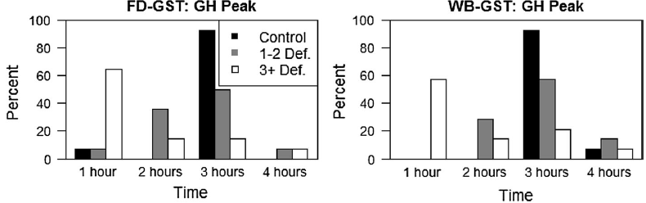

Slide 25
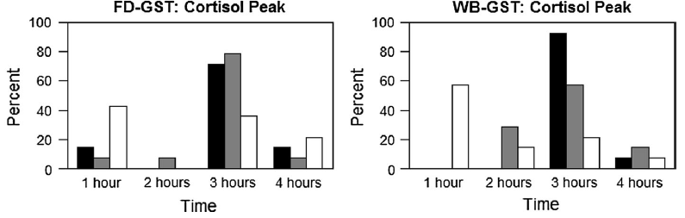

Slide 26
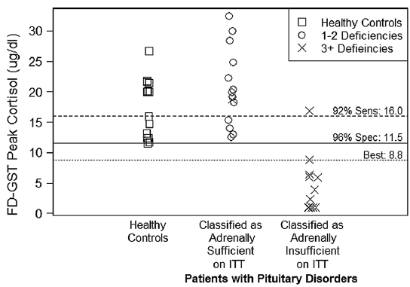

Slide 27
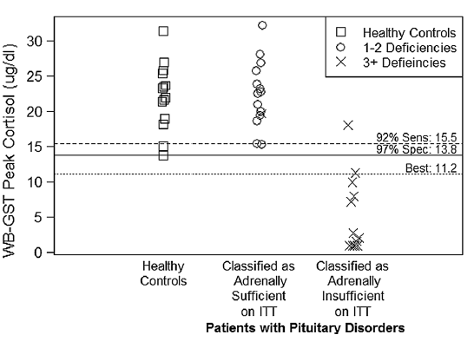

Slide 28
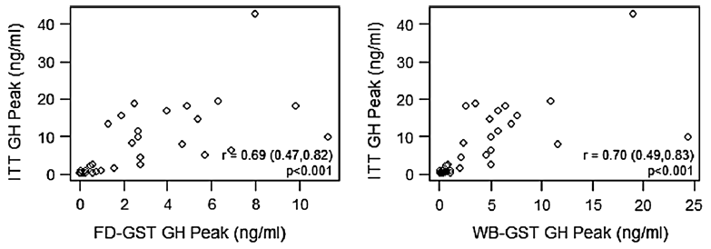

Slide 29
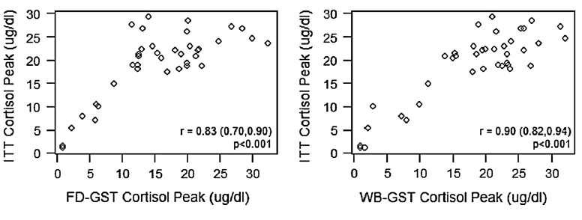

Slide 30
conclusion
The GST correctly classified GHD using GH
cut-points of 1 ng/ml for FD-GST and 2 ng/ml for WBGST,hence using 3 ng/ml as the GH cut-point will misclassify some GH-sufficient adults.
The GST may also be an acceptable alternative to the ITT for evaluating the HPA axis utilizing cortisol cut-points of 9 lg/dL for FD-GST and 11 lg/dL for WB-GST.

Slide 31
gh therapy
In UK clinical practice, patients are selected for treatment on the basis of perceived need according to one or more of a number of specific criteria outlined below.
defined severe GHD with the insulin tolerance test (ITT), glucagon, arginine, or alternative tests such as arginine plus growth hormone releasing hormone (GHRH).
Adult Growth Hormone Deficiency,2015

Slide 32
Peak GH response <9mU/l (<3ng/mL) to ITT. The appropriate threshold for the diagnosis of severe GHD using the other provocative tests needs to be cross-validated against the "gold standard" - the ITT definition.
Patient already receiving full supplementation of other deficient hormones as required.

Slide 33
Reduced QoL is the major indication for offering GH replacement. The selection of whom to treat is based on the patient's own perception of QOL reinforced by the objective assessment utilising a disease-specific questionnaire ("adult growth hormone deficiency assessment" - AGHDA) or alternative validated questionnaire

Slide 34
GH replacement should also be considered in patients in whom an adverse cardiovascular risk profile and/or osteopenia have been demonstrated.

Slide 35
The aim of GH replacement therapy is to treat the signs and symptoms of GHD by correcting the metabolic abnormalities and impaired QoL associated with AGHD.
women require more GH per kilogram of body weight than men, younger patients require more GH than older patients, and
adult patients who had childhood-onset require more GH than adult-onset GHD to obtain an equivalent clinical response.
Neurol Med Chir (Tokyo) 54, August, 2014

Slide 36
GH replacement therapy should start with a
low dose, especially in older individuals (0.1
mg/day), administered as daily subcutaneous
injections in the evening.
GH dosages should be increased gradually and individualized, on the basis of clinical and biochemical responses, no more frequently than at monthly intervals.
Neurol Med Chir (Tokyo) 54, August, 2014

Slide 37
Incremental dose increases should be between 0.1 mg/day and 0.2 mg/day.
Clinical status and serum IGF-I levels should
be monitored.
The GH maintenance dose should seldom exceed 1.0 mg/day.
Neurol Med Chir (Tokyo) 54, August, 2014

Slide 38
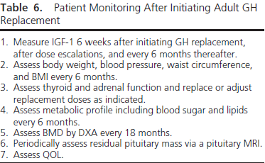

Slide 39
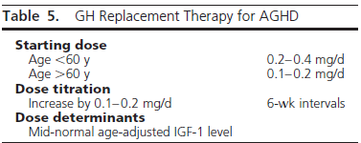

Slide 40
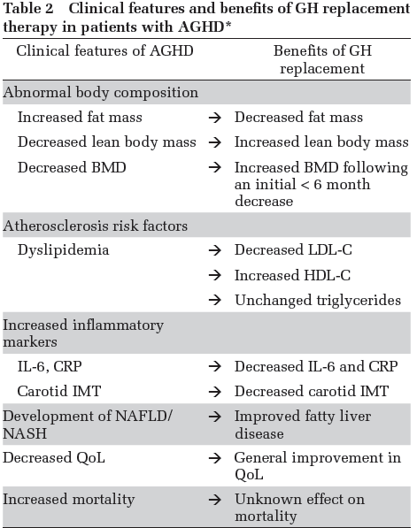

Slide 41
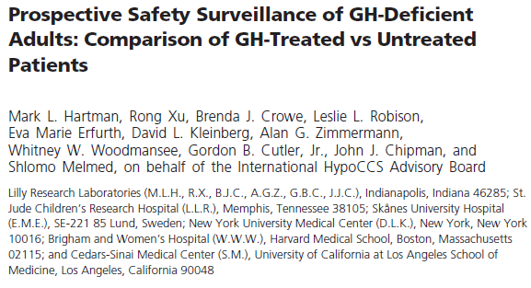

Slide 42
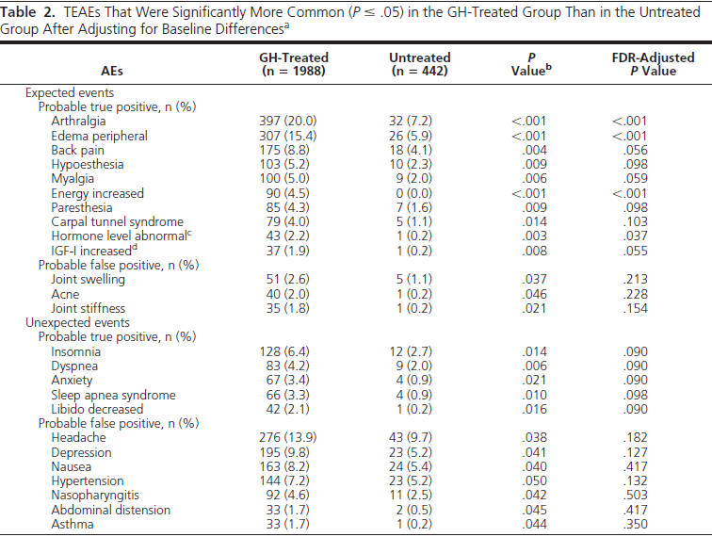

Slide 43
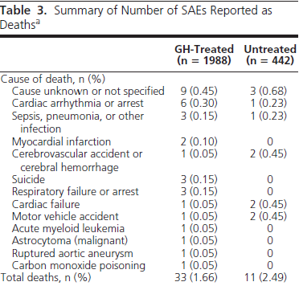

Slide 44
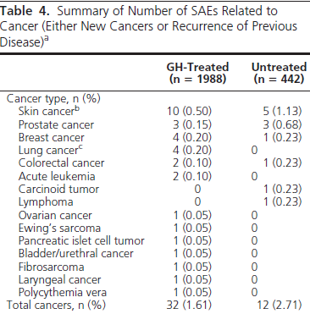

Slide 45
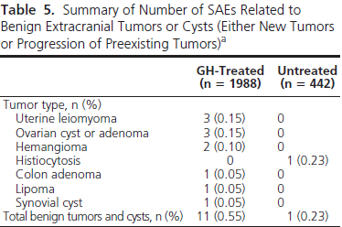

Slide 46
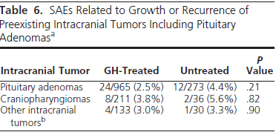

Slide 47
conclusion
In GH-deficient adults, there was no evidence for a GH treatment effect on death,cancer, intracranial tumor recurrence, diabetes, or cardiovascular events.
The identification of unexpected GH-related AEs reinforces the fact that patient selection and GH dose titration are important to ensure safety of adult GH replacement.

